Slide 1


NINDS 1R01NS062059-01A1
GRANT00431125
Occult Small Vessel Cerebrovascular Disease in High Risk Families
Paul Nyquist, MD, MPH, FAHA,
Assistant Professor,
Neurology, Anesthesiology/Critical Care Medicine, Neurosurgery

Slide 2
Presenter Disclosure Information
Paul Nyquist MD/MPH FAHA
Updates on the Acute Care of Ischemic Stroke and Intracranial Hemorrhage
Funding Sources:
Principal Investigator 1R01NS062059-01A1, GRANT00431125, “Occult Small Vessel Cerebrovascular Disease in High Risk Families”.
Investigator / Intevertional Management of Stroke (IMS) III NIH Sponsored Clinical Trial
Principal Investigator/ Clinical Trial of rFVIIa (Novoseven) in Patients with
Intracerebral Hemorrhage at Johns Hopkins University, Sponsored by NOVONORDISK
Principal Investigator/ Desmotaplase in Acute Stroke at Johns Hopkins University (DIAS), Sponsored by Forest Pharmaceuticals
Investigator, CLEAR, Use of rt-PA for the Resolution of Clot in Intra-
ventricular Hemorrhage, Sponsored by FDA Orphan Drug Program
Investigator / CREST, Carotid Revascularization Endarterectomy vs. Stent Trial, NIH Sponsored Clinical Trial
Principal Investigator/ Siblings with Ischemic Stroke Study Stroke, INOVA Fairfax Hospital
Educational Grants:
Pulsion, The Medicines Co., Codman Inc. , and Hospira Inc.
DISCLOSURE INFORMATION
Grant Support From NOVO Seven
Notes:
2

Slide 3
No.: 1 R01 NS062059-01A2
Occult Small Vessel Cerebrovascular Disease in High Risk Families
253 subjects.
Our goal for this year is 340
Supplement to do some microarray work

Slide 4
High Prevalence of Silent Small Vessel Cerebrovascular Disease, and
Co-occurrence with Occult Coronary Disease in Healthy Individuals
Subjects recruited from
Siblings of Probands with (CHD onset < age 60).
1269 Caucasian and African American healthy 30-59 year old
Participating in a 24 year prospective study
Incident stroke and CAD and are eliminated from this analysis

Slide 5
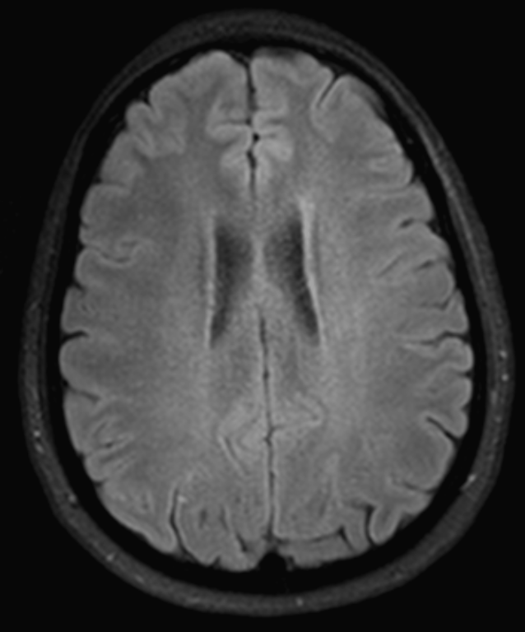
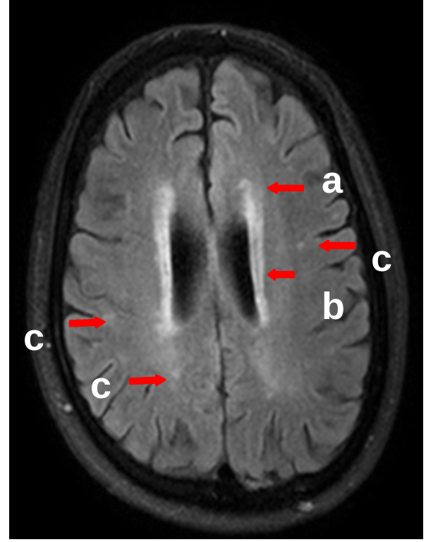

Slide 6
RESULTS
81% 33% 15% 36%

Slide 7
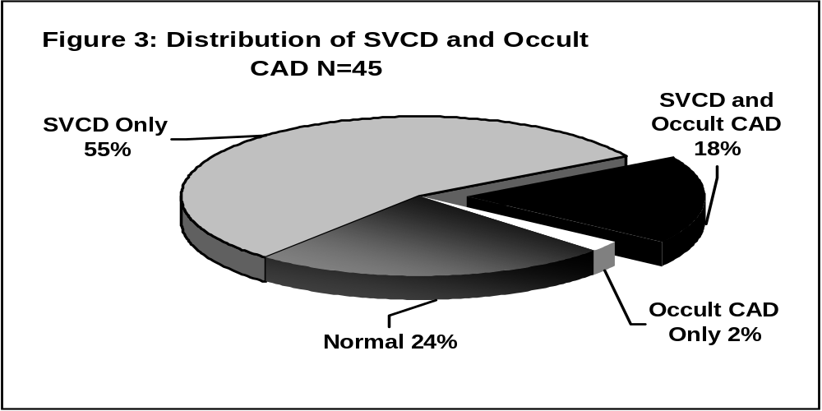
Distribution of SCVD and O-CAD in SIBS N=45

Slide 8
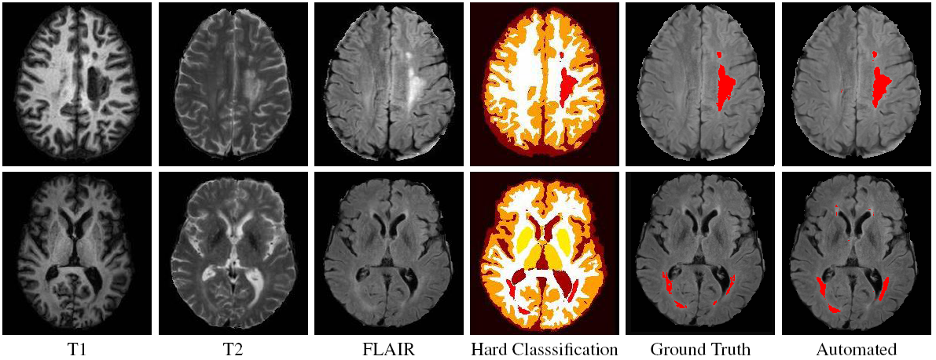
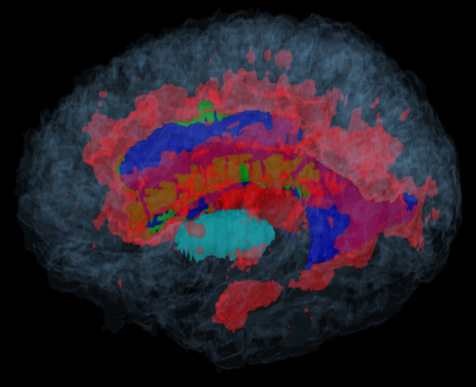
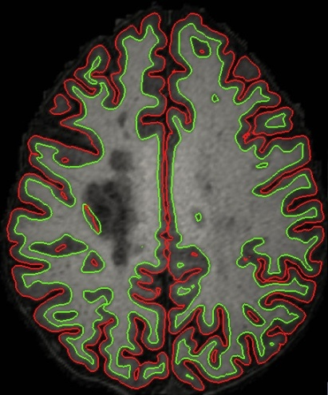
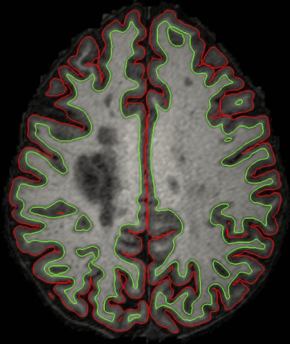
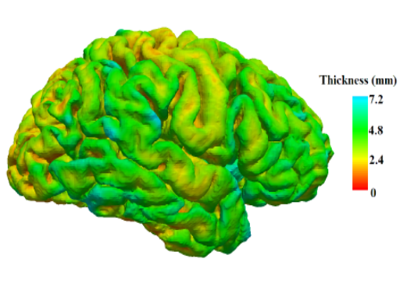
Segmentation
3-D Rendering
FreeSurfer
Lesion CRUISE

Slide 9
No.: 1 R01 NS062059-01A2
Occult Small Vessel Cerebrovascular Disease in High Risk Families
Five years
  800-1000 MRIs
  Stress Thallium
  Brain and Whole body CTA with newest Siemens 256 sensors (512) scanner
  Brachial Artery Testing
  Serological markers
  3 other Concurrent studies

Slide 10
Milestone
We surpassed the n=250 mark
Goal for the year N= 340
Present data analysis n=204 for parametric data
N=104 for white matter volumeterics

Slide 11
White matter Disease By Decade (p=0.0063)

Slide 12
Percentage Infarcts > 3mm in Decade of Life

Slide 13
Number in Decade of Life
N=204

Slide 14
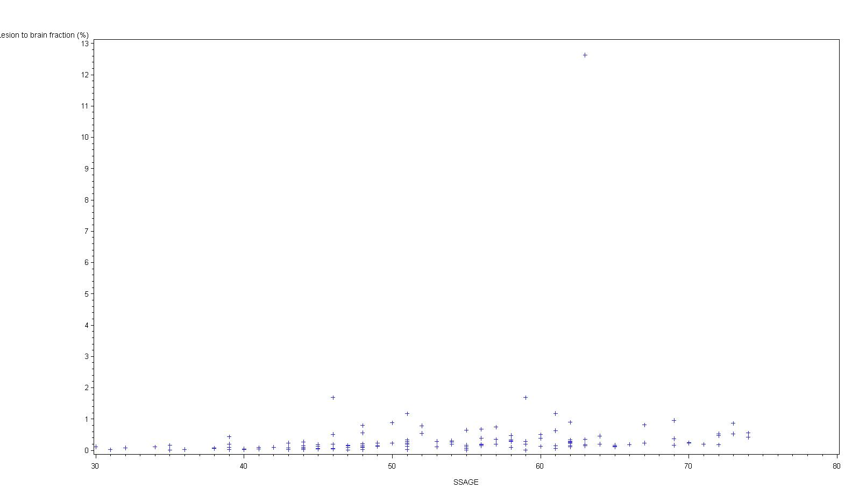

Slide 15
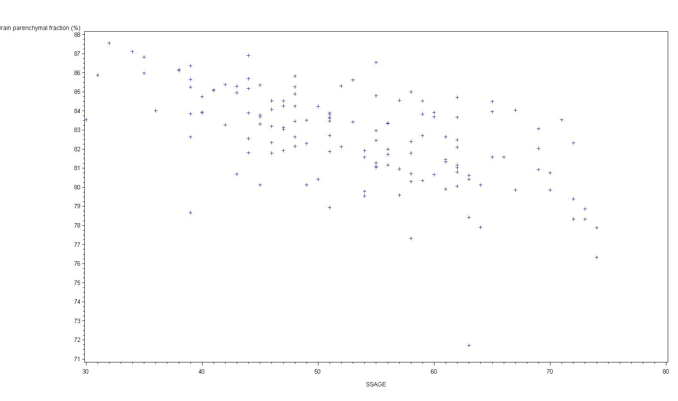

Slide 16
Current Study in High Risk Families
Proposed Study of Small Vessel Cerebrovascular Disease
ARIC prevalence
comparison
Apparently healthy 35-75 year old siblings (SIBS) of probands with premature CAD
(< 60 years).
N= 1337
Female =60%
Black = 47%
Mean age= 56
Genotyping for 213 candidate genes for cardiovascular mechanism-based phenotypes inflammation, thrombosis,
cell signaling, vascular function.
Measurement
current cardiovascular risk factors (RF), inflammatory markers, thrombosis factors endothelial function N=800
Measurement of occult CAD using exercise SPECT and of SVCD using MRI-definied white matter hyper-intensities
and lacunes N=800
Mechanism-based RF associations
Genetic analysis

Slide 17


Slide 18
SA #1
Set of genes that are differentially expressed in subjects based on their periventricular white matter volume comparing expression profiles of 162 low to 162 high subjects. We can consider race to stratify samples
For all genes found to be differentially expressed in SA#1, we can look to see what SNPs are associated with the probes on the array in cis or trans effects
For all SNPs found to be associated with phenotype in the GWAS analysis, we will look in the microarray expression analysis to see if the genes that they map to are differentially expressed.
For all genes found to be differentially expressed in SA#1, we can look to see what their GWAS signals of association were.
SA#2
eQTL analysis to identify all SNP-microarray expression associations. We will do this stratified on affection status based on extreme periventricular white matter volume i.e. two sets of analysis
For all SNPs found to be associated with phenotype in the GWAS analysis, we will look at the eQTL analysis to see what microarray probes they are associated with
GWAS analysis
Tests for association with 2.5m SNPs and phenotypes of interest
For this set of SNPs (that are associated with the genes differentially expressed) we can look at their GWAS signal.

Slide 19
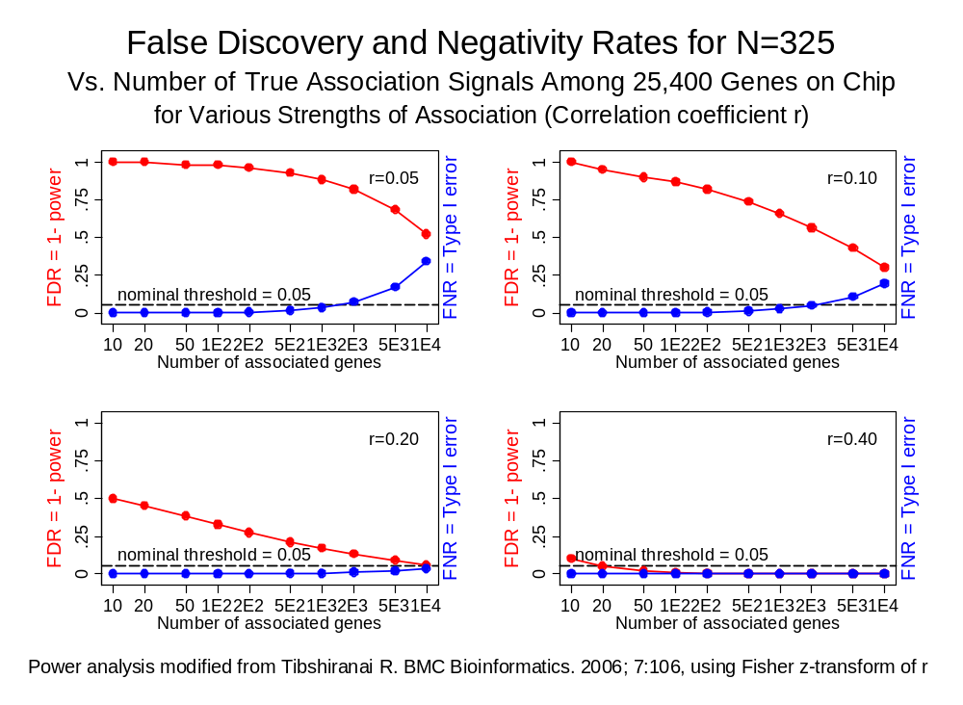

Slide 20
New Direction
We propose to use Agilent microarray gene expression
WBC subtypes, such as granulocytes and monocytes,
35 persons with and without SVCD on MRI
Subjects are from the upper and lower quartile of white matter volume on MRI

Slide 21
Hypothesis 1
Hypothesis:
WBCs from whole blood in patients with extremes of PWMV will have differential expression of genes affecting chronic inflammation, leukocyte adhesion, and endothelial activation

Slide 22
Hypothesis 2
Hypothesis:
eQTL Analysis of gene expression will identify cis- and trans-regulatory genomic elements for the 44,000 microarray-measured quantitative traits.

Slide 23
Risk Factor Characteristics N= 45
Hypertension 48%
Diabetes 9%
Current Smoking 31%
Mean systolic BP mmHg 133±15
Mean diastolic BP 85±10
Mean cholesterol mg/dl 223±49
Mean triglycerides mg/dl 142±118
Mean HDL-C mg/dl 52±16
Mean BMI kg/m² 29±6
Mean Hs-CRP 3 ± 3
Mean fibrinogen mg/dl 328±75
Mean MCP-1 152±86
Bivariable analyses showed that of all possible risk factors, expressed either as dichotomous variables (i.e. hypertension, present or absent) or continuously (i.e. systolic BP in MM Hg), only age showed a significant and notable relationship with the presence of an ARIC/CHS Score > 1 (p=0.0007) (age > 55 years).

