Slide 1
Monogenic Cerebral Small Vessel Diseases
A historical perspective
E. Tournier-Lasserve
Genetics Lab, Hôpital Lariboisière
Inserm / Paris7 University Research Unit UMR-S1161
Paris, France
ISGC 2014 Stroke meeting

Slide 2
Discovering genotypes underlying monogenic stroke
Lessons from past successes and ongoing approaches

Slide 3
1990-2014: Adult Cerebral SVD genes identification
CAA
APP
CADASIL
NOTCH3
1990
91
92
93
94
95
96
97
98
99
2000
SVD
COL4A1
HERNS
TREX1
CARASIL
HTRA1
2014
2001
01
02
03
04
05
06
07
08
09
10
11
12
13

Slide 4
Hereditary Cerebral Amyloid Angiopathy Dutch Type
1982-1989: Clinical & pathological characterisation of 4 families from 2 coastal villages of the Netherlands with an autosomal dominant cerebral amyloidosis
1990: Based on the accumulation of Abeta, 2 different teams from the Netherlands and the US raised the hypothesis that the APP gene might be the culprit. Genetic linkage and Sanger sequencing of APP confirmed this candidate gene approach, showing an APP missense mutation
2006: Based again on a candidate gene approach, identification in 5 French families with early onset Alzheimer and ICH, of an APP duplication
2014: ICH families with APP missense or duplication mutations are very rare
Van Broeckhoven et al, 1990 / Levy et al, 1990 / Grabowski etal, 1992 / Rovelet-Lecrux etal, 2006

Slide 5
CADASIL
1955: Identification of a family with an hereditary Binswanger disease
1977-1991: Identification of several families with an autosomal dominant SVD of unknown etiology
1993: Identification of GOM, a specific pathological EM marker for CADASIL, a precious tool to select homogeneous families for further studies
1993: No idea of what could be a good candidate gene
Van Bogaert 1955 / Stevens et al, 1977 / Davous et al, 1991 / Tournier-Lasserve et al, 1991, Baudrimont et al, 1993 /

Slide 6
1990-2001: Tremendous progress of genetic tools
91
92
93
94
95
96
97
98
99
2001
1990
00
microsatellites
SNP
Genetic maps
Physical maps
EST
cDNA complets
cDNA sequencing
15%
90%
Sequencing of the human genome
Thanks to these tools, genes of monogenic disorders which would never been identified
based on a candidate gene approach, could be identified with this « NO a priori » approach

Slide 7
CADASIL
1993: CADASIL locus mapping on chromosome19, providing a genetic marker
1996: Identification of the causative gene, NOTCH3, by positional cloning.
1997: All NOTCH3 mutations identified in CADASIL families with GOM, a hallmark of CADASIL, affect the number of cystein residues within EGF motifs
> 650 known CADASIL families / The most common hereditary SVD
Characterization of clinical and neuroimaging features in large series of patients
2014: Close to a full understanding of CADASIL mechanisms
Tournier-Lasserve et al, 1993 / Joutel et al, 1996 / Chabriat et al, 1995 / Peters et al, 2005 / Tikka et al, 2009 / Chabriat et al 2009

Slide 8
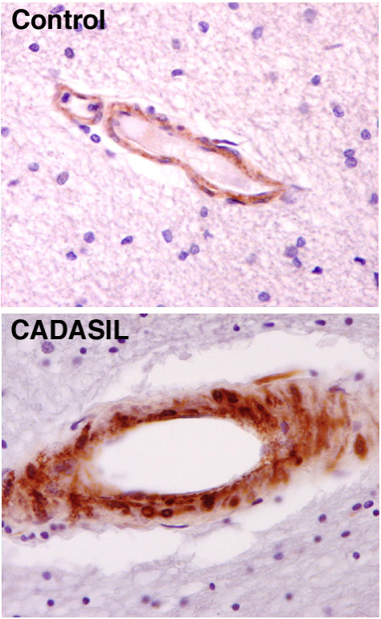
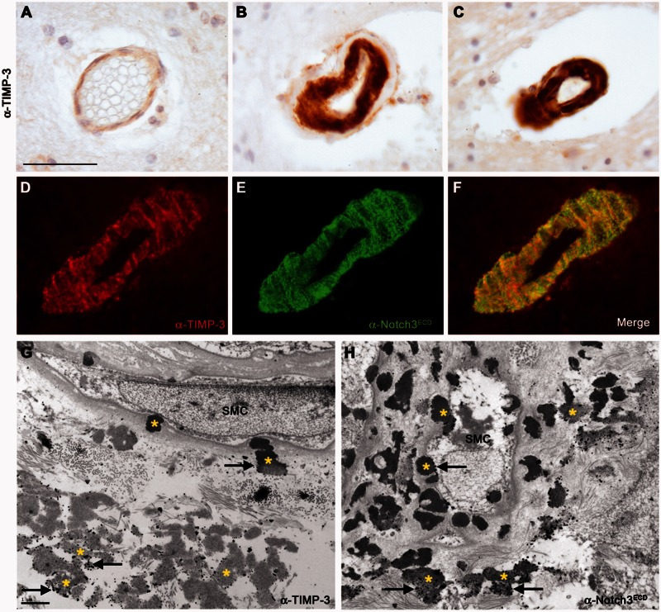
CADASIL mechanisms
Abnormal aggregation of Notch3^{ECD} leading to a sequestration of ECM proteins
Notch3 ECD accumulation in VSMC
TIMP3 and Notch3 ECD are incorporated in GOM
CADASILpatients & transgenic animal models tissues. Biochemical, proteomics, immunohisto approaches
Accumulation of Notch3^{ECD} , the starting point of pathological events leading to the abnormal recruitment and potential dysregulation of various functionally important ECM proteins leading to multifactorial toxicity.
1E4
Joutel et al, 2000 / Joutel et al, 2004 / Monet et al, 2007, Joutel et al, JCI 2010, Monet-Lepretre et al, 2013, Kast et al, 2014

Slide 9
CARASIL
1960-1976: Identification of the first families with an hereditary Binswanger disease with an autosomal recessive pattern of inheritance in Japan.
No specific pathological marker but 2 very precious associated clinical features, early onset alopecia and spondylosis deformans. These 2 features and recessivity of this disease were instrumental for families collection.
1994: Bowler & Hashinski coin the term CARASIL
Very rare but most likely overlooked in European countries
2009: Identification of the causative locus and gene, HTRA1, by genetic linkage and positional cloning. CARASIL patients have bi-allelic loss of function mutations
Nemoto S, 1966 / Maeda et al, 1976 / Hara et al, 2009 /Fukutake et al, 2011 / Nozaki et al, 2014

Slide 10
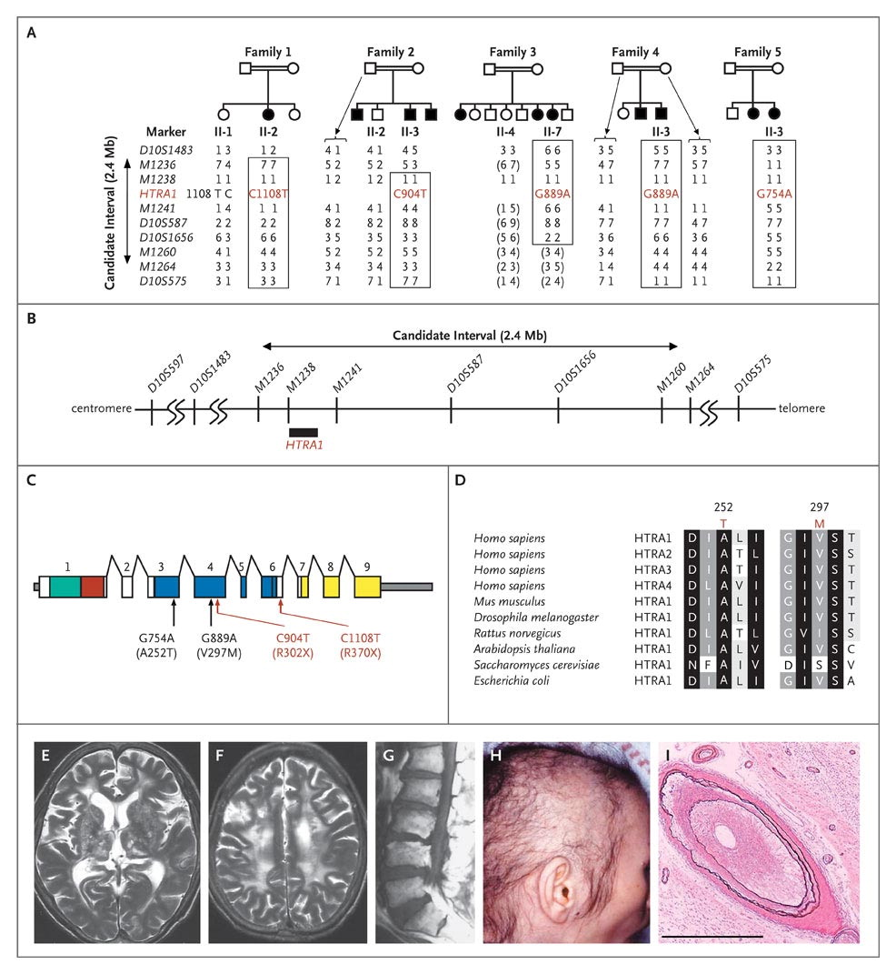
Hara K et al. NEJM 2009
Shiga et al, HMG 2011
HTRA1 Loss of function mutations and deregulation of TGFβ
HTRA1 encodes a serine protease
Patients have biallelic loss of function mutations leading to loss of activity of this enzyme
Loss of HTRA1 leads to increased TGF beta activity
Mechanisms leading to this increased TGF beta activity yet to be deciphered
Role of HTRA1 in intracellular cleavage of Pro-Tgf beta ?
Role of HTRA1 in cleavage of TGF-beta receptors ?
Notes:
Figure 1. HTRA1 Mutations in Families with Cerebral Autosomal Recessive Arteriopathy with Subcortical Infarcts and Leukoencephalopathy (CARASIL). Panel A shows the pedigrees of families with CARASIL. Squares denote men; circles, women; solid symbols, affected family members; open symbols, unaffected members; and double horizontal lines, consanguineous marriage. Pairs of alleles of selected family members are listed for several microsatellite markers; the alleles are identified with the use of identification numbers 1 through 8. Genotypes whose haplotypic phases are unknown are shown in parentheses. Regions of homozygosity are delineated in boxes. Panel B shows the physical map of the candidate region for CARASIL on chromosome 10q. In Panels A and B, the microsatellite markers are listed in order from the centromere to the q-arm terminus; the candidate gene and the nucleotide mutations therein, carried by the probands, are indicated in red. Panel C shows the distribution of mutations in HTRA1, which consists of nine exons (squares): those encoding the insulin-like growth factor binding protein domain (green), the Kazal-type serine protease inhibitor domain (red), the trypsin-like serine protease domain (blue), and the PDZ domain (yellow), as well as untranslated regions (gray). Nucleotide (and corresponding amino acid) mutations are listed — missense in black and nonsense in red. Panel D shows the conservation of mutated HTRA1 amino acid residues in patients with CARASIL and in nonhuman species. Conserved residues are shaded (black, 100% conserved; dark gray, 80% conserved; gray, 60% conserved). The T at position 252 and the M at position 297 are highlighted in red; mutations at these positions are either completely or largely conserved. Sequences were obtained from GenBank. The results of magnetic resonance imaging (MRI) in patients with CARASIL are shown in Panels E, F, and G. Panels E and F show T₂-weighted images of the brain of Subject II-7, Family 3 (repetition time, 5000 msec; echo time, 150 msec; section thickness, 5 mm), revealing an ischemic region in the basal ganglia and white matter. T₁-weighted lumbar MRI (repetition time, 519 msec; echo time, 19 msec; section thickness, 5 mm) revealed spondylotic changes of the lumbar spine in Subject II-3, Family 2 (Panel G). Diffuse hair loss in the temporal and parietal areas of the head was observed in Subject II-2, Family 1 (Panel H) at 48 years of age. Cerebral small arteries in the arachnoid mater from Subject II-1, Family 6, show marked intimal thickening, narrowing of the lumen, hyalinosis, and splitting of the internal elastic membrane (Panel I, elastic van Gieson stain; scale bar, 1 mm).

Slide 11
COL4A1/COL4A2 cerebral angiopathies
2003: Identification in a French family of an autosomal dominant disease associating infantile hemiparesis, retinal arteriolar tortosities, hemorrhagic stroke and leukoencephalopathy
2005-2006: Idetification in a glaucoma mouse mutagenized model of arteriolar tortuosities providing a candidate gene, COL4A1, shown to be mutated in porencephaly patients and in this French family
2007: Description of HANAC, a clinical variant of COL4A1 cerebral angiopathy with renal nephropathy, arteriolar retinal tortuosisties and cramps
2014: 6-8 % of patients referred for molecular screening are mutated. Steretyped Glycin mutations in the triple helix of COL4A1/COL4A2 but also stop codons and duplications
Vahedi et al 2003 / Gould et al, 2005 / Gould et al 2006 / Plaisier et al, 2009

Slide 12
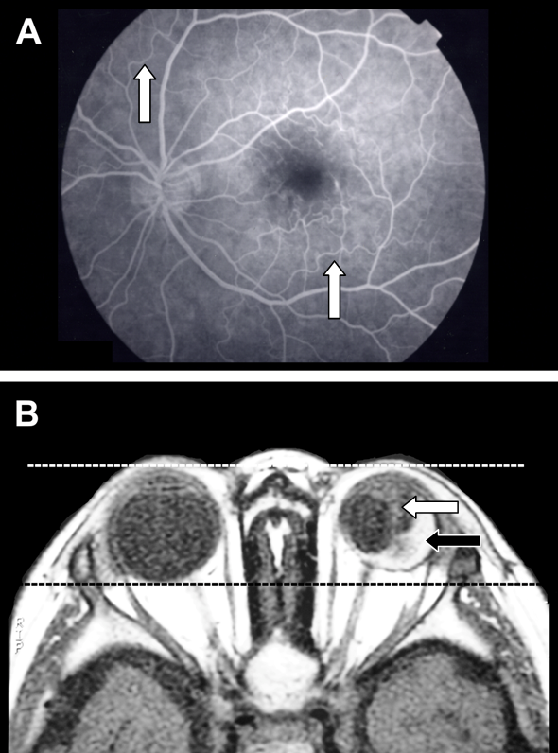
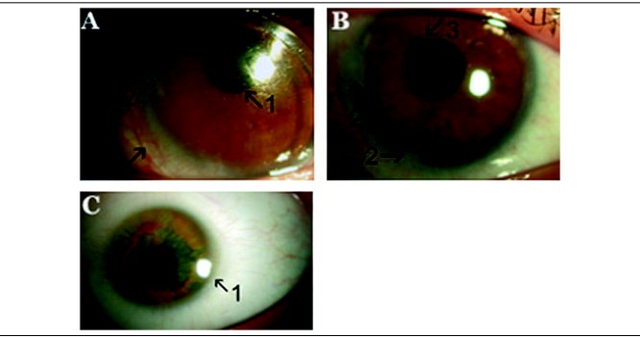
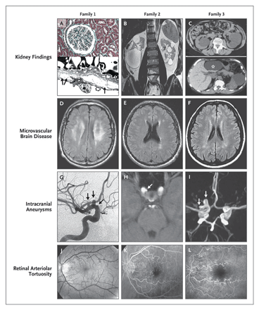
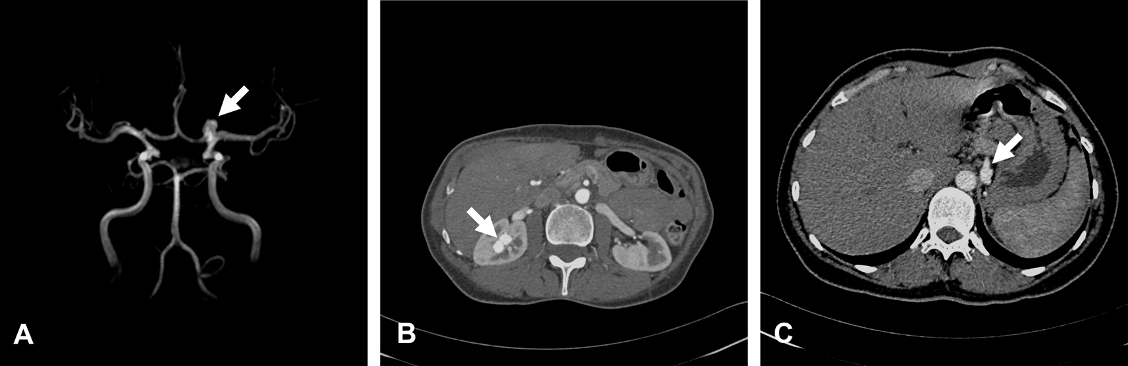
Neurological and extra neurological associated manifestations
Eye, Kidney, Muscle, Small and Large vessels…
KIDNEY
Hematuria
Renal cysts
Carotid aneurysms
Cramps
HANAC
EYE
Early onset cataract (30 % families)
Microcornea, corneal opacity, microphtalmia, glaucoma
Retinal arteriolar tortuosities (30 %)
intra and extra cranial large vessels
Intra and extra cranial aneurysms and stenoses
Intracranial aneurysms: 30 % families, mostly asymptomatic
No clinically overt ICH or stroke
Leukoencephalopathy and microbleeds plus …….
Plaisier et al 2007 / Sibon et al, 2007, Alamowitch et al, 2009, Rouaud et al, 2010

Slide 13
Clinical onset: from fetal to adult life
2009-2014: ~ 75 COL4A1 mutated families identified in Lariboisière genetics lab
COL005Du
c.3761G>A
G1254E
COL001La
c.3352G>A
G1118S
COL003Ba
IVS35-1G>T
_
_
_
?
?
?
+
+
+
?
?
?
?
2 yo
47 yo
37 yo
?
?
COL002Mo
IVS46+1G>A
COL007Cu
c.2413G>A
G805R
_
_
_
?
+
+
?
4 yo
FETUS
25 yo
Very severe forms in fetuses and infants / Importance of genetic counseling +++
Unpublished data

Slide 14
Multiple Adult Onset Monogenic SVD in which the causative genes have not yet been identified
SVD linked to Chr 20q13 (AD)
PADMAL / Pontine Leukoencephalopathy (AD)
LCC / Leucoencephalopathy Calcifications Cysts (AR)
Multiple SVD reported in unrelated families : Swedish, French ..

Slide 15
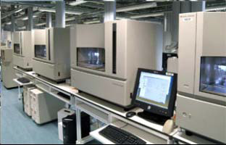
Novel Genes in the era of high-throughput Sequencing
2014 Challenges and Very Exciting opportunities for hereditary SVD
High Throughput sequencing
Very fast targeted sequencing of dozens of genes in large cohorts of patients
Whole Exome Sequencing
Targeted sequencing in a very large cohort of index patients of candidate genes identified through WES
Small families and even sporadic genetic cases also tractable for gene identification using Whole Exome Sequencing

Slide 16
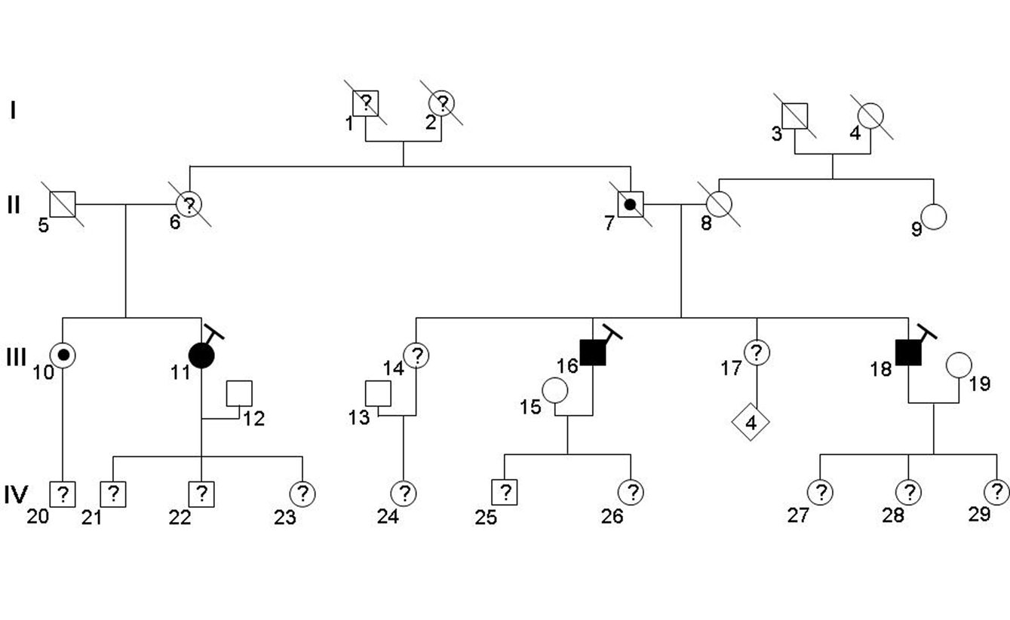
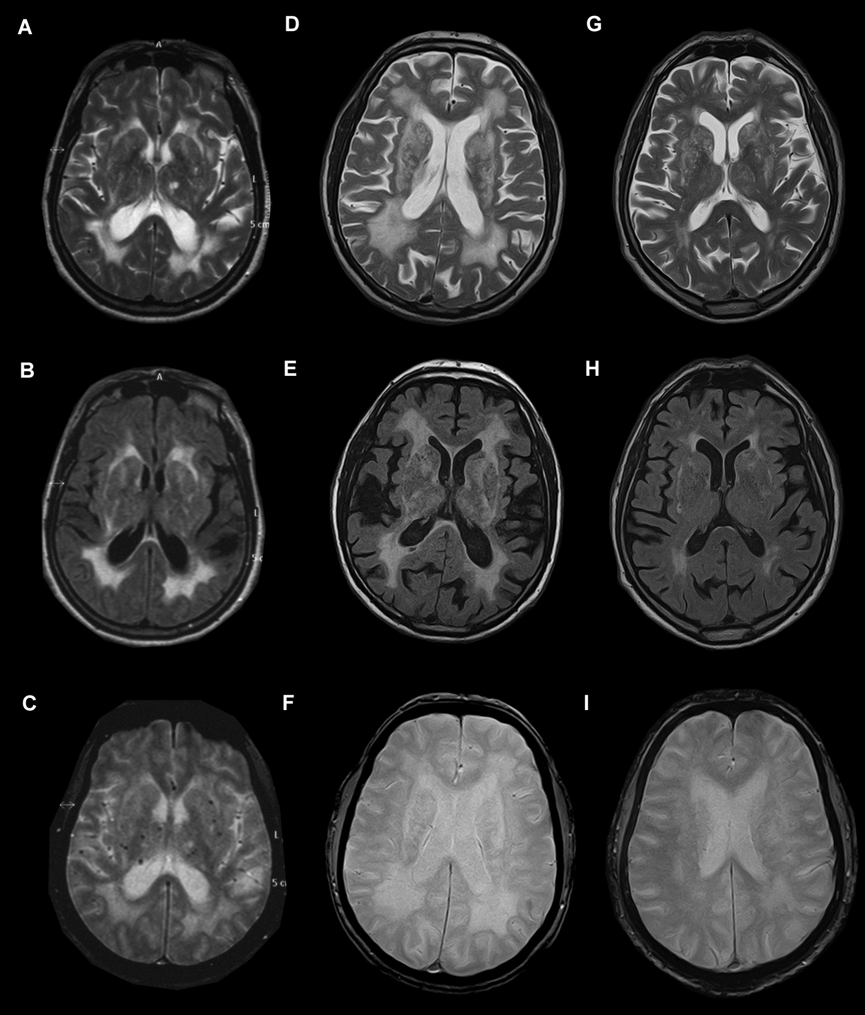
SVD gene identification in the HTTP sequencing era
Example of an ongoing project
Combination of linkage and Whole Exome sequencing
Exclusion of 80 % of the genome
WES : 5 candidate variants
Screening of 200 unrelated probands with a familial SVD in order to sort out which of these 5 candidate SNV is the good one
Identification of 10 probands / 200 probands (5 %) withmutations in one of these genes
1E4
Verdura et al, unpublished INSERM U1161

Slide 17
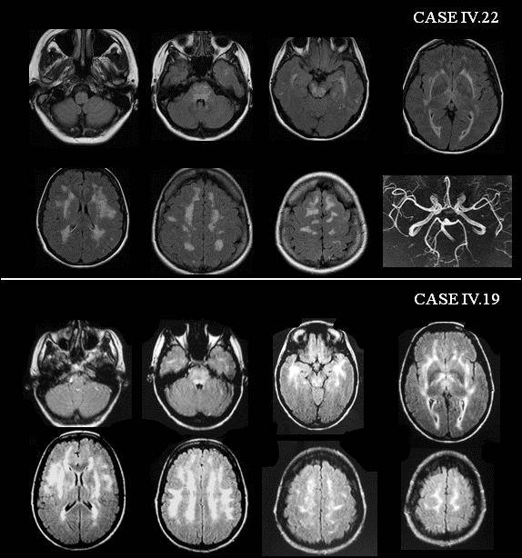
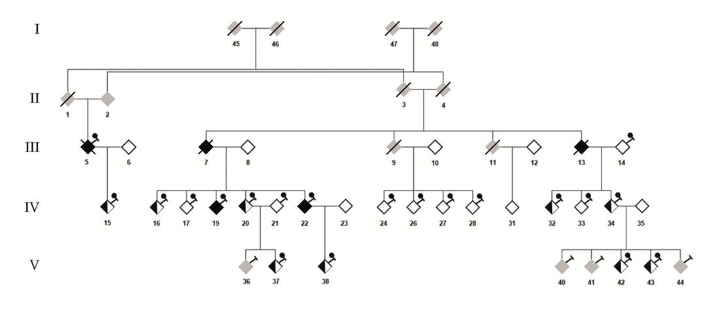
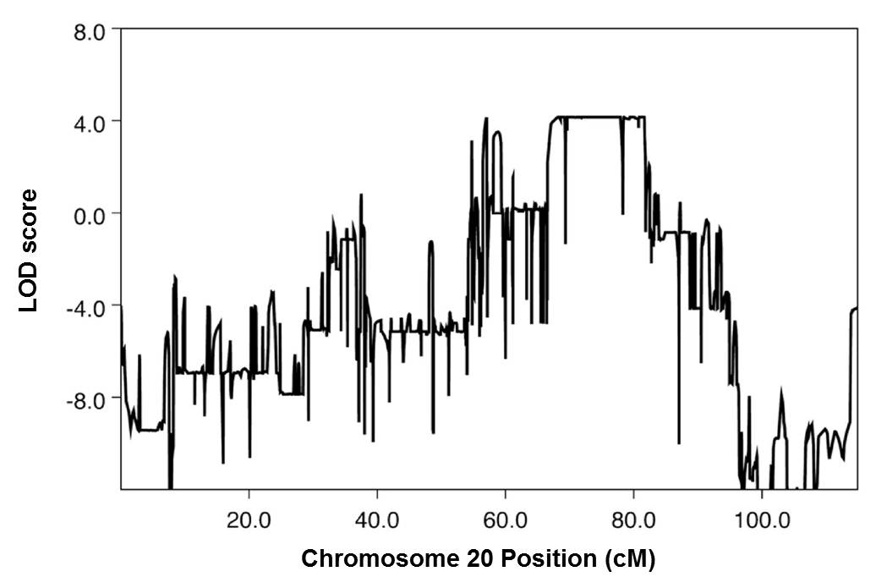
A novel autosomal dominant SVD linked to 20q13
.
Progressive, age related, hemispheric and brainstem leukoencephalopathy
Contrasting with the paucity and late onset of clinical symptoms in most patients
The gene is located on chromsome 20. WES: a strong candidate gene identified
Need to confirm in additional families but those are most likely rare or overlooked
Hervé et al, Neurology, 2012

Slide 18
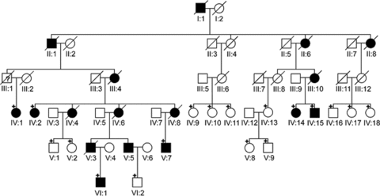
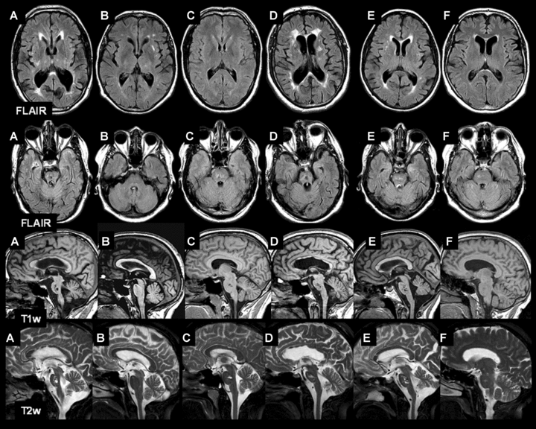
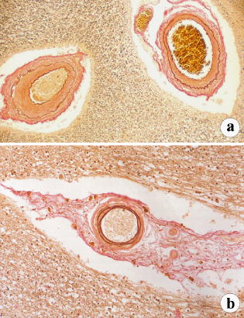
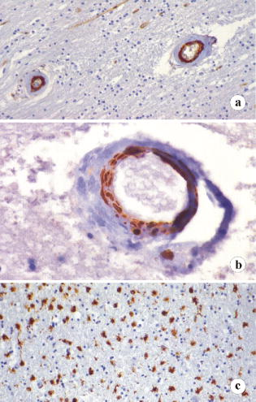
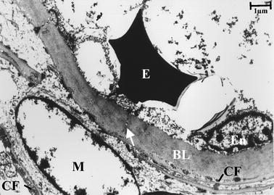
PADMAL
Pontine Autosomal Dominant Microangiopathy & Leukoencephalopathy
AD SVD in a family from Hamburg (2004)
Clinical onset: 20-50 yo
Duration of the disease: around 12 years
Recurrent lacunar infarcts, dementia
High frequency of pons infarcts
Notch3 is excluded / Nature of the gene ?
Hagel et al, 2004; Ding XQ et al, 2007

Slide 19
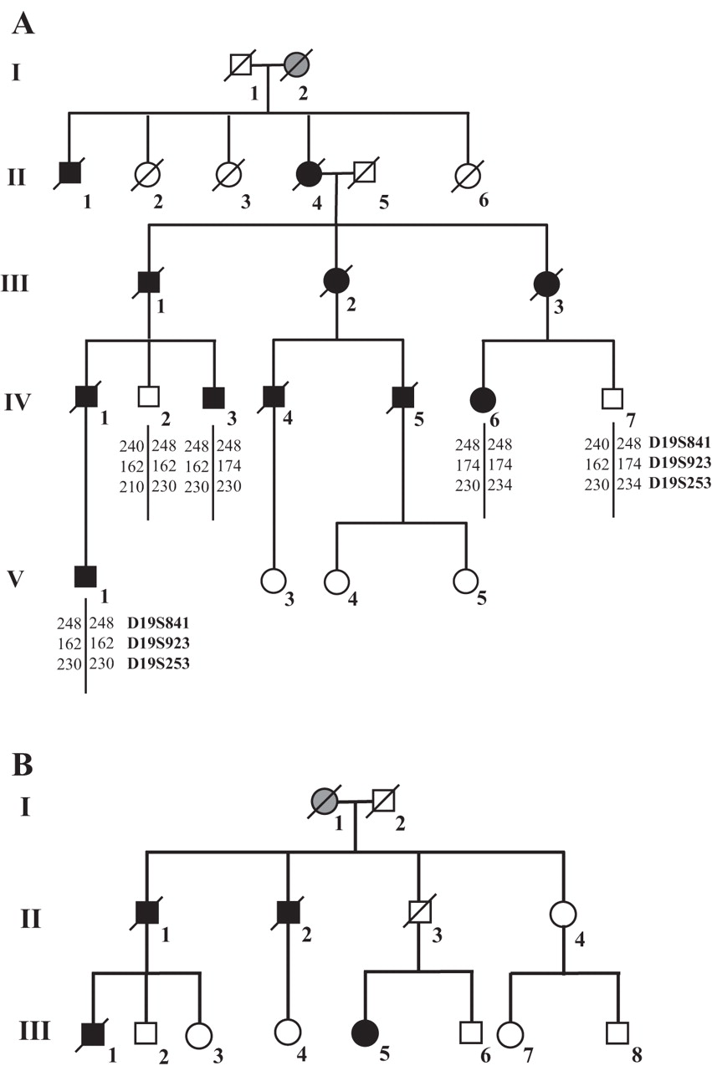
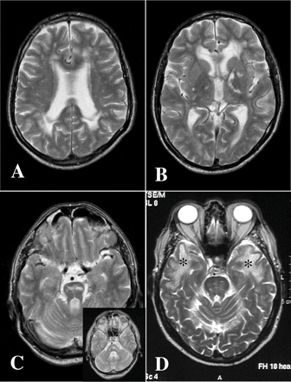
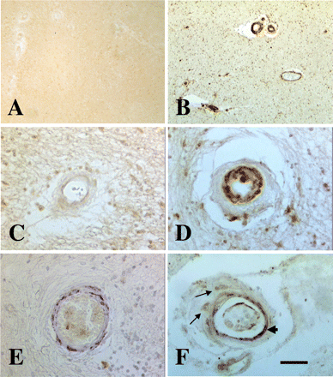
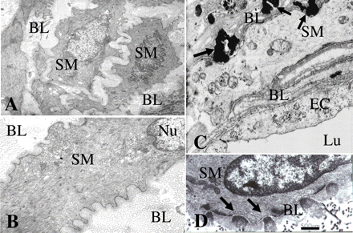
Hereditary Multi-Infarct Dementia in a Swedish Family
Autosomal dominant SVD
Clinical onset: around 35 yo
Duration of the disease: around 12 years
Recurrent lacunar infarcts, dementia
Notch3 is excluded
Nature of the gene ?
Is it the same gene than in PADMAL ?
Sourander et al, 1977; Low et al, 2007

Slide 20
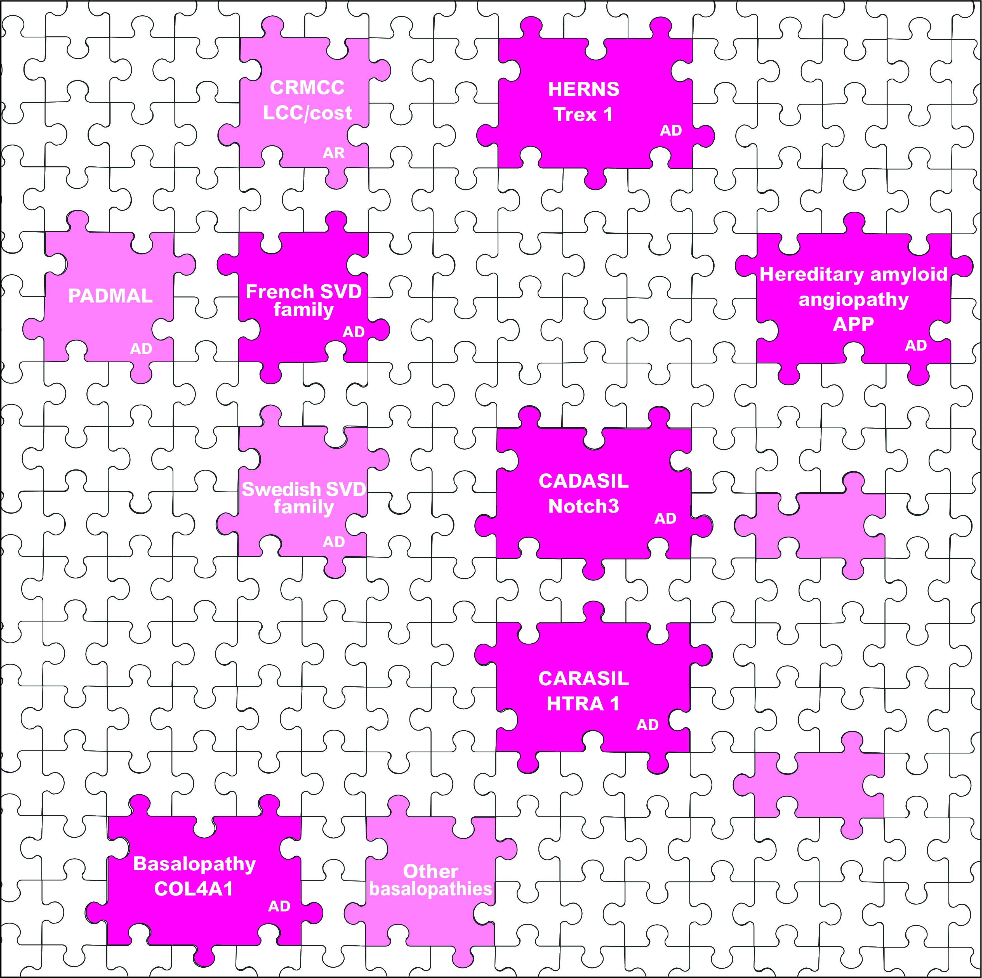
Genetics of Stroke and Vascular dementia
Our very next future
Advancing the « Next generation » of stroke research
Identification of many additional players and pathways involved in stroke pathophysiology
Similar phenotypes / different genes / may be reflective of common pathways / Biological basis may shed some light on why they overlap clinically
The next challenge will then be to bridge the gap between genes and biology

Slide 21
Genetics of Ischemic and Hemorrhagic Small Vessel Diseases
Acknowledgements
Institutions: INSERM U1161 / Paris7 University, AP-HP Lariboisière hospital genetics lab / CERVCO
Funding: INSERM, PHRC, Leducq Foundation
Lariboisière hospital Genetics lab and Inserm U1161:
- M. Mine, C. Prieto-Morin, M.D Amador, F. Buffon, A. Delaforge, ETL (SVD diagnostic),
- E. Verdura, A. Corlobé, MA Dalloz, F. Bergametti, M. Arnould, ETL (SVD gene identification / NGS)
- A. Joutel’s team (CADASIL mechanisms project)
Collaborations :
- D. Hervé, K. Vahedi, MG Bousser, H. Chabriat (Neurology Dpt, Lariboisière Hospital)
- ML Moutard ,D. Rodriguez (Neuropediatrics Trousseau Hospital)
- V. Krivosic, P. Massin, A. Gaudric (Ophtalmology, Lariboisière)
- F. Chapon (Neuropathology, Caen) & F. Gray (Neuropathology, Lariboisière hospital)
- P. Labauge, C. Denier, L. Guyant-Marechal, F. Rouanet, C. Goizet, E. Berger, M. Sevin, B. Guillon,

