Slide 1
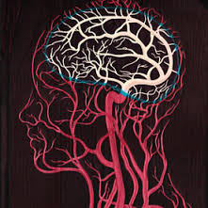
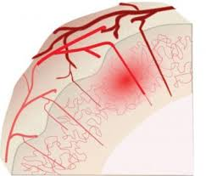
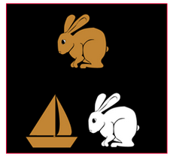


Vascular Contributions to
Cognitive Impairment and Dementia (VCID):
Genetics and Stroke/Alzheimer’s Synergy
Roderick A. Corriveau, Ph.D.
Program Director, NINDS
National Institutes of Health (NIH), USA

Slide 2

Presentation Goals
Genetics of VCID where are we? What next?
VCID - a distinct discipline on stroke spectrum, related to Alzheimer’s, scientifically & clinically poised for impact on disease burden.
Notes:
Credit for

Slide 3
“Senile Dementia” – Vascular?
“The notion that vascular factors mediate
age-related cognitive decline was the prevailing
view of ‘senile dementia’ until the 1960s.”^{1,2}
Emphasis shifted from the 1970s^{1,2} based on:
      plaques common pathology finding
      cholinergic findings + anticholinesterases
      molecular basis of plaques and tangles
1. Binswanger (1894); Maxime Durant-Fardel, un médecin et voyageur français
2. Kling et al. 2012, Alzheimer’s & Dementia
Notes:
American Heart Association founded in 1924
AN UNUSUAL TYPE OF PRE-SENILE DEMENTIA (ATYPICAL ALZHEIMER'S DISEASE WITH AMYLOID VASCULAR CHANGE)
J. A. N. CORSELLIS, J. B. BRIERLEYDOI: http://dx.doi.org/10.1093/brain/77.4.571571-587First published online: 1 December 1954
AN UNUSUAL TYPE OF PRE-SENILE DEMENTIA
(ATYPICAL ALZHEIMER'S DISEASE WITH AMYLOID VASCULAR CHANGE)
BY
J. A. N. CORSEIXIS AND J. B. BRIERLEY
(From the Neuropathological Laboratory. Rumvell Hospital, Wickford, Essex, and
the Department, of Neiiropathology, the Institute of Psychiatry, Maiidsley Hospital,
London)
IN 1927 Divry established that the central core of many senile plaques
behaved like amyloid. Later (1934) he showed that this was also true of
Alzheimer's neurofibrillary tangles.
In 1938 Scholz described an amyloid change of the blood vessels which
he had found not uncommonly to occur in the ageing brain. On account
of its possible relation to the origin of senile plaques the change was called
by him "drusige Entartung" (plaque-like degeneration). Its clinical implications
were not discussed; it had twice been found to occur below the age
of 70.
In 1940 Worster-Drought, Greenfield and McMenemey described the
clinical and pathological findings in an unusual form of pre-senile dementia
with spastic paralysis. In the same year van Bogaert, Maere and de Smedt,
when discussing the "early familial forms of Alzheimer's disease," reported
the findings in an "heredo-familial case of dementia with spastic paraplegia."
In 1947 Liiers described two siblings both of whom died
demented, at a pre-senile age and with signs of a spastic paresis of the
lower limbs.
In all these cases, and in a second one from the original family
(Worster-Drought, Greenfield and McMenemey, 1944) there was an
unusual histological picture which, while showing to a variable extent
the feature of Alzheimer's disease, also showed a most severe form of
amyloid vascular change. This was identified both by van Bogaert, Maere
and de Smedt (1940) and by Liiers (1947) as the plaque-like degeneration
of Scholz. In the cases described by Worster-Drought, Greenfield and
McMenemey (1940) and by Liiers, attention was also drawn to a
remarkable type of plaque formation.
Apart, therefore, from the intrinsic interest of an amyloid

Slide 4
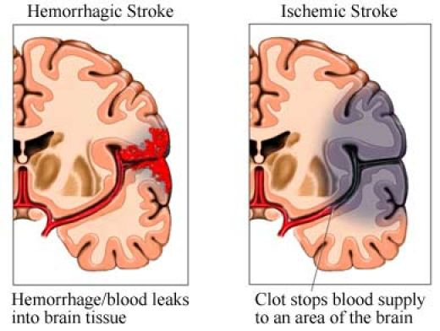
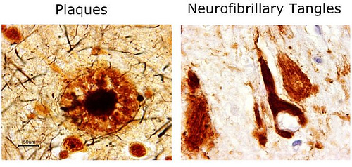
Stroke and AD Dementia:
Two Fields?
Stroke
AD Dementia
AHA – 1924
AHA adds Stroke focus - 1970
AHA/ASA - 1999
AA - 1981
Notes:
American Heart Association founded in 1924
AN UNUSUAL TYPE OF PRE-SENILE DEMENTIA (ATYPICAL ALZHEIMER'S DISEASE WITH AMYLOID VASCULAR CHANGE)
J. A. N. CORSELLIS, J. B. BRIERLEYDOI: http://dx.doi.org/10.1093/brain/77.4.571571-587First published online: 1 December 1954
AN UNUSUAL TYPE OF PRE-SENILE DEMENTIA
(ATYPICAL ALZHEIMER'S DISEASE WITH AMYLOID VASCULAR CHANGE)
BY
J. A. N. CORSEIXIS AND J. B. BRIERLEY
(From the Neuropathological Laboratory. Rumvell Hospital, Wickford, Essex, and
the Department, of Neiiropathology, the Institute of Psychiatry, Maiidsley Hospital,
London)
IN 1927 Divry established that the central core of many senile plaques
behaved like amyloid. Later (1934) he showed that this was also true of
Alzheimer's neurofibrillary tangles.
In 1938 Scholz described an amyloid change of the blood vessels which
he had found not uncommonly to occur in the ageing brain. On account
of its possible relation to the origin of senile plaques the change was called
by him "drusige Entartung" (plaque-like degeneration). Its clinical implications
were not discussed; it had twice been found to occur below the age
of 70.
In 1940 Worster-Drought, Greenfield and McMenemey described the
clinical and pathological findings in an unusual form of pre-senile dementia
with spastic paralysis. In the same year van Bogaert, Maere and de Smedt,
when discussing the "early familial forms of Alzheimer's disease," reported
the findings in an "heredo-familial case of dementia with spastic paraplegia."
In 1947 Liiers described two siblings both of whom died
demented, at a pre-senile age and with signs of a spastic paresis of the
lower limbs.
In all these cases, and in a second one from the original family
(Worster-Drought, Greenfield and McMenemey, 1944) there was an
unusual histological picture which, while showing to a variable extent
the feature of Alzheimer's disease, also showed a most severe form of
amyloid vascular change. This was identified both by van Bogaert, Maere
and de Smedt (1940) and by Liiers (1947) as the plaque-like degeneration
of Scholz. In the cases described by Worster-Drought, Greenfield and
McMenemey (1940) and by Liiers, attention was also drawn to a
remarkable type of plaque formation.
Apart, therefore, from the intrinsic interest of an amyloid

Slide 5
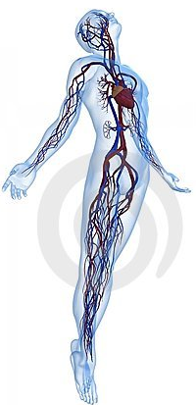
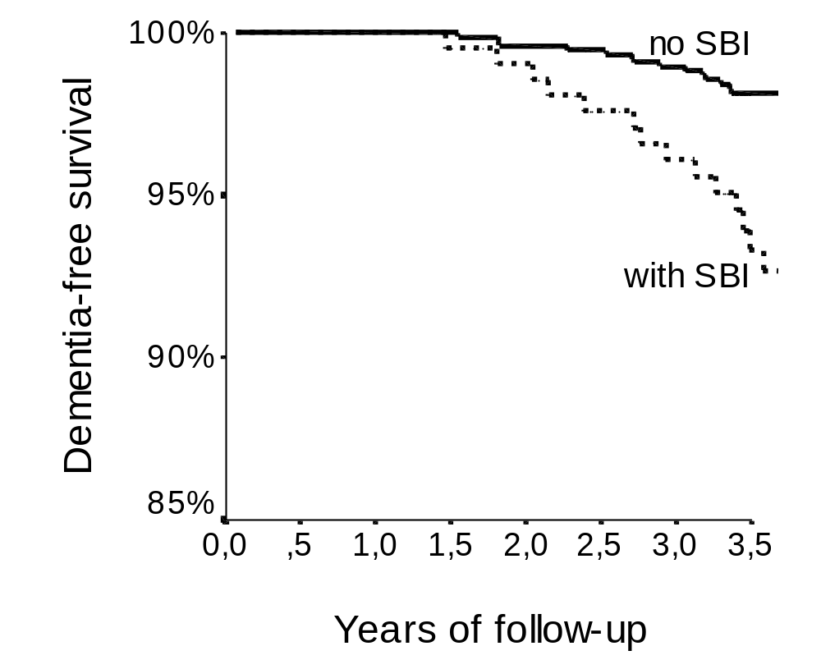
Decades of Studies Reveal
Vascular Disease/Dementia links
Dementia-free survival
HR (adj) =2.3
(=21% of stroke-free
individuals age 60-90)
Years Follow-Up (Population-Based Imaging)
Vermeer, Breteler NEJM 2003;348:1215
Vermeer, Breteler NEJM 2003;348:1215
 | No Impairment | Dementia
Alzheimer alone | 29% | 42%
Alzheimer + small strokes | 8% | 30%
Schneider Ann Neurol 2009;66:200

Slide 6
Stroke and Dementia – Scientific Fit
AD biology affects blood vessels and vice versa
Stroke & dementia dominate neurology of aging
    Stroke - 4th cause of death in the U.S.
    Alzheimer’s - 6th cause of death in the U.S.
    1 in 3 lifetime risk of stroke, dementia, or both
Most who die with dementia have a mixture of Alzheimer's and vascular disease
Circa 2.5 million affected by VCID in the U.S. alone – research needed to understand the burden & science
Notes:
Alz. Assoc. 2013 Facts and Figures. Seshadri & Wolf 2007, Lancet; Cholerton, B. et al. J. Alzheimers Dis. 36, 699–709 (2013).
In terms of burden of disease, and morbidity and mortality, stroke and dementia dominart neurological disorders.
2010, United States.
Heart disease: 596,577
Cancer: 576,691
Chronic lower respiratory diseases: 142,943
Stroke (cerebrovascular diseases): 128,932
Accidents (unintentional injuries): 126,438
Alzheimer's disease: 84,974
Diabetes: 73,831
Influenza and Pneumonia: 53,826
Nephritis, nephrotic syndrome, and nephrosis: 45,591
Intentional self-harm (suicide): 39,518
35 M in the world have dementia (WHO)
5.2 M people in U.S. have Alzheimer’s disease (AA)
AD is the 6th leading cause of death in America
800,000 people in the U.S. have a stroke each year
Alzheimer’s accounts for 60-80% of dementia

Slide 7
Stroke and AD Dementia:
Overlapping Fields
Stroke
AD Dementia
Notes:
Credit for

Slide 8
Understanding and targeting mechanisms underlying vascular contributions is critical for addressing dementia.
Yet we have much to learn about genetic, cellular and molecular mechanisms underlying VCID.

Slide 9
International Recognition of Relationship between Dementia and the Vasculature
  Congressional Task Force on Alzheimer’s (1999, US)
  Plan Alzheimer et Maladies Apparentées (2001-12, FR)
      Evaluation du Plan Alzheimer 2013
  «Elargir le champ du plan au-delà de la maladie d’Alzheimer»
  England’s National Dementia Strategy (2009)
  National Alzheimer’s Project Law (2011, US)
      includes AD, vascular dementia, FTD, and LBD
  2013: G8 Dementia Summit (London)
Notes:
“pathologies « apparentées » ont peu ou prou bénéficié du plan”
Increased Attention to Multifactoral Nature of Dementia

Slide 10

Diagnostics/Disparities/FTD/LBD/VCID
VCID Priorities:
Mechanisms, Experimental Models, Biomarkers, AD/VCID interactions
Notes:
PLANNIGN EFFORT

Slide 11
Vascular Contributions to Alzheimer’s Disease & Dementia
12/17/2013
Focus Group format follow-up to ADRD 2013
Alzheimer’s Association Request for Applications
Article in press that coins “VCID”
    H.M. Synder, R.A. Corriveau, S. Craft, J.E. Farber, S. Greenberg, D. Knopman, B.T. Lamb, T.J. Montine, M. Nedergaard, C.B. Schaffer, J.A. Schneider, C. Wellington, D.W. Wilcock, G.J. Zipfel, B. Zlokovic, L.J. Bain, F. Bosetti, Z.S. Galis, W. Koroshetz, M.C. Carrillo

Slide 12
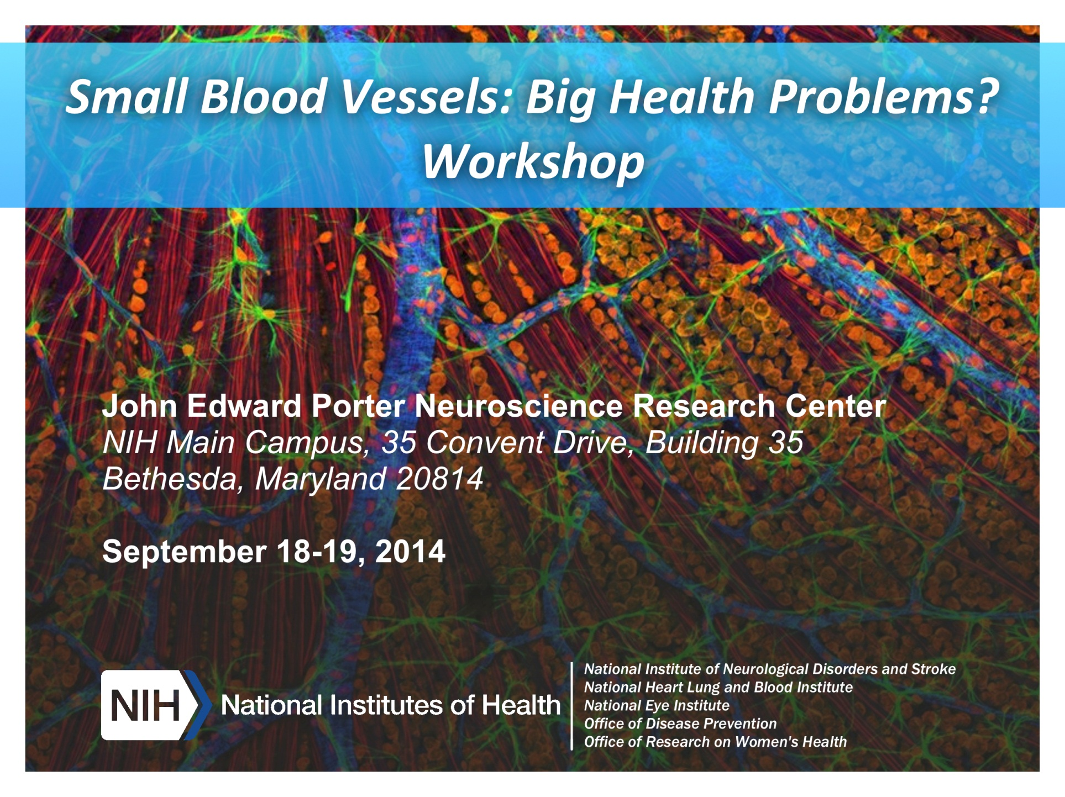
NEEDS:
Integration of small blood vessel research across diverse systems & disciplines
Biomarkers
http://www.ninds.nih.gov/news_and_events/proceedings/Report-for-Small-Blood-Vessels.htm

Slide 13
Vascular Contributions to Cognitive Impairment and Dementia (VCID) as a Discipline
Stroke
AD Dementia
VCID
Notes:
Credit for

Slide 14
Why Vascular “Contributions”?
to Cognitive Impairment and Dementia (VCID)?
Notes:
Confusion – history of VCI is “impairment”, dementia was added on
Confusion – MCI – MCI defines cognitive impairment, and MCI, unlike VCI, never includes dementia
Confusion – VCID refers to contributions, embracing its co-morbid nature – comorbid AD/VCID may be more common that pure AD or pure VaD
National Plan to Address AD still uses Vascular Dementia

Slide 15
Vascular Contributions to Cognitive Impairment & Dementia (VCID)
micro-infarct
~vascular cognitive impairment (VCI)
micro-bleed
cardiac disease
silent stroke
TIA
small vessel ischemic stroke
CADASIL
small vessel hemorrhagic stroke
~vascular dementia
cerebral amyloid angiopathy (CAA)
large vessel ischemic stroke
large vessel hemorrhagic stroke
VCID recognizes & unifies as a discipline the spectrum of Vascular Contributions to Cognitive Impairment & Dementia
VCID was historically siloed among disciplines with various names & inclusivity; result is slow advances in this area
Separating VCI & dementia not advantageous for mechanisms focused research; e.g., a person may progress from VCI to dementia

Slide 16
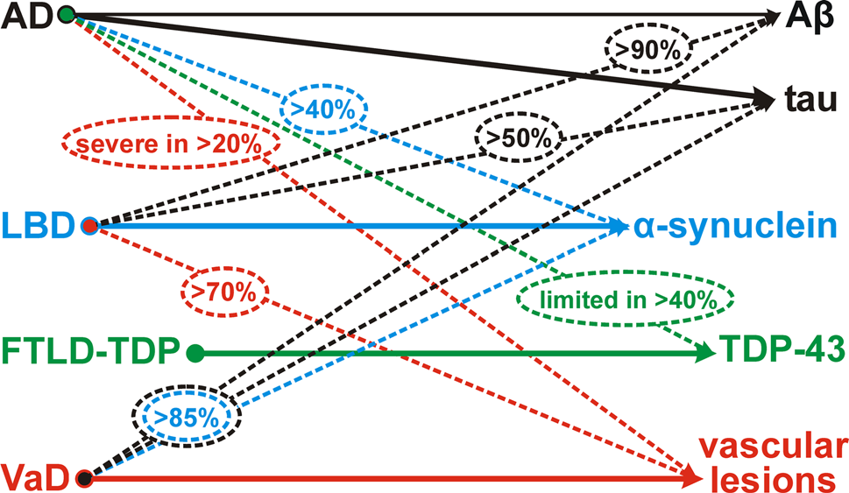
Co-Morbidities are the Norm in Dementia: VCID is the Most Common Co-Morbidity
Attems and Jellinger, 2013, Neuropathology. In: Dening T, Thomas A (eds) Oxford textbook of old age psychiatry, 2 edn., Oxford University Press., pp 87-105.
Notes:
Credit for

Slide 17
AD Pathology
micro-infarct
~vascular cognitive impairment (VCI)
micro-bleed
cardiac disease
silent stroke
TIA
small vessel ischemic stroke
CADASIL
small vessel hemorrhagic stroke
~vascular dementia
cerebral amyloid angiopathy (CAA)
large vessel ischemic stroke
large vessel hemorrhagic stroke
VCID recognizes & unifies as a discipline the spectrum of Vascular Contributions to Cognitive Impairment & Dementia
VCID includes & embraces its largely comorbid nature

Slide 18
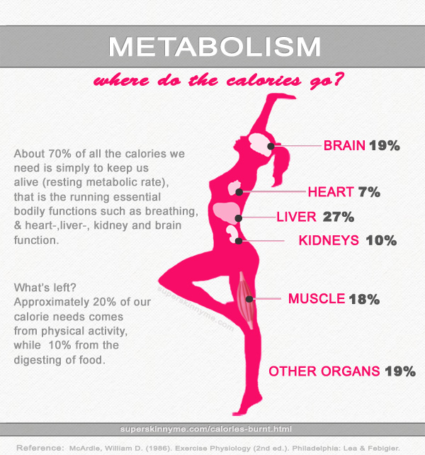
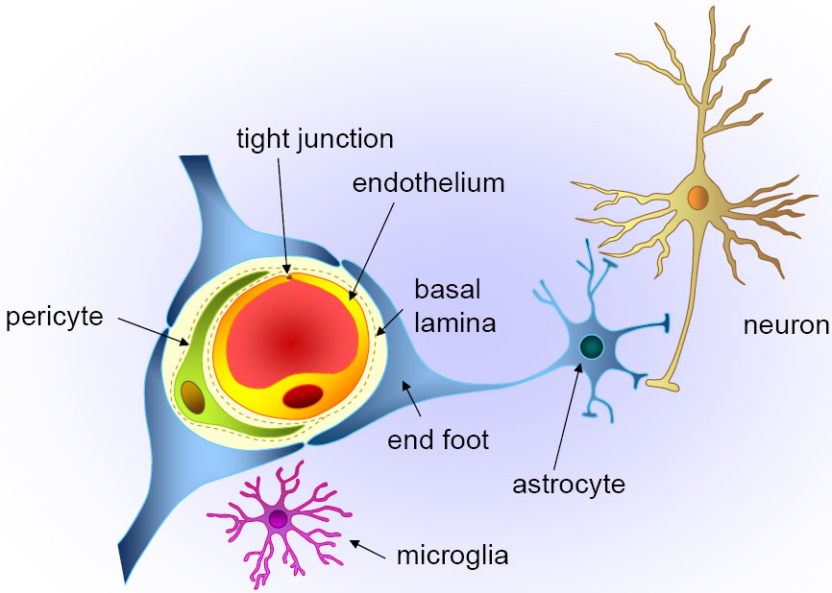

VCID as a Discipline
Stroke + Vascular Biology
Sugar + Lipid Metabolism
Neurovascular Unit
Immune Function
AD Biology
Notes:
NEUROVASCULAR UNIT – Abbott et al. 2010, Neurobiol. Disease 37:13-25

Slide 19
Presentation Goals
Genetics of VCID where are we? What next?
VCID - a distinct discipline on stroke spectrum, related to Alzheimer’s, scientifically & clinically poised for impact on disease burden.
Notes:
Credit for

Slide 20
Genetic Causes of VCID
  CADASIL (> 230 NOTCH 3 mutations)
  CARASIL (HTRA1 mutations)
  CAA (APP; other - ACys, ATTR, AGel, PrPSc, ABri, ADan)
  PSEN1 (>3 mutations, with AD)
  Trisomy 21 (with AD)
Genetic Risk for VCID
  Apoe4, Apoe2
Related Disorders with shared risk factors: Alzheimer’s disease, stroke, coronary artery disease, diabetes, sickle-cell anemia, hyperhomocysteinemia, HERNS (hereditary endotheliopathy, retinopathy, nephropathy, and stroke), Moya-Moya, Hereditary Hemorrhagic Telangiectasia,….
Notes:
Credit for

Slide 21

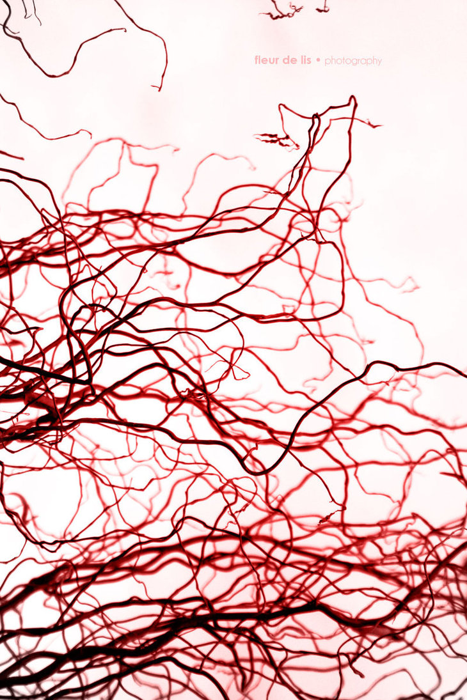
How Much of VCID Results from Genetic Causes or Risks?
Difficult/impossible to estimate at present
  Blood pressure heritability est.: 30%-50%
  Ischemic stroke heritability est.: 38%¹
Reviewed in: Journal of Stroke 2014;16(3):114-123 by Arne Lindgren
Notes:
What are the challenges: Next slide – stratification.

Slide 22
VCID Genetics - Challenges
2006
“The most critical challenge for genetic studies of VCI is to identify quantifiable phenotypes that can be reliably and effectively determined in large samples of subjects.”
Leblanc, G.G., Meschia, J.F, Stuss, S.T., and Hachinski, V.,
Stroke. 2006; 37: 248-255
2015
“Develop & validate noninvasive markers of key vascular processes related to cognitive & neurologic impairment.”
National Plan to Address Alzheimer’s Disease (U.S.)

Slide 23
AD Pathology
micro-infarct
~vascular cognitive impairment (VCI)
micro-bleed
cardiac disease
silent stroke
TIA
small vessel ischemic stroke
CADASIL
small vessel hemorrhagic stroke
~vascular dementia
cerebral amyloid angiopathy (CAA)
large vessel ischemic stroke
large vessel hemorrhagic stroke
Cognitively Normal
Cognitive Impairment
(e.g. MCI, VCI)
Dementia

Slide 24
VCID Genetics:
Stratification may be Critical and is Complex
Vessel Disease | Affected Vessel
Atherosclerosis | Arteries
Arteriolosclerosis | Arterioles
Cerebral Amyloid Angiopathy | Arterioles Arteries Capillaries
Blood Brain Barrier | Capillaries (as part of neurovascular unit)
Vascular Injury | Size
Macroinfarcts (also gross infarcts) | ≥ 1mm - 5mm¹
Microinfarcts | 100µm - 3mm (mean < 1mm)
Primary Intraparencymal Hemorrhages | ≥ 5mm
Microbleeds | ≤ 5mm
White Matter Hyperintensity (Presumed Vascular Origin) | NA
Snyder, Corriveau, et al., In Press, in Alzheimer’s & Dementia

Slide 25
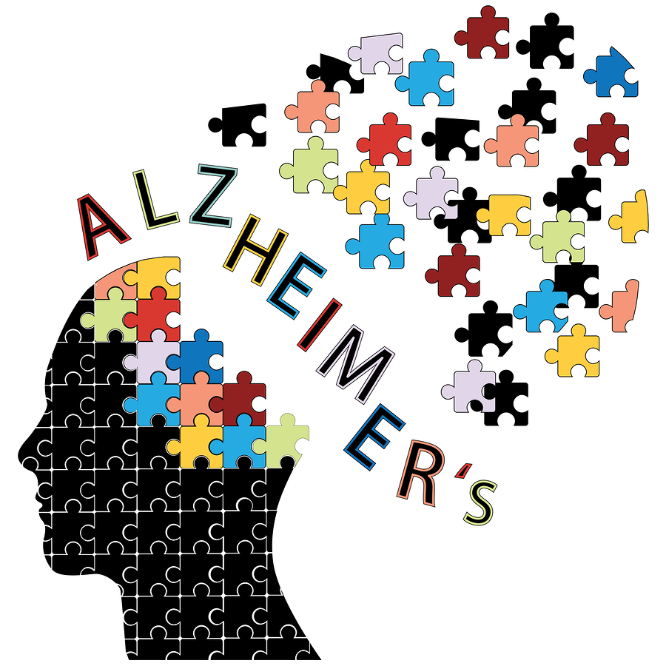
How Much of VCID Results from Genetic Causes or Risks?
Difficult/impossible to estimate at present
  Blood pressure heritability est.: 30%-50%
  Ischemic stroke heritability est.: 38%¹
Reviewed in: Journal of Stroke 2014;16(3):114-123 by Arne Lindgren
Notes:
What are the challenges: Next slide – stratification.

Slide 26
Genome-Wide Association Meta-analysis
of Neuropathologic Features of Alzheimer’s Disease and Related Dementias
Beecham, Montine, et al. and the ADGC 2014, PLOS Genetics V10, Issue 9
VBI showed a moderate negative correlation
with the previously reported AD dementia effect sizes. This was unexpected and, if validated, might indicate that the genetic risk architecture for AD and VBI are inversely related.

Slide 27
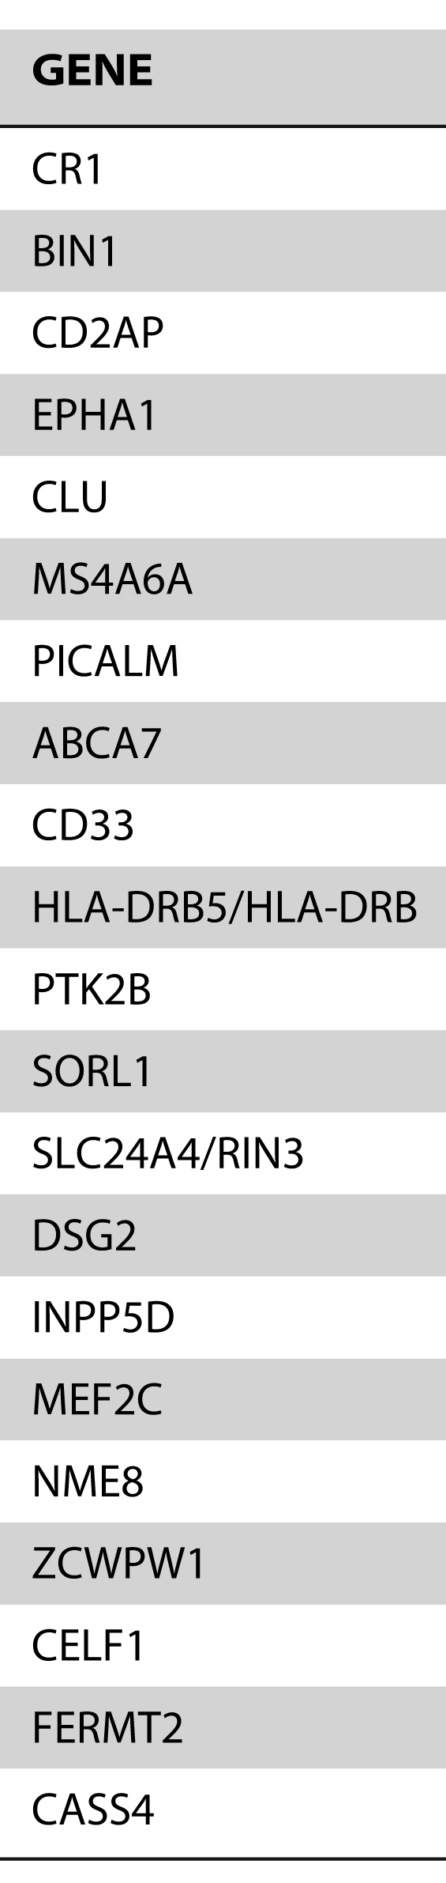
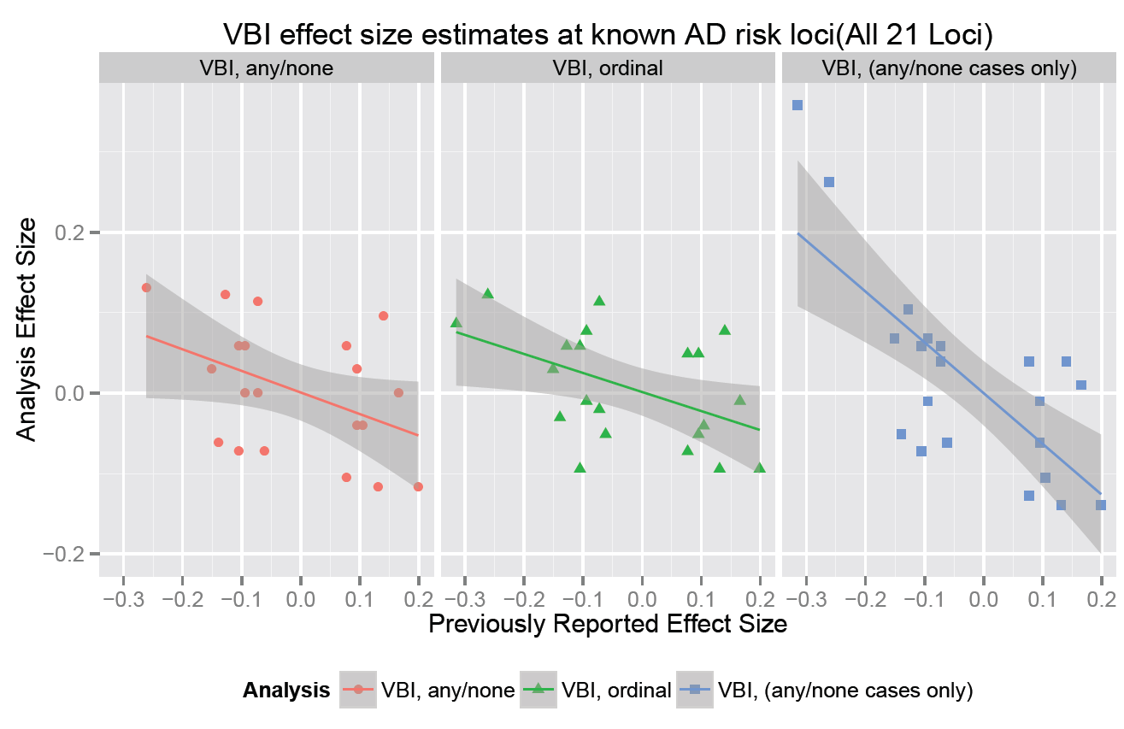
VBI Effect Size Estimates at 21 AD Candidate Risk/Protective Loci Suggest an Inverse Correlation
Analysis Effect Size
Previously Reported Effect Size

Slide 28
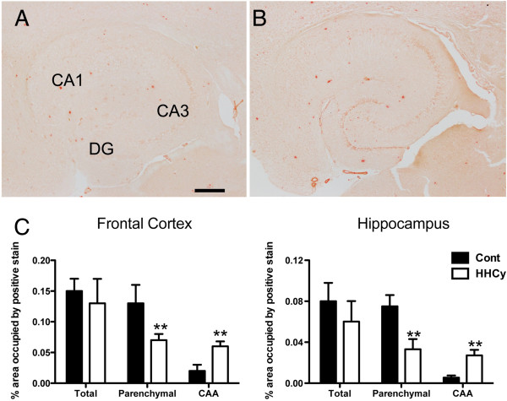
β-amyloid is Shifted to the Vasculature
by Hyperhomocysteinemia in APP/PS1 Mice
APP/PS1 Control
APP/PS1 HHCy
Suddeth, TL, Wilcock, DM et al. 2014 Jun 9;6(3):32. Alzheimer’s Research Therapeutics

Slide 29



12/3/2013
Population studies: majority of late in life dementias are mixed, frequently with vascular contributions
Addressing vascular risk factors may already be decreasing prevalence of dementia in some countries
Vascular risks and contributions are highly tractable for future intervention

Slide 30
NIH RFA-AG-15-010
Interdisciplinary Research to Understand the Vascular Contributions to Alzheimer’s Disease
MERCI

