Slide 1

Genome-wide association study of brain microbleeds: the CHARGE consortium
Arfan Ikram, Hieab Adams on behalf of the NeuroCHARGE Working Group
Nothing to disclose

Slide 2
Brain microbleeds
Marker of cerebral small vessel disease
More prevalent in persons with dementia and stroke
Identification of genetic risk factors could elucidate etiology
Currently only small candidate gene studies
Notes:
CAA & hypertensive angiopathy
Not only subclinical/preclinical stage, but also occur more often in those with overt neurodegenerative or neurovascular disease

Slide 3
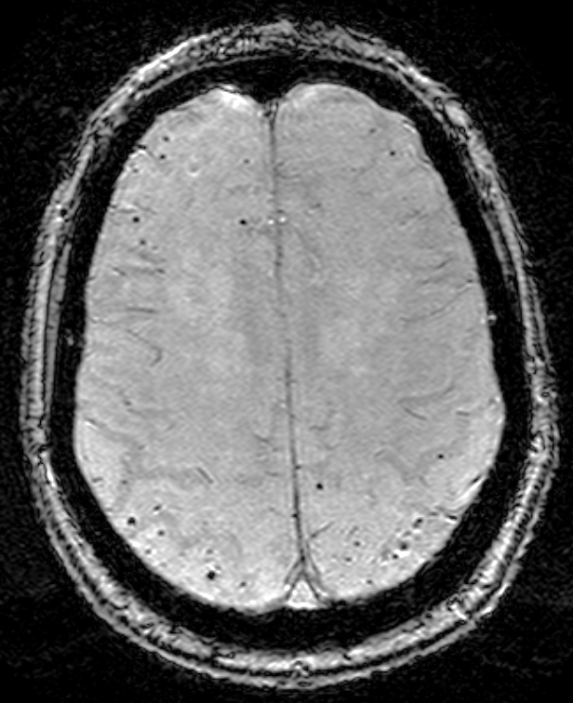
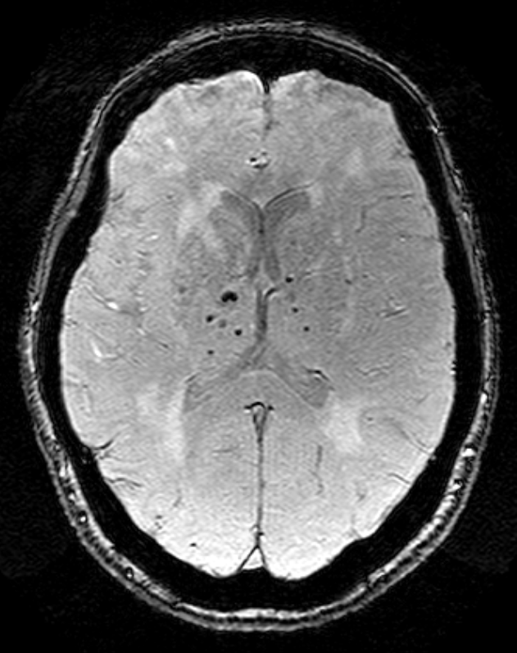
Definition:
Small, round, hypointense lesions on
susceptibility-weighted MR imaging
(Greenberg et al. Lancet Neurology. 2009)

Slide 4
Any microbleeds
Presence of microbleeds, regardless of location

Slide 5
Strictly lobar
Microbleeds exclusively in cortico-subcortical regions
Deep/infratentorial
Any microbleeds in
deep brain regions

Slide 6
Analytic approach
Site-specific genome-wide association studies
  1000 Genomes imputed genotypes
  Exclusions criteria: dementia, stroke
Binary logistic regressions for presence versus absence of microbleeds
  Any BMB, Strictly lobar, Deep/infra
  Controlling for age, sex, population stratification, and study site (if applicable)
Inverse variance based meta-analysis
  Filtering on MAF*(Number of cases)*(Imputation quality) > 5
  Genome-wide significance of p<5x10⁻⁸, suggestive association p<1x10⁻⁶

Slide 7
Participating cohorts
Cohort | N | Any BMB | Strictly lobar | Deep/infra
AGES | 2579 | 370 | 219 | 151
ASPS | 203 | 34 | - | 28
ERF | 126 | 27 | - | -
FHS | 1574 | 141 | 93 | 48
LBC1936 | 577 | 68 | 20 | 48
PROSPER | 382 | 81 | 42 | 39
RS1 | 979 | 352 | 224 | 128
RS2 | 648 | 128 | 79 | 49
RS3 | 2424 | 295 | 222 | 73
Total | 9492 | 1496 | 899 | 564

Slide 8
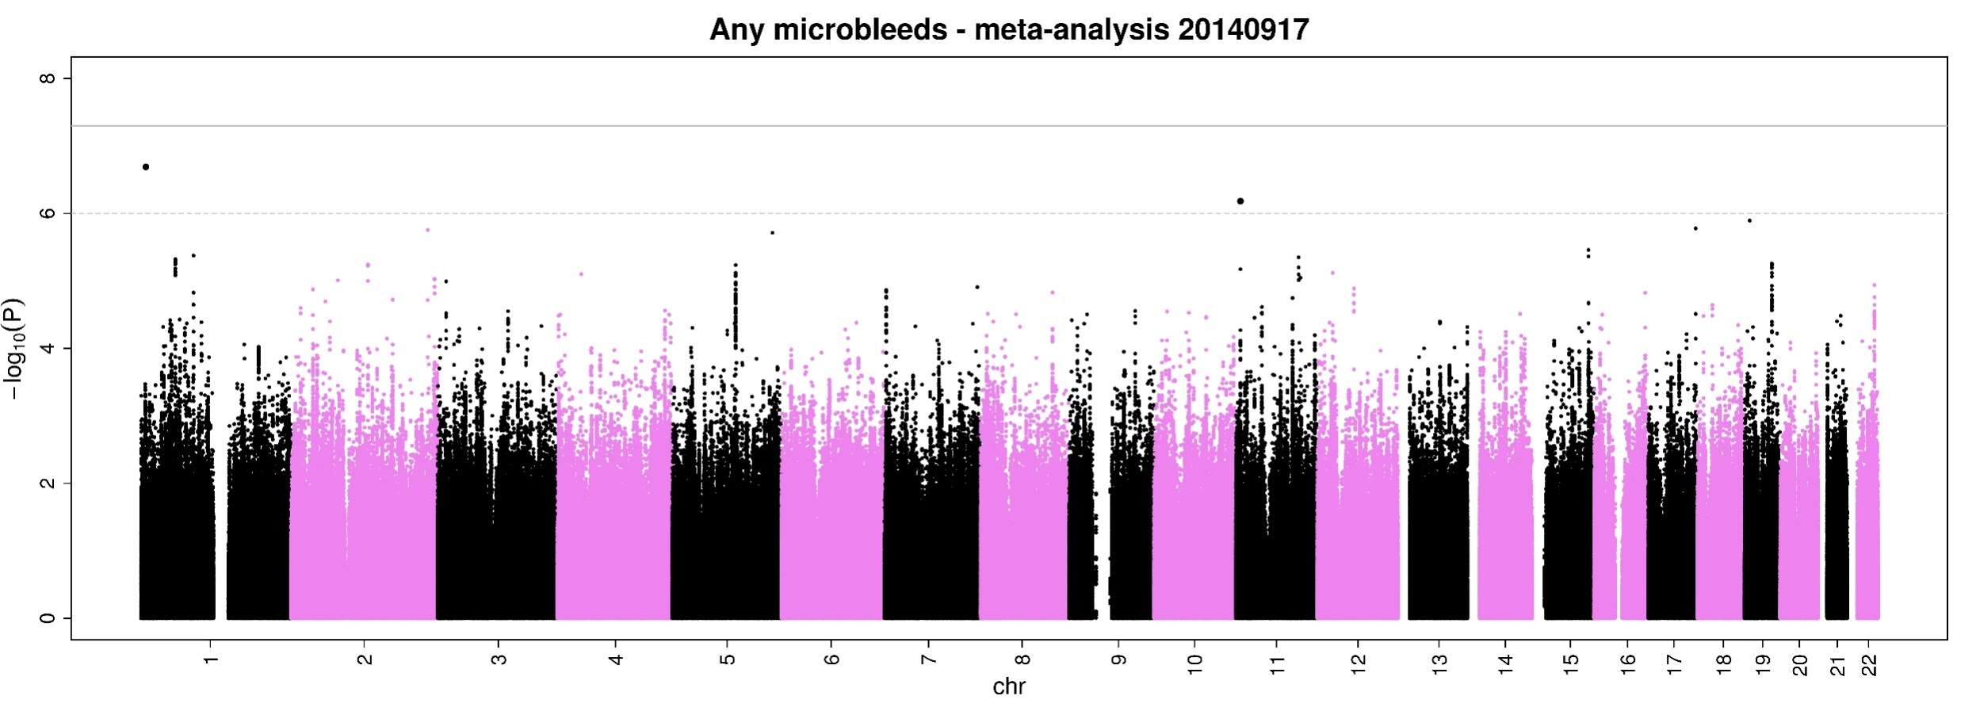
Manhattan plot - Any microbleeds
No genome-wide significant variants (p<5x10⁻⁸)
Suggestive variants (p<1x10⁻⁶)
  chr1p36 (RERE), chr11p15 (CYB5R2/OVCH2)
Notes:
This gene encodes a member of the atrophin family of arginine-glutamic acid (RE) dipeptide repeat-containing proteins. The encoded protein co-localizes with a transcription factor in the nucleus, and its overexpression triggers apoptosis. A similar protein in mouse associates with histone deacetylase and is thought to function as a transcriptional co-repressor during embryonic development. Multiple transcript variants encoding different isoforms have been found for this gene. [provided by RefSeq, Jul 2008].
CYB5R2: NADH-cytochrome b5 reductases are involved in desaturation and elongation of fatty acids, cholesterol biosynthesis, drug metabolism, and, in erythrocyte, methemoglobin reduction (By similarity). Responsible for NADH-dependent lucigenin chemiluminescence in spermatozoa by reducing both lucigenin and 2-[4-iodophenyl]-3-[4-nitrophenyl]-5-[2,4- disulfophenyl]-2H tetrazolium monosodium salt (WST-1).
OVCH2: pseudogene?

Slide 9
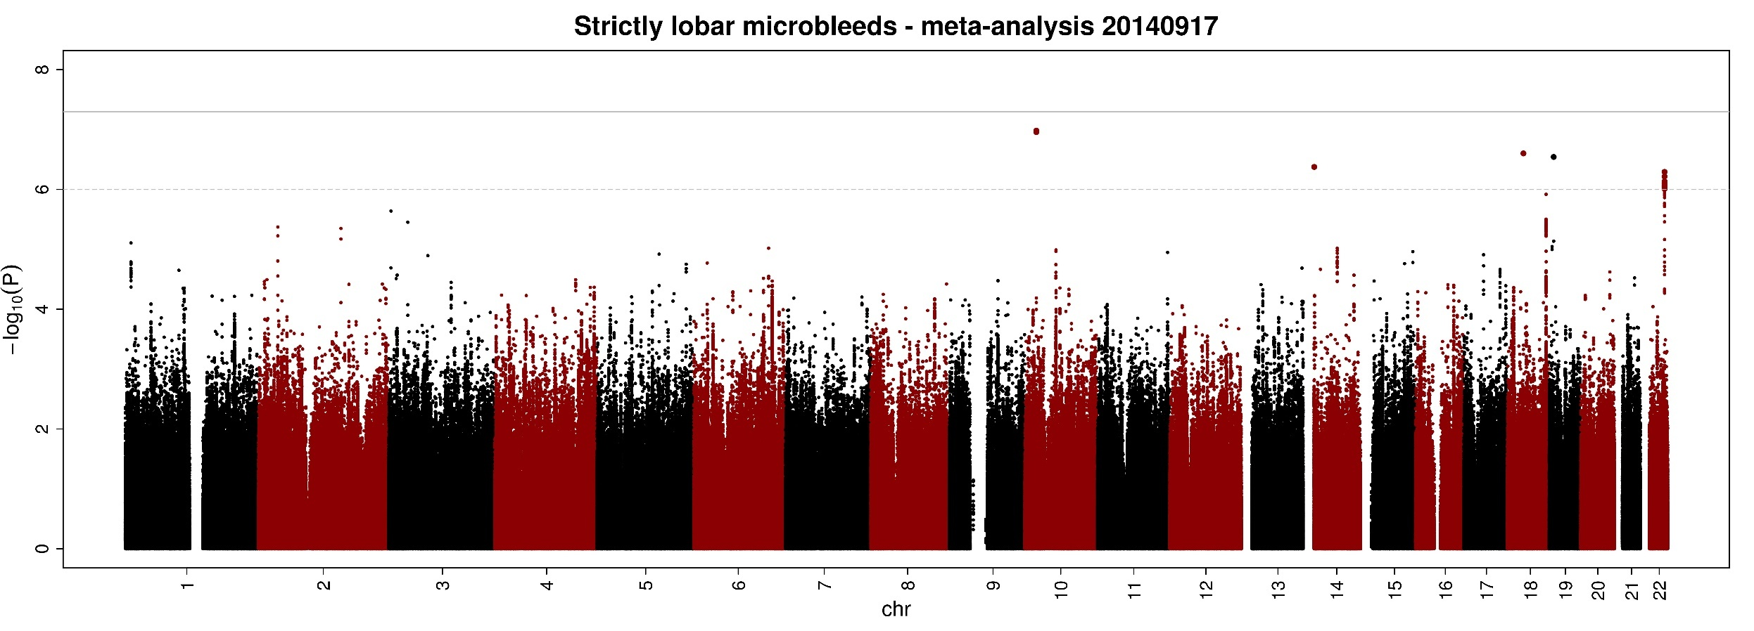
Manhattan plot - Strictly lobar
No genome-wide significant variants (p<5x10⁻⁸)
Suggestive variants (p<1x10⁻⁶)
  chr10p12 (NEBL), chr14q11 (TTC5/CNNB1IP1), chr18q12 (WBP11P1), chr19p13 (ZNF414), chr22q13 (PHF21B)
Notes:
NEBL, brain expressed, studied in muscle cells, binds actin

Slide 10
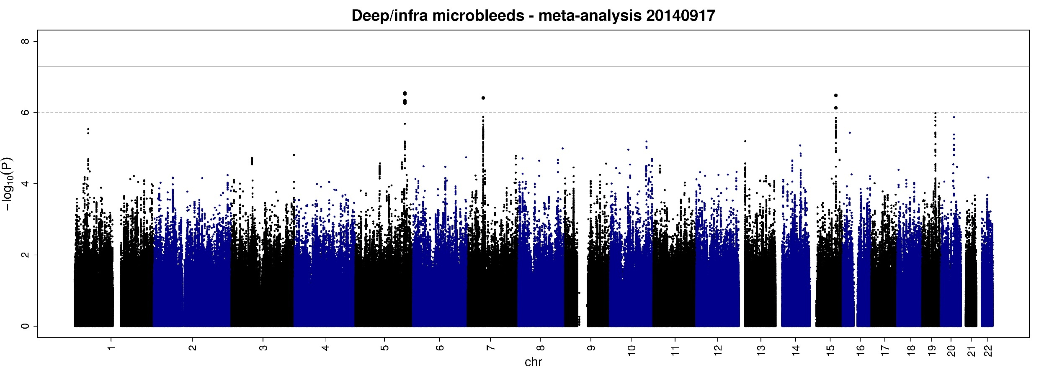
Manhattan plot - Deep/infra
No genome-wide significant variants (p<5x10⁻⁸)
Suggestive variants (p<1x10⁻⁶)
  chr5q33 (SGCD), chr7p12 (ABCA13), chr15q25 (STARD5)
Notes:
This gene encodes a member of the atrophin family of arginine-glutamic acid (RE) dipeptide repeat-containing proteins. The encoded protein co-localizes with a transcription factor in the nucleus, and its overexpression triggers apoptosis. A similar protein in mouse associates with histone deacetylase and is thought to function as a transcriptional co-repressor during embryonic development. Multiple transcript variants encoding different isoforms have been found for this gene. [provided by RefSeq, Jul 2008].
CYB5R2: NADH-cytochrome b5 reductases are involved in desaturation and elongation of fatty acids, cholesterol biosynthesis, drug metabolism, and, in erythrocyte, methemoglobin reduction (By similarity). Responsible for NADH-dependent lucigenin chemiluminescence in spermatozoa by reducing both lucigenin and 2-[4-iodophenyl]-3-[4-nitrophenyl]-5-[2,4- disulfophenyl]-2H tetrazolium monosodium salt (WST-1).
OVCH2: pseudogene?

Slide 11
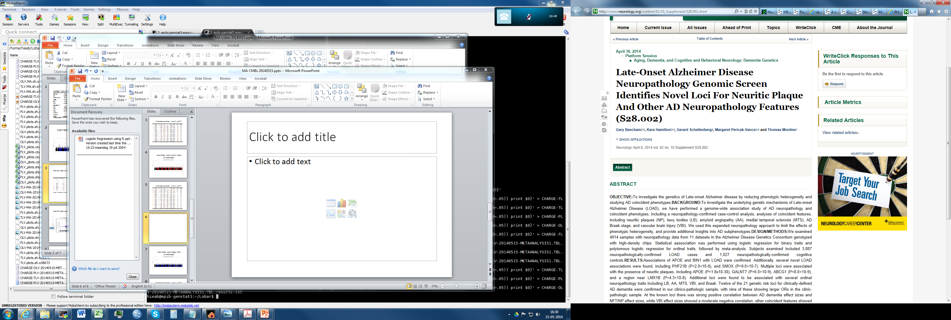
20 Alzheimer’s disease variants:
APOE
  Any BMB: OR=1.30, p=2.00x10⁻⁵
  Strictly lobar: OR=1.29, p=1.07x10⁻³
  Deep/infra: OR=1.27, p=2.19x10⁻²
2 Intracerebral haemorrhage variants:
chr12q21, lobar ICH
  Any BMB: OR=1.01, p=.82
  Strictly lobar: OR=1.03, p=.71
  Deep/infra: OR=.95, p=.54
chr1q22, nonlobar ICH
  Any BMB: OR=1.14, p=5.06x10⁻³
  Strictly lobar: OR=1.09, p=.16
  Deep/infra: OR=1.33, p=2.54x10⁻⁴

Slide 12
Conclusions
No variants associated with microbleeds at genome-wide significance
  Currently including more studies
Alzheimer’s disease variants associated with microbleeds,
  Slightly stronger with strictly lobar microbleeds
  Evidence of potential mechanistic links between Alzheimer’s disease and small vessel disease
Nonlobar ICH variant associated with deep microbleeds
  Disease-associated variant also affects people free of stroke

Slide 13
Acknowledgements
NeuroCHARGE Working Group
Lenore J. Launer
Jose Rafael Romero
Alexa Beiser
Mark A. van Buchem
Vincent Chouraki
Charles DeCarli
Reinhold Schmidt
Cornelia M. van Duijn
Stephanie Debette
Sarah R. Preis
Natalia S. Rost
Joshua Bis
Sudha Seshadri
Myriam Fornage
Meike W. Vernooij
Joanna M. Wardlaw
Paul Nyquist
M. Arfan Ikram
…
and many others!

Slide 15
Extra slides

Slide 16
Heritability
Cohort | Any BMB | Strictly lobar | Deep/infra
 | H² (SE) | H² (SE) | H² (SE)
Family study
ASPS | - | - | -
FHS | .25 (.10) | .15 (1.01) | .23 (.47)
ERF | - | - | -
Unrelated sample
RS1-3 | .08 (.11) | .05 (.11) | .00 (.12)
Total | 1462 | 899 | 536

Slide 17
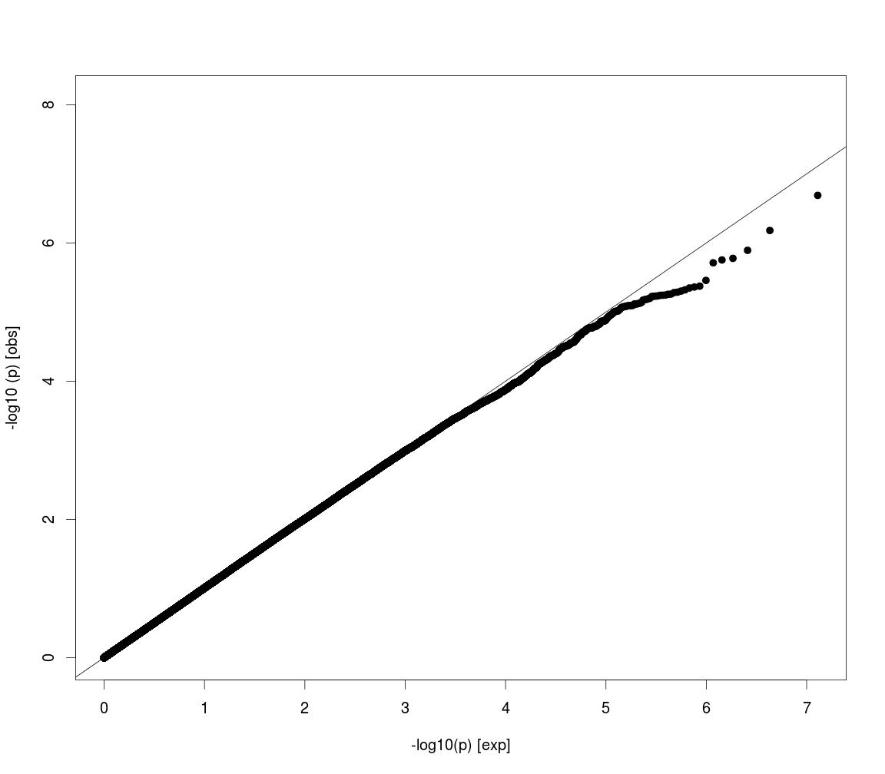
QQ plot - Any microbleeds

Slide 18
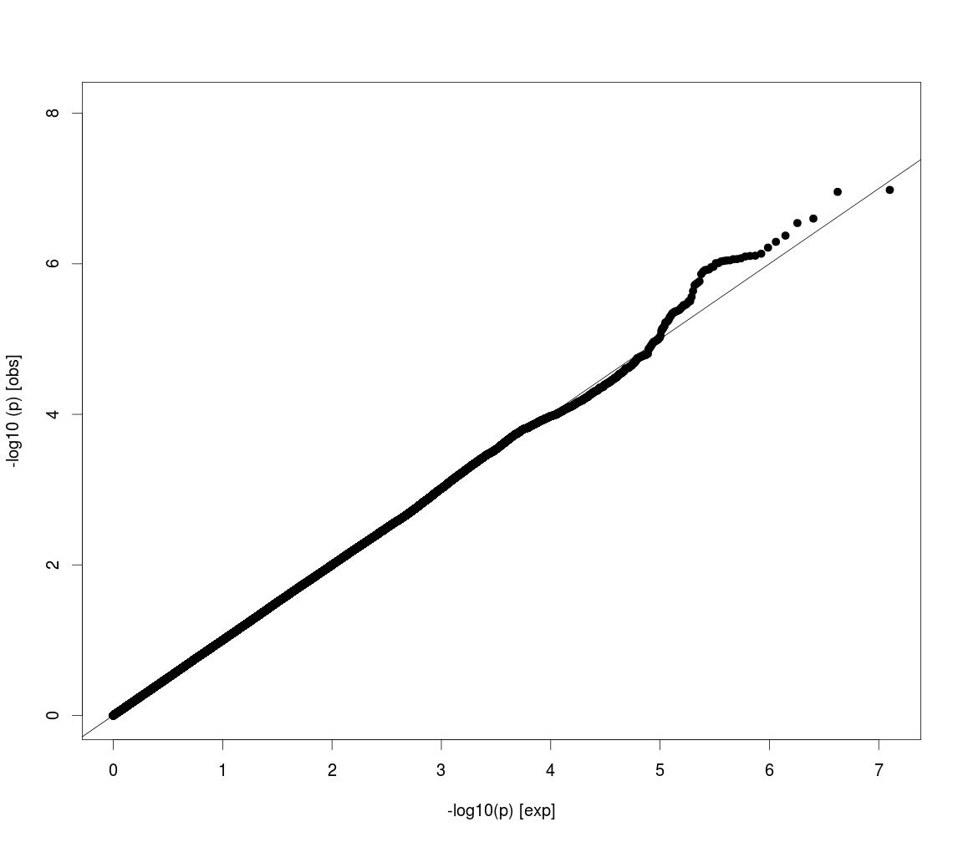
QQ plot - Strictly lobar

Slide 19
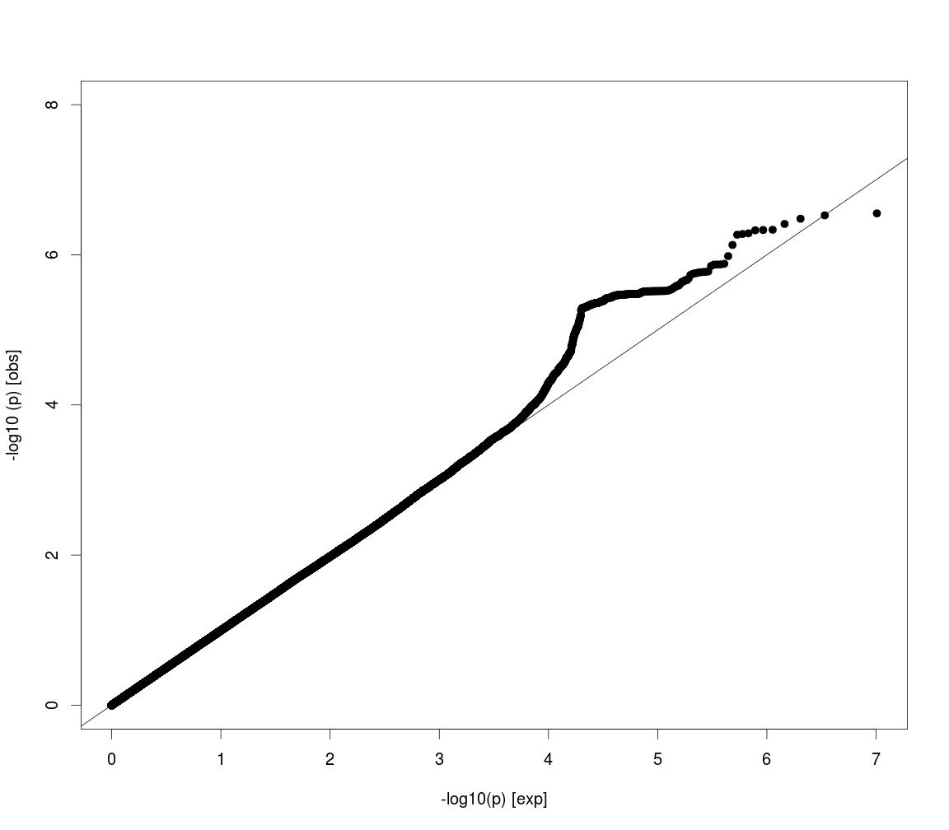
QQ plot - Deep/infra

