Slide 1
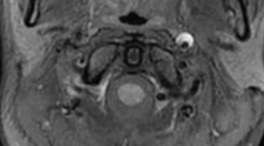


Agnostic approaches to decipher determinants of
Cervical Artery Dissection
Stéphanie Debette, MD PhD
Epidemiology / Neurology, Bordeaux University Hospital
Inserm U897, Bordeaux, France
DHU Neurovasc Paris-Sorbonne
Department of Neurology,
Boston University School of Medicine, Boston, USA

Slide 2
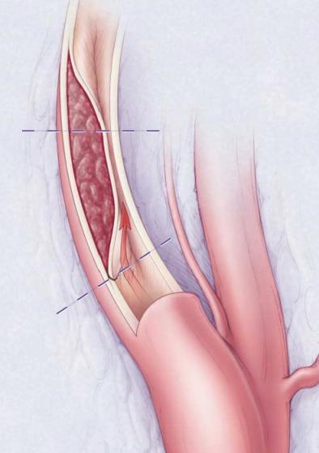
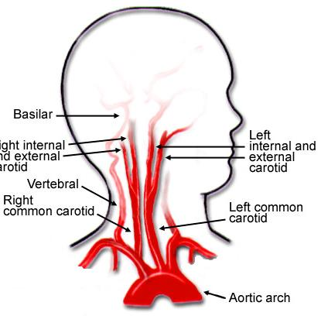
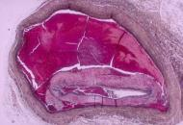
Cervical Artery Dissection (CeAD)
Internal carotid art.
Vertebral art.
Artère vertébrale
Modified with permission from Schievink, NEJM 2001
Schievink, NEJM 2001
Schievink & Debette, Neurology 2011

Slide 3
Epidemiology of CeAD
Major cause of ischemic stroke in young and middle-aged adults
Incidence = low in general population
  2.6 to 3.0 / 100,000 inhabitants / year
Mean age = 44 years (seldom beyond age 65)
Internal carotid artery > vertebral artery in European populations
  ~ 60% vs. 40%
Cerebral ischemia in 67-77% of patients
  Lee, Neurology 2006; Putaala, Stroke 2009
  Debette & Leys, Lancet Neurol 2009
  Schievink, NEJM 2001; Béjot, Int J Stroke 2013

Slide 4
« Environmental » Risk factors
Cervical trauma
Recent infection
Migraine (esp. without aura)
Hypertension
↗ CeAD Risk
Hypercholesterolemia
Obesity
↘ CeAD Risk
Southerland, Curr Opin Neurol 2013; Haldeman, Spine 1999; Dittrich, CVD 2007
Pezzini, Cephalalgia 2005; Schürks, BMJ 2009; Metso, Neurology 2012
Naggara, Eur Radiol 2009; Guillon, Stroke 2003; Grau, Stroke 1997
Debette, Neurology 2011; Debette, Circulation 2011
Notes:
REFERENCES
4

Slide 5
Genetic risk factors
Rarely (<1%), as part of a monogenic disorder
  Vascular Ehlers-Danlos syndrome
  Classic / Hypermobile Ehlers-Danlos syndrome
  Marfan syndrome (distinct from extension of aortic dissection)
  Osteogenesis Imperfecta
  Loeys-Dietz syndrome (extremely rare)
Debette, Goeggel-Simonetti, et al., Neurology in press
Rodrigues, AJNR 2009; Debette & Markus, Stroke 2009
Grond-Ginsbach & Debette, Curr Mol Med 2009; Pepin, NEJM 2000
Notes:
5

Slide 6
Genetic risk factors
Family history of CeAD < 2.5% in published series
Among 1,934 consecutive CeAD patients from CADISP-plus registry
  20 patients (1.0%, 95%CI[0.6-1.5%])
  from 17 families (0.9% [0.5-1.3%]) had a family history of CeAD
Family history of CeAD more frequent in patients with carotid dissection & elevated cholesterol levels
Schievink, Stroke 1996
Debette, Goeggel-Simonetti, et al., Neurology in press
Notes:
6

Slide 7
Genetic risk factors
In most cases, CeAD is sporadic
  Genetic variants ↑ risk of CeAD as part of a multifactorial predisposition
Published candidate gene association studies
  Based on a priori hypotheses on underlying pathophysiology
  Few positive results, not replicated, except weak association with MTHFR (677TT) polymorphism
CADISP-genetics → Aim to perform a genome-wide association study of CeAD
Debette & Markus, Stroke 2009
Notes:
7

Slide 8
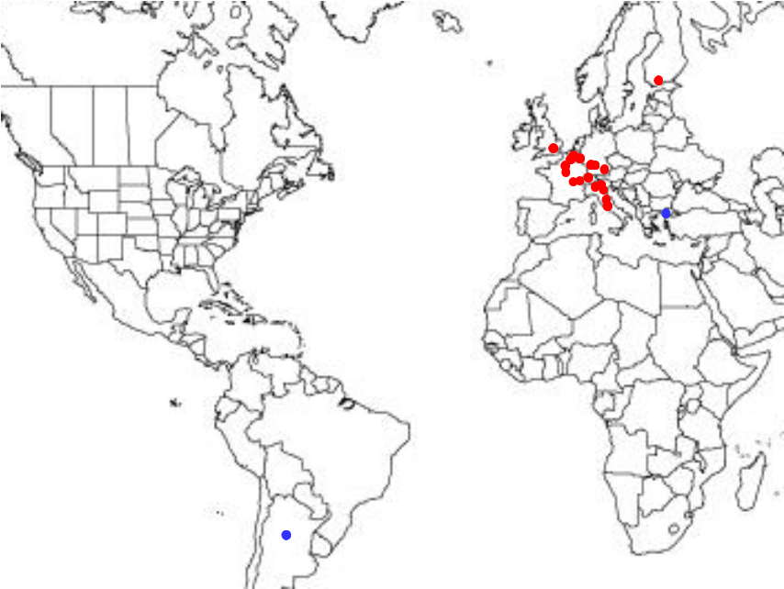
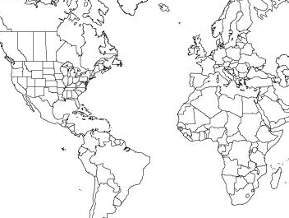
CADISP
Cervical Artery Dissections and Ischemic Stroke Patients
1,393 CeAD patients recruited for GWAS
CADISP-1:
942 patients / 9,259 controls
772 / 8,972 for CADISP-1 non-Finnish
170 / 287 for CADISP-1 Finnish
CADISP-2:
451 patients / 5,157 controls
www.cadisp.com; www.clinicaltrials.gov
Notes:
8

Slide 9
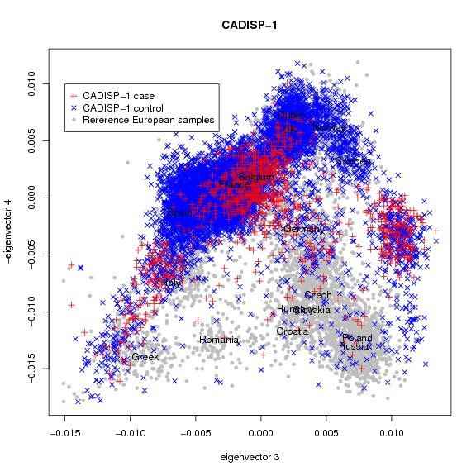
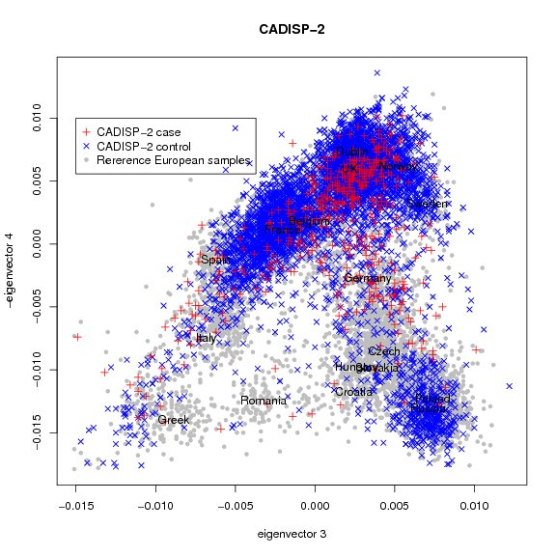
14,416 controls drawn from an anonymized control genotype database at the French National Genotyping Center, and matched on cases for ethnic background (based on distribution of Eigenvectors)
CADISP
Cervical Artery Dissections and Ischemic Stroke Patients

Slide 10
Genotyping and imputation
Arrays used:
  Illumina Human 610K and 660W-Quad mostly
Stringent quality control (QC):
  Sample QC: call rate <0.95, sex discrepancy, duplicates, first degree relatives, non-Europeans based on PCA
  SNP QC: call rate <0.98, HWE p<10⁻⁶, MAF < 0.01
→ 472,862 autosomal SNPs, 10,029 X-chromosome SNPs
Imputation analysis:
  MACH® and Minimac®softwares
  HapMap2 CEU and 1000 Genomes August 2010 ref panels
Notes:
was performed for regional association plots of significant loci, and for evaluating association statistics of previously published loci

Slide 11
Statistics - GWAS
Additive genetic model
  relating genotype dose (0 to 2 copies of the minor allele) to CeAD
Logistic regression, genome-wide
  separately for CADISP-1 Finns, CADISP-1 non Finns,CADISP-2
Adjustment for gender and principal components of population stratification
  PC1-10 (CADISP-1 non Finns, CADISP-2), PC1 (CADISP-1 Finns)
Meta-analysis of GWAS using inverse-variance weighted meta-analysis (METAL)
  genomic control was applied before meta-analysis

Slide 12
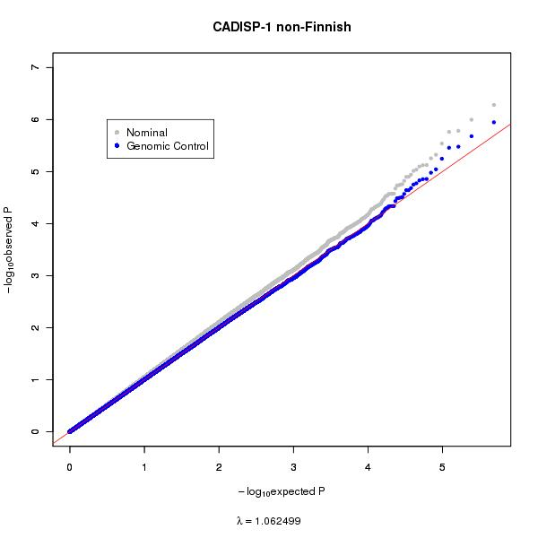
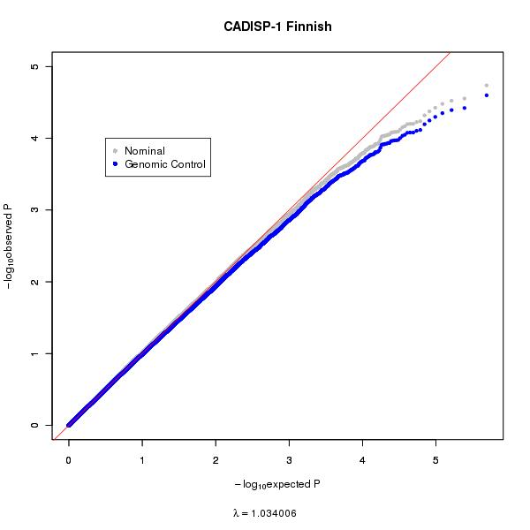
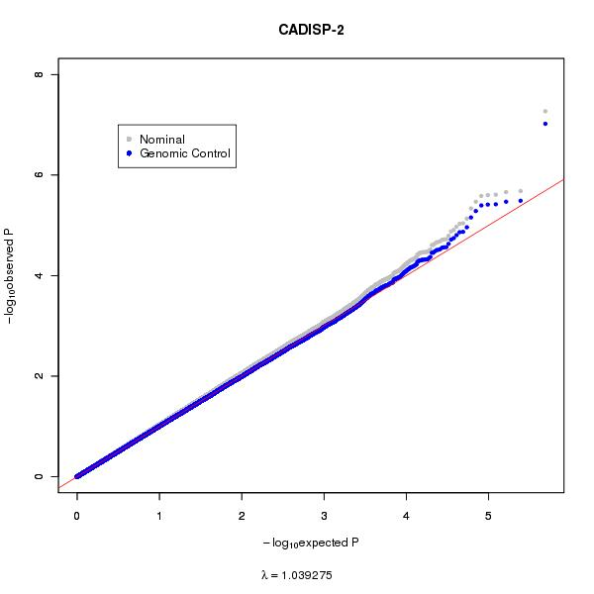
QQ plot: no inflation of association statistics
CADISP-1 non-Finnish
CADISP-1 Finnish
CADISP-2
-log₁₀observed P
-log₁₀expected P
λ = 1.062
-log₁₀expected P
λ = 1.034
-log₁₀expected P
λ = 1.039
GWAS meta-analysis
λ = 1.032
Debette et al., Nat Genet in press
Notes:
Be quite confident that findings are not mere artefacts due to population stratification

Slide 13
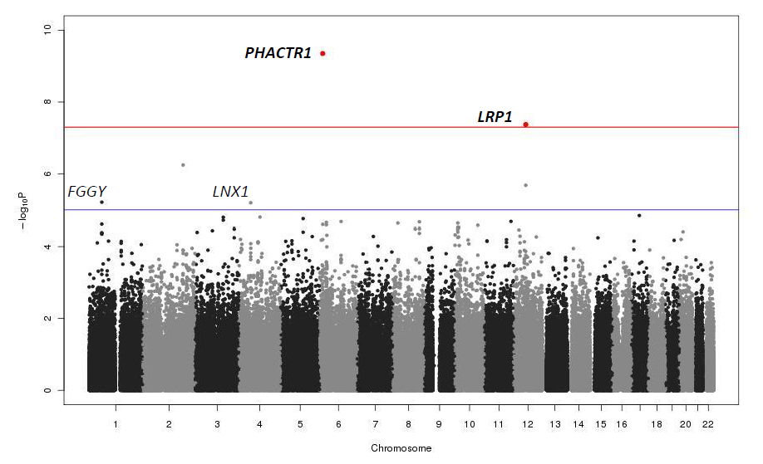
Manhattan plot
p = 5 x 10⁻⁸
Debette et al., Nat Genet in press

Slide 14
Associations with genotyped SNPs at p<10⁻⁵
Six SNPs from five independent loci reached p < 10⁻⁵
Two loci reached genome-wide significance in discovery dataset
SNP | Chr | Position | EA | Nearest Gene | MAF | OR (95%CI) | P
rs12402265 | 1 | 59463190 | A | FGGY | 0.27 | 1.23 (1.13-1.35) | 6.12x10⁻⁶
rs6741522 | 2 | 185544143 | A | ZNF804A | 0.13 | 1.34 (1.19-1.50) | 5.65x10⁻⁷
rs6820391 | 4 | 54109453 | A | LNX1 | 0.29 | 1.23 (1.12-1.35) | 6.35x10⁻⁶
rs9349379 | 6 | 13011943 | G | PHACTR1 | 0.42 | 0.75 (0.69-0.82) | 4.46x10⁻¹⁰
rs11172113 | 12 | 55813550 | C | LRP1 | 0.39 | 0.78 (0.71-0.85) | 4.22x10⁻⁸
rs1466535 | 12 | 55820737 | A | LRP1 | 0.32 | 0.80 (0.73-0.88) | 2.07x10⁻⁶
Debette et al., Nat Genet in press

Slide 15
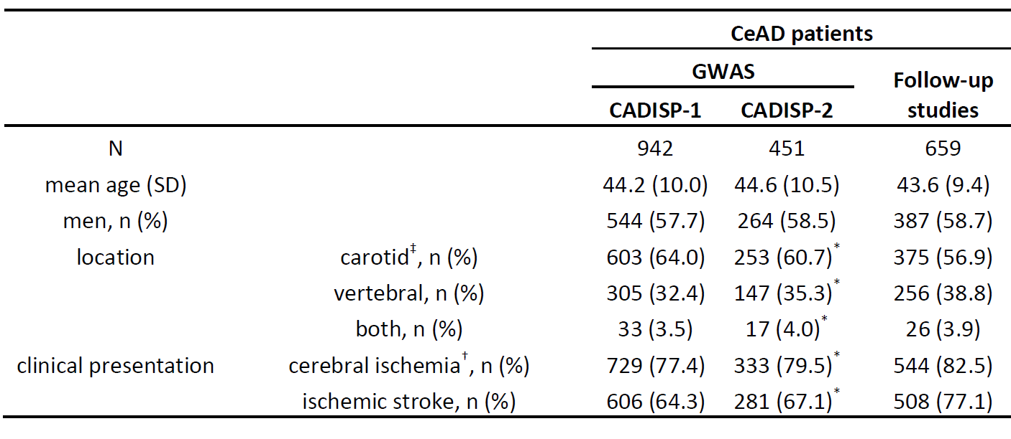
Follow-up sample
We recruited 659 additional CeAD patients from 11 studies, in
Germany, Italy, Netherlands, Russia, Spain, Sweden, USA

Slide 16
Association of top SNPs in follow-up
PHACTR1 locus replicated, but not LRP1
Suggestive locus at LNX1 replicated, GW significant in combined analysis
 |  |  | GWAS meta-analysis |  | Follow-up meta-analysis |  | Overall meta-analysis
 |  |  | (N=1,393/14,416) |  | (N=659/2,648) |  | (N=2,052/17,064)
SNP | Chr | Gene | OR | P-value | OR | P-value | OR | P-value
rs12402265 | 1 | FGGY | 1.23 | 6.12x10⁻⁶ | 1.21 | 0.012 | 1.23 | 2.30x10⁻⁷
rs6741522 | 2 | ZNF804A | 1.34 | 5.65x10⁻⁷ | 1.09 | 0.36 | 1.26 | 2.29x10⁻⁶
rs6820391 | 4 | LNX1 | 1.23 | 6.35x10⁻⁶ | 1.28 | 9.28x10⁻⁴ | 1.24 | 2.36x10⁻⁸
rs9349379 | 6 | PHACTR1 | 0.75 | 4.46x10⁻¹⁰ | 0.81 | 3.91x10⁻³ | 0.77 | 1.00x10⁻¹¹
rs11172113 | 12 | LRP1 | 0.78 | 4.22x10⁻⁸ | 0.93 | 0.34 | 0.82 | 3.03x10⁻⁷
rs1466535 | 12 | LRP1 | 0.80 | 2.07x10⁻⁶ | 0.92 | 0.30 | 0.83 | 4.94x10⁻⁶
Threshold for significance in follow-up p < 5.00x10⁻³

Slide 17
Additional evidence for association
Bayesian approach to evaluate the significance of associations using Wakefield’s approximate Bayes factor
SNP | Chr | Nearest gene | Frequentist P-value |  | Asymptotic Bayes Factor
 |  |  | GWAS | Combined | GWAS | Combined
rs12402265 | 1 | FGGY | 6.12x10⁻⁶ | 2.30x10⁻⁷ | 2.28x10⁻⁴ | 1.10x10⁻⁵
rs6741522 | 2 | ZNF804A | 5.65x10⁻⁷ | 2.29x10⁻⁶ | 4.27x10⁻⁵ | 1.36x10⁻⁴
rs6820391 | 4 | LNX1 | 6.35x10⁻⁶ | 2.36x10⁻⁸ | 5.71x10⁻⁴ | 3.25x10⁻⁶
rs9349379 | 6 | PHACTR1 | 4.46x10⁻¹⁰ | 1.00x10⁻¹¹ | 6.51 x10⁻⁹ | 1.70x10⁻¹⁰
rs11172113 | 12 | LRP1 | 4.22x10⁻⁸ | 3.03x10⁻⁷ | 4.01x10⁻⁶ | 2.37x10⁻⁵
rs1466535 | 12 | LRP1 | 2.07x10⁻⁶ | 4.94x10⁻⁶ | 1.35x10⁻⁴ | 2.90x10⁻⁴
Wakefield, Genet Epidemiol 2009
Debette et al., Nat Genet in press

Slide 18
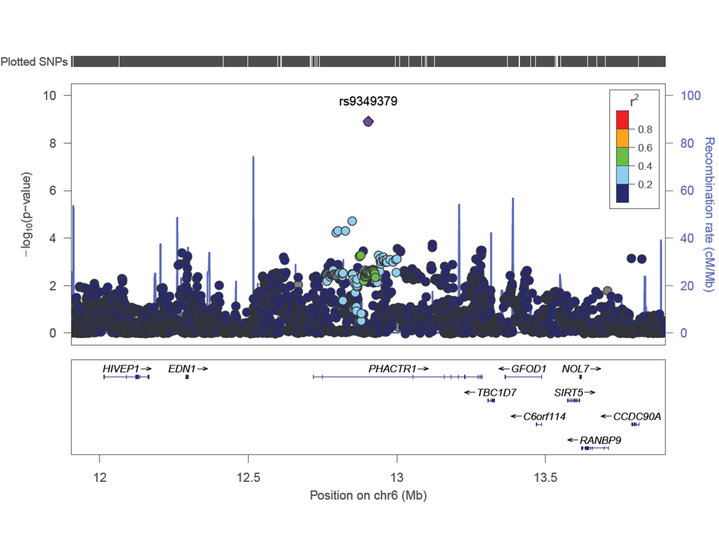
PHACTR1: regional association plot
Debette et al., Nat Genet in press

Slide 19
PHACTR1: regional association plot
Intron 2 of PHACTR1
SNPs in weak LD with top SNP were associated with expression of PHACTR1 in whole blood and cerebellum cells
Highly conserved genomic region
Pivotal role in vascular tube formation and actin polymerization → role in angiogenic processes?
Upregulation of PHACTR1 by TGFβ described in breast cancer cell lines (TGFβ signaling pathway implicated in Marfan and Loeys-Dietz syn, and in genetic predisposition to migraine)
Debette et al., Nat Genet in press

Slide 20
Secondary analyses
Heterogeneity by dissection site in discovery GWAS (856 carotid CeAD and 452 vertebral CeAD)
SNP | Chr | Gene | CeAD site | p (het) | OR | 95% CI | P-value
rs12402265 | 1 | FGGY | carotid | 0.70 | 1.23 | (1.10-1.38) | 2.95x10⁻⁴
 |  |  | vertebral |  | 1.27 | (1.10-1.47) | 1.36x10⁻³
rs6741522 | 2 | ZNF804A | carotid | 0.64 | 1.37 | (1.19-1.57) | 1.17x10⁻⁵
 |  |  | vertebral |  | 1.32 | (1.10-1.60) | 3.53x10⁻³
rs6820391 | 4 | LNX1 | carotid | 0.038 | 1.30 | (1.16-1.45) | 3.88x10⁻⁶
 |  |  | vertebral |  | 1.09 | (0.94-1.26) | 0.28
rs9349379 | 6 | PHACTR1 | carotid | 0.52 | 0.76 | (0.68-0.85) | 1.27x10⁻⁶
 |  |  | vertebral |  | 0.72 | (0.62-0.84) | 1.38x10⁻⁵
rs11172113 | 12 | LRP1 | carotid | 0.061 | 0.74 | (0.66-0.83) | 1.14x10⁻⁷
 |  |  | vertebral |  | 0.89 | (0.77-1.03) | 0.11
rs1466535 | 12 | LRP1 | carotid | 6.49x10⁻³ | 0.73 | (0.65-0.82) | 2.50x10⁻⁷
 |  |  | vertebral |  | 0.97 | (0.84-1.12) | 0.68

Slide 21
Secondary analyses
No association of top SNPs with non-CeAD ischemic stroke (N=583 patients matched on age and gender)
SNP | Chr | EA | EAF | Gene | OR | 95%CI | P value
rs12402265 | 1 | A | 0.27 | FGGY | 0.98 | 0.85-1.14 | 0.82
rs6741522 | 2 | A | 0.13 | ZNF804A | 1.06 | 0.88-1.28 | 0.52
rs6820391 | 4 | A | 0.29 | LNX1 | 0.95 | 0.83-1.10 | 0.53
rs9349379 | 6 | G | 0.40 | PHACTR1 | 0.98 | 0.85-1.11 | 0.72
rs11172113 | 12 | C | 0.39 | LRP1 | 0.96 | 0.84-1.10 | 0.57
rs1466535 | 12 | A | 0.32 | LRP1 | 1.01 | 0.88-1.16 | 0.88

Slide 22
Pleiotropy with vascular & neurological conditions
Coronary Calcifications
Myocardial infarction
PHACTR1 (opposite)
SLC5A3 (opposite)
HDAC9 (opposite)
CDKN2B-AS1 (same)
PHACTR1 (opposite)
Cervical Artery Dissection
Ischemic Stroke
PHACTR1 (opposite)
HDAC9 (opposite)
Migraine
(without aura)
Abdominal aortic aneurysm
PHACTR1 (same)
LRP1 (same)
FHL5 (same)
LRP1 (same)
Debette, Nat Genet in press; Bown, AJHG 2011; Bevan, Stroke 2012; Bellenguez, Nat Genet 2012
O’Donnell, Circulation 2011; Kathiresan, Nat Genet 2009; Deloukas, Nat Genet 2013
Chasman, Nat Genet 2011; Freilinger , Nat Genet 2012; Anttila, Nat Genet 2013

Slide 23
Acknowledgements
CADISP centers (www.cadisp.org)
Belgium: Shérine Abboud, Vincent Thijs; Finland: Tiina Metso, Antti Metso, Turgut Tatlisumak; France: Philippe Amouyel, Yannick Béjot, Marie Bodenant, Sandrine Canaple, Jean Dallongeville, Maurice Giroud, Olivier Godefroy, Didier Leys (PI), Chantal Lamy, Fabien Louillet, Jean-Louis Mas, Elizabeth Medeiros, Thierry Moulin, Yves Samson, Emmanuel Touzé, Fabrice Vuillier; Germany: Tobias Brandt, Martin Dichgans, Michael Dos Santos, Armin Grau, Caspar Grond-Ginsbach, Andreas Gschwendtner, Manja Kloss, Christoph Lichy; Italy: Simone Beretta, Anna Bersano, Valeria Caso, Elisabetta Del Zotto, Giacomo Giacalone, Stefano Paolucci, Alessandro Pezzini, Maria Sessa; Switzerland: Stefan Engelter, Philippe Lyrer; UK: Hugh Markus
Centers collaborating with CADISP
The International Stroke Genetics Consortium (www.strokegenetics.org) Germany: Ralf Dittrich, Bernd Ringelstein, Eva Bartels; Italy: Giorgio Boncoraglio, Elena Ballabio; France: Benoît Guillon, Christophe Tzourio; the Netherlands: Evita van de Herik, Peter Koudstaal; Spain: Israel Fernandez; Sweden: Switzerland: Patrik Michel; UK: Pankaj Sharma; USA: John Cole, Steven Kittner, Jennifer Majersik, James Meschia, Braxton Mitchell, Bradford Worrall, Andrew Southerland
Centre National de Génotypage / Genome Quebec
Yoichiro Kamatani, Mark Lathrop
Notes:
Which has been extremely supportive in this endeavor

Slide 24

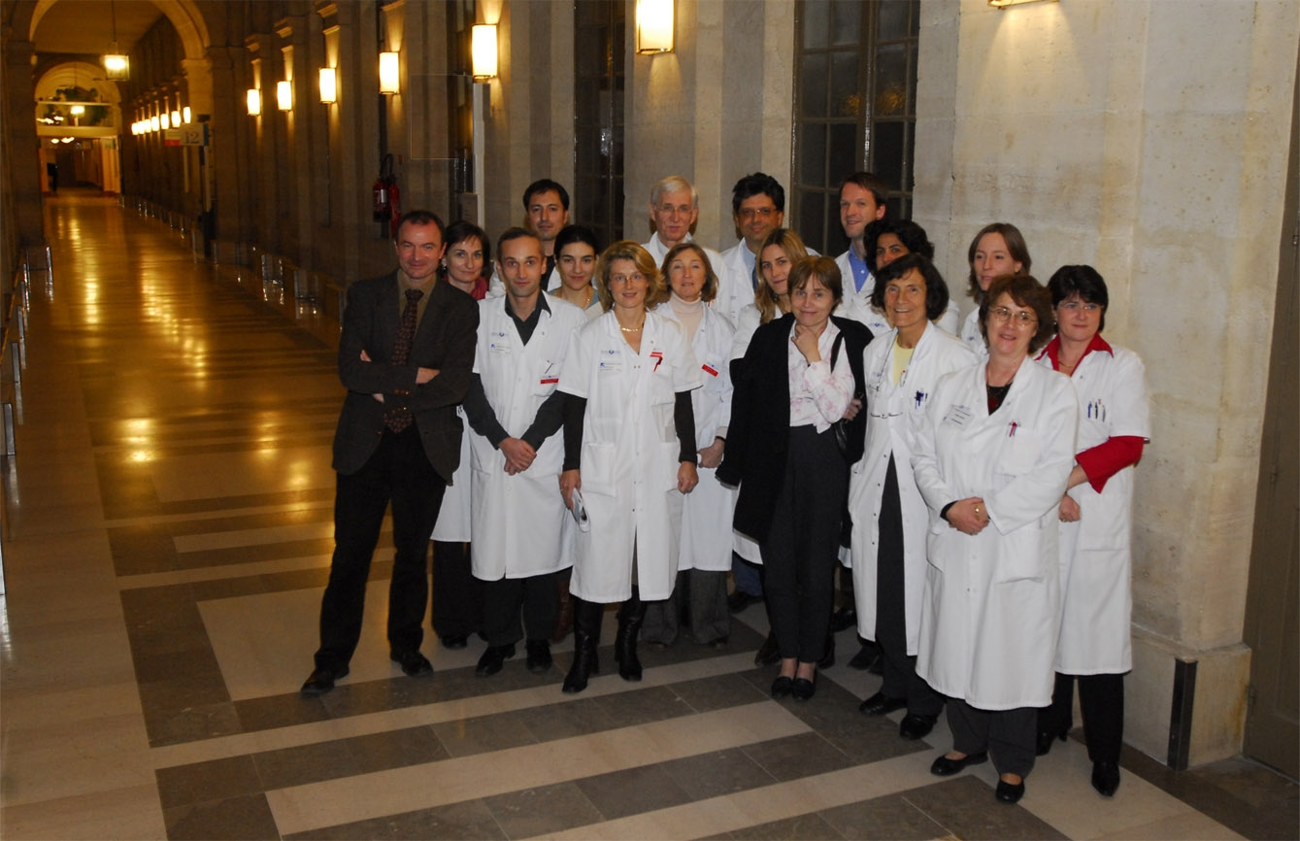
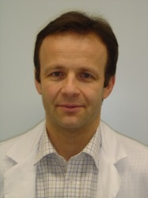

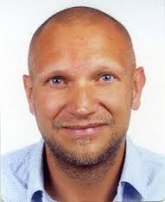

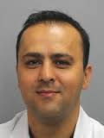


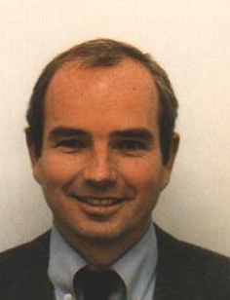




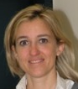

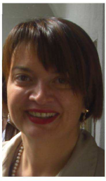





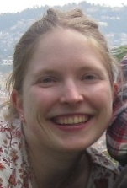




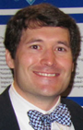





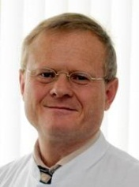
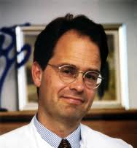

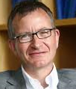





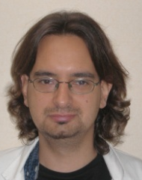



And more…
www.cadisp.com

Slide 25
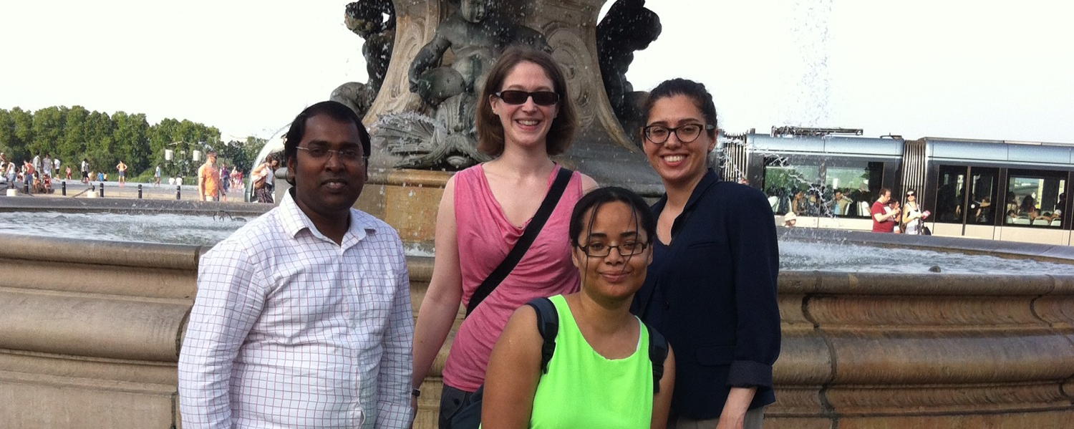

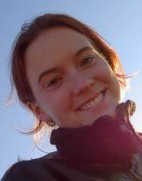
Sabrina Schilling
Dr. Ganesh Chauhan
Dr. Sara Kaffashian
Dr. Aïcha Soumaré
Dr. Muralidaran Sargurupremraj
Laurence Bellengier
(Lille University Hospital)

Slide 26
THANK YOU!

Slide 27
Conclusion
CeAD seldom occurs as part of monogenic disorder
  Inherited disorders of connective tissue exceptional (<1%)
  Familial CeAD is also rare (~1-2%)
In a first dissection GWAS, we identified
  Novel genome-wide significant risk locus for CeAD at PHACTR1
  Additional highly suggestive loci requiring confirmation (LRP1 = risk locus for migraine and abdominal aortic aneurysm)
PHACTR1 also major susceptibility locus for MI and migraine
  Understanding mechanisms by which this locus appears to influence key vascular functions could have major applications
Notes:
for the treatment of these severe and disabling conditions.

Slide 28
CADISP-plus hospital-based registry of CeAD patients (23 hospitals):
from 1,934 consecutive CeAD patients, 6 (0.3%) had inherited CTD
Connective tissue disorder | Known before CeAD | Other DCT criteria | Gene with Mutation | Age | Sex | CeAD location
Vascular Ehlers-Danlos | yes | positive family history, colon rupture, thin and translucent skin, characteristic face | COL3A1 p.Gly540Arg | 25 | M | carotid (bilateral)
Vascular Ehlers-Danlos | yes | colon rupture, thin and translucent skin, easy bruising, muscle ruptures, joint dislocations, sprains | COL3A1 p.Gly571Arg | 29 | M | vertebral
Classic Ehlers-Danlos | no | cutis hyperlaxa, thin skin, easy bruising, joint hypermobility | not tested | 43 | M | carotid
Hypermobile Ehlers-Danlos | yes | multiple sprains, joint hypermobility and 3 out of 3 children with joint hypermobility, mild cutis hyperlaxa | not tested | 42 | F | carotid
Osteogenesis Imperfecta | yes | >50 fractures | not tested | 40 | F | carotid + vertebral
Marfan | yes | positive family history, glaucoma, retinal detachment, pneumothorax, aortic insufficiency, mitral valve prolapse, dilatation of ascending aorta | not tested | 24 | F | vertebral (bilateral)
Debette, Goeggel-Simonetti, et al., Neurology in press
Notes:
SHORTEN

Slide 29
 | Clinical features of index patient |  |  |  |  |  | Clinical features of affected relative
Family | Patient | Age | Gender | Location of dissection | Cerebral ischemia |  | Relative(s) with CeAD | Age | Location of dissection | Cerebral ischemia
1 | 1 | 60 | F | left carotid | 1 |  | brother | 49 | left carotid | 1
2 | 2 | 31 | M | left vertebral | 1 |  | father | 31 | left carotid | 1
3 | 3 | 43 | M | left carotid | 1 |  | sister (patient 4) | 41 | left carotid | 1
3 | 4 | 41 | F | left carotid | 1 |  | brother (patient 3) | 43 | left carotid | 1
4 | 5 | 48 | M | bilateral carotid | 0 |  | male cousin* | 59 | left carotid | 1
5 | 6 | 53 | M | left carotid | 1 |  | brother | 51 | left carotid | 1
 |  |  |  |  |  |  | male cousin | 46 | right carotid | 0
6 | 7 | 49 | M | left carotid | 1 |  | sister (patient 8) | 45 | right carotid | 1
6 | 8 | 45 | F | right carotid | 1 |  | brother (patient 7) | 49 | left carotid | 1
7 | 9 | 44 | F | left vertebral | 1 |  | female cousin | 50 | carotid | 1
8 | 10 | 53 | F | left carotid | 0 |  | male cousin | n.a. | n.a. | n.a.
 |  |  |  |  |  |  | male cousin | n.a. | n.a. | n.a.
9 | 11 | 36 | F | left carotid | 1 |  | uncle | 60 | carotid | 1
10 | 12 | 45 | M | left carotid | 1 |  | brother (patient 13) | 50 | left carotid | 1
10 | 13 | 50 | M | left carotid | 1 |  | brother (patient 12) | 45 | left carotid | 1
11 | 14 | 44 | M | right carotid | 1 |  | mother | n.a. | carotid | n.a.
12 | 15 | 40 | F | left carotid | 0 |  | sister | n.a. | n.a. | n.a.
13 | 16 | 38 | M | left carotid | 0 |  | brother | 48 | carotid | 0
14 | 17 | 53 | F | left carotid | 1 |  | sister | n.a. | carotid | 1
 |  |  |  |  |  |  | brother | n.a. | carotid | 1
15 | 18 | 38 | M | left carotid | 0 |  | male cousin | 57 | common carotid | 0
16 | 19 | 48 | F | left carotid | 1 |  | sister | n.a. | right carotid | 1
17 | 20 | 38 | F | bilateral carotid | 1 |  | uncle | n.a. | n.a. | n.a.
Debette, Goeggel-Simonetti, et al., Neurology in press
Notes:
29

Slide 30
Secondary analyses
Two additional loci reached genome-wide significance when imputed (1000G)
  rs2163474 in CCDC102B on chr18q22.1, OR=1.78[95%CI:1.50-2.11], p=3.86x10-11
  rs9915775 on chr17q21.1 OR=3.39[95%CI:2.21-5.19], p=1.97x10-8 (removed from further consideration because of low MAF [0.01] and relatively poor imputation quality (R²=0.59)
No significant replication (p>0.15)

Slide 31
Secondary analyses
No association with CeAD of:
  SNPs reported to be associated with CeAD in candidate gene association studies
  SNPs within a 100kb window of COL3A1, the gene harboring causal mutations for vascular Ehlers-Danlos syndrome
  Published genome-wide susceptibility SNPs for intracranial aneurysms, and for thoracic aortic aneurysms & dissection

Slide 32
Perspectives
Next steps
  More GWAS… Re-run GWAS with imputation on latest version 1000G (including UK10K), increase sample size
  Aim at performing whole exome / genome sequencing to explore role of rare variants (“extreme phenotypes”?)
  More systematic analysis of shared genetic variation with migraine and vascular disease
  Explore association of CeAD with structural variants and gene expression in relation with CeAD
  Decipher genes underlying familial CeAD (esp. if > 2 affected)
Notes:
for the treatment of these severe and disabling conditions.

