Slide 1


Genetics of type 2 diabetes – pitfalls and possibilities
ISGC, Lund, November 15, 2013
Leif Groop
Lund University Diabetes Centre
Finnish Institute for Molecular Medicine

Slide 2

The diabetes pandemic
52.8
64.2
22%
37.7
51.2
36%
North America
Europe
Asia
199
302
52%
N Africa & M-East
32.6
59.7
83%
Africa
S & C
America
14.7
28.0
90%
25.1
39.9
59%
Oceania
IDF prognosis
2012> 300 million
2030 > 500 million
4.3
6.5
53%
Notes:
2

Slide 3
Outline
Type 2 diabetes - a collision between genes and environment
Four genes –four stories
Back to families
Systems biology – a holstic view
Do we know what type 2 diabetes is?

Slide 4

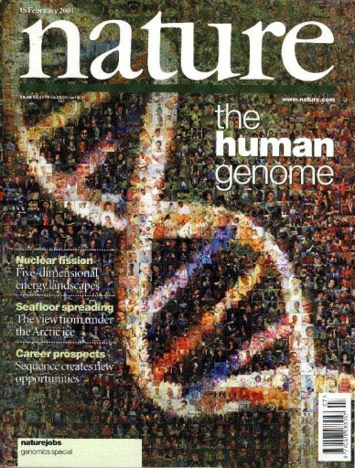
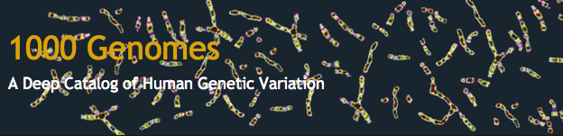
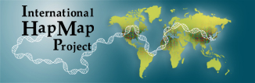

Genomic evolution
Whole genome sequencing
3,000,000,000 bp
∼100% of genome
Linkage
400 microsatellites
10% of genome
GWAS
500,000 SNP
75% of genome
Epigenome
DNA methylation
ChIP sequencing
2011
1996 2000 2007
GoT2D
2800 genomes,
1400 T2D

Slide 5
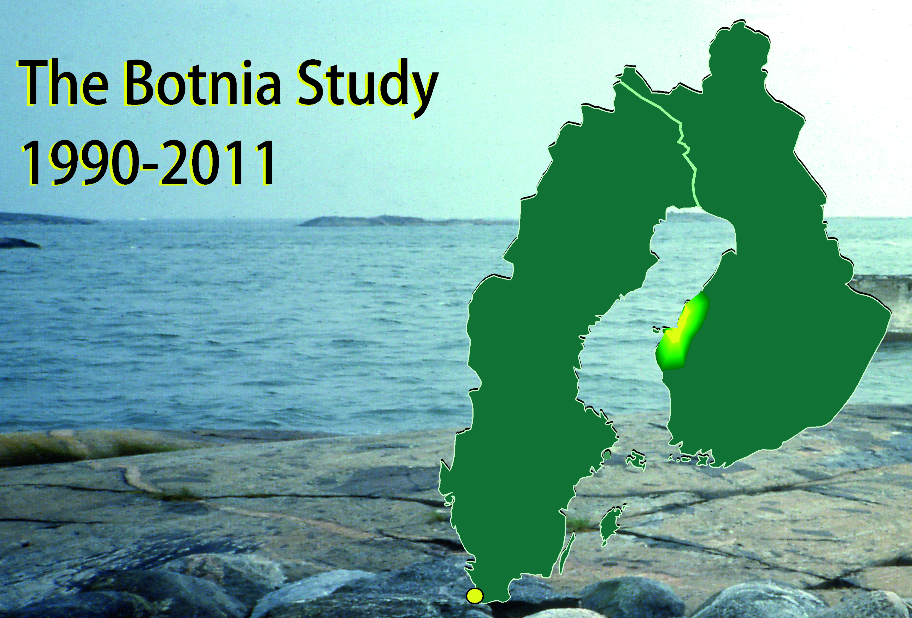

Slide 6
Family history of T2D, BMI30 and FPG 5.5mmol/l identify high-risk individuals
T2D
incidence
(%)
FH +
,
40
28.8
FH –
35
30
HR 16.1 [7.0-37.0]
P<0.0001
25
20
11.7
10.8
15
7.7
10
8.2
10.8
FPG≥ 5.5
5
4.2
1.0
FPG < 5.5
BMI≥30
BMI<30
Lyssenko et al. Diabetes 2005

Slide 7
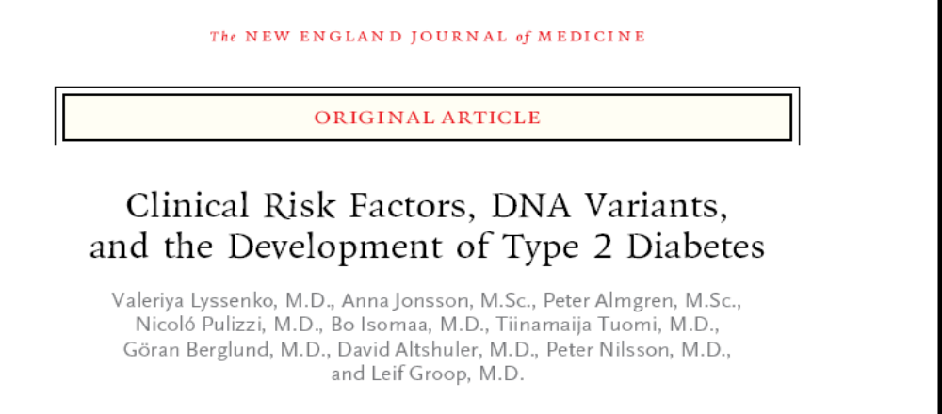
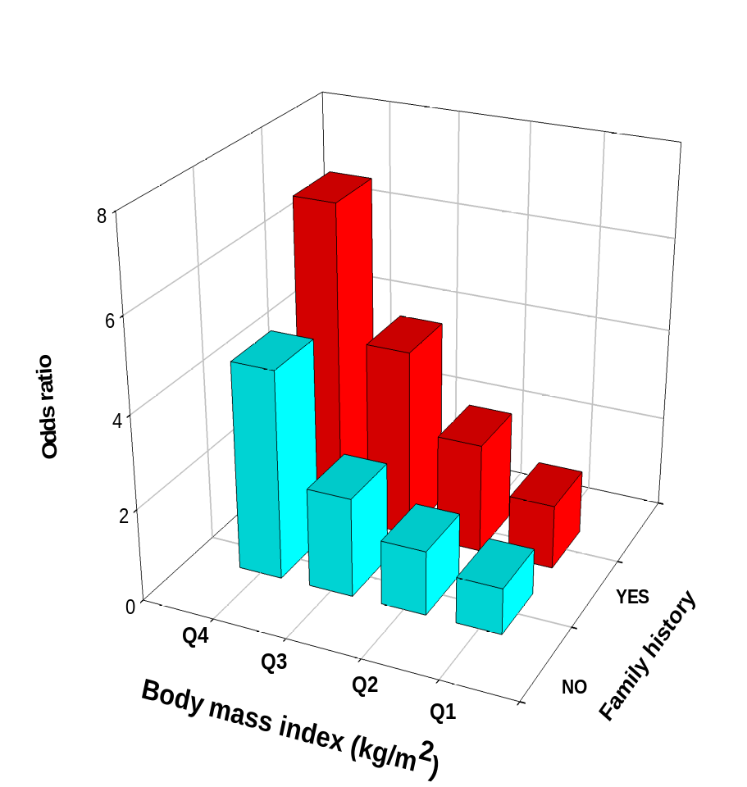
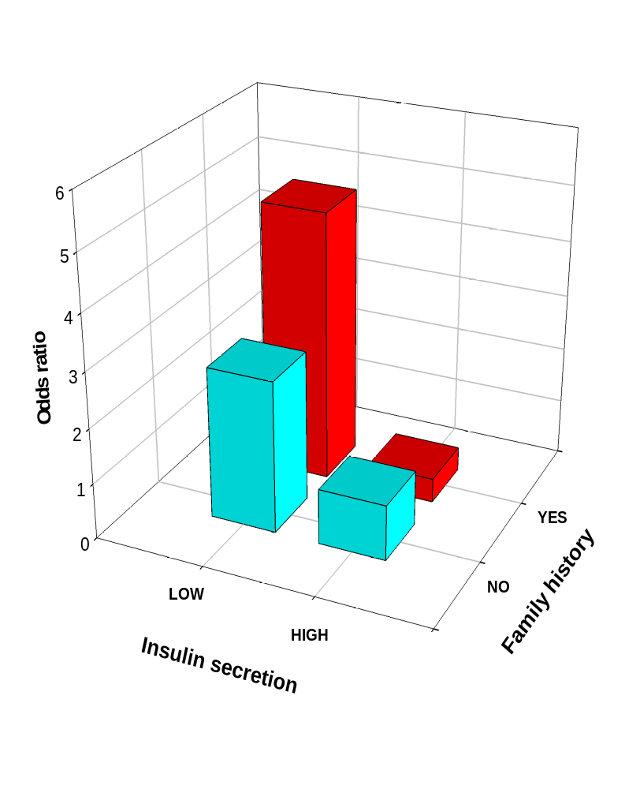
Lyssenko et al, 2008, 359: 2220-2232.
Notes:
Recently we repeated the studies from the BPS in the much larger MPP where more than 2200 individuals developed diabetes after a 25 yr follow-up period.
There was an increased risk of T2D with increasing quartiles of BMI but this risk was doubled in subjects with a family history of T2D.
Also a FH of T2D doubled the risk of T3D associated with a low insulin response to oral glucose.

Slide 8
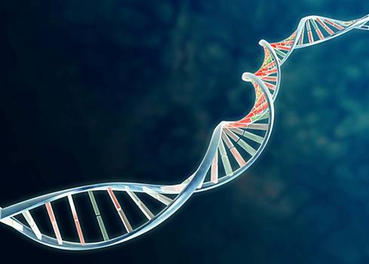
2010
2009
2008
2007
CENTD2
GIPR
KCNQ1
FTO
ADCY5
BCL11A
MTNR1B
2006
SLC30A8
GCK
ZBED3
NOTCH2
HHEX
GCKR
KLF14
2000
TCF7L2
ADAMTS9
CDKN2B/A
DUSP9
PRC1
PPARG
LGR5
IGF2BP2
TP53INP1
ZFAND6
KCNJ11
THADA
CDKAL1
PROX1
HMGA2
CAMKD1
HNF1A
WFS1
DGKB
HNF1B
JAZF1
IRS-1
CHCHD9

Slide 9
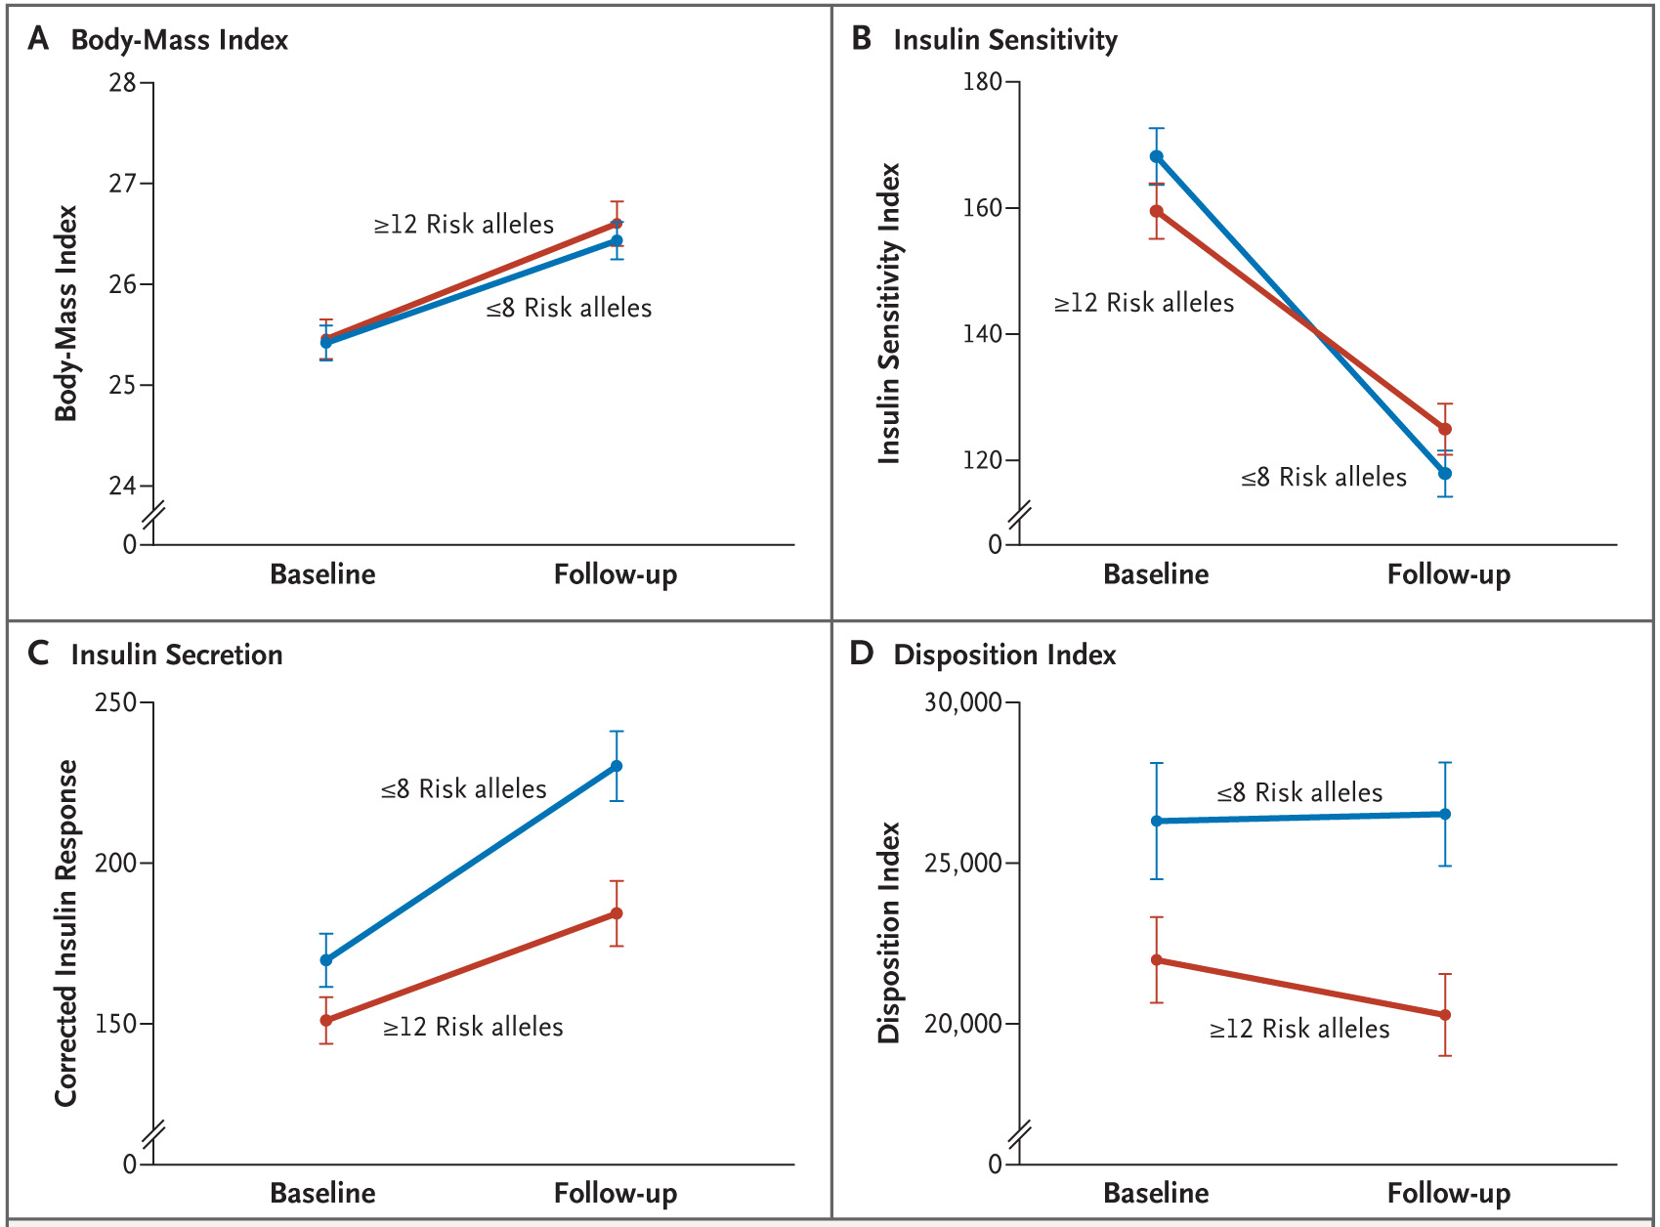

Different phenotypes in carriers of high and low risk genotypes
Body-Mass index
Insulin Sensitivity index
≥12 Risk alleles
Body-Mass index
≤8 Risk alleles
Insulin Sensitivity index
≥12 Risk alleles
≤8 Risk alleles
Baseline Follow-up
Baseline Follow-up
Insulin Secretion
Disposition index
≤8 Risk alleles
≤8 Risk alleles
Corrected Insulin Response
Disposition Index
≥12 Risk alleles
≥12 Risk alleles
Baseline Follow-up
Baseline Follow-up
Lyssenko et al. New Engl J Med 359; 2220-32,2008
Notes:
This slide shows results from the same Botnia prospective study I already referred to. Now we analyzed the effect of high and low genetic risk on changes in BMI, insulin sensitivity, CIR and DI over the 8-year follow-up period. Red line shows carriers of high genetic risk (top quartile) and blue line shows carriers of low genetic risk (lowest quartile). We saw an increase in BMI and a concomitant decrease in insulin sensitivity which was uninfluenced by genotype. However, individuals with a high genetic risk were not able to increase their insulin secretion to compensate for the decrease in insulin sensitivity as efficiently as individuals with low genetic risk.

Slide 10
Outline
Type 2 diabetes - a collision between genes and environment
Four genes –four stories
Systems biology – a holistic view
Back to families
Do we know what type 2 diabetes is?

Slide 11
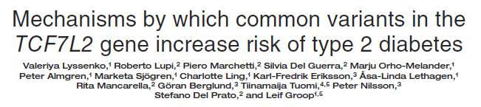
The No 1 T2D gene – but how does it increase risk of T2D?
TCF7L2

Slide 12
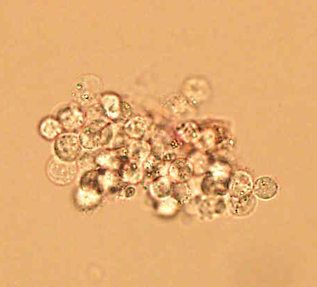
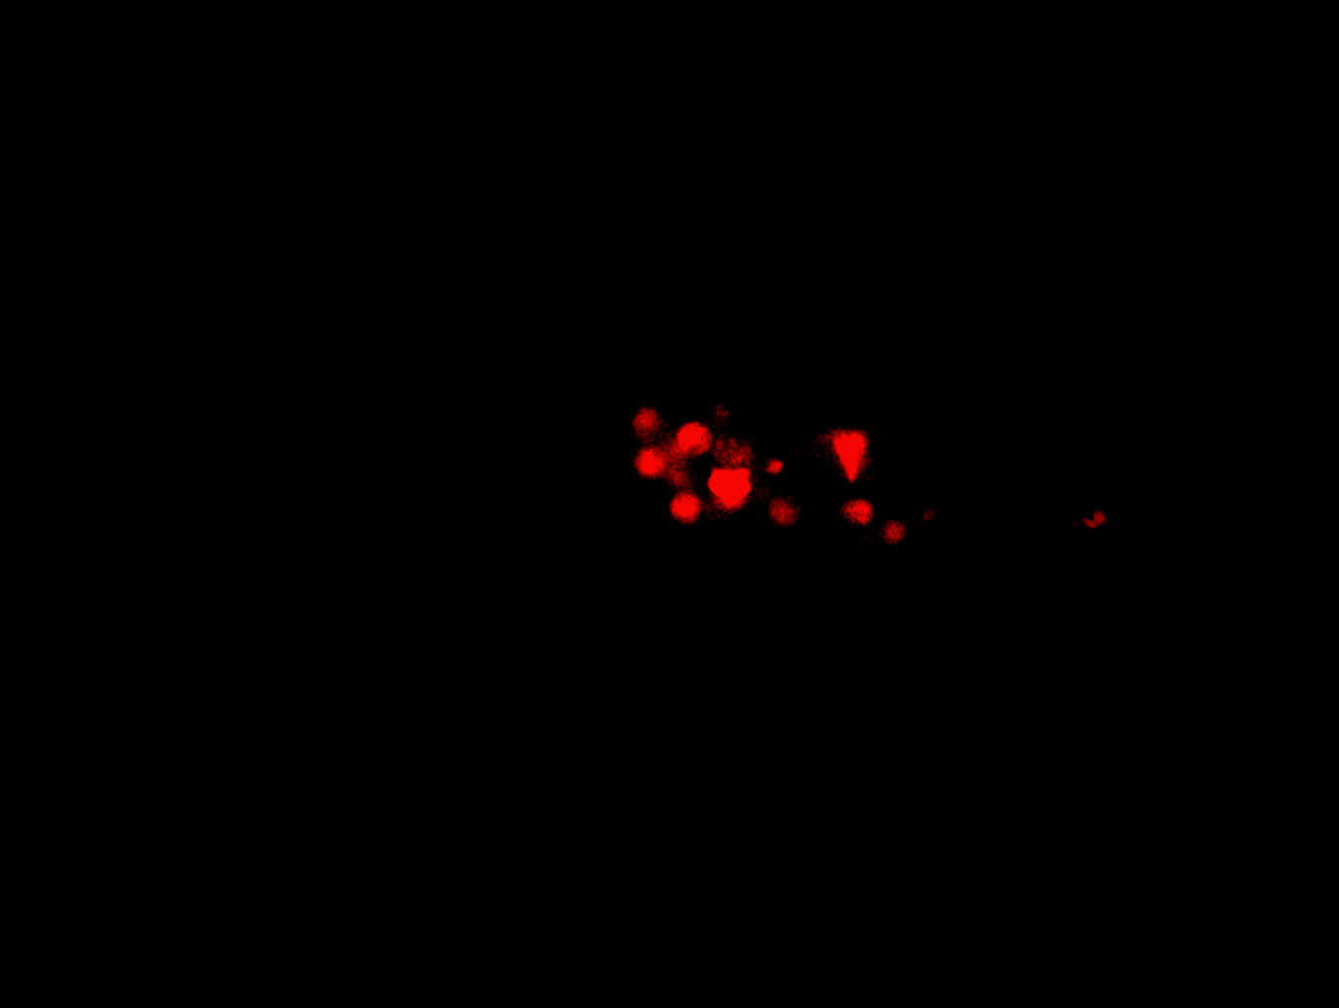
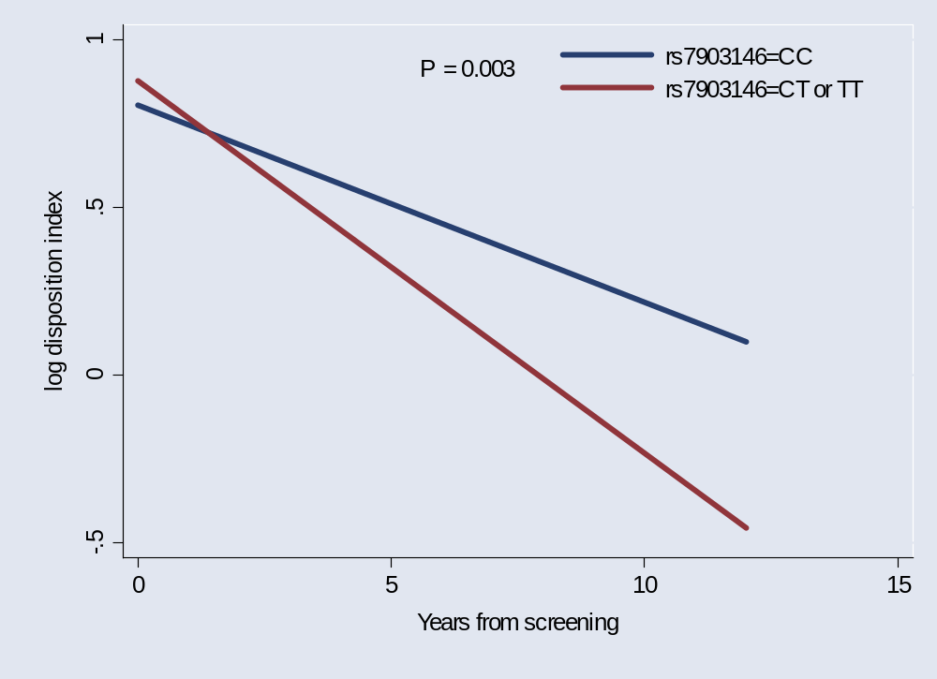
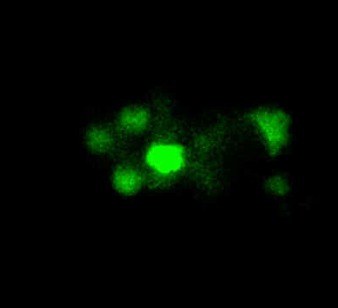

TCF7L2 is expressed in human islets and risk genotypes are associated with deterioration of β-cell function over time
Human islet
Beta-cell
TCF7L2
merge
Lyssenko et al. JCI, 2007, 117: 2155-2163.
Notes:
The Kaplan-Meier curves for diabetes-free survival on this slide show graphically the same results I just referred to. The red line shows risk allele carriers which progressed to diabetes faster as compare to the non-risk carriers, shown in blue.
This figure also shows insulin response to glucose during OGTT. The carriers of the risk genotype (in red) had lower insulin response to glucose as compared to wild type carriers in MPP study. Moreover, most important result was that the risk carriers had faster deterioration in insulin secretion over time as compared to non-risk carriers in individuals who progressed to diabetes.

Slide 13
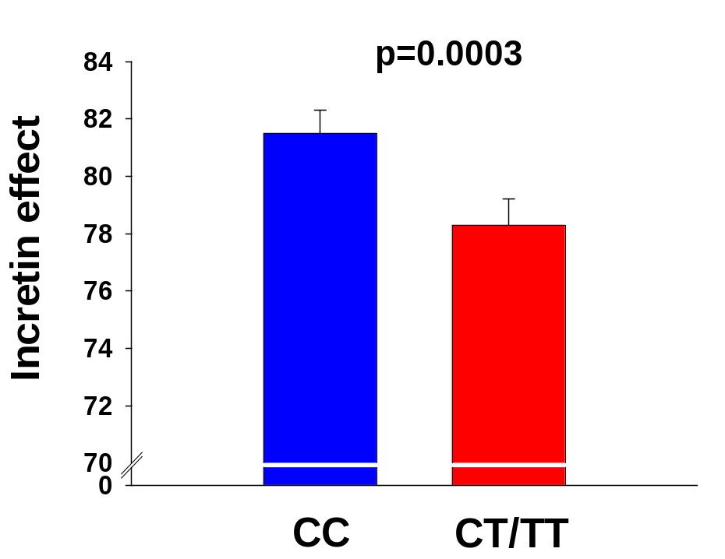
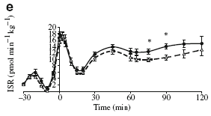
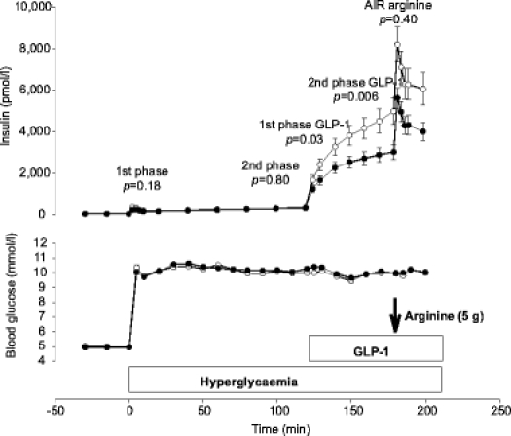
TCF7L2 is associated with impaired incretin effect
Incretin effect = 100% x (AUCins _{OGTT}-AUCins _{IVGTT})/AUCins _{OGTT}
Lyssenko et al. JCI, 2007, 117: 2155-2163.
Pilgaard et al. Diabetologia. 2009, 52:1298-307
Schafer et al. Diabetologia, 2007, 50: 2443-2450.
Notes:
It has been suggested that the preprogluagon has a TCF7L2 binding site in its promoter. We therefore wanted to study whether this variant would influence secretion and action of incretins. There is no evidence for an effect of the variant on conc of GLP-1 and GIP. The insulin response to oral glucose as compared to IVGTT was impaired suggesting an impaired incretin effect.
Together with Kasper Pilgaard and co-workers we could show directly that this was due to impaired GLP-1-stimulted insulin secretion. Similar data have been reported by Hans Häering and co-workers.

Slide 14
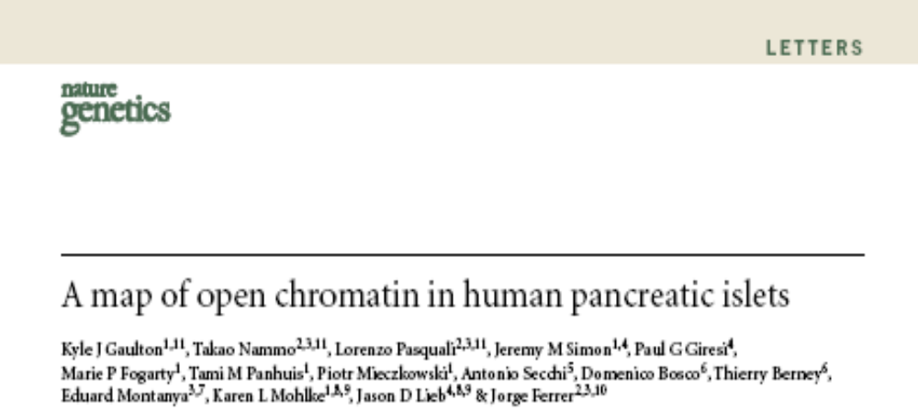
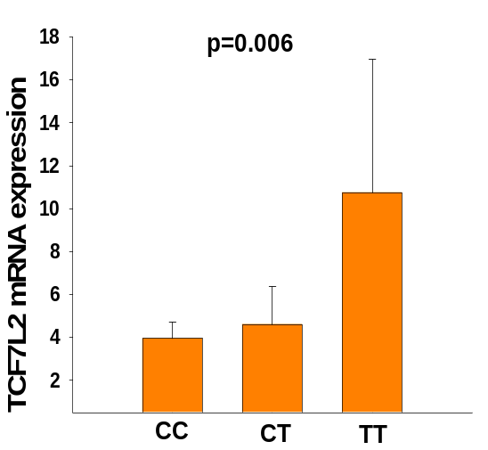
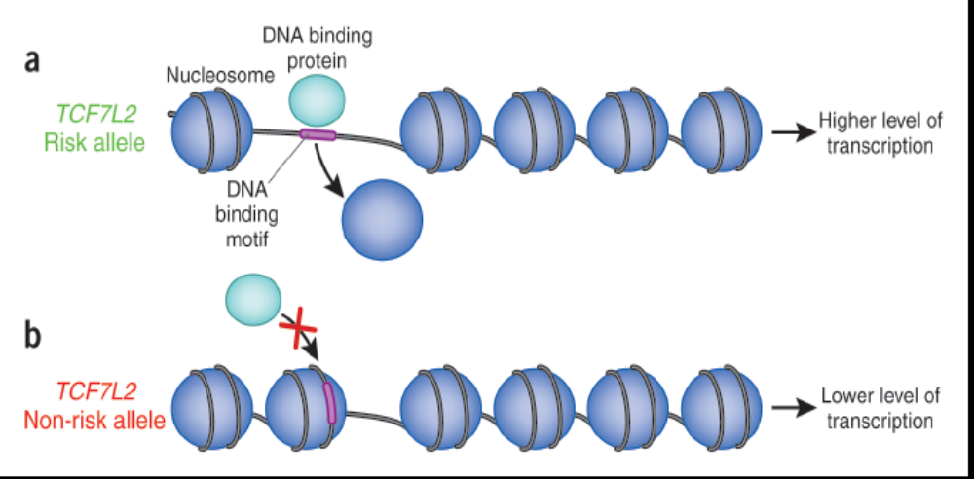
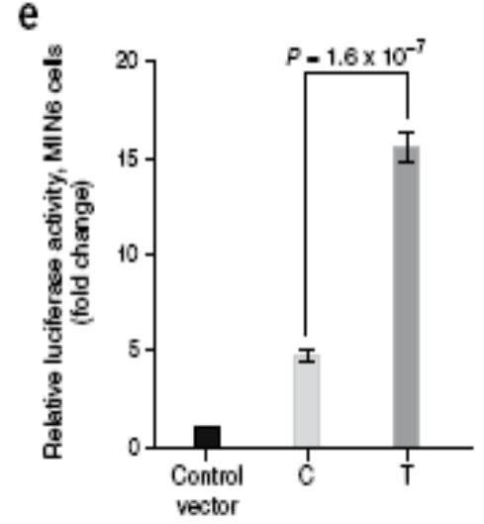

Slide 15
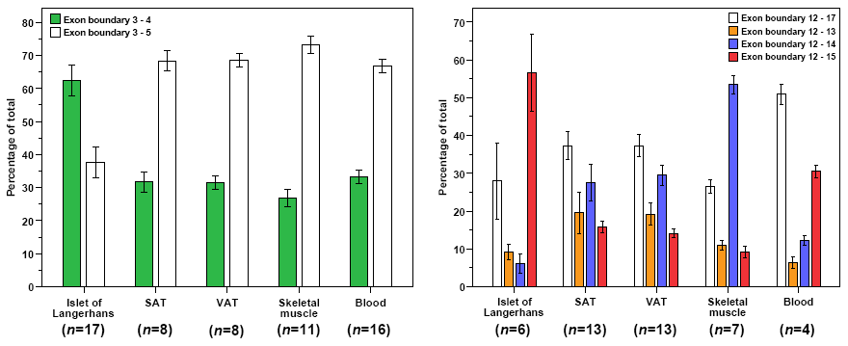
The predominant TCF7L2 isoform in human islets contains exon 4
5’-end
3’-end
Osmark et al. Diabetologia. 2009, 52:850-4.
Notes:
One potential mechanism by which the variant in TCF7L2 could influence expression and risk of T2D could be by influencing splicing.
The TCF7L2 gene shows a very rich splicing pattern in different tissues. Human islets differed from most other tissues, as the predominant isoform in islets was the one containing exon 4, which is close to the rs7903146 variant. However, we could not see a clear effect of genotype on splicing pattern.

Slide 16
A common variant in the SLC30A8, which encodes for ZnT8, is associaterd with increased risk of T2D
SLC30A8
Autoantibodies to ZnT8 are associated with increased risk of T1D

Slide 17
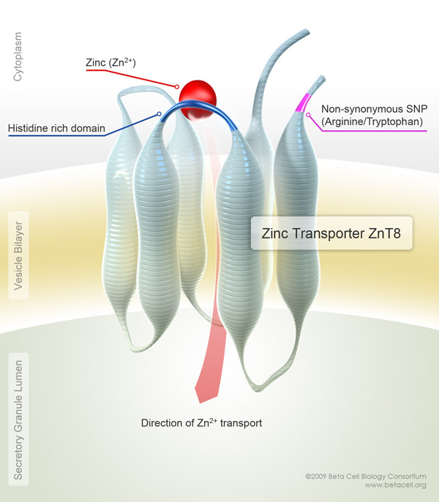
Target sequencing of T2D-associated loci in a Finnish/Swedish population
Cases: 366 early-onset T2D
Controls: 399 older, obese patients who despite clustering of risk-factors had not developed T2D
1826 variants found
(87% MAF<1%)
a stop codon R138* in the SLC30A8 gene (Freq 0.2%)

Slide 18
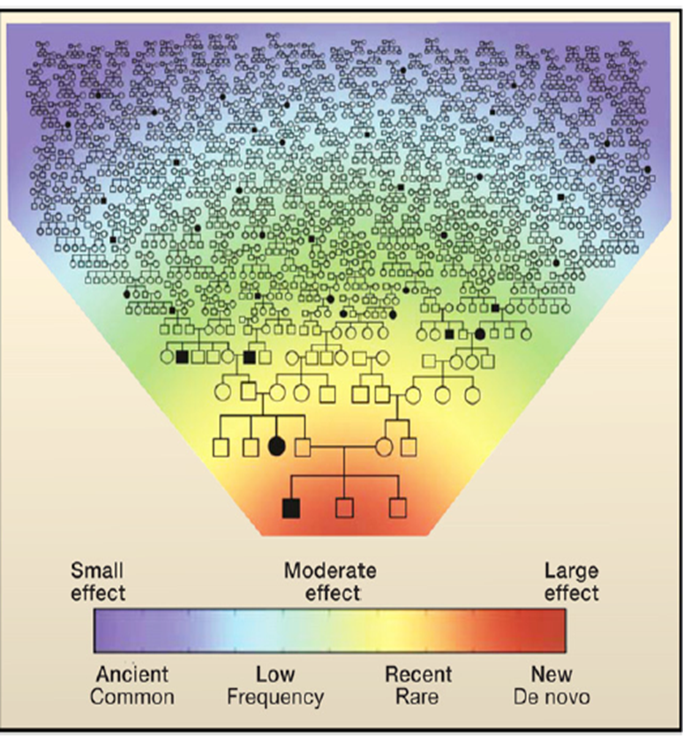
Genetics is about segregation of alleles across generations
Effect size
6.0
Rare variants of high effect
RAF 54%
High
3.0
Low frequency variants of moderate effect
Intermediate
2.0
Common variants of modest effect
Modest
1.1
Low
Very rare
0.1%
Rare
0.5%
Low frequency
5%
Common
Allele frequency
McCarthy
Notes:
Point: It is unknown to what extent variants not tested in genome wide association studies could deliver insights into T2D biology

Slide 19
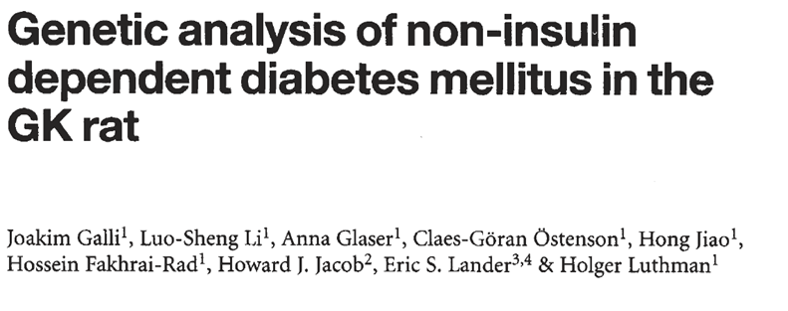
ADRA2
Nat Genet 1996

Slide 20
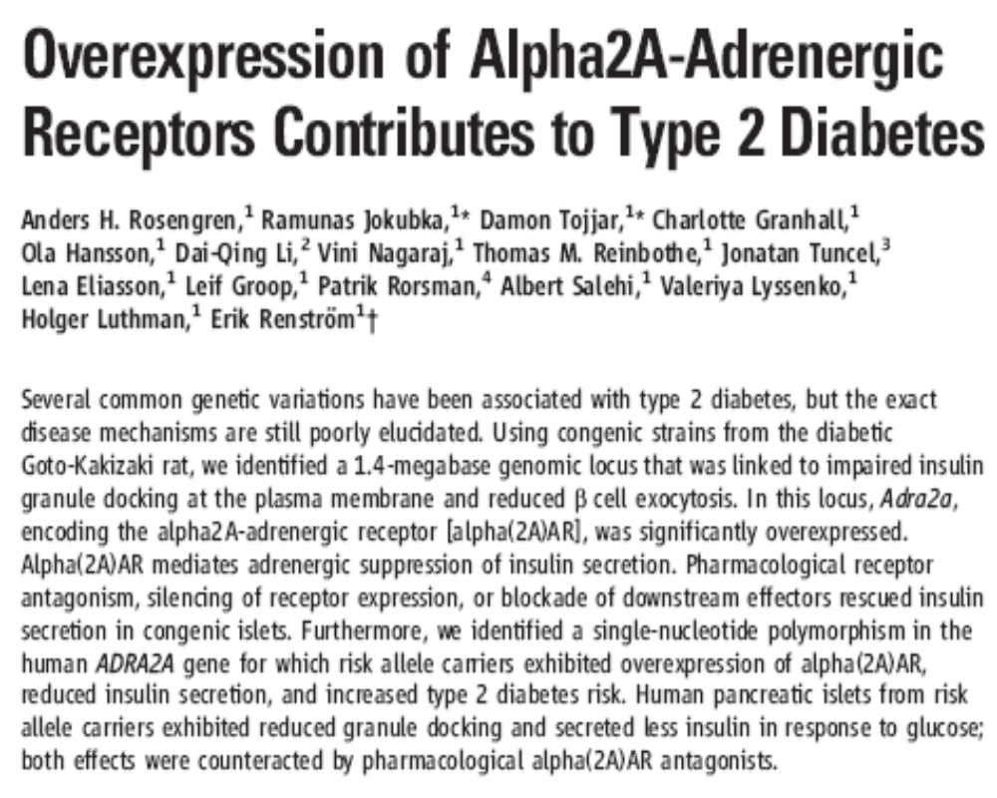

Slide 21
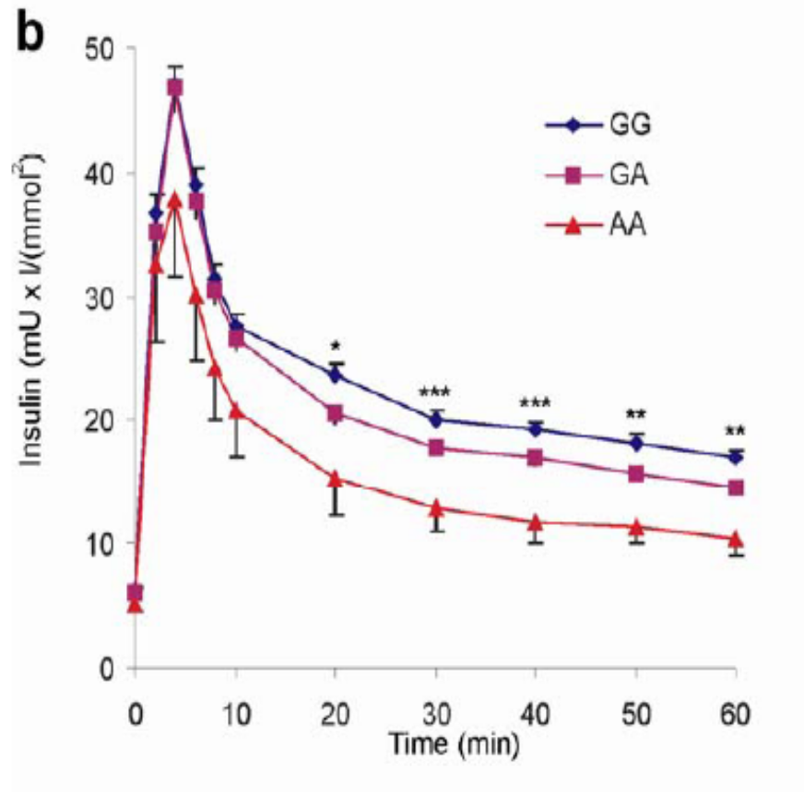
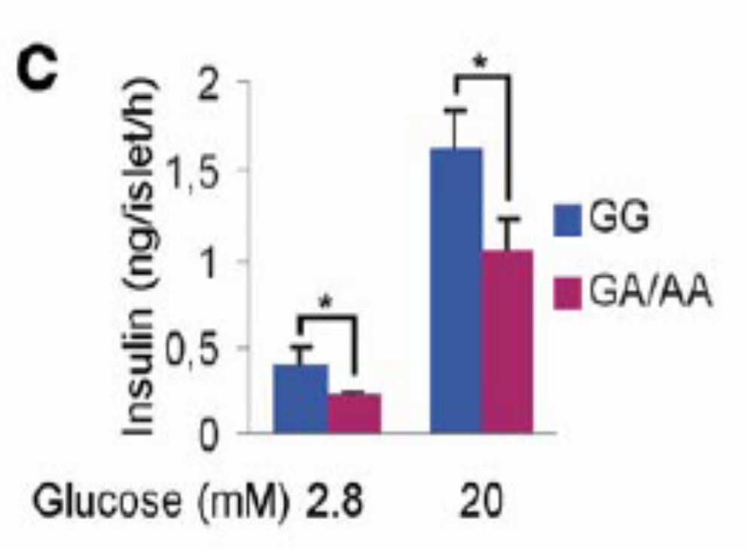
Variants in the alpha 2 adrenergic receptor (ADRA2) gene are associated with impaired insulin secretion
In vivo
In vitro in human islets
Rosengren A et al. Science 327;217-220,2010.

Slide 22
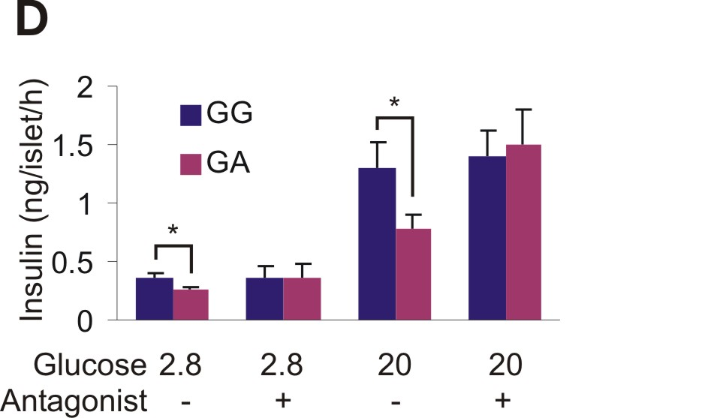
α_{2A}-dependent hyposecretion of insulin in islets from risk (A) allele carriers
-static human islet incubations RIA

Slide 23
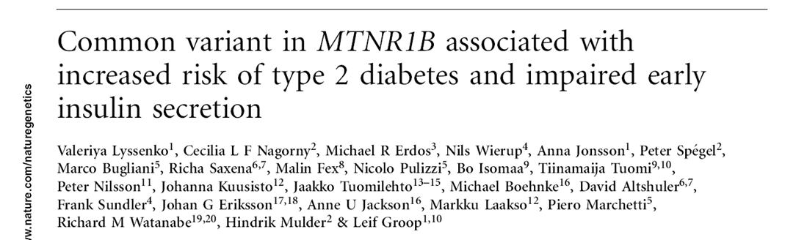
MTNR1B

Slide 24
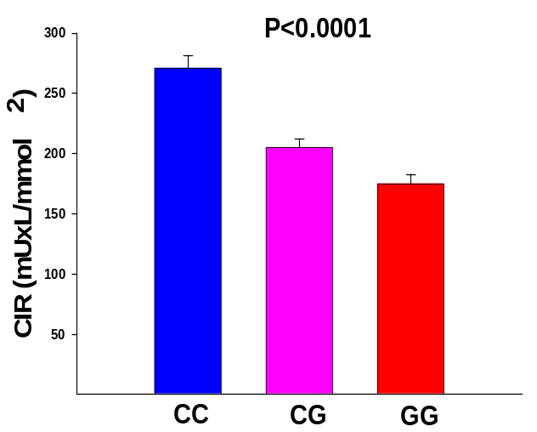
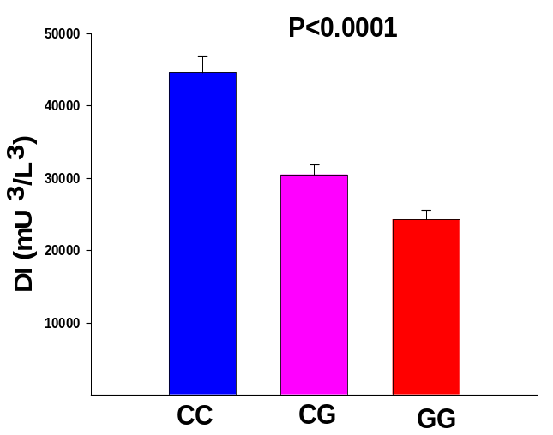
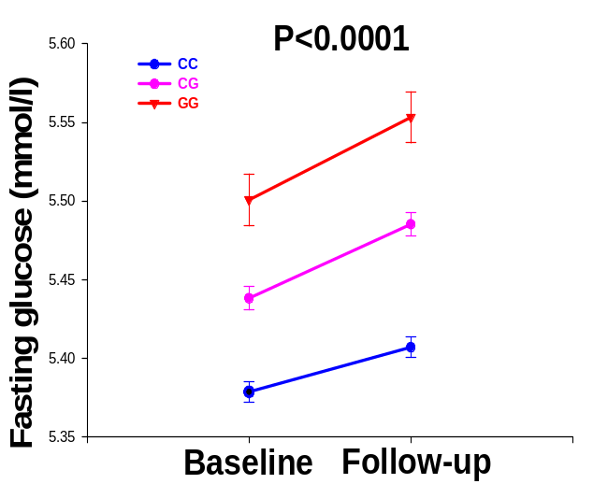
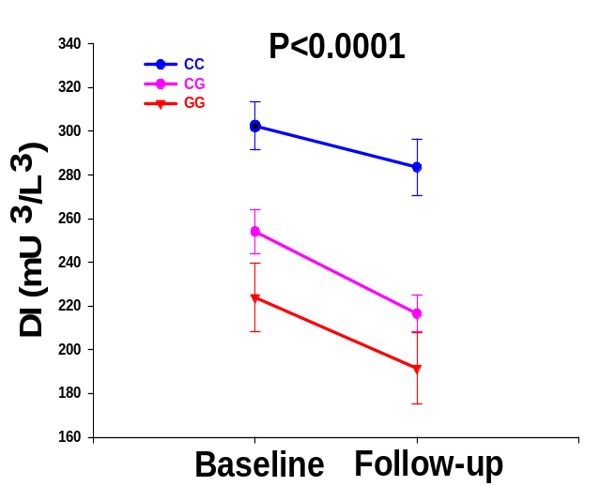
Effect of variants in the MTNR1B gene on insulin and glucose
F
Lyssenko V et al. Nat Genet 41; 82-88,2008
Notes:
24

Slide 25
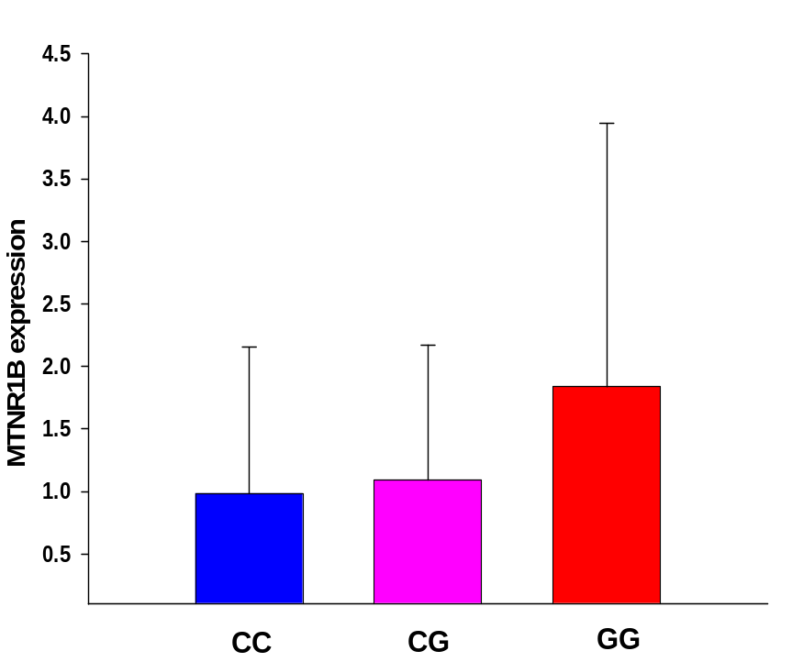
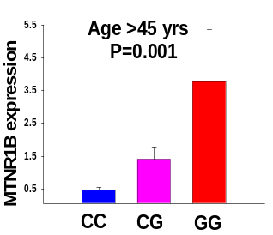
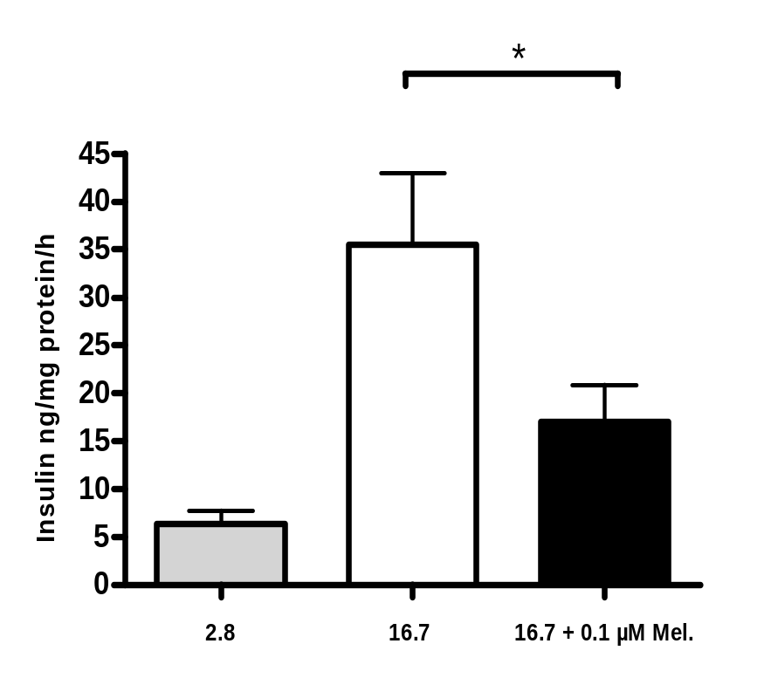
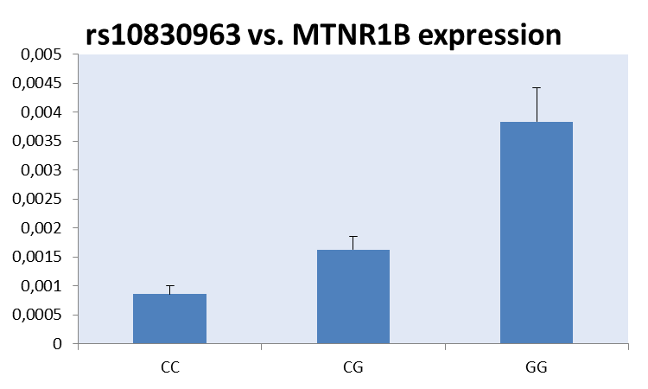
Risk genotype carriers of MTNR1B have increased expression of MTNR1B in human islets. Melatonin impairs insulin secretion.
A
B
N> ^{150; p=10-8}
Lyssenko V et al. Nat Genet 41; 82-88,2008

Slide 26


MTNR1B
Melatonion
Stress hormons
12:00 PM
12:00 AM
9:00 PM
3:00 AM
40
40
Physical
repair
30
30
20
20
15
Wind - Down
Dim - Lights
Psychological
repair
15
10
10
5
5
6:00 AM
6:00 PM
6:00 AM
Boden et al. Evidence for a circadian rhythm of insulin secretion.
Am. J. Physiol. 1996, 271:246–252.
Notes:
and high during the night. In fact, it has been proposed that melatonin could be involved in a circadian lowering of nocturnal insulin levels.

Slide 27
Outline
Type 2 diabetes - a collision between genes and environment
Four genes –four stories
Back to families
Systems biology – a holistic view
Do we know what type 2 diabetes is?

Slide 28
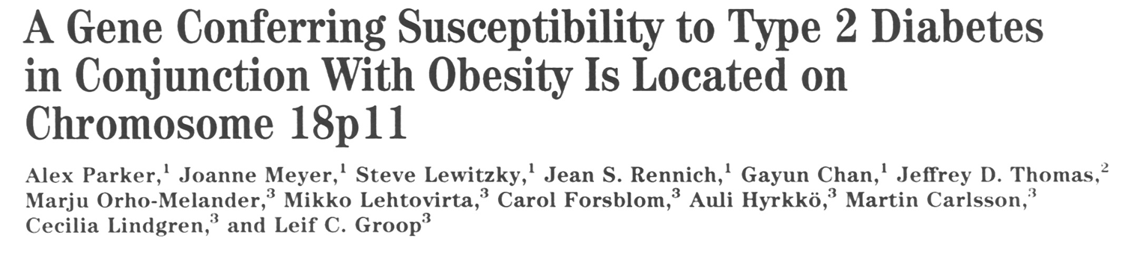
NPL score
LOD
20% highest BMI, fine mapping
20% highest BMI (78 sibpairs)
30% highest BMI
40% highest BMI
50% highest BMI
Entire sample (480 sibpairs)
4
3
2
1
Chromosome 18
5 50 75 0 1
Parker A et al. Diabetes 50;675-80,2001
2
Notes:
Additional information provided by the analysis of markers with mean interval of 1.5 cM, illustrated by the yellow line, instead of 8.8 in the original scan did not significantly narrow down the region of interest.

Slide 29
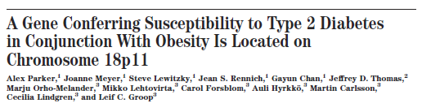
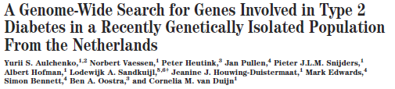
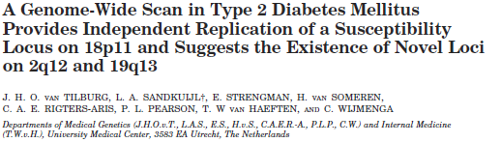
DIABETES, VOL. 50, MARCH 2001
DIABETES, VOL. 52, DECEMBER 2003
J Clin Endocrinol Metab 88: 2223–2230, 2003

Slide 30
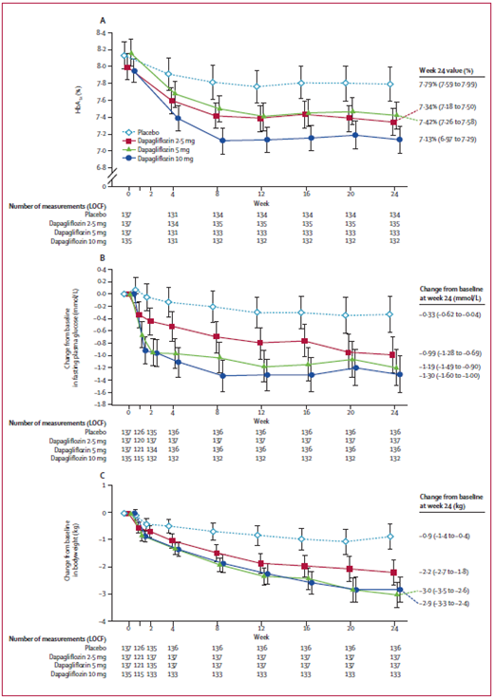
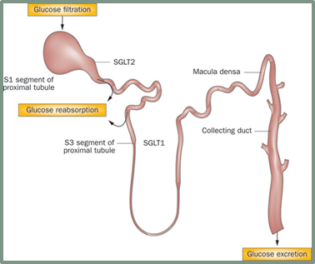
Inhibition of SGLT2 for treatment of T2D
Lessons to be learned from carriers of natural mutations in the SLC5A2 gene

Slide 31
Outline
Type 2 diabetes - a collision between genes and environment
Four genes –four stories
Back to families
Systems biology – a holistic view
Do we know what type 2 diabetes is?

Slide 32
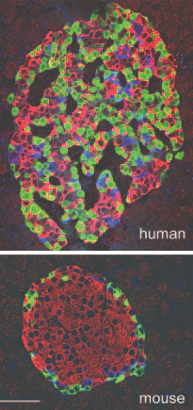
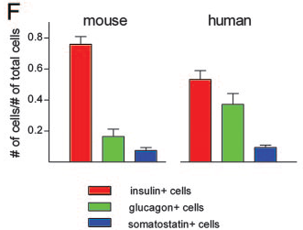
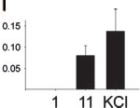
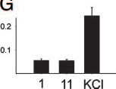
Human islets ≠ mouse islets
Cabrera et al. PNAS 2005
Notes:
This study has revealed five findings relevant to the biology of human islets of Langerhans: (i) human islets contained proportionally fewer beta cells and more alpha cells than mouse islets, the prototypical islets described in the literature; (ii) beta cells intermingled with alpha and gama cells throughout the human islet; (iii) all endocrine cell types were closely associated with the islet’s microcirculation; (iv) there was no particular order in the alignment of endocrine cells along the blood vessels; and (v) human islets have a distinct physiology that is consistent with the
morphological findings.
[Ca2]i responses (Fura 2-AM) elicited by low glucose (1 mM, 1), high glucose (11 mM, 11), and high KCl (30 mM, KCl) showed that human (D) and monkey islets (E), but not mouse islets (F) responded to low glucose. Bars under the traces indicate the duration of the stimulus. The peak amplitudes of these responses were quantified for human (G), monkey (H), and mouse (I) islets (n 10 islets).

Slide 33
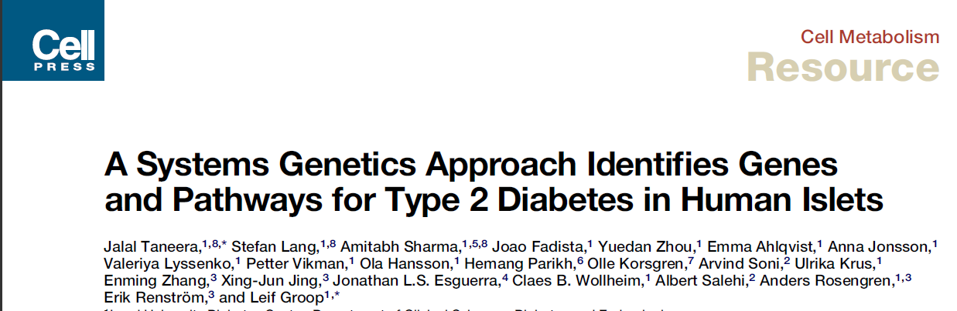
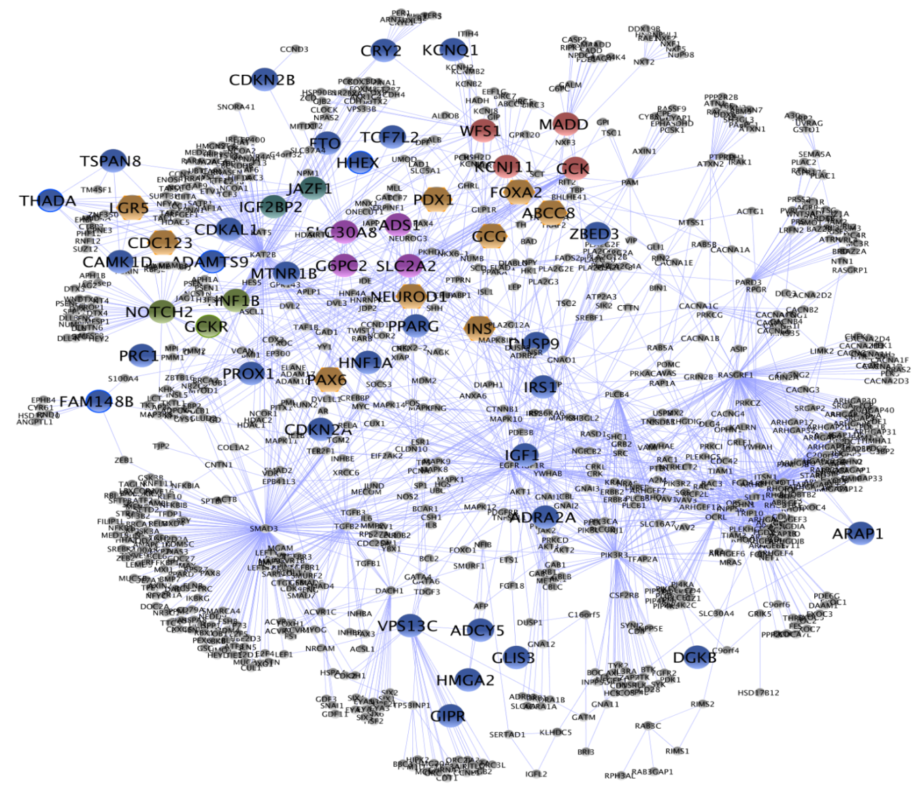
Module_1
Module_3
Module_2
Module_4

Slide 34

Expression of top 20 ranked genes explains to 24% of the variance in HbA1c (or vice versa)
0.4
p
P
= 0.005
o
t
0.2
e
s
h
e
Hyperglycemic
t
n
f
e
-0.0
o
g
Normoglycemic
d
d
i
e
o
k
-0.2
r
t
n
n
a
e
r
-0.4
c
0
n
2
a
e
-0.6
M
Genes ranked based upon 5 criteria, i.e. correlation between gene expression and 1) insulin secretion in vitro and 2) HbA1c, 3) SNPs in DIAGRAM, differential expression in 4) human ilsets from hyperglycemic and normoglycemic donors and in 5) β-cells from T2D and non-diabetic donors
Taneera J et al Cell Metab 2012

Slide 35



Slide 36

SFRP4 concentrations inm blood predict future T2D
Mahdi T et al Cell Metab 2012

Slide 37
Outline
Type 2 diabetes - a collision between genes and environment
Four genes –four stories
Systems biology – a holistic view
Do we know what type 2 diabetes is?

Slide 38
1975
Typ 2
Typ 1

Slide 39
1990
Typ 2
LADA
Typ
Typ 1
LADA: Latent autoimmune diabetes in adults

Slide 40


9000 1000
ANDIS/ANDIU
All New Diabetics In Scania/Uppsala
4500
DIREVA
Diabetes REgistry VAasa

Slide 41

ANDIS: The spectrum of diabetes

Slide 42

A GPS for the diabetic patient

Slide 43


Slide 44


Diabetes & Endocrinology
Research Group
Ola Hansson
Peter Osmark
Jalal Taneera
Emma Ahlqvist
Petter Vikman
Jenny Vikman
Peter Almgren
Yang De Marinis
Joao Fadista
Nikolay Orskolkov
Rashmi Prasad
Om Prakash
Yuedan Zhou
Emilia Ottoson Laakso
Anna Lessmark
The Botnia Study Group- T Tuomi et al

Slide 45





Collaborators
Broad Institute
David Altshuler
Mark Daly
Eric Lander
Vamsi Mootha etc
FIMM
Aarno Palotie
Samuli Ripatti etc
FinnDiane
Per-Henrik Groop
Oxford-Exeter
Mark Mc Carthy
Anna Gloyn
Andrew Hattersley
FUSION-NIH
Mike Boehnke
Francis Collins
Leipzig
Svante Pääbo
Michael Stumvoll
Copenhagen
Allan Vaag
Torben Hansen
Oluf Pedersen
Italy
Ele Ferrannini
Stefano DelPrato
Riccardo Bonadonna
Kuopio University
Markku Laakso
Jussi Pihlajamäki

