Slide 1
Age at onset informed analysis of ischaemic stroke GWAS
Matthew Traylor
for the ISGC analysis Group
Clinical Neurosciences, University of Cambridge

Slide 2
Motivation
Stroke is a heterogeneous disease
Some genetic loci may be specific to, or at least have stronger effects in, stroke cases with early age-at-onset
  Cheng YC et al. Trans-ethnic meta-analysis of genome-wide association studies identifies 10q25 locus associated with early-onset ischemic stroke. (submitted)
  Stronger Family history of stroke has been identified in young onset cases
Can we increase power by focusing on individuals with stronger genetic influence?
  i.e those with early age-at-onset

Slide 3
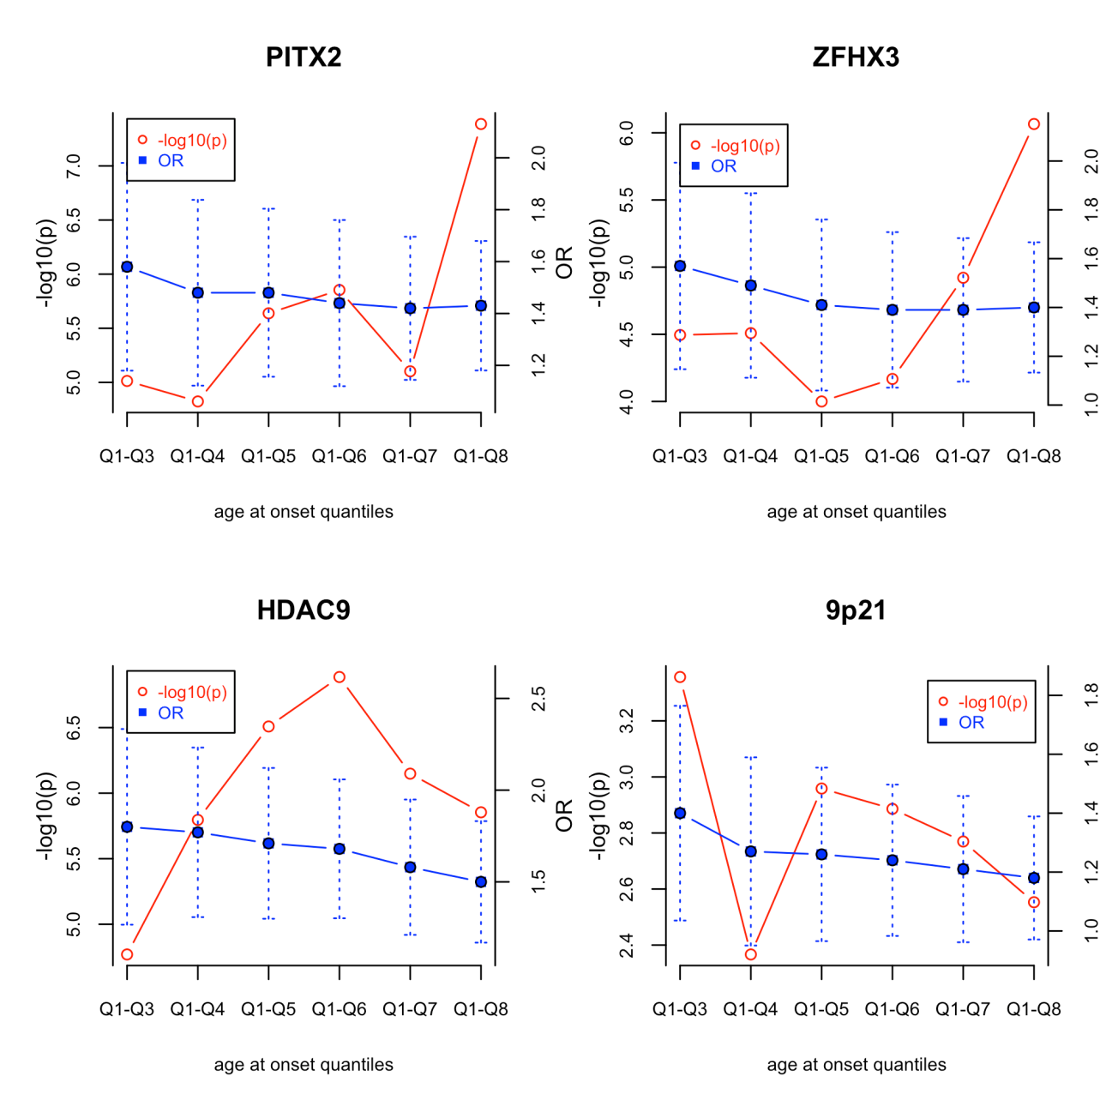
Genetic Associations by age-at-onset in WTCCC2
All known SNP association have stronger effect in younger onset cases
BUT
power is not always gained when analysis is limited to younger onset cases
AND
what is an appropriate age threshold? / Multiple testing issue
Traylor M et al., Genetic Epidemiology 2013

Slide 4
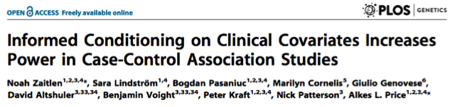
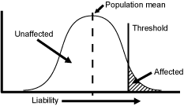
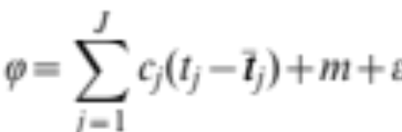
Covariate Informed approach
Assume disease liability can be modeled using liability threshold model
Use epidemiological data on risk factor prevalence in disease to estimate c_{j} (risk factor effect size) and m (disease prevalence at risk factor mean) for the disease
Calculate posterior mean liabilities (E(ε|z,t)) per individual using estimated parameters
Perform regression on posterior mean liabilities

Slide 5
Estimating individual liabilities
From epidemiological data, estimate liability threshold model parameters
In Framingham study, from an index age of 55, lifetime risks of stroke are as follows:
  Age 65: 2.4% (men), 1.8% (women)
  Age 75: 7.3% (men), 5.4% (women)
  Age 85: 12.6% (men), 12.1% (women)
Gives following model for all ischaemic stroke:
  ε_{j} = –0.042 (Age–55)+2.36 in men
  ε_{j} = –0.046 (Age–55)+2.55 in women
And the following model for stroke subtypes (20% of cases)
  ε_{j}= –0.032 (Age–55)+2.88 in men
  ε_{j}= –0.036 (Age–55)+3.03 in women

Slide 6
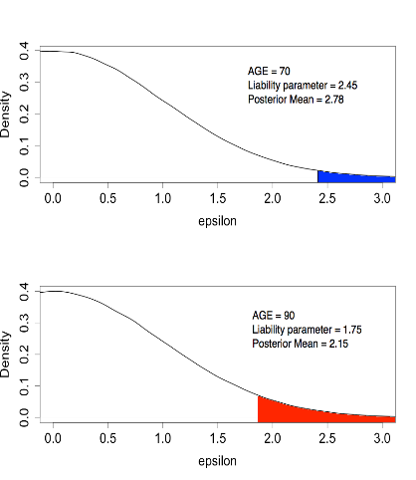
Calculating parameters
- Example
Disease status (z) | Age (t) | Liability Parameter (ε) | Posterior Mean Liability E (ε|z,t)
Case | 50 | 3.15 | 3.42
Case | 70 | 2.45 | 2.78
Case | 90 | 1.75 | 2.15
Control | 50 | 3.15 | –0.00
Control | 70 | 2.45 | –0.02
Control | 90 | 1.75 | –0.09
  ε= –0.035 (Age – 55) + 2.97

Slide 7
Methods

Slide 8
Genome-wide Analysis
CIAO-GWAS (Covariate-Informed-Analysis-Of-GWAS) software developed to perform analysis on imputed data (IMPUTE or MaCH format)
Test association of posterior mean liabilities (E(ε|z,t)) with imputed SNP genotypes (dosages g) using generalized armitage trend test
Also perform generalized armitage trend test without informing on age to compare the effect of including age
meta-analyse using Z weighted method (Stouffer’s method)
remove SNPs with INFO<0.8, MAF<0.01
Analysis performed on cohorts from METASTROKE and those held at Cambridge University

Slide 9
Stage 1 : METASTROKE analysis
Population | All ischaemic stroke | Cardioembolic stroke | Large vessel stroke | Small vessel stroke | Controls
ASGC | 1,162 | 240 | 421 | 310 | 1,244
WTCCC2-D | 1,174 | 330 | 346 | 106 | 797
WTCCC2-UK | 2,374 | 474 | 498 | 460 | 5,175
Milano | 366 | 64 | 73 | 25 | 407
DNA-lacunar | 1,287 | 80 | 64 | 1,012 | 970
Leuven | 455 | 157 | 70 | 55 | 455
ISGS-SWISS | 1,014 | 235 | 217 | 187 | 1,370
BRAINS | 361 | 29 | 120 | 97 | 444
MGH-GASROS | 294 | 106 | 68 | 23 | 376
TOTAL | 8,487 | 1,715 | 1,877 | 2,275 | 11,238

Slide 10
Preliminary Results

Slide 11
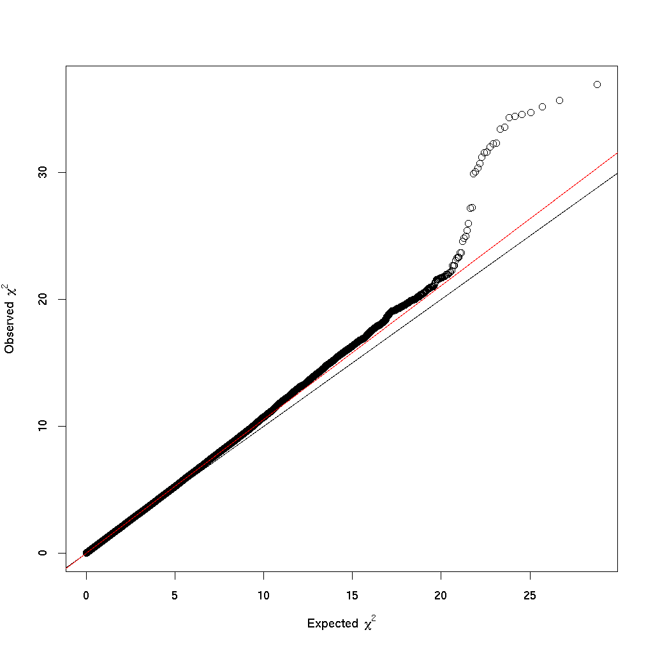
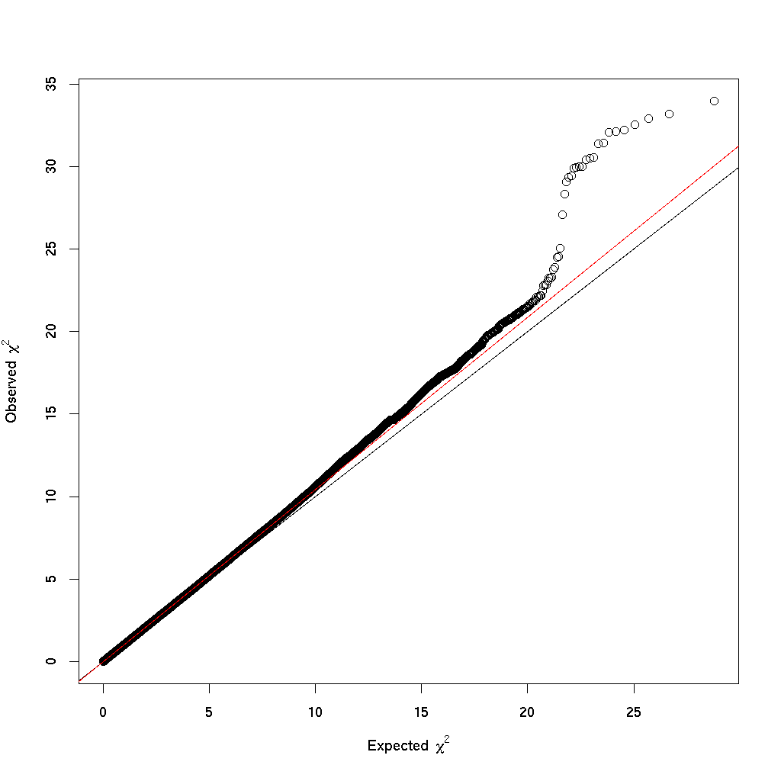
Genomic inflation – all ischaemic stroke
Population | Age-at-onset informed | Armitage trend test (no Age)
 | λ values
ASGC | 1.03 | 1.04
WTCCC2-D | 1.04 | 1.04
WTCCC2-UK | 1.05 | 1.05
Milano | 1.02 | 1.02
DNA-lacunar | 1.05 | 1.05
Leuven | 1.01 | 1.01
ISGS-SWISS | 1.02 | 1.02
BRAINS | 1.00 | 1.00
MGH-GASROS | 1.08 | 1.06
TOTAL (λ₁₀₀₀ ) | 1.05 (1.00) | 1.05 (1.00)

Slide 12
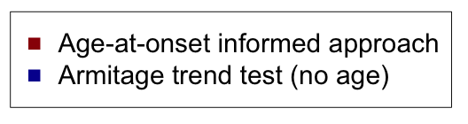

All but one more significant using age-at-onset informed approach
Differences are small in most cases (except 9p21)

Slide 13
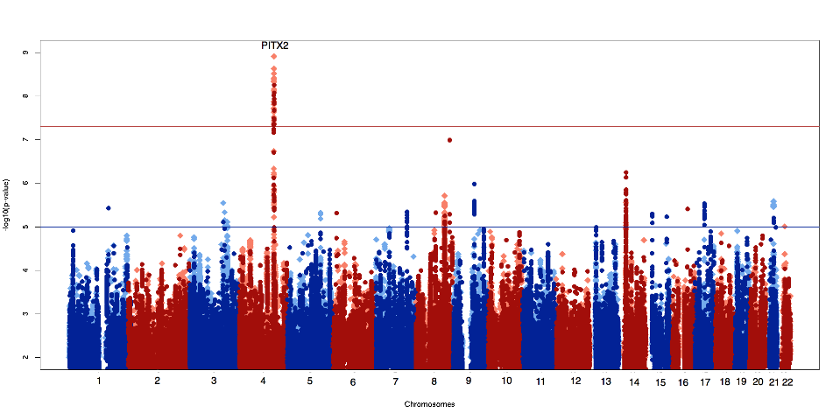
All Ischaemic stroke

Slide 14
Regions with strong age-at-onset effects
SNP | p-value using age-at-onset informed approach | p-value using Armitage trend test | % increase in –log10(p) | Region
rs6783098 | 7.8x10⁻⁶ | 1.7x10⁻⁴ | 36.00% | ISGF10
rs7922120 | 3.1x10⁻⁵ | 5.0x10⁻⁴ | 36.50% | 10q25**
rs10811652 | 4.2x10⁻⁵ | 4.4x10⁻⁴ | 30.60% | 9p21
rs4721314 | 8.5x10⁻⁵ | 9.2x10⁻⁴ | 34.10% | MAD1L1
rs1114738 | 7.8x10⁻⁵ | 1.2x10⁻³ | 40.10% | 9p31.1
rs10764914 | 3.6x10⁻⁵ | 4.2x10⁻⁴ | 31.40% | MGMT
rs2409412 | 9.9x10⁻⁵ | 8.9x10⁻⁴ | 31.30% | TIAM1
**Locus from Cheng YC et al.

Slide 15
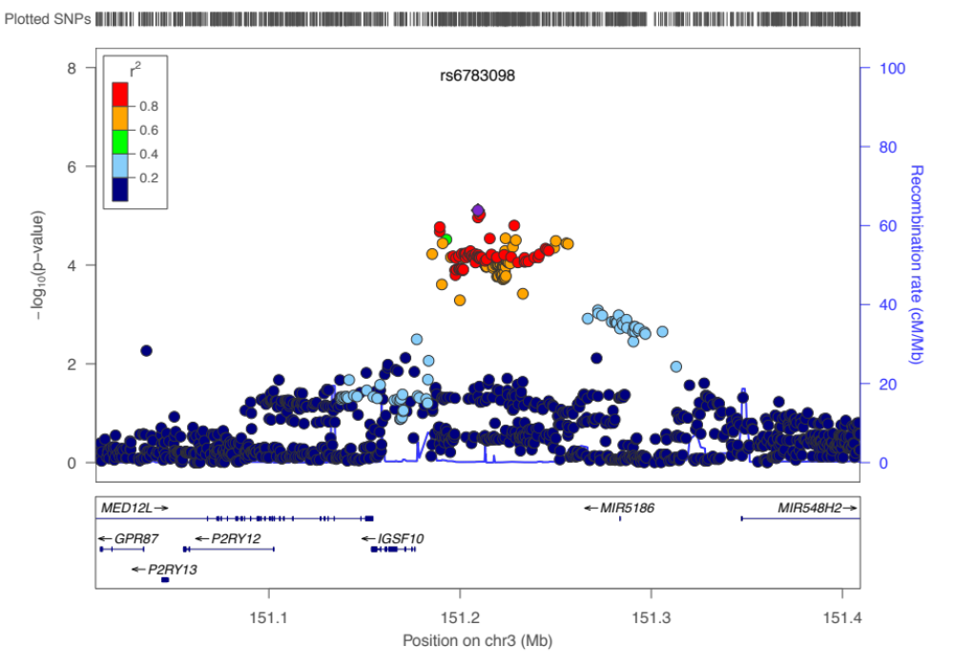
CHR | 3
BP | 151209357
SNP | rs6783098
Z-value | 4.47
P-value | 7.8x10⁻⁶
risk allele frequency | 0.21
heterogeneity p | 0.71

Slide 16
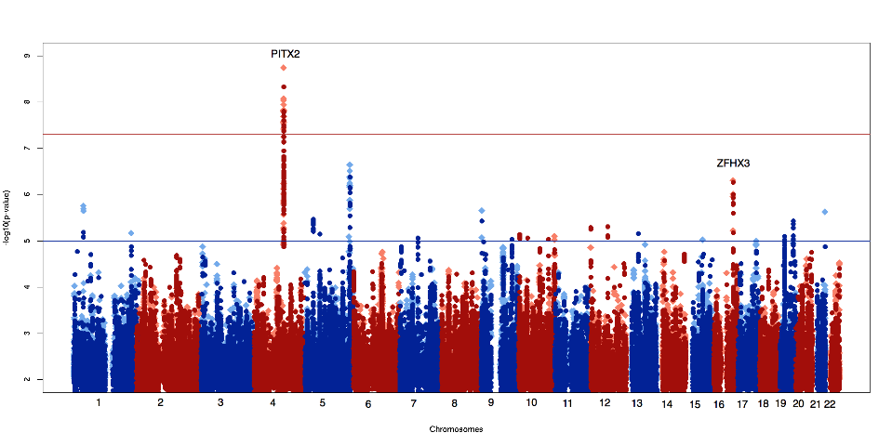
Cardioembolic Stroke

Slide 17
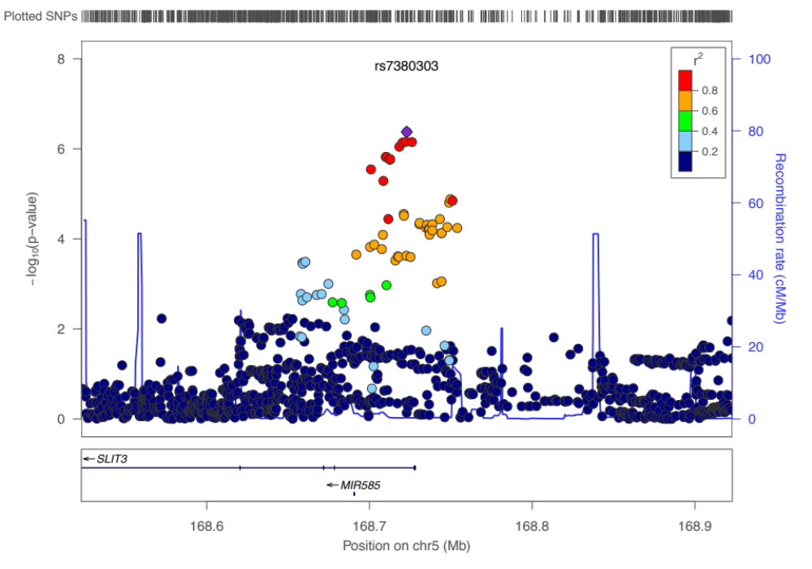
CHR | 5
BP | 168722937
SNP | rs7380303
Z-value | 5.175
P-value | 2.3x10⁻⁷
risk allele frequency | 0.26
heterogeneity p | 0.82

Slide 18
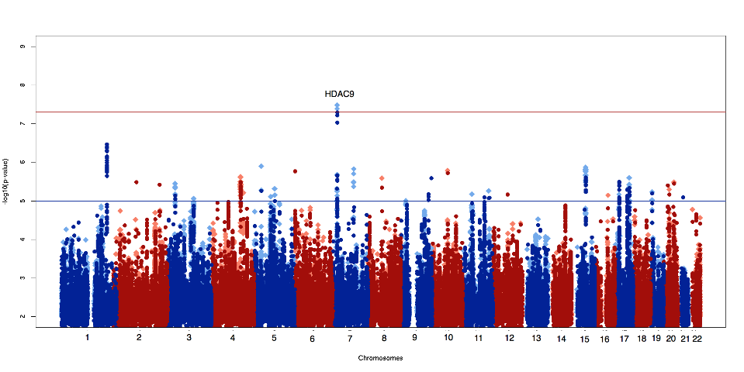
Large Vessel Stroke

Slide 19
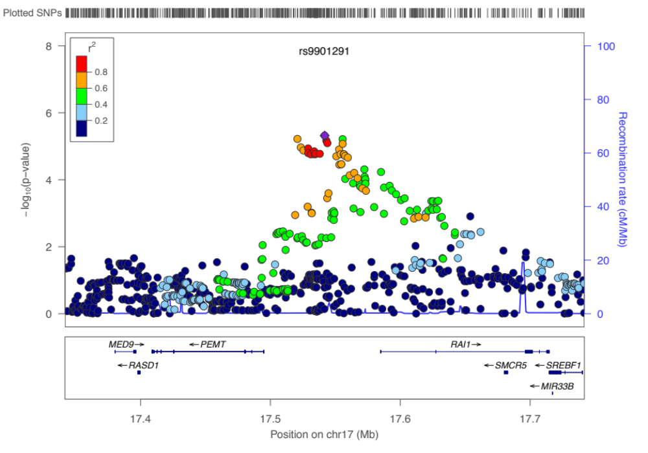
Region associated with coronary artery disease (Schunkert et al, Nature Genetics 2011)
CHR | 17
BP | 17541750
SNP | rs9901291
Z-value | 4.57
P-value | 4.8x10⁻⁶
risk allele frequency | 0.44
heterogeneity p | 0.26

Slide 20
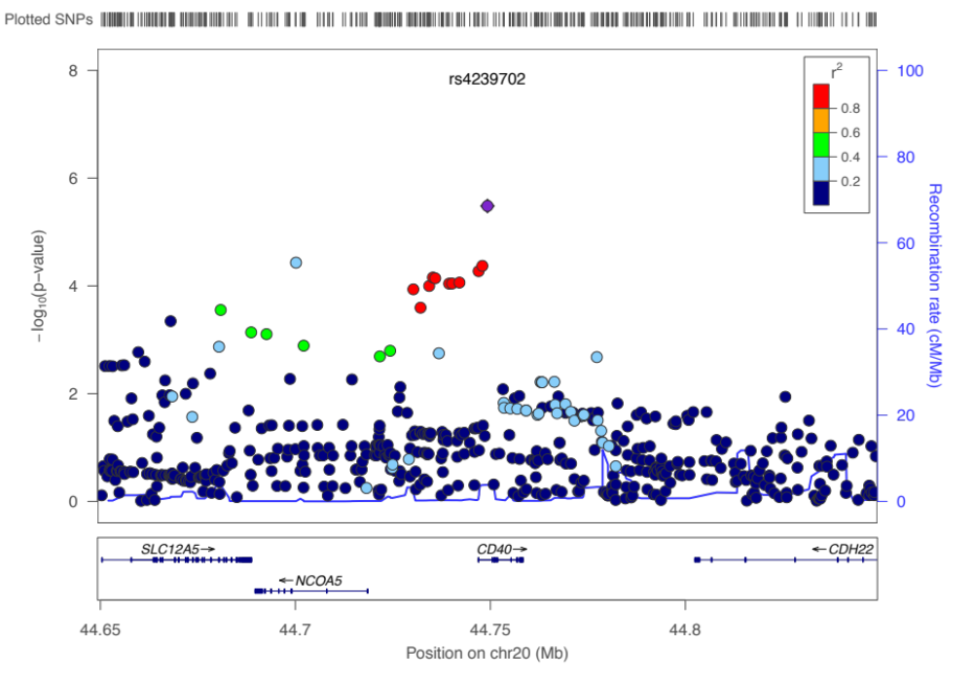
CHR | 20
BP | 44749251
SNP | rs9901291
Z-value | 4.65
P-value | 3.3x10⁻⁶
risk allele frequency | 0.27
heterogeneity p | 0.63
Important in progression of atherosclerosis (CD40)

Slide 21
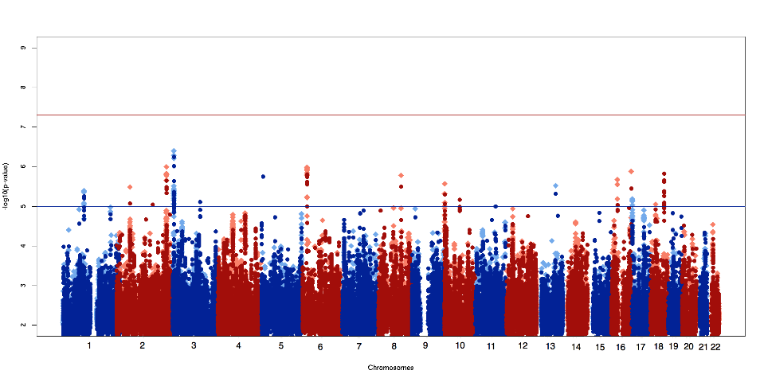
Small Vessel Stroke

Slide 22
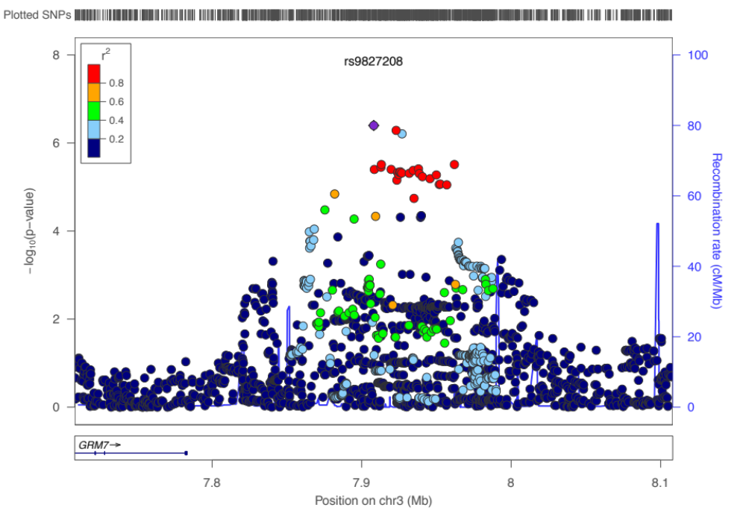
CHR | 3
BP | 7908121
SNP | rs9827208
Z-value | 5.07
P-value | 4.0x10⁻⁷
risk allele frequency | 0.31
heterogeneity p | 0.87

Slide 23
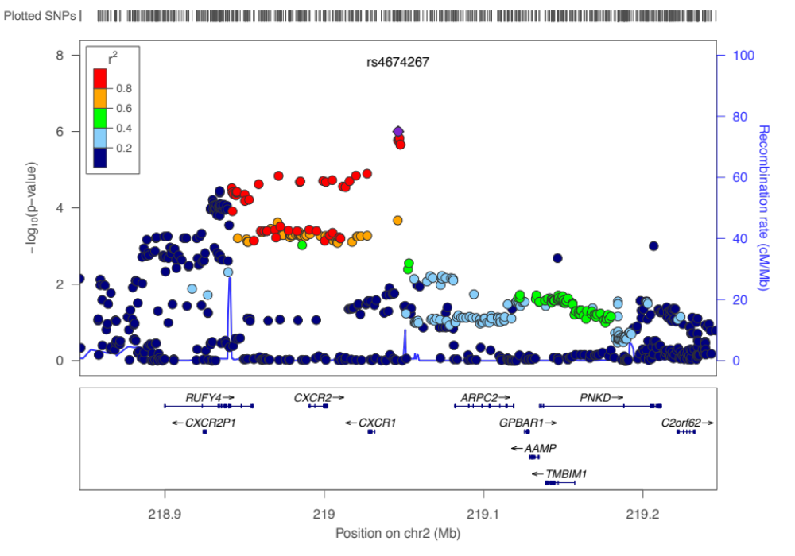
CHR | 2
BP | 7908121
SNP | rs4674267
Z-value | 4.89
P-value | 1.0x10⁻⁶
risk allele frequency | 0.43
heterogeneity p | 0.50
Haematological traits affected by rare variants in CXCR2 (Auer et al, Nature Genetics 2013)

Slide 24
Conclusions
A more general approach to identifying SNPs with stronger effects in young onset cases
  not dependent on arbitrary age cutoff
  avoids multiple testing issues
  avoids small case numbers issues from dividing dataset up
All but one known association with stroke are more significant using age-at-onset informed approach
Can give much improved significance when age-at-onset effect is strong
Many promising suggestive loci worth following up
Next Steps
  Have applied to perform analysis on SiGN data
  replication?

Slide 25
Acknowledgements
With thanks to:
KCL, UK
  Cathryn Lewis
University of Cambridge
  Steve Bevan
  Hugh Markus
Imperial College London
  Ioana Coatlarciuc
  Pankaj Sharma
NIH
  Mike Nalls
Mayo Clinic, Jacksonville
  James Meschia
Newcastle University, Australia
  Liz Holliday
  Chris Levi
  John Attia
MGH, Boston
  Farid Radmanesh
  Jonathan Rosand
Leuven University, Belgium
  Robin Lemmens
  Vincent Thijs
Milano
  Giorgio Boncoraglio
VISP
  Brad Worrall
  Wei-Min Chen
METASTROKE
  Brad Worrall
  Sudha Seshadri
WTCCC2 Collaborators
  Cathie Sudlow
  Peter Rothwell
  Martin Dichgans
  Rainer Malik
ISGC analysis group

