Slide 1
Whole Exome Sequence Analysis of Cerebral White Matter Hyperintensities on MRI
Myriam Fornage, Josh Bis, Vincent Chouraki, Hieab Adams, Xuequi Jian, Anita Destefano, Jennifer Brody, Donna Muzny, Ginger Metcalf, Mahmoud Dahdouli, Bruce M. Psaty, Richard A. Gibbs, Charles Decarli, Cornelia Van Dijn, Thomas H. Mosley, W.T. Longstreth Jr., Eric Boerwinkle, Arfan Ikram, Sudha Seshadri For the Neurocharge Consortium

Slide 2
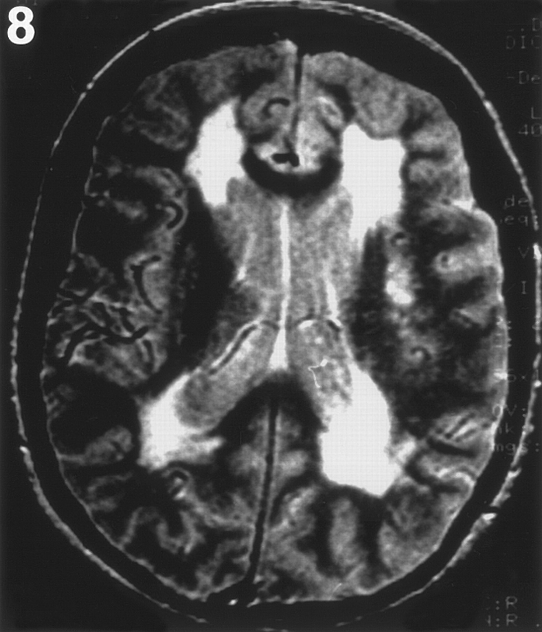
Background
Abnormalities of the WM are readily identified on MRI as signal of hyperintensity on T2-weighted and FLAIR sequences
WMH are associated with an increased risk for cognitive deficits, motor function impairment, and future stroke
WMH may represent ischemic damage to the small vessels of the brain
WMH are heritable: h2=55%-80%
GWAS of WMH in CHARGE identified 5 significant loci: 17q25, 10q24, 2p16, 1q22, and 2p21

Slide 3
Methods of Analysis
We sequenced the protein coding region of 17,473 genes in 2,753 study participants from 4 population-based cohorts (ARIC, 629 EA and 587 AA; CHS, 474 EA; FHS, 820 EA, and RS, 243 EA)
Samples were sequenced at the BCM Human Genome Sequencing Center (except RS) in paired-end mode on the Illumina HiSeq2000 or HiSeq2500 platform
Variant calling was performed using the Mercury Pipeline (Reid et al. BCM Bioinformatics, 2014; 15:30)
  Reads were mapped to the Genome Reference Build 37 (GRCh37) human reference sequence using Burrows-Wheeler Alignment
  Aligned reads were then recalibrated using Genome Analysis ToolKit (GATK)
  The Atlas2 suite was used to call single nucleotide variants and insertion-deletions and produce high-quality Vcf files

Slide 4
Sequence Data QC
Variant-level QC
  Variants outside the exon capture regions (VCRhrome 2.1) were excluded
  Multi-allelic sites
  Missing rate >20%
  Mapping score <0.8, and mean depth of coverage >500-fold.
  Variants not meeting Hardy-Weinberg equilibrium expectations (P<5x10⁻⁶) in ancestry-specific groups were also excluded.
Sample-level QC
  QC metrics were calculated by cohort and ancestry group.
  A sample was excluded for missingness >20%
  Or if it fell beyond 6 SDs of any of 4 selected measures: number of singletons, heterozygote to homozygote ratio, mean depth, or transition to transversion (Ti/Tv) ratio
Mean depth of coverage across all CHARGE samples: 92 fold

Slide 5
Variant Annotation
To facilitate meta-analysis across cohorts, we used the same annotation file
Variants were annotated using ANNOVAR and dbNSFP v2.0
Coding variants were annotated to a unique gene and functional category.
A file was created that merged the annotated variant lists in all studies to ensure that a variant has the same reference allele and functional annotation
This multiple study-combined SNPinfo file was used as a component of the seqMeta R package

Slide 6
Methods of Analysis
All studies modeled the natural log(WMH+1) adjusted for age and sex and TIV (except for the semi-quantitative measures (intrinsic adjustment)) and PCs (if applicable)
  ARIC and CHS measured WMH based on a semi-quantitative scale
  FHS and RS measured WMH using a volumetric scale
We performed two types of analyses: single variant (common and lower frequency variants, MAF>1%) and gene-based (rare and lower frequency variants only MAF<1% or 5%)
We restricted our analyses to putatively-functional variants (variants annotated as missense, nonsense, and affecting a splice site)
Cohort-level analyses were carried out using the SeqMeta R package in a race-specific manner (ARIC).
  Score statistics for each variant and genotypic covariance matrices within specified regions
Meta-analyses combined score statistics from cohorts measuring WMH on the same scale (ie., ARIC + CHS and FHS+RS) and the p-values derived from these 2 meta-analyses were combined using a z-based method.
We first examined candidates genes from the 5 GWAS regions, then investigated exome-wide signals

Slide 7
Analysis of Single Variants
12,790 putatively-functional SNV with MAF ≥ 1%
We identified 47 putatively-functional SNVs mapping to one of the 5 GWAS-identified WMH loci.
Among these, the most significant association was with a low frequency missense variant (MAF~1%) in the TAF5 gene on chr10q24 (p=4.7x10⁻³). S (AGT) --> N (AAT)

Slide 8
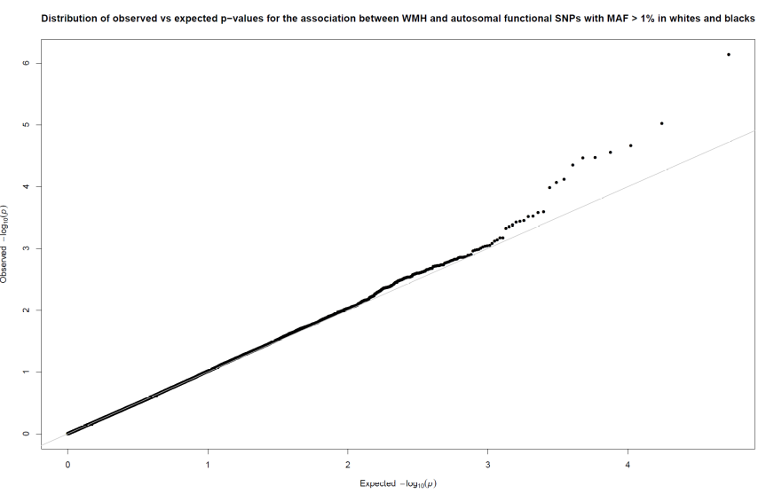
Analysis of Single Variants
In genome-wide analyses, no SNV significantly associated using a Bonferroni-corrected significance threshold
The most significantly associated variant was a common missense in the ELL gene (p=2.6x10⁻⁵)

Slide 9
Gene-Based Analyses
Burden test and SKAT calculated for 17,473 genes
37 genes mapped to regions previously identified in GWAS. Several genes contained rare to low frequency putatively functional variants that were in aggregate nominally associated with WMH burden
  TAF5 on chr10q24 (SKAT-O5 p=5.6x10⁻³ in whites) had the strongest evidence of association when including variants <5%
  LOC729020 on chr10q24 (SKAT-O1 p=1.0x10⁻² in whites) had the strongest evidence of association when including variants <1%
Genome-wide analyses: Threshold of significance: p=2.8x10⁻⁶
In whites only, 4 genes reached genome-wide significance in at least one test when including only rare variants (MAF<1%)
In the combined meta-analysis including ARIC AA, 2 genes reached genome-wide significance when including only rare variants (MAF<1%), suggesting possible heterogeneity by race
When including rare and low frequency variants (MAF<5%), one additional gene reached genome-wide significance in the analysis combining whites and AA

Slide 10
Conclusions and Next Steps
We have identified 7 novel genes that harbor rare and low frequency variants associated with WMH burden
  These genes have known or suspected function in phospholipid binding and signaling (2 genes); oxidative stress-induced cell death (1 gene); and immunity (1 gene)
  They have been implicated in microvascular complications of diabetes and hypertension
  Gene expression of 2 of these genes was altered in brain of AD and autism patients
Pathway Analyses under way to identify functional groups of genes that may play a role in WMH pathogenesis
Replication: Plan to use data from Exome Chip if feasible

