Slide 1


Hemorrhagic Transformation after rt-PA
Paris ISGC workshop
Israel Fernández-Cadenas, Stroke Pharmacogenomics and Genetics, Fundació Docència i Recerca MutuaTerrassa and Neurovascular Research Laboratory, Barcelona, Spain.

Slide 2
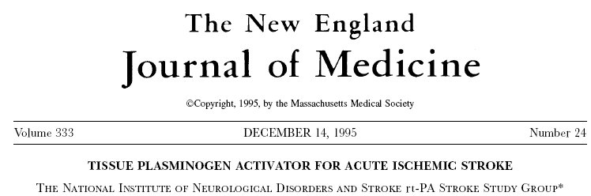

Hemorrhagic Transformation after rt-PA

Slide 3
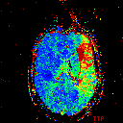
Hemorrhagic Transformation after rt-PA
Recanalization
No
Recanalization
30-40%
Symptomatic
Hemorrhagic
Transformation
2-6%
Notes:
Despite the great benefits of rt-PA 2-6% of patients suffer symptomatic HT and 30-40% do not recanalizate or do it too late.

Slide 4

Hemorrhagic Transformation after rt-PA
Total Hemorrhagic Transformation (HT): 20-22%
Parenchymal Hematoma subtype (PH): 10-15%.
PH subtype is strongly associated with a higher risk of
neurological worsening (PH: 25.4%, no PH: 5.3%; p = 3.4E-12).
Only rt-PA during the first 4.5h after symptoms onset. Only 6-14% of strokes are treated.

Slide 5
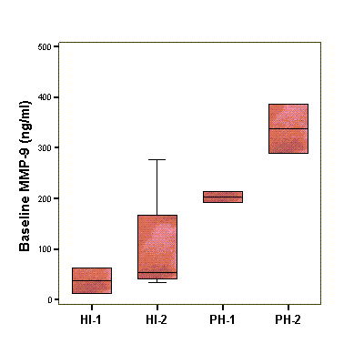
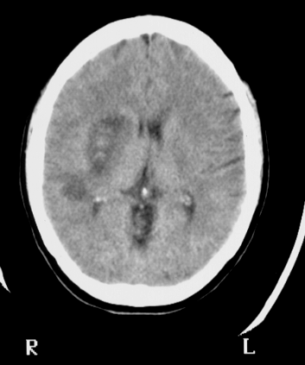
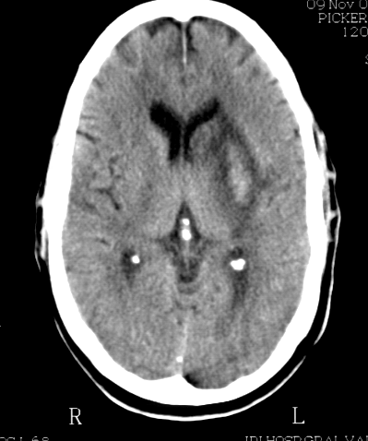
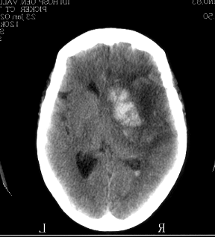
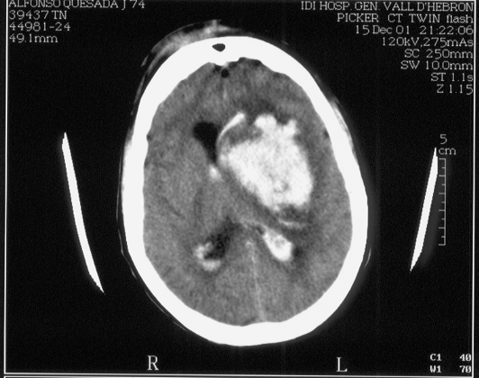
Hemorrhagic Transformation after rt-PA
Metalloproteinase-9 protein levels (Montaner et al 2003. Circulation).
HI₁
HI₂
PH₁
PH₂

Slide 6
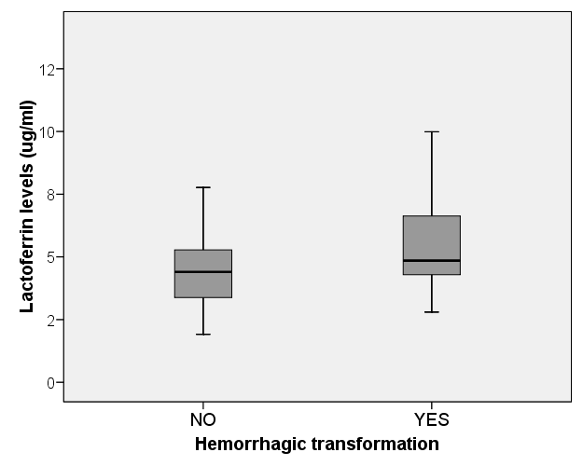
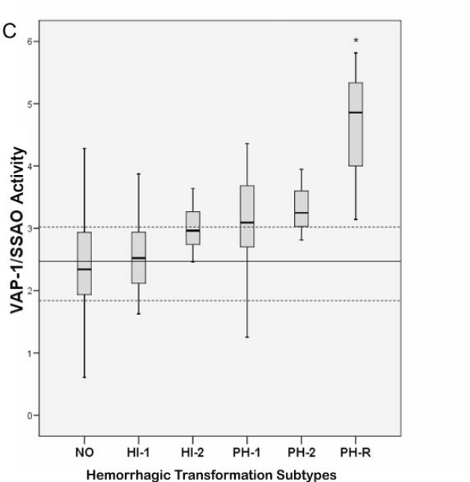
Hemorrhagic Transformation after rt-PA
Lactoferrin mRNA and protein levels.
(Fernandez-Cadenas et al 2014.
Pharmacogenomics).
Fibronectin protein levels.
(Castellanos et al 2004. Stroke).
VAP-1 protein activity.
(Hernandez-Guillamon et al 2010. Stroke).

Slide 7
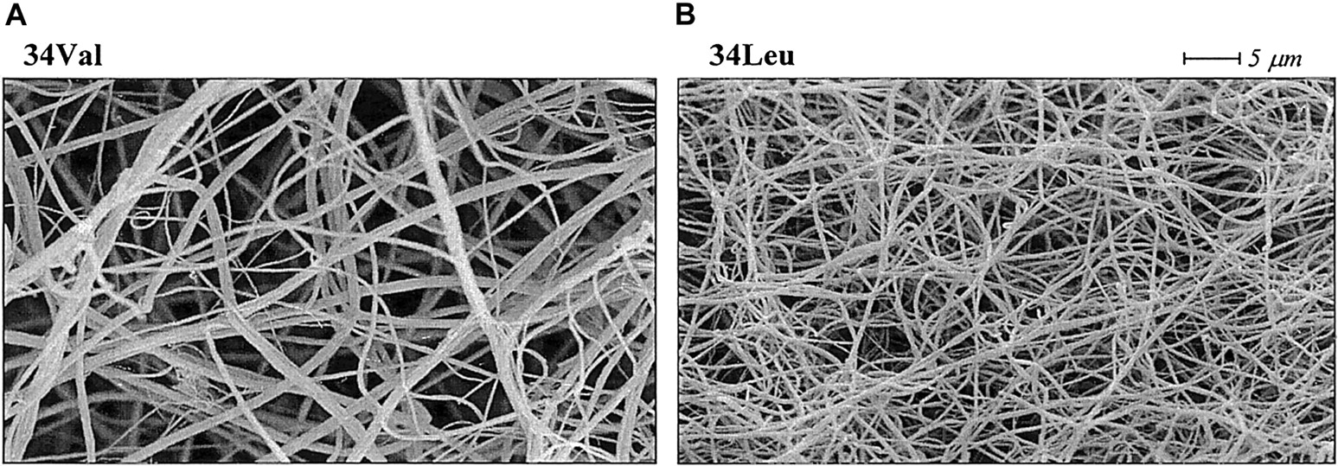
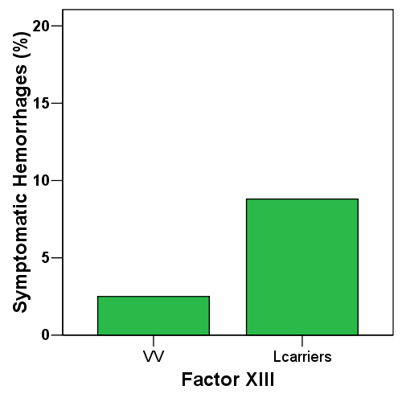
Previous results suggested that genetic background could be
associated with HT after rt-PA.
Factor XIII Val34Leu (Gonzalez-Conejero et al 2006).
P=0.049

Slide 8
Previous results suggested that genetic background could be
associated with HT after rt-PA.
A2M and Factor XII (Del Rio-Espinola 2012, Fernandez-Cadenas 2013).
 |  | HT% Cohort A (n=540) |  |  | HT% Cohort B (n=360) |  |  | HT% Training Set (n=885)
Gene | SNP | At-Risk | Other | p-value | At-Risk | Other | p-value | At-Risk | Other | p-value
A2M | rs669 | 25.8 | 14.7 | 0.0002 | 23.1 | 14.6 | 0.014 | 24.7 | 14.6 | 1.0 E-5*
F12 | rs1801020 | 23.9 | 17.3 | 0.074 | 23.0 | 11.5 | 0.004 | 23.5 | 14.6 | 0.001†
MCP1 | rs1024611 | 24.2 | 22.1 | 0.529 | 29.1 | 18.2 | 0.003 | 26.3 | 20.4 | 0.015
ApoB | rs1367117 | 24.6 | 18.5 | 0.049 | 21.6 | 17.2 | 0.208 | 23.3 | 17.9 | 0.021
VEGF | rs3025042 | 37.5 | 23.0 | 0.334 | 60.0 | 20.7 | 0.031 | 46.2 | 22.0 | 0.047
IL1a | rs1800587 | 23.2 | 20.6 | 0.429 | 22.8 | 15.1 | 0.039 | 23.0 | 18.3 | 0.055
VEGF | rs3025000 | 23.9 | 22.5 | 0.644 | 26.4 | 17.9 | 0.014 | 25.0 | 20.6 | 0.056
SERPINE1 | rs7242 | 22.7 | 21.0 | 0.558 | 24.9 | 17.8 | 0.025 | 23.7 | 19.6 | 0.057
VEGF | rs3025047 | 25.0 | 22.1 | 0.889 | 75.0 | 19.3 | 0.005 | 50.0 | 21.0 | 0.067
ADIPOQ | rs2241766 | 22.8 | 20.4 | 0.544 | 22.3 | 14.0 | 0.047 | 22.6 | 17.5 | 0.075

Slide 9
Hemorrhagic Transformation after rt-PA
Previous results suggest that genetic variants could improve
the prediction of clinical models (Del Rio-Espinola 2012).
Variables in | B | S.E. | Sig. | OR | 95% C.I.for OR
the Model |  |  |  |  | Lower | Upper
Baseline NIHSS | 0.053 | 0.017 | 2.06E-03 | 1.054 | 1.019 | 1.091
Atrial Fibrillation | 0.534 | 0.198 | 6.92E-03 | 1.705 | 1.158 | 2.512
DBP (10mm) | 0.149 | 0.060 | 1.24E-02 | 1.161 | 1.033 | 1.305
OTT (10min) | 0.039 | 0.016 | 1.35E-02 | 1.039 | 1.008 | 1.072
rs1801020 (C allele) | 0.711 | 0.199 | 3.62E-04 | 2.036 | 1.378 | 3.010
rs669 (A allele) | 0.784 | 0.170 | 3.99E-06 | 2.190 | 1.569 | 3.056
Score=0.053*baseline NIHSS score + 0.534*AF + 0.039* OTT (10 min) + 0.149 * DBP (10mm Hg) +
0.711 * rs1801020 (C allele) + 0.784 * rs669 (A allele)
Notes:
DBP: Diastolic blood preassure (before rt-PA), OTT: Onset to treatment. Using the Beta values (OR) of logistic regression we generated a clinical-genetic algorithm

Slide 10
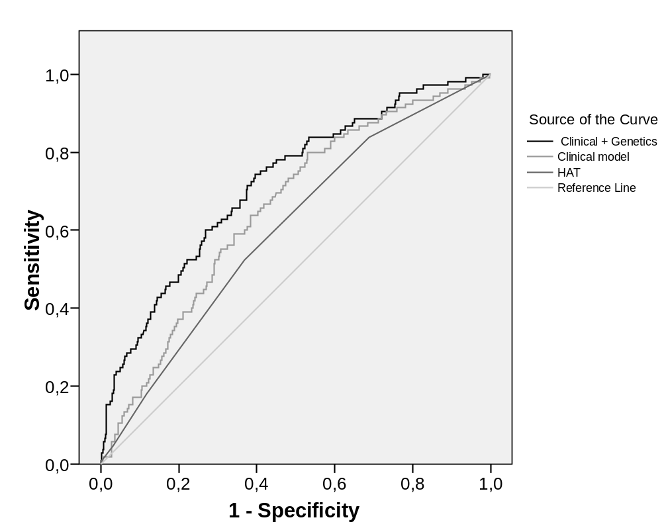
Hemorrhagic Transformation after rt-PA
Variables in | B | S.E. | Sig. | OR | 95% C.I.for OR
the Model |  |  |  |  | Lower | Upper
Baseline NIHSS | 0.053 | 0.017 | 2.06E-03 | 1.054 | 1.019 | 1.091
Atrial Fibrillation | 0.534 | 0.198 | 6.92E-03 | 1.705 | 1.158 | 2.512
DBP (10mm) | 0.149 | 0.060 | 1.24E-02 | 1.161 | 1.033 | 1.305
OTT (10min) | 0.039 | 0.016 | 1.35E-02 | 1.039 | 1.008 | 1.072
rs1801020 (C allele) | 0.711 | 0.199 | 3.62E-04 | 2.036 | 1.378 | 3.010
rs669 (A allele) | 0.784 | 0.170 | 3.99E-06 | 2.190 | 1.569 | 3.056
 |  | AUC | p-value | 95%C.I. for AUC |  | Hosmer
 |  |  |  | Lower Bound | Upper Bound | Lemeshow
Training Set | CG score | 0,720 | 3,20E-12 | 0,666 | 0,775 | 0,249
(n=685) | Clinical score | 0,654 | 1,06E-06 | 0,598 | 0,711 | 0,286
 | HAT score | 0,603 | 1,09E-03 | 0,544 | 0,662 | 0,218
Off-label tPA | CG score | 0,651 | 1,10E-04 | 0,576 | 0,726 | 0,500
(n=300) | Clinical score | 0,628 | 1,01E-03 | 0,555 | 0,702 | 0,522
Validation (n=62) | CG score | 0,730 | 1,13E-02 | 0,569 | 0,891 | 0,349
 | Clinical score | 0,692 | 3,41E-02 | 0,536 | 0,849 | 0,960
Notes:
The clinical-genetic algorithm presented significant higher AUCs compared to previous HAT score and clinical variable alone. This better prediction was confirmed in a validation cohort. CG: clinical genetics score.

Slide 11
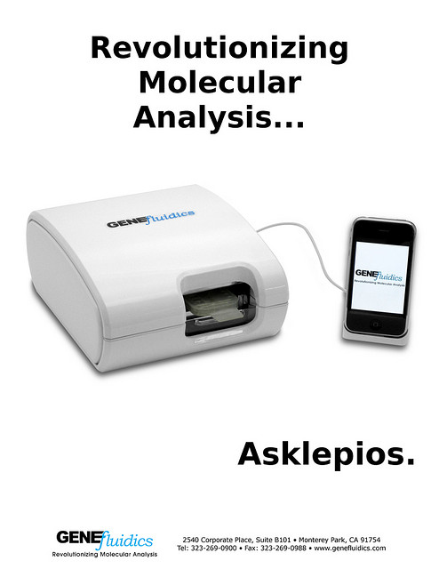
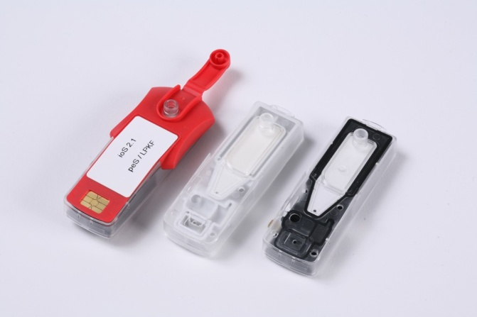
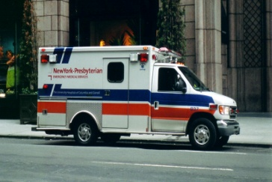
HT- project. Implementation.
Rapid detection devices can detect genetic variants in less than 30 minutes
using a blood sample.
The detection could be done on route to the hospital
(at the ambulance) or in the emergency room of the hospital.

Slide 12
HT-project. Objectives.
1-Our aim is to find new polymorphisms associated with HT in rt-PA treated
patients to improve the prediction models with the future goal of the
implementation of these prediction models in the clinical practice.
2-A second objective is to find polymorphisms associated with
spontaneous HT in patients without rt-PA treatment.
We will conduct a meta-analysis with all the GWAs available.

Slide 13
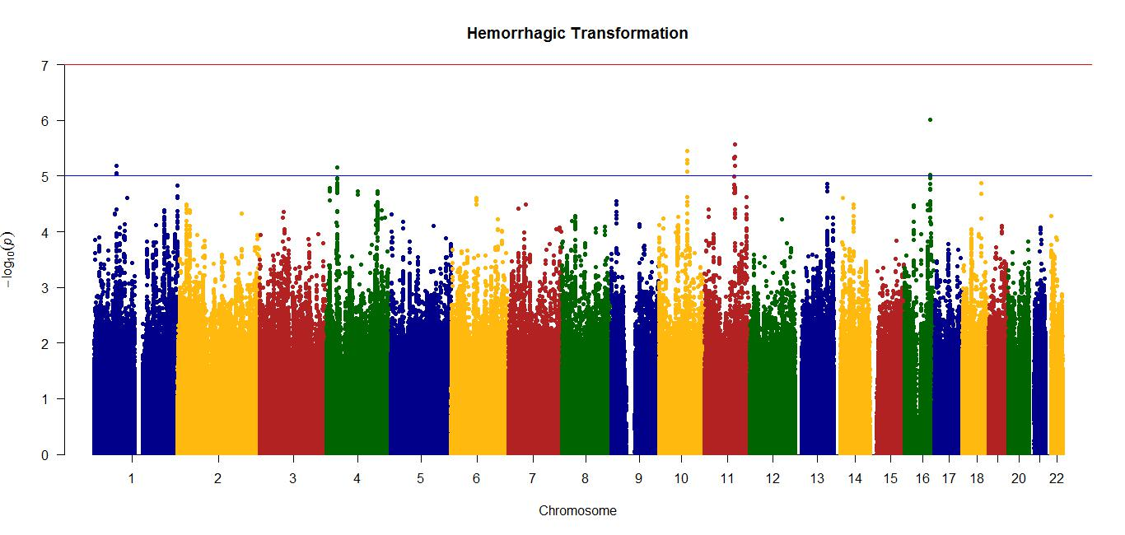
HT-project.
GWAs, pilot results.
Cohort | Sample Size | Ancestry | Female (%) | TH (%) | PH (%) | Rec (%) | IH Mort. (%) | Age (years) | Genotyping
GENOTPA | 216 | Caucasi | 110 (50,9) | 97 (44,9) | 44 (20,4) | 49 (22,7) | 29 (13,4) | 72,49 ± 10,54 | Illumina Human Omni 2.5
SPANISH STROKE | 167 | Caucasi | 76 (46,3) | 20 (11,6) | 12 (7,3) | 46 (28) | 22 (13,4) | 72,36±11,52 | Axiom® Biobank Genotyping Array
N | 383 |  | 186 | 117 | 56 | 95* | 51
LOC1001128497
SYCE1L
ADAMTS18
MAPRE1P2
LOC101927363
NOX4
IL23R
NGR3
signal near to Lactoferrin gene.

Slide 14
HT- project.
Meta-GWAs: ISGC and SiGN approval.
Genetics of Hemorrhagic Transformation with or without rt-PA treatment.
Vall d’Hebron/FMT: 600 GWAs, Stroke patients treated with rt-PA, with HT data.
Vall d’Hebron/St Louise: 300 GWAs, Stroke patients treated with rt-PA, with HT data.
Helsinki: 750 GWAs, Stroke patients treated with rt-PA, with HT data.
Baltimore: 917 GWAs, Stroke patients with HT data.
Newcastle: checking the cohorts.
Leuven: checking the cohorts.
H. Del Mar: checking the cohorts.
Hospitals with DNA for replication analysis: Miami, Krakow, Bordeaux, Barcelona
and other hospitals from Spain.

Slide 15
NEXT STEPS
Meta-GWAs: we have the approval of ISGC and SiGN.
Genetics of Hemorrhagic Transformation with or without rt-PA treatment.
Currently: 1.650 GWAs for HT after rt-PA treatment.
2.567 GWAs for HT with/without rt-PA treatment.
Timelines: analysis of the meta-analysis of the GWAs December 2014- January 2015.
replication of results January 2015-July 2015.
More collaborators will be very wellcome!
E-mail: israelcadenas@yahoo.es

Slide 16

Thanks.
Stroke pharmacogenomics
and genetics lab.
Neurovascular reserach lab.
Caty Carrera.
Cristina Gallego.
Elena Muiño.
St Louise, Washington University
Newcastle University.
Helsinki University.
Baltimore, Maryland University.
H. Del Mar, Autonoma University.
Krakow, Jagiellonian University Medical College.
Miami University.
Bordeaux University.
Genestroke Consortium. www.genestroke.com
Joan Montaner, Eduardo Salas, Jeanette Tuval, Turgut Tatlisumak, Daniel Strbian,
Magí Lluch-Ariet, Stéphanie Debette, Igor Sibon, Jurek Krupinski, Jin-Moo Lee,
Carlos Cruchaga, Dominick McCabe, Vincent Thijs, Robin Lemmens, Agnieszka Slowik,
Joanna Pera, Arne Lindgren, Christian Foerch, Birgit Fuchs, Jane Maguire.

