Slide 1
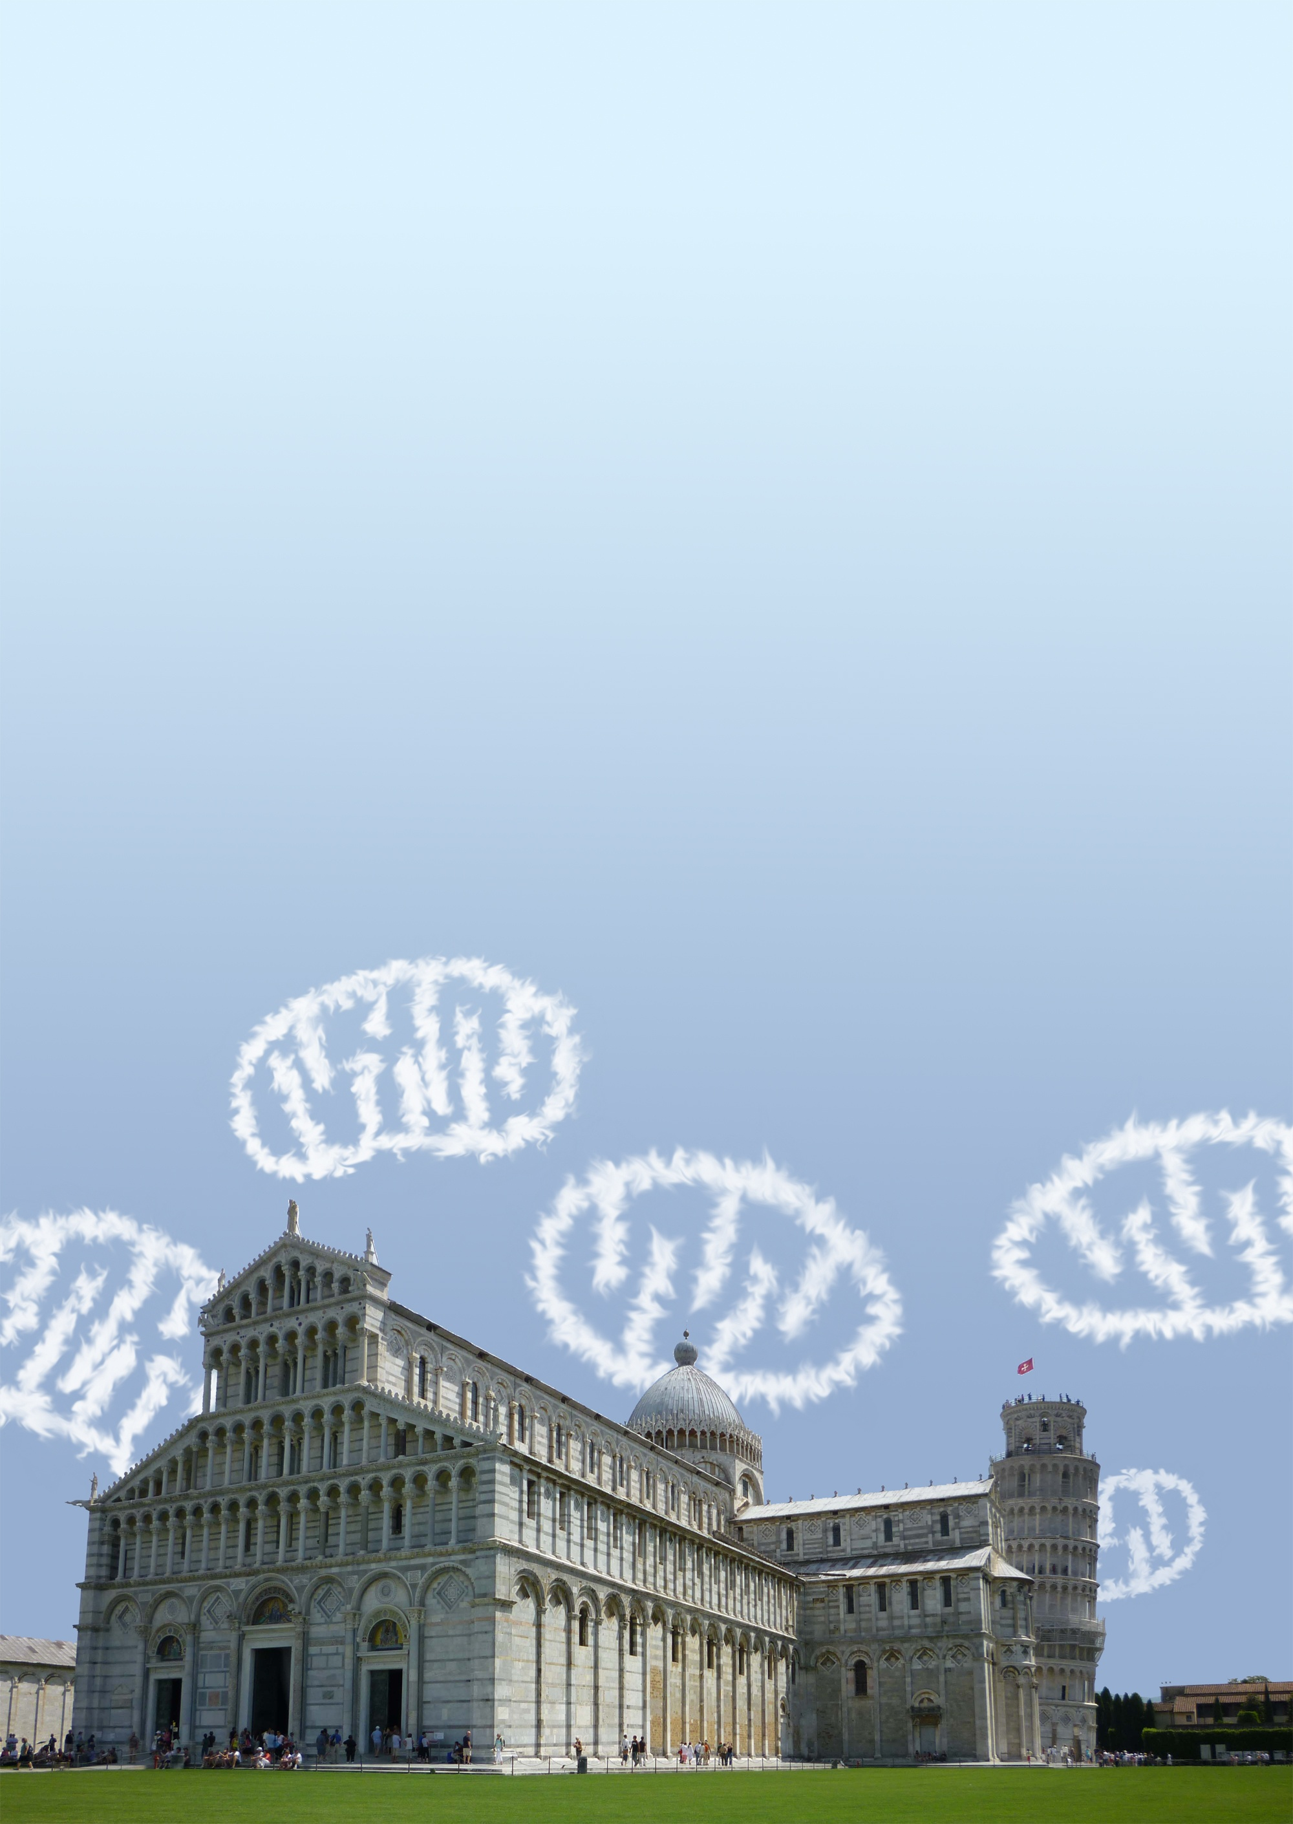
16TH WORKSHOP OF THE INTERNATIONAL STROKE GENETICS CONSORTIUM
Mitochondria,
mitochondrial DNA
and Stroke
Dr. Michelangelo Mancuso
University of Pisa
Italy

Slide 2
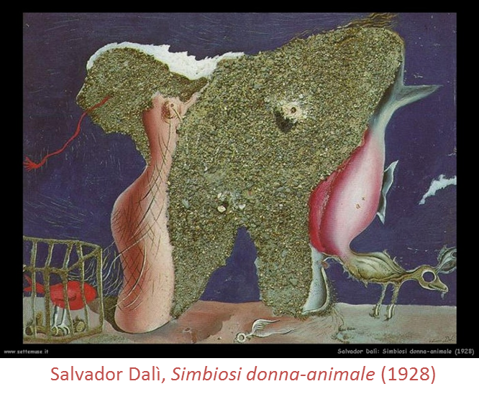
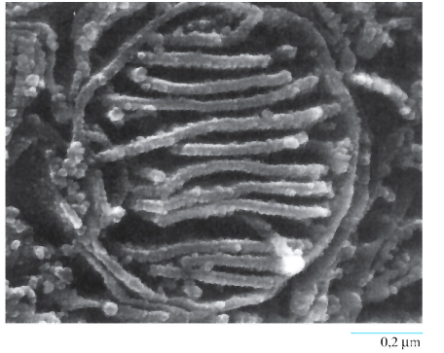
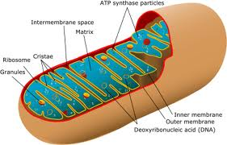
MITOCHONDRIA
all eukaryotes
“endosymbiosis” theory
relevant structure
powerhouse of the cell (ATP)
Salvador Dalì, Simbiosis mujer-animal, 1982

Slide 3
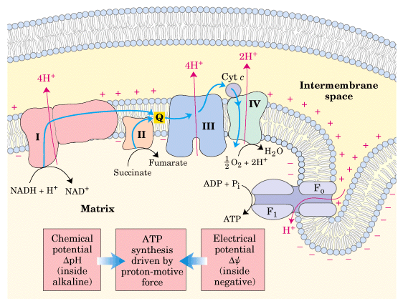
Inner membrane: Oxidative phosphorylation
OXPHOS is a metabolic pathway that uses energy released by the oxidation of nutrients to produce adenosine triphosphate (ATP)

Slide 4
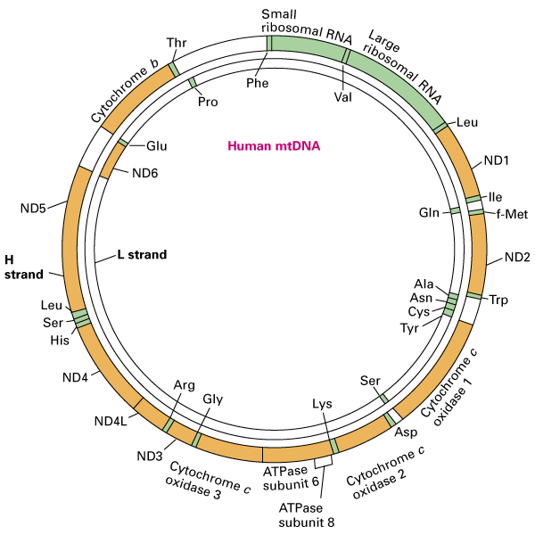
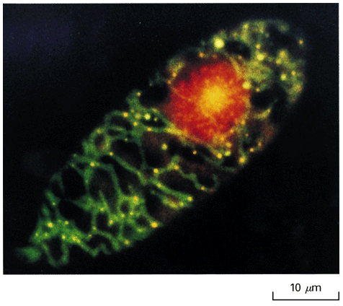
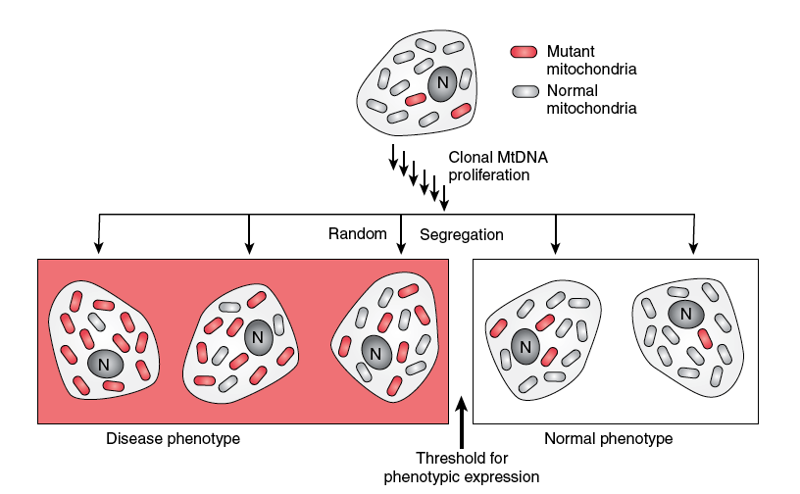

Mitochondrial Genome
Circular DNA molecule - 16 kilobases.
37 genes: 13 for subunits of respiratory complexes, 22 for mitochondrial tRNA and 2 for rRNA.
two to ten copies each mitochondrion
Maternal Inheritance
Heteroplasmia
Mitotic Segregation
Threshold Effect

Slide 5
Genetic classification
Defects of mtDNA
  Mutations in protein synthesis genes
    tRNA, rRNA, rearrangements
  Mutations in protein-coding genes
    Multisystemic (LHON, NARP/MILS)
    Tissue-specific
Defects of nDNA
  Mutations in respiratory chain subunits
    Complex I, Complex II
  Mutations in ancillary proteins
    Complex IV, Complex III
  Defects of intergenomic signaling
    AR-PEO with multiple -mtDNA
    mtDNA depletion
  Defects of the lipid milieu
    Barth syndrome
  Defects of motility/fusion/fission

Slide 6
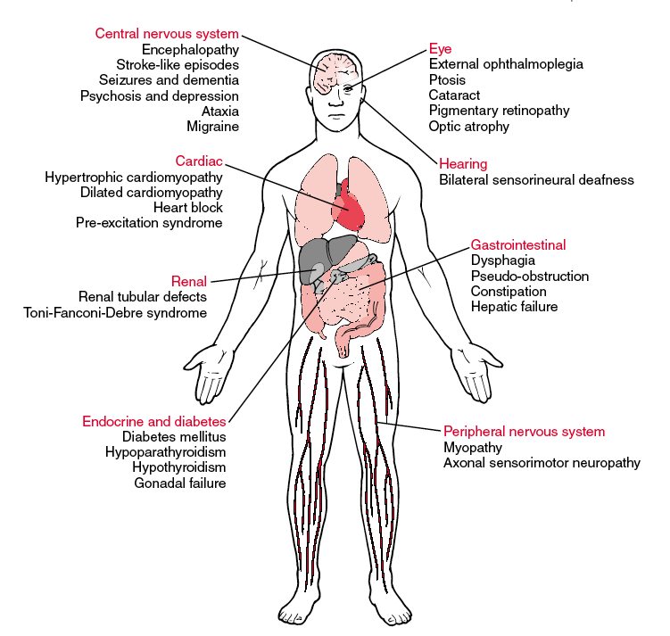
MITOCHONDRIAL DISORDERS
Phenotypic variability:
ratio mtDNA mutant / normal mtDNA
percentage of mutant mtDNA
functional dependence of the different tissues from oxidative metabolism.
SNC, skeletal striated muscle, heart, the kidney and liver

Slide 7
Mitochondrial archetype: MELAS syndrome
MITOCHONDRIAL ENCEPHALOMYOPATHY, LACTIC ACIDOSIS, AND STROKE-LIKE EPISODES
Stroke-like: metabolic stroke!
Early onset (first year in 10%; since 15 yrs 60-80%)
Recurrent stroke-like episodes: mostly posterior lesions
Myopathic features
mutation A3243G tRNA Leu gene (most frequent mtDNA mutation, 16.3/100 000 - Majamaa 1998)
but also other genes.. (ie tRNA Val, cyt b genes..)

Slide 8
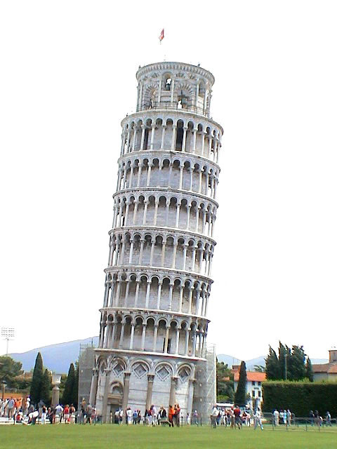
MITO CHALLENGES IN STROKE UNDER THE TOWER
-EPIDEMIOLOGY OF MTDNA RELATED STROKE
MT HAPLOGROUPS AND STROKE
MT - GENDER AND STROKE
MT AND STROKE THERAPIES
MT AND NEUROPROTECTION

Slide 9

MITO CHALLENGES IN STROKE
-EPIDEMIOLOGY OF MTDNA RELATED STROKE
MT HAPLOGROUPS AND STROKE
MT - GENDER AND STROKE
MT AND STROKE THERAPIES
MT AND NEUROPROTECTION

Slide 10
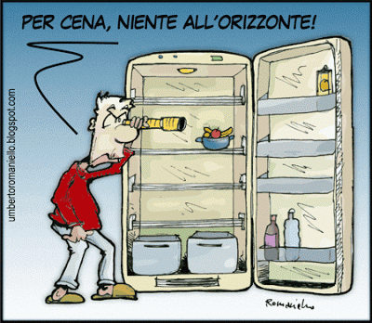
EPIDEMIOLOGY OF MTDNA RELATED STROKE
Lack of data!

Slide 11
N= 250 < 60-yrs

Slide 12
13 pts 5 %
6 CADASIL 2,4
4 MELAS 1,5
2 Fabry disease 0,8
1 Pseudoxantoma Elasticum 0,4

Slide 13
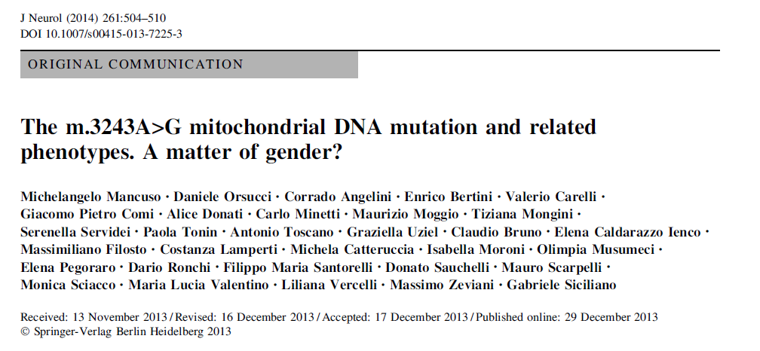
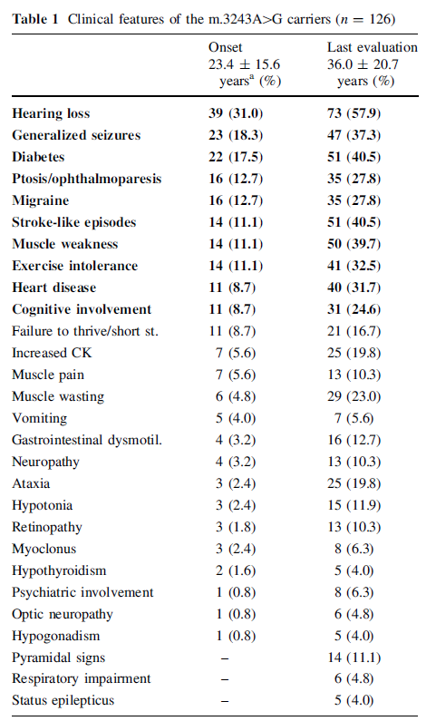
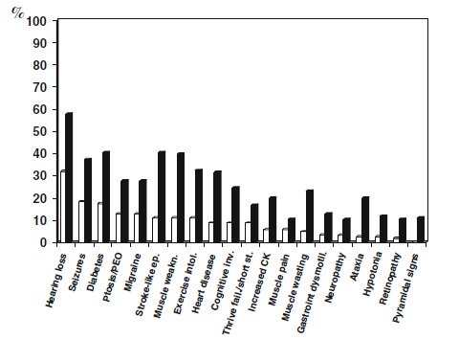
Mt-3243 related MELAS clinical features (n=126)

Slide 14
MITO CHALLENGES IN STROKE
-EPIDEMIOLOGY OF MTDNA RELATED STROKE
MT HAPLOGROUPS AND STROKE
MT - GENDER AND STROKE
MT AND STROKE THERAPIES
MT AND NEUROPROTECTION

Slide 15
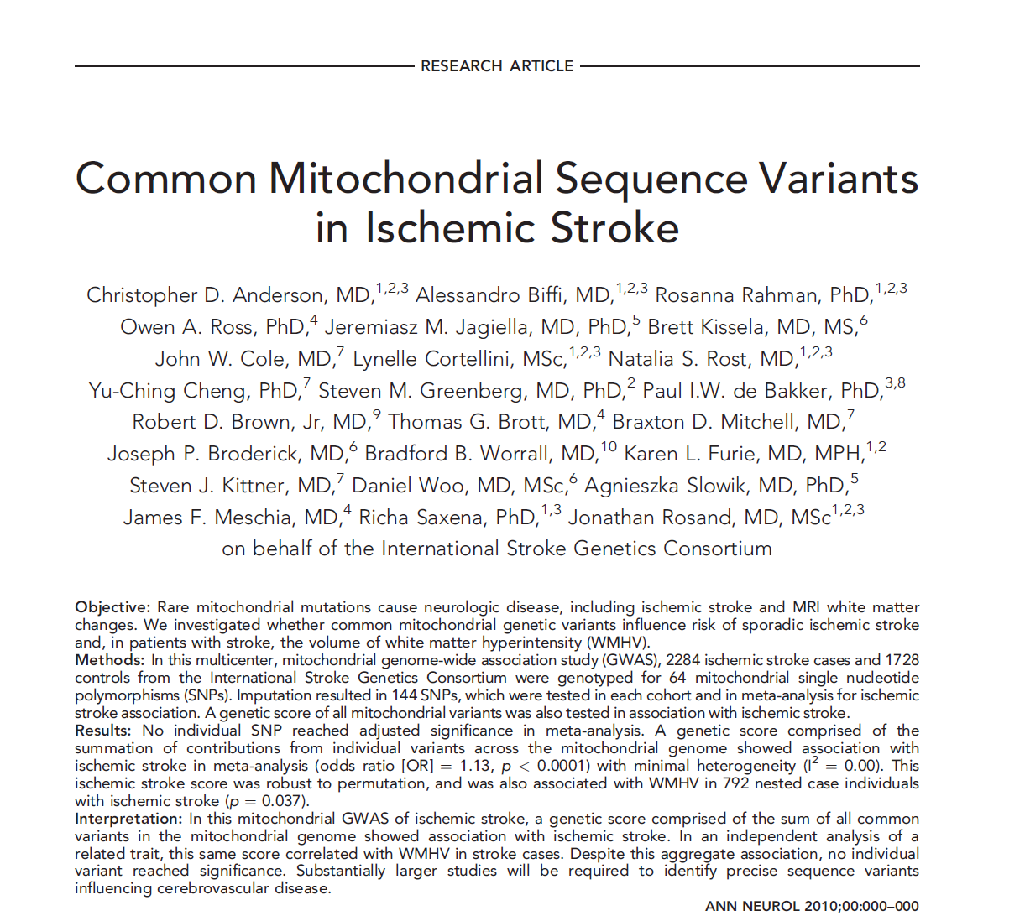
2284 ischemic stroke cases and 1728
controls from the International Stroke Genetics Consortium were genotyped for 64 mitochondrial SNPs

Slide 16
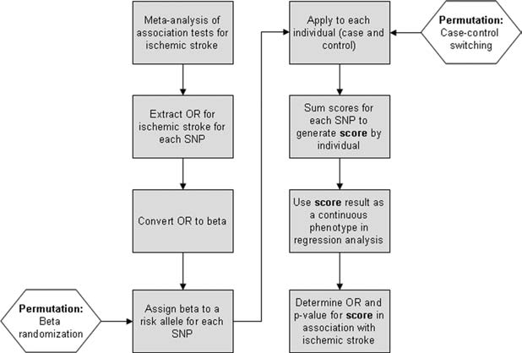
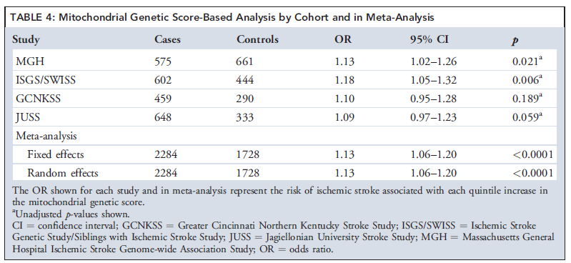
A genetic score comprised of the sum of all common variants in the mitochondrial genome was calculated:
strongly associated with ischemic stroke
correlated with white matter hyperintensity in stroke cases
no individual variant reached significance.

Slide 17
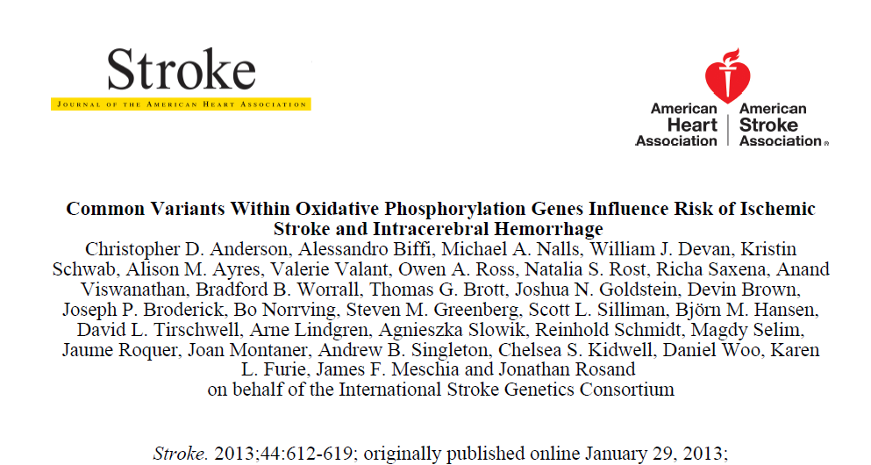
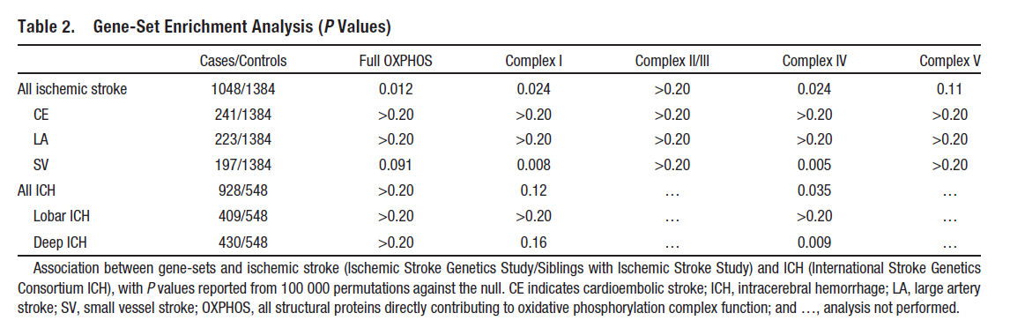
Association between common genetic variants within OXPHOS genes and stroke. The associations for small vessel stroke and deep ICH suggest that genetic variation in OXPHOS influences small vessel pathobiology.

Slide 18
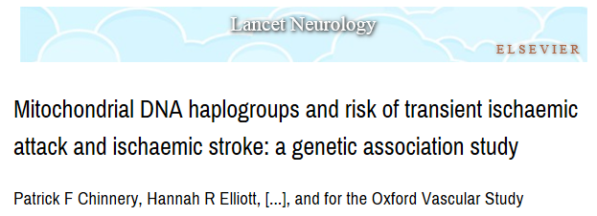
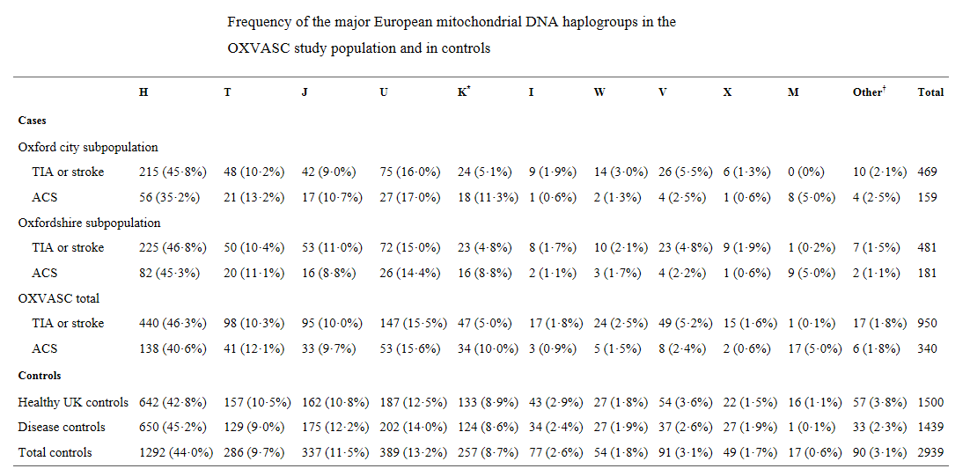
Haplogroups and stroke: POSITIVE RESULTS
sub-haplogroup K less frequent in patients with TIA or stroke than in controls. The association was significant for patients with TIA and stroke separately and was independent of known risk factors
2010

Slide 19
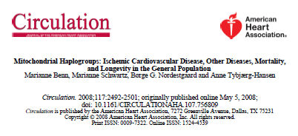
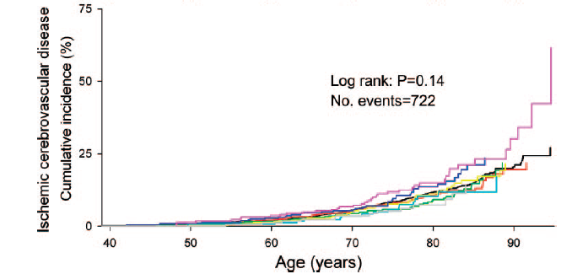
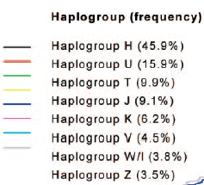
Haplogroups and stroke: NEGATIVE RESULTS

Slide 20
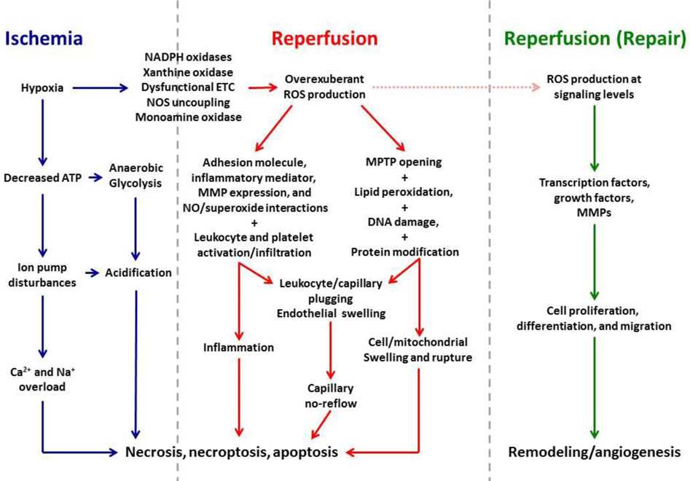
Mitochondrial mechanisms have been implicated in the pathophysiology of acute stroke
A LOT OF MITO FOOTPRINTS!

Slide 21
MITO CHALLENGES
MT HAPLOGROUP(S) & OXPHOS SNP(S) INFLUENCING THE CLINICAL AND FUNCTIONAL OUTCOME (mRS, NIHSS; BI). Chinnerry study negative
MT HAPLOGROUP(S) & OXPHOS SNP(S) INFLUENCING THE POSITIVE –or negative- RESPONSE TO ACTLYLISE
WORK IN PROGRESS
1.MT HAPLOGROUPS
2.D-LOOP

Slide 22
MITO CHALLENGES IN STROKE
-EPIDEMIOLOGY OF MTDNA RELATED STROKE
MT HAPLOGROUPS AND STROKE
MT - GENDER AND STROKE
MT AND STROKE THERAPIES
MT AND NEUROPROTECTION

Slide 23
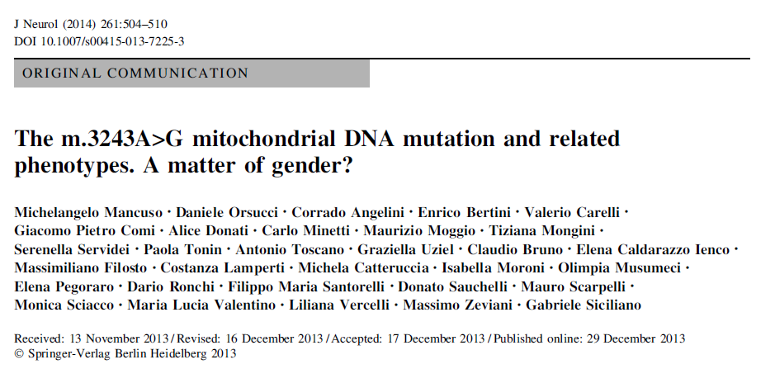
ONGOING: MELAS phenotype vs gender in our cohort (110 mt pts > 1300

Slide 24
MITO CHALLENGES IN STROKE
-EPIDEMIOLOGY OF MTDNA RELATED STROKE
MT HAPLOGROUPS AND STROKE
MT - GENDER AND STROKE
MT AND STROKE THERAPIES
MT AND NEUROPROTECTION

Slide 25
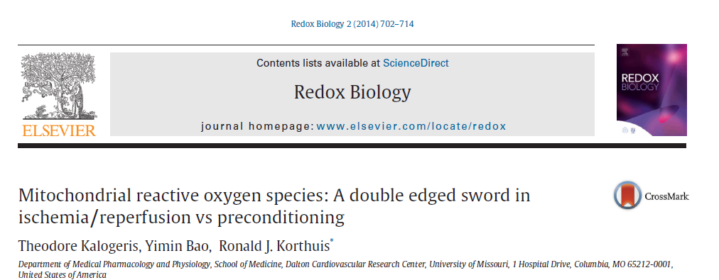
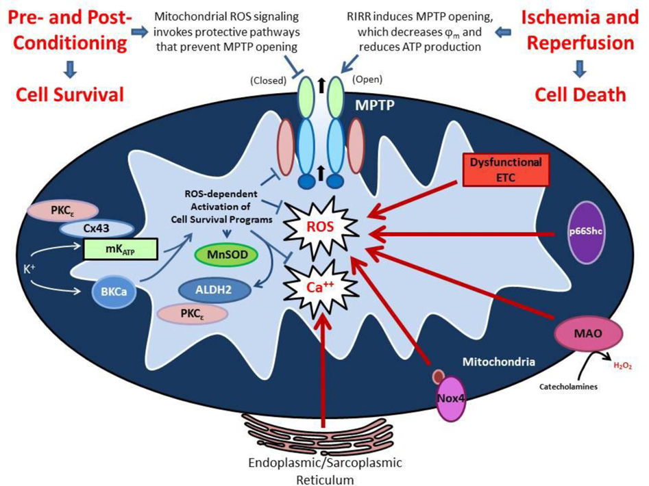

Slide 26
A LOT OF MITO FOOTPRINTS!

Slide 27
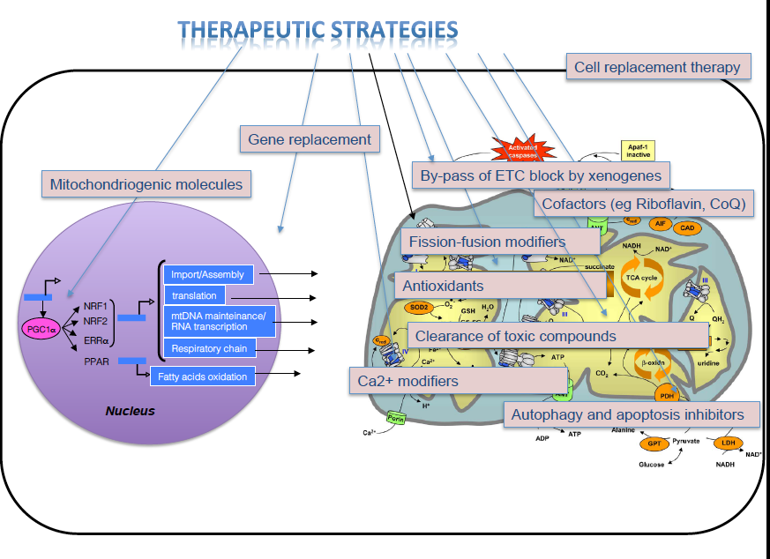
May mitochondrial-dependent therapeutic agents provide neuroprotection following stroke??
MT & OXPHOS SNPs AND SECONDARY PREVENTION
MT THERAPIES AND STROKE -> FUNCTIONAL UTCOME
ANTIOX
ARGININE
NR
CoQ10

Slide 28
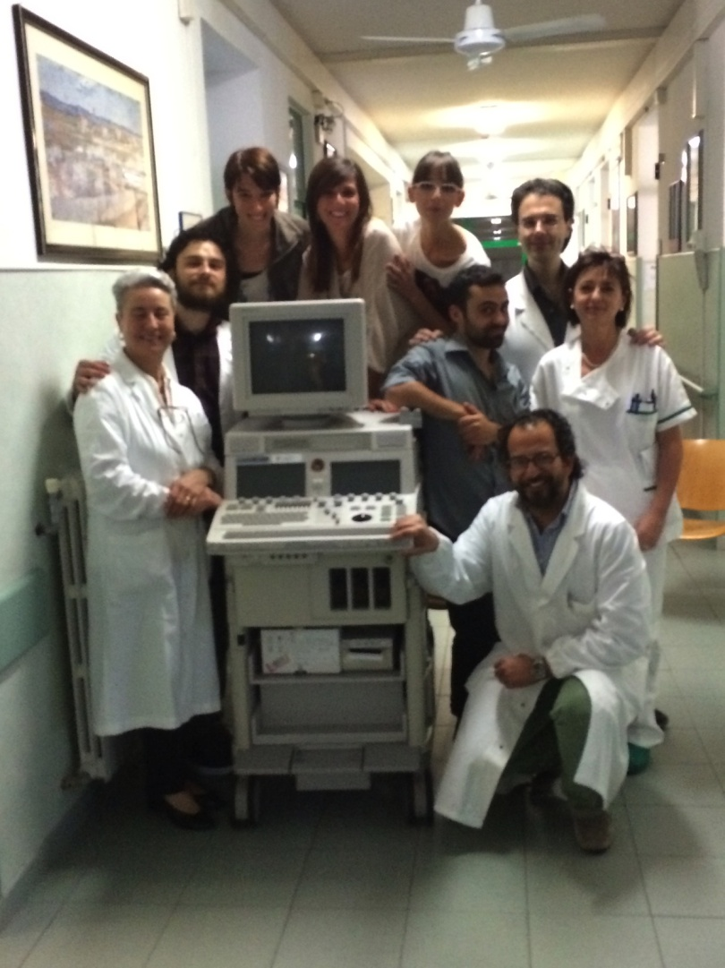
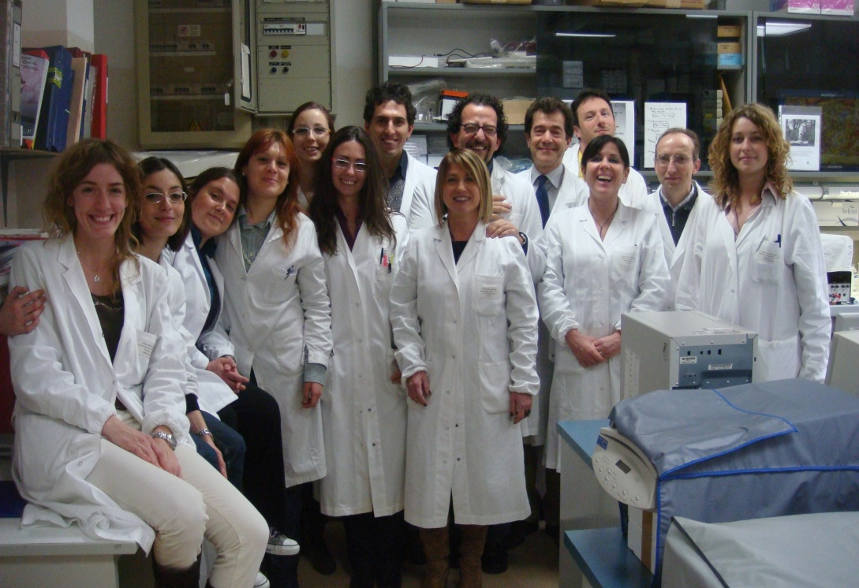
STROKE TEAM
NEUROGENETICS TEAM

Slide 29

THANKS!

