Slide 1
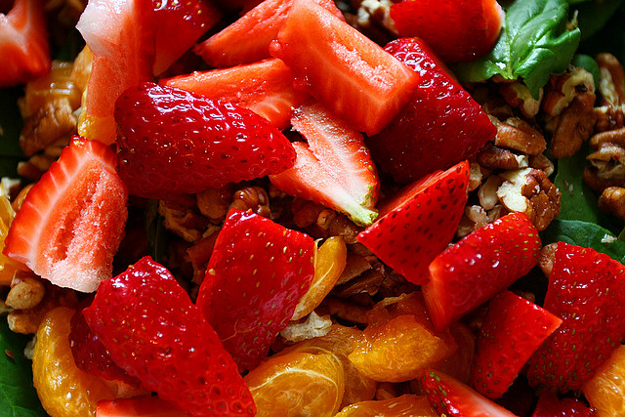

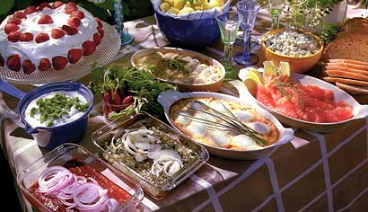
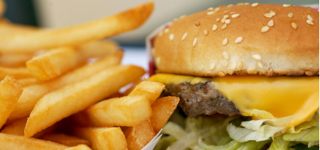
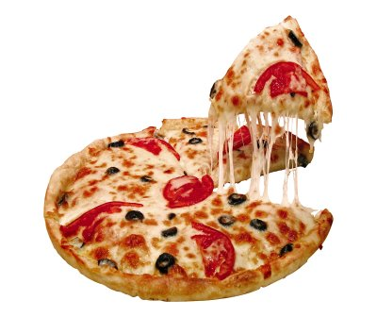
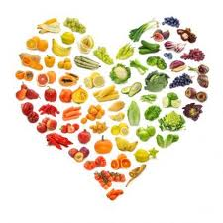

Gene-environment interactions in cardiometabolic disease some examples
Marju Orho-Melander
Professor
LUDC, Lund University
14th International Stroke Genetics Consortium
13-14th November 2013, Lund, Sweden

Slide 2
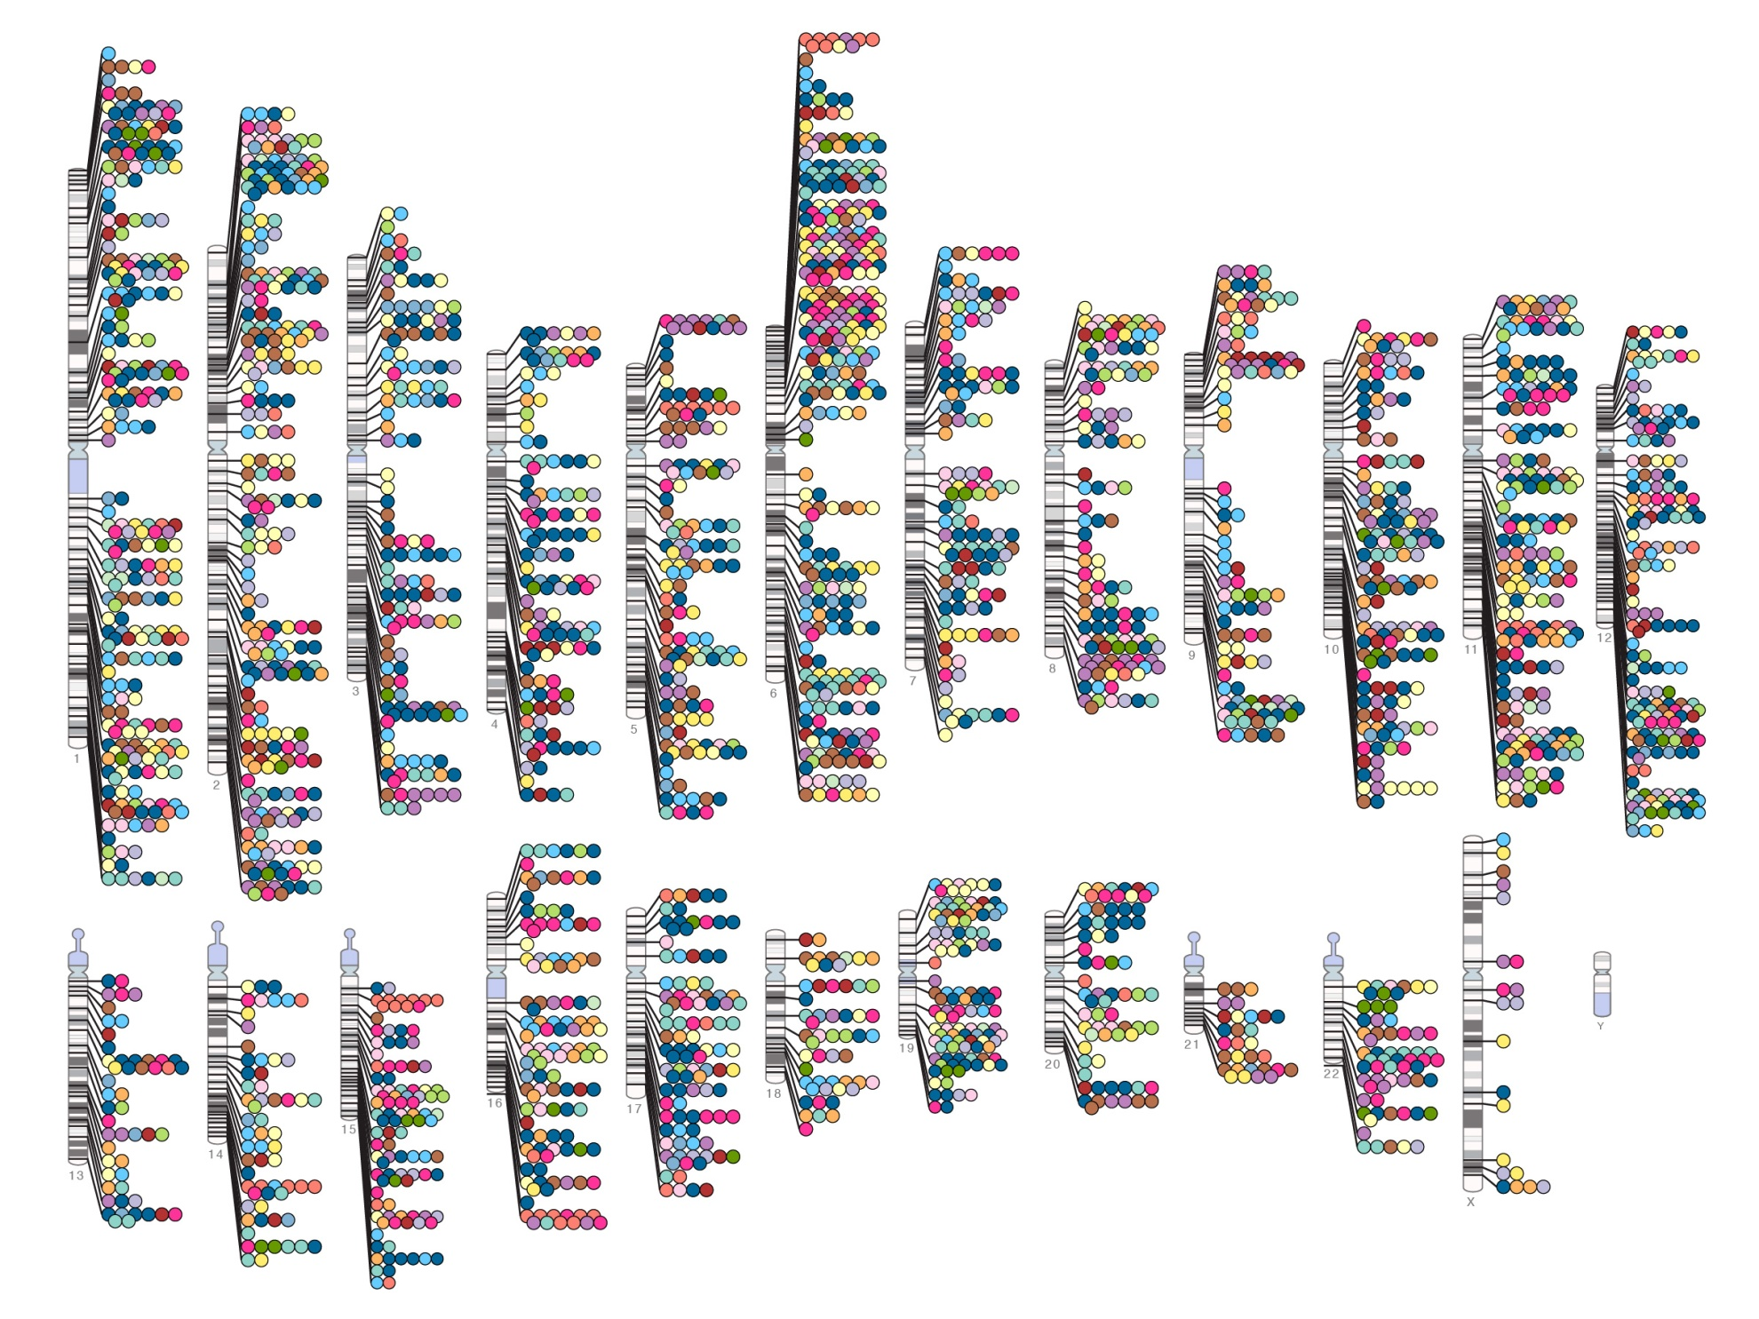
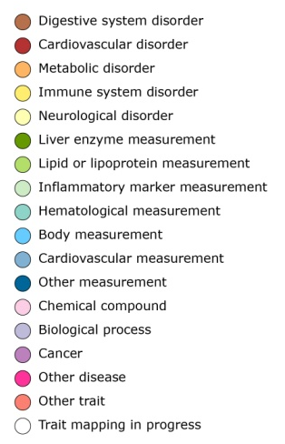

Published Genome-Wide Associations through 07/2012
Published GWA at p≤5X10⁻⁸ for 18 trait categories
NHGRI GWA Catalog
www.genome.gov/GWAStudies
www.ebi.ac.uk/fgpt/gwas/

Slide 3
”Law of technology”
We invariably overestimate the short-term impacts of new technologies and underestimate
their longer-term effects

Slide 4

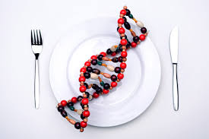

  Understand biological mechanisms
  ↓
  Possibilities for prevention
  Possibilties for treatment
  Understand Gene x environment interactions
  ↓
  Understand heritability
  Understand genetics of multifactorial diseases

Slide 5

our hypotheses:
Genetic factors modify what kind of diet protects from cardiometabolic diseases
  What is healthy diet?
  Why is it so difficult to answer?
Dietary factors modify your genetic susceptibility for cardiometabolic diseases
Notes:
Vad är fetma?
Definieras som BMI>30 Kg/m²
kaloriintag > förbrukning
WHO (2005): globalt 400 miljoner vuxna lider av fetma
År 2015 förväntas 2.3 billion vuxna i världen vara överviktiga och >700 miljoner lida av fetma
Studier på enäggstvillingar som separerades när de var spädbarn och föddes upp i olika familjer:
Tvillingparens BMI stämde väldigt bra överens även om de inte träffat sedan de var spädbarn
men hade väldigt lite med resten av respektive familj att göra
(=50% gener, 50% annat)

Slide 6
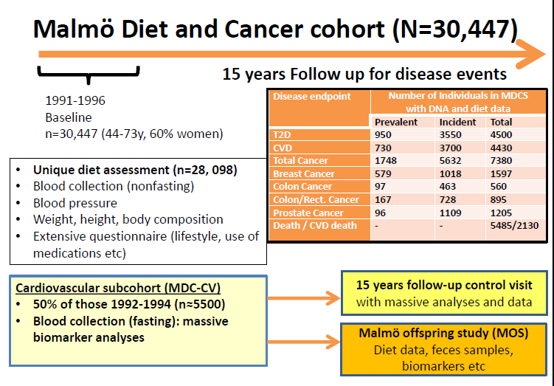

Slide 7
Agenda
Diet and cardiometabolic disease
Genes and Diet in T2D: TCF7L2 and GIPR
Chr9p21 and environment in CVD

Slide 8
Diet and T2D /CVD risk?
Protein from animal sources increases the risk of type 2 diabetes
High whole grains / fibers intake decreases the risk of type 2 diabetes
High whole grains / fibers intake decreases the risk of CVD
A healthy dietary pattern decreases the risk of cardiometabolic diseases

Slide 9

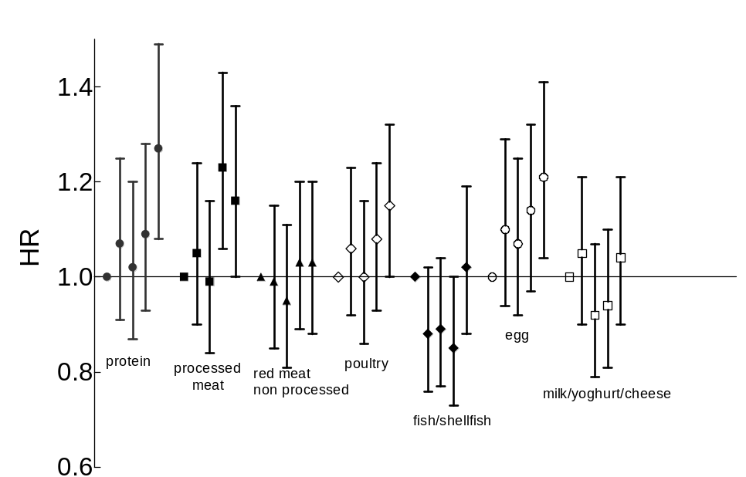
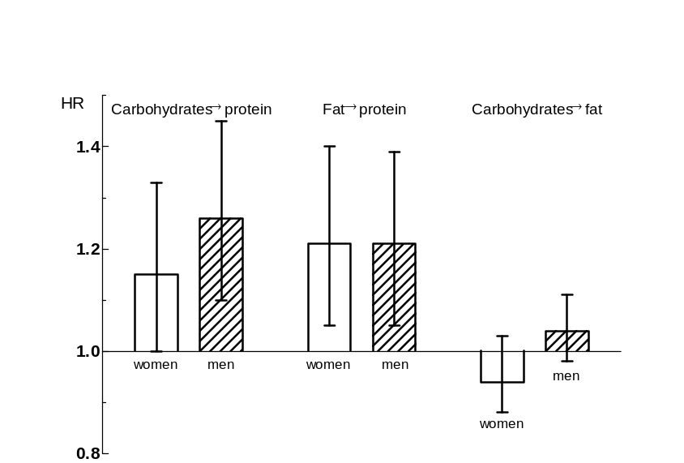
High intakes of protein and processed meat associate with increased incidence of T2D
Ulrika Ericson, Emily Sonestedt, Bo Gullberg, Sophie Hellstrand, George Hindy, Elisabet Wirfält, Marju Orho-Melander
P-interaction
with sex = 0.040
If protein consumption increased by 5 E-% at the expense of
- carbohydrates: HR 1.20; 95% CI: 1.09, 1.33
- fat HR 1.21; 95% CI: 1.09, 1.33
High intake of processed meat : 1.16 [1.00-1.36], P =0.01
High intake of eggs: 1.21 [1.04-1.41], P =0.02
High intake of fibre-rich bread and cereals:
0.84 [0.73- 0.98] P =0.004
Ericson et al. J Nutr 2012

Slide 10
Risk of incident coronary event and stroke by categories of food groups in MDCS
 | Categories of intake
Food groups | 1 | 2 |  | 3 |  | 4 |  | 5 |  | P_{trend}
Carbohydrates
Coronary event | 1.00 | 0.95 | 0.82-1.11 | 1.02 | 0.87-1.19 | 1.05 | 0.90-1.23 | 1.04 | 0.89-1.23 | 0.34
Stroke | 1.00 | 0.92 | 0.77-1.11 | 0.93 | 0.77-1-12 | 0.94 | 0.78-1.14 | 0.94 | 0.77-1.14 | 0.66
Sucrose
Coronary event | 1.00 | 0.95 | 0.81-1.10 | 1.01 | 0.87-1.18 | 0.97 | 0.83-1.13 | 1.11 | 0.95-1.28 | 0.19
Stroke | 1.00 | 0.87 | 0.72-1.05 | 1.02 | 0.86-1.23 | 0.90 | 0.75-1.09 | 1.04 | 0.87-1.25 | 0.59
Fiber
Coronary event | 1.00 | 0.96 | 0.83-1.10 | 0.91 | 0.79-1.06 | 0.89 | 0.76-1.04 | 0.92 | 0.79-1.08 | 0.18
Stroke | 1.00 | 0.84 | 0.71-1.00 | 0.88 | 0.73-1.04 | 0.77 | 0.64-0.93 | 0.81 | 0.67-0.98 | 0.02
Whole grains
Coronary event | 1.00 | 0.85 | 0.73-0.98 | 0.91 | 0.79-1.05 | 0.85 | 0.73-0.98 | 0.88 | 0.76-1.01 | 0.10
Stroke | 1.00 | 0.96 | 0.81-1.14 | 0.92 | 0.78-1.10 | 0.75 | 0.62-0.90 | 0.85 | 0.71-1.01 | 0.006
¹Adjusted for age, sex, season, diet assessment method, energy intake, BMI, smoking, alcohol consumption, leisure-time physical activity, education
Sonestedt et al. unpublished 2013

Slide 11
Healthy dietary pattern
Dietary Component | Limit | Points
Saturated fat | <14 % of energy | 1
Polyunsaturated fat | 5-10 % of energy | 1
Fish and seafood | >300 g/ week | 1
Dietary fibre | 25-35 g/ day | 1
Fruits and vedgetables | >400 g/ day | 1
Sucrose | <10 % of energy | 1
Total points |  | 0-6
Drake et al., Public Health Nutrition, 2013

Slide 12
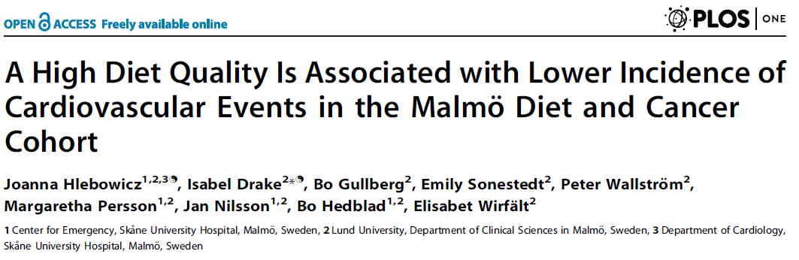
Healthy dietary pattern in MDCS
21% lower risk of death among men with 4-6 points compared to those with 0-1 points
41% lower risk of CVD-death among men with 4-6 points compared to those with 0-1 points
Drake, Public Health Nutrition, 2013

Slide 13
Diet and T2D /CVD risk in the Malmö Diet and Cancer Study
V
V
V
V
Protein from animal sources increases the risk of type 2 diabetes
High whole grains / fibers intake decreases the risk of type 2 diabetes
High whole grains / fibers intake decreases the risk of CVD
A healthy dietary pattern decreases the risk of cardiometabolic diseases

Slide 14
Conclusion 1
Malmö Diet and Cancer study can be used to study role of dietary components and – patterns in cardiometabolic disease

Slide 15
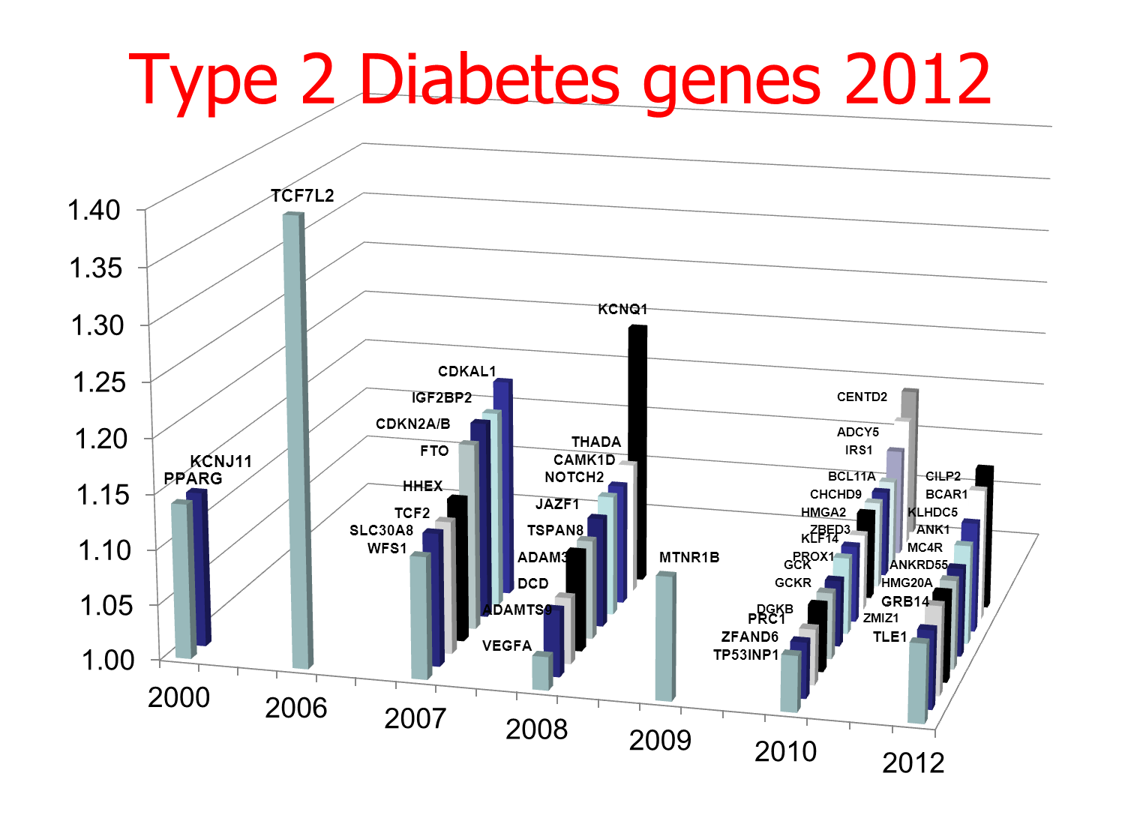

_________________________________________________
Variant of transcription factor 7-like 2 (TCF7L2) gene confers risk of type 2 diabetes
TCF7L2: the strongest T2D gene
HNF1A

Slide 16
What does TCF7L2 do?
Transcription factor in the canonical WNT signalling pathway
Target genes are involved in cellular proliferation and differentiation (β-cell mass)
Activates transcription of the proglucagon gene encoding GLP-1 in intestinal L cells
TCF7L2 risk variant has been shown to be associated with an attenuated insulin response
  defective incretin system or incretin resistance
Dietary carbohydrates and fats are strong stimuli of GLP-1
Dietary fibers have been associated with increased, decreased, and unaffected GLP-1
Notes:
Pancreatic development, beta cell cytoprotection, suggestive of a role of tcf7l2 in maintaing beta cell mass. Also may play a role in secretory function of beta cells. Consensus sequence for binding in proprotein convertase 1 and 2, PC1 and 2 that are essential for conversion of proinsulin into mature insulin.

Slide 17
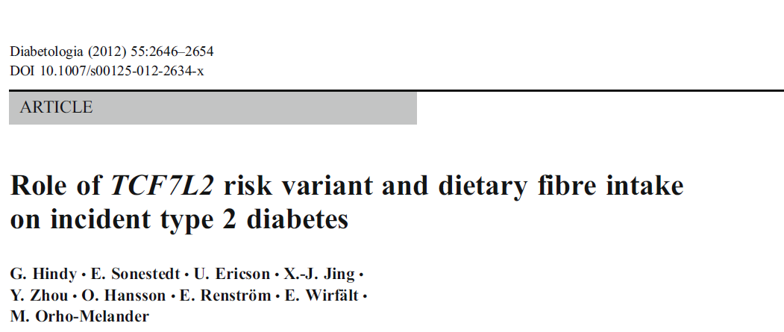
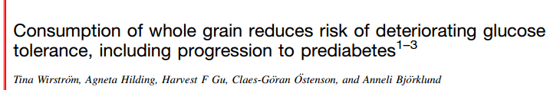
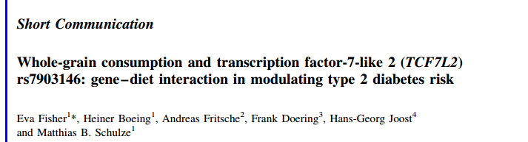
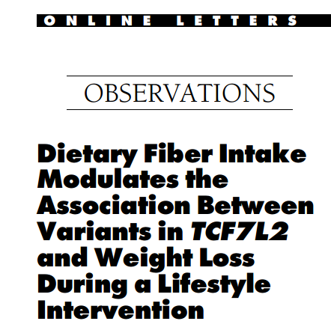
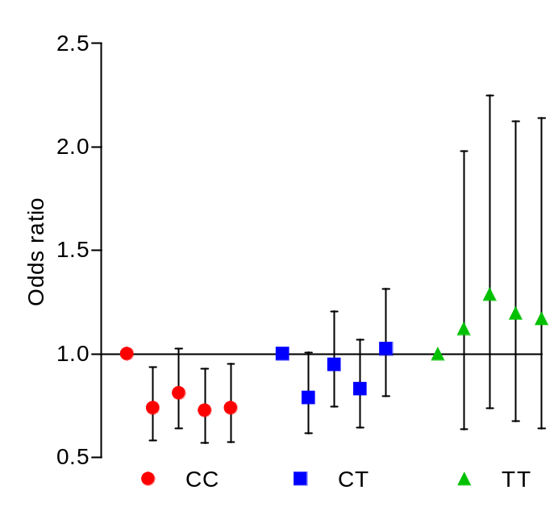
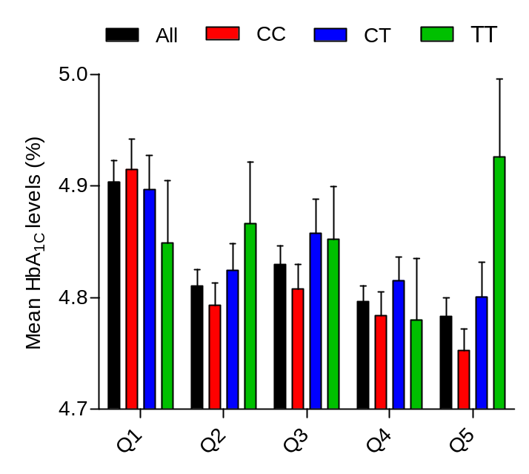
N=13,571
N=9,488
N=1,740

Slide 18
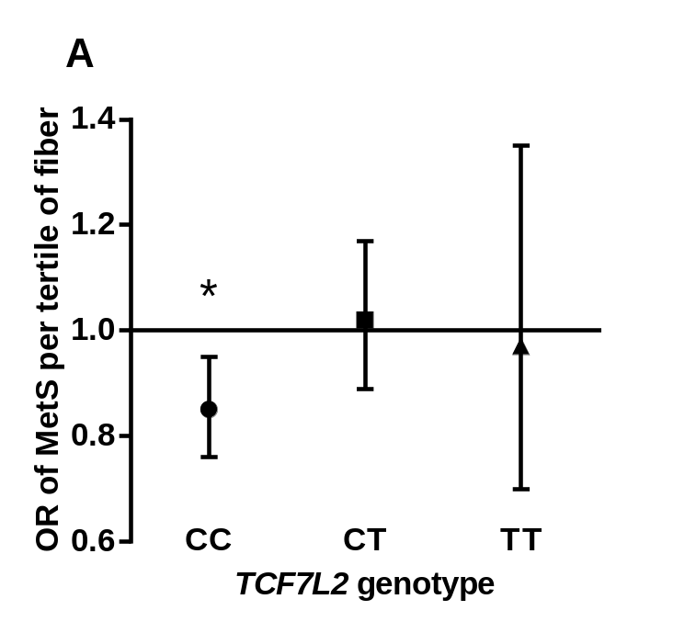
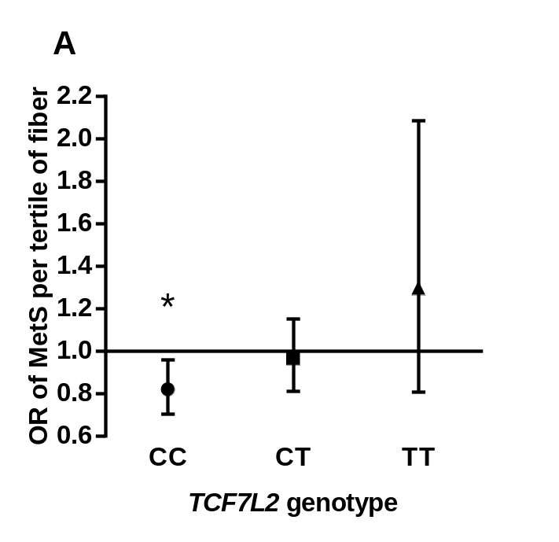
MetS (NCEP-ATPIII)
Abdominal obesity (waist circumference ≥ 102 cm for men and ≥ 88 cm for women)
Moderate hypertriglyceridemia (plasma TG concentrations ≥ 1.7 mmol/l)
Reduced HDL-C levels ( < 1.0 mmol/l for men and < 1.3 mmol/l for women)
Elevated blood pressure ( ≥ 130/85 mm Hg)
Fasting hyperglycemia ( ≥ 5.6 mmol/l)
N=4,677
1,270 Prevalent MetS
N=2,375
772 Incident MetS
P-interaction=0.028
P-interaction=0.20

Slide 19
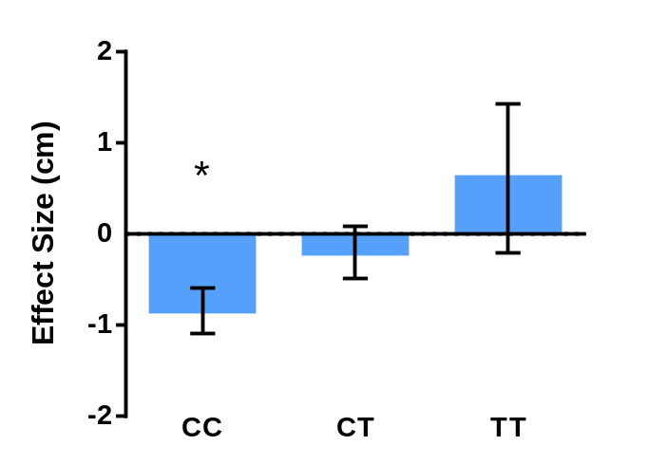
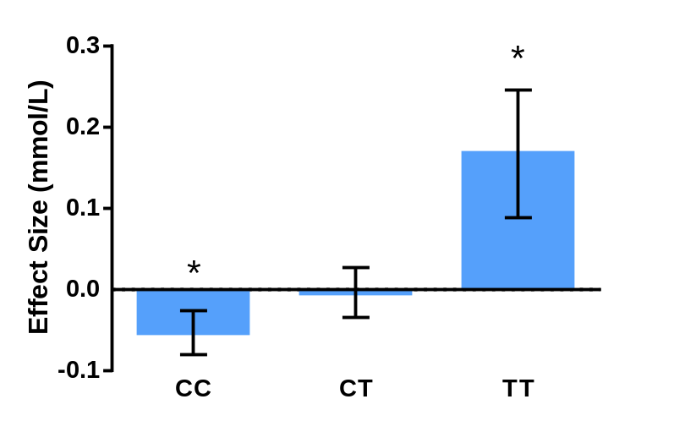
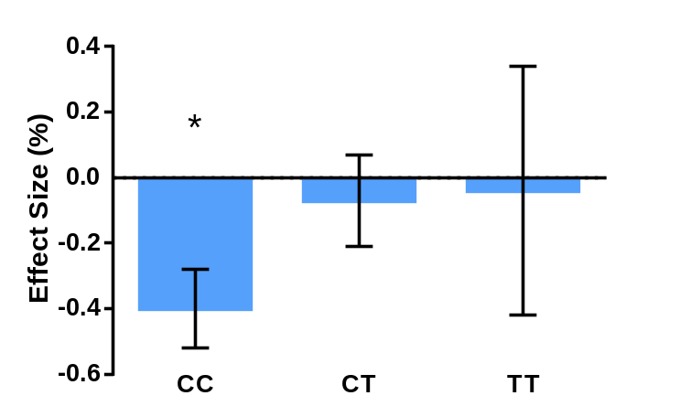
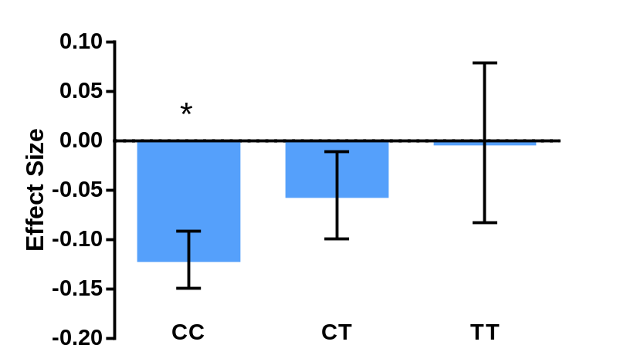
Waist circumference
Total cholesterol
P-interaction=0.008
P-interaction=0.008
Body fat %
HOMA-IR
P-interaction=0.04
P-interaction=0.05

Slide 20
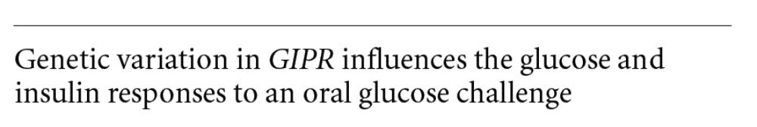

Glucose-dependent insulinotropic polypeptide GIPR
Saxena et al. 2010
GIP is an incretin hormone released from intestinal K cells after food ingestion
The release of GIP is influenced mainly by dietary intake of carbohydrates and fat
gipr ko-mice fed a high-fat diet (but not a high carbohydrate diet) are protected against obesity and related traits

Slide 21

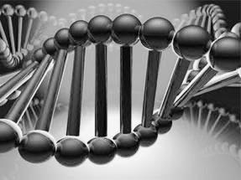
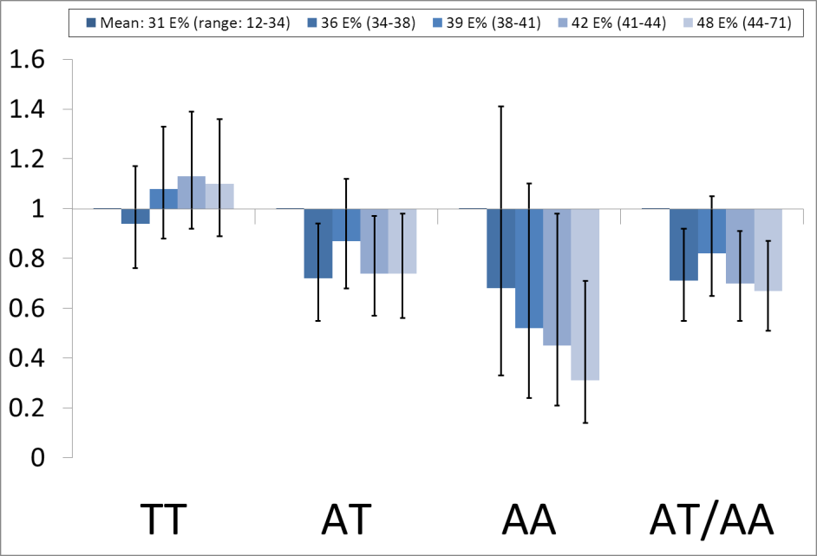
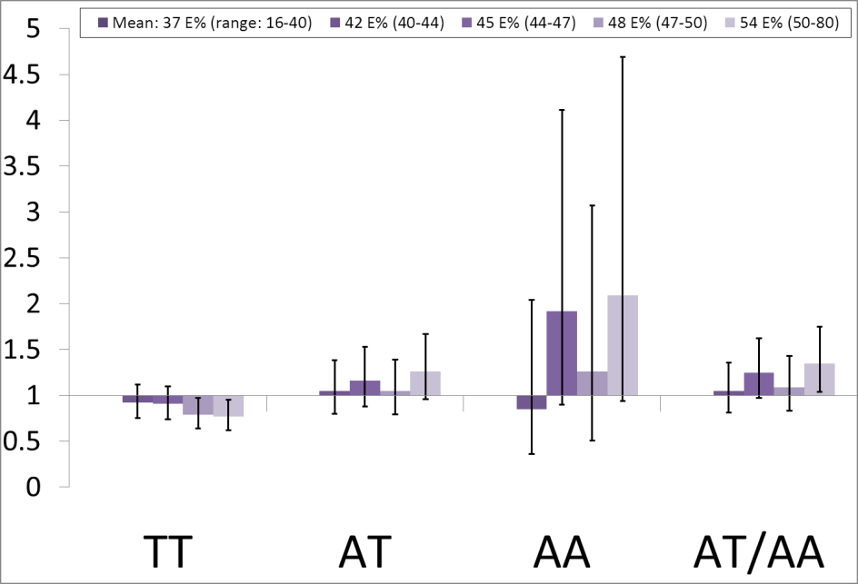
GIPR and carbohydrate/fat intake
Fat intake
Carbohydrate intake
P-interaction = 0.0006 P-interaction = 0.0005
P=0.14
P=0.06
P=0.004
P=0.005
P=0.005
P=0.14
P=0.06
P=0.04
Neither low-fat nor low-carbohydrate diet will be effective for prevention of type 2 diabetes in all individuals
Sonestedt et al. J. Clin Endo Metab 2012

Slide 22
Conclusion 2
Dietary fiber intake may modify the risk of T2D and associated metabolic traits by TCF7L2 risk variant
Association between dietary carbohydrates and fats and T2D may be dependent on genetic factors (GIPR)

Slide 23
Chr9p21 and CVD
The 9p21 visar starkast association med risken för kardiovaskulärsjukdom
25% av vår population är homozygota bärare av risk allelen och har 30-40% ökad risk för kardiovaskulärsjukdom
Riskökningen är oberoende av kända riskfaktorer såsom (LDL, HDL, diabetes, eller högt bloodtryck)
Mekanismen för riskökningen är okänd

Slide 24
Malmö Diet and Cancer Study
Variable | N (%)
Gender, n (%) Men Women | 9455 (37.9) 15489 (62.1)
Age, years | 58.0 (7.7)
Chromosome 9p21 SNP, n (%) 0 risk alleles: A/A 1 risk allele: A/G 2 risk alleles: G/G | 7609 (30.5) 12311 (49.4) 5024 (20.1)
Smoking status, n (%) Never smoker Earlier smoker Current smoker | 9643 (38.7) 8300 (33.3) 7001 (28.1)
Utbildningsnivå, n (%) No elementary school Elementary school (6-8 yrs) Junior Sec. School (9-10 yrs) Advanced level (12 yrs) At least one additional year University degree | 203 (0.8) 10123 (40.6) 6558 (26.3) 2237 (9.0) 2214 (8.9) 3609 (14.5)
Low physical activity level | 4858 (19.5)

Slide 25
Chr9p21 variant, smoking, low education level and physical inactivity increases the risk of CAD, stroke and CVD mortality in MDCS
 | CAD HR (95 % CI) | Ischemic Stroke HR (95 % CI) | CVD mortality HR (95 % CI)
Chr9p rs4977574, per allel | 1.16 (1.09-1.23) | 1.12 (1.04-1.22) | 1.14 (1.05-1.24)
Smoking status
Former smoker Current smoker | 1.21 (1.09-1.34) 2.01 (1.8-2.23) | 1.02 (0.89-1.17) 1.65 (1.44-1.89) | 1.27 (1.09-1.48) 2.67 (2.31-3.09)
Highest education Elementary school (6-8 yrs) Junior Sec. School (9-10 yrs) Advanced level (12 yrs) At least one additional year University degree P for trend | 0.97 (0.63-1.50) 0.81 (0.52-1.25) 0.75 (0.48-1.17) 0.75 (0.48-1.18) 0.63 (0.40-0.98) <0.001 | 0.53 (0.34-0.82) 0.45 (0.29-0.71) 0.38 (0.23-0.62) 0.40 (0.24-0.64) 0.35 (0.22-0.57) <0.001 | 0.82 (0.46-1.45) 0.68 (0.38-1.22) 0.58 (0.32-1.07) 0.54 (0.29-0.99) 0.55 (0.30-1.00) <0.001
Quintiles of PA score Q2 Q3 Q4 Q5 | 0.68 (0.60-0.78) 0.70 (0.62-0.80) 0.73 (0.64-0.83) 0.75 (0.67-0.85) | 0.70 (0.59-0.83) 0.70 (0.59-0.83) 0.63 (0.53-0.75) 0.66 (0.56-0.78) | 0.62 (0.52-0.75) 0.64 (0.54-0.77) 0.63 (0.53-0.75) 0.61 (0.51-0.72)

Slide 26
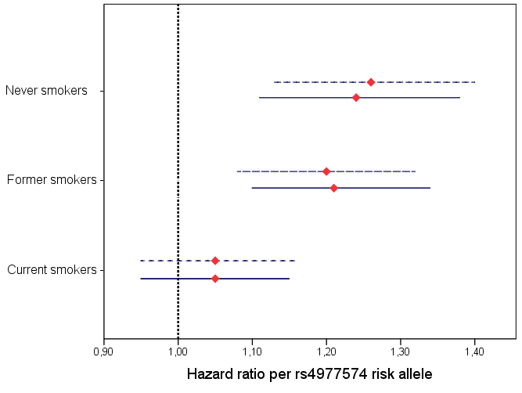
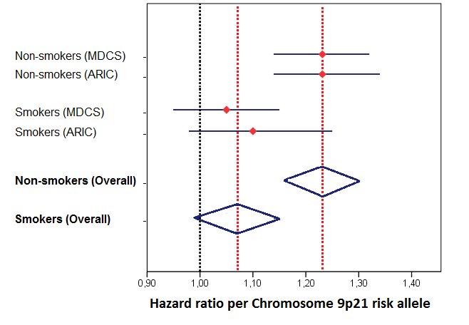
Smoking modifies the risk increase of incident CVD by Chr9p21 rs4977574
Never
smokers
Former
smokers
Smokers
Folsom et al. Atherosclerosis 224:435-9, 2012
0.9 1.0 1.1 1.2 1.3 1.4
Hazard ratio per rs4977574 risk allele
Hamrefors et al. submitted 2013

Slide 27
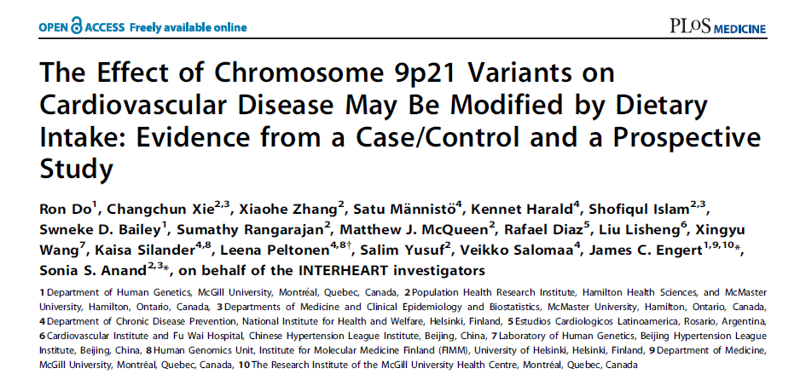
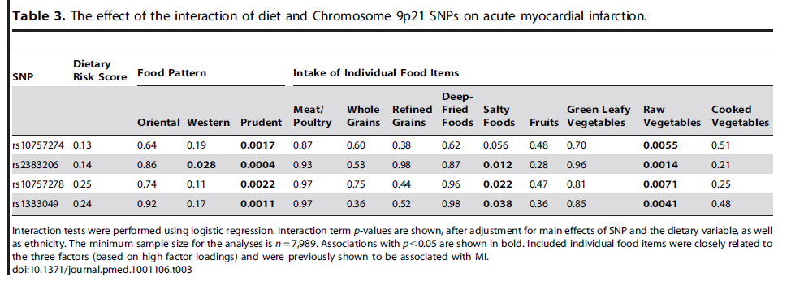

Slide 28
 | Chr9p rs4977574 genotype
 | AA | AG | GG | HR (95%CI) or β (SE) | P_{trend}
Total Number (% women) | 7335 (62.6) | 11797 (62.3) | 4864 (62.3)
Age | 57.9 ± 7.7 | 57.9 ± 7.6 | 57.8 ± 7.7 | – 0.03 (0.07) | 0.63
Incident CVD (%) | 771 (10.5) | 1396 (11.8) | 655 (13.5) | 1.15 (1.09-1.21) | 9×10^{–08}
BMI (kg/m²) | 25.7 ± 3.9 | 25.6 ± 3.9 | 25.7 ± 3.9 | 0.005 (0.035) | 0.89
SBP (mmHg) | 141 ± 20 | 141 ± 20 | 141 ± 20 | 0.21 (0.17) | 0.20
DBP (mmHg) | 86 ± 10 | 85 ± 10 | 86 ± 10 | 0.03 (0.09) | 0.70
F-glucose (mmol/L) | 5.63 ± 0.84 | 5.63 ± 0.74 | 5.68 ± 1.00 | 0.02 (0.02) | 0.29
LDL-cholesterol (mmol/L) | 4.15 ± 1.00 | 4.19 ± 0.98 | 4.18 ± 0.97 | 0.01 (0.02) | 0.38
HDL-cholesterol (mmol/L) | 1.39 ± 0.37 | 1.40 ± 0.38 | 1.39 ± 0.36 | 0.001 (0.007) | 0.85
Triglycerides (mmol/L) | 1.35 ± 0.73 | 1.32 ± 0.71 | 1.37 ± 0.90 | 0.002 (0.02) | 0.52
Total energy intake (kcal) | 2280 ± 652 | 2274 ± 654 | 2276 ± 655 | 4.6 (13.3) | 0.73
Vegetables (g/day) | 180 ± 98 | 182 ± 100 | 180 ± 99 | – 0.12 (0.90) | 0.90
Fruits (g/day) | 196±127 | 193±125 | 197±127 | 0.31 (1.14) | 0.79
Alcohol (g/day) | 12.3 ± 13.2 | 12.7 ± 13.5 | 12.7 ± 13.6 | 0.17 (0.12) | 0.17
Wine (g/day) | 5.4±7.3 | 5.6±7.5 | 5.6±7.7 | 0.11 (0.07) | 0.12
Chr9p rs4977574 does not associate with any of the classical CVD risk factors in MDCS

Slide 29
 | Non-cases | Inc CVD | HR (95%CI) or β (SE) | P_{trend}
Number (% women) | 21174 (64.9) | 2822 (42.5)
Age (years) | 57.3 ± 7.6 | 62.0 ± 7.0 | 4.68 (0.15) | <0.00001
BMI (kg/m²) | 25.5 ± 3.9 | 26.4 ± 4.0 | 0.51 (0.08) | <0.00001
Systolic blood pressure | 139 ± 20 | 151 ± 21 | 6.13 (0.37) | <0.00001
Diastolic blood pressure | 85 ± 10 | 89 ± 10 | 2.63 (0.20) | <0.00001
Fp-Glucose (mmol/L) | 5.62 ± 0.79 | 5.81 ± 1.07 | 0.12 (0.04) | 0.002
LDL-cholesterol (mmol/L) | 4.16 ± 0.99 | 4.33 ± 0.98 | 0.08 (0.05) | 0.08
HDL-cholesterol (mmol/L) | 1.41 ± 0.37 | 1.26 ± 0.34 | -0.10 (0.02) | <0.00001
Triglycerides (mmol/L) | 1.31 ± 0.75 | 1.50 ± 0.83 | 0.11 (0.04) | 0.0004
Total energy intake (kcal) | 2264 ± 647 | 2369 ± 695 | 3.5 (12) | 0.77
Vegetable intake (g/day) | 183 ± 100 | 167 ± 93 | – 6.6 (2.0) | 0.001
Fruit intake (g/day) | 196 ± 126 | 187 ± 126 | – 6.4 (2.5) | 0.01
Alcohol intake (g/day) | 10.7 ± 12.4 | 10.9 ± 13.7 | – 0.34 (0.28) | 0.79
Wine intake (g/day) | 5.7 ± 7.5 | 4.6 ± 7.3 | – 0.50 (0.16) | 0.002
CVD status

Slide 30
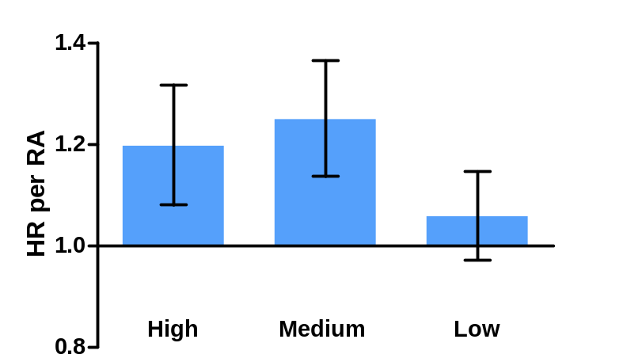
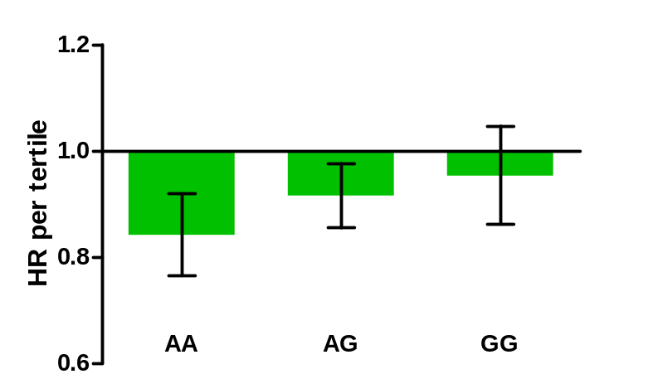
Interaction between Chr9p rs4977574
and vegetable intake on CVD
P_{interaktion} = 0.034
ref
P=0.20
P=0.000002
P=0.001
P=0.0002
P=0.008
P=0.30

Slide 31
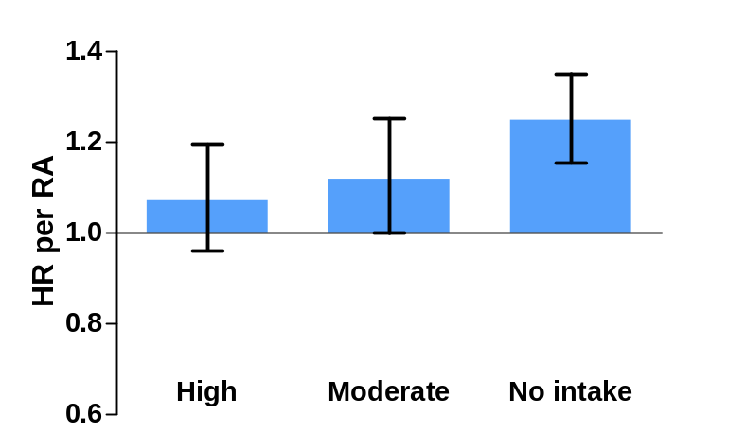
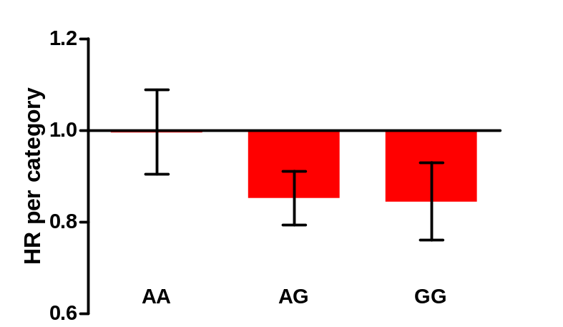
Interaction between Chr9p rs4977574
and wine intake on CVD
P_{interaction} = 0.017
HR
P=3.4 ×10⁻⁸
ref
P=0.051
P=0.22
P=0.87
P=3.9 ×10⁻⁶
P=0.001

Slide 32
Conclusions 3
Our results indicate that the Chr9p21 risk variant interacts with several environmental factors on the risk of CVD
Chr9p21 risk variant had significantly higher risk increase for CVD among individuals who:
    Never smoke
    Have a high intake of vedgetables
    Never drink wine

Slide 33
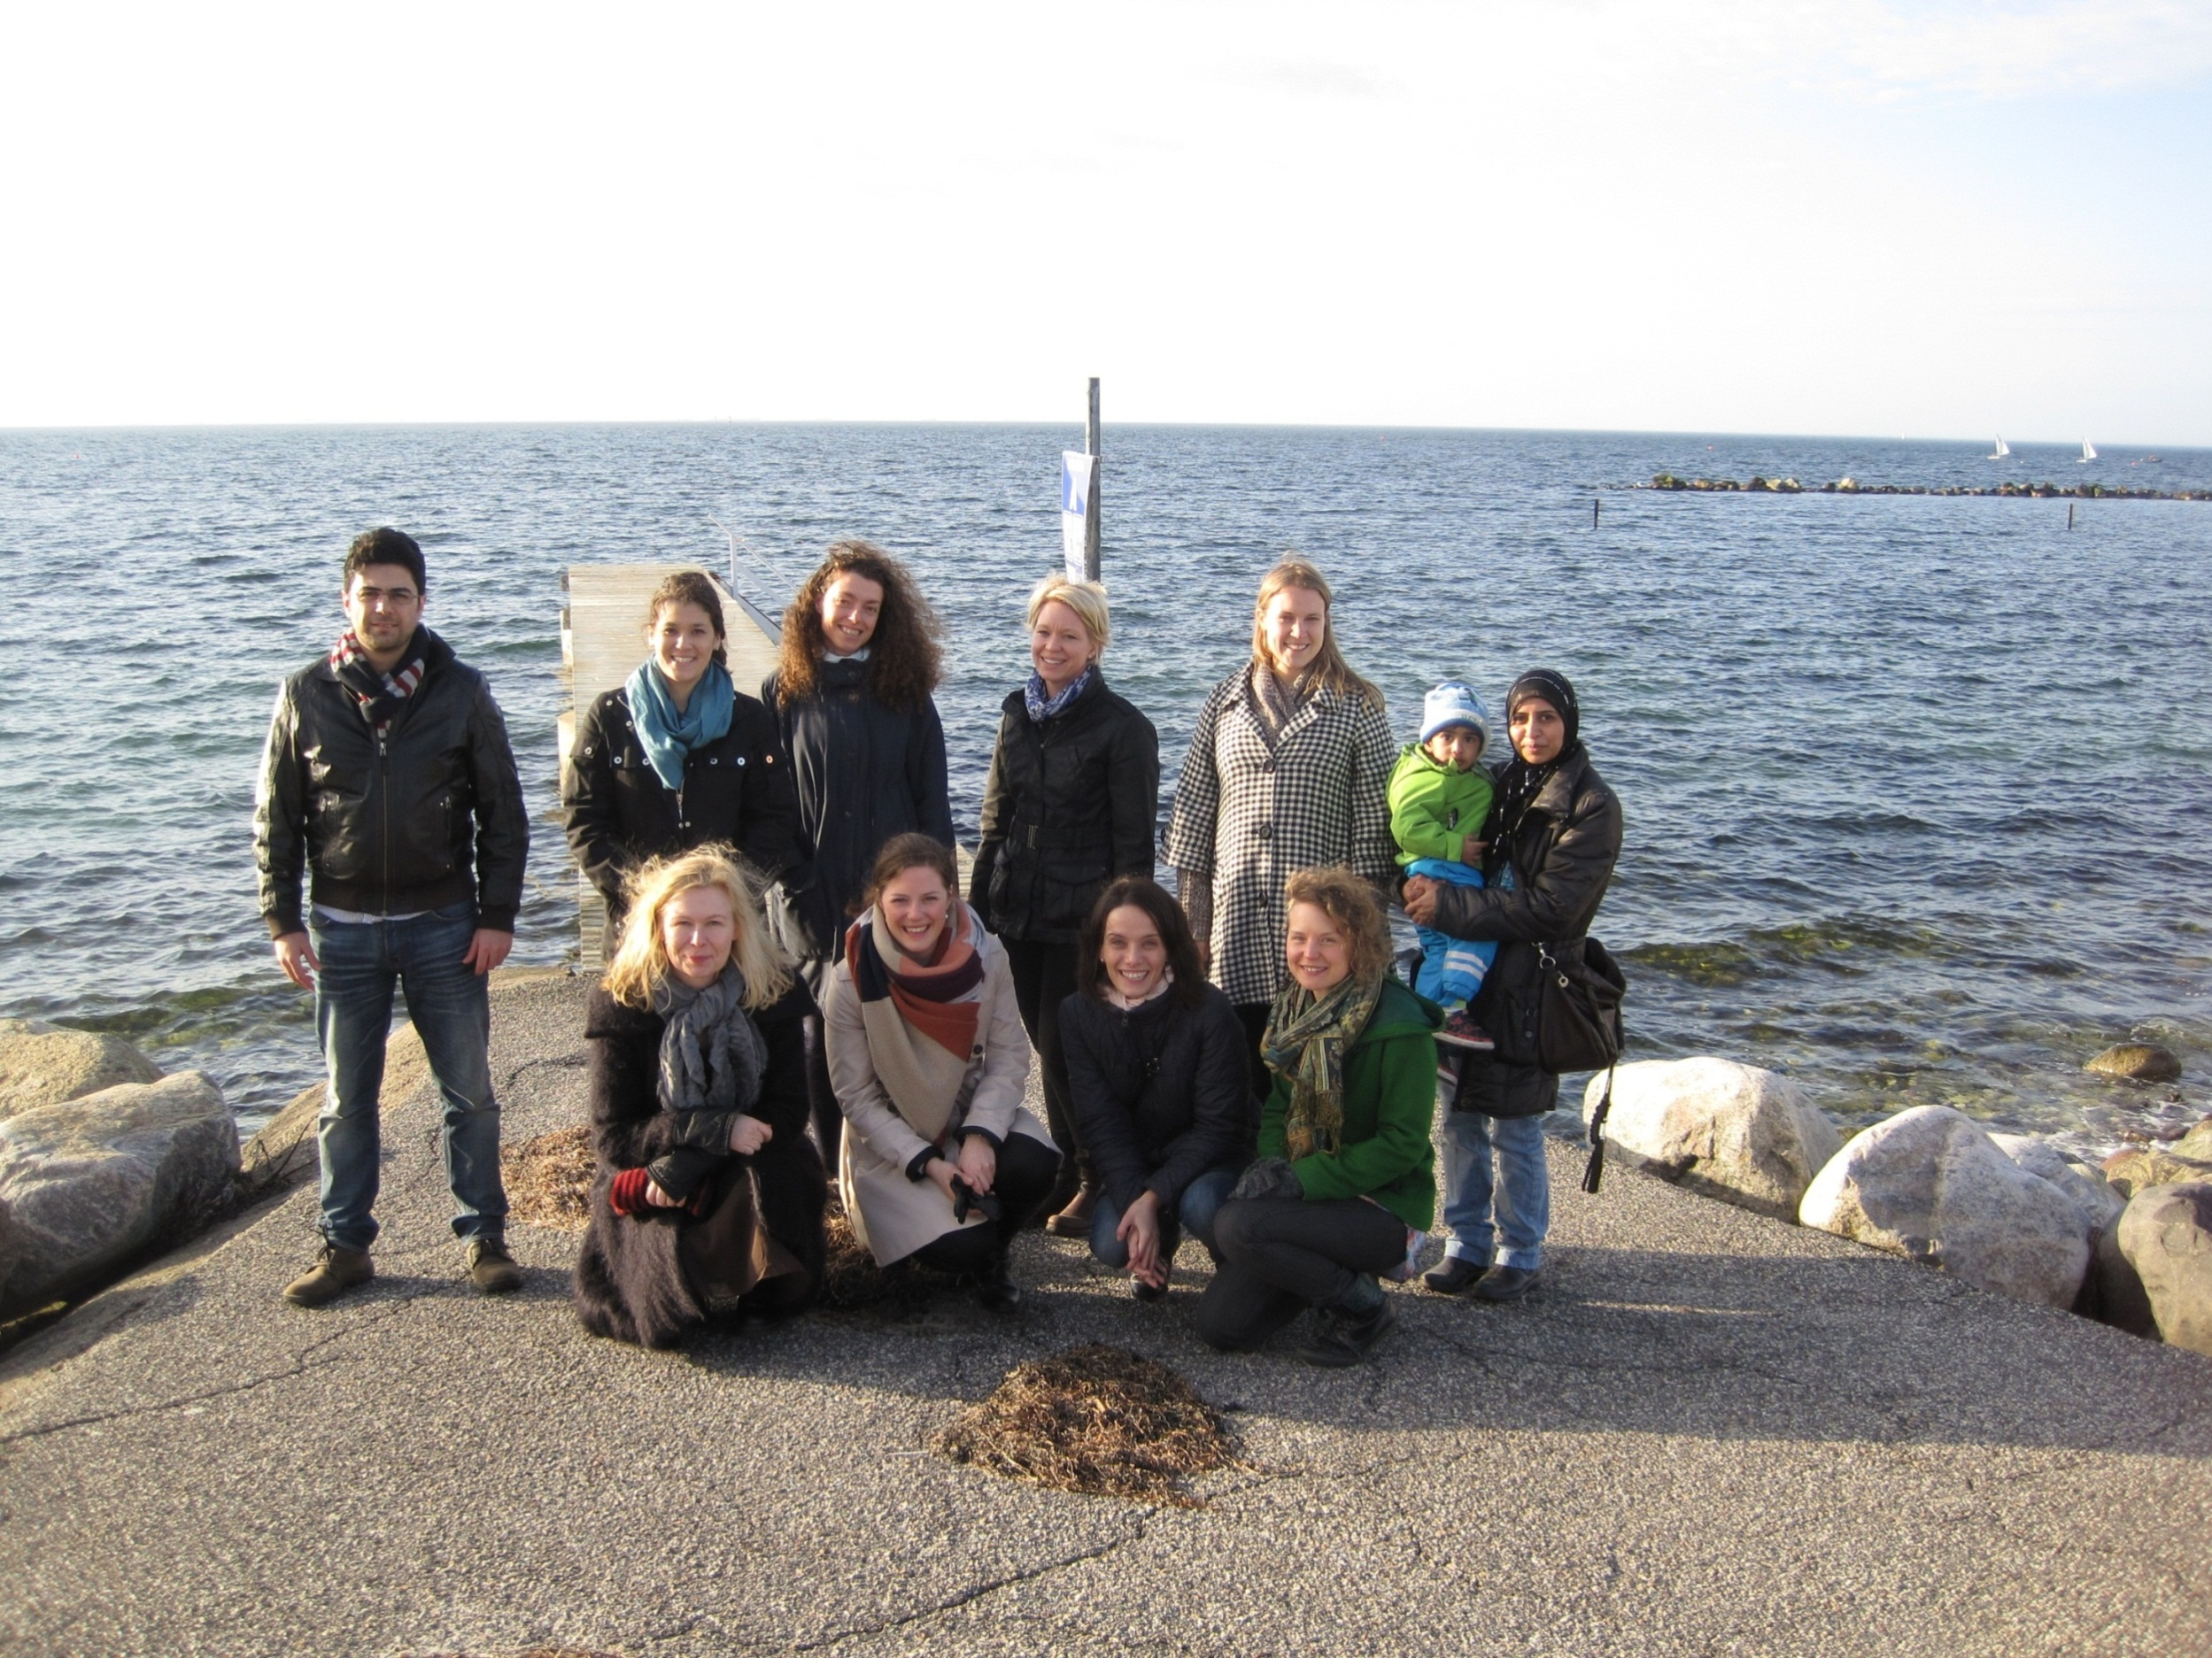
Diabetes and CVD– genetic epidemiology
Marju Orho-Melander, professor
Emily Sonestedt, post doc
Ulrica Ericson, postdoc
Ricardo Almond, MD, post doc
Malin Svensson, lab engineer
Sophie Hellstrand, PhD student
George Hindy, PhD student
Gull Rukh, PhD student
Ivana Stojkovic, PhD student
Louise Brunkwall, student
Christina Schulz, student
Jeanette Nilsson, student
Ines Mollet, post doc (with Lena E)
Helena Malm, PhD student (with Lena E)
Olle Melander group
Widet Tas
Viktor Hamrefors
Peter Almgren
Elisabet Wirfelt group
Anders Bergman

Slide 34
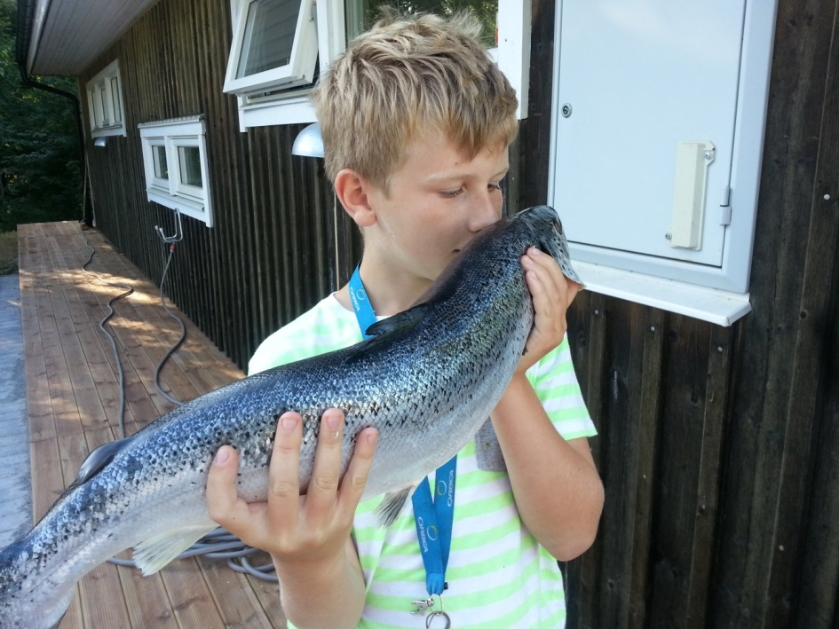

Thank
You!

