Slide 1
Genetics of acute infarct lesions
Natalia S. Rost, MD, MPH
ISGC Workshop - Paris, France
November 7th 2014

Slide 2
Number of DWI sequences by site
n=2847

Slide 3
Acute infarcts on DWI
Of great interest to clinical & research community
Specific focus of the MRI-GENIE grant
Specific interest in joint modeling
  size & location,
  size & stroke subtype,
  MRI-based traits only,
  MRI vs. clinical outcome, etc
Multiple methods currently available and coming down the pipeline

Slide 4
Aim 2: MRI-GENIE MRI traits
DWI:
  acute infarct location (hemisphere, vascular territory, cortical, subcortical, watershed)
  single vs. multiple acute infarct lesions
  MRI-based stroke subtypes (e.g., single symptomatic lacune)
T2 FLAIR:
  evidence of subacute/chronic infarcts/SBI
  SVD subtypes
  WMH severity grade scored on Fazekas scale
GRE/SWI:
  CMB count
  CMB location (lobar vs. deep)
  macrohemorrhages, including hemorrhagic infarct transformation
MRA:
  level of arterial occlusion (MCA, ACA, PCA 1/2/3; VA or BA; or small/penetrator vessel)
  leptomeningeal collaterals grade*
  evidence of significant extracranial or intracranial large artery stenosis

Slide 5
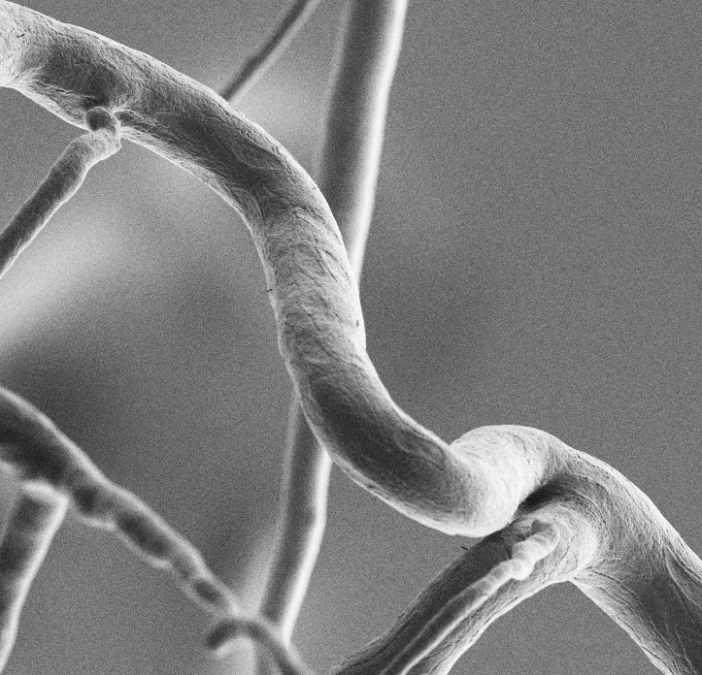
The Collateral Circulation:
Genetic Determinants and Biomarkers
SEM corrosion cast of a mouse cerebral collateral
nucleus of
endothelial cell
James Faber
Department of Cell Biology and Physiology, UNC-Chapel Hill

Slide 6

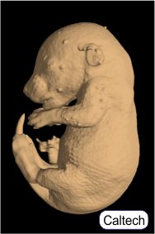
Faber lab’s focus:
genetic
factors
collateral
rarefaction
environmental
factors
collaterogenesis
native collateral
circulation
chronic
obstruction
acute
obstruction
neo-collateral
formation
chronic
obstruction
collateral
recruitment
collateral
remodeling
Faber et al ATVB 2014
Notes:
Cener vignette shows 3 native, pre-existing (ie, in healthy tissue, before occlusive disease) collaterals cross connecting the distal most arterioles of adjacent arterial trees. Arrows depict absence of net flow in the collaterals…when there is no obstruction. Collateral recruitment shows that flow across the col network occurs with acute obstruction.
Animal studies of the collateral circulation has focused for many years on collateral remodeling (anatomic enlargement of lumen diameter after blockade of one of the trees; requires days to weeks to reach maximum→ 2-10 fold increase in diameter) – the biology of the process, that some cardiovasvular risk factors impair it and how, and how to augment it. The larger black arrows depict the great flow that then can occur across the collaterals.
Faber lab’s research has brought attention to the four other areas shown – that the native, pre-existing collateral circulation varies with differences in genetic background and presence of certain environmental factors (eg, CV risk factors, age), the mechanisms underlying both, when and how collaterals form in the first place – we’ve found this occurs late in gestation (and termed it collaterogenesis), and that new collaterals can form de novo in adults animals with AIS and acute MI – with significant functional impact (we’ve termed this process neo-collateral formation).

Slide 7
Candidate genes in Dce1 → 85% of variability
None is an “angiogenic” gene!
111 genetic elements (737 Kb):
- 28 protein-coding genes
- 2 miRtrons (miRNAs at intron splice junctions)
- 52 long noncoding RNAs
many consensus reg motifs
27 SNPs (BC = AKR; ≠ B6, etc)
Atxn2l *
Eif3c *
Cln * ^{Cn}
Apobr
IL27
Nupr1
Ccdc101 *
Sulta1
Giyd2 *
Slx1b
bola-like 2k
Coro1a
X
Gsg1L
Xpo6 *
SH3 binding kinase 1
Lat
Spns1
Nfatc2ip **
Cd19 antigen
Rabep2 * ^{Cn}
Atp2a1
Sh2b1
LOC100861803
Tufm
Mapk3
Gdpd3
Ypel3
Tbx6 ** ^{Cn,SS}
Ppp4c
Aldoa
Fam57b
4930451I11Rik
Doc2a
Ino80e **
Hirip3 ? ^{Cn}
X
** Cn+del=FS
Maz
COD^{+/-}
X
∗,∗∗ diff expressed Cn, coding SNP del, deletion FS, frame shift
In progress: - CRISPR/Cas9 nuclease RNA-guided genome editing
- Introgression of SNP-dense region (BAC)
- In-utero knock down with siRNAs
- expression analysis in congenics
Sealock et al 2014
Lucitti et al unpublished
Notes:
We’ve named the locus “Determinant of collateral extent-1”. The slide shows the protein coding genes contained therein. And the steps we are taking to identify the causal locus are the word bullets at the bottom of the slide. The red Xs indicate knock out mice or a spontaneous deletion mutant mouse (COD) that we’ve phenotyped – finding no effect on collateral number or diameter in brain or hindlimb, thus indicating the bordered genes are not the causal one.
Bacterial artificial chromosome (BAC) method. We hope to have the gene soon, if it is a protein coding gene. Otherwise, on to the other genetic elements in the interval.
Dce1 is contiguous on Chr 16 in human. Same protein coding genes are present in the human locus.

Slide 8
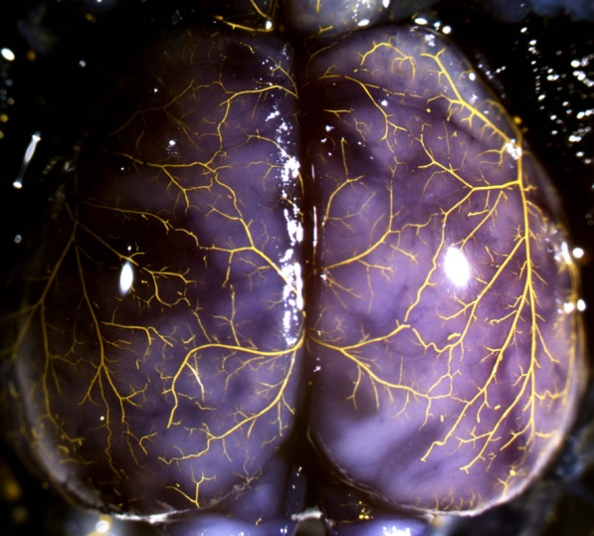
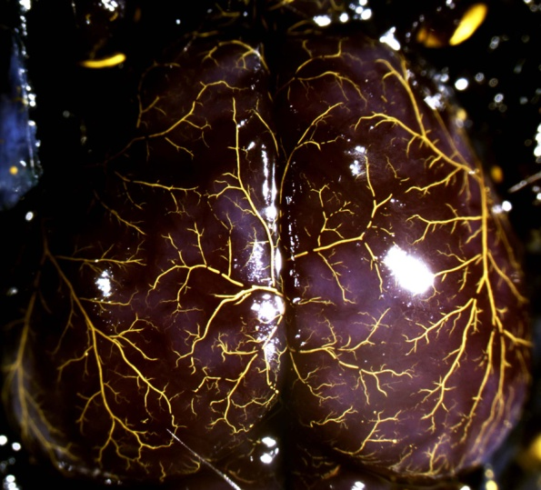
homo B6-like
homo BC-like
*
*
*
*
*
*
*
*
*
*
*
*
*
*
*
*
*
*
*
*
H_{o}: Dce1…
harbors a major driver locus for the collaterogenesis pathway
is a risk allele for collateral deficiency in brain and other tissues
↓46%
**
↓79%
***
Same locus in humans? (Chr 16)
almost a single gene disorder in mice. → good chance.
pathways for embryonic vascular development highly conserved.
GENEtic Determinants of Collateral Status in Stroke (GENEDCSS)
Patients with acute MCA stroke
(10 stroke centers)
SNP association mapping across human Dce1 and related genes.
→ COL status, stroke severity, function outcome.
#
Faber et al ISC 2014
Notes:
The pictures at the top show a congenic Balb mouse (BC-like) that is homozygous BALB for the Dce1 allele as well as balb everywhere else in the genome (in other words, essentially a wild-type Balb mous). It has only one collateral (and it is 50% smaller in diameter that C57 average diameter of collaterals). The other is a Balb mouse ~everywhere in the genome except at Dce1 where it is homozygous for the C57 (“B6”) allele of Dce1. This “introgression” restores 85% of the collateral number and average collateral diameter that is seen in the B6 wild type strain. These congenic strains have been back-crossed to Balb 10 generations, so essentially “pure” balb except at the Dce1 locus.
The two word bullets are two features that make us think that variants in human Dce1 may be important in variation in collateral extent (score/status) in humans, eg as seen in AIS patients, and collateral circulation of heart and lower extremities, which are also known to vary widely among healthy pts w/o CAD and w/o PAD.
The last panel shows the prospective observational study announced at ISC14 that is just now beginning enrollment. The 10 stroke centers are centers with a particular interest in the human cerebral pial collateral circulation in stroke patients, and that obtain collateral status during sub-acute stage workup as standard of care. They are in US, Canada, Barcelona and U Newcastle Australia. I am seeking to recruit more centers.
The study is a SNP association study across human Dce1 (and across several genes on different chromosomes that we’ve shown are part of (required) the collaterogenesis pathway). The pts are M1/M2 complete occlusions, with no involvement of COW, CEU enthnicity. The primary endpoint is collateral score (DSI, multimodal/dynamic/perfusion CTA or MRI). Major secondary are stroke severity and outcome.

Slide 9
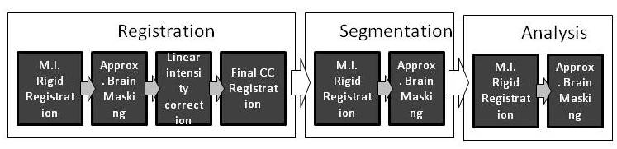
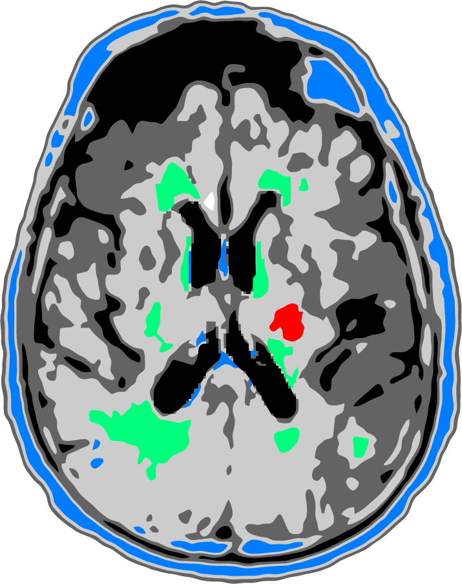
Volumetric MRI analysis: full pipeline
  WMH
  Other hyperintensities
  Acute stroke

