Slide 1

Rare Genetic Disorders in Young Stroke
Guillaume Paré MD
ISGC Workshop November 7th 2014

Slide 2
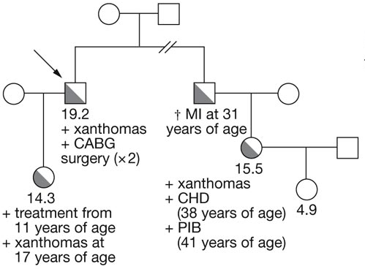
Background
Mendelian diseases
  Stroke
    CADASIL
    Fabry’s Disease
Previous Studies
  Case-only
  Single Ethnicity
  Single gene
Familial Hypercholestorolemia

Slide 3
Hypothesis
Rare mutations in Mendelian stroke genes are important risk factors for young stroke

Slide 4
Objectives
Determine which genes, if any, should be screened in young stroke patients
Characterize the prevalence, risk, and clinical features of Mendelian stroke mutations

Slide 5
INTERSTROKE-Genetics
Youngest cases (N=185)
Oldest controls (N=185)
  Gender, ethnicity, and center ID
  Minimal hypertension and diabetes
Small-vessel etiology
  ICH (N=100)
  SVIS (N=85)

Slide 6
Study Characteristics
 | SVIS | ICH | Case | Control
N | 85 | 100 | 185 | 185
Women | 36 (42.4%) | 47 (47%) | 83 (44.9%) | 83 (44.9%)
Age (SD) | 50.1 (9.79) | 45.6 (12.55) | 47.6 (11.55) | 74.0 (8.36)
Hypertension | 46 (54.12%) | 49 (49%) | 95 (51.35%) | 106 (57.30%)
Diabetes | 23 (27.06%) | 12 (12%) | 35 (18.92%) | 27 (14.59%)
Current Smoker | 31 (36.47%) | 21 (21%) | 52 (28.11%) | 17 (9.19%)
BMI (SD) | 26.9 (4.88) | 27.7 (5.51) | 27.3 (5.23) | 26.1 (4.83)
APOB/APOA (SD) | 0.90 (0.29) | 0.87 (0.28) | 0.88 (0.28) | 0.80 (0.31)

Slide 7
Ethnic Distribution

Slide 8
Methods
Gene | Disease | Mode of Inheritance
APP | Amyloid Angiopathies | Dominant
CST3 | Amyloid Angiopathies | Dominant
CECR1 | Early-onset stroke and cerebral vasculopathy | Recessive
COL4A1 | Porencephaly / ICH | Dominant
COL4A2 | Porencephaly / ICH | Dominant
GLA | Fabry’s Disease | Recessive
HTRA1 | CARASIL | Recessive
NOTCH3 | CADASIL | Dominant
SAMHD1 | Early-onset stroke and cerebral vasculopathy | Recessive
TREX1 | RVCL | Dominant
Screened 10 known Mendelian Stroke Genes
Gene-based Analysis
  Rare & Pathogenic Mutations

Slide 9
Results
Gene |  | SVIS Case | SVIS Control | SVIS P |  | ICH Case | ICH Control | ICH P |  | ALL Case | ALL Control | ALL P
APP |  | 2 | 2 | 1 |  | 1 | 1 | 1 |  | 3 | 3 | 1
CECR1 |  | 0 | 0 | 1 |  | 2 | 1 | 1 |  | 2 | 1 | 1
COL4A1 |  | 2 | 3 | 1 |  | 5 | 0 | 0.06 |  | 7 | 3 | 0.33
COL4A2 |  | 12 | 12 | 1 |  | 11 | 9 | 0.81 |  | 23 | 21 | 0.87
CST3 |  | 0 | 0 | 1 |  | 0 | 0 | 1 |  | 0 | 0 | 1
GLA |  | 0 | 0 | 1 |  | 0 | 2 | 0.50 |  | 0 | 2 | 0.50
HTRA1 |  | 0 | 0 | 1 |  | 1 | 0 | 1 |  | 1 | 0 | 1
NOTCH3 |  | 7 | 8 | 1 |  | 22 | 8 | 0.009 |  | 29 | 16 | 0.06
SAMHD1 |  | 0 | 0 | 1 |  | 0 | 0 | 1 |  | 0 | 0 | 1
TREX1 |  | 0 | 1 | 1 |  | 1 | 0 | 1 |  | 1 | 1 | 1
Total |  | 23 | 26 | 0.74 |  | 43 | 21 | 0.001 |  | 66 | 47 | 0.04
Experiment-wide significance for NOTCH3 (P=0.012)
OR_{ICH}=3.23; 95% CI: 1.29 to 8.87; P=0.009

Slide 10
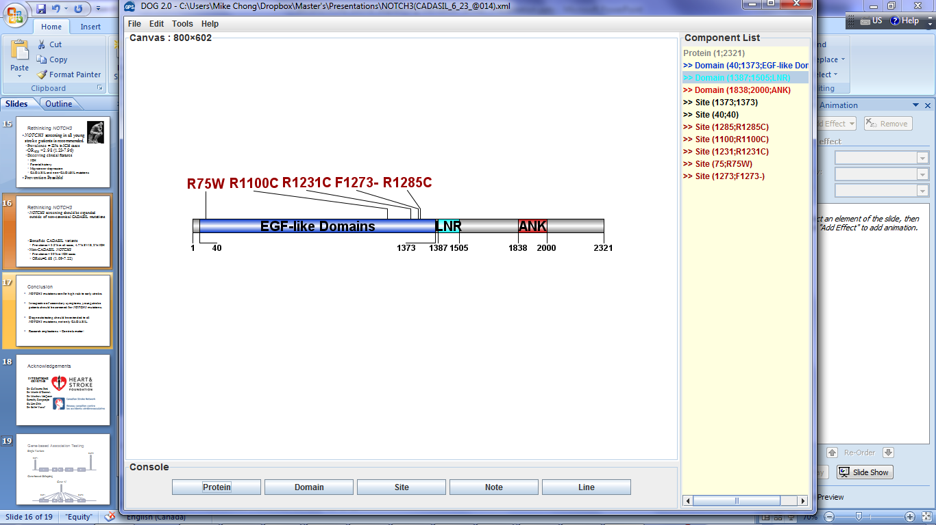
NOTCH3 & CADASIL
Primary Feature
  SVIS/TIA in ~80% CADASIL carriers
Secondary Features
  Migraine in 75%
  Depression in 35%
Unique Mutation Spectrum
  Stereotypical mutation pattern
  Diagnostic Testing confined to specific domains

Slide 11
NOTCH3 CADASIL Mutation Carriers
Variant | Stroke Type | Ethnicity | Migraine | Depression
R1285C | SVIS | Persian | NO | NO
R1231C | SVIS | Persian | NO | YES
R1231C | ICH | Persian | NO | NO
R1100C | ICH | African | NO | NO
R75W | ICH | African | NO | NO
F1273- | SVIS | European | NO | NO
  All stroke: 3.2%, None in controls (P=0.03)
    SVIS: 3.5%, ICH: 3 %
  Non-CADASIL mutations mostly explain association

Slide 12
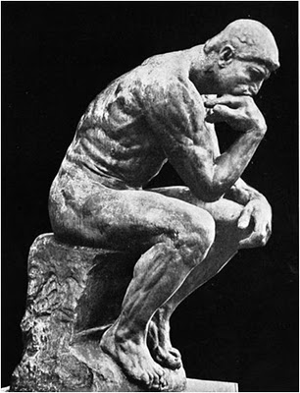
Rethinking NOTCH3
Screening warranted for young stroke?
  High Risk: OR_{ICH}=3.23(1.29 to 8.87) (P=0.009)
  Common: 22% ICH cases, 8% Controls
  Absence of measured
  clinical features
  Treatment potential
ICH as a primary feature?
Implications for prevention,
anticoagulant use and cognitive decline

Slide 13
Conclusion
NOTCH3 mutations are common and significant risk factors for early stroke
NOTCH3 screening suggested in young stroke
irrespective of presentation
Diagnostic testing should be extended beyond CADASIL

Slide 14
Conclusion
No gene other than NOTCH3 associated but suggestive association with COL4A1 for ICH
Penetrance lower than previously assumed for most genes, even for known disease-causing mutations
Research implications - Controls matter!

Slide 15


Acknowledgements
INTERSTROKE
GENETICS
Dr. Martin O’Donnell
Michael Chong
Dr. Matthew McQueen
Sumathy Rangarajan
Siu Lim Chin
Dr. Salim Yusuf

