Slide 1

Associations of common variation in COL4A1 / COL4A2 with cerebral small vessel disease
Kristiina Rannikmäe
University of Edinburgh

Slide 2
Background
COL4A1 & COL4A2 encode collagen IV α1 and α2 chains – basement membrane components
In blood vessels, basement membrane separates smooth muscle from endothelium
Rare COL4A1 & COL4A2 mutations cause hereditary disorders, including autosomal dominant cerebral small vessel disease (SVD)

Slide 3
Collagen IV genes
& inherited cerebrovascular disease
COL4A1:
  Imaging phenotype: deep ICHs & BMBs, lacunar infarcts, WMHs
Clinical phenotype:
  Perinatal haemorrhage with porencephaly
  SVD with infantile- or adult-onset haemorrhage
  SVD with Axenfeld-Rieger anomaly
  HANAC syndrome (hereditary angiopathy with nephropathy, aneurysms, and muscle cramps)
COL4A2: similar phenotypes
Notes:
4 major phenotypes with overlapping features. Age of onset perinatal to 50s
Axenfeld-Rieger anomaly: variable degrees of retinal arterial tortuosity, cataracts, glaucoma, anterior segment dysgenesis of the eye.
Further data needed to assess genotype – phenotype correlations
HANAC: nephropathy, aneurysms, muscle cramps, arrythmia

Slide 4
Aim
Some genes causing hereditary disorders are also associated with risk of sporadic disease
We aimed to test the hypothesis that single nucleotide polymorphisms (SNPs) in COL4A1 and COL4A2 are associated with sporadic cerebrovascular disease, especially cerebral SVD:
      Deep intracerebral haemorrhage (ICH)
      Lacunar ischaemic stroke
      White matter hyperintensities (WMHs)

Slide 5
Methods
We collected existing GWAS data on common SNPs in COL4A1 / COL4A2 from European-origin cohorts with:
    ICH and subtypes (deep and lobar)
    Ischaemic stroke and subtypes (TOAST)
    WMHs in ischaemic stroke & general population
We performed meta-analyses to assess the association between SNPs and these cerebrovascular disease phenotypes

Slide 6
Methods
Phenotype | Cohorts | Subjects
ICH | 3 | 1545 cases + 1485 controls
Ischaemic stroke | 15 | 12389 cases + 62004 controls
WMH | 7 | 9361 in population-based studies
 | 9 | 2733 ischaemic stroke cases
p value for significant association < 0.00008, accounting for multiple testing (1070 SNPs) and linkage disequilibrium

Slide 7
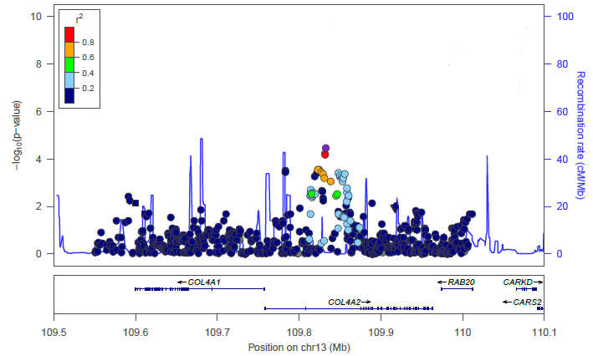
Results
3 SNPs in COL4A2 significantly associated with deep ICH
rs9521732
rs9521733
rs9515199
Consistent across included cohorts with no heterogeneity
Notes:
Regional association plot for deep ICH meta-analysis: Dots mark individual SNPs; y-axis: p-value for association between each SNP and deep ICH; x-axis: position of SNPs

Slide 8
No significant associations at p<0.00008 with other phenotypes
Results
rs9521732 (C=>A)
Odds ratio (95% CI)
all ICH
1.17 (1.05, 1.29)
p=0.00286
deep ICH
1.28 (1.13, 1.44)
p=0.00007
lobar ICH
1.05 (0.92, 1.20)
p=0.4722
all IS
1.03 (0.99, 1.06)
p=0.1057
CE IS
1.02 (0.96, 1.09)
p=0.4925
LVD IS
0.95 (0.89, 1.02)
p=0.1889
lacunar IS
1.09 (1.02, 1.17)
p=0.01639
WMH ischaemic stroke
1.07 (1.01, 1.14)
p=0.01442
WMH population
1.01 (0.99, 1.04)
p=0.2685
0.5
1
2

Slide 9
But same direction of effect with other SVD phenotypes
Results
rs9521732 (C=>A)
Odds ratio (95% CI)
all ICH
1.17 (1.05, 1.29)
p=0.00286
deep ICH
1.28 (1.13, 1.44)
p=0.00007
lobar ICH
1.05 (0.92, 1.20)
p=0.4722
all IS
1.03 (0.99, 1.06)
p=0.1057
CE IS
1.02 (0.96, 1.09)
p=0.4925
LVD IS
0.95 (0.89, 1.02)
p=0.1889
lacunar IS
1.09 (1.02, 1.17)
p=0.01639
WMH ischaemic stroke
1.07 (1.01, 1.14)
p=0.01442
WMH population
1.01 (0.99, 1.04)
p=0.2685
0.5
1
2

Slide 10
Conclusions
We report an association between common variation in COL4A2 and common cerebral SVD, particularly deep ICH
These results merit confirmation in replication studies
Importance:
Consistent signals with a SVD phenotype support the hypothesis of a common underlying pathology
Associations of even modest effect sizes may improve understanding of pathophysiological mechanisms and eventually lead to novel treatment targets

Slide 11
Ongoing work
Replicate COL4A2 analysis results in different cohorts
Include BMBs (deep vs lobar) and silent brain infarcts (subcortical) as additional phenotypes in the analysis
Extend approach to NOTCH3, HTRA1, TREX1 and CECR1 genes which also cause rare familial forms of SVD

Slide 12
Acknowledgements
Edinburgh
Prof. Cathie Sudlow
Dr. Gail Davies
Dr. Pippa Thomson
Glasgow
Dr. Tom Van Agtmael
Cambridge
Prof. Hugh Markus
Dr. Steve Bevan
Dr. Matthew Traylor
  Boston
  Prof. Jonathan Rosand
  Dr. Guido Falcone
  Dr. Christopher Anderson
  Dr. Natalia Rost
  Dr. Billy Devan
  Prof. Sudha Seshadri
  International Consortia
  METASTROKE Consortium
  CHARGE Consortium
  WTCCC-2 Consortium,
  ISGC Consortium
This research was supported by the Edinburgh Lothian Health Foundation & European Social Fund’s Doctoral Studies and Internationalisation Programme DoRa, which is carried out by Foundation Archimedes.
Notes:
.

