Slide 1
Machine Learning for Stroke GWAS
Opportunities and Challenges
Lawrence Wee, Ph.D.
Principal Investigator
Genome Analysis and Systems Biology
Institute for Infocomm Research
jklwee@i2r.a-star.edu.sg

Slide 2

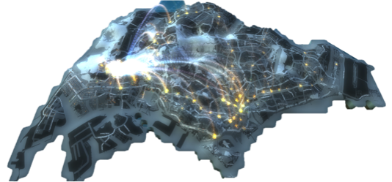
Singapore’s Largest
Infocomm Research Institute
600 Scientists
5546
Research Publications
1255
Technology
Disclosures
223 Patents
12
1st in International Benchmarking Competitions
18 Contributions to Industry Standards
681 Industry Collaborations

Slide 3
Our Editors and IEEE/IET Fellows
INTELLIGENCE
Dr. Guan Cun Tai
Associate Editor, IEEE Transactions on Biomedical Engineering,
Associate Editor, Frontiers in Neuroprosthetics,
Associate Editor, IEEE Access (Life Sciences & Biomedical Engineering)
Dr. Li Haizhou
IEEE Fellow for leadership in multilingual speaker and language recognition
Associate Editor, IEEE Transactions on Audio, Speech & Language Processing,
Associate Editor, ACM Transactions on Speech & Language Processing,
Associate Editor, Springer International Journal of Social Robotics,
Guest Editor, Proceedings of the IEEE,
Member, IEEE Speech and Language Technical Committee,
Senior Editor, IEEE/ACM Transactions on Audio, Speech and Language Processing
Dr. Tang Huajin
Associate Editor, IEEE Transactions on Neural Networks & Learning Systems
Dr. Zhou Jianying
Associate Editor, IEEE Transactions on Information Forensics & Security
Dr. Su Jian
Action Editor, Transactions of Association for Computational Linguistics
COMMUNICATIONS
Dr. Chen Zhining
IEEE Fellow for contributions to small & broadband antennas for wireless applications,
Associate Editor, IEEE Transactions on Antennas and Propagation (T-AP)
Dr. Liang Ying Chang
IEEE Fellow for contributions to cognitive radio communications,
Editor-in-Chief, IEEE Journal on Selected Areas in Communications – Cognitive Radio Series,
Editorial Board Member, IEEE Signal Processing Magazine
Dr. Tee Keng Peng
Associate Editor, IEEE Control Systems Society, Conference Editorial Board
Dr. Qing Xianming
Editorial Board Member, International Journal of Microwave & Wireless Technologies
Dr. Sun Sumei
Associate Editor, IEEE Transactions on Vehicular Technology,
Editor, IEEE Wireless Communications Letters
Dr. Pramod Kumar Meher
Associate Editor, IEEE Transactions on Circuits and Systems-I: Regular Papers,
Associate Editor, IEEE Transactions on VLSI Systems
Dr. Nasimuddin
Editorial Board Member, Open Journal of Antennas and Propagation (OJAPr)
Dr. Yu Changyuan
Editorial Board Member, Photonic Network Communications Journal
MEDIA
Dr. Tham Jo Yew
Associate Editor, IEEE Access
Dr. Yu Rongshan
IET Fellow, Electrical Engineering,
Associate Editor, IEEE Transactions on Audio, Speech & Language Processing
Associate Editor, IEEE Access online Mega-journal
Dr. Shu Haiyan
Chief Editor, for the audio part of the IEEE Standard Association
Audio Video Standard (AVS)
Dr. Yau Wei Yun
Editorial Board Member, International Journal of Biometrics

Slide 4
Paper Awards
INTELLIGENCE
“A Large Clinical Study on the Ability of Stroke Patients to Use an EEG-Based Motor Imagery Brain-Computer Interface” was ranked “Most-Read Articles during August 2013" - Journal of Clinical EEG and Neuroscience
“Privacy Preservation in Streaming Data Collection” - Parallel and Distributed Systems, IEEE International Conference 2012
“Symbian Smartphone Forensics: Linear Bitwise Data Acquisition and Fragmentation Analysis” - International Conference on Security Technology
“A Novel Rainbow Table Sorting Method” - 2nd International Conference on Technical and Legal Aspects of the e-Society 2011
COMMUNICATIONS
“Cognitive Radio: Ten Years of Experimentation and Development” - WUN CogCom Consortium 2013
“Enhancing Responsiveness and Scalability for OpenFlow Networks via Control-Message Quenching“ - International Conference on ICT Convergence 2012
“Cognitive Network Interference “ - William R. Bennett Prize 2012 from IEEE Communications Society
“A Dynamic Wavelength Allocation Capable Passive Optical Network with Shared Transceivers” - IEEE International Conference on Communications 2012
“Eigenvalue-based spectrum sensing algorithms for cognitive radio” - IEEE Transactions on Communications 2012
“Dual Grid Array Antennas in a Thin-Profile Package for Flip-Chip Interconnection to Highly Integrated 60-GHz Radios,” - Sergei A. Schelkunoff Prize Award 2012 from IEEE Transactions on Antennas and Propagation
“Bayesian spectrum sensing for digitally modulated primary signals in cognitive radio” -IEEE Vehicle Technology Conference 2011 Spring
MEDIA
“Multibiometric Template Security Using Fuzzy Vault” published in the International Conference on Biometircs: Theory, Applications and Systems (BTAS) 2008 conference won “The Most Cited BTAS Paper in 5 years” - BTAS 2013 conference
“Topic Based Query Suggestions for Video Search” - 18th International Conference on Multimedia Modeling 2011

Slide 5







International Benchmarking Competitions
2013
We ranked FIRST in:
Best Application Award (Liver Workbench) at 2013 Symposium on GPU Computing
General Electric Flight Quest Challenge Phase 1 2013
Document Image Binarization Competition & Robust Reading Competition (Text Segmentation in Real Scenes) at International Conference on Document Analysis and Recognition (ICDAR 2013)
2012
Best App for Corporate category in 2nd ITU IPTV Application Challenge 2012
Accuracy Ranking at National Institute for Standards and Technology Speaker Recognition Evaluation International Benchmarking 2012
“Consumer Segment” in the Data Mining Competition organized by 16th (PAKDD) 2012
2011
Sleepiness Sub-Challenge of INTERSPEECH 2011 Speaker State Challenge
Activity Recognition Challenge 2011 by the European Union-funded OPPORTUNITY project

Slide 6














Big Data Analytics
VOLUME
Value (Actionable Insights)
Terabytes
Transactions, Tables
Records
Files
Processing + Analytics
Big Data
Batch
Near Time
Real Time
Streams
Structured
Unstructured
Semi-structured
VELOCITY
VARIETY

Slide 7
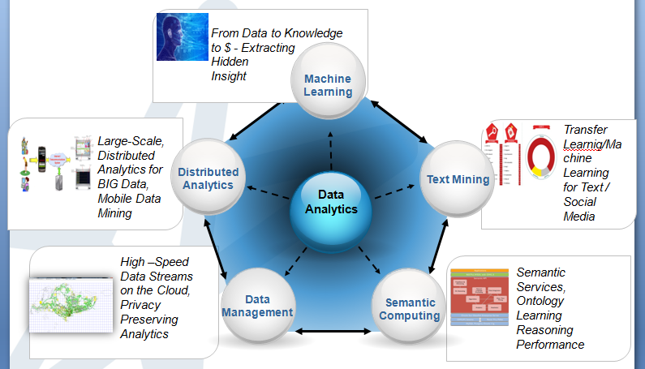
Data Analytics Department

Slide 8
















Industry Engagement
Finance &Insurance
Aerospace / Aviation
Energy and Utilities
Telecommunications
Consumer
Transportation
Social Media
Healthcare
Maritime

Slide 9
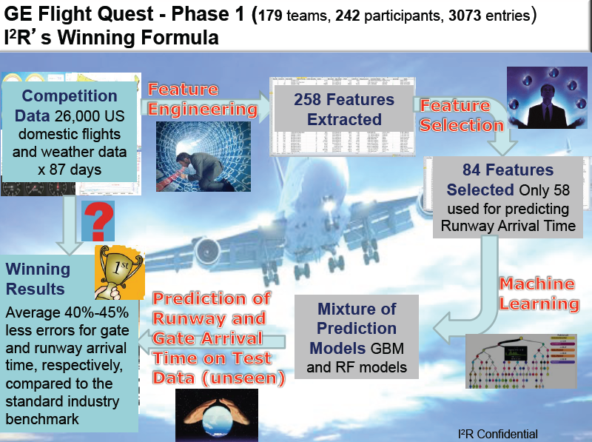

Slide 10

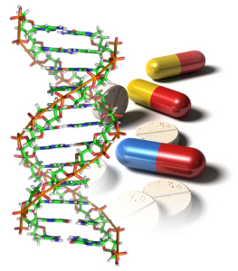
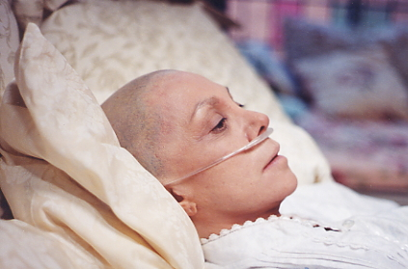
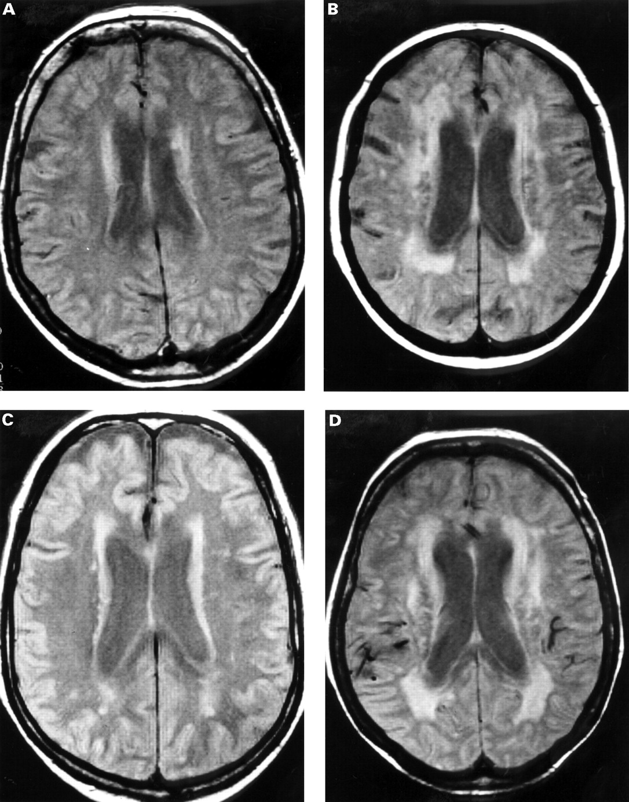


Machine Learning for Biology and Healthcare
Innovative data-driven applications for the biomedical and healthcare spectrum
Biomarker and Drug Discovery
Systems Biology
Genomic Medicine
Medical Imaging
Hospital and Patient Care
Digital Health and Wellness
Notes:
10

Slide 11

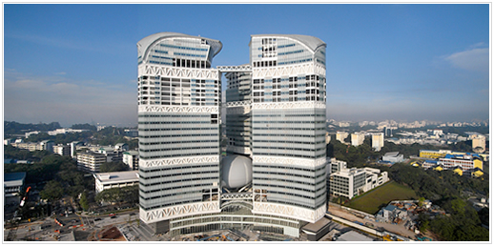
Joint operation with A*STAR
(Institute for Infocomm Research and Genome Institute Singapore)
Software Infrastructure and Knowledge Management
Healthcare Data Analysis and mobile Healthcare system
Cancer patient stratification and clinical decision making
Drug repositioning, etc.

Slide 12
The Machine Learning Process
Training Set
Machine Learning Algorithm
Learned Model
Data with unknown label
Data with predicted label (or group)
Novel dataset
Prediction

Slide 13
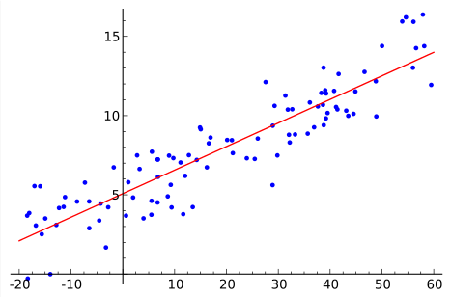
The Linear Regression

Slide 14
The Machine Learning Process
Training Set
Machine Learning Algorithm
Learned Model
Data with unknown label
Data with predicted label (or group)
Novel dataset
Prediction

Slide 15
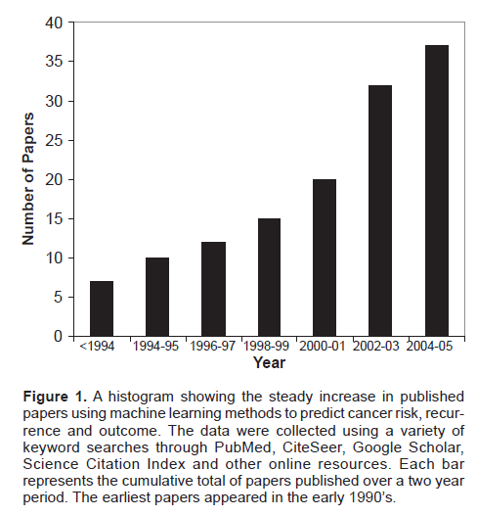
The Machine Learning Landscape
Machine learning domains
Supervised Learning
Unsupervised Learning
Semi-supervised Learning
Reinforcement Learning
Transfer Learning
Deep Learning
Many more…
Algorithms
Decision Trees
Random Forests
Neural Networks
Support Vector Machines
Gradient Boosting
Many more…

Slide 16
Machine Learning for Stroke GWAS
Why use machine learning methods?
Designed to handle complex, non-linear, multi-dimensional data.
Able to handle main and snp-snp interaction effects.
  Whole genome-wide loci and variants space
Able to handle genetic heterogeneity.
Naturally scalable for integrating diverse datasets
  diet, lifestyle, imaging etc…
Gets better with more data!

Slide 17
Machine Learning for GWAS - nascent research area
Machine Learning Method | Disease (Data Source) | Type of Analysis | References
Random Jungle | Crohn’s disease (NIDDK IBD Genetics Consortium) | Epistasis analysis | (Schwarz, Konig et al. 2010)
Random Forest Fishing | Hypertensive heart disease (Unknown/Proprietary) | Epistasis analysis | (Yang and Charles Gu 2014)
K-means Clustering with Mutual Information | Bipolar disorder, coronary artery disease, Crohn’s disease, hypertension, rheumatoid arthritis, Type 1 and 2 Diabetes (WTCCC) | Epistasis analysis | (Leem, Jeong et al. 2014)
Ant Colony Optimization | Rheumatoid arthritis (WTCCC) | Epistasis analysis | (Wang, Liu et al. 2010)
Bayesian Networks with Minimum Description Length | Late onset Alzheimer’s disease (Link Out-of-Date) http://www.tgen.org/neurogenomics/data | Epistasis analysis | (Jiang, Barmada et al. 2010)
Support Vector Machines | Type 1 Diabetes (WTCCC, CHOP, and GoKinD) | Risk Estimation/ Classification | (Wei, Wang et al. 2009)
Support Vector Machines | Parkinson’s disease (NINDS Human Genetics Resource Center), Type 1 and 2 diabetes and bipolar disorder (WTCCC) | Risk Estimation/Classification | (Mittag, Buchel et al. 2012)
Naïve Bayes Classifier | Cirrhosis (Unknown) | Risk Estimation/ Classification | (Huang, Shiffman et al. 2007)
K-Nearest Neighbours (KNN) combined with MeanDiff feature selection method | Breast Cancer (Tomorrow Project) http://www.in4tomorrow.ca/ | Risk Estimation/ Classification | (Hajiloo, Damavandi et al. 2013)

Slide 18
Machine Learning for GWAS
2 Key Objectives:
Accurate and robust quantification of individual risk for common diseases.
Deciphering the complex, multi-dimensional genetic architecture of common diseases.

Slide 19
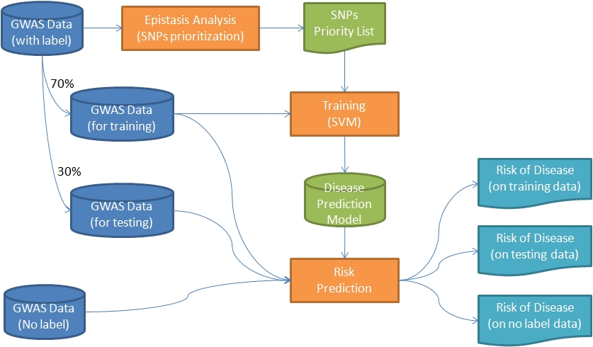
Machine Learning for GWAS
Our workflow for disease risk estimation using machine learning:
Machine Learning
Outputs/read-outs
Datasets
Type 2 diabetes (T2D) dataset
Malaysians living in Singapore: 533 cases, 1,064 controls
557,824 SNPs

Slide 20
Machine Learning for GWAS
Our workflow for disease risk estimation using machine learning:
Identify key SNPs
Machine Learning
Outputs/read-outs
Datasets
Type 2 diabetes (T2D) dataset
Malaysians living in Singapore: 533 cases, 1,064 controls
557,824 SNPs

Slide 21
Machine Learning for GWAS
Our workflow for disease risk estimation using machine learning:
Build prediction model
Machine Learning
Outputs/read-outs
Datasets
80-90% accuracy (400-10,000 SNPs)
Type 2 diabetes (T2D) dataset
Malaysians living in Singapore: 533 cases, 1,064 controls
557,824 SNPs

Slide 22
Machine Learning for GWAS
Our workflow for disease risk estimation using machine learning:
Machine Learning
Outputs/read-outs
Datasets
Prediction and classification of unknown
Type 2 diabetes (T2D) dataset
Malaysians living in Singapore: 533 cases, 1,064 controls
557,824 SNPs

Slide 23
Lawrence Wee, Ph.D.
Principal Investigator
Genome Analysis and Systems Biology
jklwee@i2r.a-star.edu.sg
Team:
Srinath Sridharan, Ph.D
Mathematical modeling, non-linear dynamics
Nanying Liang, Ph.D.
Machine learning, computational genomics
Yongli Hu, Ph.D.
Machine learning, computational genomics
James Mah, MBBS
Medical liaison, vital signs analysis,
cardiovascular disorders
Collaborators:
National University of Singapore
Duke-NUS
Massachusetts General Hospital
Harvard Medical School, MIT
National Cancer Center
Singapore General Hospital
National University Hospital
Systems Biology Institute (Tokyo)
Singapore Institute for Clinical Sciences
Genome Institute of Singapore
Nestle
Procter & Gamble

Slide 24
Collaboration
Data analysis using machine learning and systems biology methods. Disease risk estimation? Gene and functional networks? Heterogeneous datasets (imaging, genetics, vital signs etc)?
Interest for stroke GWAS research in Singapore. New cohorts, new studies?

Slide 25
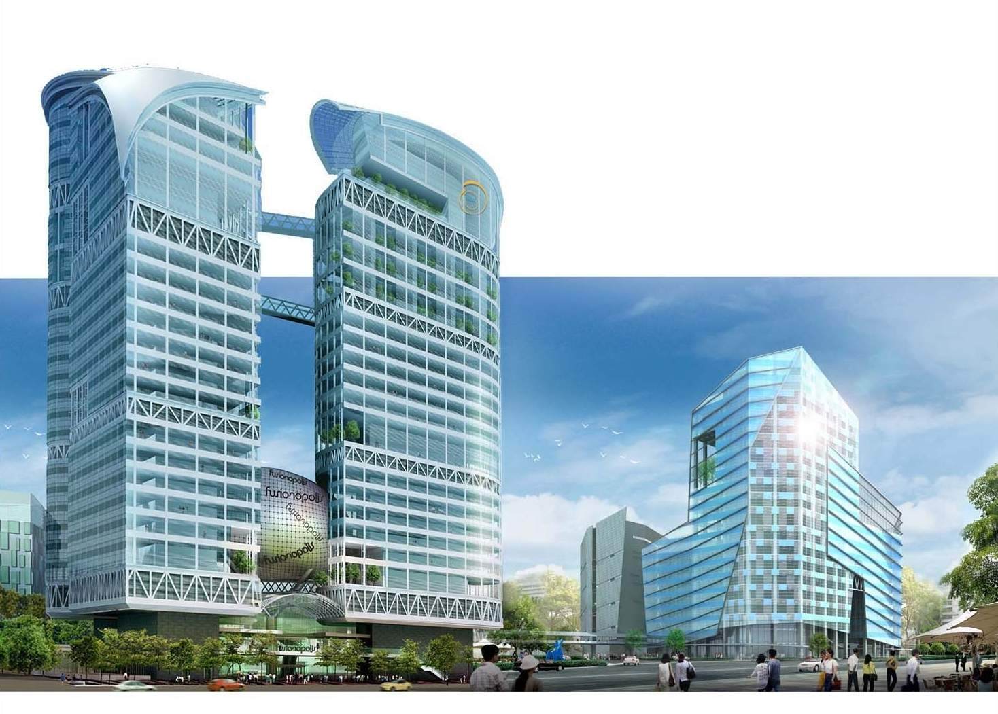
Lawrence Wee, Ph.D.
Principal Investigator
jklwee@i2r.a-star.edu.sg

