Slide 1





DNA methylation & cardiovascular phenotypes
16th Workshop of the International Stroke Genetics Consortium
Friday November 7, 2014
Trégouët David – david.tregouet@upmc.fr

Slide 2
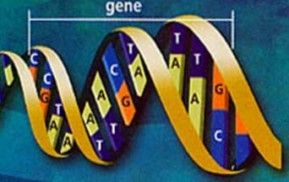
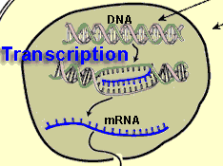
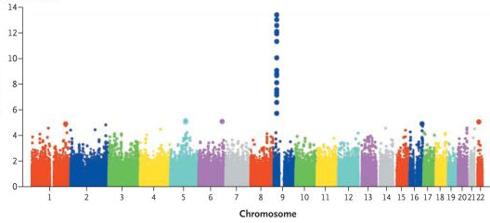
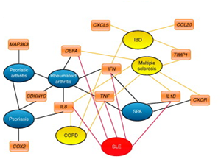
Identification of new genes/pathways of predisposition to common cardiovascular diseases by use of genome-wide approaches
DNA sequence
variability
RNA expression
variability
GWAS
GWES
eQTL studies
To increase power for detecting associations
To provide starting elements about the likely functional mechanisms
? Missing variability

Slide 3
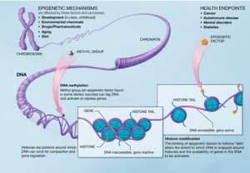
Identification of new genes/pathways of predisposition to common cardiovascular diseases by use of genome-wide approaches
DNA sequence
variability
RNA expression
variability
GWAS
EWAS
GWES
Epigenetics
eg DNA methylation

Slide 4
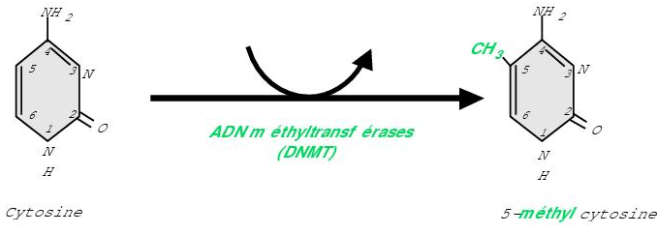
DNA methylation
Heritable attachment of a methyl group to a nucleotide.
The most common form of DNA methylation is that which occurs at the 5’ carbon of cytosine, creating 5-methylcytosine.
5’ carbon methylation of cytosine occurs at CpG dinucleotides
often found in CpG islands that are located within the promoter region or first exon of genes, or upstream from genes within CpG shores or shelves
DNA methylation is involved in transcriptional gene regulation, alternative promoter usage, splicing
DNA methylation is generally a cell-specific mechanism but can be measured in body fluids (distorted mirror effect)

Slide 5
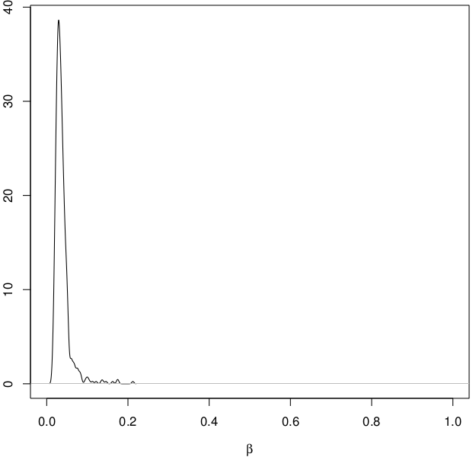
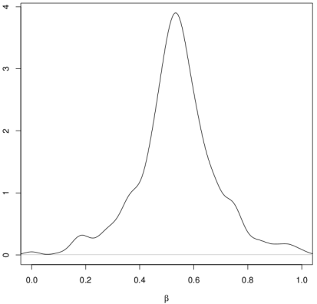
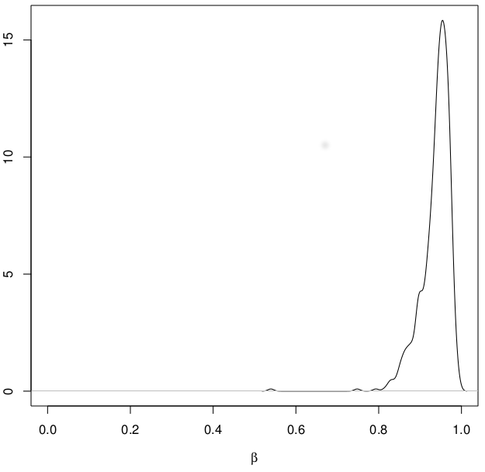
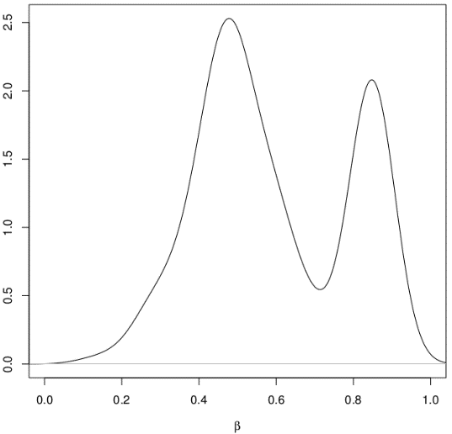
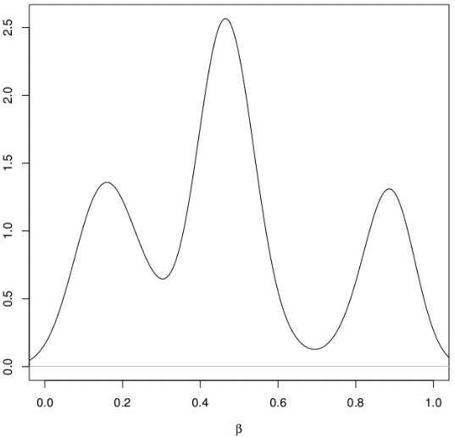
Methylome Wide DNA chip – Ilumina H450K
Optimized, high-value content
  All designable human RefSeq genes, including promoter, 5' and 3’ regions, and miRNA
- 21,500 gene symbols (>35K transcripts) (including >3000 non-coding RNAs)*
- 96% of all RefSeq genes
- targeting average ≥ 4 sites per gene promoter region + sites in 5’ UTR, gene body and 3’ UTR
  CpG islands and flanking regions*
- > 26,000 at 19 sites / island
- > 52,000 shores (upstream and downstream, ≥ 2000bp from islands)
- > 52,000“shelves” (upstream and downstream, ≥ 4000bp from islands)
  CpG sites outside of islands / outside of coding regions
  non-CpG methylated sites identified in human stem cells
  Differentially methylated sites identified in tumor versus normal (multiple forms of cancer) and across several tissue types
  miRNA promoter regions
Adapted from illumina _technology report
For each CpG site, a quantitative signal ranging [0 – 1] is produced

Slide 6

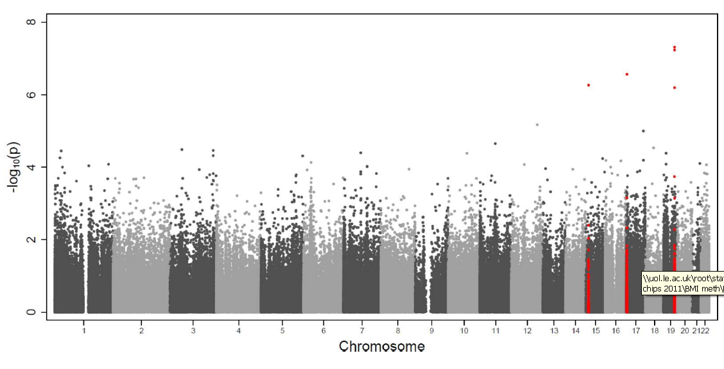
Methylome Wide Association Study (MWAS) on BMI
in peripheral blood DNA
Discovery EWAS in 459 individuals & 351,669 probes
3 loci with significant DNA methylation probes (FDR 5%)

Slide 7
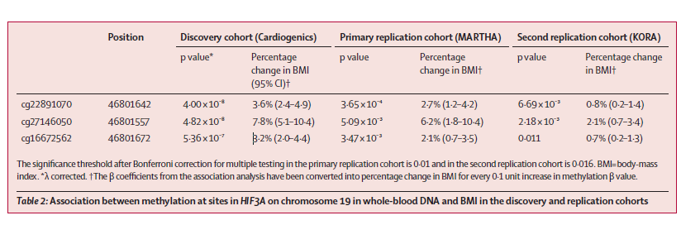
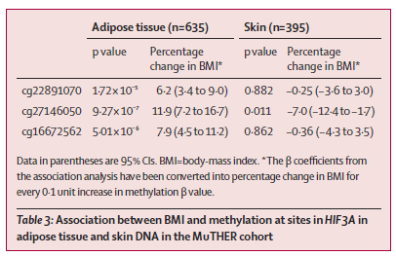
Methylome Wide Association Study (MWAS) on BMI
in peripheral blood DNA
MWAS in ~500 participants identified 1 locus explaining 3% of the BMI variability.
HIF3A not identified in GWAS on ~100000 subjects

Slide 8




MWAS on lipid levels in peripheral blood DNA
GWAS in > 100 000 participants identified 157 loci explaining 15% of the variability of plasma lipid levels
MWAS in ~500 participants identified 1 locus (not detected in GWAS) explaining 4% of the variability of plasma lipid levels

Slide 9

To annotate and help digging into GWAS results
Stroke associated SNPs (information provided by S. Debette)
DNA methylation levels measured in peripheral blood DNA of 329 MARTHA participants
GWAS & MWAS Illumina data
Applied filters:
MAF > 0.01
Imputation criterion r² > 0.3
mQTL pvalue < 5 10⁻⁸
exclusion of CpG with SNP within the probe sequence
Selection of the best mSNP per CpG site

Slide 10
ZFHX3 locus
SNP | MAF | Rsq | CpG | MAPINFO_CpG | Pvalue
rs756719 | 0.27124 | 0.91242 | cg05972185 | 72972644 | 6.98 10⁻³⁵
rs7197875 | 0.43831 | 0.76364 | cg09293559 | 72911729 | 3.33 10⁻¹⁴
rs6499600 | 0.47661 | 0.68429 | cg16563255 | 72995177 | 3.54 10⁻¹²
rs34003787 | 0.0935 | 0.89333 | cg06086177 | 73090646 | 1.52 10⁻⁹
rs8048267 | 0.27011 | 0.99632 | cg04990190 | 73096894 | 1.82 10⁻⁹
rs73590774 | 0.12513 | 0.72145 | cg05918327 | 72955295 | 2.96 10⁻⁸
Stroke SNP
rs879324 | 0.16448 | 0.99323 | cg01744822 | 73100510 | 2.34 10⁻⁴
Distant -31832bp from the CpG site (r² = 0.024, D’ = 0.56 wtih lead meSNP)

Slide 11
NINJ2 locus
SNP | MAF | Rsq | CpG | MAPINFO_CpG | Pvalue | R² with the STROKE rs11833579
rs34038797 | 0.49206 | 0.87663 | cg01201512 | 740338 | 1.254 10⁻¹²⁰ | 0.101
chr12:756092:D | 0.15054 | 0.9331 | cg14760797 | 753199 | 2.580 10⁻⁴² | -
rs12312948 | 0.37092 | 0.94872 | cg00237010 | 772861 | 5.966 10⁻²⁹ | 0.162
rs35557779 | 0.26955 | 0.8276 | cg26654770 | 740100 | 5.686 10⁻²⁸ | -
chr12:777112:I | 0.39371 | 0.85352 | cg03277819 | 772529 | 4.934 10⁻²⁷ | -
rs11063832 | 0.42896 | 0.94135 | cg16639540 | 716805 | 7.004 10⁻⁹ | -
rs12227525 | 0.42349 | 0.8001 | cg03833982 | 685403 | 9.106 10⁻⁹ | 0.01

Slide 12
HDAC9 locus
SNP | MAF | Rsq | CpG | MAPINFO_CpG | Pvalue
chr7:18778926 | 0.012 | 0.36129 | cg27396284 | 18591072 | 8.165 10⁻¹²
chr7:18879415 | 0.01101 | 0.89828 | cg15014369 | 18393351 | 4.756 10⁻⁸
Stroke SNP
rs2107595 | 0.16868 | 0.98168 | cg13420273 | 18810212 | 1.14 10⁻²
CDKN2B locus
SNP | MAF | Rsq | CpG | MAPINFO_CpG | Pvalue
rs72654298 | 0.015 | 0.9394 | cg19133618 | 22008970 | 4.835 10⁻⁵
Stroke SNP
Rs2383207 | 0.42591 | 1 | cg08390209 | 22005563 | 5.020 10⁻²

Slide 13
PITX2 locus
SNP | MAF | Rsq | CpG | MAPINFO_CpG | Pvalue | R² with the STROKE rs6843082
rs142388781 | 0.31778 | 0.94357 | cg19602081 | 111553161 | 1.254 10⁻¹²⁰ | -
rs1947187 | 0.18458 | 0.9963 | cg10699857 | 111532996 | 4.623 10⁻¹⁵ | 0.062
ALDH2 locus
SNP | MAF | Rsq | CpG | MAPINFO_CpG | Pvalue
rs11834780 | 0.08386 | 0.86673 | cg22158248 | 112204136 | 1.871 10⁻¹³
Stroke SNP
rs10744777 | 0.30438 | 0.81549 | cg26649504 | 112196397 | 2.960 10⁻³
Distant 36621bp from the CpG site
MMP12 locus
SNP | MAF | Rsq | CpG | MAPINFO_CpG | Pvalue
chr11:102697062 | 0.0137 | 0.86931 | cg15619439 | 102700944 | 1.022 10⁻⁹⁷
chr11:102753072:I | 0.0334 | 0.53676 | cg15124926 | 102702624 | 1.017 10⁻⁸
Stroke SNP
rs660599 | 0.1928 | 0.9930 | cg09615874 | 102706606 | 7.45 10⁻²
Distant 23151bp from the CpG site

Slide 14
H450K based MWAS approach
A powerful tool to complement the common/rare variants analyses
Either in specific cells type or whole blood if one accepts that the latter serves as a mirror of some more localized mechanism:
Van den Oord et al. (San Diego ASHG 2014) :
~65% concordance between Brain & Blood SNP-CpG associations
Experimental MWAS Validation
Methylation-specific PCR or bisulfite sequencing
in the circulating cells
in specific target cells relevant to the studied phenotype
Caution
Similar issues with the interpretation of GWAS/MWAS as GWAS/GWES (LD bias)
Remaining Challenges
Statistical Challenges to
efficiency handle multiple CpG probes at a locus
efficiency address the non-Gaussian distribution of some CpG data
……
Notes:
75 post mortem brain tissue and 1,459 blood (schizophrenia + controls) with Methyl Binding Protein Sequencing

Slide 15
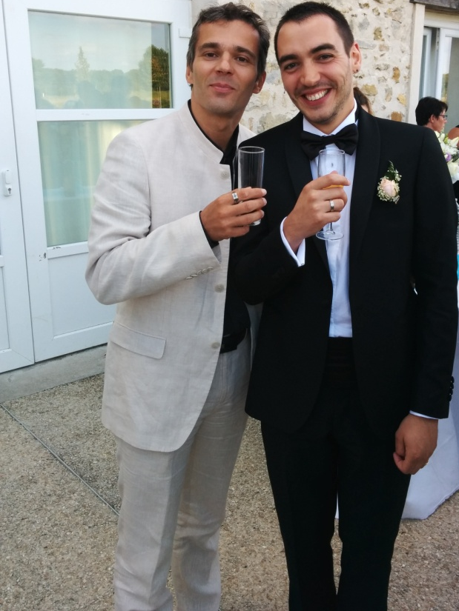



Credits
Division of Epidemiology,
Dalla Lana School of Public Health, Toronto
Jessica Dennis, Martin Ladouceur, Mathieu Lemire, Vinh Truong, France Gagnon
INSERM UMR_S 1166, Paris
Genomics & Pathophysiology of Cardiovascular Diseases
Dylan Aïssi, Marine Germain

