Slide 1
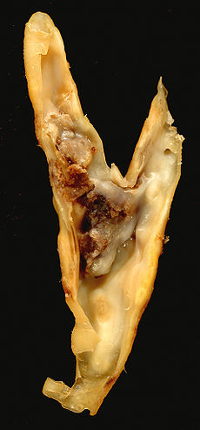
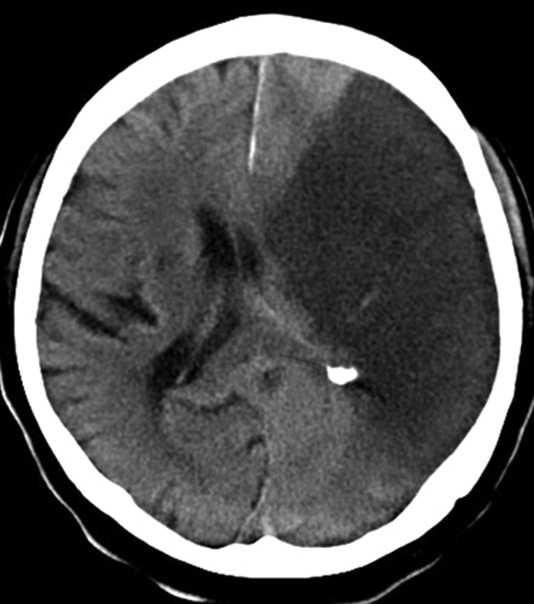
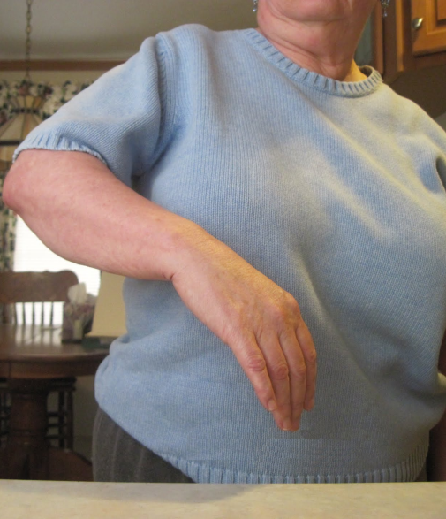
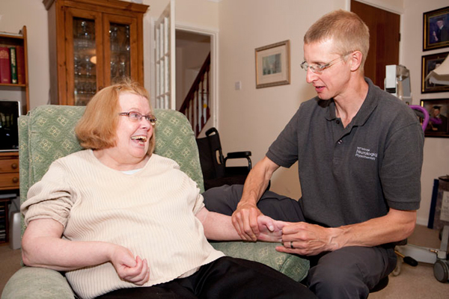

Lesion localization and genetics of stroke recovery
Paul Bentley, Imperial College London
Cause
Effect – Early
Response to Rx
Effect – Late
Response to Rx

Slide 2
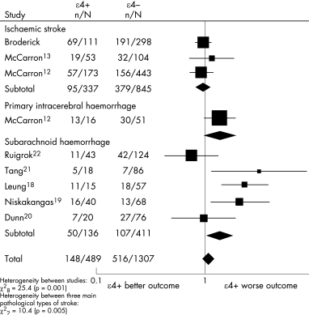
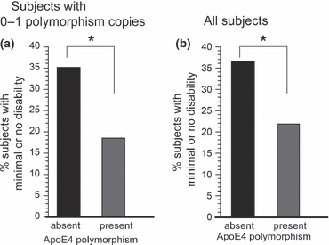
Genetics of stroke recovery
e.g. Apo E4+ associated with poor outcome, esp. hemorrhage; BDNF; Endoglin
Martínez-González NA, Sudlow CL. Effects of apolipoprotein E genotype on outcome after ischaemic stroke, intracerebral haemorrhage and subarachnoid haemorrhage. J Neurol Neurosurg Psychiatry. 2006 Dec;77(12):1329-35.
Cramer SC, Procaccio V; GAIN Americas; GAIN International Study Investigators. Correlation between genetic polymorphisms and stroke recovery: analysis of the GAIN Americas and GAIN International Studies. Eur J Neurol. 2012 May;19(5):718-24.

Slide 3
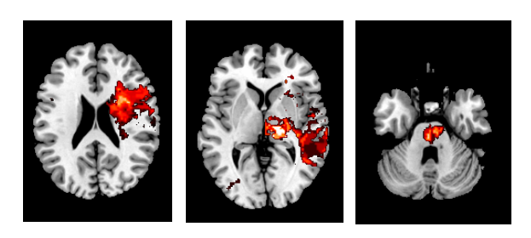

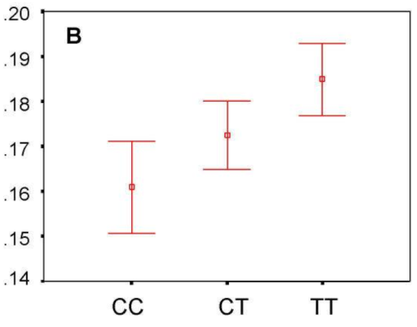
Genetics of stroke deficits
e.g. triple dissociation of attention deficits, seen in ~2/3rds of strokes
Executive control
Orienting
Alertness
R
R
h2=0.89:
MAOA, DAT, COMT, DRD-4
h2=0:
CHRNA4 ?
h2=0.18:
DDC
Executive control score
Rinne P, Hassan M, Goniotakis D, Chohan K, Sharma P, Langdon D, Soto D, Bentley P. Triple dissociation of attention networks in stroke according to lesion location. Neurology. 2013 Aug 27;81(9):812-20.
Fossella J, Sommer T, Fan J, Wu Y, Swanson JM, Pfaff DW, Posner MI. Assessing the molecular genetics of attention networks. BMC Neurosci. 2002 Oct 4;3:14.
Fan J, Wu Y, Fossella JA, Posner MI. Assessing the heritability of attentional networks. BMC Neurosci. 2001;2:14.

Slide 4



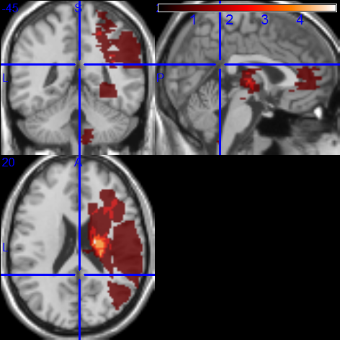
Genetics of stroke deficits recovery
e.g. executive impairments influence motor deficits and learning
Motor improvement intra-session %
conflict %
High Total Conflict
(p<0.01, corr, vs. controls)
Normal Total Conflict
(p≥0.01, corr , vs. controls)
High - Normal
1
6+
No of patients
Rinne P, et al. In Preparation.

Slide 5
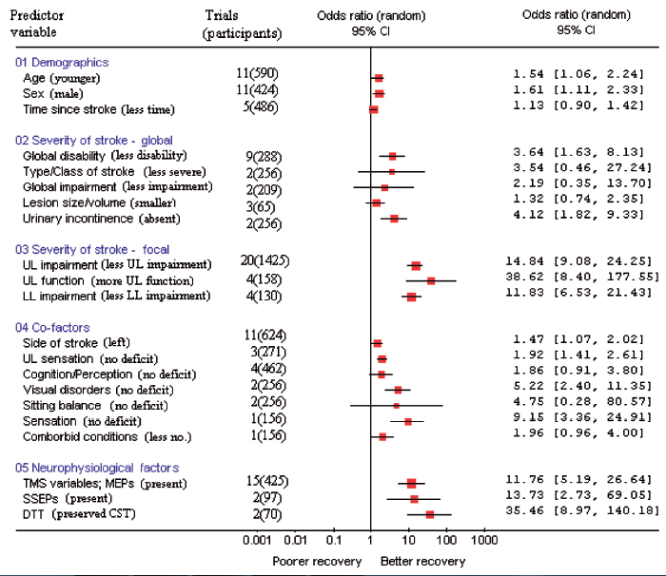
Determinants of stroke recovery
Coupar F, Pollock A, Rowe P, Weir C, Langhorne P. Predictors of upper limb recovery after stroke: a systematic review and meta-analysis. Clin Rehabil. 2012, 26:291.

Slide 6
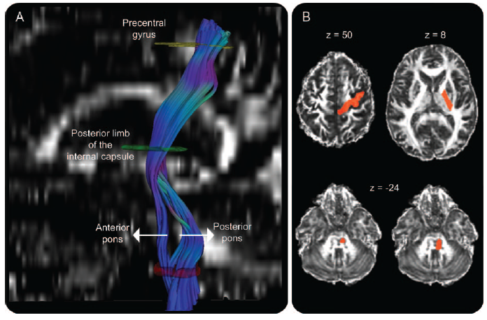
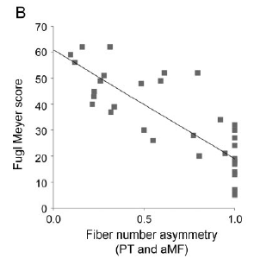
Determinants of recovery – lesion location
Lindenberg R, Renga V, Zhu LL, et al. Structural integrity of corticospinal motor fibers predicts motor impairment in chronic stroke. Neurology. 2010; 74; 280

Slide 7
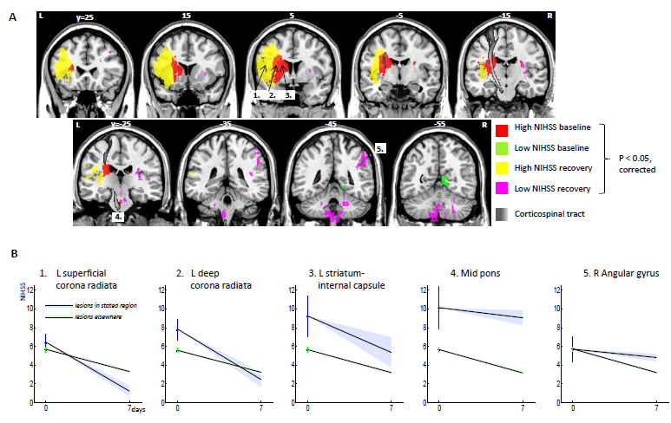
Determinants of recovery – lesion location
Bentley P, Kumar G, Rinne P, Buddha S, Kallingal J, Hookway C, Sharma P, Mehta A, Beckmann C. Lesion locations influencing baseline severity and early recovery in ischaemic stroke. Eur J Neurol. 2014 Sep;21(9):1226-32.

Slide 8
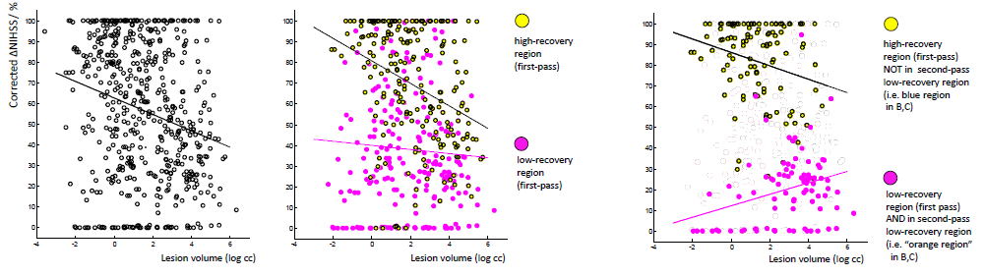
Determinants of recovery – lesion location
Lesion size, age, white matter disease
+ lesion location (1°)
+ lesion location (2°)
Cross validation R² = 0.08
Cross validation R² = 0.39
Cross validation R² = 0.45
Bentley P, Kumar G, Rinne P, Buddha S, Kallingal J, Hookway C, Sharma P, Mehta A, Beckmann C. Lesion locations influencing baseline severity and early recovery in ischaemic stroke. Eur J Neurol. 2014 Sep;21(9):1226-32.

Slide 9
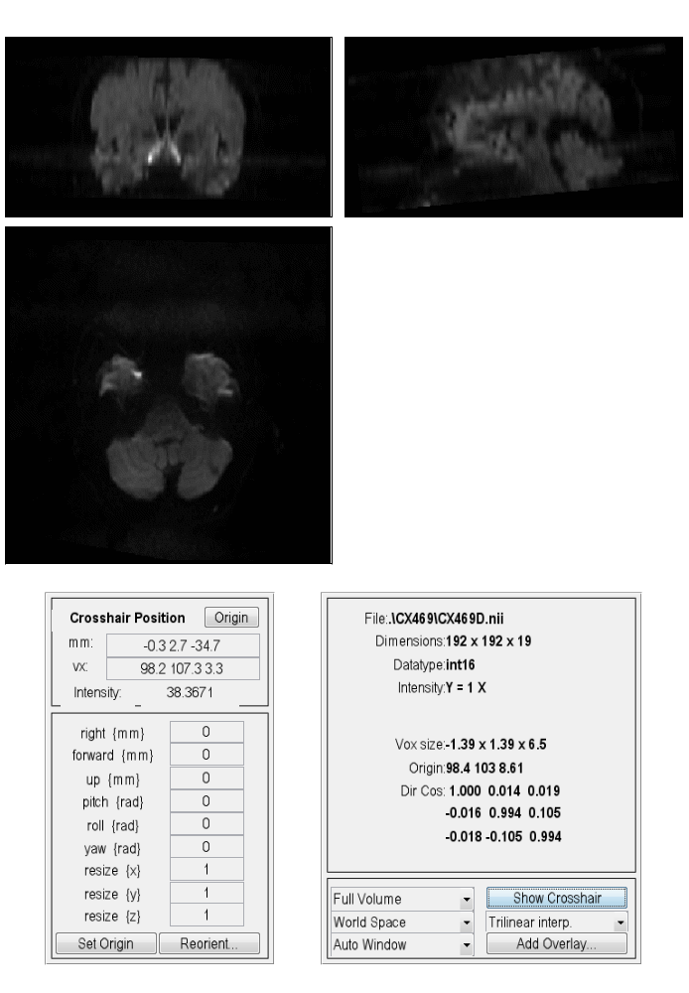
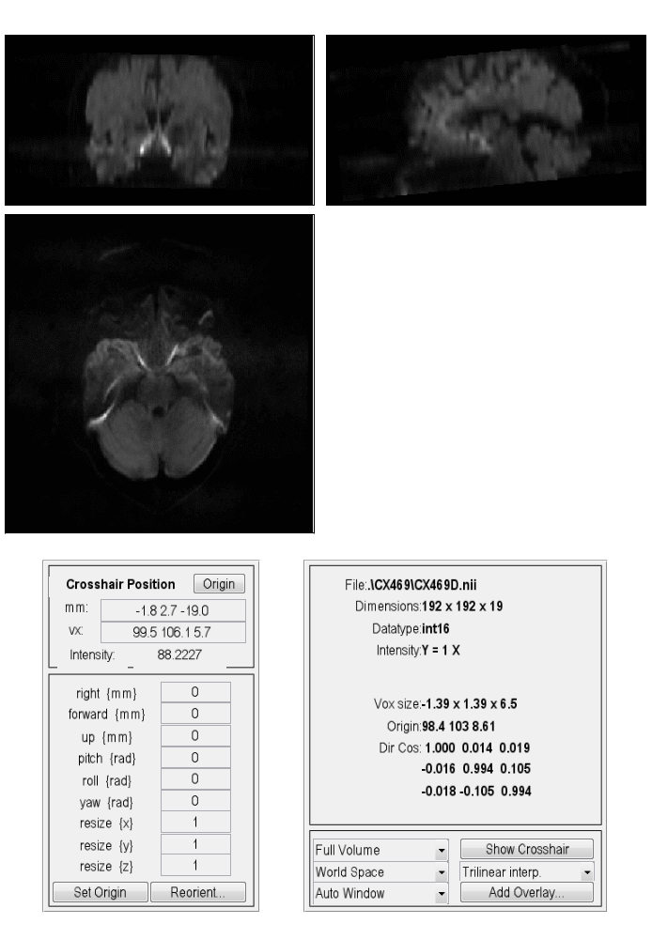

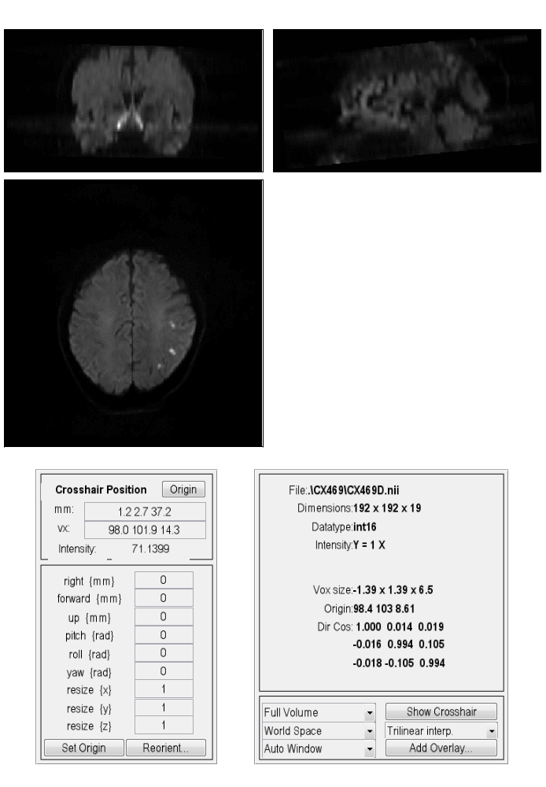
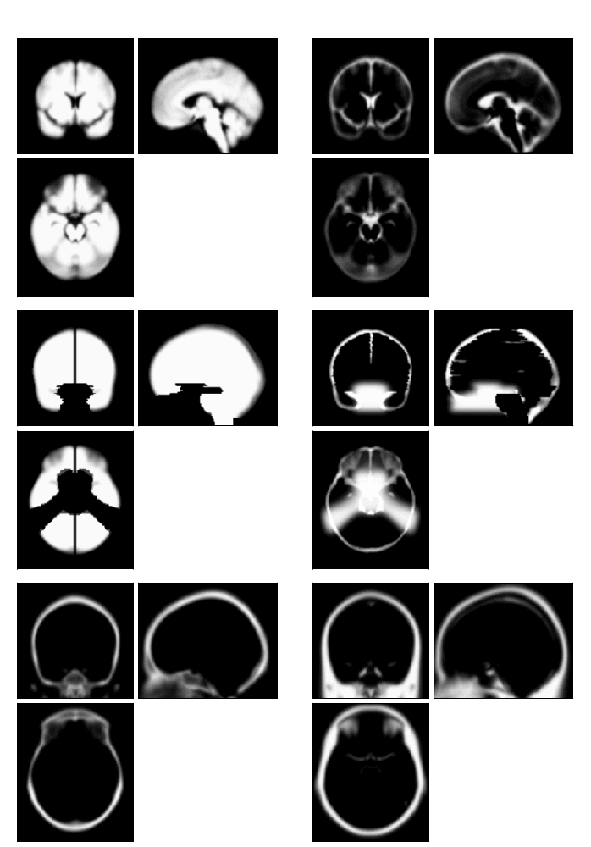
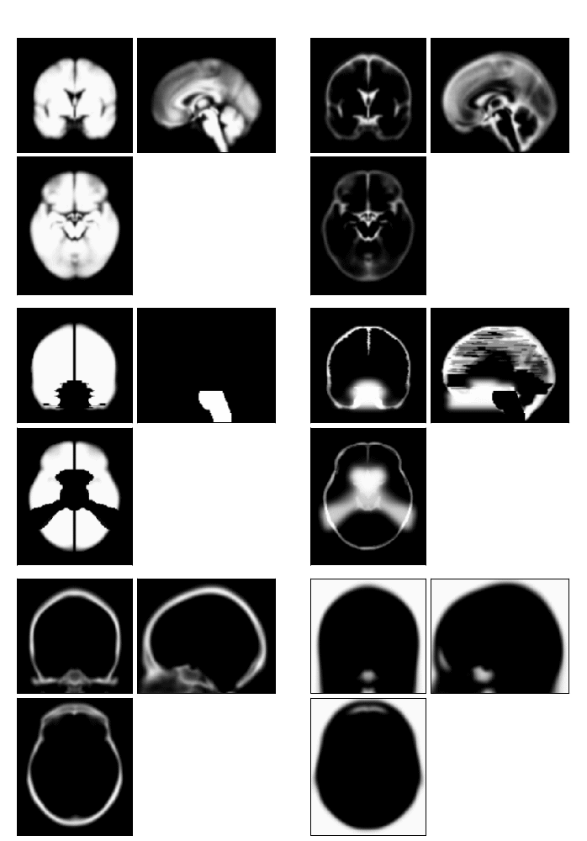



Automated acute lesion delineation – method
Need to distinguish lesion from artefact based upon spatial priors
GWM
CSF
LES
ART
skull
scalp
other
$$μ_{LES}^{(n)}=\max\left(μ_{LES}^{(n)} , μ_{GWM}^{(n)}+5σ_{GWM}^{(n)}\right)$$
$$σ_{LES}^{2,(n)}=\min\left(σ_{LES}^{2,(n)},10σ_{GWM}^{2,(n)}\right)$$
$$μ_{ART}^{(n)}=\max\left(μ_{ART}^{(n)} ,μ_{ART}^{(n)}+σ_{GWM}^{(n)}\right)$$
Unified probabilistic normalisation-segmentation, using Expectation-Maximization algorithm
Enhancements: 1) artefact spatial priors can be based upon control set; 2) calibration
Open source software toolbox for SPM.
Seghier M, Rinne P, Dias A, Bentley P. Automated delineation of acute stroke lesions from standard diffusion-weighted MR images. In Preparaton

Slide 10
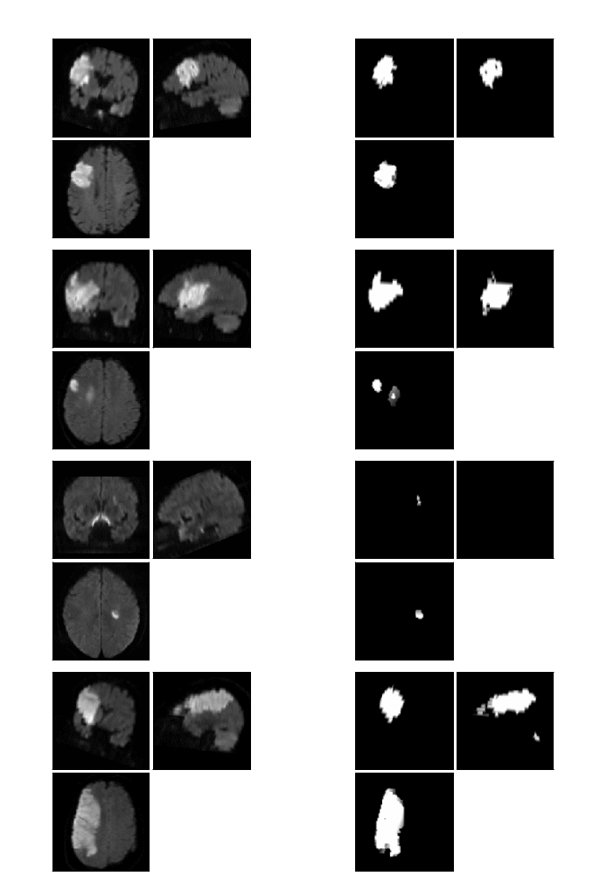
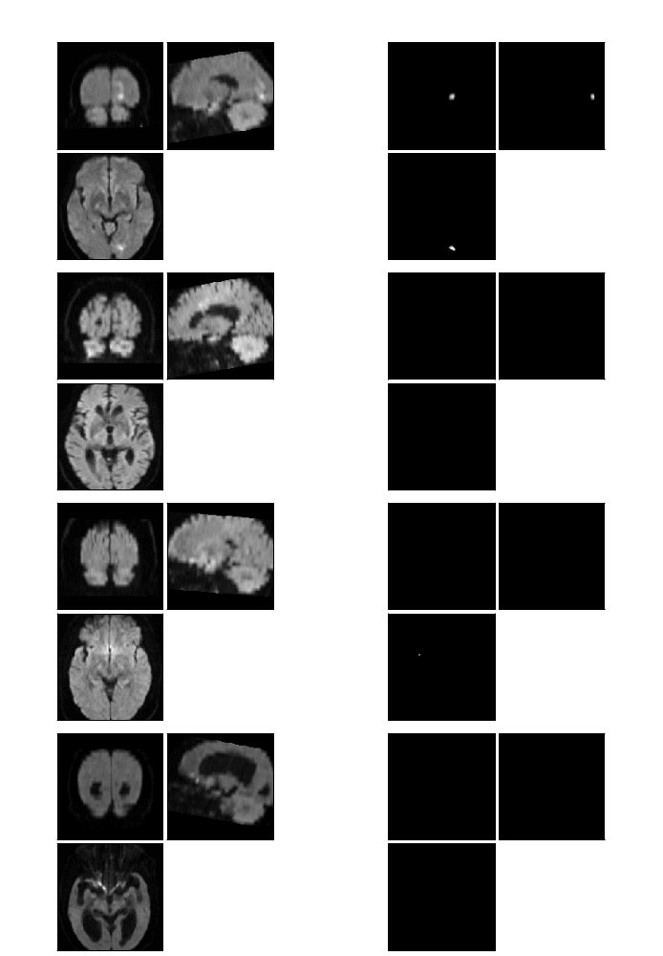
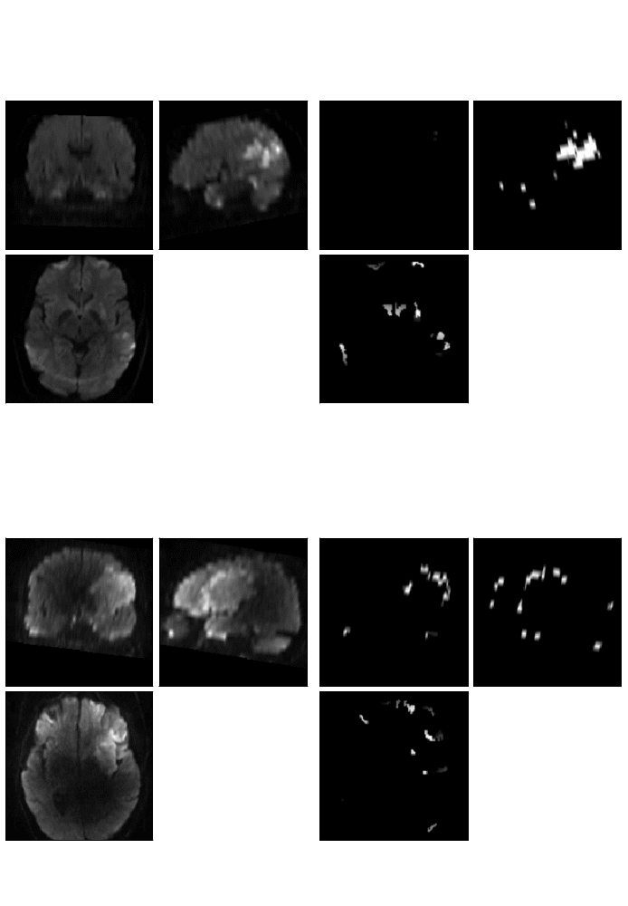
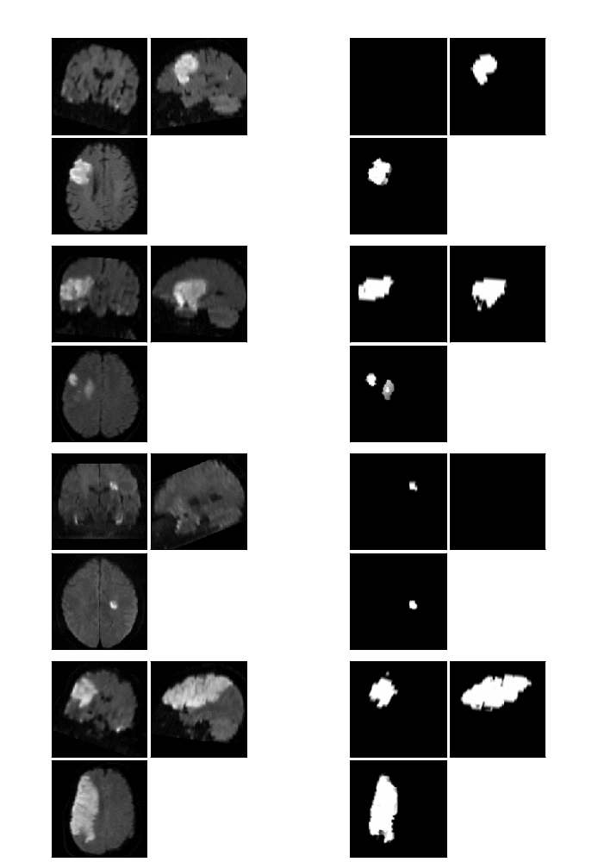
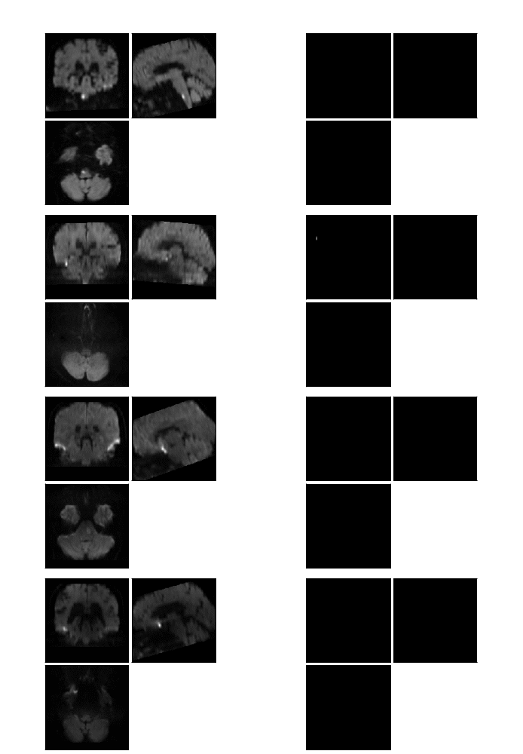
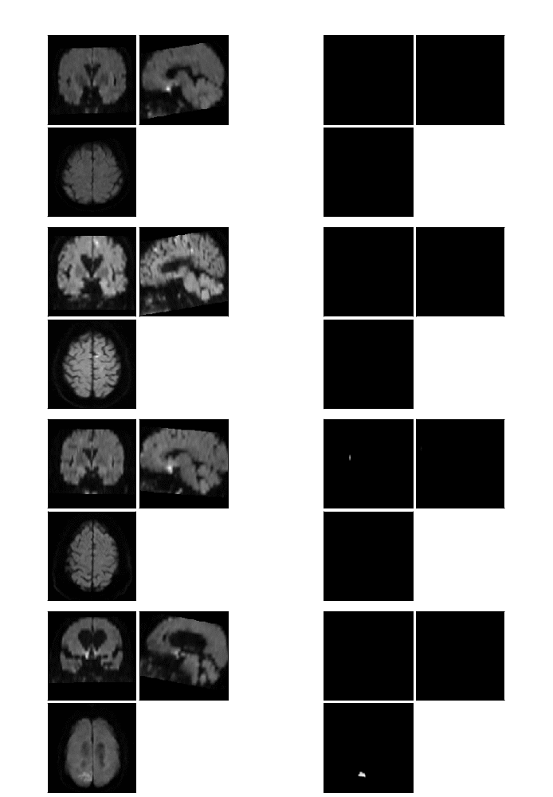
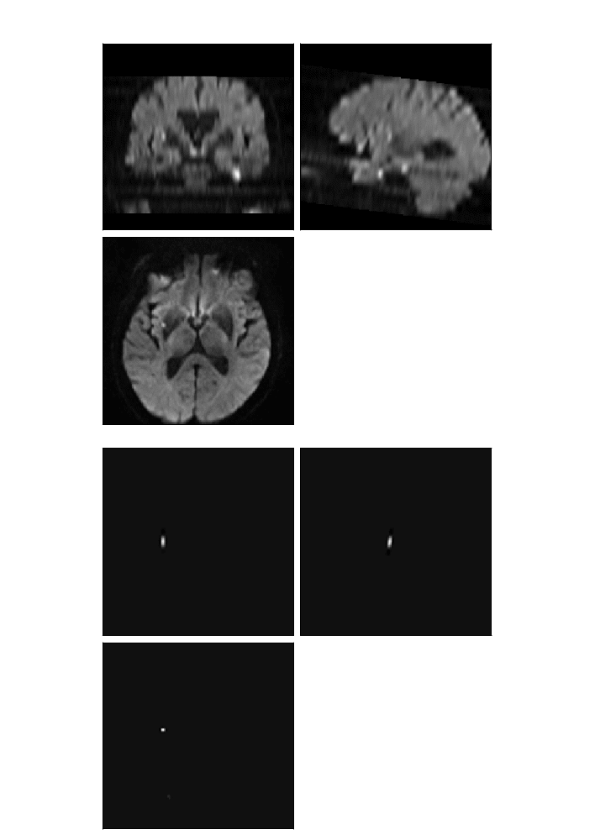
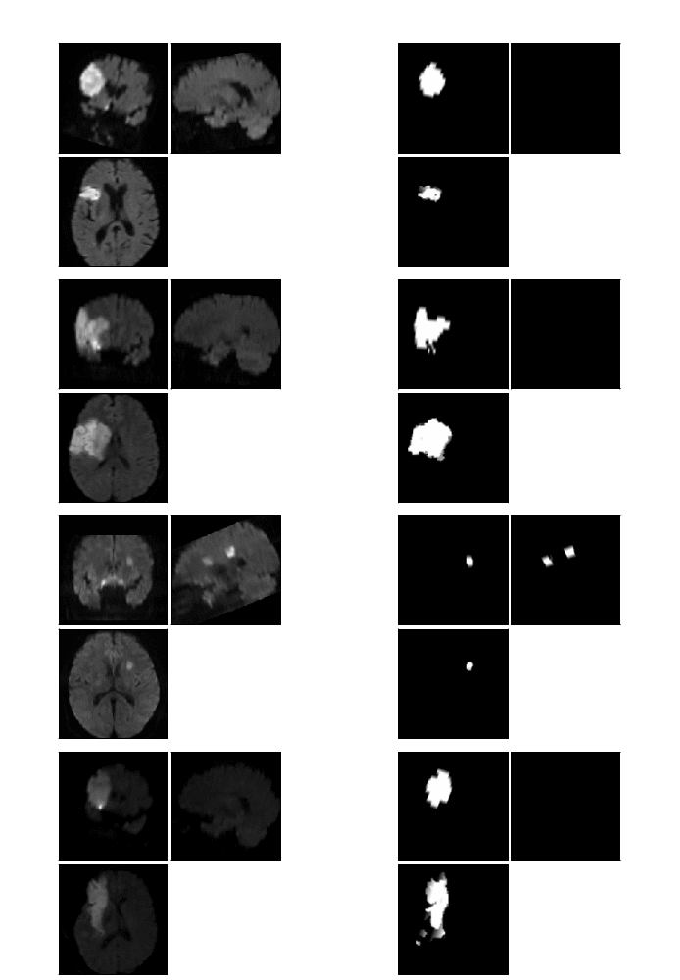
Automated lesion delineation - examples
Good
Not so good
1
2
Missed
3

Slide 11
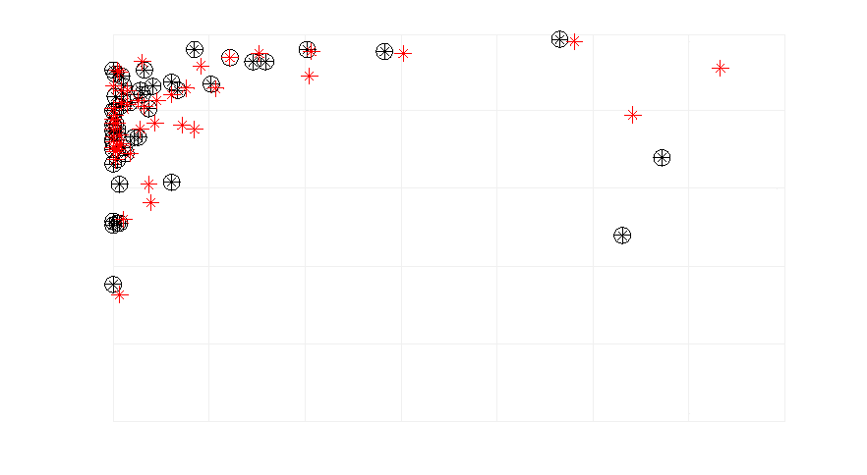
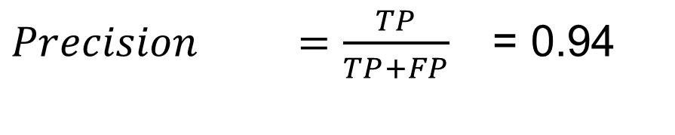
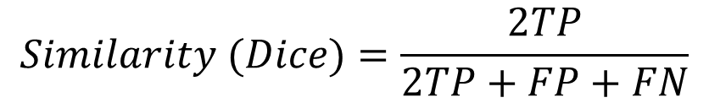
Automated lesion delineation - performance metrics
$Precision =\frac{TP}{TP+FP}$ = 0.94
Theoretical performance
d
d=1mm
V
d=2mm
Similarity
d=3mm
$$Similarity (Dice)=\frac{2TP}{2TP+FP+FN}$$
1
2
3
4
5
V [volume in cm3]
Automated vs Expert 1
Expert 1 vs Expert 2 or 3
Mean similarity=0.570
Mean similarity=0.779
1
0.8
0.6
Similarity
0.4
0.2
0
80
100
120
140
0
20
40
60
V [volume in cm3]
V [volume in cm3]

