Slide 1
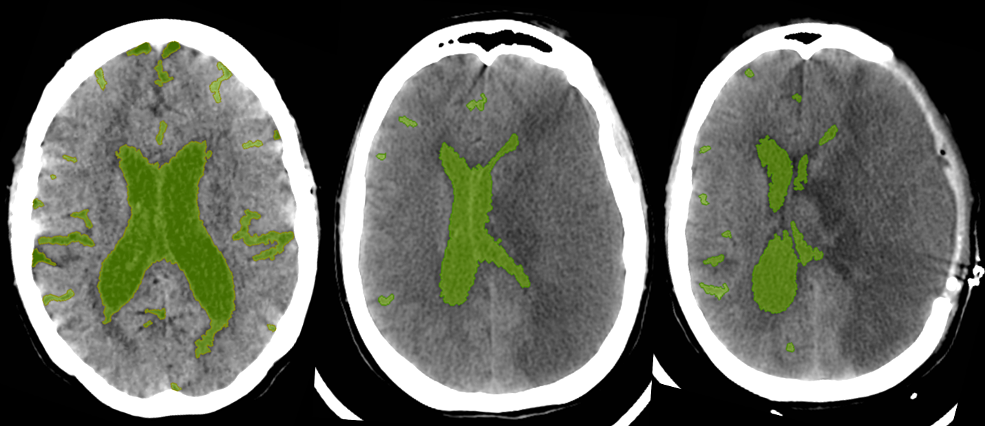

CSF Volumetric Change as a Quantitative Endophenotype of Cerebral Edema after Stroke
Rajat Dhar MD, FRCP(C)
Assistant Professor of Neurology
Division of Neurocritical Care
Washington University in St. Louis – School of Medicine

Slide 2
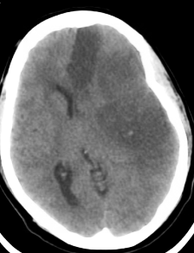

Cerebral Edema after Hemispheric Stroke
Multiple biologic pathways contribute to edema after large-vessel ischemia (significant in 20-50% of MCA infarcts)
Accumulation of excess brain water within rigid compartment
Leading cause of death / neurologic deterioration in acute period
Severity/progression of edema not fully explained by variables such as age, stroke severity, or even infarct volume
  Genetic factors likely influence variability in edema kinetics
24-hours
Notes:
#1 cause of death in 1st week after stroke – Hachinski & Norris paper
In some cases, progression of edema exhausts intracranial compliance, leading to pressure gradients, tissue shifts / herniation
Recent analysis of swelling/edema after stroke (Battey et al. Stroke) analyze serial MRI from EPITHET and NBO if baseline DWI > 10 ml
NIHSS lower at 13-14 median, first MRI at 4-7 hours, smaller strokes on average but wide variety, but 2/3 have some degree of swelling on FU MRI (more common than infarct growth, 39-43%)
Presence of swelling was associated with worse outcomes, independently, unlike infarct growth
VOLUME OF SWELLING was associated with poor outcome (MRS 3-6) – independent of baseline DWI, NIHSS, age
ROC cutoff of 11 ml optimal, AUC 0.798

Slide 3
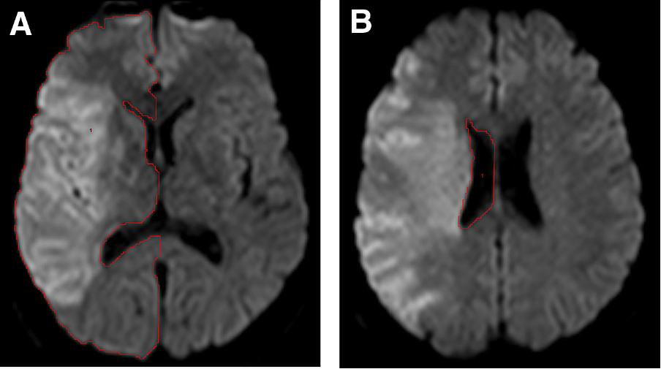
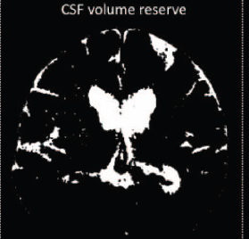
Imaging Biomarkers of Cerebral Edema
Midline shift and signs of herniation are primary existing markers of edema, but focus on extreme phenotype
No validated quantitative measure across broad spectrum
  Hemispheric volume increase by MRI proposed for clinical research
Baseline CSF volume risk factor for malignant course in LHI
Propose Δ CSF as biomarker for quantifying edema kinetics
  Use serial CT scans for large-scale genetic studies of dynamic effect
Yoo AJ, et al. J Stroke Cerebrovasc Dis 2013; 22: 742-49.
Minnerup J, et al. Stroke 2011; 42: 3403-09
Notes:
Existing markers do not capture pure biology of edema but also incorporate compliance and bias toward severe spectrum (need easily available / sensitive marker applicable to any severity of edema)
Infarct/hypodensity volume mixes two processes (infarct growth/swelling) – hard to separate
Yoo evaluate 12 patients from EPIPET with MRI at baseline and days 3-5, include if baseline DWI > 82 ml
Outline IL hemisphere excluding sulci at least 2mm wide and cisterns/ventricles, took 25-30 minutes
Also measure volume of IL ventricle, peak MLS
Clinical endpoint was END (NIHSS >= 4 increase at time of day3-5 MRI) = average of 62 hours between scans, END in 3 of 11 evaluable patients with NIHSS, no DHC
Similar age, NIHSS demophgraphics (mean 18.5), average DWI lesion 138 ml
Find average HVI of 72 ml (16%) – similar to volume of CSF reduction we found! (lower % since denominator larger – whole hemisphere vs. CSF volume)
Lateral ventricle went from 20+/-8 ml to 12+/-7 ml (45% decrease or 9.3 ml) – in our data, IL vent change to peak in 16 subjects was -9.2 ml (median -6.5), -57%, median -51%
ICC in this study was 0.92-0.97 for IHV
Large increase in HV in those with END (82 vs. 60 ml, p=.08), % increase was 19.5+/-5% vs. 12+/-2%, p=0.008 (13.8% as ROC cutoff), trend to smaller baseline HV
Did not find association of absolute or % HV increase and MLS (r=-0.17) or absolute ventricle decrease, but associated with % volume decrease (r=0.63, p=0.03), ? MLS not associated with END (strongly in ours)
In our data IL vent volume change (abs/%) both similarly associated with MLS r=0.64, p=0.008 for both
Rat study validate hemisphere volume growth as strongly correlated with brain water content increase (Gerriets Stroke 2004)
In limitations section mention that since peak edema may happen <= 48 hours, MRI often later, “future studies should evaluate early edema formation within the first 24-36 hours”

Slide 4
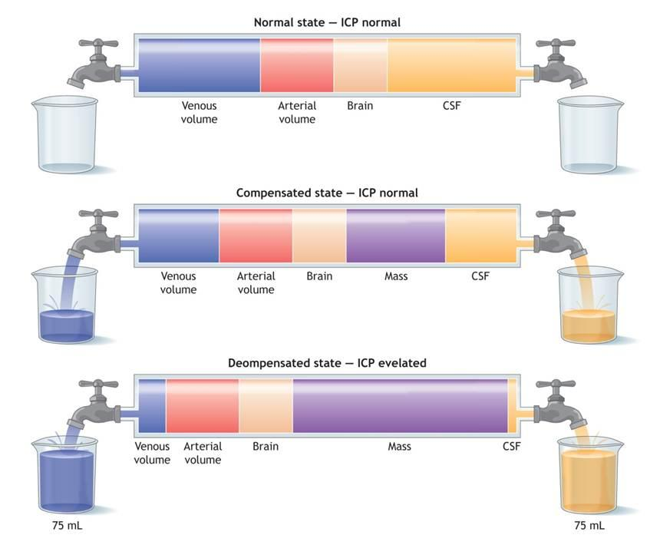
24-hours after stroke
Stroke
ΔCSF
48-72 hours after stroke

Slide 5

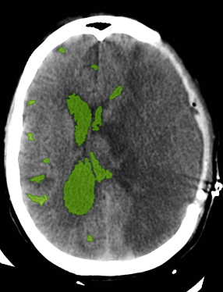
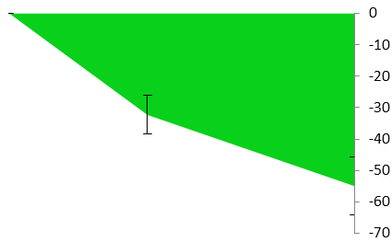
Using Dynamic CSF Volumetrics as a Biomarker of Edema Severity
114 ml
53 ml
10 ml
Stroke onset
Baseline Head CT
24-hr
Head CT
Peak Edema
Within 6 hours; NIHSS ≥ 8
No significant HT
Clinical Deterioration:
Need for osmotic Rx or hemicraniectomy
Change in CSF Volume (ml)
Notes:
Use of CT scans as available/reliable serial imaging for dynamic process
Intraclass (inter-rater) concordance coefficients for most compartments and total CSF volume above 90%
For total CSF volume, n=12 scans by 2 subjects, ICC using two-way random effects model, looking at single measures = 0.99 (0.969-0.997), p<0.001 for consistency
For absolute agreement in volume (type A) – ICC = 0.97 (0.44-0.99), p<0.001
Baseline CSF volume of 114ml, down to 53 ml at 24-hours then 10 ml at peak edema (DHC)

Slide 6
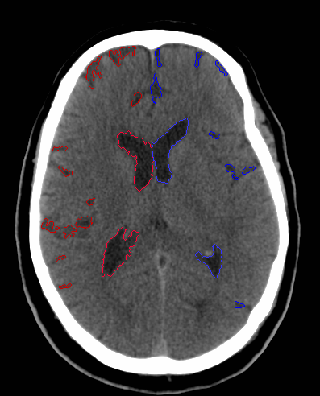
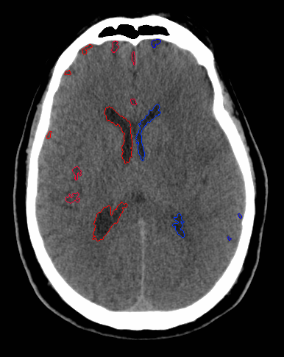
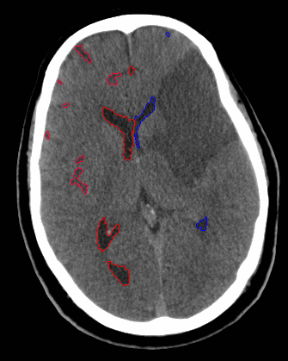
55 year-old man, baseline NIHSS 17
1 hour
16 hours
54 hours
121 ml
71 ml
65 ml
Notes:
Subject 39; 55-year old man with baseline CT at < 1 hour from symptom onset, NIHSS 17 (20 at 24-hours), given TPA
Baseline CSF volume 121 ml
Next CT at 16 hours, early hypodensity with edema/MLS
CSF volume decreased to 71 ml (-50 ml), 41% reduction
Initially mild sulcal asymmetry (0.67) reduced to 0.51 – same for hemispheric volume IL:CL
Peak edema scan at 54 hours (2+ days), may not be ‘peak’ but CSF volume 65 ml (less change from 24-hours, slowing of rate)
46% reduction from baseline – no clinical worsening

Slide 7
Preliminary Data: ΔCSF volume _{24-hr}
28 subjects with scans at baseline and 24-hrs
  Baseline NIHSS was 16 ± 6 (range 8-29)
  Baseline CSF volume was 138 ± 74 ml (29-320 ml)
  Mean time to FU scan was 20.8 ± 12 hours
  13 had another CT beyond 48 hours showing infarct and ‘peak’ edema (1 only post-DHC)
7 (25%) developed malignant edema
  need for osmotic therapy, hemicraniectomy or decline in GCS associated with ≥ 5mm of MLS
Notes:
Baseline CSF volume did not predict deterioration or MLS in this small cohort, but % sulcal volume did trend to be associated with malignant edema risk
75% of CSF volume located in sulic (vs. Ventricles)

Slide 8
Dynamic CSF Changes
Baseline
24-hr
Peak Edema

Slide 9
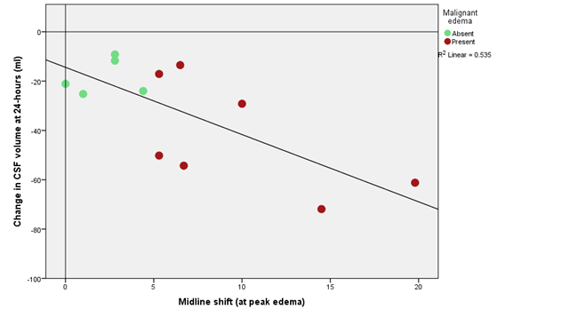
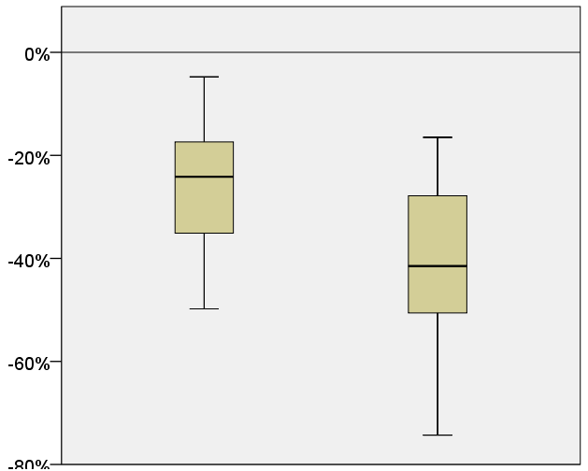
ΔCSF_{24hr} as a marker of edema
- clinical deterioration
+ clinical deterioration
Peak MLS correlated with:
  ΔCSF_{24hr} (r=0.75, p=0.01)
  Hypodensity volume (r=0.75)
  Δ%CSF (r=0.86, p=0.002)
    Even after controlling for infarct volume (r=0.76, p=0.02)
Greater ΔCSF_{24hr} in those with subsequent clinical deterioration from edema
24-hr Change in CSF Volume (ml)
0
R² = 0.535
-50
-100
5
10
15
20
Peak Midline Shift (mm)
% Change in CSF Volume at 24-hr
P=0.07
Mann-Whitney
NO
YES
Malignant Edema
Notes:
Clinical deterioration also associated with:
Age (54 vs. 66 yrs, p=0.09)
Similar results to Battey et al. with greater swelling volume with worse outcome
No difference in baseline NIHSS or 24-hour NIHSS
Trend to lower baseline sulcal CSF volume (as % of brain) – 5.9% vs. 8.7%, p=0.08
AUC for % 24-hr CSF change was 0.74 (p=0.07)

Slide 10
Grant: Genetics of Edema (Request for Collaboration)
Aim #1: Quantify kinetics of cerebral edema in a cohort of acute ischemic stroke patients
Aim #2: Identify genetic influences on severity of edema
  Use ΔCSF_{24hr} as quantitative endophenotype
Utilizes readily available CT scans to quantify edema
  Majority of stroke (esp. tPA Rx) patients get repeat CT at 24-hours
  Those with edema / deterioration often get further imaging
Two-center GWAS of 1,000 stroke patients: genotyped and otherwise phenotyped – imaging analysis underway
  Cohort growing with ongoing NIH funding (R01NS085419)
  Estimate that 60-65% will meet criteria for edema study
Notes:
Baseline CT to normalize baseline CSF volume

Slide 11
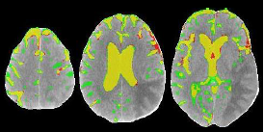

Aim #1: Automated Image Analysis
High throughput required to obtain CSF volumes at 2+ time points in 1000+ patients
Working with UNC to develop automated image analysis algorithm to accurately delineate CSF spaces from CT scans
  Utilizes machine-learning approach to segmentation with Random Forest classifier and extraction of Haar-like features
  Tested on pilot training set with Dice ratio of 72±9% (compared to Hounsfield thresholding method (51±17%, p<0.001)
Pipeline: able to import and deidentify serial CT scans from multiple sites using CNDA (Central Neuroimaging Data Archive)

Slide 12
Aim #2: Genomic Analyses
Quantitative endophenotype provides more power than regular case-control approach
Incorporate approaches to identify rare coding variants
  SKAT combined with exome-chip arrays
  Moderately large effect size can be detected
Accrue replication cohort with ongoing subject enrollment

Slide 13
Collaborators
Washington University in St. Louis
Jin-Moo Lee, Laura Heitsch, Carlos Cruchaga
Kristy Yuan, Tobias Kulik
University of North Carolina
Hongyu An, Yasheng Chen
Vall d’Hebron Research Institute, Barcelona
Joan Montaner, Israel Fernandez, Caty Carrera

Slide 14

We need your help!
Inclusion Criteria
Acute ischemic stroke with blood samples
NIHSS ≥ 8 (± tPA Rx)
CT scans:
  Baseline CT within 6 hours of stroke onset
  Repeat CT at 24 ± 12 hours (with hemispheric infarction)
  All follow-up CT scans
At this point we only need:
  # of patients currently available with above data
  # of patients accruing per month with above data

Slide 15
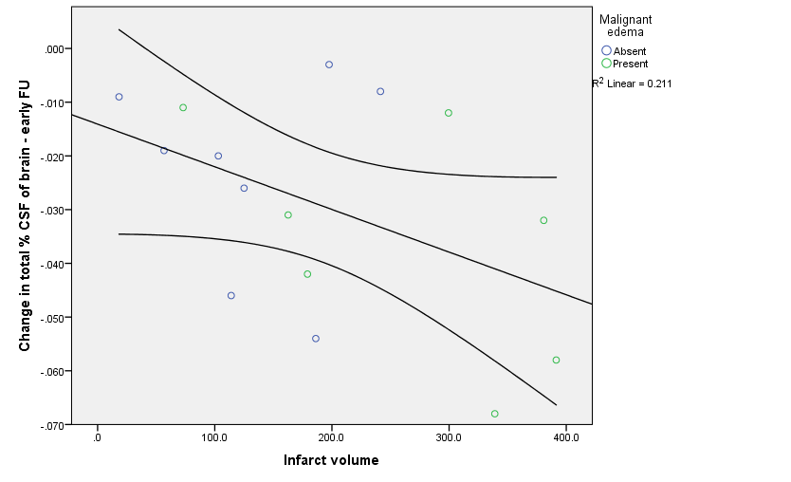
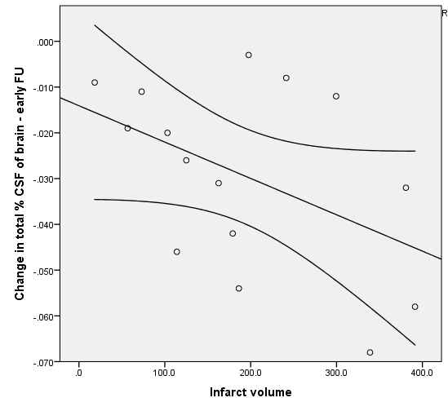
Outliers of Edema

Slide 16
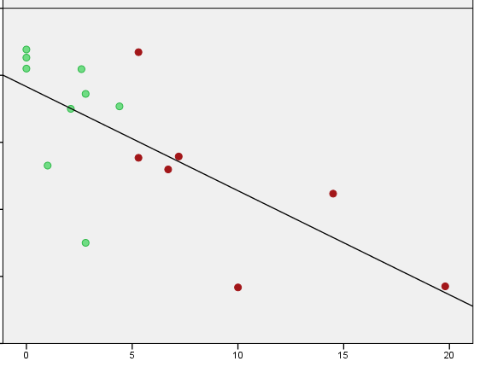
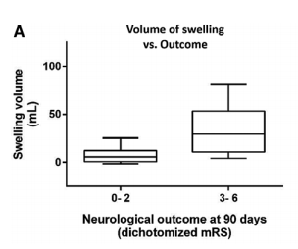
0
Change in CSF Volume (ml)
-50
Battey TWK, et al. Stroke 2014
-100
Peak Midline Shift (mm)

Slide 17
CSF Volume as a Biomarker of Baseline Cerebral Atrophy

Slide 18
Data
Baseline CT within 6 hours of stroke onset
Follow-up CT scan with hemispheric stroke:
  Ideally around 24-hours post-onset
  If available – another at time of maximal swelling (2-5 days)
  Exclude if significant hemorrhagic transformation (PH-1/2)
Clinical data on:
  Age, gender
  Baseline NIHSS (24-hour NIHSS, if available)
  tPA treatment
  Malignant edema: clinical deterioration based on need for hemicraniectomy, or 5mm or more of MLS associated with death, decline in GCS, or need for osmotic therapy
If available: TOAST subtype, recanalization, baseline glucose and other labs

Slide 20
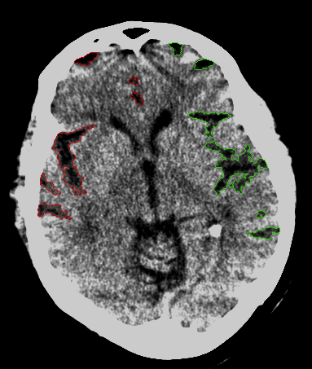
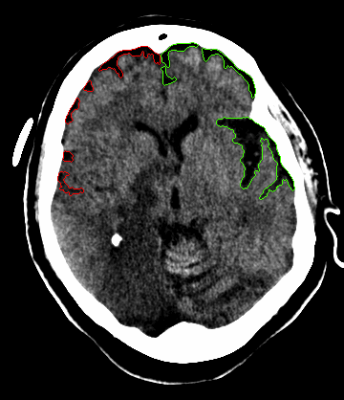
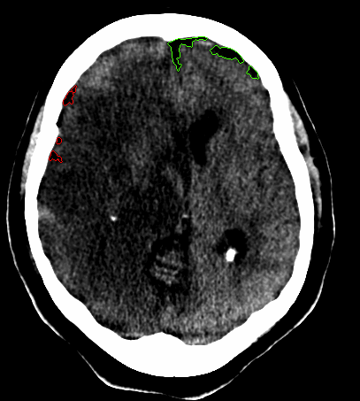
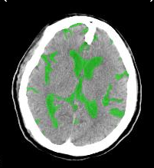
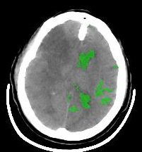
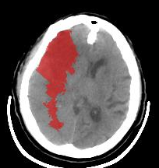
Time after
onset
3 hrs
48 hrs
175 cc
61 cc
Infarct
Volume
CSF Volume

Slide 22
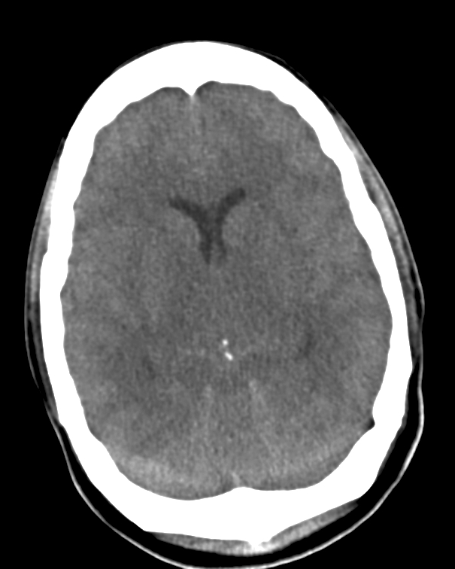
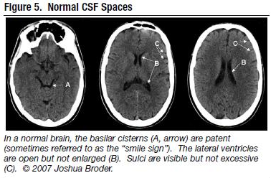
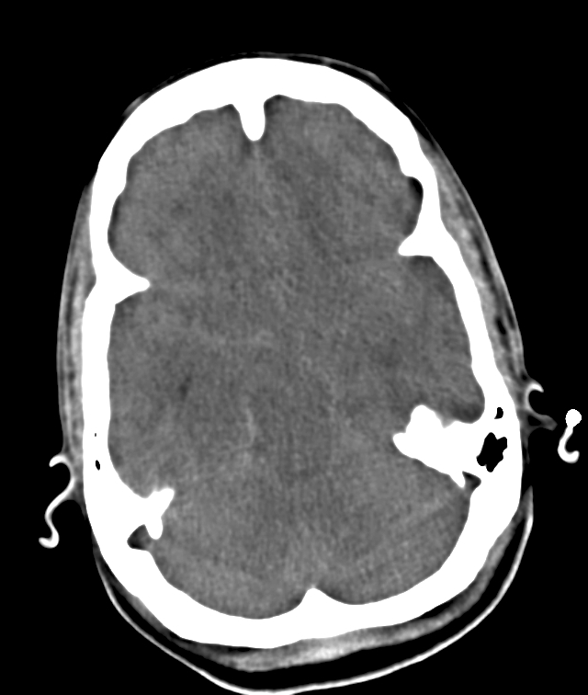
CSF Dynamics with Evolving Edema

