Slide 1
Association and meta-analysis strategies for rare variants
Josée Dupuis
Boston University School of Public Health

Slide 2
Outline
Association methods for rare variants
  Single SNV (single nucleotide variant) approaches
  General framework for joint analysis of rare variants
  Selection of rare variants most likely to influence disease risk/quantitative trait
  Application: Effect of rare variants on C-reactive protein (CRP) plasma levels

Slide 3
Analysis of Rare Variants
Genome-wide association analysis is based on the hypothesis of “common diseases, common variants”
GWAS have identified numerous genes associated with disease traits, but identified genes account for only a small portion of the total heritability
Moreover, associated SNVs are not necessarily the functional or causal SNVs
  Associated SNVs thought to be in LD with causal variants
Where is the “missing” heritability?
  Copy number variants?
  Rare mutations?

Slide 4
Analysis of Rare Variants
It is hypothesized that rare mutations may account for some of the missing heritability
  Carrying one of several possible rare mutations within a gene could increase risk to disease
  Different disrupting mutations could be carried by different families
Single SNV analysis would have low power to detect association between rare variants and trait of interest
  Often exclude SNVs with MAF < 1%!

Slide 5
Analysis of Rare Variants
If hypothesis that multiple rare variants within a gene can increase risk of disease is true, methods that jointly analyze all rare variants within a gene may offer increased power
However, not all rare variants may increase risk; some may be rare mutations without any effect on disease risk
Most challenging issue in rare variant analysis: which SNVs to include in a joint test for association
5

Slide 6
Analysis of Rare Variants:
Review of Single SNV Approaches
Regression and χ² methods may not be appropriate for rare variants
  Inflated type-I error when using asymptotic distribution to determine significance
Nonparametric approaches more appropriate
  Permutation test
  Fisher’s exact test (binary trait)
  Alternatives to Fisher’s exact test proposed
    Li Q, Zhang H, Yu K. (2010) Approaches for Evaluating Rare Polymorphisms in Genetic Association Studies. Hum Hered 69:219-28.
6

Slide 7
Collapsing Approaches for Binary Traits
In the collapsing approach proposed by Li and Leal (2008), the detection of an association of multiple rare variants is transformed into a test of whether the proportions of individuals with rare variants in cases and controls differ
Compare the proportion using χ² or Fisher’s exact test
Meta-analysis: combine p-values or counts across cohorts
 | Cases | Controls
Carry at least one rare variants | N_{A1} | N_{U1}
Does not carry any rare variants | N_{A0} | N_{U0}
Total | N_{A} | N_{U}
7

Slide 8
General Framework For Analysis of Rare Variants
Because analysis of single rare SNV is not powerful, joint analysis of multiple rare variants have been proposed
Most rare variant methods are based on the following model:
  Y_{i} is the disease phenotype or quantitative trait for individual i
  z_{ci} is the value of known risk factor c (out of C risk factors) for person i
  G_{ki} is the genotype for variant k (out of K variants) for person i
    Could be number or expected number (dosage) of rare alleles
    Count be a 0/1 variable for the presence of at least one rare allele
8

Slide 9
General Framework For Analysis of Rare Variants
General model:
For continuous traits, g(x) is the identify function ( ):
For binary traits, g(x) is the logit function,
Typical hypothesis of interest H₀: β₁ = β₂ = … = β_{K} = 0
  Specific form of the null hypothesis varies according to the approach
9

Slide 10
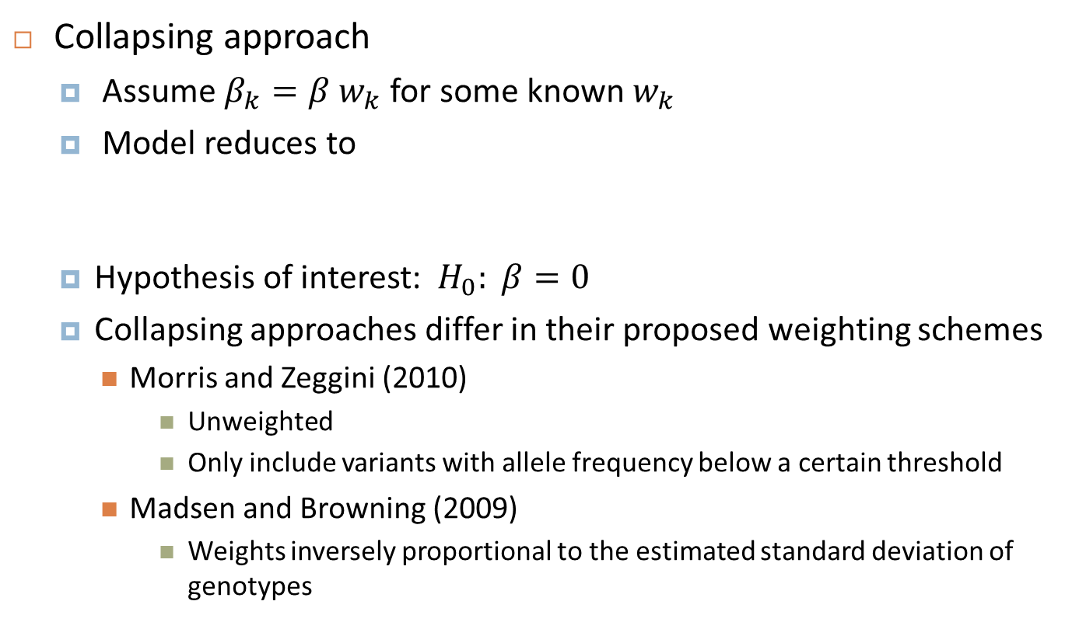
General Framework For Analysis of Rare Variants
Collapsing approach
  Assume $β_{k}={β w}_{k}$ for some known $w_{k}$
  Model reduces to
  Hypothesis of interest: $H_{0}: β=0$
  Collapsing approaches differ in their proposed weighting schemes
    Morris and Zeggini (2010)
      Unweighted
      Only include variants with allele frequency below a certain threshold
    Madsen and Browning (2009)
      Weights inversely proportional to the estimated standard deviation of genotypes
10

Slide 11
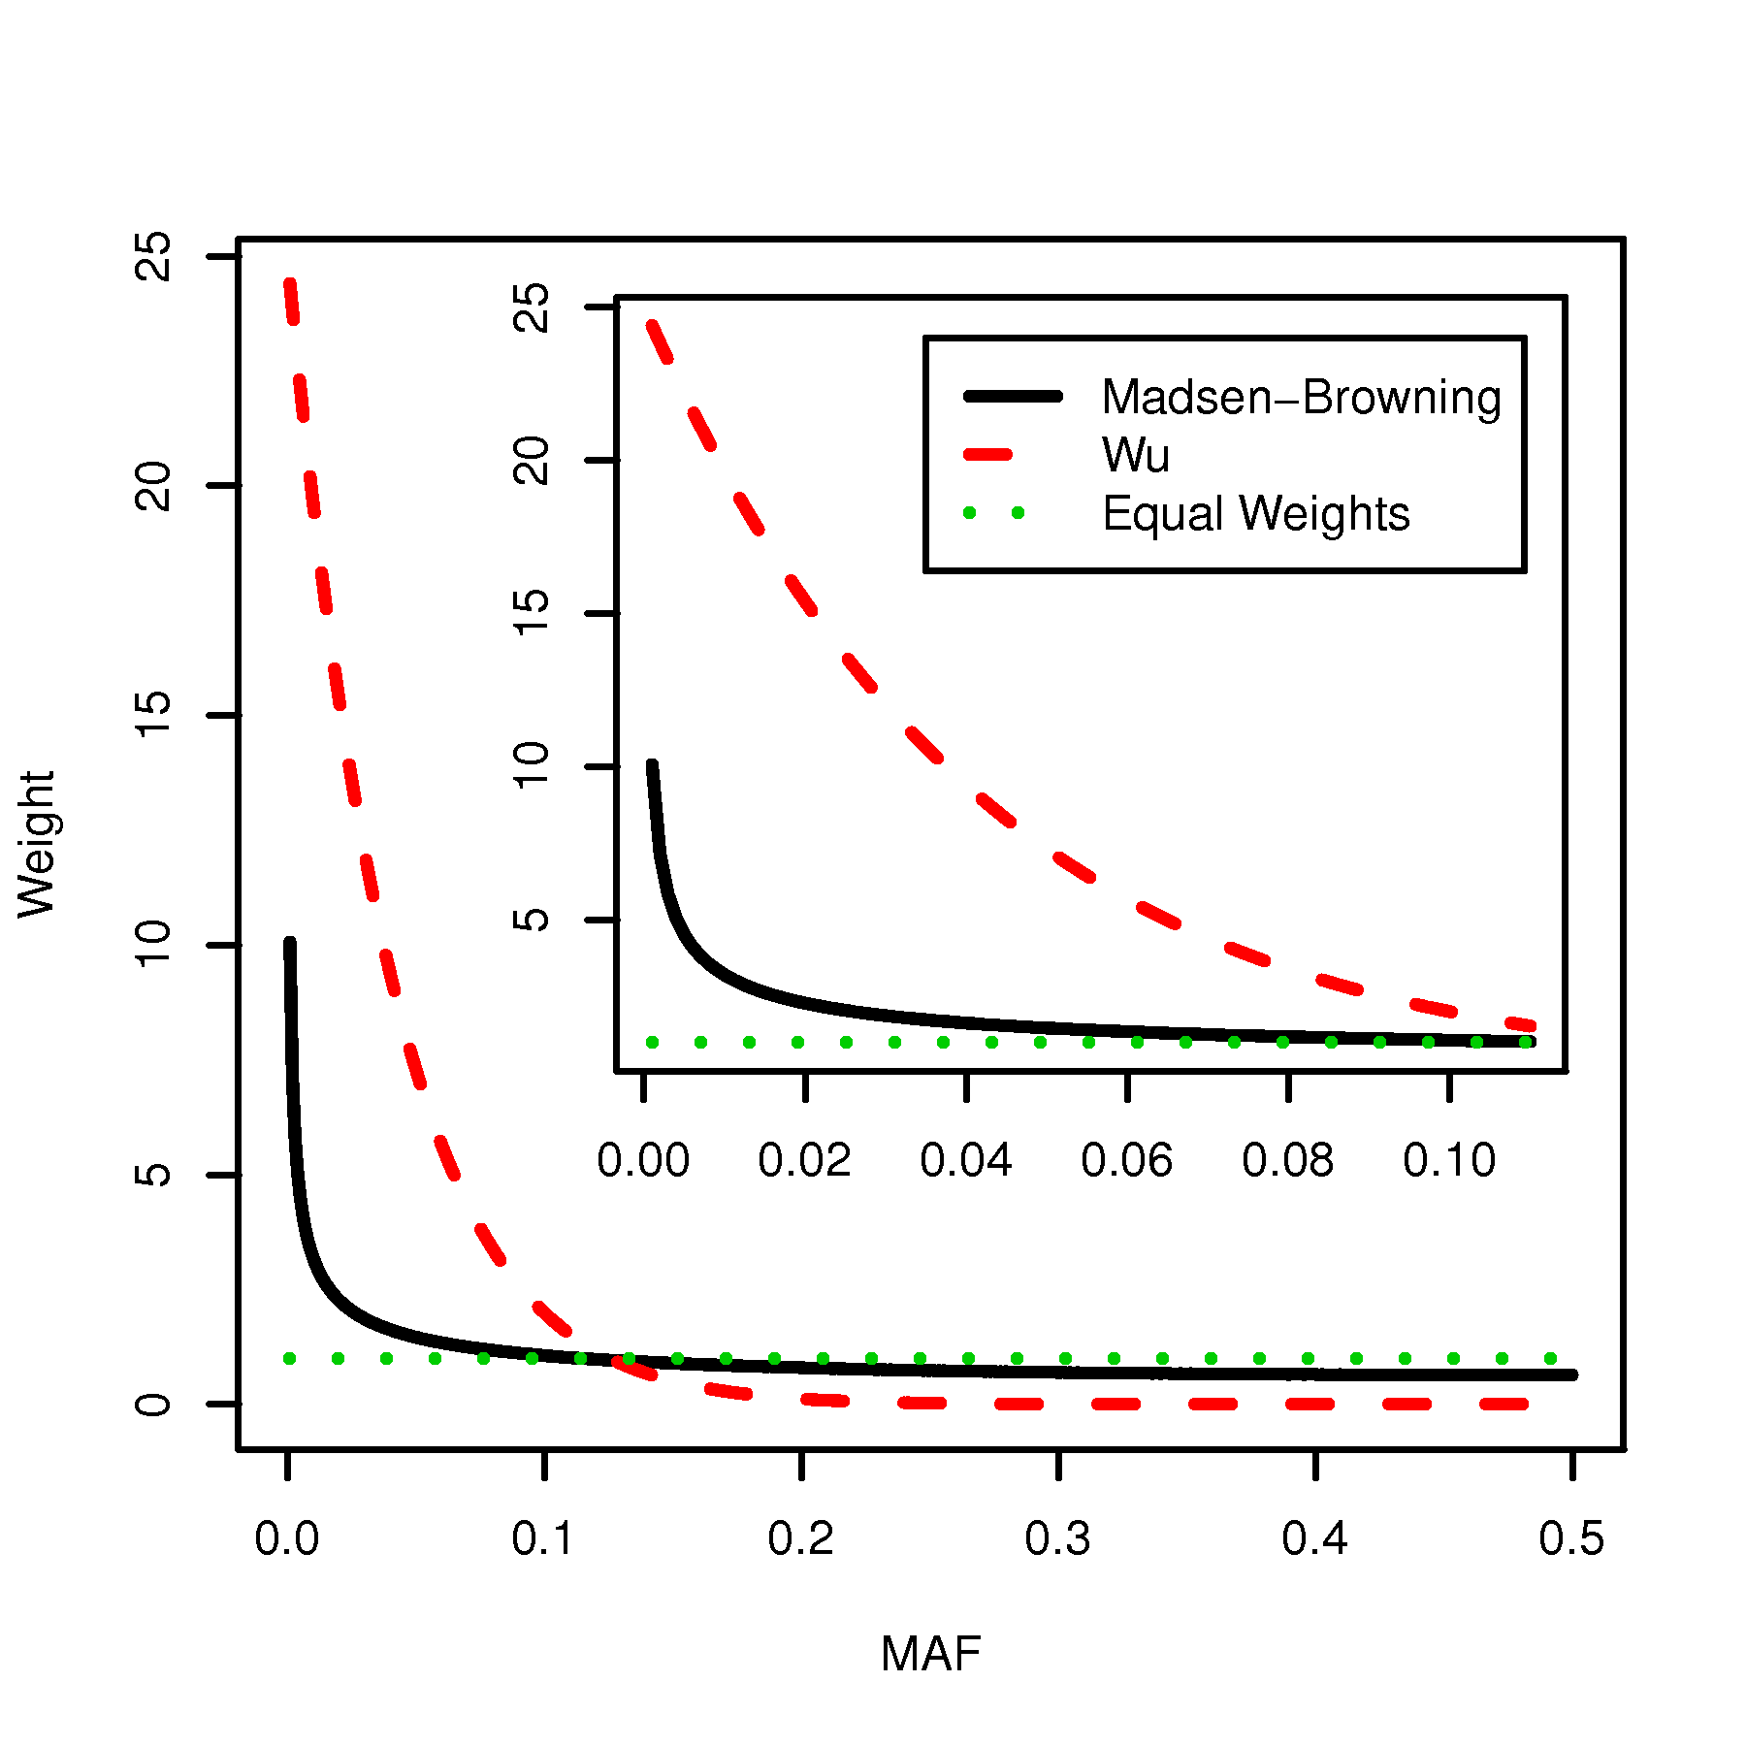
Comparison of Weighting Schemes

Slide 12
Summary of Collapsing Methods
Get a summary measure of all rare variants for each individual
  Li and Leal: Sum of variants or indicator of the present of at least one rare variants
  Morris and Zeggini: Number/proportion of variants with a least one copy of the rare allele
  Madsen and Browning: Weighted sum of the number of rare alleles
Measure association between genetic summary measure and trait of interest
  Logistic regression for binary traits
  Linear regression for quantitative traits
  Survival analysis for censored traits
12

Slide 13
Meta-analysis Approach for Collapsing Methods
From collapsing approaches, get an estimate of effect of collapsed gene score (β ) and its standard error
Perform meta-analysis using typical approaches
  Inverse-variance weighted (fixed-effect) meta-analysis
  Random effect meta-analysis
  If β ’s are not comparable (e.g. different scale), combine p-values using weighted Z-score or Fisher’s approach
Limitations
  Need to verify that “rare” alleles are the same across cohorts
  Most powerful when all variants have same direction of effect
13

Slide 14
Sequence Kernel Association Test (SKAT)
Wu, MC, Lee S, Cai T, Li Y, Boehnke M, Lin X (2011) Rare-variant association testing for sequencing data with the Sequence Kernel Association Test. Am J Hum Gent 89: 82-93.
Supervised test for the joint effects of multiple variants in a region on a phenotype
  Region can be genes, moving windows across the genome, etc.
Allows for inclusion of covariates
Does not require permutation
14

Slide 15
Sequence Kernel Association Test (SKAT)
General Model:
Assumptions:
Want to test H₀: β₁ = β₂ = … = β_{K} = 0
Assume
  τ is a variance component & w_{k} is a pre-specified weight for variant k
Testing H₀: β₁ = β₂ = … = β_{K} = 0 equivalent to H₀: τ = 0
15

Slide 16
SKAT Statistic
Variance component score test statistic
G is the N x K genotype matrix (additively coded genotypes)
W=diag(w₁, w₂, w₁,…, w_{K})
  Weights of the K variant sites
Under the null hypothesis, Q ~ mixture of χ² distributions
  Mixing parameters can be estimated from eigenvectors of matrix GWG’
  Depends on weights (W) and on LD between variants
  Very computationally efficient; no need for permutations
16

Slide 17
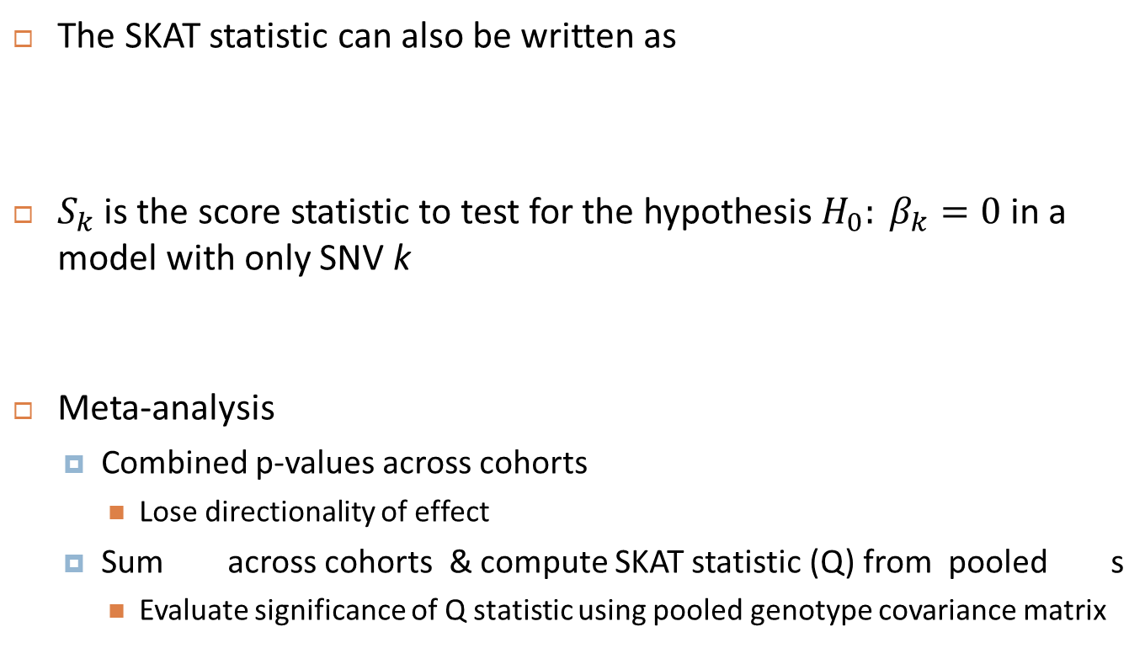
Meta-analysis of SKAT Statistic
The SKAT statistic can also be written as
$S_{k}$ is the score statistic to test for the hypothesis $H_{0}: β_{k}=0$ in a model with only SNV k
Meta-analysis
  Combined p-values across cohorts
    Lose directionality of effect
  Sum across cohorts & compute SKAT statistic (Q) from pooled s
    Evaluate significance of Q statistic using pooled genotype covariance matrix
17

Slide 18
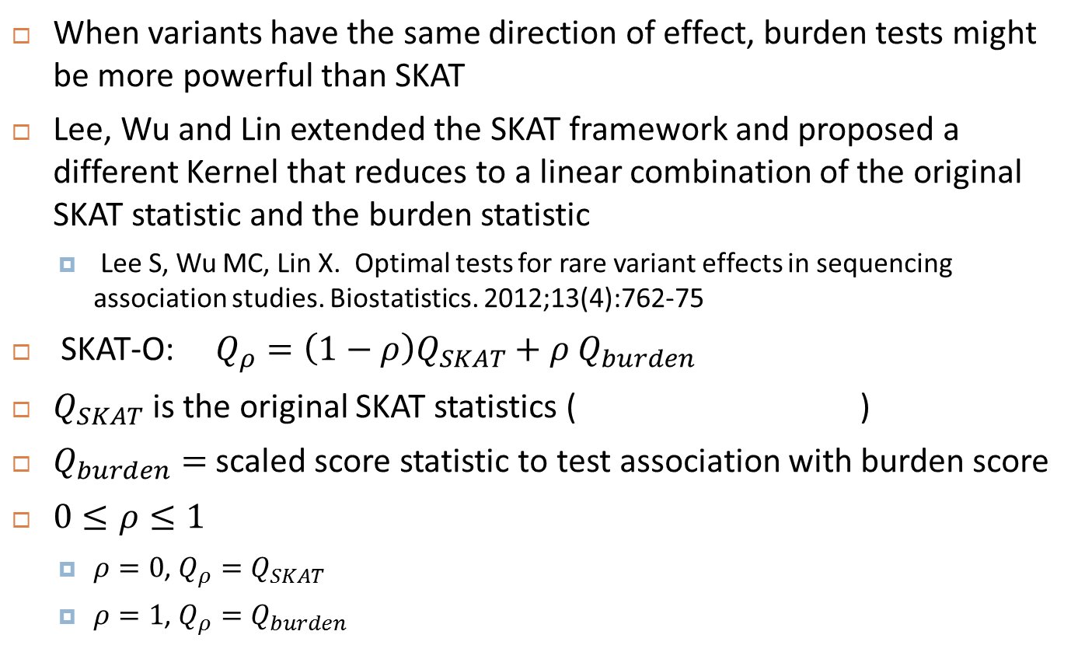
SKAT-O
When variants have the same direction of effect, burden tests might be more powerful than SKAT
Lee, Wu and Lin extended the SKAT framework and proposed a different Kernel that reduces to a linear combination of the original SKAT statistic and the burden statistic
  Lee S, Wu MC, Lin X. Optimal tests for rare variant effects in sequencing association studies. Biostatistics. 2012;13(4):762-75
SKAT-O: $Q_{ρ}=\left(1−ρ\right)Q_{SKAT}+ρ Q_{burden}$
$Q_{SKAT}$ is the original SKAT statistics ( )
$Q_{burden}=$ scaled score statistic to test association with burden score
$0≤ρ≤1$
  $ρ=0$, $Q_{ρ}=Q_{SKAT}$
  $ρ=1$, $Q_{ρ}=Q_{burden}$

Slide 19
Rare Variant Analysis
Currently, more statistical approaches than application papers
Although simulation studies are useful in evaluating new methods, the value of these approaches will be judged by whether or not they can identify regions with rare variants associated with a trait of interest
Multiple ongoing projects are collecting exome chip data, and exome or whole genome sequencing data
  Applications of these rare variant approaches should be forthcoming
  Which statistical method will be most useful/successful?
Most challenging issue in rare variant analysis: which SNVs to include in gene-based/region-based tests
  Omitting SNVs with true effect will reduce power
  Including SNVs with no effect will add noise and also reduce power

Slide 20
Selecting Groups of Rare Variants
Zuk et al. proposed several strategies to improve the chances to select all “causal” variants while omitting benign mutations
  Select only disruptive variants (stop, frameshift, or splice-sites which severely disrupt protein structure), as predicted by a variety of prediction algorithms (e.g. SIFT, Polyphen2, MutationTaster;
  Include disruptive mutations + missense mutations filtered by allele frequency;
  Include disruptive mutations and missense mutations filtered by severity, as predicted by the prediction algorithms;
  Selecting disruptive mutations from all genes within a gene set.
Zuk O et al. Searching for missing heritability: designing rare variant association studies. PNAS 2014; 111(4):E455-64

Slide 21
Effect of Exonic Rare Variants on CRP
C-reactive protein (CRP) is a biomarker of inflammation measured in plasma
Significant predictor of cardiovascular diseases
GWAS identified ~25 variants associated with CRP plasma levels
Goal: investigate association of rare exonic variants with CRP plasma levels
  In genes with SNPs known to be associated with CRP
  All genes (genome-wide)
Schick et al. Association of exome sequences with plasma C-reactive protein levels in >9000 participants. Hum Mol Genet. 2014 [Epub ahead of print]

Slide 22
Effect of Exonic Rare Variants on CRP
Exome Sequencing performed as part of Exome Sequencing Project (ESP) and CHARGE-S project
  ESP samples: ARIC (N=528), CARDIA (N=190), CHS (N=203), FHS (N=387), JHS (N=346), MESA (N=399) and the WHI (N=1307)
    1,832 European Ancestry (EA); 1,528 African Ancestry (AA)
    ESP samples were pooled and analyzed together (race stratified)
  CHARGE-S samles: FHS (757 EA), ARIC (2718 EA, 1581 AA), CHS (743 AA)
    CHARGE samples were analyzed within cohort (race stratified)
Replication in WHI (11,414 EA, 2,380AA) and JHS (2201 AA)

Slide 23
Sample Sizes by Cohort and Race
ESP |  | CHARGE ARIC |  | CHARGE FHS | CHARGE CHS | WHI |  | JHS
EA | AA | EA | AA | EA | AA | EA | AA | AA
1,832 | 1,528 | 2,718 | 1,581 | 757 | 743 | 11,414 | 2,380 | 2,201

Slide 24
Single SNV Analysis
All variants with minor allele count ≥ 5 in combined studies (ESP & CHARGE)
  5 or more carriers of 1 minor allele
  Higher threshold (20 or 40) typically used
Separate analysis in ESP, ARIC, FHS and CHS
  Race stratified analyses
  Linear regression adjusted for age, sex, BMI and principal components
    PC computed from GWAS SNPs
Inverse variance weighted meta-analysis of results

Slide 25
Gene-based Tests
Restricted to SNVs annotated as nonsynonymous, stop-gain, stop-loss, noncoding RNA splice or splice variants
Unweighted burden test (T1)
  Includes SNVs with allele frequency ≤ 1%
  Race and cohort specific analyses, inverse variance weighted meta-analysis
SKAT
  Includes SNVs with allele frequency ≤ 5%
  Wu weights
  Race and cohort specific analyses, meta-analysis of score statistics

Slide 26
Single SNV Results
Non-synonymous SNV in CRP gene (chromosome 1) associated with lower plasma CRP levels
Not explained by known common CRP SNPs
SNP | Sample | MAF | beta | SE | P | Heterogeneity (I²)
rs77832441 | EA | 0.0022 | -0.75 | 0.197 | 1.4 × 10⁻⁴ | 0
 | AA | 0.0005 | -2.06 | 0.605 | 6.7 × 10⁻⁴ | 0
 | Combined | 0.0016 | -0.88 | 0.187 | 2.9 × 10⁻⁶ | 28.4
 | Replication (EA) | 0.0031 | -0.9 | 0.110 | 3.0 × 10⁻¹⁵ | ­

Slide 27
Single SNV Results
Synonymous SNV in TOMM40 gene (chromosome 19) associated with lower plasma CRP levels
SNP | Sample | MAF | beta | SE | P | Heterogeneity (I²)
rs112849259 | EA | 0.0266 | -0.28 | 0.058 | 1.3 × 10⁻⁶ | 14.1
 | AA | 0.0391 | -0.37 | 0.069 | 1.1 × 10⁻⁷ | 0
 | Combined | 0.0308 | -0.32 | 0.044 | 1.1 × 10⁻¹² | 16.2

Slide 28
Gene-based Results
Results reaching statistical significance (exome-wide: P<2.5x10⁻⁶; candidate-gene wide: P<2.0x10⁻³)
 |  | Discovery |  |  | Replication
Test | Gene | P (EA) | P (AA) | P (EA+AA) | P (EA) | P (AA)
T1 | CRP | 0.0007 | 0.0011 | 2.4x10⁻⁶ | 2.5x10⁻¹⁴ | 0.51
SKAT | CRP | 0.0002 | 0.06 | 3.4x10⁻⁶ | 3.2x10⁻¹⁵ | 0.65
SKAT | RORA | 0.83 | 0.0017 | 0.08 | 0.28 | 0.062

Slide 29
Effect of Exonic Rare Variants on CRP: Conclusion
Novel non-synonymous SNV in CRP gene associated with decreased CRP levels
  Not associated with other inflammation-mediated traits including CHD, stroke, systolic blood pressure, waist-to-hip ratio and BMI
Gene based test suggested association with rare variants in RORA in AA
No novel genes found to be associated with CRP levels in this exome sequencing project

Slide 30
Challenges of Rare Variant Analyses
Which method(s) to use?
  Many available approaches
  Most powerful depends on underlying disease mechanism
    Are variants likely to be deleterious? (burden)
    Are both deleterious and gain-of-function mutations present? (SKAT-like)

Slide 31
Challenges of Rare Variant Analyses
Which SNVs to jointly analyze
  Choice of unit of analysis (genes or exons) is intuitive in whole exome sequencing
  For whole genome sequencing, what is an appropriate way to select SNVs for joint testing?
    Sliding windows?
    ENCODE based annotation?
  How to use of available functional annotation
    ENCODE
    Functionality prediction software

Slide 32
Acknowledgment
Ursula M. Schick
Paul L. Auer
Joshua C. Bis
Honghuang Lin
Peng Wei
Nathan Pankratz
Leslie A. Lange
Jennifer Brody
Nathan O. Stitziel
Daniel S. Kim
Christopher S. Carlson1,
Myriam Fornage
Jeffery Haessler
Li Hsu
Rebecca D. Jackson
Charles Kooperberg
Suzanne M. Leal
Bruce M. Psaty
Eric Boerwinkle
Russell Tracy
Diego Ardissino
SvatiShah
Cristen Willer
RuthLoos
Olle Melander
RuthMcpherson
Kees Hovingh
Muredach Reilly
Hugh Watkins
Domenico Girelli
Pierre Fontanillas
Daniel I. Chasman
Stacey B. Gabriel
Richard Gibbs
Deborah A. Nickerson
Sekar Kathiresan
Ulrike Peters1,
Josee Dupuis
James G. Wilson
Stephen S. Rich
Alanna C. Morrison
Emelia J. Benjamin
Myron D. Gross
Alex P. Reiner
Cohorts for Heart and Aging Research in Genomic Epidemiology
National Heart, Lung, and Blood Institute GO Exome Sequencing Project

Slide 33
Merci!
Thank you!

