Slide 1
1000 Genomes imputation results
Rainer Malik
For the ISGC analysis group
ISGC Workshop, Paris,2014

Slide 2
Discovery - Studies included
Study | N cases (IS) | N controls | TOAST
ASGC | 1,162 | 1,244 | Y
BRAINS | 371 | 2,640 | Y
GASROS_affy | 485 | 3,030 | Y
GASROS_illumina | 296 | 377 | Y
GEOS | 448 | 498 | Y
HPS | 588 | 571 | N
ISGS-SWISS | 1,014 | 1,370 | Y
MILANO | 366 | 407 | Y
VISP | 1,723 | 1,047 | N
WHI | 306 | 2,170 | Y
WTCCC2-D | 1,174 | 797 | Y
WTCCC2-UK | 2,374 | 5,175 | Y
TOTAL | 10,307 | 19,326

Slide 3
Subtype information
Study | N cases (LAS) | N_cases (CE) | N_cases (SVD) | N controls
ASGC | 421 | 240 | 310 | 1,244
BRAINS | 40 | 78 | 29 | 2,640
GASROS_affy | 102 | 198 | 59 | 3030
GASROS_illu | 68 | 106 | 24 | 377
GEOS | 37 | 90 | 54 | 498
ISGS-SWISS | 217 | 235 | 187 | 1,370
MILANO | 73 | 64 | 25 | 407
WHI | 31 | 42 | 81 | 2,170
WTCCC2-D | 330 | 346 | 106 | 797
WTCCC2-UK | 498 | 460 | 474 | 5,175
TOTAL | 1,817 | 1,859 | 1,349 | 17,708

Slide 4
Subtype | Locus | Top SNP | P-value
IS | PCDH18 | rs9683944 | 1.50E-6
IS | PLSCR5 | rs342920 | 3.18E-7
IS | GLRX | rs3777209 | 6.59E-7
IS | SHISA6 | rs16944241 | 2.13E-6
IS | IL12RB2 | rs10489625 | 1.93E-6
LAS | HDAC9 | rs57301765 | 2.93E-11
LAS | CHD1 | rs79980116 | 8.56E-7
LAS | GUCY1A3 | rs79472290 | 1.44E-6
LAS | Chr6p21/SUPTH3 | rs4714801 | 4.42E-5
LAS | CTNNA3 | rs2660040 | 1.77E-6
CE | TNFSF11 | rs4941428 | 3.37E-9
CE | PITX2 | rs2723334 | 1.61E-8
CE | ZFHX3 | rs12932445 | 1.27E-7
CE | CBFA2T3 | rs4039572 | 3.04E-6
SVD | GCH1 | rs142220441 | 4.45E-7
SVD | MKNK2 | rs115591258 | 3.55E-7
SVD | LRRTM4 | rs59078057 | 4.65E-7
SVD | ALK | rs78522260 | 2.10E-6
SVD | AKAP12 | rs10457874 | 7.04E-7

Slide 5
European Replication

Slide 6
Replication Samples included
Study | IS cases | LAS cases | SVD cases | CE cases | controls
Portugal | 395 | 62 | 37 | 99 | 264
Krakow | 295 | 50 | 28 | 100 | 297
Lund | 346 | 36 (*) | 13 (*) | 94 (*) | 191
Leuven (**) | 123 | 25 | 14 | 38 | 0
Germany (***) | 3,264 | 2,013 | 246 | 669 | 1,074
CADISP | 555 | 67 | 31 | 211 | 9,259
USA | 714 | 106 | 128 | 157 | 214
TOTAL | 5,692 | 2,359 | 497 | 1,368 | 11,300
* Only CCS available, were removed from subtype analysis
** no control data, were folded into German analysis
*** cases/controls from Munich and Münster (K. Berger)

Slide 7
All IS – SNPs in replication, allele frequencies
(7 loci, p threshold=7.1E-3)
SNP | Gene | EAF discovery | EAF replication
rs9683944 | PCDH18 | 0.7974 | 0.7949
rs9330355 | PCDH18 | 0.7975 | 0.7966
rs13148045 | PCDH18 | 0.8347 | 0.8361
rs6664757 | IL12RB2 | 0.0626 | 0.0584
rs10489625 | IL12RB2 | 0.9525 | 0.9516
rs16944241 | SHISA6 | 0.9788 | 0.9791
rs78160483 | SHISA6 | 0.9800 | 0.9790
rs3777209 | GLRX | 0.9418 | 0.9373
rs532436 | ABO | 0.1936 | 0.2033
rs60436833 | intergenic | 0.0681 | 0.0637
rs318373 | intergenic | 0.5135 | 0.5312
rs342920 | PLSCR5 | 0.3760 | 0.3609
rs342919 | PLSCR5 | 0.3726 | 0.3645

Slide 8
SNP | Gene | Discovery p | Discovery OR [CI] | European Replication p | European Replication OR [CI] | No. Of studies in replication
rs9683944 | PCDH18 | 1.5E-6 | 0.88 [0.84-0.93] | 0.3687 | 0.96 [0.88-1.05] | 5
rs9330355 | PCDH18 | 3.0E-6 | 0.89 [0.84-0.93] | 0.4625 | 0.97 [0.90-1.05] | 5
rs13148045 | PCDH18 | 9.3E-6 | 0.88 [0.83-0.93] | 0.7187 | 0.98 [0.90-1.07] | 6
rs6664757 | IL12RB2 | 2.0E-6 | 0.81 [0.74-0.88] | 0.2145 | 0.93 [0.82-1.05] | 6
rs10489625 | IL12RB2 | 1.9E-6 | 1.26 [1.14-1.38] | 0.873 | 1.01 [0.88-1.16] | 6
rs16944241 | SHISA6 | 2.1E-6 | 0.71 [0.62-0.82] | 0.5238 | 1.08* [0.85-1.37] | 6
rs78160483 | SHISA6 | 9.4E-5 | 0.74 [0.64-0.86] | 0.648 | 1.06* [0.83-1.35] | 6
rs3777209 | GLRX | 6.6E-7 | 0.81 [0.75-0.88] | 0.2037 | 1.14* [0.93-1.38] | 5
rs532436 | ABO | 3.6E-6 | 1.12 [1.07-1.18] | 0.007923 | 1.15 [1.04-1.28] | 5
rs60436833 | intergenic | 1.0E-5 | 1.19 [1.12-1.26] | 0.6643 | 0.97* [0.85-1.11] | 6
rs318373 | intergenic | 9.7E-8 | 0.90 [0.86-0.93] | 0.417 | 0.97 [0.89-1.05] | 5
rs342920 | PLSCR5 | 3.2E-7 | 1.11 [1.07-1.15] | 0.0482 | 1.07 [1.00-1.14] | 6
rs342919 | PLSCR5 | 0.0055 | 1.06 [1.02-1.10] | 0.04581 | 1.10 [1.00-1.20] | 5

Slide 9
Combined discovery & replication | all IS
SNP | Gene | Combined p | Combined OR
rs9683944 | PCDH18 | 4.3E-6 | 0.90 [0.87-0.94]
rs9330355 | PCDH18 | 1.2E-5 | 0.91 [0.87-0.95]
rs13148045 | PCDH18 | 9.17E-5 | 0.91 [0.87-0.95]
rs6664757 | IL12RB2 | 4.4E-6 | 0.85 [0.79-0.91]
rs10489625 | IL12RB2 | 5.98E-5 | 1.17 [1.08-1.27]
rs16944241 | SHISA6 | 0.0002 | 0.79 [0.70-0.89]
rs78160483 | SHISA6 | 0.002 | 0.82 [0.72-0.93]
rs3777209 | GLRX | 4.2E-5 | 0.85 [0.79-0.92]
rs532436 | ABO | 1.00E-7 | 1.13 [1.08-1.18]
rs60436833 | intergenic | 0.0003 | 1.13 [1.06-1.21]
rs318373 | intergenic | 2.19E-7 | 0.91 [0.88-0.94]
rs342920 | PLSCR5 | 6.67E-8 | 1.10 [1.06-1.14]
rs342919 | PLSCR5 | 0.0008 | 1.10 [1.07-1.14]

Slide 10
LAS– SNPs in replication, allele frequencies
(7 loci, p threshold=7.1E-3)
SNP | Gene | EAF discovery | EAF replication
rs9472313 | SUPT3H | 0.3179 | 0.3410
rs556621 | SUPT3H | 0.3220 | 0.3418
rs151212397 | PCDH15 | 0.0140 | 0.0198
rs73143582 | intergenic | 0.0249 | 0.015
rs184207444 | intergenic | 0.9865 | 0.9854
rs77935123 | intergenic | 0.9789 | 0.9838
rs112713881 | UBR5 | 0.0450 | 0.0415
rs112447110 | UBR5 | 0.0434 | 0.0371
rs74443985 | NACC2 | 0.0282 | 0.0308
rs79472290 | GUCY1A3 | 0.0149 | 0.0180
rs2660040 | CTNNA3 | 0.2967 | 0.2865
rs12258032 | CTNNA3 | 0.7053 | 0.7205

Slide 11
LAS – Discovery & replication data
SNP | Gene | Discovery p | Discovery OR [CI] | European Replication p | European Replication OR [CI] | No. Of studies in replication
rs9472313 | SUPT3H | 4.5E-7 | 1.23 [1.13-1.33] | 0.1468 | 1.08 [0.97-1.19] | 5
rs556621 | SUPT3H | 5.8E-5 | 1.18 [1.09-1.27] | 0.1456 | 1.08 [0.97-1.19] | 5
rs151212397 | PCDH15 | 7.7E-7 | 2.32 [1.66-3.23] | 0.213 | 0.81* [0.59-1.13] | 5
rs73143582 | intergenic | 1.4E-6 | 2.05 [1.53-2.74] | 0.4326 | 1.25 [0.71-2.18] | 3
rs184207444 | intergenic | 1.4E-7 | 0.42 [0.31-0.58] | 0.6201 | 1.34* [0.42-4.28] | 3
rs77935123 | intergenic | 3.5E-6 | 0.50 [0.37-0.67] | 0.5409 | 0.82 [0.42-1.57] | 3
rs112713881 | UBR5 | 6.3E-7 | 1.64 [1.35-1.99] | 0.6152 | 1.07 [0.83-1.37] | 5
rs112447110 | UBR5 | 3.1E-6 | 1.62 [1.32-1.90] | 0.9186 | 0.99* [0.76-1.28] | 5
rs74443985 | NACC2 | 2.9E-7 | 2.32 [1.68-3.21] | 0.4874 | 1.10 [0.84-1.44] | 4
rs79472290 | GUCY1A3 | 1.4E-6 | 2.24 [1.61-3.11] | 0.24 | 1.86 [0.66-5.22] | 3
rs2660040 | CTNNA3 | 1.8E-6 | 1.22 [1.13-1.33] | 0.3102 | 0.95* [0.86-1.05] | 5
rs12258032 | CTNNA3 | 2.1E-6 | 0.82 [0.76-0.89] | 0.5811 | 1.03* [0.93-1.14] | 5

Slide 12
Combined discovery & replication – LAS
SNP | Gene | Combined p | Combined OR
rs9472313 | SUPT3H | 1.24E-6 | 1.17 [1-10-1.24]
rs556621 | SUPT3H | 5.05E-5 | 1.14 [1-07-1.21]
rs151212397 | PCDH15 | 0.0103 | 1.36 [1.07-1.71]
rs73143582 | intergenic | 3.39E-6 | 1.84 [1.42-2.38]
rs184207444 | intergenic | 7.56E-7** | 0.46 [0.34-0.63]
rs77935123 | intergenic | 7.62E-6 | 0.54 [0.41-0.71]
rs112713881 | UBR5 | 2.26E-5 | 1.39 [1.20-1.63]
rs112447110 | UBR5 | 0.00030 | 1.34 [1.15-1.56]
rs74443985 | NACC2 | 0.00012 | 1.50 [1.22-1.85]
rs79472290 | GUCY1A3 | 7.45E-7 | 2.20 [1.61-3.01]
rs2660040 | CTNNA3 | 0.0026 | 1.10 [1.03-1.18]
rs12258032 | CTNNA3 | 0.00087 | 0.90 [0.84-0.96]

Slide 13
CE - SNPs in replication, allele frequencies
(7 loci, p threshold=7.1E-3)
SNP | Gene | EAF discovery | EAF replication
rs2723334 | PITX2 | 0.2141 | 0.2178
rs2975831 | KCNB2 | 0.6550 | 0.6589
rs2929558 | KCNB2 | 0.6631 | 0.6594
rs4941428 | TNFSF11 | 0.2511 | 0.2527
rs9525624 | TNFSF11 | 0.2410 | 0.2397
rs9533106 | TNFSF11 | 0.7595 | 0.7582
rs7252106 | EMR3 | 0.0149 | 0.0136
rs531905 | CBFA2T3 | 0.9594 | 0.9615
rs4039572 | CBFA2T3 | 0.9609 | 0.9627
rs78636564 | MYO3B | 0.9283 | 0.9337
rs12932445 | ZFHX3 | 0.8291 | 0.8056

Slide 14
CE – Discovery and replication data
SNP | Gene | Discovery p | Discovery OR [CI] | European Replication p | European Replication OR [CI] | No. Of studies in replication
rs2723334 | PITX2 | 1.6E-8 | 1.30 [1.18-1.42] | 5.2E-5 | 1.26 [1.12-1.40] | 5
rs2975831 | KCNB2 | 1.7E-6 | 1.21 [1.12-1.31] | 0.6106 | 1.03 [0.93-1.14] | 5
rs2929558 | KCNB2 | 7.4E-7 | 1.22 [1.13-1.32] | 0.8261 | 1.01 [0.91-1.13] | 5
rs4941428 | TNFSF11 | 3.3E-9 | 1.28 [1.18-1.39] | 0.6035 | 1.03 [0.92-1.15] | 5
rs9525624 | TNFSF11 | 6.0E-9 | 1.28 [1.18-1.39] | 0.05304 | 1.12 [0.99-1.25] | 5
rs9533106 | TNFSF11 | 7.6E-9 | 0.78 [0.72-0.85] | 0.02954 | 0.88 [0.79-0.99] | 5
rs7252106 | EMR3 | 7.3E-7 | 2.57 [1.77-3.72] | 0.3981 | 0.83* [0.53-1.28] | 4
rs531905 | CBFA2T3 | 3.8E-6 | 0.61 [0.49-0.75] | 0.1133 | 0.76 [0.54-1.07] | 3
rs4039572 | CBFA2T3 | 3.0E-6 | 1.65 [1.34-2.04] | 0.4705 | 1.09 [0.86-1.37] | 5
rs78636564 | MYO3B | 4.5E-7 | 0.68 [0.59-0.79] | 0.6389 | 0.95 [0.79-1.16] | 5
rs12932445 | ZFHX3 | 1.3E-7 | 1.29 [1.18-1.42] | 0.2069 | 1.08 [0.96-1.22] | 5

Slide 15
CE - Combined discovery & replication
SNP | Gene | Combined p | Combined OR
rs2723334 | PITX2 | 4.02E-12 | 1.28 [1.19-1.37]
rs2975831 | KCNB2 | 4.17E-5 | 1.14 [1.07-1.21]
rs2929558 | KCNB2 | 3.86E-5 | 1.14 [1.07-1.22]
rs4941428 | TNFSF11 | 4.26E-7 | 1.18 [1.11-1.26]
rs9525624 | TNFSF11 | 4.88E-9 | 1.22 [1.14-1.30]
rs9533106 | TNFSF11 | 2.87E-9 | 0.81 [0.77-0.87]
rs7252106 | EMR3 | 0.0012 | 1.60 [1.20-2.12]
rs531905 | CBFA2T3 | 1.90E-6 | 0.65 [0.54-0.77]
rs4039572 | CBFA2T3 | 8.22E-5 | 0.73 [0.63-0.85]
rs78636564 | MYO3B | 1.99E-5 | 0.77 [0.69-0.87]
rs12932445 | ZFHX3 | 7.88E-7 | 0.83 [0.77-0.89]

Slide 16
SVD – SNPs in replication – allele frequencies
(7 loci, p threshold=7.1E-3)
SNP | Gene | EAF discovery | EAF replication
rs75725351 | intergenic | 0.0687 | 0.0457
rs17014247 | LRRTM4 | 0.7006 | 0.6996
rs59078057 | LRRTM4 | 0.7003 | 0.7959
rs57569024 | LRRTM4 | 0.7002 | 0.7003
rs117481954 | GCH1 | 0.9846 | 0.9791
rs74712762 | TMEM108 | 0.0204 | 0.0201
rs79380341 | TMEM108 | 0.9808 | 0.9812
rs7256023 | MOB3A | 0.0810 | 0.0956
rs12259419 | KIAA1217 | 0.0170 | 0.0200
rs77420780 | KIAA1217 | 0.0170 | 0.0225
rs118000664 | KIAA1217 | 0.0138 | 0.0242
rs10457874 | AKAP12 | 0.3991 | 0.3758
rs13220913 | AKAP12 | 0.4007 | 0.3956

Slide 17
SVD – Discovery and replication data
SNP | Gene | Discovery p | Discovery OR [CI] | European Replication p | European Replication OR [CI] | No. Of studies in replication
rs75725351 | intergenic | 1.2E-7 | 1.67 [1.38-2.02] | 0.951 | 0.99* [0.68-1.44] | 5
rs17014247 | LRRTM4 | 4.6E-7 | 0.80 [0.73-0.87] | 0.9931 | 1.00 [0.85-1.17] | 5
rs59078057 | LRRTM4 | 4.6E-7 | 0.80 [0.73-0.87] | 0.3526 | 0.86 [0.63-1.18] | 3
rs57569024 | LRRTM4 | 5.1E-7 | 0.80 [0.73-0.87] | 0.4833 | 0.95 [0.81-1.11] | 5
rs117481954 | GCH1 | 1.2E-6 | 0.46 [0.34-0.63] | 0.4726 | 0.82 [0.48-1.40] | 4
rs74712762 | TMEM108 | 3.6E-7 | 2.27 [1.66-3.11] | 0.06607 | 1.55 [0.97-2.49] | 4
rs79380341 | TMEM108 | 2.6E-7 | 0.42 [0.30-0.59] | 0.05831 | 0.49 [0.24-1.03] | 3
rs7256023 | MOB3A | 1.8E-6 | 1.44 [1.24-1.67] | 0.06122 | 0.80* [0.64-1.01] | 5
rs12259419 | KIAA1217 | 1.9E-7 | 2.52 [1.78-3.57] | 0.4098 | 0.81* [0.50-1.31] | 5
rs77420780 | KIAA1217 | 1.2E-7 | 2.49 [1.78-3.49] | 0.4224 | 0.78* [0.42-1.43] | 5
rs118000664 | KIAA1217 | 3.4E-8 | 3.09 [2.07-4.61] | 0.1422 | 0.61* [0.32-1.18] | 5
rs10457874 | AKAP12 | 7.0E-7 | 1.24 [1.14-1.34] | 0.2362 | 1.09 [0.94-1.27] | 5
rs13220913 | AKAP12 | 6.0E-7 | 1.24 [1.14-1.35] | 0.018 | 1.84 [1.11-3.06] | 1*

Slide 18
Combined discovery + replication – SVD
SNP | Gene | Combined p | Combined OR
rs75725351 | intergenic | 2.68E-6 | 1.50 [1.27-1.78]
rs17014247 | LRRTM4 | 1.05E-5 | 0.84 [0.78-0.91]
rs59078057 | LRRTM4 | 3.29E-7 | 0.80 [0.74-0.87]
rs57569024 | LRRTM4 | 2.31E-6 | 0.83 [0.77-0.90]
rs117481954 | GCH1 | 5.45E-6 | 0.54 [0.41-0.70]
rs74712762 | TMEM108 | 1.51E-7 | 2.02 [1.55-2.62]
rs79380341 | TMEM108 | 4.34E-8 | 0.43 [0.32-0.58]
rs7256023 | MOB3A | 0.0028 | 1.21 [1.07-1.37]
rs12259419 | KIAA1217 | 0.00016 | 1.73 [1.30-2.29]
rs77420780 | KIAA1217 | 2.34E-5 | 1.89 [1.41-2.54]
rs118000664 | KIAA1217 | 8.07E-5 | 1.99 [1.41-2.80]
rs10457874 | AKAP12 | 9.66E-7 | 1.20 [1.12-1.29]
rs13220913 | AKAP12 | 1.09E-7 | 1.25 [1.15-1.36]

Slide 19
Trans-Ethnic Replication using RACE
Using Han&Eskin Random Effects Model if heterogeneity is present

Slide 20
RACE Sample Characteristics
Study | IS cases | LAS cases | SVD cases | CE cases | controls
RACE1 | 1,218 | 200 | 192 | 229 | 1,158
RACE2 | 1,167 | 155 | 122 | 193 | 4,035
TOTAL | 2,385 | 355 | 314 | 422 | 5,193

Slide 21
Selected loci – RACE replication data
SNP | Subtype | Discovery + EUR replication p | Discovery + European Replication OR [CI] | RACE Replication p | RACE Replication OR [CI]
rs532436 | IS (ABO) | 1.00E-7 | 1.13 [1.08-1.18] | 0.9887 | 1.00 [0.89-1.12]
rs342920 | IS (PLSCR5) | 6.67E-8 | 1.10 [1.06-1.14] | 0.4597 | 1.03 [0.95-1.12]
rs342919 | IS (PLSCR5) | 0.00083 | 1.10 [1.07-1.14] | 0.4571 | 1.03 [0.95-1.12]
rs79472290 | LAS (GUCY1A3) | 7.54E-7 | 2.20 [1.61-3.01] | 0.0122 (only RACE1) | 2.44 [1.22-4.92]
rs2723334 | CE (PITX2) | 4.02E-12 | 1.28 [1.19-1.37] | 0.3549 | 1.08 [0.92-1.26]
rs9525624 | CE (TNFSF11) | 5.71E-10 | 1.26 [1.17-1.35] | 0.1686 | 1.12 [0.95-1.33]
rs9533106 | CE (TNFSF11) | 2.87E-9 | 0.81 [0.77-0.87] | 0.1458 | 0.88 [0.75-1.04]
rs74712762 | SVD (TMEM108) | 1.51E-7 | 2.02 [1.55-2.62] | NA (QC) | NA (QC)
rs79380341 | SVD (TMEM108) | 4.34E-8 | 0.43 [0.32-0.58] | NA (QC) | NA (QC)
rs59078057 | SVD (LRRTM4) | 3.29E-7 | 0.80 [0.74-0.87] | 0.5527 | 1.06* [0.88-1.26]
rs10457874 | SVD (AKAP12) | 9.66E-7 | 1.20 [1.12-1.29] | 0.2263 | 1.13 [0.93-1.39]
rs13220913 | SVD (AKAP12) | 1.09E-7 | 1.25 [1.15-1.36] | 0.2193 | 1.14 [0.93-1.39]

Slide 22
Selected loci – overall analysis results
SNP | Subtype | Gene | Discovery + EUR replication+ RACE replication P-value
rs532436 | IS | ABO | 1.06E-06
rs342920 | IS | PLSCR5 | 1.47E-07
rs342919 | IS | PLSCR5 | 0.0074
rs79472290 | LAS | GUCY1A3 | 3.00E-08
rs2723334 | CE | PITX2 | 3.01E-11
rs9525624 | CE | TNFSF11 | 3.31E-09
rs9533106 | CE | TNFSF11 | 1.41E-09
rs59078057 | SVD | LRRTM4 | 5.92E-06
rs10457874 | SVD | AKAP12 | 5.19E-07
rs13220913 | SVD | AKAP12 | 7.45E-08
rs79380341 (TMEM108, SVD is GW-significant without replication in RACE)

Slide 23
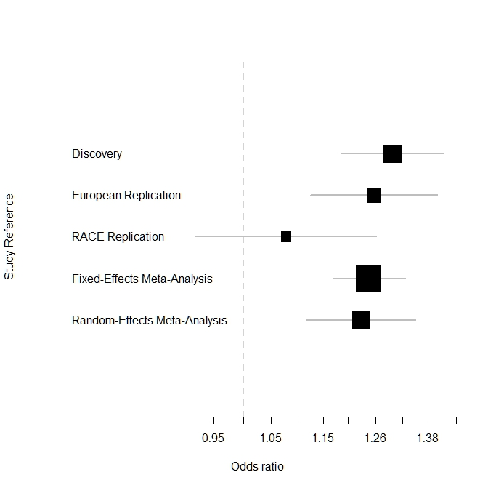
rs2723334 (PITX2)

Slide 24
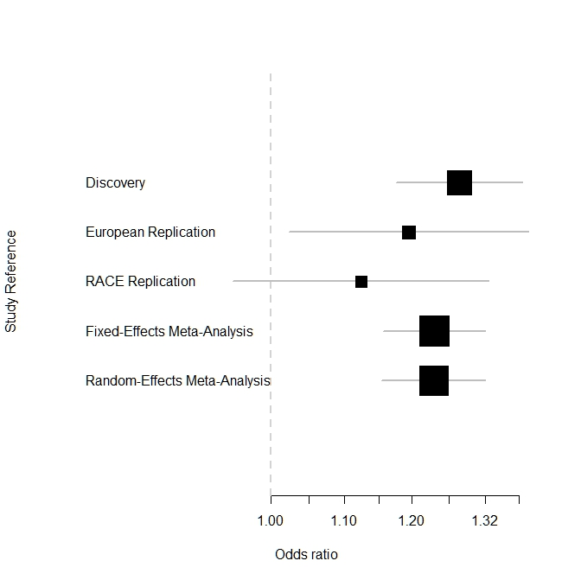
rs9525624 (TNFSF11)

Slide 25
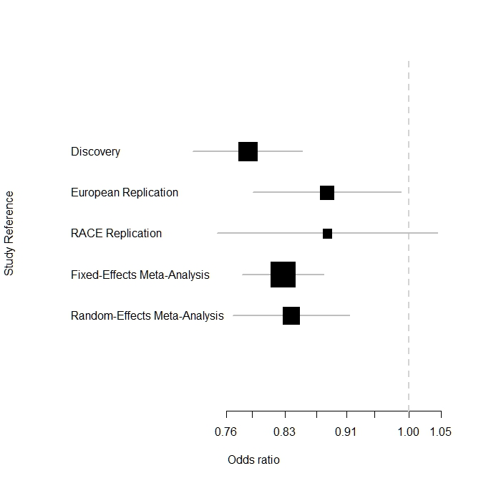
rs9533106 (TNFSF11)

Slide 26
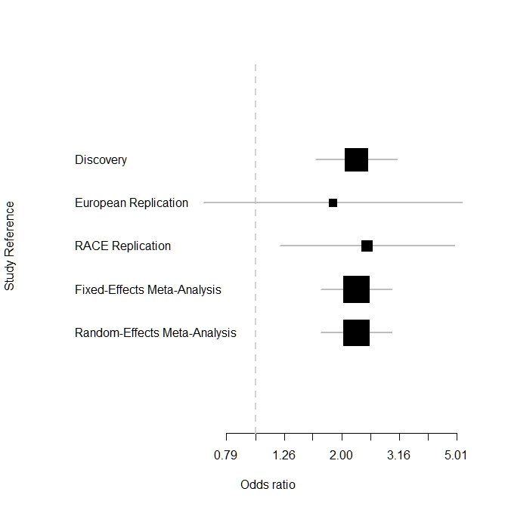
rs79472290 (GUCY1A3)

Slide 27
TNFSF11
tumor necrosis factor (ligand) superfamily, member 11
Formerly known as: RANKL
Important player in the RANK/RANKL/OPG pathway of osteogenesis
One of main risk loci for osteoporosis
rs9525624 and rs9533106 are eQTLs for TNFSF11 (Lappalainen et al.,
Nature, 2013) in lymphoblastoid cell lines
rs9525624 is eQTL for AKAP11 (Westra et al., Nature Genetics, 2013) in
non-transformed peripheral blood samples

Slide 28
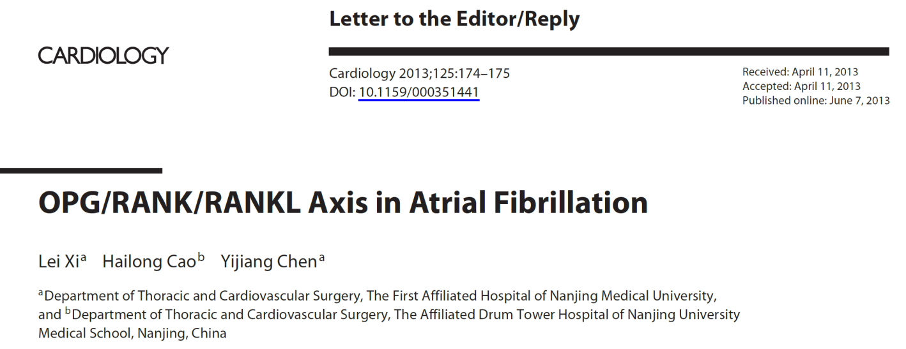
TNFSF11
Not seen in AF > contact AF consortium
Mechanism?

Slide 29
GUCY1A3
guanylate cyclase 1, soluble, alpha 3
Main receptor for nitric oxide (NO)
CAD risk locus (Deloukas et al, Nature Genetics, 2013)
Blood pressure GWAS hit (Ehret et al, Nature, 2011)
New locus for MI after exome sequencing (Erdmann et al, Nature, 2013)

