Slide 1
1000 Genomes imputation
Rainer Malik
For the ISGC analysis group
ISGC Lund, 2013

Slide 2
Overview
Studies included
Analysis strategy
Results
Trans-ethnic meta-analysis
Replication / outlook

Slide 3
PRELIMINARY DATA !!!!
(also confidential)
At least two additional studies will be integrated
(WHI and VISP)
in the discovery phase

Slide 4
Studies included
Study | N cases (IS) | N controls | TOAST
ASGC | 1,162 | 1,244 | Y
BRAINS | 371 | 2,640 | Y
GASROS_affy | 485 | 3,030 | Y
GASROS_illumina | 296 | 377 | Y
GEOS | 448 | 498 | Y
HPS | 588 | 571 | N
ISGS-SWISS | 1,014 | 1,370 | Y
MILANO | 366 | 407 | Y
WTCCC2-D | 1,174 | 797 | Y
WTCCC2-UK | 2,374 | 5,175 | Y
TOTAL | 8,368 | 16,109
WHI: 306 cases / 2,170 controls uploaded

Slide 5
Subtype information
Study | N cases (LAS) | N_cases (CE) | N_cases (SVD) | N controls
ASGC | 421 | 240 | 310 | 1,244
BRAINS | 40 | 78 | 29 | 2,640
GASROS_affy | 102 | 198 | 59 | 3030
GASROS_illu | 68 | 106 | 24 | 377
GEOS | 37 | 90 | 54 | 498
ISGS-SWISS | 217 | 235 | 187 | 1,370
MILANO | 73 | 64 | 25 | 407
WTCCC2-D | 330 | 346 | 106 | 797
WTCCC2-UK | 498 | 460 | 474 | 5,175
TOTAL | 1,786 | 1,817 | 1,268 | 15,538
WHI: 31 LAS, 42 CE, 81 SVD / 2,170 controls

Slide 6
Analysis strategy
Individual Association results
QC:
Parameters: r2>0.3, MAF>0.01
Filter out SNPs p<1E-10
Genomic control
Inverse-variance Fixed-effects meta-analysis for InDels using genomic control
Inverse-variance Fixed-effects meta-analysis for SNPs using genomic control
N_studies > 5
I²<50
Final results
~7.5M SNPs

Slide 7
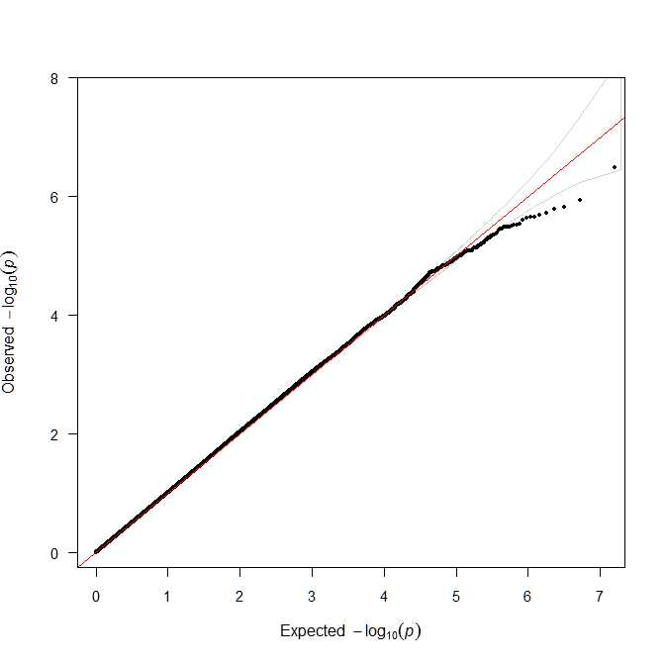
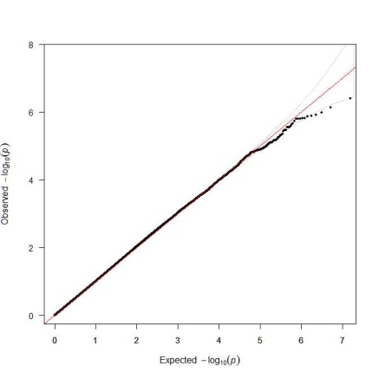
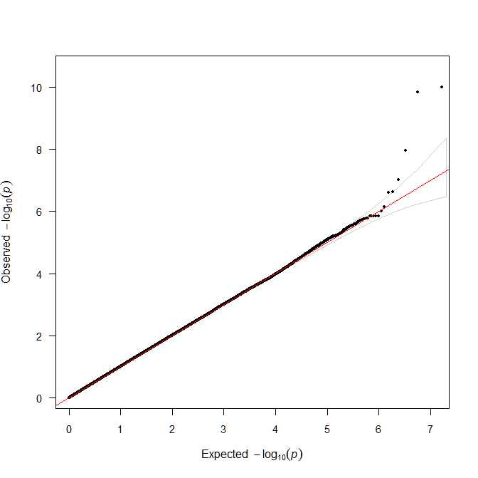
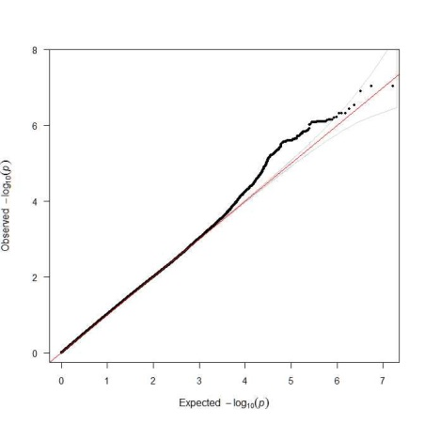
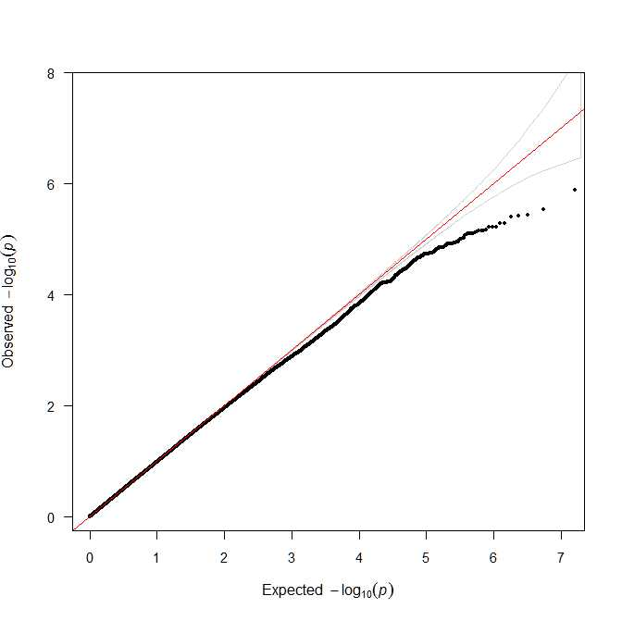
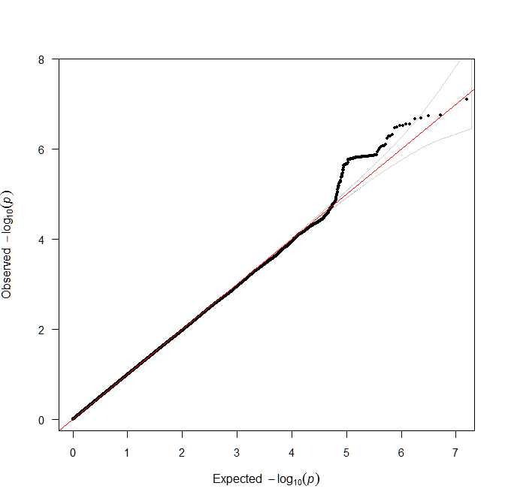
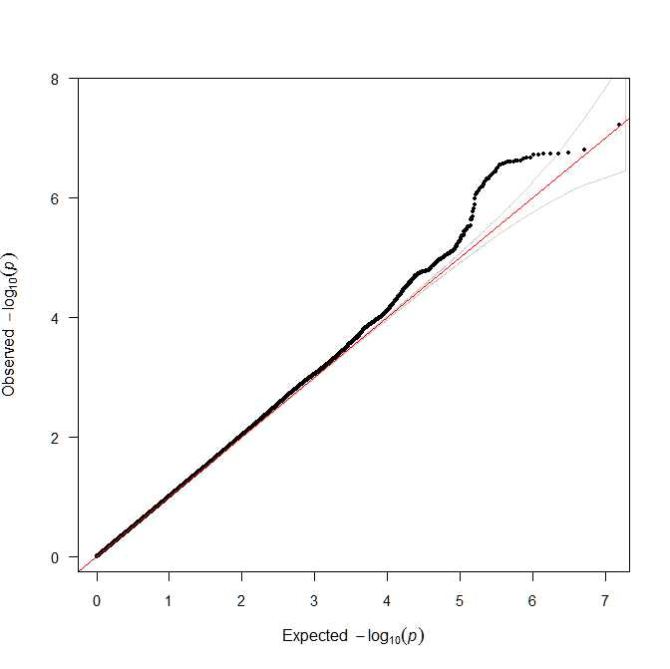
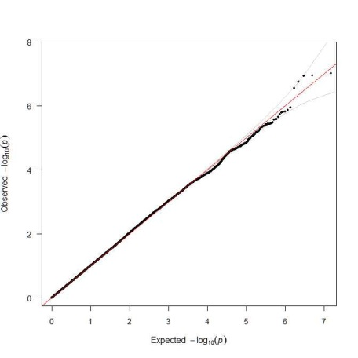
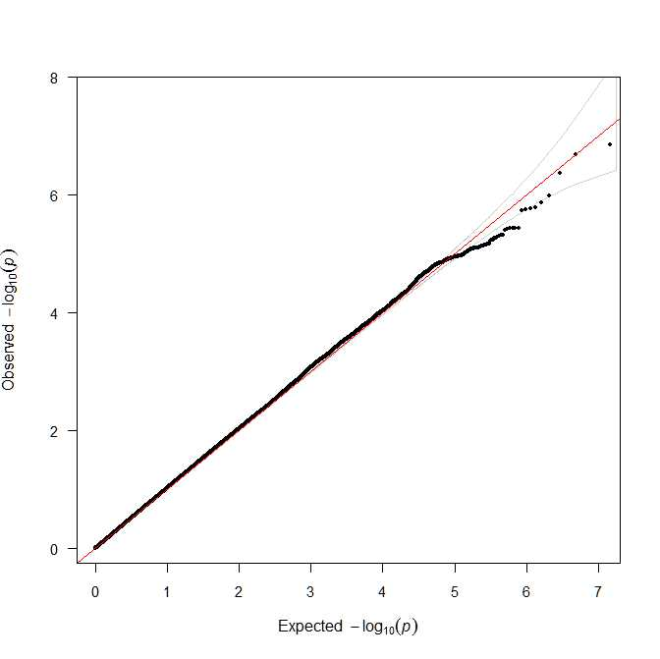
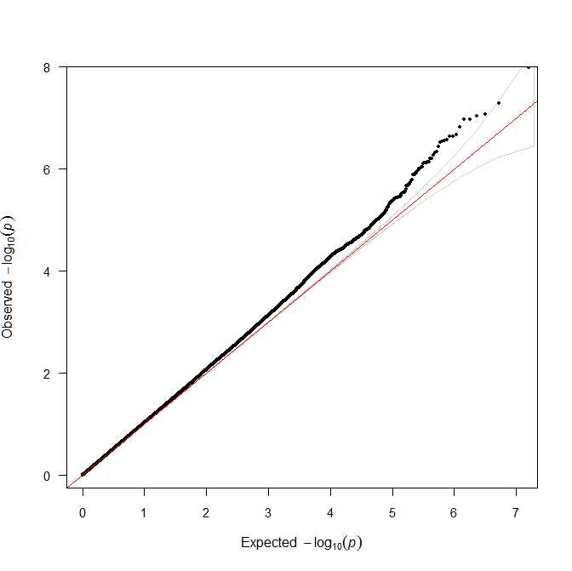
QC results – individual studies (IS)

Slide 8
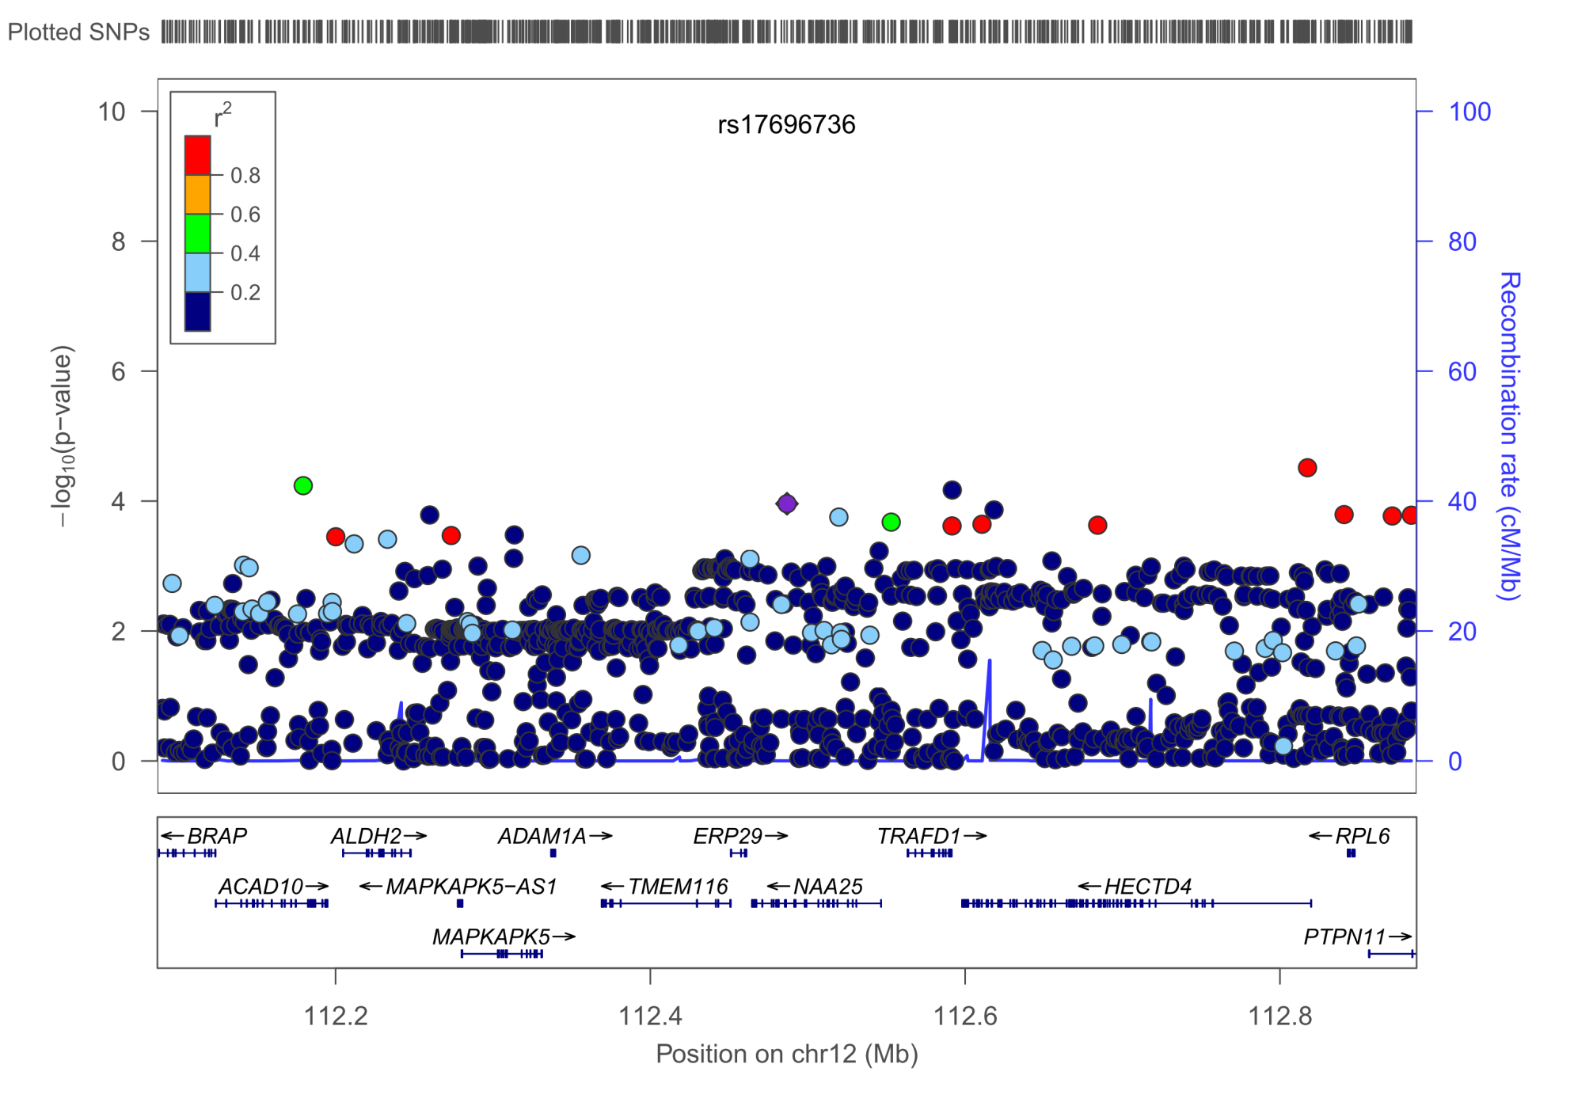
Known loci – IS (chr12), p=3.07E-5 (smallest p in region)
Previous lead SNP in known locius is shown as purple diamond

Slide 9
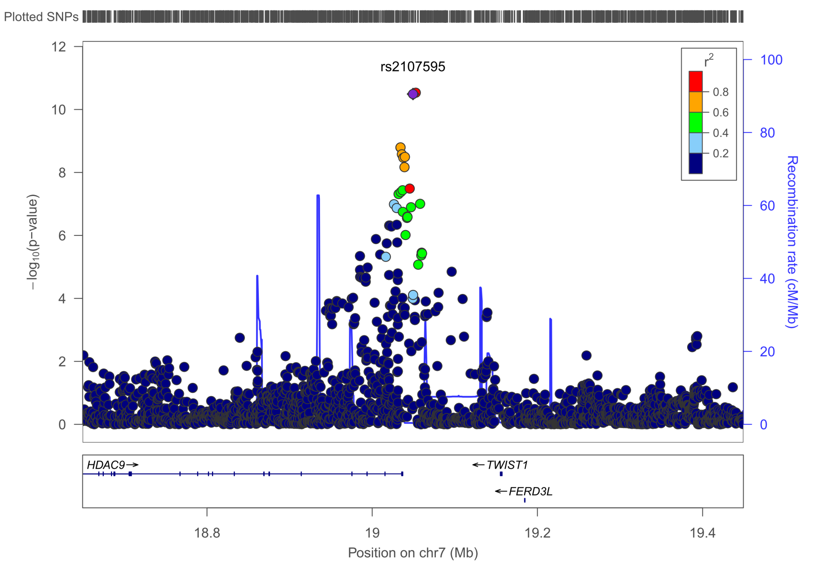
HDAC9 – LAS, p=2.93E-11

Slide 10
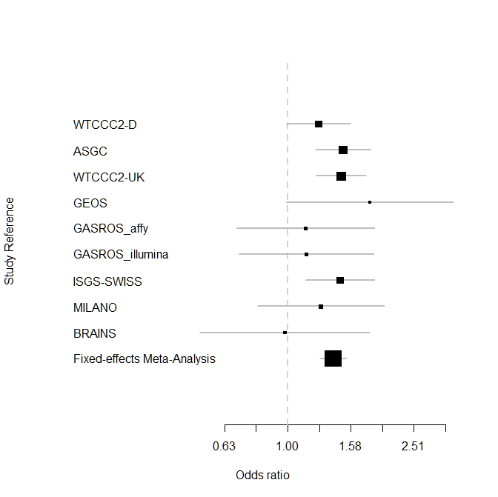
OR METASTROKE 1.39 (1.24–1.56)
OR=1.40 [1.26-1.53]
I²=0.0%
P_{het}=0.7463

Slide 11
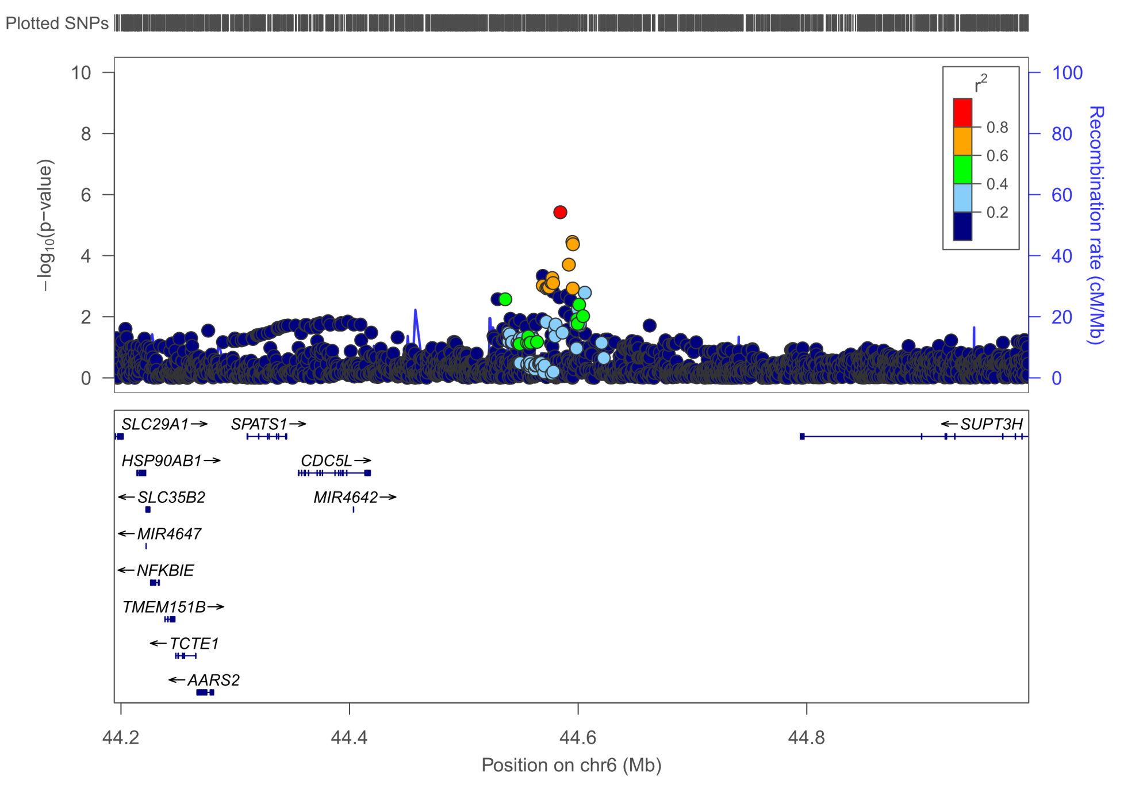
Chr6p21 – LAS, p=3.78E-6
Previous lead SNP not present in dataset

Slide 12
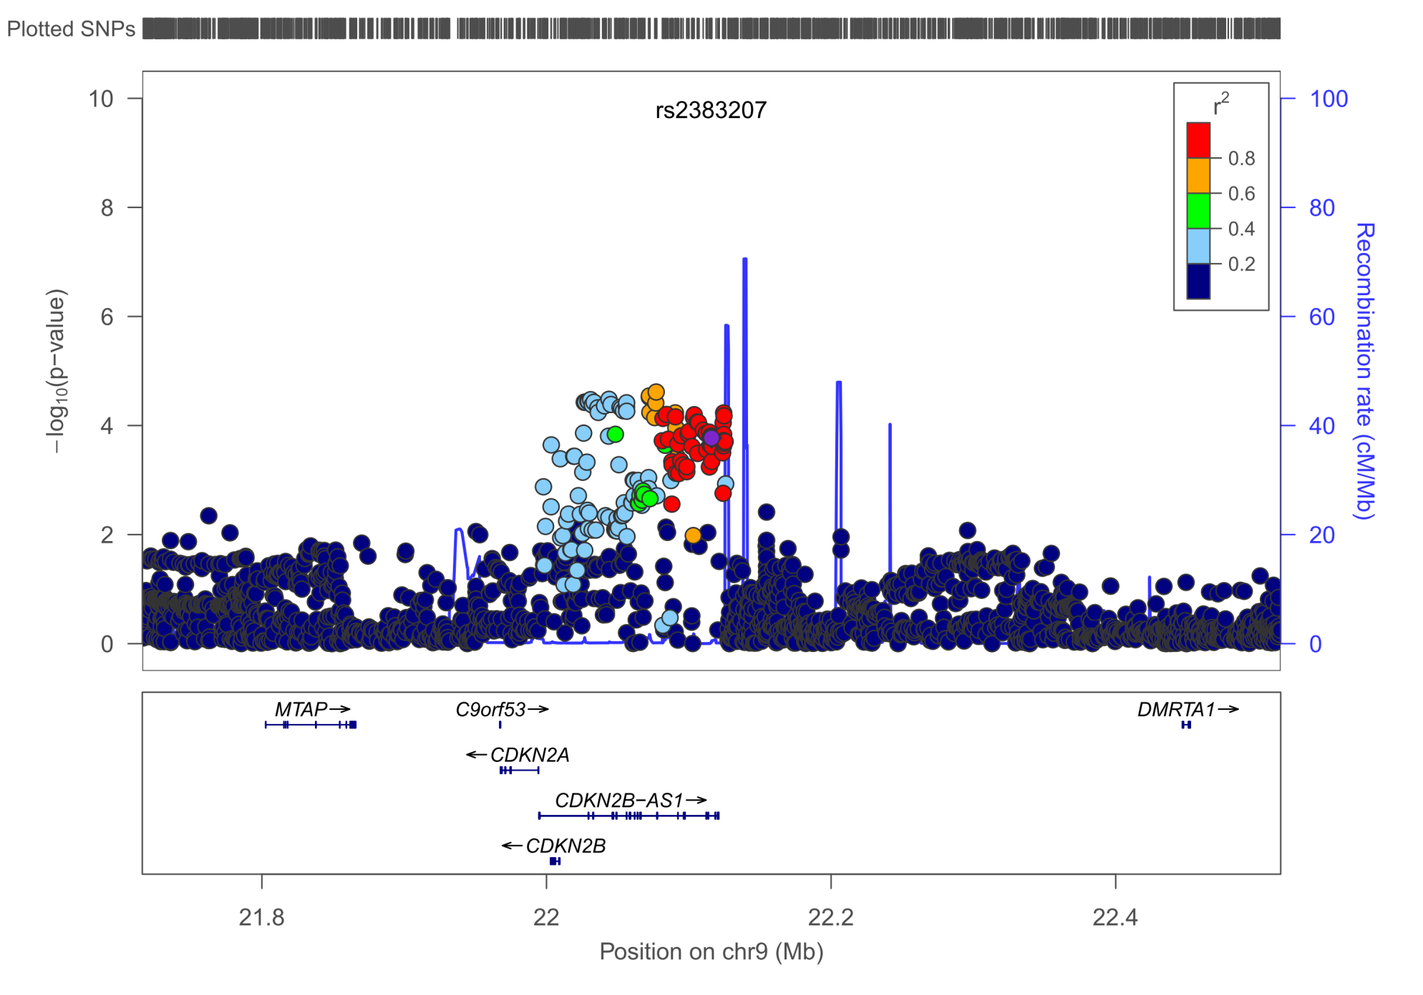
9p21 – LAS, p=2.43E-5

Slide 13
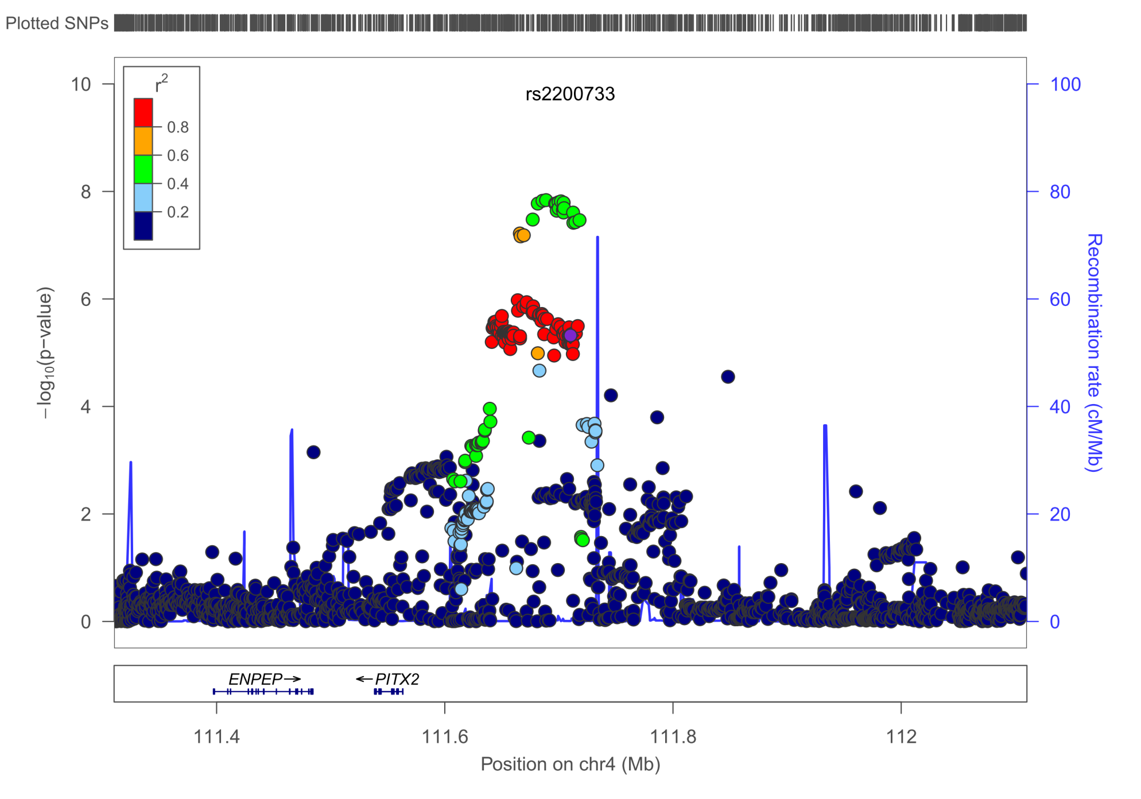
PITX2 – CE, p=1.45E-8
Previous lead SNP in known loci is shown as purple diamond

Slide 14
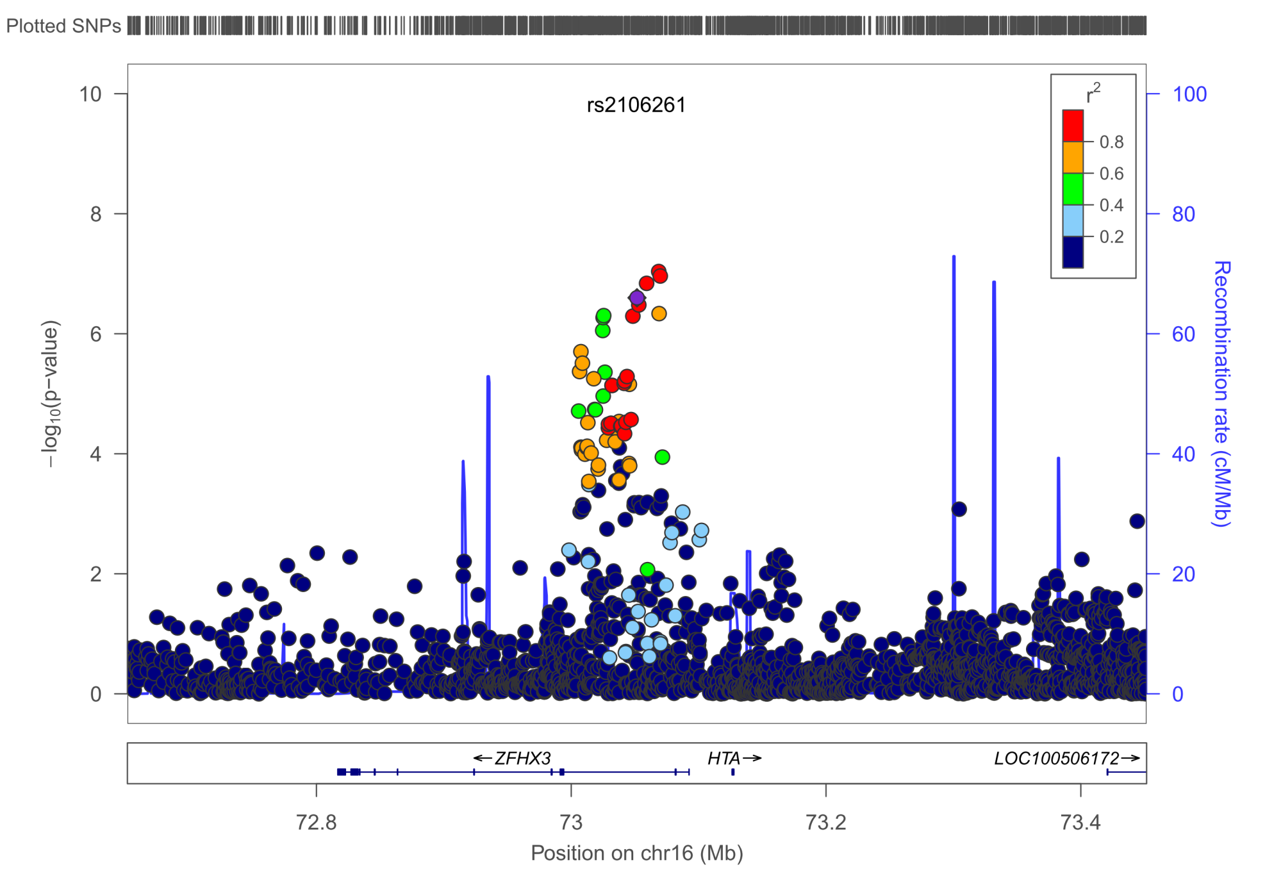
ZFHX3 – CE, p=9.17E-8

Slide 15
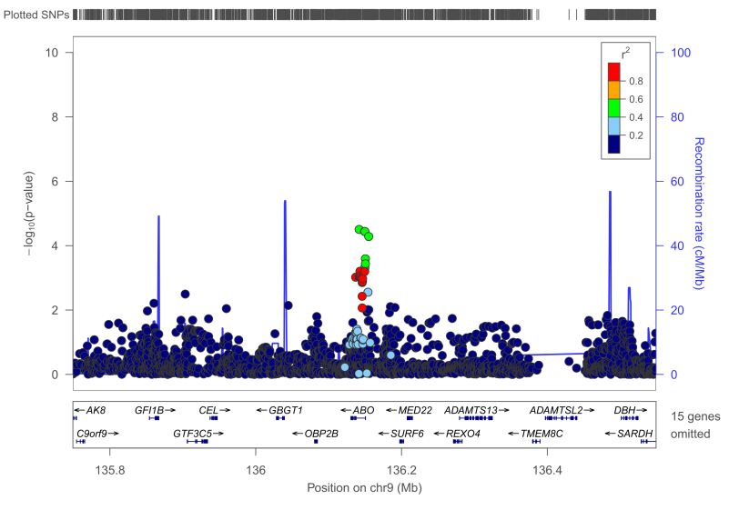
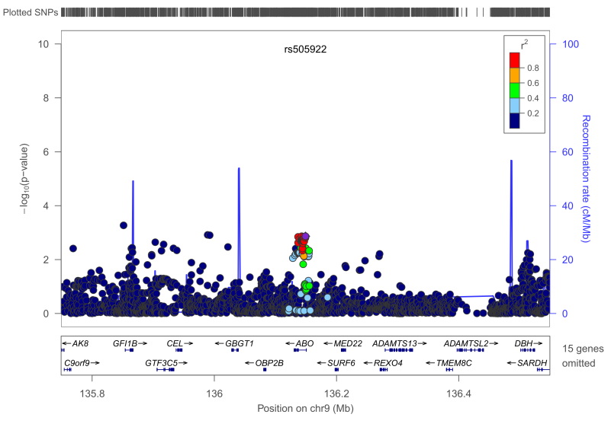
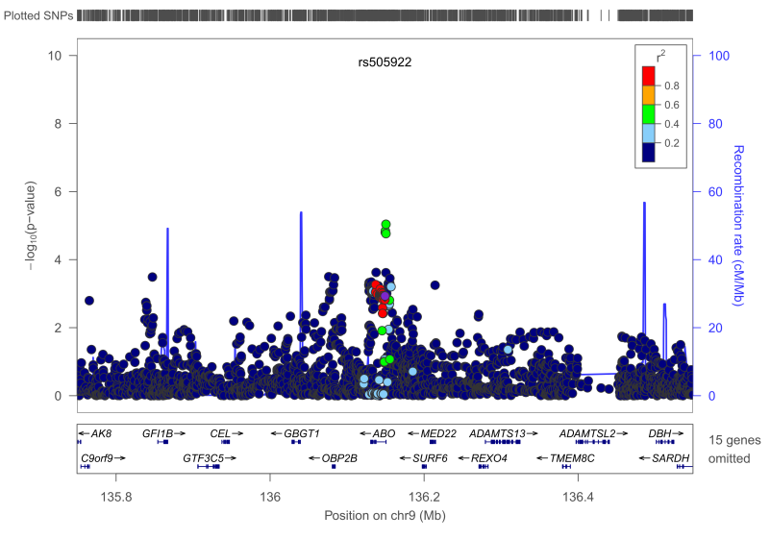
ABO – IS/LAS/CE, p=3.13E-5 / 1.3E-3 / 9.12E-6
IS
LAS
CE

Slide 16
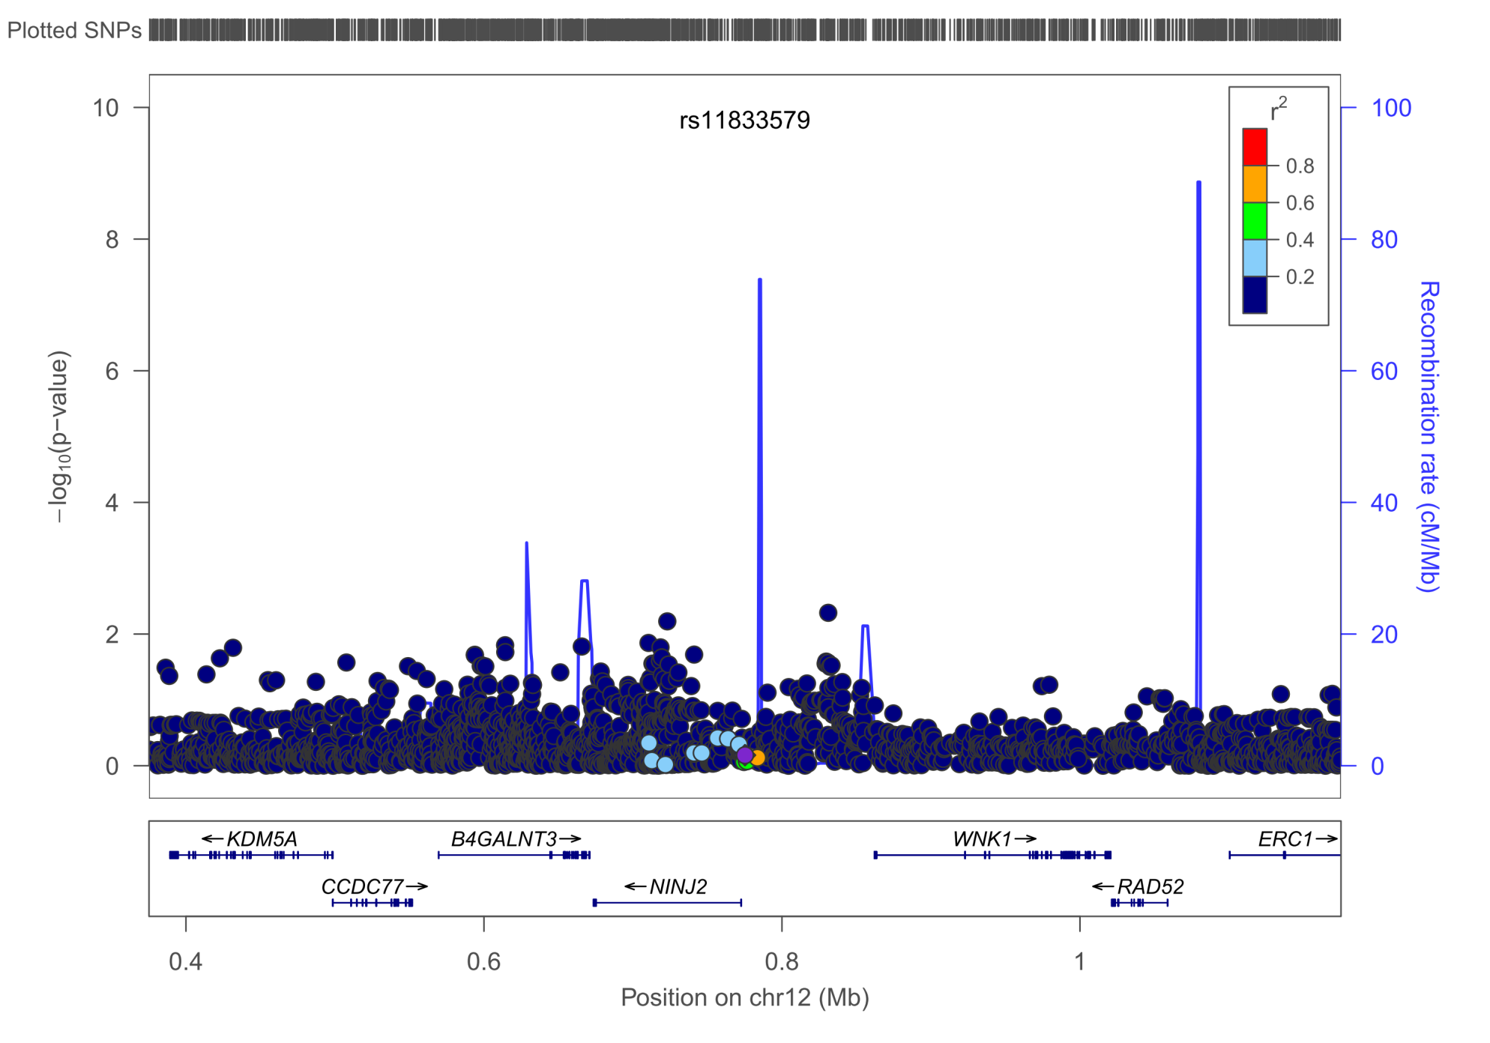
NINJ2 - IS, p=4.75E-3

Slide 17
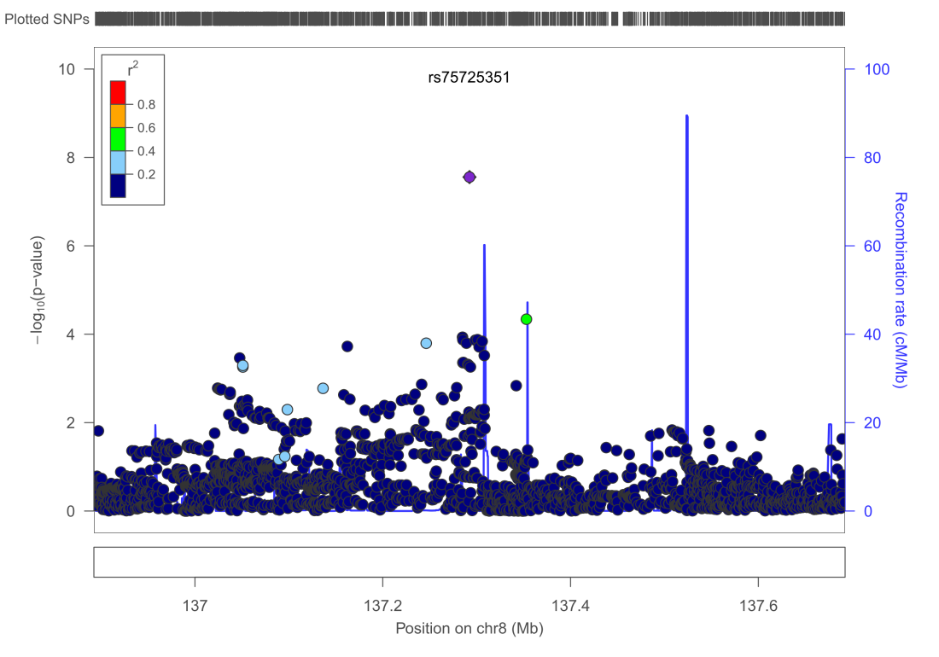
New loci
Presenting all findings with a p-value < 5E-6 with support of multiple SNPs (peak)
Lots of singletons – still worth investigating (data not shown)
Loci with support of >2 SNPs
OR always in direction of minor allele

Slide 18
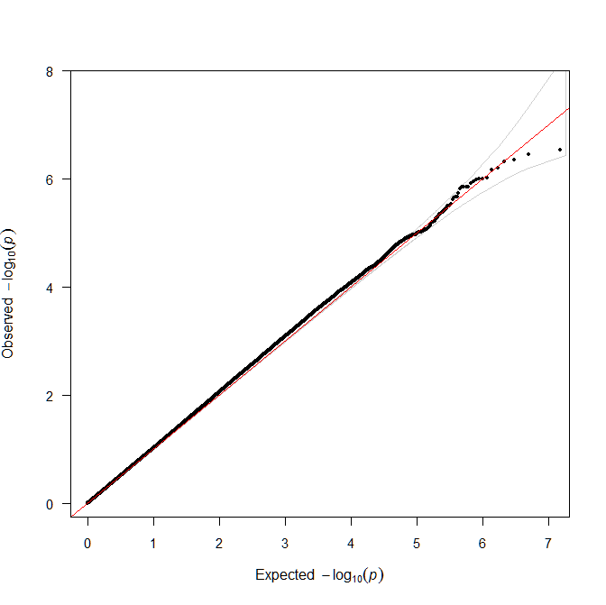
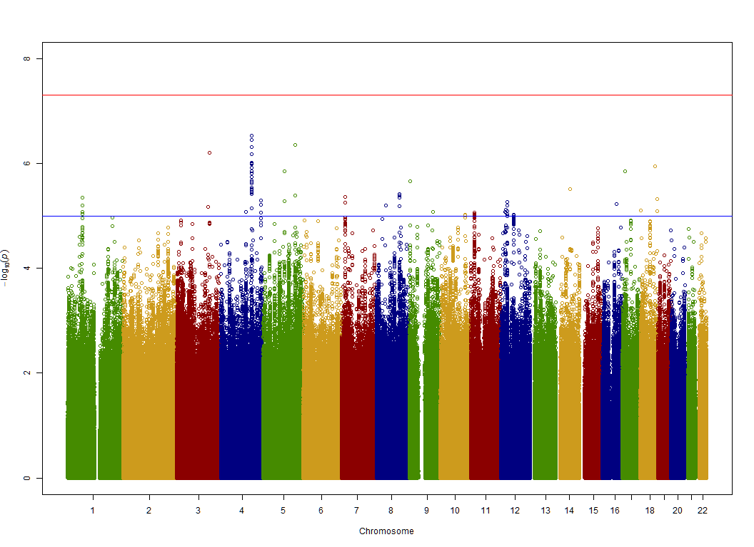
IS
Filtered data!
λ(GC_filtered)=1.003
λ(GC_unfiltered)=1.002
Note: λ1000 is used

Slide 19
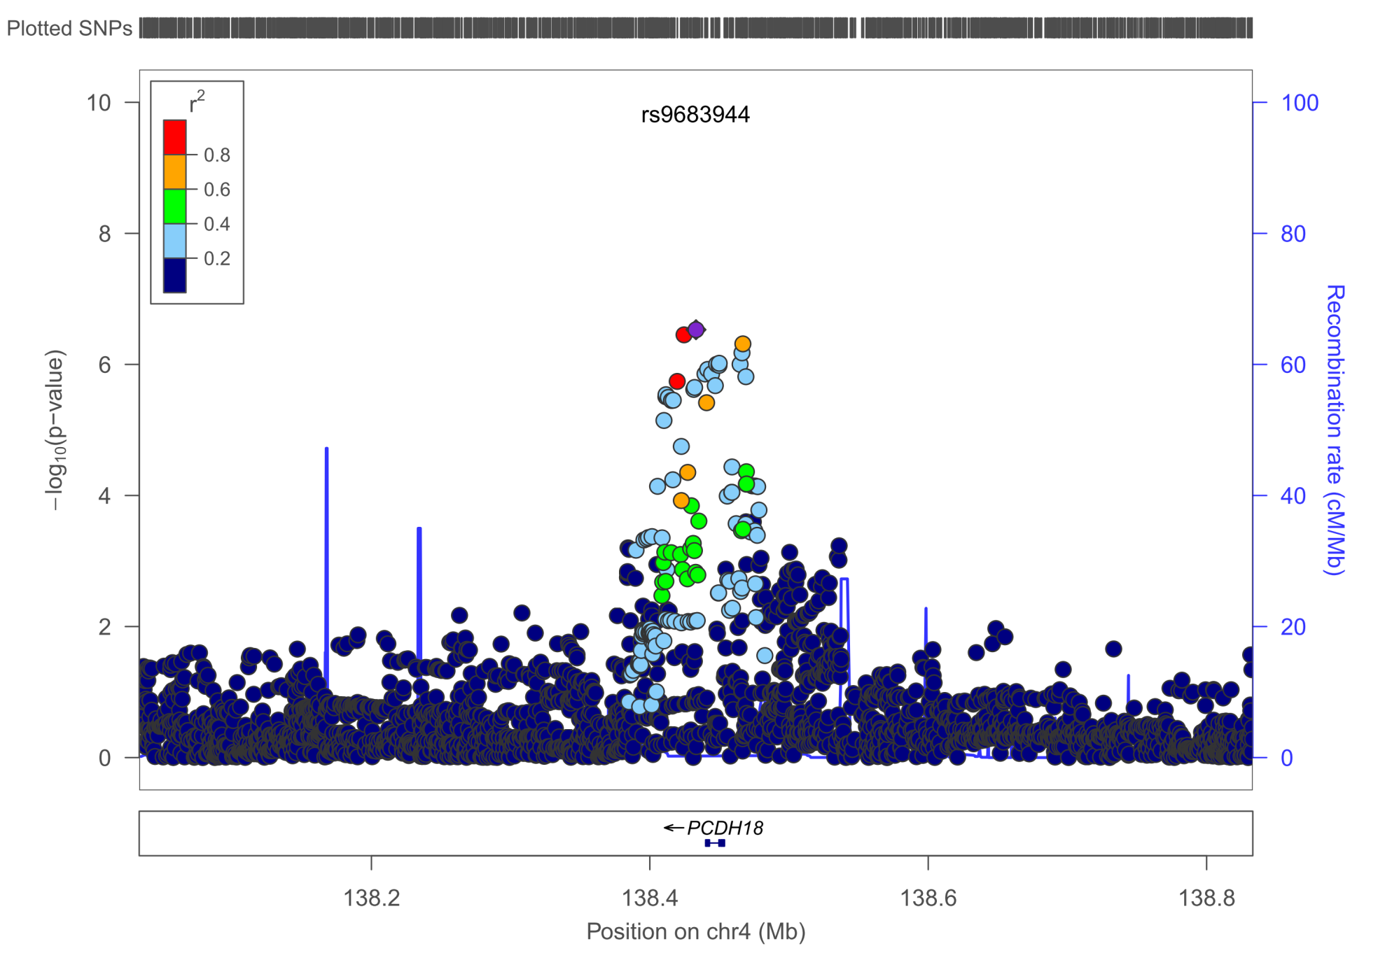
IS – PCDH18, MAF=20.13%, p=2.95E-7, OR 1.15 [1.09-1.22]
All r²>0.8

Slide 20
PCDH18
Protocadherin-18
Function not known, thought to be involved in cell-cell connections in the brain
Interacts with Disabled-1 (DAB1), implicated in the Reelin pathway

Slide 21
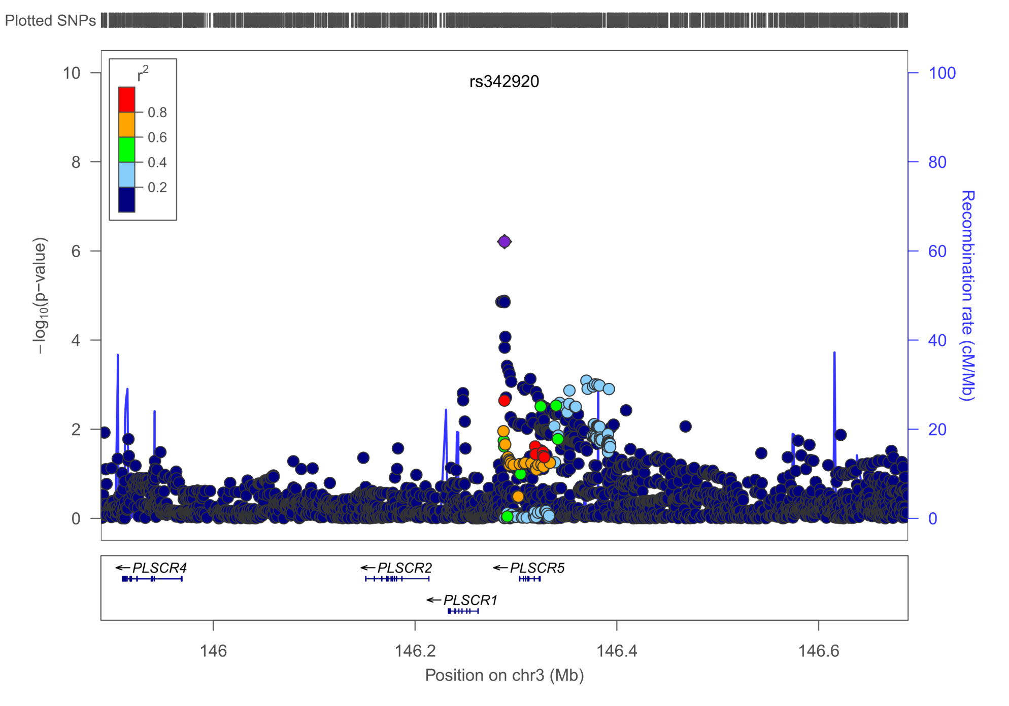
IS – PLSCR5, MAF=37.59%, p=6.18E-7, OR 1.11 [1.07-1.16]
All r²>0.95

Slide 22
PLSCR5
phospholipid scramblase family, member 5
Nothing known, may play a role in blood coagulation
Suggestive GWAS hit for Subcutaneous adipose tissue in women
PLSCR1:
May mediate accelerated ATP-independent bidirectional transbilayer migration of phospholipids upon binding calcium ions that results in a loss of phospholipid asymmetry in the plasma membrane.
May play a central role in the initiation of fibrin clot formation, in the activation of mast cells and in the recognition of apoptotic and injured
cells by the reticuloendothelial system

Slide 23
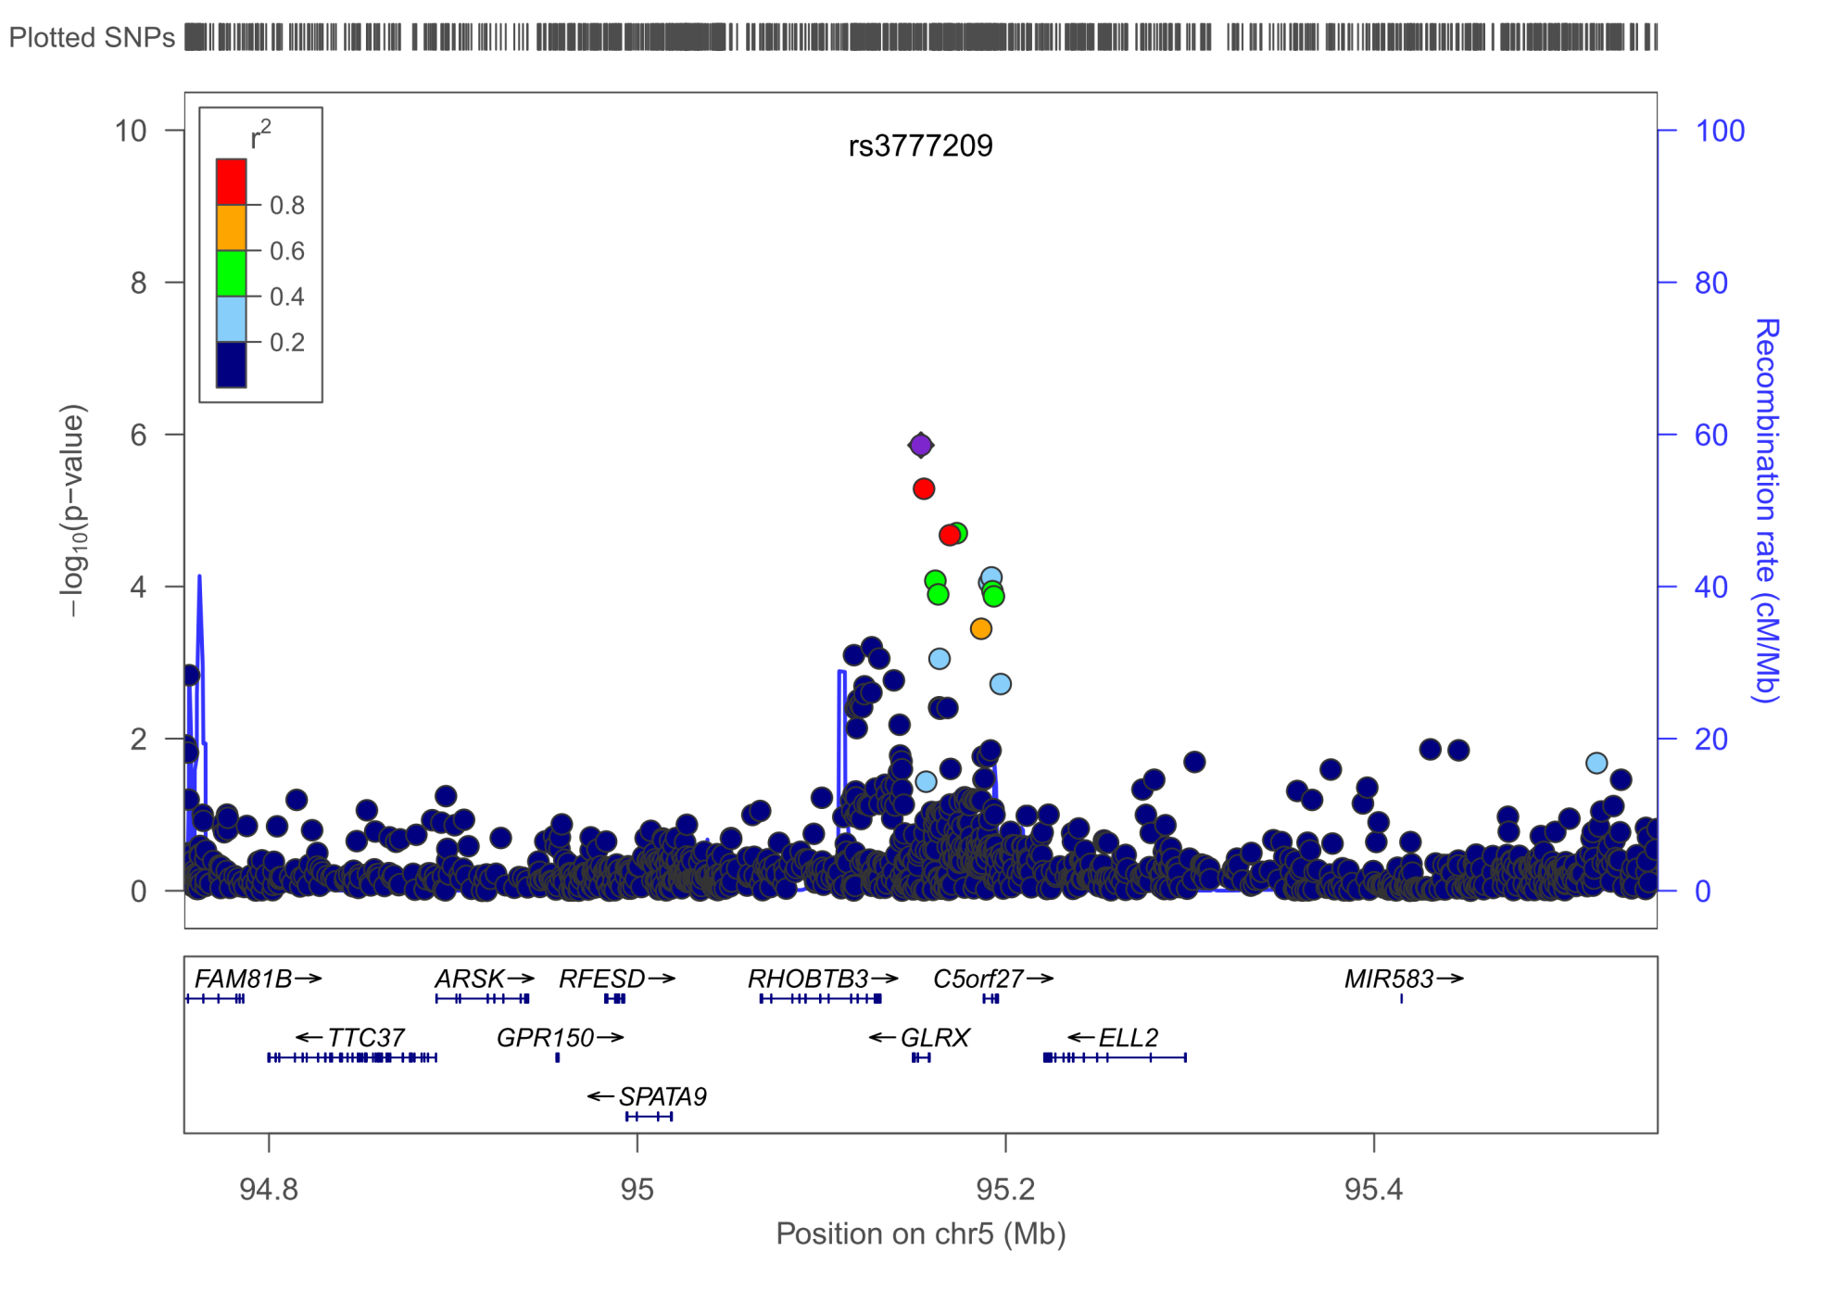
IS – GLRX, MAF=5.88%, p=1.38E-6, OR 1.24[1.14-1.36]
All r²>0.85

Slide 24
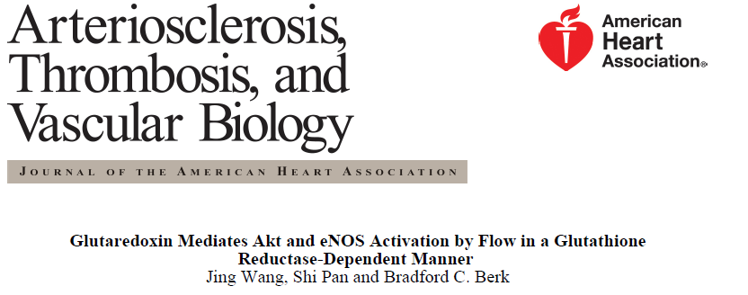
GLRX
Glutaredoxin (Thioltransferase)
The encoded protein is a cytoplasmic enzyme catalyzing the
reversible reduction of glutathione-protein mixed disulfides.
This enzyme highly contributes to the antioxidant
defense system.
It is crucial for several signalling pathways by controlling the S-glutathionylation status of signalling mediators.
It is involved in beta-amyloid toxicity and Alzheimer's disease.

Slide 25
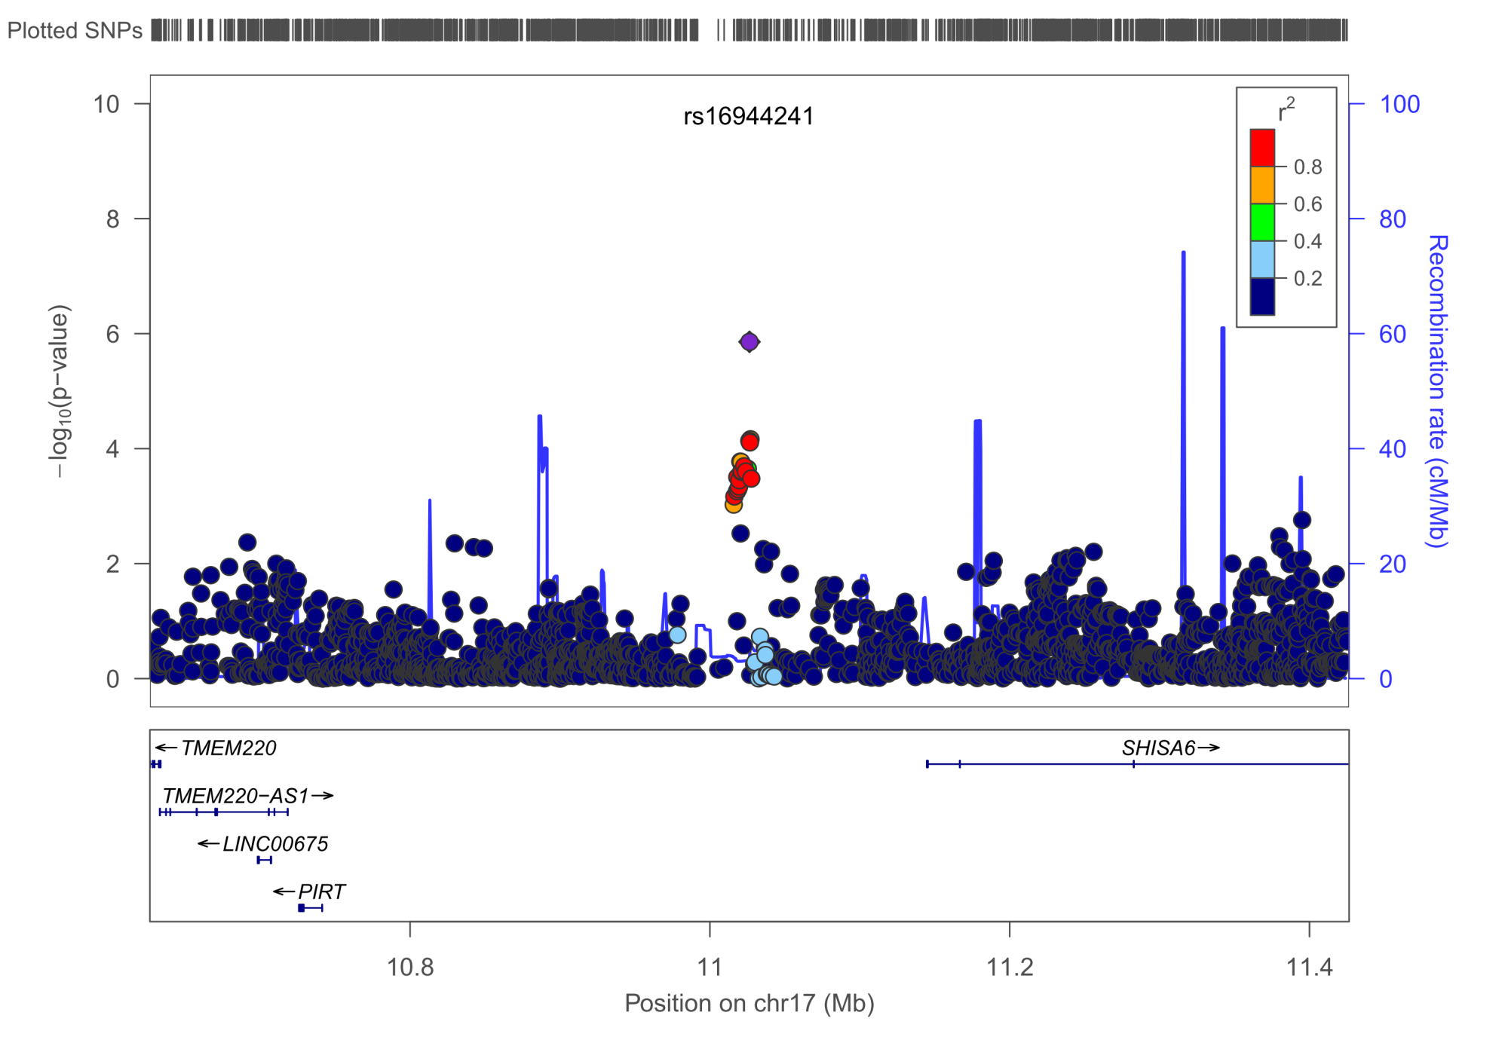
IS – SHISA6, MAF=2.16%, p=1.39E-6, OR 1.44[1.24-1.67]
All r²>0.8

Slide 26
SHISA6
Shisa Homolog 6 (Xenopus Laevis)
Nothing known

Slide 27
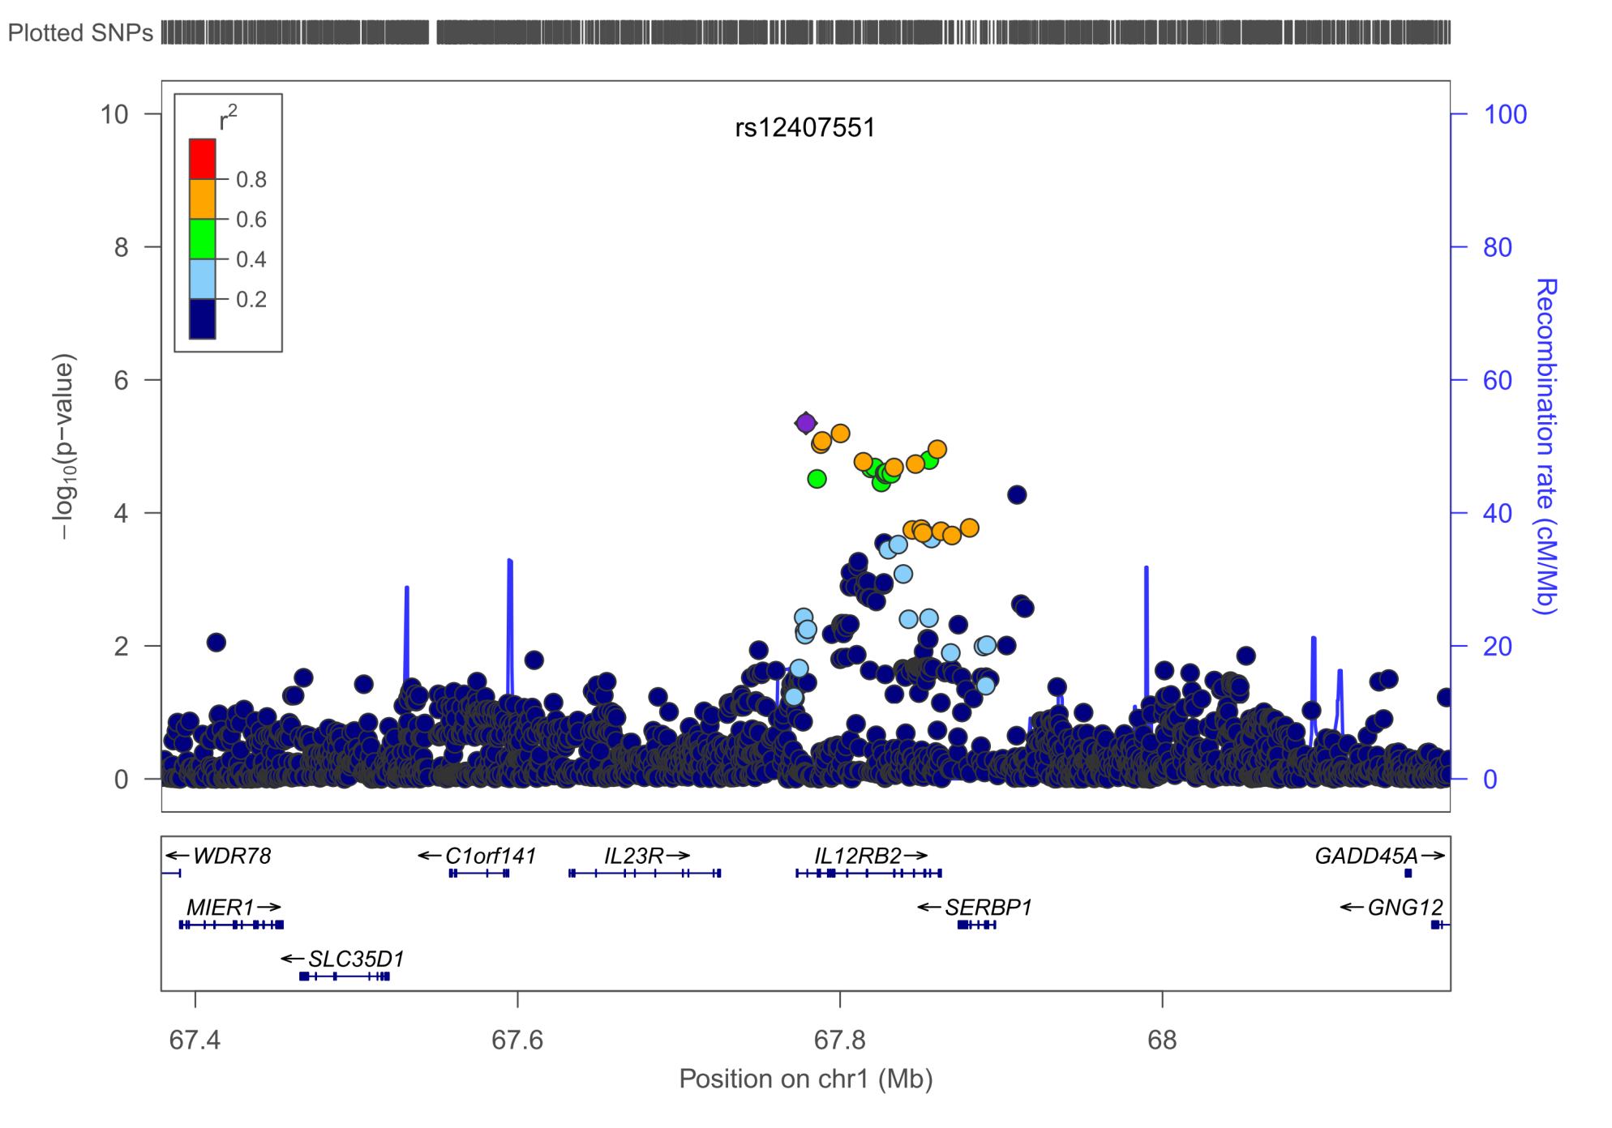
IS - IL12RB2 – MAF=4.5%, p=4.48E-6, OR 0.77[0.69-0.86]
All r²>0.75

Slide 28
IL12RB2
Interleukin 12 Receptor, Beta 2
This subunit is the signaling component coupling to the JAK2/STAT4 pathway.
Promotes the proliferation of T-cells as well as NK cells.
Induces the promotion of T-cells towards the Th1 phenotype
by strongly enhancing IFN-gamma production
Implicated in atopy, asthma, inflammatory bowel disease, primary biliary cirrhosis, Behcet’s disease

Slide 29
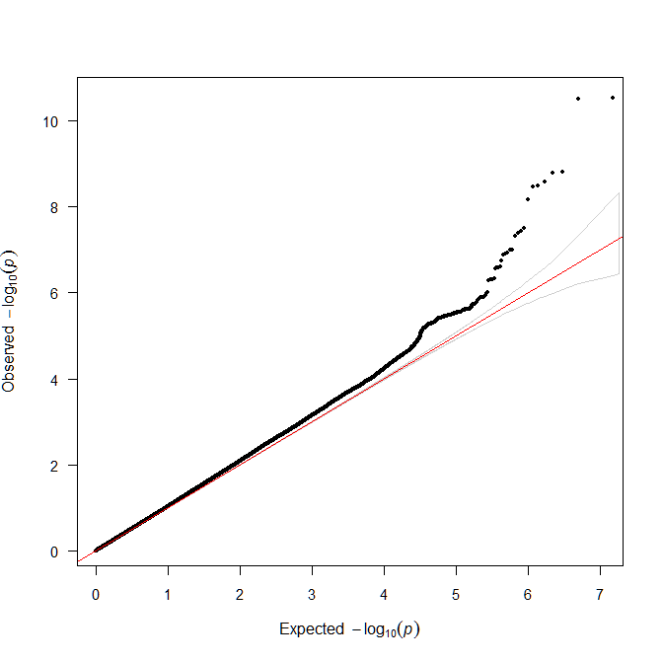
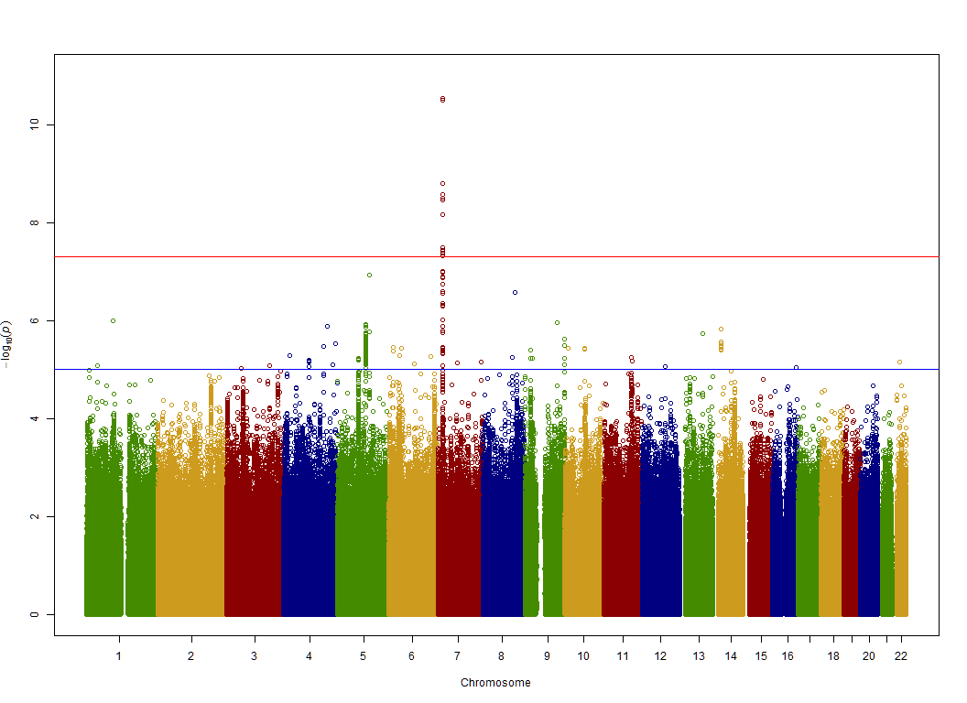
LAS
Filtered data!
λ(GC_filtered)=1.015
λ(GC_unfiltered)=1.012
Note: λ1000 is used

Slide 30
LAS – HDAC9 – as shown before
Another variant in perfect LD with rs2107595 is top SNP
rs57301765 – rs2107595, r²=0.99, D‘=1
P-value rs57301765 = 2.298E-11
P-value rs2107595 = 3.229E-11
3,345bp distance between SNPs

Slide 31
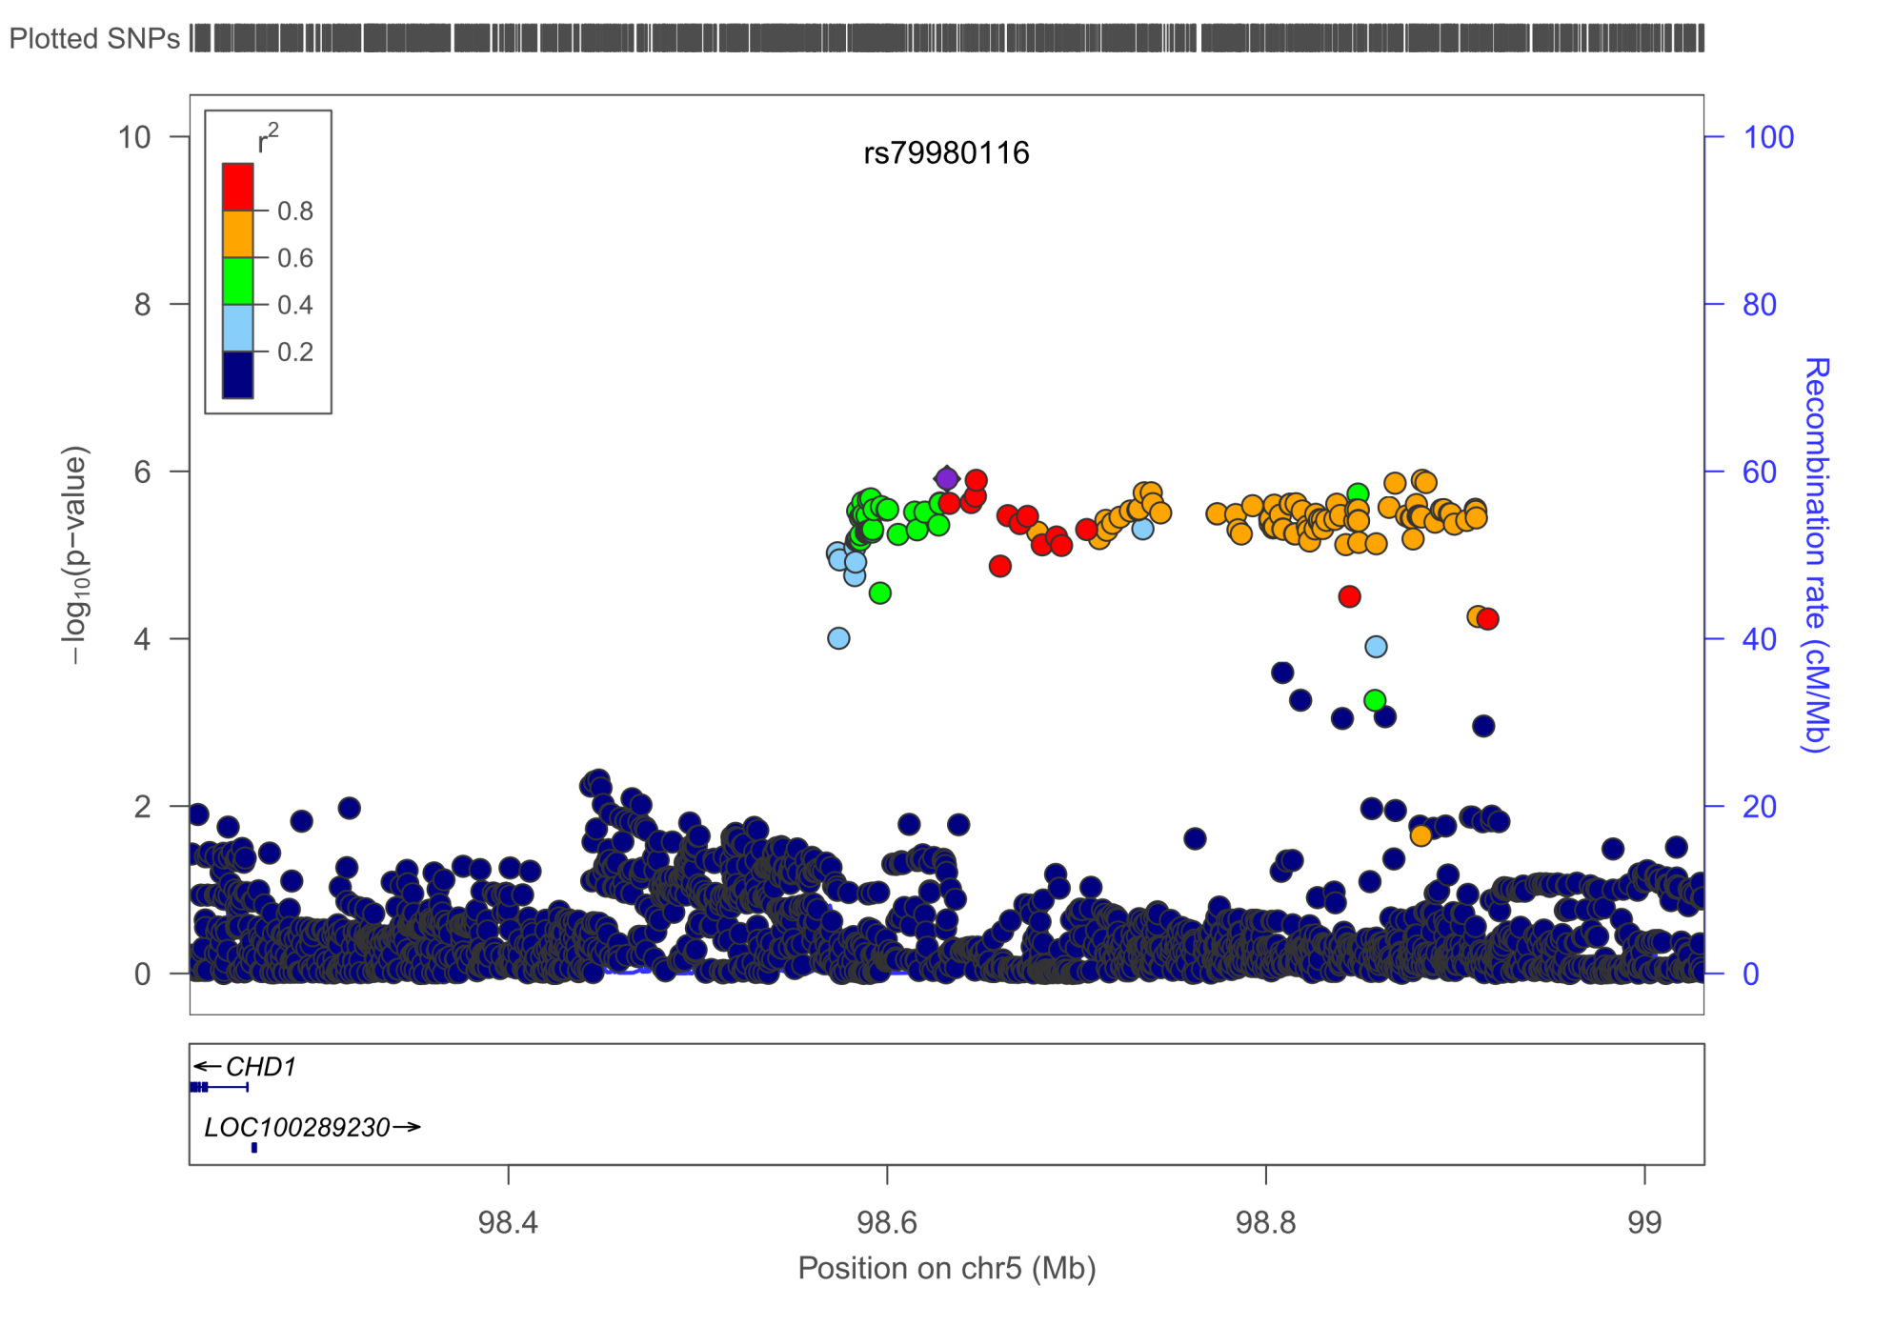
LAS - CHD1, MAF=2.02%, p=1.23E-6, OR 2.11 [1.56-2.85]
All r²>0.7

Slide 32
CHD1
Chromodomain Helicase DNA Binding Protein 1
CHD genes alter gene expression possibly by modification of chromatin structure thus altering access of the transcriptional apparatus to its chromosomal DNA template.

Slide 33
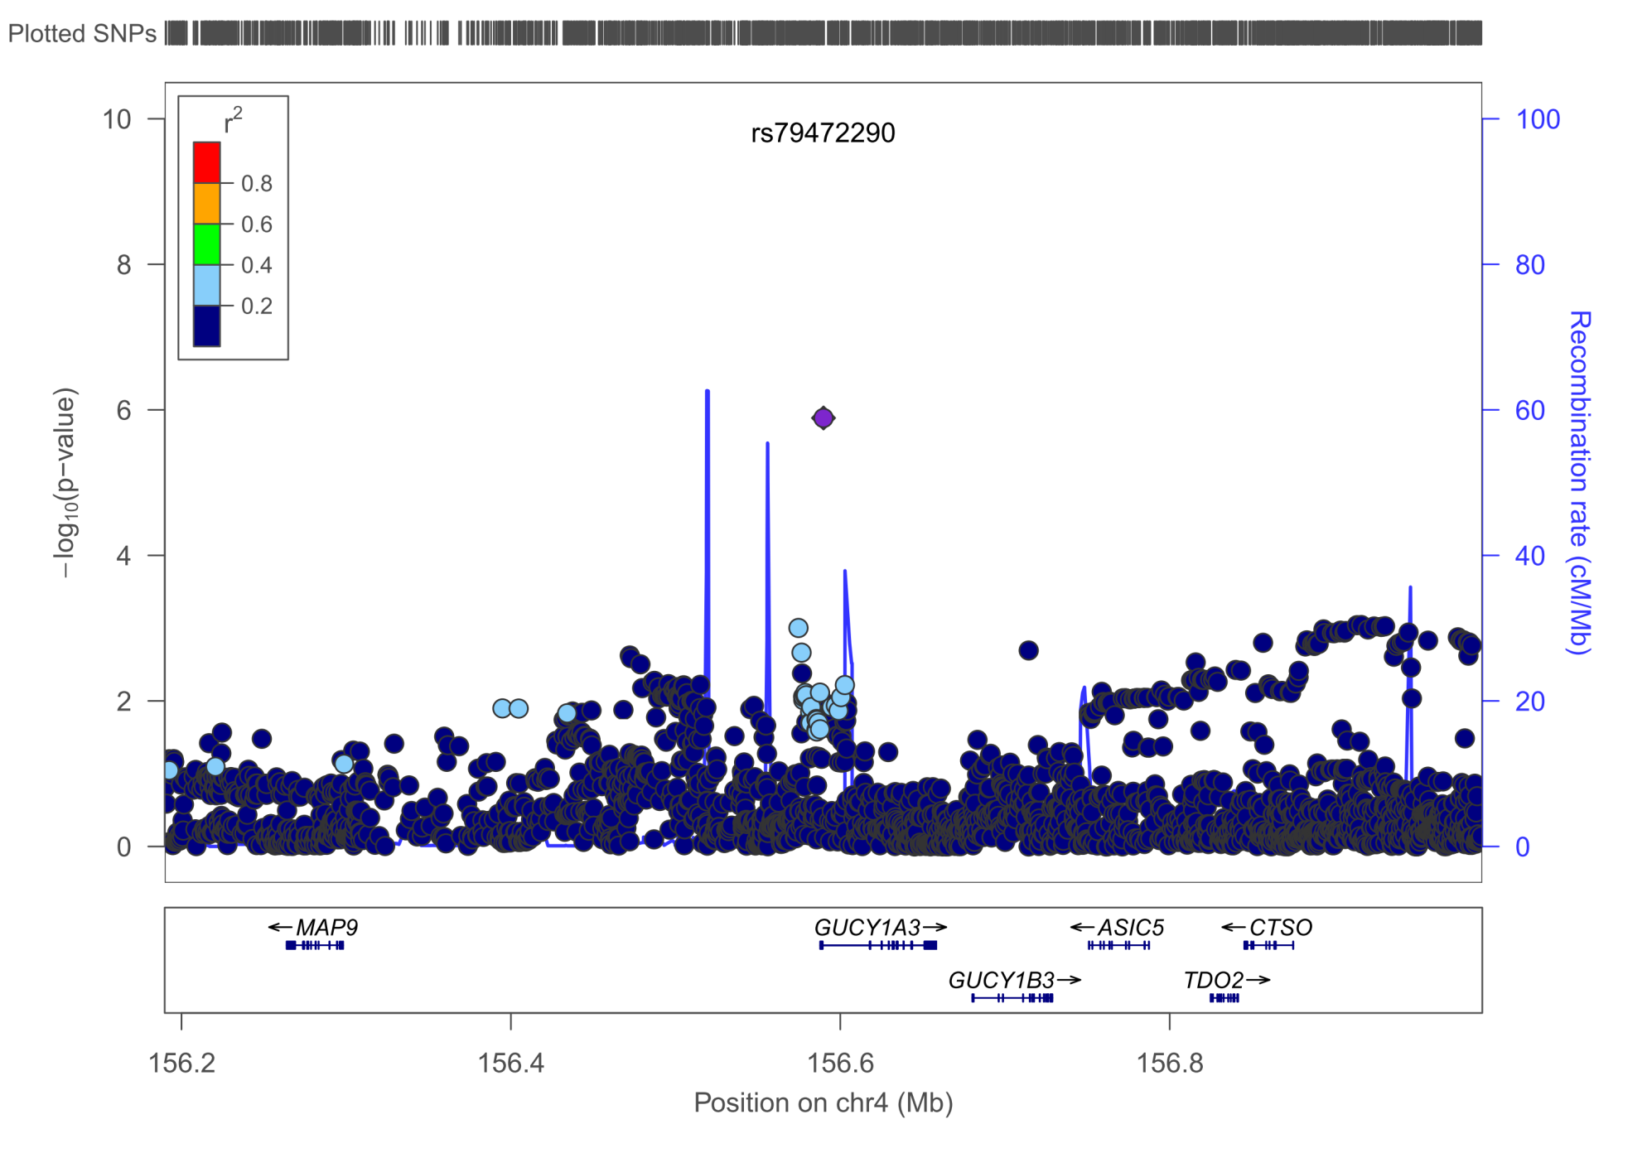
LAS – GUCY1A3, MAF=1.5%, p=1.29E-6, OR=2.27 [1.63-3.16]
All r²>0.9

Slide 34
GUCY1A3
guanylate cyclase 1, soluble, alpha 3
CAD risk locus (Deloukas et al, Nature Genetics, 2013)
Blood pressure GWAS hit (Ehret et al, Nature, 2011)
New locus for MI after exome sequencing (Erdmann et al, Nature, 2013)

Slide 35
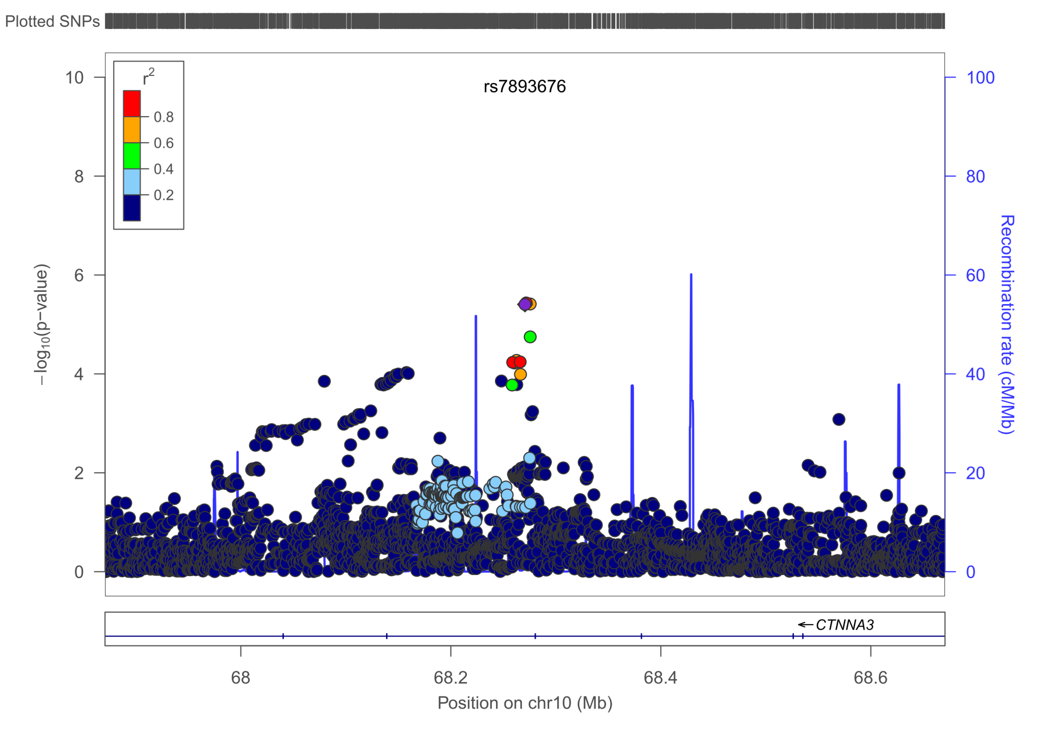
LAS – CTNNA3, MAF=29.33%, p=3.93E-6, OR 1.22 [1.12-1.32]
All r²>0.9

Slide 36
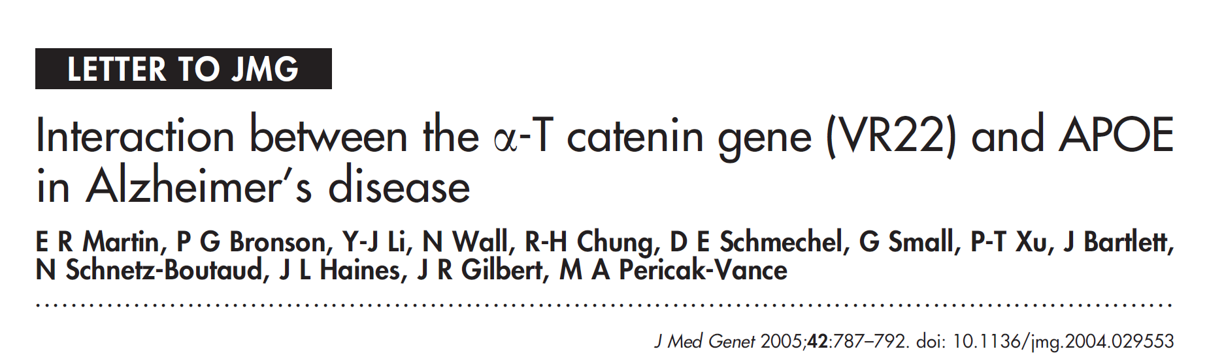
CTNNA3
catenin (cadherin-associated protein), alpha 3
key protein of the adherens junctional complex in epithelial cells playing
a crucial role in cellular adherence
Alzheimer risk gene
Has LRRTM3 nested inside -> see SVD!!
co-localizes with plakophilin 2; mutations of which lead to cardiac muscle malfunction

Slide 37
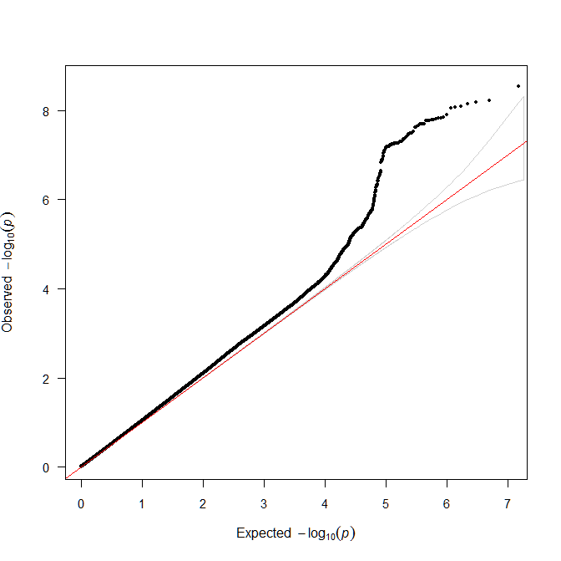
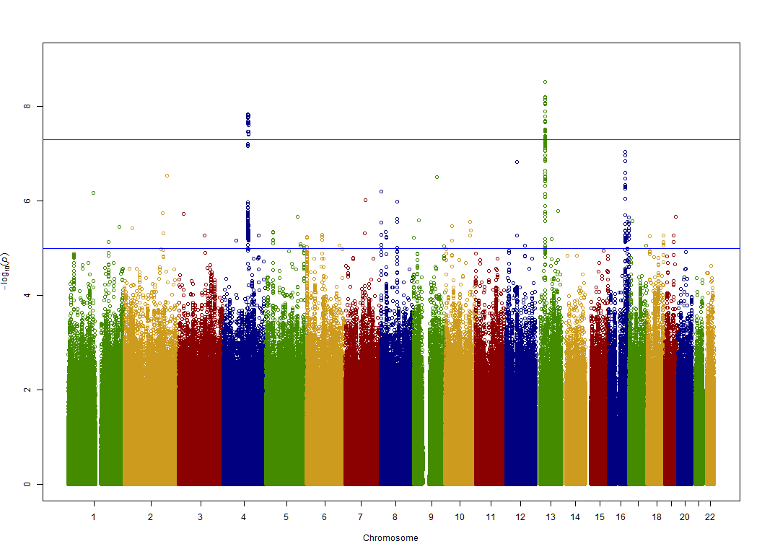
CE
Filtered data!
λ(GC_filtered)=1.017
λ(GC_unfiltered)=1.013
Note: λ1000 is used

Slide 38
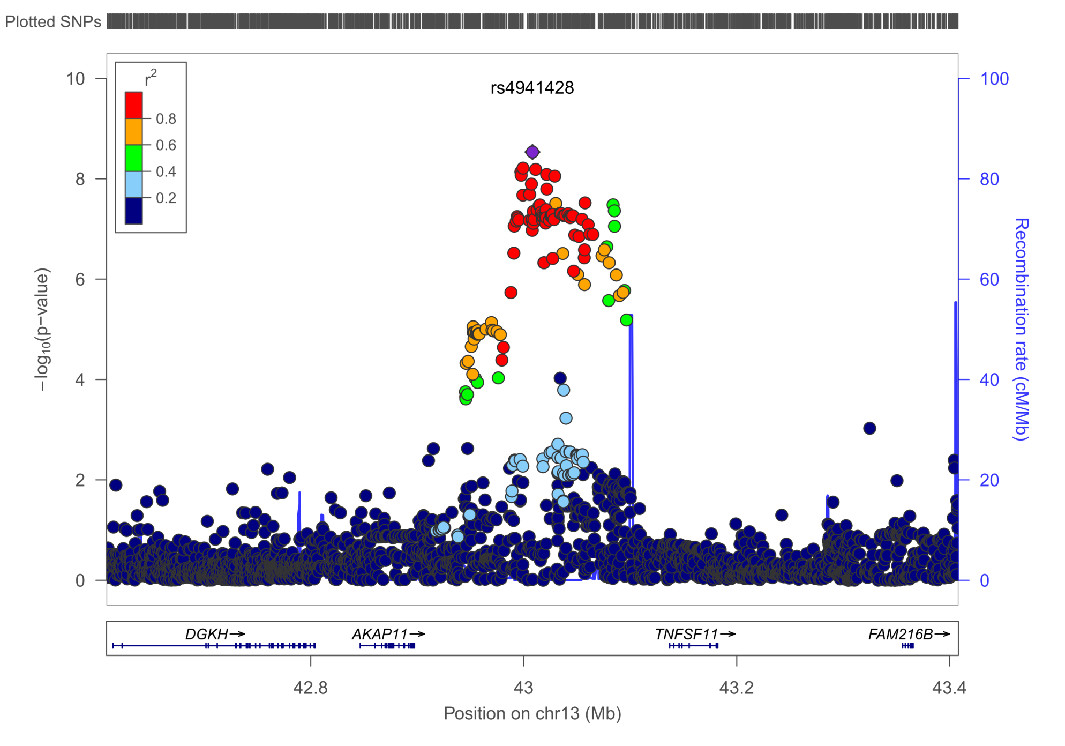
CE – TNFSF11, MAF=25.12%, p=2.93E-9
All r²>0.95

Slide 39
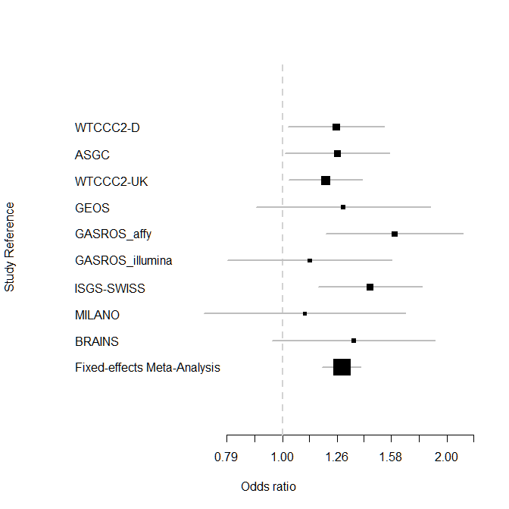
TNFSF11
tumor necrosis factor (ligand) superfamily, member 11
Formerly known as: RANKL
Important player in the RANK/RANKL/OPG pathway of osteogenesis
One of main risk loci for osteoporosis
Top SNP is eQTL for TNFSF11
OR=1.28 [1.18-1.39]
I²=0.0%
P_{het}=0.7185

Slide 40
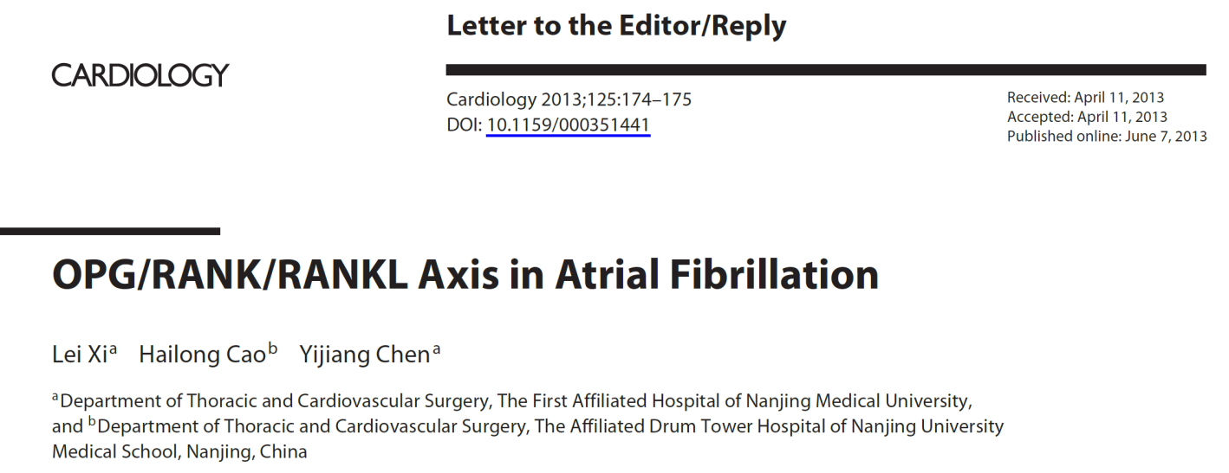
TNFSF11
Not seen in AF so far (contact AF consortium)
Mechanism?

Slide 41
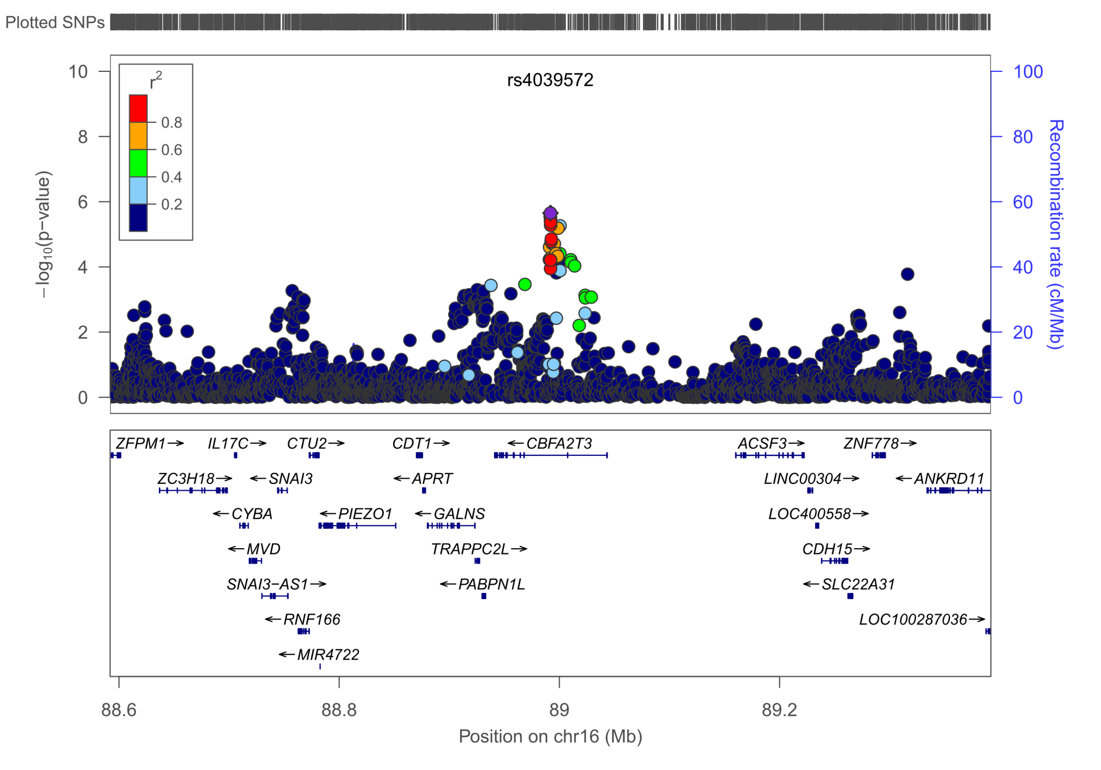
CE - CBFA2T3, MAF=3.90%, p=2.23E-6, OR 1.68[1.35-2.08]
All r²>0.5

Slide 42
CBFA2T3
Core-Binding Factor, Runt Domain, Alpha Subunit 2
myeloid translocation gene family which interact with DNA-bound transcription factors and recruit a range of corepressors to facilitate transcriptional repression
is a component of a protein complex containing master regulators of hematopoiesis
Regulates the proliferation and the differentiation of erythroid
progenitors by repressing the expression of TAL1 target genes.
Plays a role in granulocyte differentiation

Slide 43
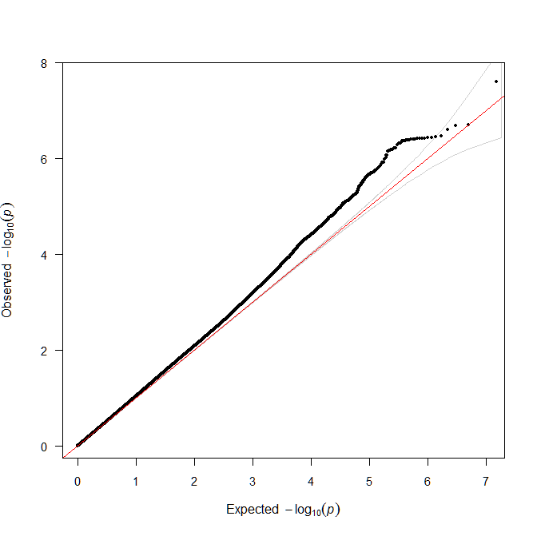
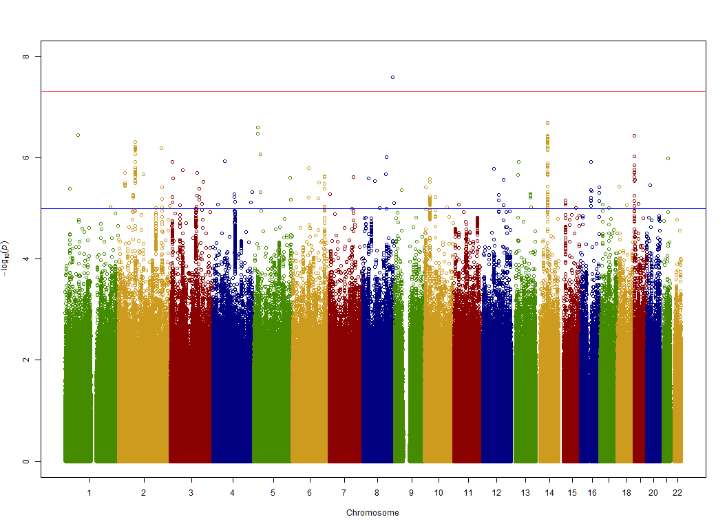
SVD
Filtered data!
λ(GC_filtered)=1.023
λ(GC_unfiltered)=1.021
Note: λ1000 is used

Slide 44
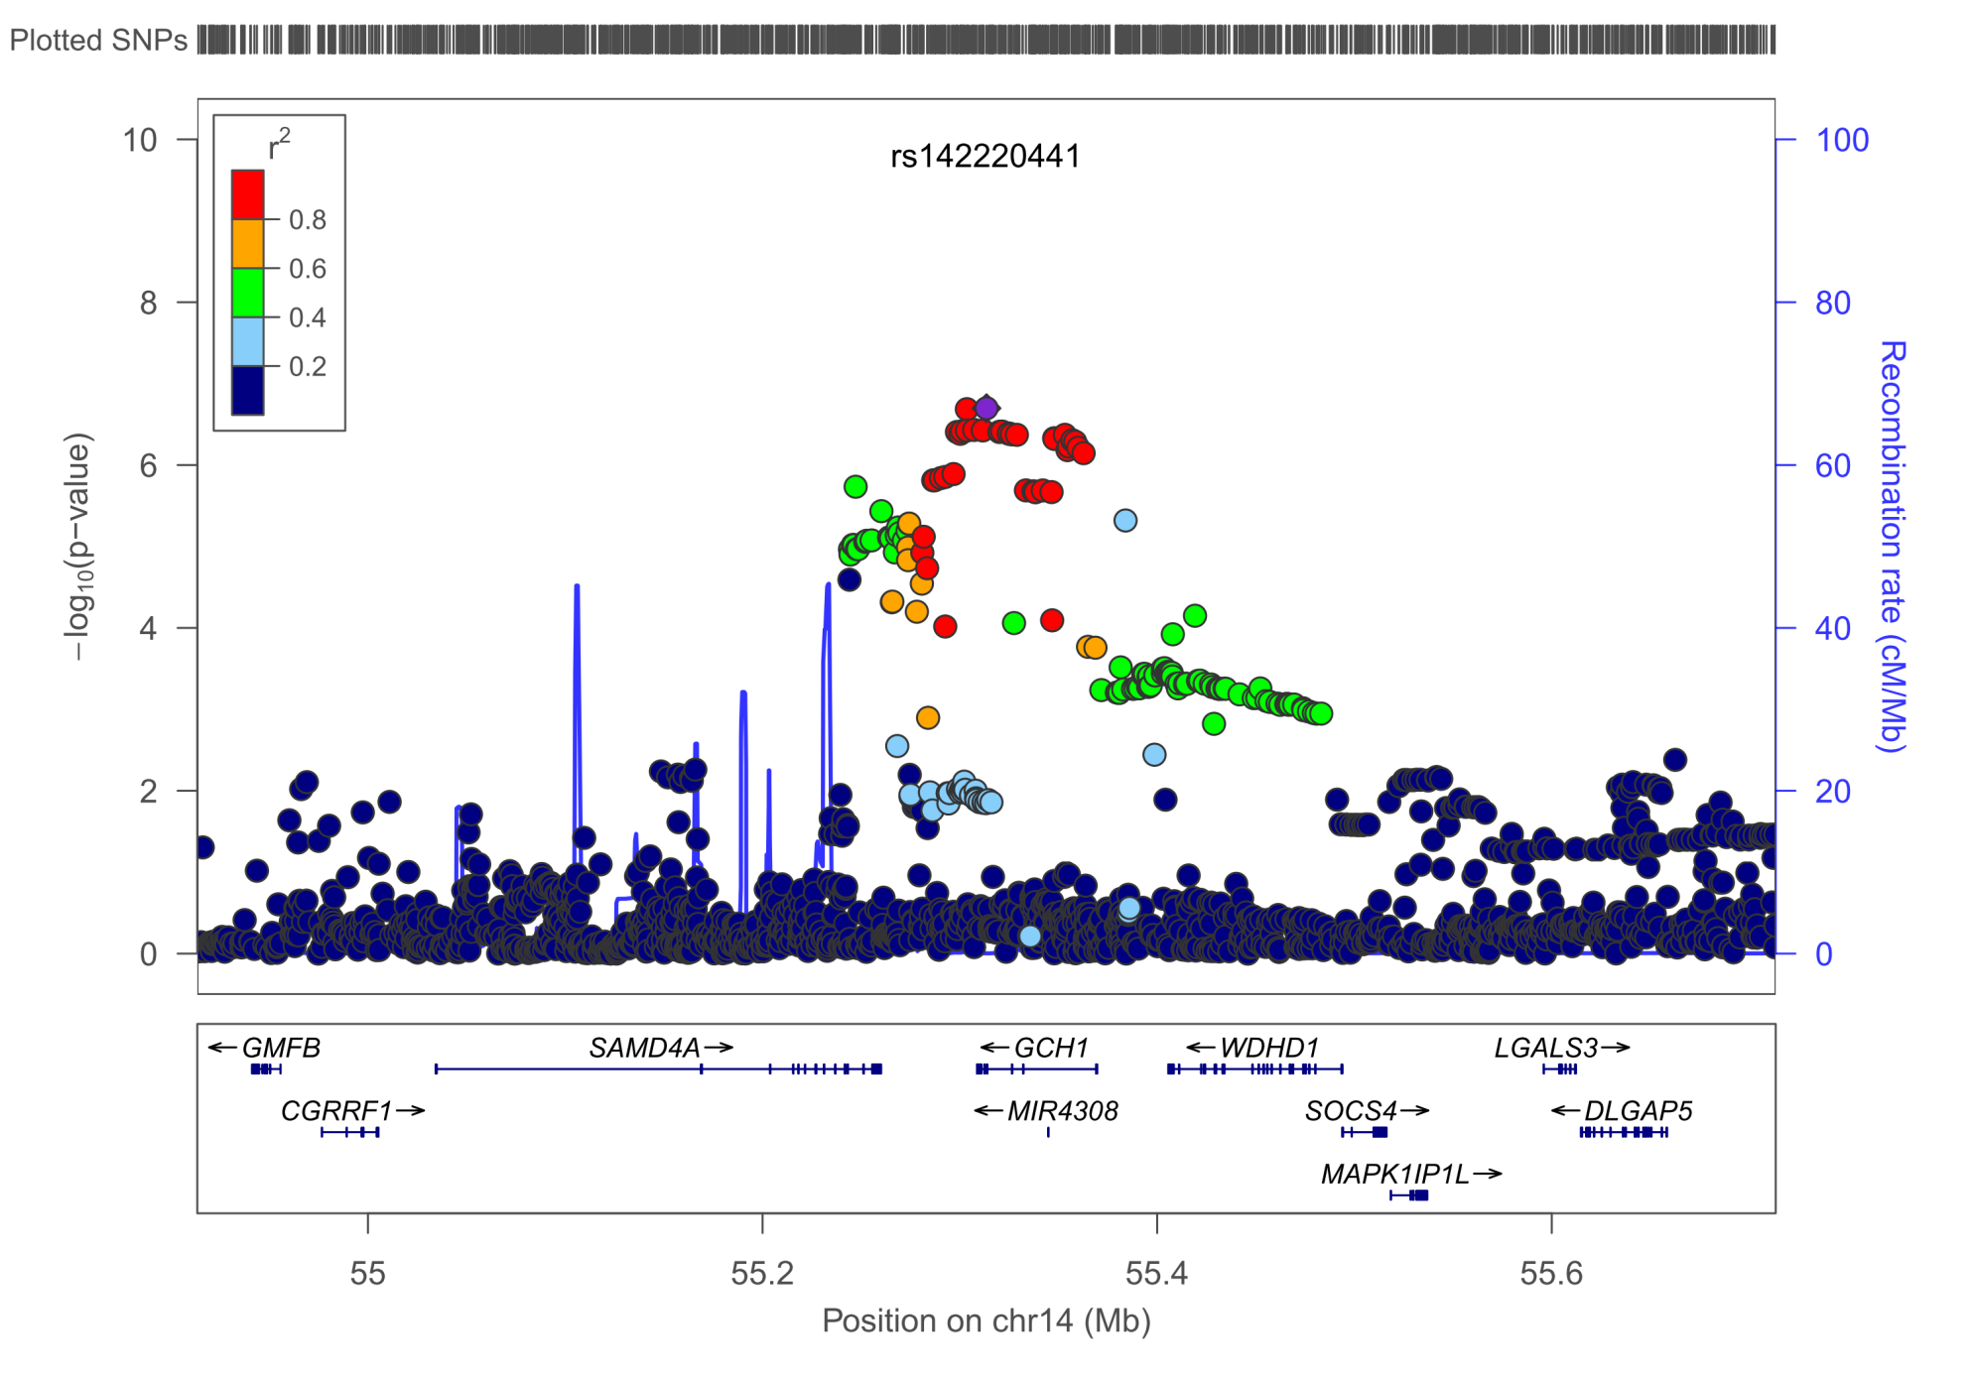
SVD – GCH1, MAF=1.61%, p=2.00E-7
All r²>0.6

Slide 45
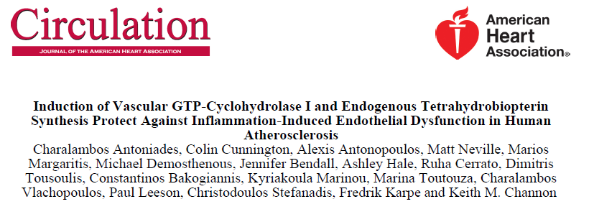
GCH1
GTP cyclohydrolase 1
The encoded protein is the first and rate-limiting enzyme in tetrahydrobiopterin (BH4) biosynthesis
BH4 is an essential cofactor required by aromatic amino acid hydroxylases as well as nitric oxide synthases
Positively regulates nitric oxide synthesis in umbilical vein endothelial cells (HUVECs)

Slide 46
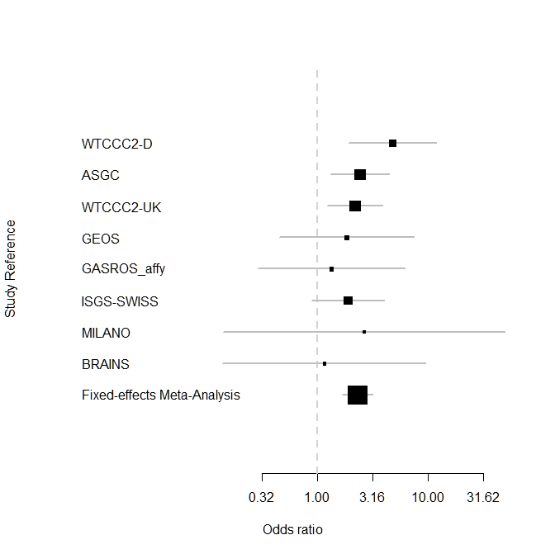
No data on GASROS_illumina
OR=2.31 [1.69-3.17]
I²=0.0%
P_{het}=0.8036

Slide 47
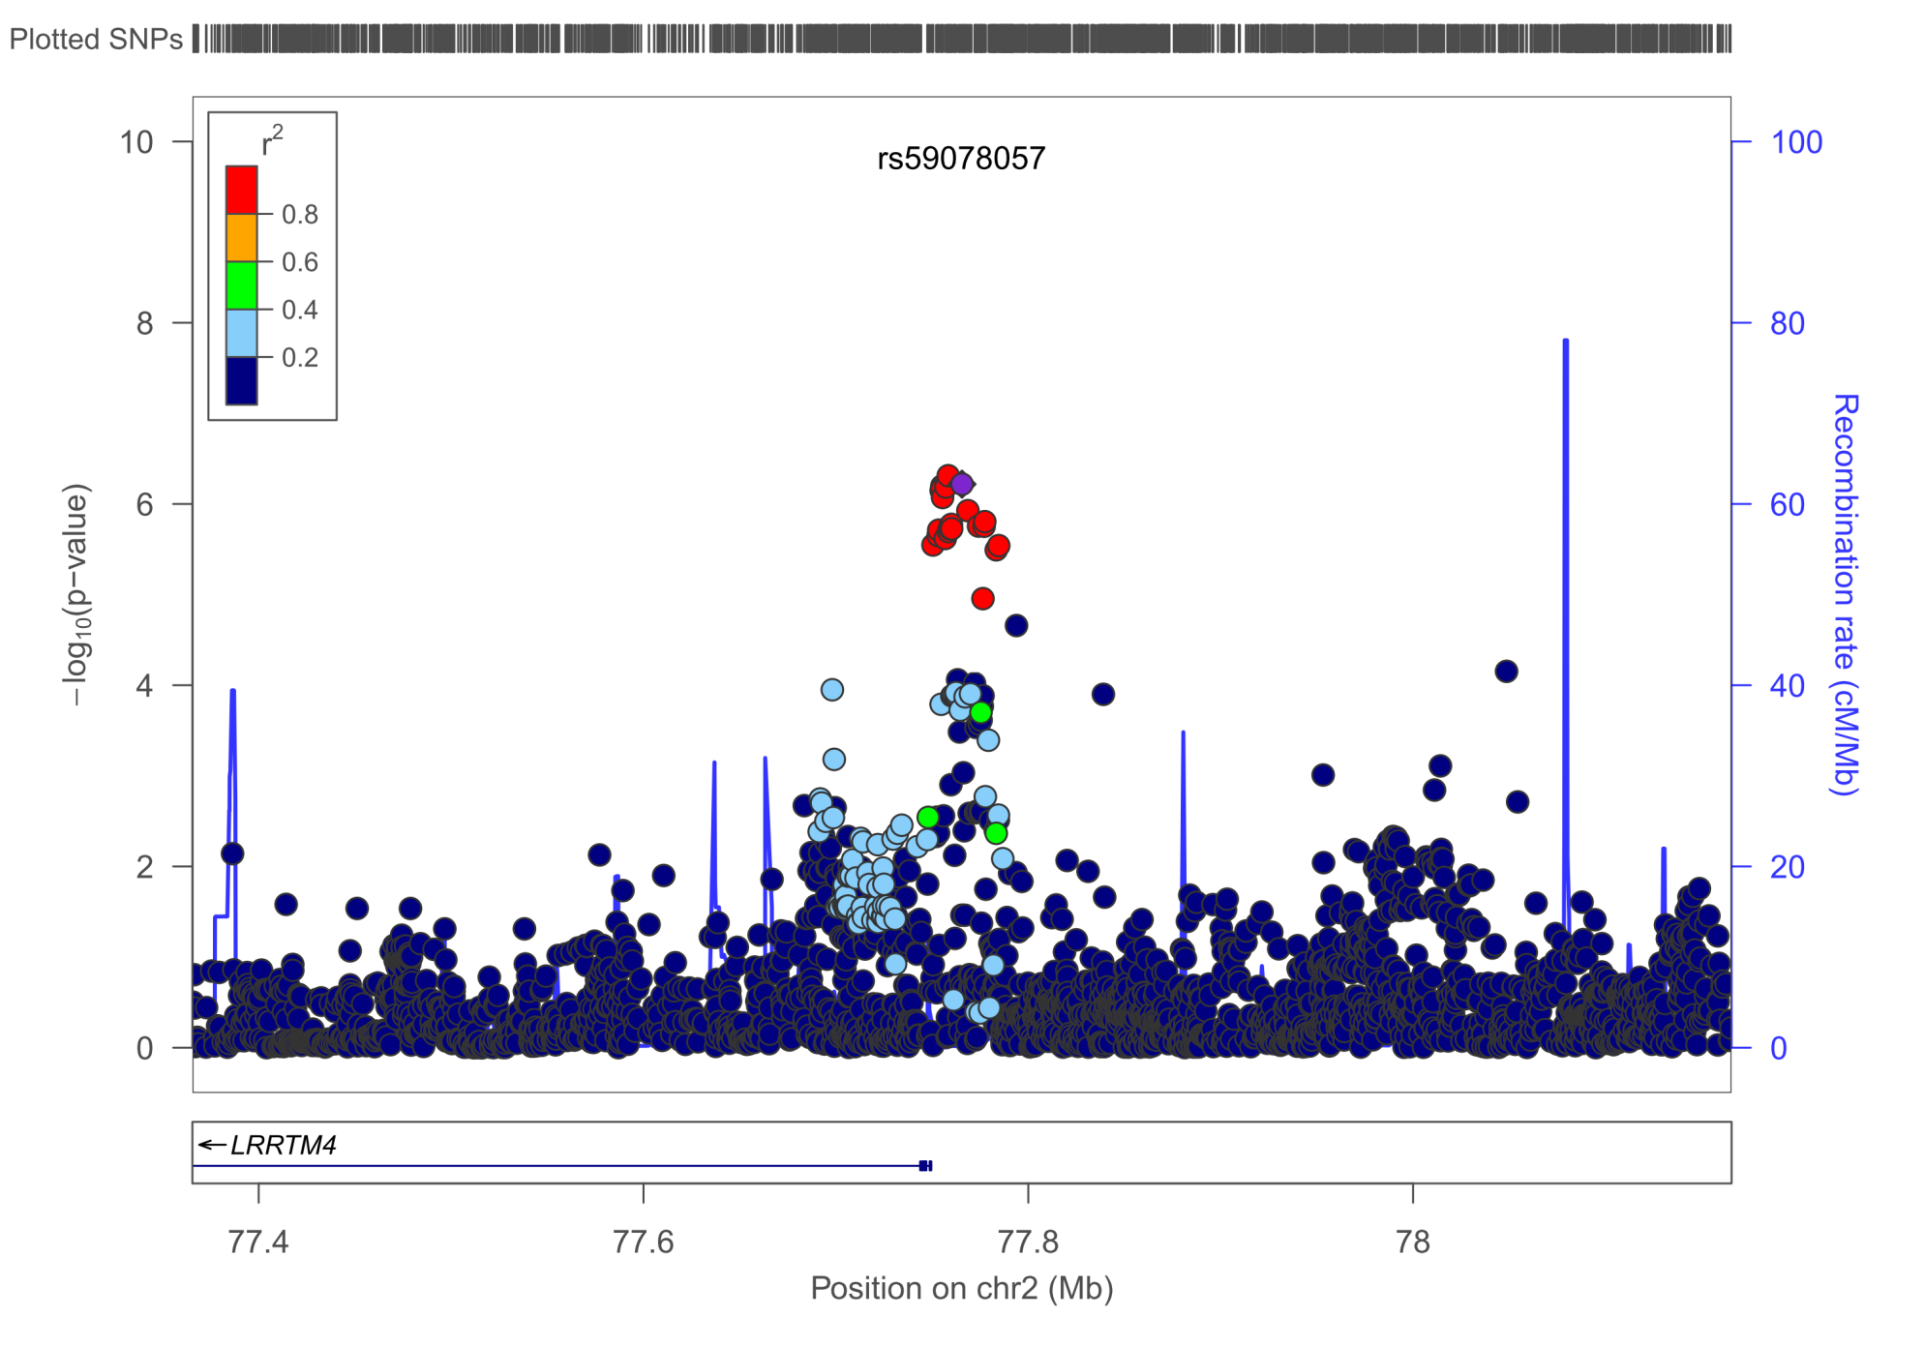
SVD – LRRTM4, MAF=29.9%, p=6.04E-7, OR 1.26[1.15-1.38]
All r²>0.9

Slide 48
LRRTM4
leucine rich repeat transmembrane neuronal 4
May play a role in the development and maintenance of the vertebrate nervous system.
Exhibits strong synaptogenic activity, restricted to excitatory presynaptic differentiation
Binding partners: heparan sulfate proteoglycans (HSPG) e.g. perlecan, syndecan, agrin, collagen XVIII
Role in aneurysms, AD, is pro-angiogenic and protective after stroke

Slide 49
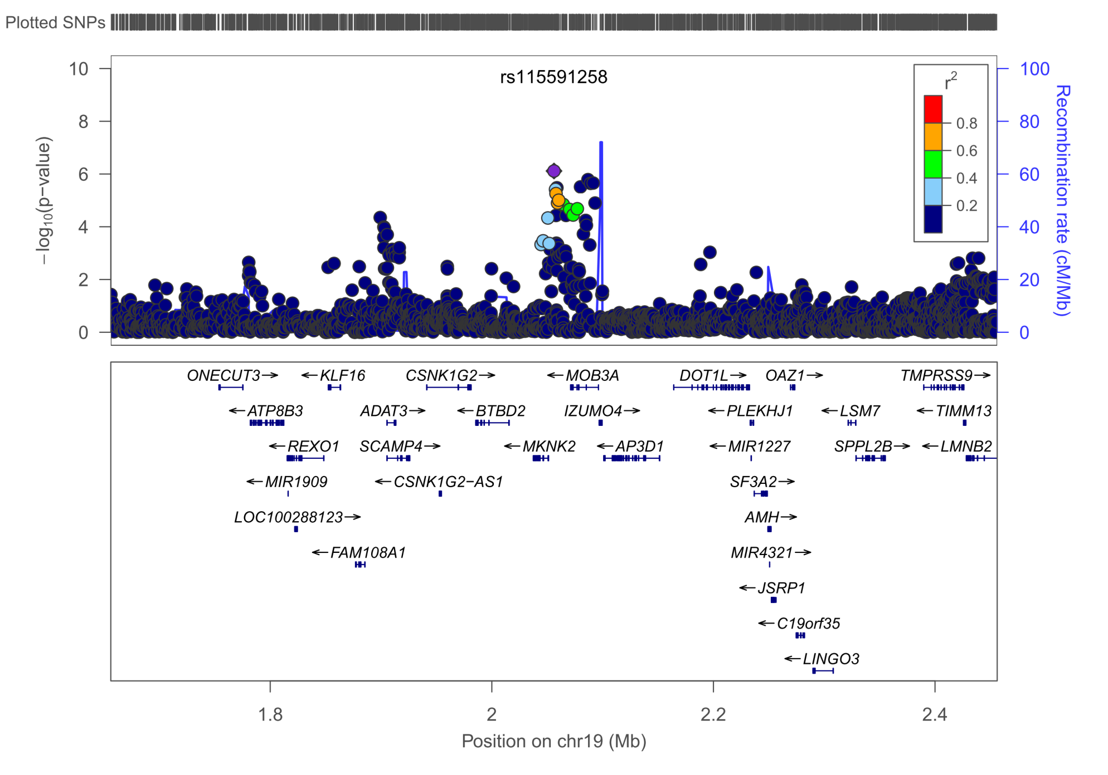
SVD – MKNK2, MAF=6.2%, p=3.66E-7, OR, OR 1.72[1.40-2.12]
All r²>0.3

Slide 50
MKNK2
MAP Kinase Interacting Serine/Threonine Kinase 2
May play a role in the response to environmental stress and cytokines.
Appears to regulate translation by phosphorylating EIF4E
Acts as a mediator of the suppressive effects of IFNgamma on hematopoiesis

Slide 51
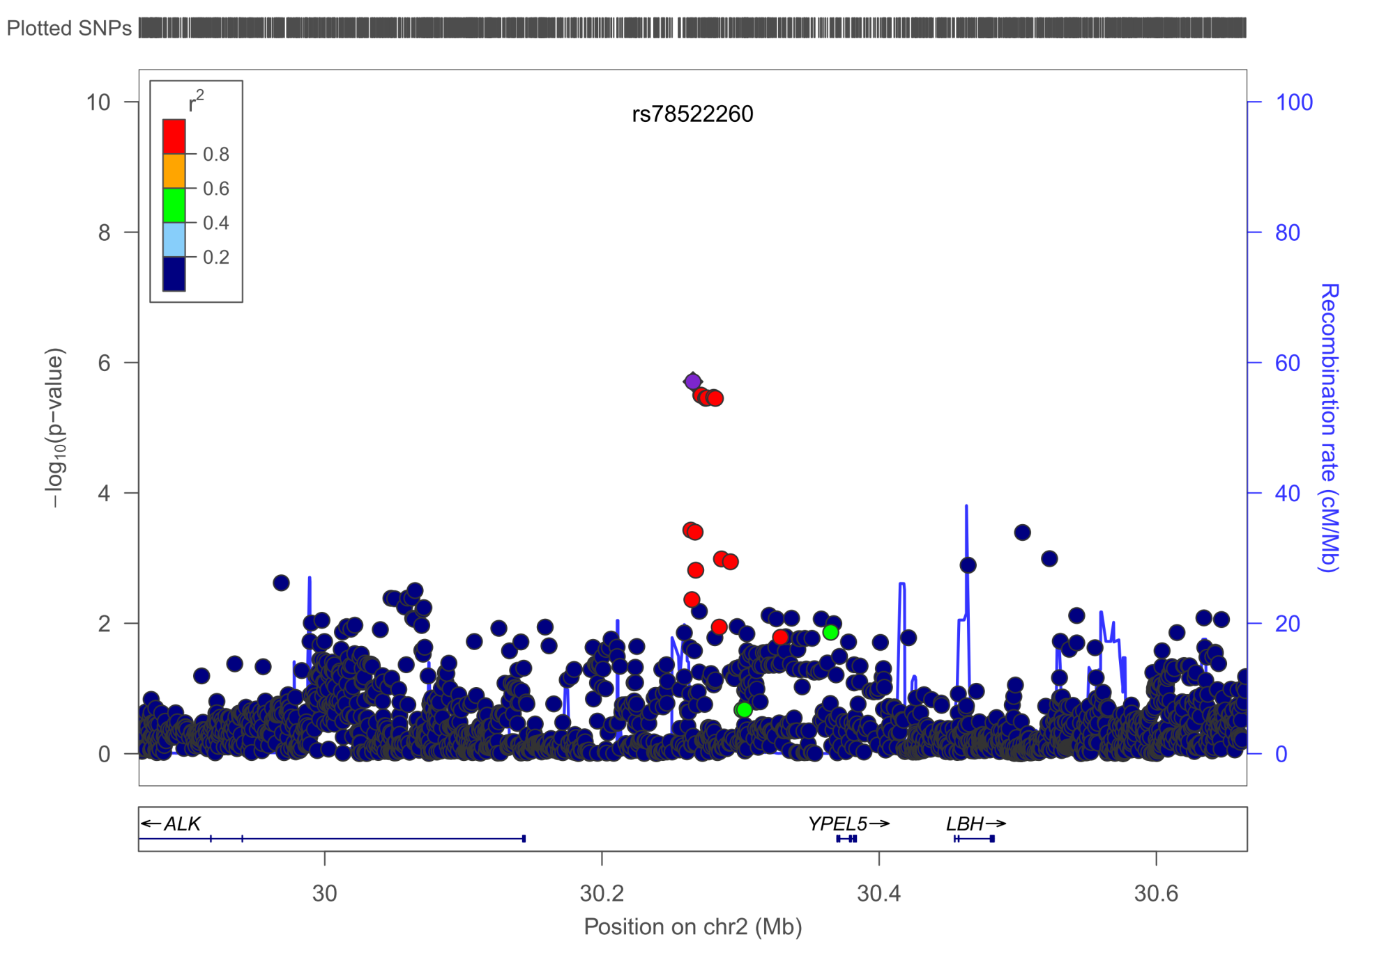
SVD – ALK, MAF=1.42%, p=1.96E-6, OR=2.97 [1.90-4.64]
All r²>0.5

Slide 52
ALK
Anaplastic lymphoma receptor tyrosine kinase
Appears to play an important role in the normal development and function of the nervous system
Mostly associated with gliomas and other tumors

Slide 53

SVD – AKAP12, MAF=39.78%, p=2.31E-6, OR=1.23 [1.13-1.35]
All r²>0.9

Slide 54
AKAP12
A-kinase anchor protein 12 (Gravin)
Interactor of PDE4D and EGFR
Regulates vascular integrity
Angiogenesis supressor

Slide 55
Subtype | Locus | Top SNP | P-value
IS | PCDH18 | rs9683944 | 2.95E-7
IS | PLSCR5 | rs342920 | 6.18E-7
IS | GLRX | rs3777209 | 1.38E-6
IS | SHISA6 | rs16944241 | 1.39E-6
IS | IL12RB2 | rs12407551 | 4.48E-6
LAS | HDAC9 | rs57301765 | 2.93E-11
LAS | CHD1 | rs79980116 | 1.23E-6
LAS | GUCY1A3 | rs79472290 | 1.29E-6
LAS | chr6p21 | rs4714801 | 3.78E-6
LAS | CTNNA3 | rs7893676 | 3.93E-6
CE | TNFSF11 | rs4941428 | 2.93E-9
CE | PITX2 | rs2723334 | 1.45E-8
CE | ZFHX3 | rs879324 | 9.17E-8
CE | CBFA2T3 | rs4039572 | 2.23E-6
SVD | GCH1 | rs142220441 | 2.00E-7
SVD | MKNK2 | rs115591258 | 3.66E-7
SVD | LRRTM4 | rs59078057 | 6.04E-7
SVD | ALK | rs78522260 | 1.96E-6
SVD | AKAP12 | rs12195473 | 2.31E-6

Slide 56
Trans-ethnic meta-analysis – in preparation
RACE1: 1218 IS cases / 1158 controls (200 LAS, 229 CE, 192 SVD)
RACE2: 1167 IS cases / 4035 controls (155 LAS, 193 CE, 122 SVD)
Including subtypes, eQTL etc….
METASOFT (Han&Eskin, Am. J. Hum. Genet, 2011, Han&Eskin, Plos Genet, 2012)
New „random effects model“ optimized to detect associations under heterogeneity.
Assumption: if heterogeneity is too high –> random effects model

Slide 57
Downstream Analyses
•eQTL analysis
• ANNOVAR to check SNP function through the UCSC browser
•ENCODE: Haploreg and Regulome DB
•GWAS catalog: overlapping traits
•GWAS-based Pathway Analysis tool (Tune Pers)
•GRAIL
•DAPPLE: protein-protein interaction
•MAGENTA : pathway analysis
•Cell specificity based on DNA hypersensitivity
Further analyse InDels – no genome-wide loci so far

Slide 58
Replication?
Genotyping of most promising variants in the ISGC samples?
Replication of variants p<5E-5 in:
CHARGE?
NiNDS-SiGN?
COMPASS?
deCODE?
GoDARTS?

Slide 59







Liz Holliday
Yu-Ching Cheng
Zhao Wei
Ioana Cotlarciuc
Jemma Hopewell
Guido Falcone
Matthew Traylor
Mike Nalls
Danish Saleheen
Steve Bevan
Martin Dichgans

