Slide 1






Functional genomics in cardiovascular disease – lessons from hypertension
Fadi J. Charchar

Slide 2
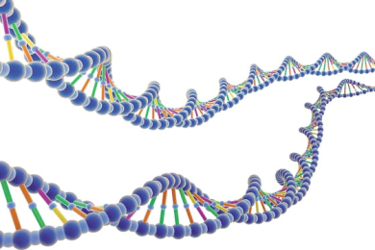

What we know?
Genes
Environment
30%
70%
Essential HYPERTENSION (common)
Notes:
I would like to thnak the organising committee for inviting to talk about the intriguing topic of hypertension genetics. I will try to give a very quick background of where we are in the area and to show where I think the future of hypertension genetics may lie. We certainly know that genes genes contribute to hypertension and most studies ponint to nuber around the 30% mark, some even sugeest up to fiffty percent genetics

Slide 3
Hypertension as a complex, polygenic trait
Gene B
Gene E
Environment 3
Gene C
Environment 2
Environment 4
Environment 5
Gene A
Intermediate phenotype α
Intermediate phenotype β
Gene F
Environment 6
Gene D
Intermediate phenotype γ
Hypertension
Environment 1
Notes:
We also know the common form of hypertension is complex and polygenic with multiple genes and pathways, affecting intermediate phenotypes contributing to it pathogenesis in additon to the envt.

Slide 4
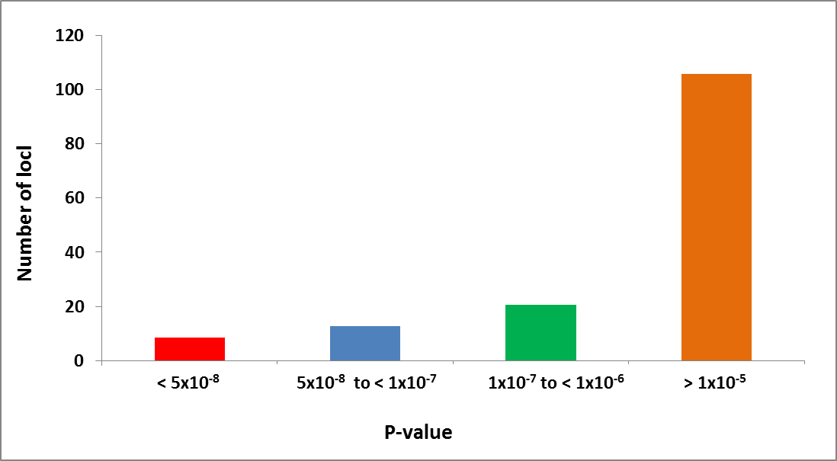
How many hypertension loci?
Where are the known targets?
GWAS
significant
Level
Notes:
Genone wide scans have been used to to identify genes associated with BP. Intererstingly many gwas studies failed to to attain genome wide significance seen in the red here. Interestingly genes known to alter bp such as the current drug targets and causative in rare mendelian forms oten fail to prodcue strong signals

Slide 5
Missing Heritability
Notes:
So if we look e at the genetics there are some rare variant and monofenics forms and GWAS and metanalysis hits. However most of the phenotype remains hidden from our site. In the large gwas 1 mmhg per allele for SBP and 0.5 for DBP. This adds no improvemtns to risk prediciton as of yet

Slide 6
The new genetics
Genetic variation
(large,small)
Epigenetic processes
(noncoding, methylation)
Gene expression
Blood
Pressure
Notes:
This brings me to propose a new way to look at the way our genome contributes to bp regulation, to date most of our concentration has been on small genetic variation or SNPs on bp. The last few years there has been a bit of revolution in our thinking of how the genome behaves in the cell. In particular there is many forms of variaition.. Epigenetic processes. Gene expression in particulr non-coding rna.

Slide 7
Regions of CNV in the Hypertensive Rat associated with Hypertension
Charchar et al . Hypertension 2010
Notes:
In summary we detected 12 regions of possible CNV in the rat between

Slide 8
CNV in human hypertension
GWA meta-analysis identified 29 SNPs
n=203,056
Ehret et al., 2011 Nature
4 SNPs were in CNV regions
MOV10: CNVs 3306 and 64617 (chr 1)
JAG1: CNV 4094 (chr 20)
ADM: CNV 0143 (chr 11)
GOSR2: CNV 4038 (chr 17)
Notes:
Low BP: age 32.3±14.5; BMI 22.7±3.3
High BP: age 55±8.3; BMI 28.3±4.5

Slide 9
Over-representation of a deletion in MOV10 CNV in the high extreme end of BP distribution using digital PCR
*P=0.013

Slide 10
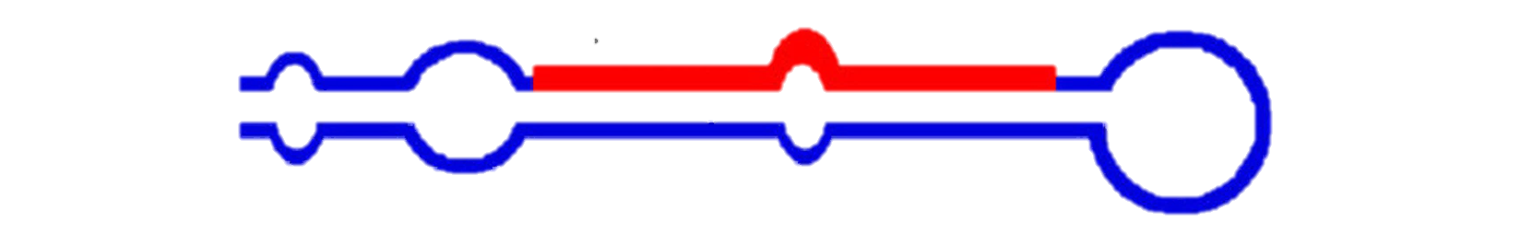
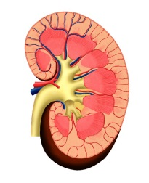

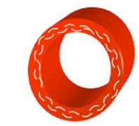
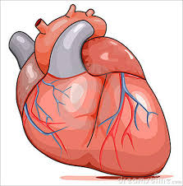

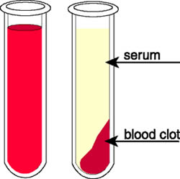
Role of microRNAs in blood pressure
microRNA
mRNA
Degradation of mRNA
Block translation
Tissues
Circulating RNA
Easily available, but low amount of RNA and difficult interpretation
Urine
Heart
CNS
Kidney
Vasculature

Slide 11
Gene Networks of the human hypertensive kidney study (GENHKS)
200 white European individuals – Patients with non invasive renal cancer after unilateral elective nephrectomy
Tissue sample collected from a healthy pole of the kidney (unaffected by cancer)
Genome wide transcriptome study

Slide 12
Kidney and Serum miR-181a are Strongly Associated with BP
Marques et al. Hypertension 2011, 2014
Notes:
Both renal and serum expression of miR-181a were associated with BP in both patients who were on antihypertensive treatment and those not managed pharmacologically (P<0.05 for all analyses). The most significant association was identified between serum levels of miR-181a and diastolic BP in those not on BP lowering therapy – each unit increase in microRNA level increased diastolic BP by approximately 2.5mmHg (β=2.47,SE=0.5, P<0.001). The association between serum miR-181a and BP was independent of kidney expression of renin or its serum levels.

Slide 13
miR-181a affects renin levels
miR-181a and renin mRNA overexpressed in the cortex of hypertensives
Marques et al. Hypertension 2011, 2014

Slide 14
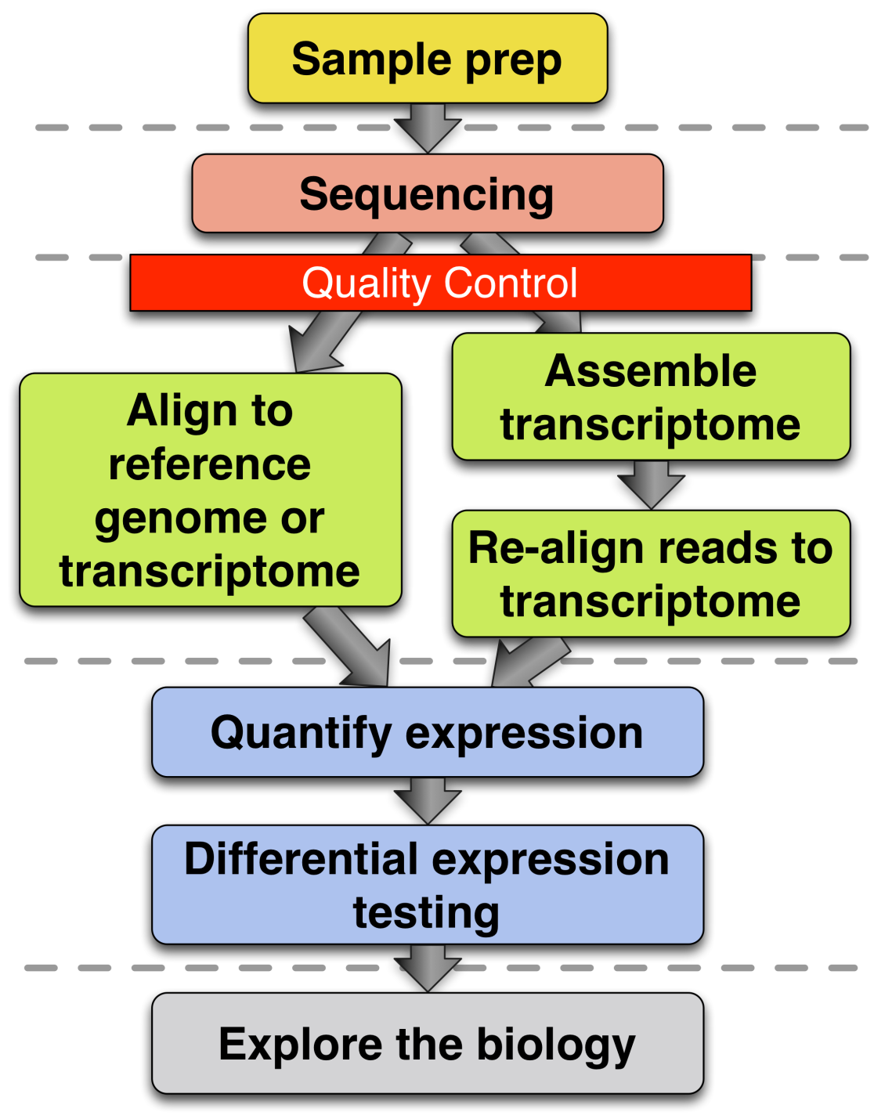
RNA-seq of hypertensive kidneys

Slide 15
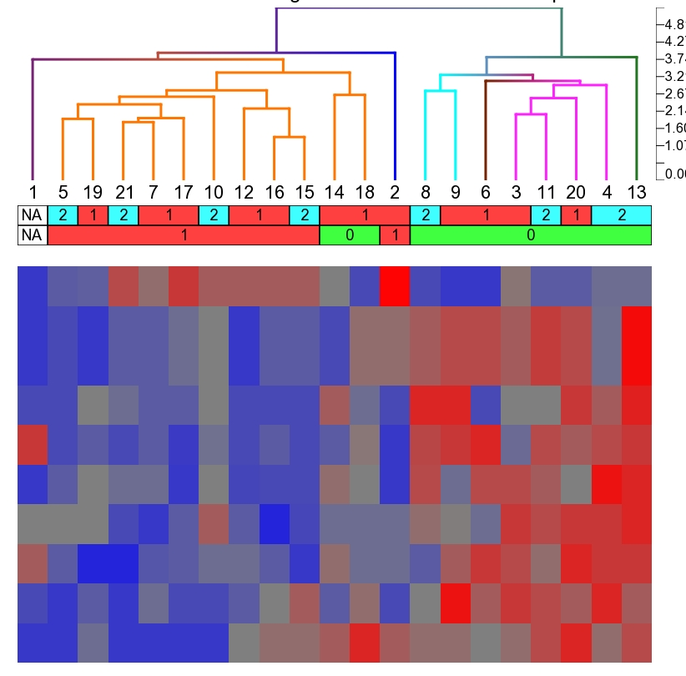
Clustering of hypertensive kidney

Slide 16
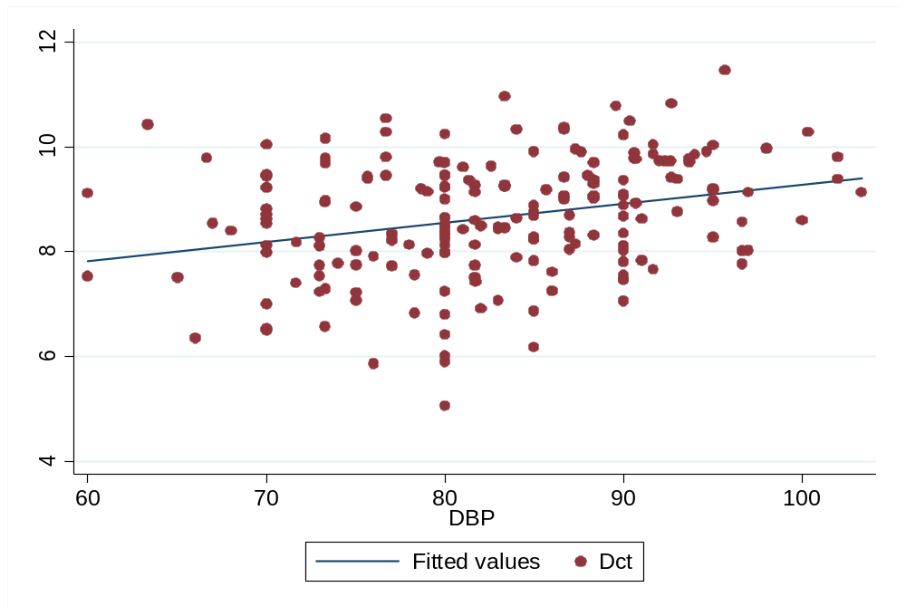
Correlation between non-coding RNA expression WRD74 and DBP
r=0.29
P=0.03 adjusted

Slide 17
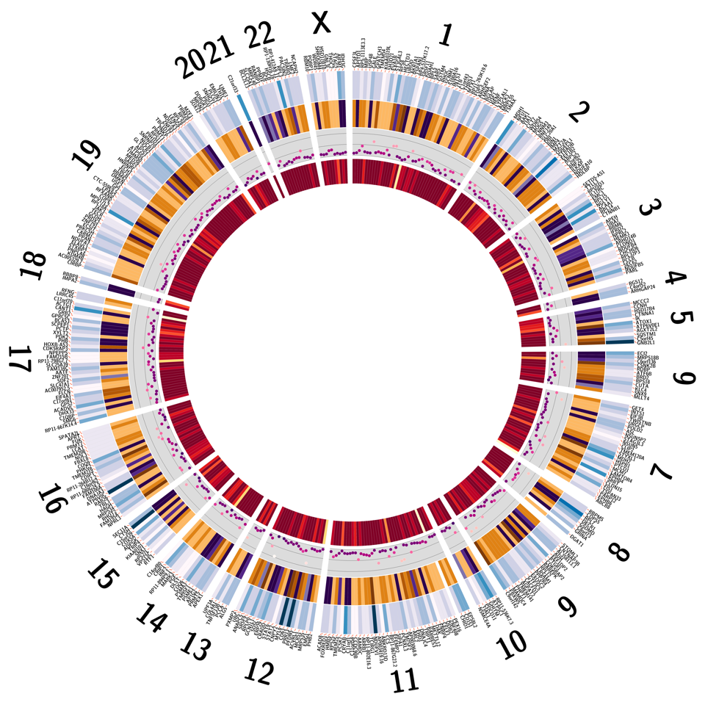
RNA metabolic/HDAC process gene network

Slide 18
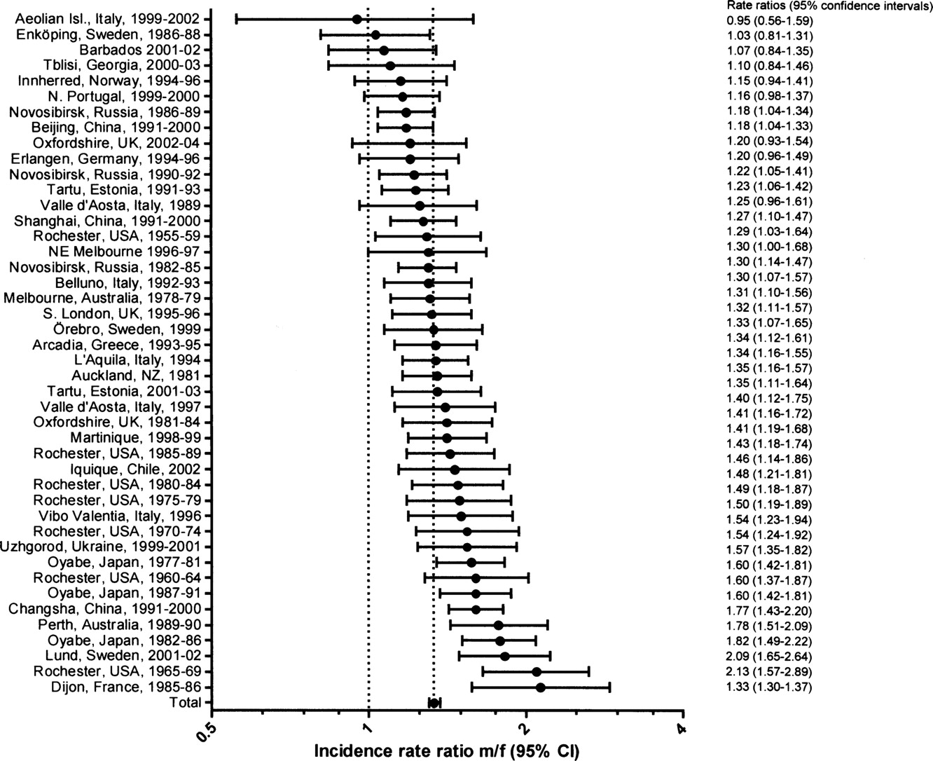

Male/female stroke incidence rate ratios
Appelros P et al. Stroke. 2009;40:1082-1090
Copyright © American Heart Association, Inc. All rights reserved.
Notes:
Figure 1. Male/female stroke incidence rate ratios with 95% CIs for different populations. Ages ≥45 years are included. (Adjusted to the WHO world population.) Test for heterogeneity: χ2=144.18, df=43, P<0.00001, I2=70%; test for overall effect: Z=6.48 (P<0.00001).

Slide 19
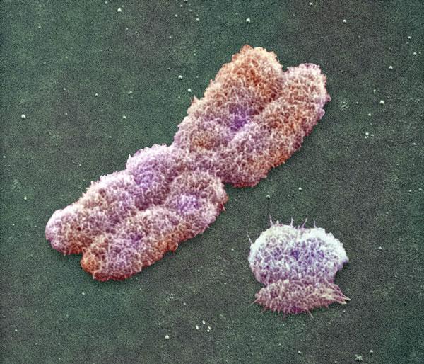
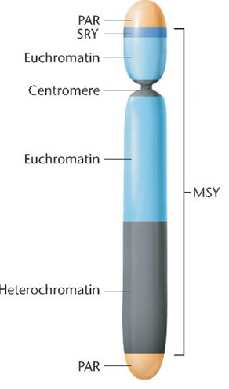
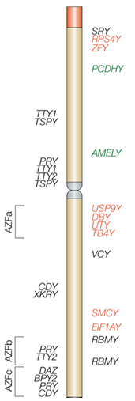

The human Y chromosome
Resolution 1:10000
“ ... the human Y is a pathetic little chromosome that lost most of its genes, other than a sex determining gene...”
(Jenny Graves)
X
Y
4000 genes
MSY
27 genes
200 genes
▪16 X-degenerate genes
▪2
X-transposed genes
▪9
multi-copy ampliconic genes
Nature 2003;423:825-837.
Nature Reviews Genetics 2011;2:207-216.

Slide 20
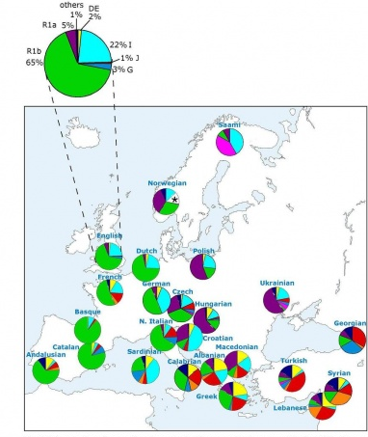
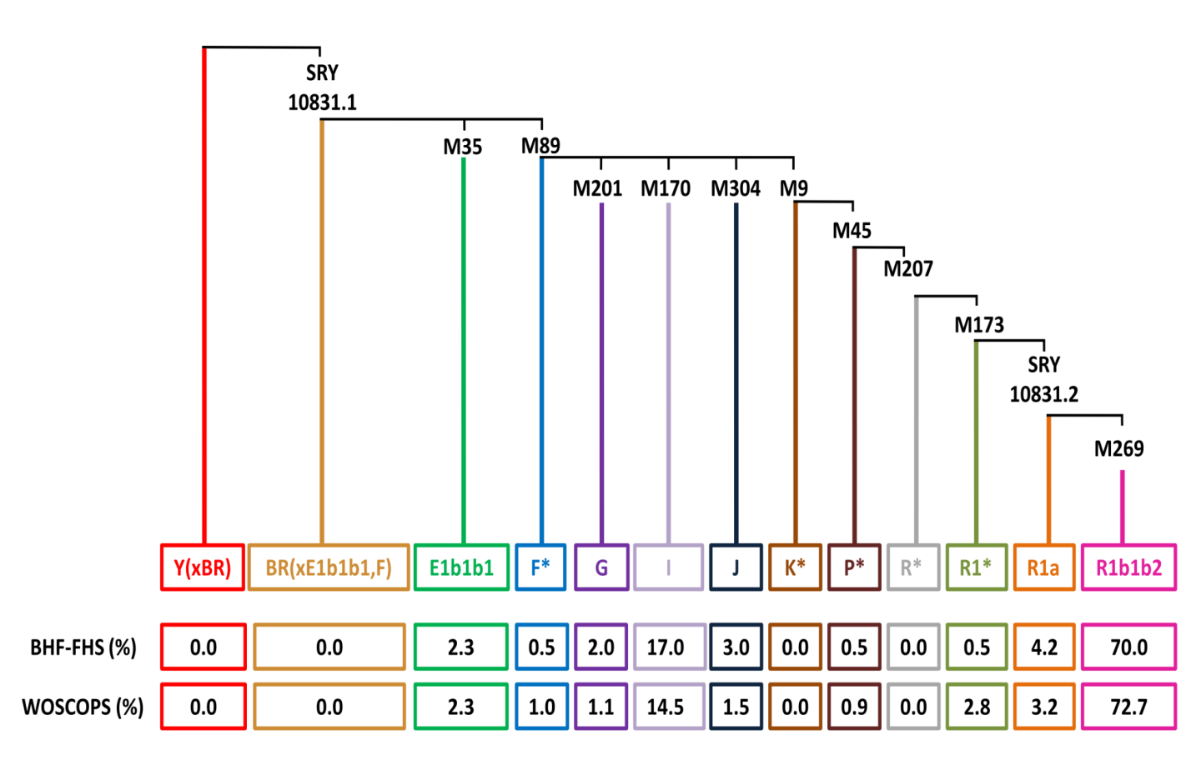
Ancestry of Y chromosome haplogroups
Haplogroups have the same single nucleotide polymorphism (SNP) mutation in a haplotype and share a common ancestor
Current Biology 2003;13:979–984.
Notes:
Each vertical line represents one branch (haplogroup) of the Y chromosome phylogenetic tree. The 13 most common Y chromosome haplogroups are shown in different colours [Y(xBR) - red, BR(xE1b1b1,F) - gold, E1b1b1 - green, F* - blue, G - purple, I - lavender, J – dark blue, K* - brown, P* - maroon, R* - grey, R1* - light green, R1a - orange and R1b1b2 - pink] and are lined up from the phylogentically oldest on the left [Y(xBR)] to the youngest on the right (R1b1b2). The vertical length/height of each line corresponds to the age of each haplogroup (the longest line being the oldest haplogroup). The symbols at the top of each line (SRY10831·1, M35, M89, M201, M170, M304, M9, M45, M207, M173, SRY10831·2 and M269) are the identification numbers of the SNPs that define specific haplogroups according to the Y Chromosome Consortium nomenclature. The numbers in boxes reflect prevalence (percentage) of each haplogroup in BHF-FHS (upper row) and WOSCOPS (lower row) populations.

Slide 21
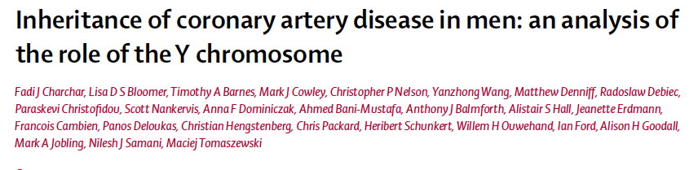
The Y chromosome and Stroke
Carriers of haplogroup I had an approximately 50% higher age-adjusted risk of CAD
Seven genes on the Y chromosome were differentially expressed in males with ischemic stroke
Charchar et al Lancet 2012

Slide 22

Summary
The new genetic biomarkers come in many forms
  SNP
  CNV
  microRNA
  Non-coding RNA

Slide 23


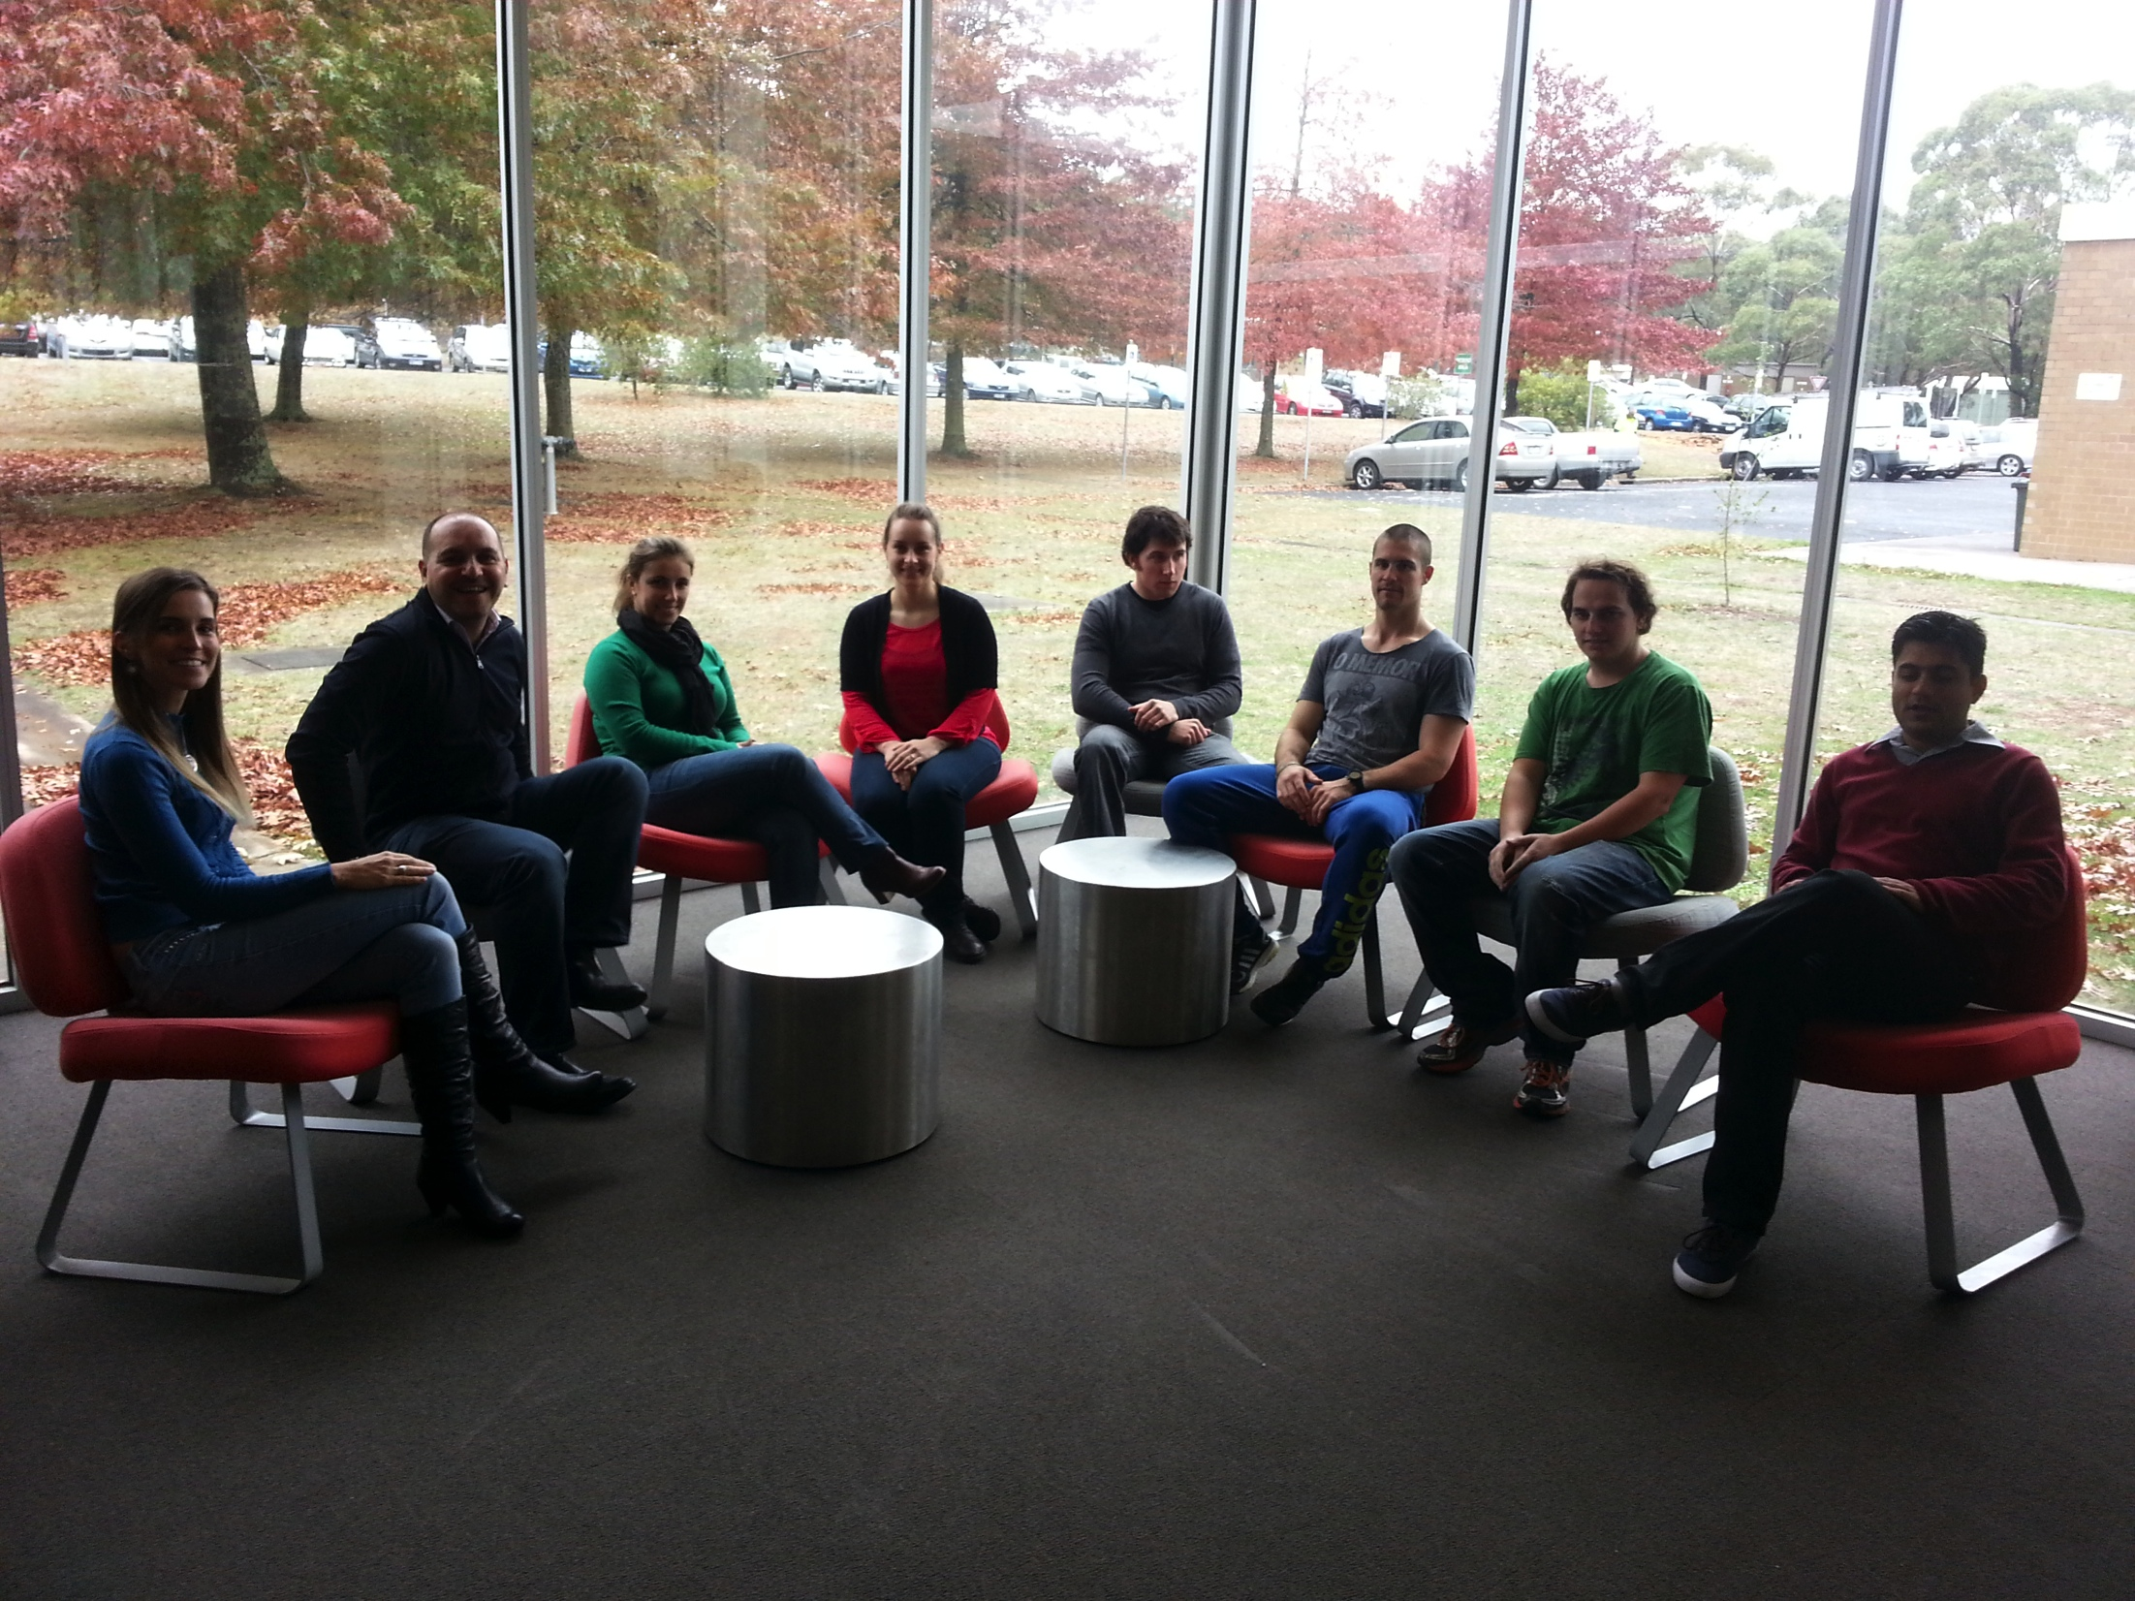


Acknowledgements
Francine Marques
Priscilla Prestes
Evi Christiphidou
Maciej Tomaszewski
James Eales
Nilesh samani
Stephen Harrap
Jan Danser

Slide 24
CNV in Victorian Family Heart Study
“Power of the extreme” approach
Heritability of SBP was estimated to be 41
Digital PCR to measure absolute copy number
 | Extreme low BP (n=92) | Extreme high BP (n=96) | P value
SBP (mean ± SD) | 98.6 ± 5.2 mmHg | 165.9 ± 12.3 mmHg | <0.001
DBP (mean ± SD) | 64.3 ± 7.2 mmHg | 94.4 ± 10.8 mmHg | <0.001

Slide 25
miR-181a is the main regulator of renin mRNA in the kidney
β=–0.35,SE=0.2, P=0.028
miR-181a was the only determinant of renin mRNA levels in human kidneys

Slide 26
Kidney and serum renin are correlated
.
β= -0.34, SE=0.16, P=0.038
Serum levels of renin were correlated with its expression in human kidneys

Slide 27
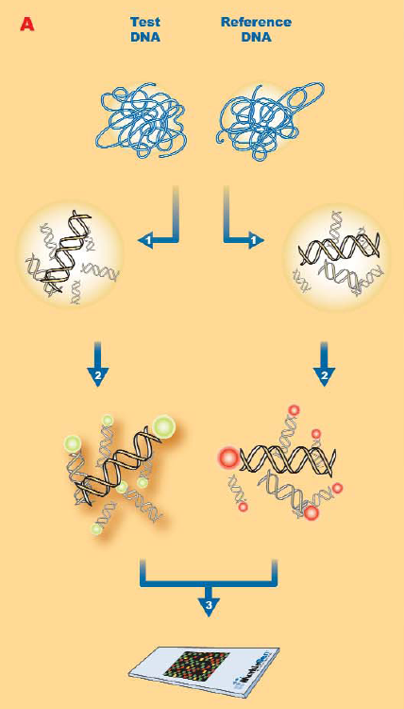

CNV in the hypertensive rat
SHR DNA
WKY DNA
Notes:
The cGH array experiments was performed using a We performed a comparative genomic hybridization (CGH) using a whole-genome array containing 385000 probes (Roche NimbleGen Inc.) with a 5303bp median probe spacing. We performed 2X hybridisations.We also performed dye swapping

Slide 28
Serum renin is associated with HT and BP
OR=5.2, 95%CI:2.2-12
Serum renin was associated with HT in treated and untreated subjects
Serum renin was correlated with SBP and DBP in treated and untreated subjects

Slide 29
Serum miR-181a is associated with HT in untreated subjects
Kidney miR-181a or renin were not associated with HT
Serum miR-181a was associated with HT in untreated subjects
.

Slide 30
Conclusions
miR-181a is a negative regulator of renin expression in the human kidney.
miR-181a and renin are together in the circulation and both affect BP, but their effect is independent of each other.
Renin-independent effect of miR-181a on BP suggests that this microRNA must affect transcription of other molecule(s) that contribute to BP regulation and the net effect of these interactions translates into BP elevation.

Slide 31
MOV10 - biological functions
• encodes Moloney leukemia virus 10,
homolog (mouse):
belongs to the RNA helicase superfamily-2
is required for the miRNA-mediated cleavage of RNA
is important for the function of miRNAs in human cells – potentiates the efficiency of miRNA-mediated translational repression in human cells
Liu C et al. J Biol Chem. 2012;287:29373-29383.
Notes:
cdoi: 10.1074/jbc.M112.354001. Epub 2012 Jul 12.
APOBEC3G inhibits microRNA-mediated repression of translation by interfering with the interaction between Argonaute-2 and MOV10.
Liu C1, Zhang X, Huang F, Yang B, Li J, Liu B, Luo H, Zhang P, Zhang H.

Slide 32
Kidney and serum miR-181a are correlated
β=0.52, SE=0.1, P<0.001
Serum levels of miR-181a are representative of its expression in human kidneys

