Slide 1
International Stroke Genetics Consortium
Outreach Committee
2012-2014
Paris 2014

Slide 2
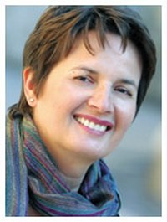
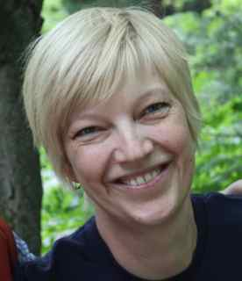
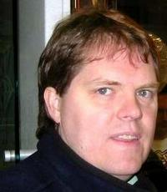
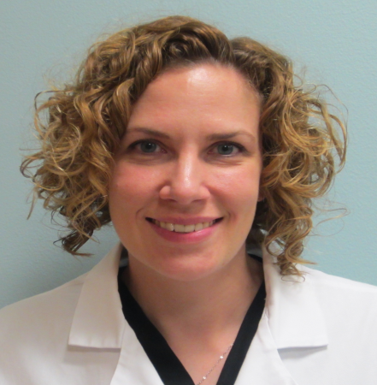
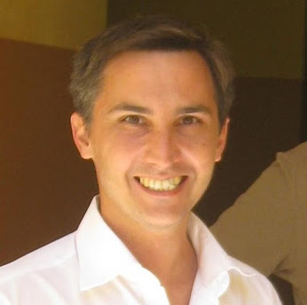
Members of the Outreach Committee
2012-2014
Agnieszka Słowik (Jagiellonian University, Krakow, Poland) - Chair
Jennifer Majersik (University of Utah, Salt Lake City, USA)
John Cole (University of Maryland School of Medicine, Baltimore, USA)
Laura Heitsch (Washington University, School of Medicine, St Louis, USA)
Juan Jose Martin (Cordoba, Argentina)
Thomas Battey – Convener - (MGH-Harvard, Boston, MA)

Slide 3
Outreach Committee: activities
Documents generation and their update
Flyers
Letter of Invitation
Letterhead
Presentations of the Consortium to public
Conferences
  2012: World Stroke Conference, Brazil
  2013: European Stroke Conference, Congress of the Iberoamerican Society of Cerebrovascular Disease, Asia-Pacific Stroke Conference, German Neurocritical Care Society, MC Utrecht, Cornell Medical College, American Neurological Association, Neurocritical Care Society,
  2014: Finnish Institute of Molecular Medicine, Unversity of Edinburgh, University of Cambridge, Fourth Annual International Cerebral Amyloid Angiopathy Conference, World Stroke Conference Istanbul,University of Massachusetts

Slide 4
Outreach Committee: activities
20 new members
Standardized process of acceptance of new members (application form, presentation to the Steering Committee)
Electronic database of new members
Presentation of the new members on the ISGC webpage and to the Workshops

Slide 5
New Member Invitation Process
We invite or they request membership
The convener (Tom) sends a membership form
  Includes: their institution, interests, and sample numbers
Once they fill out form & send it in, Tom sends to all of us
Depending on location, one of us personally contacts the new member
We report back to Agnieszka (Chair) who reports to the Steering Committee

Slide 6
New members: major interests
Europe
Michanangelo Mancuso (Pisa, Italy): mitochondrial diseases, rare diseases and stroke genetics
Rustam Al.-Shahi Salman (UK): “interested in anything that bleeds in the brain”
Gabriel Rinkel JE (Netherland): subarachnoid hemorrhage and intracranial aneurysms; huge DNA resources
Marcel Arnold (Bern, Switzerland)*: biomarkers, including genetics of large vessel diseases, dissection, and ischemic stroke
Tom Van Agtmael (Glasgow, UK)*: investigation of collagen VI in stroke
Reecha Sofat (London, UK)*: established UCL stroke case Collection (UStroC)
* Waiting for final acceptance by the Steering Committee

Slide 7
New members: major interests
North America
Adam de Havenon (University of Utah): the use of MRI and TCD to develop stroke prevention treatment paradigms
James E Faber (University of North Carolina at Chapel Hill): vascular biology (including genetics) of collateral circulation in the brain, heart and lower extremities and its significance in mouse model of occlusive disease
Rajat Dhar (Washington University School of Medicine): GWAS on acute cerebral edema, collaborates with Washington University Projects
Jason Chang (University of Tennessee Health Sciences Center, Memphis): stroke genetic biomarkers and their correlation with metabolic syndrome
Andrei Alexandrov (University of Tennessee Health Sciences Center, Memphis): stroke genetic biomarkers and their correlation with metabolic syndrome

Slide 8
New members: major interests
South America
Jamary Oliveira Filho (Brazil): serum and neuroimaging biomarkers of stroke, Chagas disease
Violeta Diaz (Chile): dissection
Pablo Bonardo (Argentina): represents 30 centers sharing DNA samples from young stroke patients
Africa
Foad Abd Allah (Egypt): vascular neurology and stroke medicine
Masharip Atadzhanov (Zambia): genetic and environmental contributors to ischemic stroke and intracerebral hemorrhage in Zambian patients

Slide 9
New members: major interests
Asia
Lawrence Wee (Singapore): principal investigator of lab focused on genome analysis using maschine learning method
Ranil de Silva: (Sri Lanka): genetic risk factors of stroke in Sri Lankan population
Loo Keat Wei (Malaysia): genetics and epigenetics of stroke, hypertension and diabetes, translational research
Australia
Christina Miteff: local principal investigator for the IPPS (International Pediatric Stroke Study)

Slide 10
New members: their current resources
EUROPE | Ischemic stroke | ICH | SAH | controls | Other
Italy | 150 | 50 | 0 | 200 | 0
UK (Glasgow) UK (London) | 0 60 | 100 0 | 0 0 | Generation Scotland controls* >10000 from existing longitudinal studies at UCL* | 0
Netherlands | 1500 | 500 | 1500 | 1500 | 0
USA (Aleksandrow) | 1200 | 250 | 0 | 0 | 0
Brazil | 250 | 0 | 0 | 250* | 0
Chile | 0 | 0 | 0 | 0 | Dissection*
Argentina | 150 | 0 | 0 | 0 | 0
Malaysia | 294 | 0 | 0 | 294 | 0
Sri Lanka | 600 | 0 | 0 | 200 | 0
TOTAL | 4204 | 900 | 1500 | >2444
* Exact numbers not provided

Slide 11
Future directions
Database of new members and their phenotype/genotype resources
Describe opportunities for ISGC participation on the ISGC webpage
Specific roles (better differentiate responsibilities) for the committee members
Improve Committee communication (every two months teleconferences)
Continued ISGC exposure and recruitment at meetings worldwide

