Slide 1
SiGN GWAS of ischemic stroke and its subtypes
SiGN Working Meeting
Sara Pulit
de Bakker Lab, UMC Utrecht
4 November 2014

Slide 2







SiGN Analysis Team
University of Maryland
Brackie Mitchell
Steven Kittner
Patrick McArdle
Jeff O’Connell
Tushar Dave
Kathy Ryan
Huichun Xu
Yuching Cheng
John Cole
Mary J Sparks
University of Virginia
Steve Rich
Ani XXX?
Univ. of Texas (Houston)
Myriam Fornage
University of Washington
Cathy Laurie
Quenna Wong
LMU Munich
Rainer Malik
Newcastle University
Liz Holliday
UMC Utrecht
Paul de Bakker

Slide 3
SiGN GWAS: Data overview
Samples
Genotypes
Three populations
  European (EUR)
  African American (AFR)
  Hispanic (HIS)
Collection sites
  18 cohorts from the US
  13 cohorts from Europe and Australia
All Illumina-array genotyping
  Smallest: 610k array
  Largest: 5M array
Cases and controls (mostly) genotyped separately

Slide 4
Data cleaning workflow
Clean individual cohorts
Sample, SNP QC
Establish array-based groups
Establish ancestry-based groups (within array groups)
PCA, spatial clustering
EUR
AFR
HIS
Clean ancestry- and array-based groups
Sample, SNP QC
Run initial (all stroke) GWAS
Genomic inflation check

Slide 5
EUR groups (I)
Group 1:
610 array
Group 2:
660 array
Group 3:
1M array
Group 4:
2.5M array
Group 5:
5M array
HABC
ISGS
SWISS
GASROS
BRAINS
WTCCC
KORA
EDIN
STGEORGE
MUNICH
OXVASC
GEOS
GEOS
CIDR
OAI
HRS
KRAKOW
KRAKOW
754 cases
1,586 controls
2,572 cases
5,954 controls
460 cases
519 controls
3,291 cases
11,820 controls
878 cases
716 controls
360k SNPs
360k SNPs
767k SNPs
1.75M SNPs
4.0M SNPs
Case groups: bold italics

Slide 6
EUR groups (II)
Group 6:
5M array
Group 7:
1M + 5M arrays
Group 8:
610 + 5M arrays
Group 9:
Omni + 5M arrays
Group 10:
610 array
LEUVEN
LEUVEN
ADHD
INMA
BASICMAR
GRAZ
GRAZ
MALMO
MALMO
LUND
LUND
GOTEBURG
ASGC
ASGC
459 cases
453 controls
868 cases
1,218 controls
607 cases
815 controls
1,597 cases
1,362 controls
256* cases
1,200 controls
4.0M SNPs
500k SNPs
239k SNPs
580k SNPs
550k SNPs
*with CCS. TOAST N = 1,100
Case groups: bold italics

Slide 7
AFR and HIS groups
AFR
AFR
HIS
Group 3:
1M array
Group 4:
2.5M array
Group 4:
2.5M array
GEOS
GEOS
CIDR
OAI
HRS
CIDR
SOL
383 cases
361 controls
970 cases
2,022 controls
942 cases
2,429 controls
745k SNPs
1.61M SNPs
1.75M SNPs
Case groups: bold italics

Slide 8
Meta-analysis workflow
Imputation
Pre-GWAS QC
SNP, sample level QC
GWAS
Pre-meta QC
SNP level QC
Meta-analysis
Fixed effects across all strata

Slide 9
Primary traits of interest
CCS causative classification
CCS phenotypic classification
TOAST classification
LAA
CE major
SAO
Other
Undetermined
Cryptogenic + CE minor
Incomplete + Unclassified
LAA major
CE major
SAO major
Other major
Cryptogenic
LAA
CE
SAO
Other
Undetermined

Slide 10
Known loci in CCS and TOAST (I)
Chr | Gene | SNP | Phenotype | CCS (C) | CCS (P) | TOAST
4q25 | PITX2 | rs2200733 | CE | 1.24 x 10⁻¹⁶ | 3.26 x 10⁻¹⁹ | 1.02 x 10⁻¹⁶
4q25 | PITX2 | rs10033464 | CE | 2.32 x 10⁻⁷ | 5.69 x 10⁻³ | 2.15 x 10⁻³
4q25 | PITX2 | rs6843082 | CE | 2.50 x 10⁻¹⁶ | 1.27 x 10⁻¹⁹ | 5.29 x 10⁻¹⁹
4q25 | PITX2 | rs1906599 | CE | 3.80 x 10⁻¹⁷ | 2.11 x 10⁻²⁰ | 1.99 x 10-¹⁹
16q22 | ZFHX3 | rs7193343 | CE | 1.12 x 10⁻⁵ | 2.93 x 10⁻⁷ | 1.45 x 10⁻⁵
16q22 | ZFHX3 | rs12932445 | CE | 1.48 x 10⁻⁷ | 1.29 x 10⁻⁸ | 2.94 x 10⁻⁸
16q22 | ZFHX3 | rs879324 | CE | 1.08 x 10⁻⁷ | 6.43 x 10⁻⁹ | 1.75 x 10⁻⁸
9p21 | CDKN2B-AS1 | rs2383207 | LAA | 3.33 x 10⁻⁴ | 8.06 x 10⁻⁴ | 6.34 x 10⁻³
9p21 | CDKN2B-AS1 | rs1537378 | LAA | 8.32 x 10⁻⁴ | 1.61 x 10⁻² | 3.05 x 10⁻²
9p21 | CDKN2B-AS1 | rs7865618 | LAA | 3.20 x 10⁻⁴ | 2.61 x 10⁻³ | 6.41 x 10⁻³
7p21 | HDAC9 | rs11984041 | LAA | 8.47 x 10⁻⁸ | 3.50 x 10⁻⁸ | 3.62 x 10⁻⁷
7p21 | HDAC9 | rs2107595 | LAA | 1.30 x 10⁻¹⁰ | 1.42 x 10⁻¹⁰ | 2.79 x 10⁻¹¹
12q24 | NAA25 | rs10744777 | All stroke | 4.96 x 10⁻⁸ | -- | --

Slide 11
Known loci in CCS and TOAST (II)
Chr | Gene | SNP | Phenotype | CCS (C) | CCS (P) | TOAST
12p13 | NINJ2 | rs11833579 | All | 2.15 x 10⁻² | -- | --
12p13 | NINJ2 | rs12425791 | All | 5.95 x 10⁻¹ | -- | --
12p13 | NINJ2 | rs7193343 | All | 8.72 x 10-3 | -- | --
6p21 | Intergenic | rs556621 | LAA | 3.19 x 10⁻¹ | 6.36 x 10⁻¹ | 2.55 x 10⁻³
6p21 | Intergenic | rs556512 | LAA | 1.85 x 10⁻¹ | 3.82 x 10⁻¹ | 2.69 x 10⁻³
9q34 | ABO | rs505922 | All | 2.03 x 10⁻⁵ | -- | --
 |  |  | CE | 1.88 x 10⁻¹ | 1.62 x 10⁻¹ | 5.66 x 10⁻³
 |  |  | LAA | 6.92 x 10⁻³ | 1.29 x 10⁻³ | 2.15 x 10⁻⁴
9q34 | ABO | rs643434 | All | 9.65 x 10⁻⁴ | -- | --
 |  |  | CE | 2.05 x 10⁻¹ | 2.84 x 10⁻¹ | 7.07 x 10⁻³
 |  |  | LAA | 1.60 x 10⁻² | 9.72 x 10⁻³ | 1.63 x 10⁻³

Slide 12
Results overview: all stroke and TOAST
All stroke
  12q locus found in METASTROKE (p = 10⁻¹¹)
    Locus GW-significant in SAO subtype
  No other genome-wide significant loci
TOAST
  Replication of most known loci
  No novel genome-wide significant loci

Slide 13
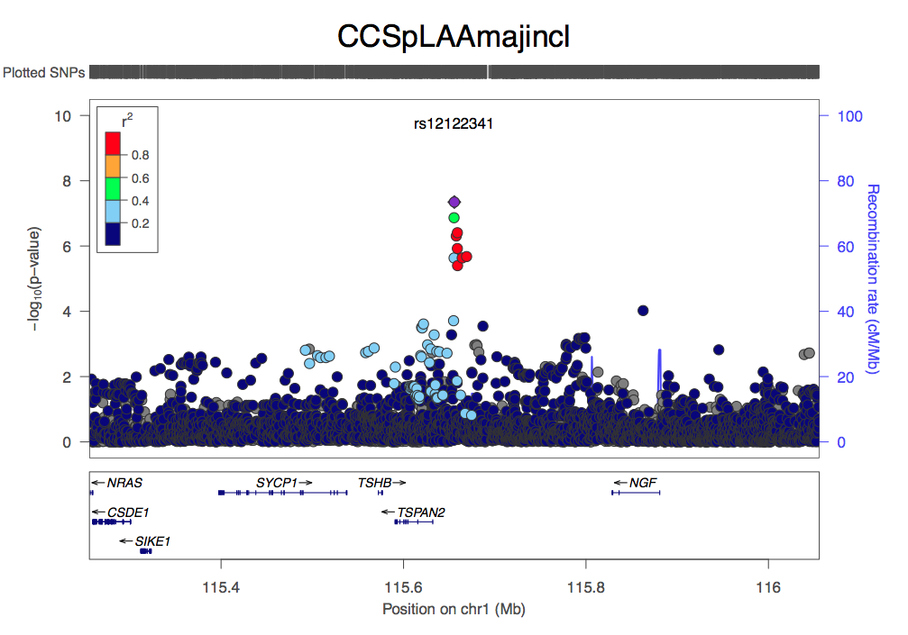
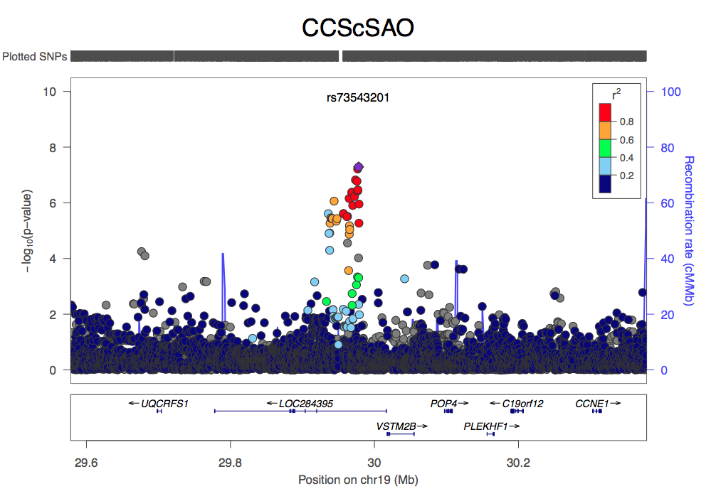
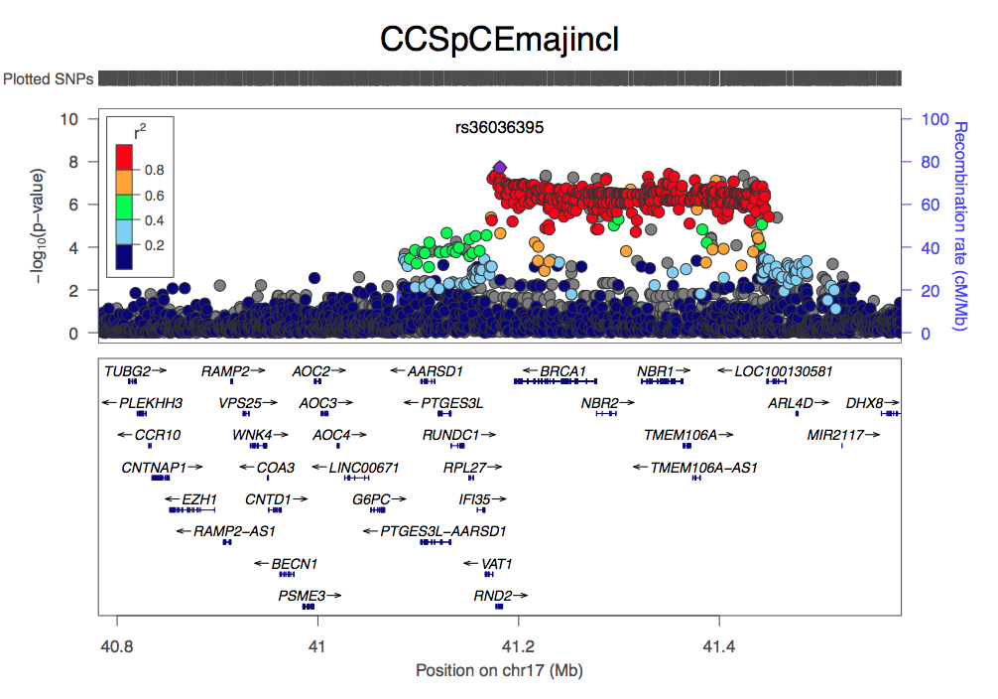
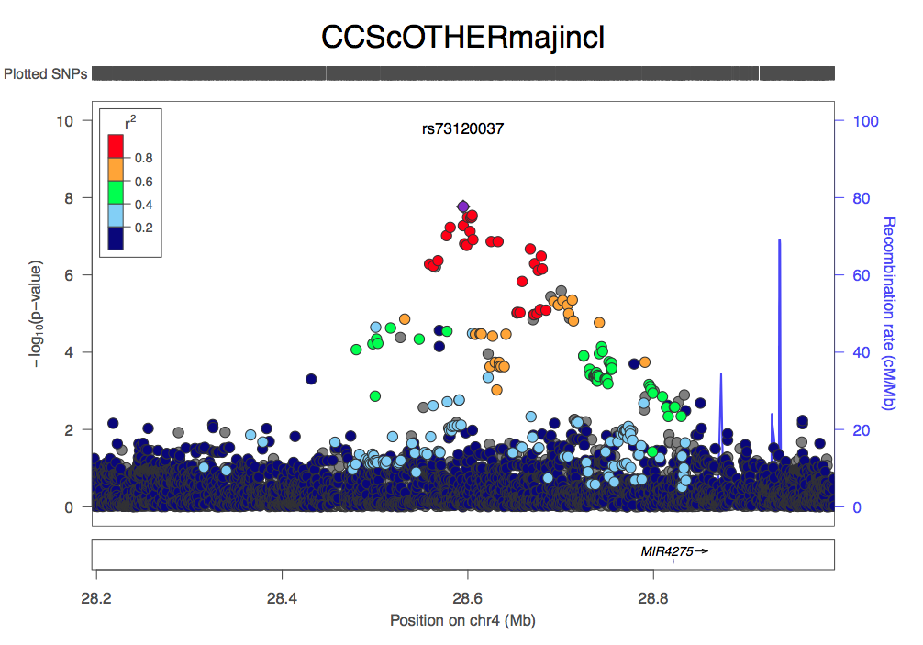
Results overview: CCS
Subtype | GW-sig loci | Suggestive loci (p < 1 x 10⁻⁶)
LAA | 4 | 9
CE | 4 | 7
SAO | 1 (almost 2) | 9
Other | 3 | TBD
Crypto | 2 | TBD

Slide 14
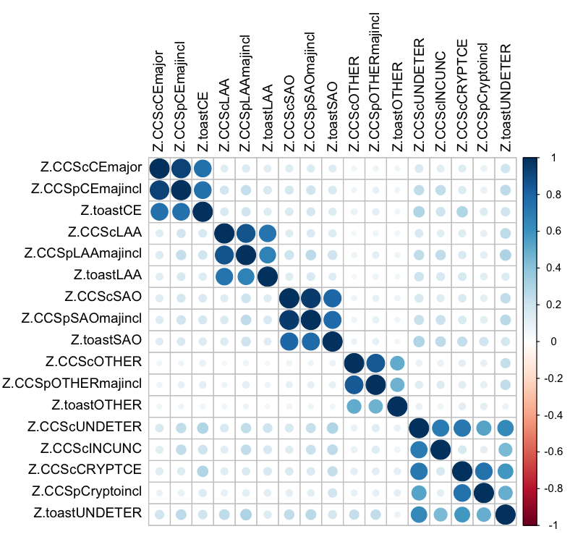
Correlation within subtypes (r)
Based on genome-wide z-scores
CCS Causative vs. CCS Phenotypic
LAA | 0.829
CE | 0.907
SAO | 0.943
Other | 0.809
Cryptogenic | 0.684
CCS Causative vs. TOAST
LAA | 0.678
CE | 0.700
SAO | 0.751
Other | 0.446
Undetermined | 0.569
CCS Phenotypic vs. TOAST
LAA | 0.611
CE | 0.699
SAO | 0.733
Other | 0.424

Slide 15
Next steps and related efforts
GWAS and meta-analysis of remaining phenotypes
Replication
Age of onset analyses
chrX analysis and sex-specific analyses
Heritability analysis
Replication

Slide 16
Stroke mega-analysis
Merging of SiGN, METASTROKE, additional available stroke cases
“Greedy” approach
  Largest assembly of stroke cases to date

