Slide 1
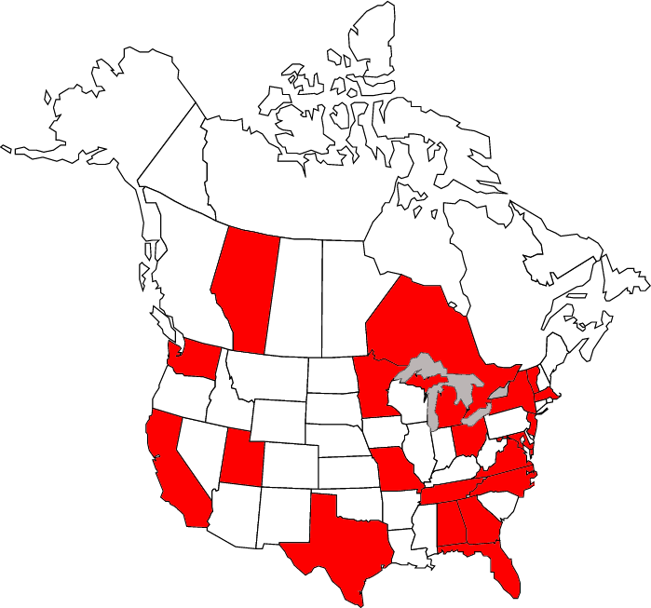
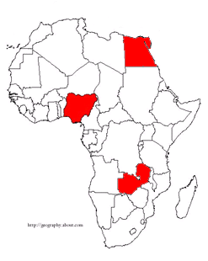
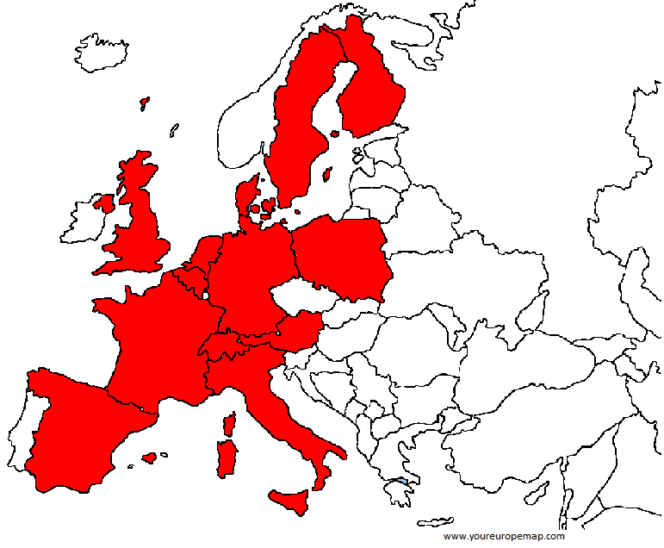
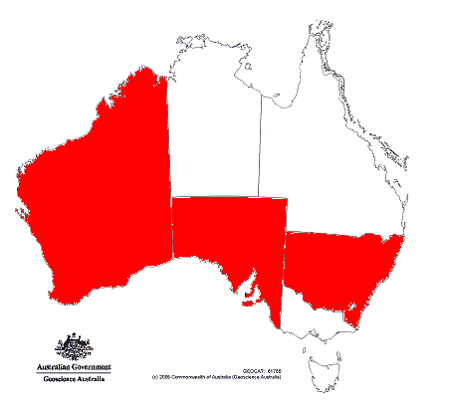
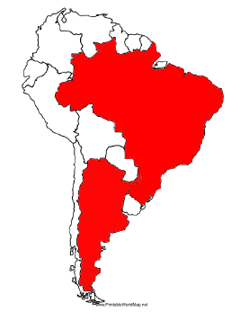
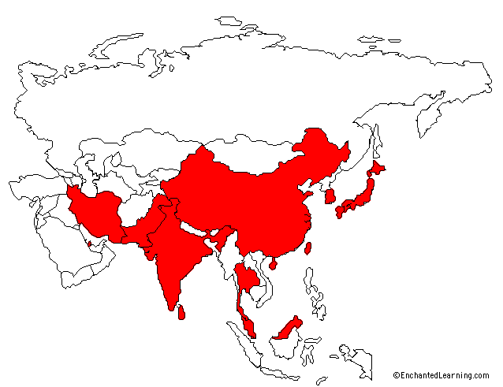
ISGC Sites

Slide 2
ICH meta-analysis phase 2: Discovery
Study | Controls (n) | All ICH (n) | Lobar ICH (%) | Non-lobar ICH (%)
GOCHA (Multicenter, USA) | 387 | 387 | 54 | 46
Warfarin-associated ICH (GOCHA) | 190 | 170 | 30 | 66
HM + VVH (Spain, Barcelona) | 160 | 236 | 38 | 62
JUHSS (Poland, Krakow) | 217 | 156 | 36 | 54
LSR (Lund, Sweden) | 153 | 136 | 26 | 74
GERFHS (Cincinnati, USA) | 539 | 797 | 41 | 59
RACE (Pakistan) | 4027 | 1436 | 10 | 90
MDC (Malmo, Sweden) | 372 | 199 | 38 | 62
University of Cambridge | 970 | 150 | 39 | 61
CHARGE Consortium | 42,840 | 277 | NA | NA
Total | 48,885 | 3,794 | 26% | 74%

Slide 3
ICH GWAS Meta-analysis
Attempting replication in 32 loci
Secondary analysis
  Age of onset analysis
  Warfarin X Gene Interaction
Genotyping platforms
  TaqMan for ERICH samples
  Fluidigm for RACE samples
  Sequenom for MGH samples

Slide 4
ICH GWAS Meta-analysis Phase 2: Replication
Study | Controls (n) | All ICH (n) | Lobar (%) | Non-lobar (%) | Mixed (%)
GOCHA (Multicenter, USA) | 469 | 246 | 125 (51) | 100 (41) | 21 (8)
ERICH (Multicenter, USA) | 2261 | 1681 | 484 (29) | 1197 (71) | 0
University of Brescia (Italy) | 185 | 201 | 83 (41) | 118 (59) | 0
UMC Utrecht (The Netherlands) | 161 | 159 | 60 (38) | 98 (61) | 1 (1)
RACE
Total | 3076 | 2287 | 752 (33) | 1513 (66) | 22 (1)

Slide 5
Samples for future studies
Site | Controls | Cases | Type
CHARGE Consortium | 42,840 | 277 | Summary Statistics
Georgetown University | 131 | 65 | DNA
MGH | 131 | 45 | DNA
Medical University of Graz | 0 | 17 | DNA
University of Helsinki | Pending | 94 | DNA -- Genotype Data
Hospital Del Mar | 20 | 10 | DNA
Imperial College London | 2640 | 24 | DNA -- Genotype Data
Lund University | 12 | 14 | DNA
McMaster University | 2968 | 781 | Summary Statistics
Ludwig-Maximilian University | 0 | 125 | DNA
University of Oxford | 0 | 13 | DNA
Jagiellonian university | 180 | 53 | DNA
University College London | Pending | 603 | DNA -- Genotype Data
University of Edinburgh | Pending | 111 | DNA -- Genotype Data
University of Newcastle | 1200 | 22 | Genotype Data
Vall’d Hebron Hospital | 24 | 44 | DNA
Washington University in St. Louis | 109 | 96 | DNA
University of Pisa | 83 | 11 | DNA
Total | 50,338 | 2,405

Slide 6
GERFHS IV
Aim #1: Deep sequencing of Chr 1q22 among non-Hispanic white and black ICH cases and controls
Aim #2: Prospectively collect DNA, RNA, and serum on ICH cases and geographic region site-specific controls both at the time of ICH and in the convalescent period.
  RNA expression profiling between cases and controls and over time in cases
  Expression quantitative trait locus (eQTL) analysis with SNPs arising from Aim 1.
  Determine whether alternatively spliced transcripts differ between cases and controls

Slide 7
GERFHS IV Recruitment
Principal Investigator | Institution | #Samples | 4-year #samples
Jordi Jimenez-Conde | Hospital Del Mar | 60 cases/controls y.a. | 240
C.J.M. Klijn | University of Utrecht | 40 cases/more controls y.a. | 160
Alessandro Pezzini | University of Brescia | 60 cases/controls y.a. | 240
Cathy Sudlow | University of Edinburgh | 40 cases/controls y.a. | 160
Agnieszka Slowik | Jagiellonian University | 30 cases/60 controls y.a. | 120
Turgut Talitsumak | University of Helsinki | 100 cases/200 controls y.a. | 400
Vincent Thijs | University of Leuven | 100 cases/controls y.a. | 400
David Werring | University College London | 800 cases by 2018 | 800
T.H. Lee | Chang Gung Memorial Hospital | 480 cases/controls y.a. | 480
TOTAL |  |  | 3000

Slide 8
ICH Exome Array: European Ancestry
 | All ICH (n) | Deep ICH (%) | Lobar ICH (%) | Controls
GOCHA | 430 | --- | 430 (100) | 468
GERFHS | 321 | 196 (61) | 125 (39) | 327
Malmo Diet and Cancer Study | NA | NA | NA | NA
McMaster University | 40 | NA | NA | 468
Total | 791 | 196 | 555 | 1,263

Slide 9
Additional studies
ERICH
  Recovery
  Recurrence
RACE
Megastroke
Sharing platform (R24 application)

Slide 10
Platform for accelerating genetic discovery for cerebrovascular disease

Slide 11
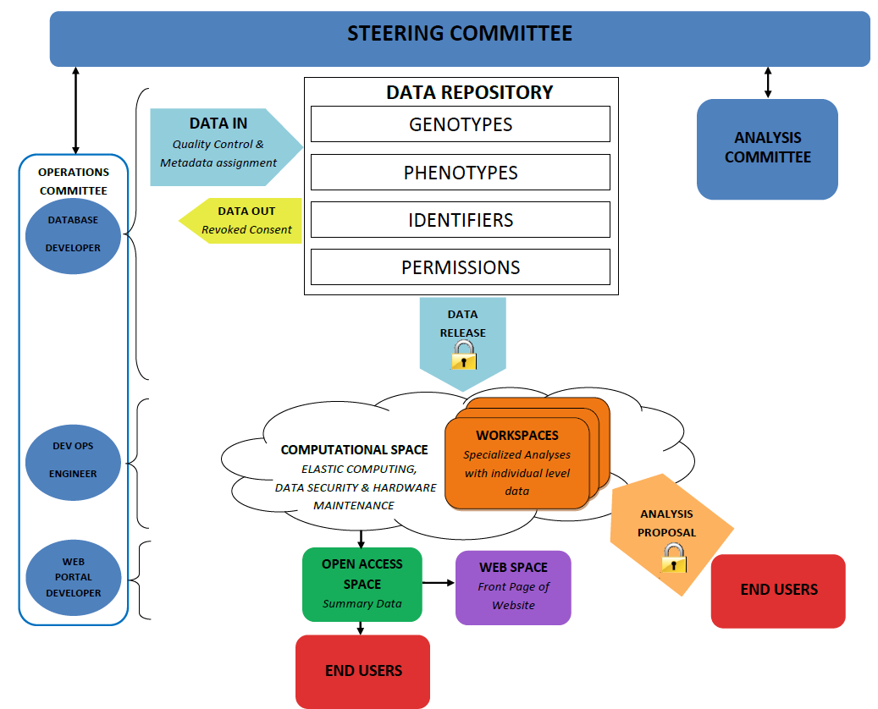

Slide 12
What we can do now:
Harmonize and align data
  MegaSTROKE
  We need to set up a resource akin to the R24 no matter whether we are funded this time or next
Protocols exist, we’ve agreed on them
  Majersik et al. 2014, Battey et al. 2014
We can use this lead time productively to get a head start on the platform

Slide 13
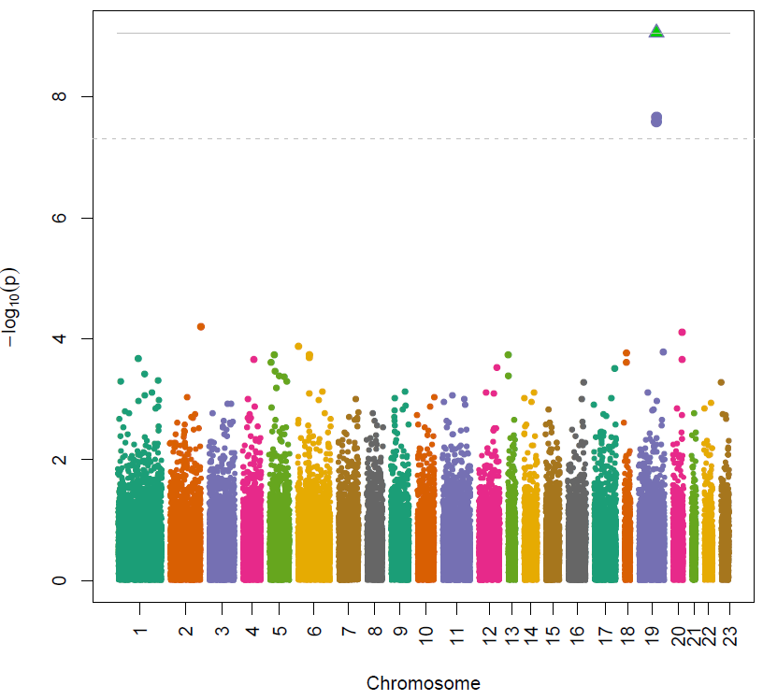
ICH Exome Array: Single-SNP Association

Slide 14
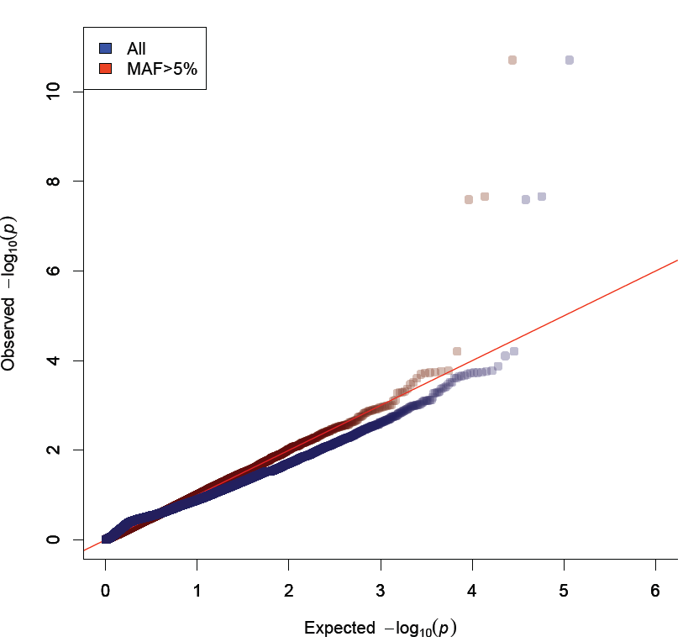
ICH Exome Array: Underpowered

