Slide 1
WMH in ischaemic stroke GWAS Study Collaboration
Matthew Traylor
for the WMH in ischaemic stroke study group
Clinical Neurosciences, University of Cambridge

Slide 2
WMH in ischemic stroke GWAS Study
WMH increased in ischaemic stroke patients
Studying this “extreme population” may increase ability to detect genetic associations
Ischaemic stroke patients recruited
    Age > 18
    Self-reported European ancestry
    diagnosis of ischemic stroke of any subtype
    Exclusion criteria: CADASIL or any other suspected monogenic cause of stroke, vasculitis, demyelinating and mitochondrial disorders.

Slide 3
WMH in ischemic stroke GWAS Study
MRI-Volumetric analysis of leukoaraiosis in ischaemic stroke patients
leukoaraiosis quantified on hemisphere contralateral to stroke to avoid confounding
semi-automated methods used
Mostly FLAIR scans used (92.4%); T2 used where not available (7.6%)
5% of MRI scans excluded : excessive movement artefact, incomplete brain coverage, or bihemispheric infarcts (other than lacunar) precluded accurate WMH quantification.

Slide 4
Dataset
19 studies from US, UK, Australia, Germany, Italy and Belgium: 3,670 subjects
  Analyses performed:
    Primary GWAS analysis
    Hypertensive–only analysis
    Evaluate published associations with
      WMH in community populations (CHARGE)
      non-lobar ICH
    Heritability analyses

Slide 5
Methods
Leukoaraiosis volume normalized by intracranial volume, corrected for age and sex and 2 ancestry informative principal components
All studies imputed to 1000 Genomes Phase 1 integrated variant set using IMPUTE
Association of SNP dosages with WMH tested using PLINK
SNPs with MAF<0.01 or INFO<0.7 removed
Meta-analysis using inverse-variance weighted approach
Residual inflation corrected using genomic control

Slide 6
Centre | N | Lambda | No. of SNPs
Milano | 151 | 1.01 | 7,959,374
WTCCC2-Edinburgh | 64 | 0.99 | 7,875,762
WTCCC2-Munich FLAIR | 447 | 1.00 | 8,287,283
WTCCC2-Munich T2 | 203 | 0.99 | 8,194,948
WTCCC2-Oxford Flair | 65 | 1.03 | 7,891,788
WTCCC2-Oxford T2 | 75 | 1.02 | 7,979,101
WTCCC2-SGUL | 323 | 0.99 | 8,256,772
GENESIS 1 | 121 | 0.99 | 7,554,414
GENESIS 2 | 228 | 0.99 | 7,663,158
SGUL 1 | 70 | 0.98 | 7,278,977
SGUL 2 | 57 | 0.97 | 7,399,139
DNA Lacunar | 303 | 0.99 | 7,679,415
Leuven Stroke Study | 361 | 1.01 | 8,741,082
MGH-Affymetrix | 476 | 1.09 | 7,973,366
MGH-Omni | 84 | 1.02 | 8,234,605
MGH-Illumina | 228 | 1.00 | 8,144,043
ASGC | 96 | 1.01 | 8,113,545
ISGS | 207 | 1.01 | 7,985,259
SWISS | 111 | 1.02 | 7,927,980
Overall | 3,670 | 1.04 (1.01) | 7,567,914

Slide 7
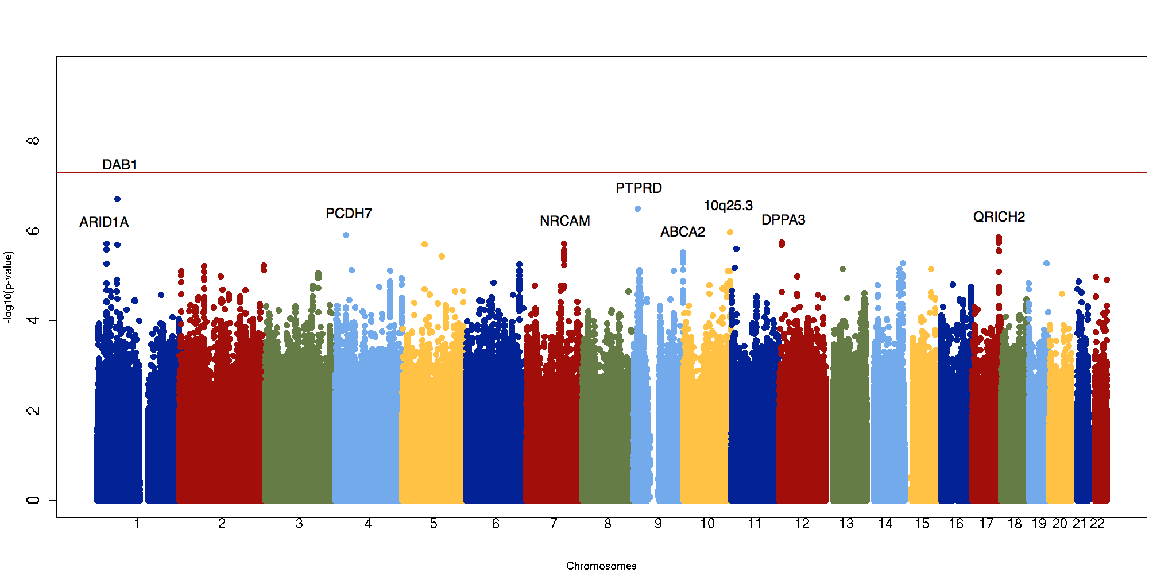
Primary analysis : N=3,670

Slide 8
Primary analysis
SNP | Chr:position | Gene | RA | OA | RAF | OR (95% CI) | P | Het p
rs17579352 | 1:58350805 | DAB1 | C | T | 0.95 | 1.40 (1.23–1.59) | 1.9x10⁻⁷ | 0.55
rs1535459 | 9:10550204 | PTPRD | C | G | 0.98 | 1.87 (1.47–2.38) | 3.2x10⁻⁷ | 0.27
rs7082237 | 10:131889797 | N/A | C | T | 0.88 | 1.20 (1.12–1.29) | 1.1x10⁻⁶ | 0.44
rs3733655 | 4:31146018 | PCDH7 | A | C | 0.64 | 1.13 (1.07–1.18) | 1.3x10⁻⁶ | 0.55
rs346785 | 17:74283769 | QRICH2 | T | C | 0.61 | 1.12 (1.07–1.18) | 1.4x10⁻⁶ | 0.70
rs73267033 | 12:7864476 | DPPA3 | A | G | 0.96 | 1.45 (1.25–1.69) | 1.8x10⁻⁶ | 0.49
rs11247594 | 1:27067417 | ARID1A | G | A | 0.79 | 1.15 (1.09–1.22) | 1.9x10⁻⁶ | 0.53
rs11974528 | 7:107832411 | NRCAM | C | T | 0.98 | 1.53 (1.29–1.83) | 1.9x10⁻⁶ | 0.78

Slide 11
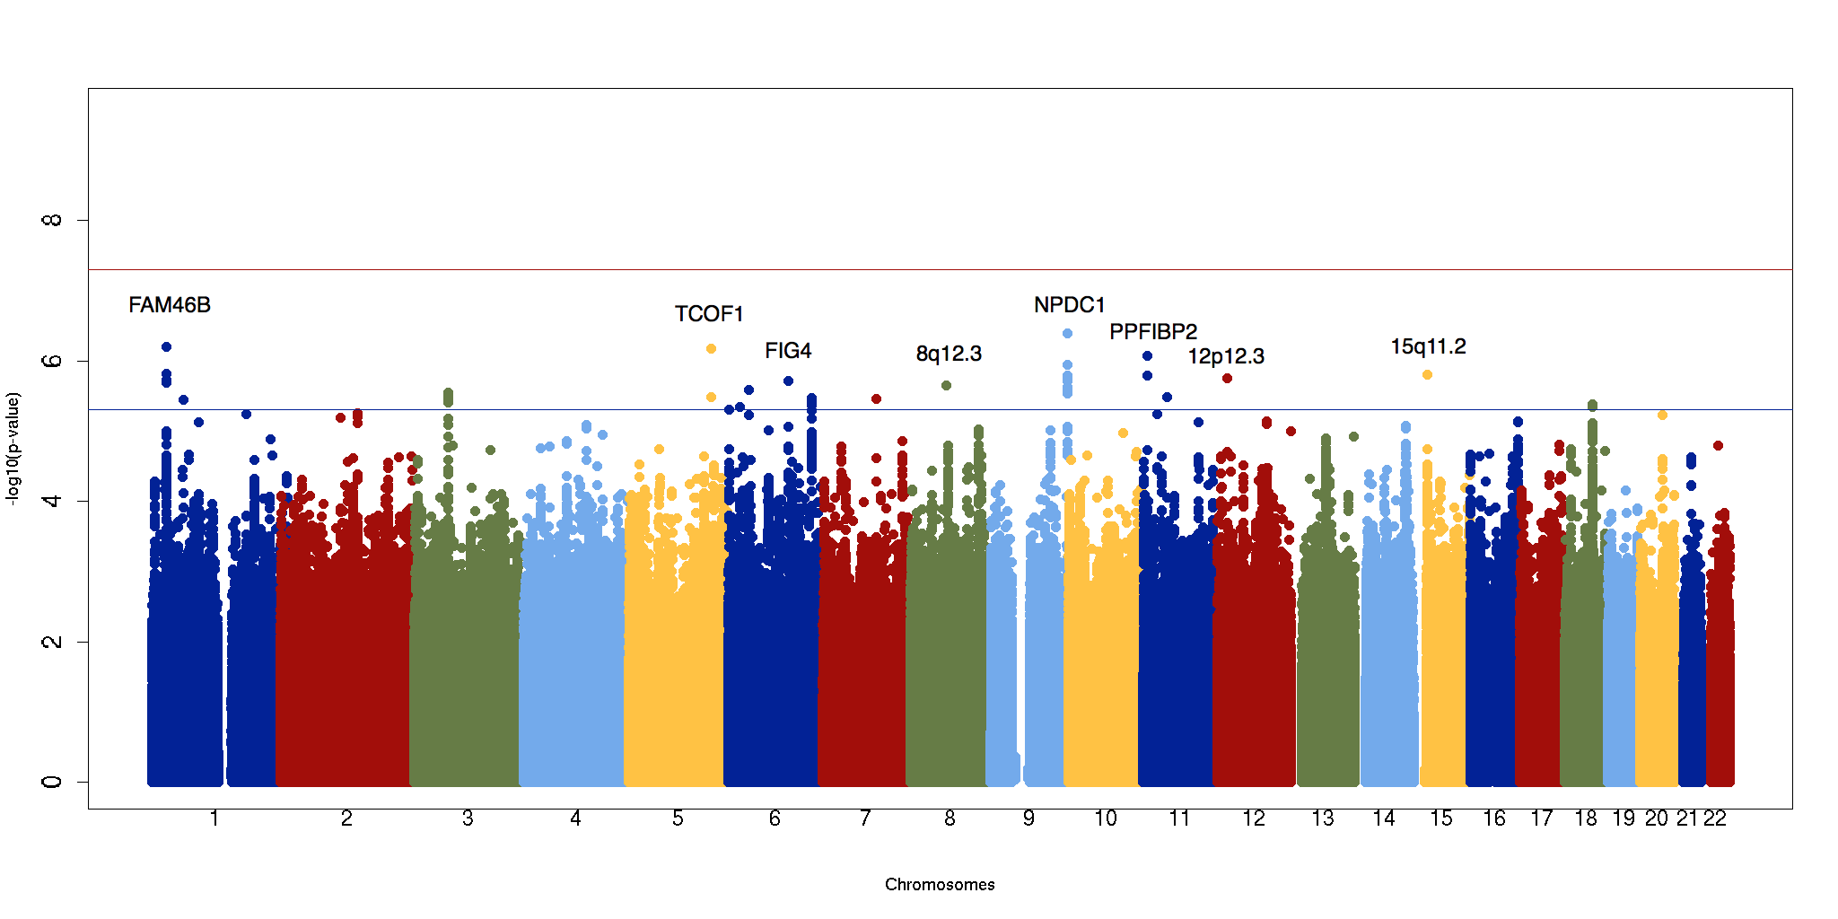
  Hypertensive–only analysis : N=2,250
  (coded positive if sbp/dbp > 140/90 OR on hypertensive medication, negative otherwise)

Slide 12
Hypertensive–only analysis
SNP | Chr:position | Gene | RA | OA | RAF | OR (95% CI) | P | Het p
rs13289619 | 9:139936141 | NPDC1, ABCA2, FUT7 | G | A | 0.92 | 1.38 (1.22–1.57) | 4.9x10⁻⁷ | 0.33
rs4970496 | 1:27367686 | FAM46B | C | T | 0.82 | 1.23 (1.13–1.34) | 6.3x10⁻⁷ | 0.49
rs150910570 | 11:7561481 | PPFIBP2 | TG | T | 0.37 | 1.17 (1.10–1.24) | 8.5x10⁻⁷ | 0.45
rs77457270 | 5:149709264 | TCOF1 | T | C | 0.95 | 1.44 (1.24–1.67) | 6.6x10⁻⁷ | 0.45
rs12438704 | 15:24422603 | PWRN2 | C | T | 0.75 | 1.19 (1.11–1.29) | 1.6x10⁻⁶ | 0.85
rs73062799 | 12:17672547 | N/A | C | G | 0.07 | 1.34 (1.19–1.51) | 1.8x10⁻⁶ | 0.77
rs12664532 | 6:110180571 | FIG4 | T | C | 0.25 | 1.19 (1.11–1.29) | 1.9x10⁻⁶ | 0.10
rs142253994 | 8:65886433 | N/A | A | C | 0.03 | 1.58 (1.31–1.91) | 2.2x10⁻⁶ | 0.003

Slide 15
Known Associations with related phenotypes
SNP | Chr position | Gene | Trait | RA | OA | RAF | OR (95% CI), p-value | Het p
rs7214628 | 17q25 | TRIM65 | WMH | G | A | 0.20 | 1.08 (1.01–1.14), 0.015* | 0.012
rs2984613 | 1q22 | MF1-BGLAP | non-lobar ICH | C | T | 0.66 | 1.06 (1.01–1.12), 0.017* | 0.94
Associations with WMH in community populations (Fornage M et al, 2011) and non-lobar ICH (Woo D et al, 2014) both replicate in our dataset

Slide 16
GCTA analysis - methods
Assess SNP-heritability (h²) of WMH in our population
Combine all imputed datasets
Calculate genetic relatedness between each individual based on SNPs
Use GREML approach to estimate proportion of phenotypic variance (h²) explained by relatedness between individuals
Calculate h² for all individuals, then two strata:
  Stratified by hypertension (coded positive if sbp/dbp > 140/90 OR on hypertensive medication, negative otherwise)
  Stratified by gender

Slide 17
GCTA heritability analysis
 | N | h² | p
WMHV | 2,243 | 0.21 (0.09) | 0.0065
WMHV – hypertensive | 1,515 | 0.45 (0.12) | 8x10⁻⁵
WMHV – non-hypertensive | 727 | 0.13 (0.25) | 0.31
WMHV – Females | 889 | 0.40 (0.20) | 0.020
WMHV – Males | 1,353 | 0.18 (0.14) | 0.092

Slide 18
GCTA analysis – bivariate
Risk Factor | Correlation coefficient | Correlation P-value
Gender | 0.83 (0.57) | 0.04*
Hypertension | 0.15 (0.56) | 0.40
SNP-heritability is higher in hypertensives compared to non-hypertensives
Genetic factors leading to leukoaraiosis are different in hypertensives and non-hypertensives
Manuscript under review at Stroke (Adib-Samii P et al)

Slide 19
Conclusions
Larger samples needed to detect genetic associations
Increase sample size in future:
  >3,000 individuals from NINDS SiGN already genotyped
  >3,000 extra individuals with MRI and DNA by June 2015
  > 500 individuals from GENESIS study, UK
  300 Finland (Turgut Tatlisumak)
New centres willing to join are welcome

Slide 20


Acknowledgements
MGH, Boston
  Natalia Rost
  Jonathan Rosand
  Cathy Zhang
  Billy Devan
University of Cambridge
  Hugh Markus
  Steve Bevan
St. George’s, London
  Poneh Adib-Samii
WTCCC2
  Cathie Sudlow
  Peter Rothwell
  Martin Dichgans
Milano
  Giorgio Boncoraglio
DNA–lacunar
  Jean-Claude Baron
  Ahamad Hassan
ISGS/SWISS
  James Meschia
ASGC
  Chris Levi
  Liz Holliday
  Jane Maguire
Leuven
  Vincent Thijs
  Robin Lemmens
King’s College London
  Cathryn Lewis

