Slide 1
Update from Administrative Core

Slide 2
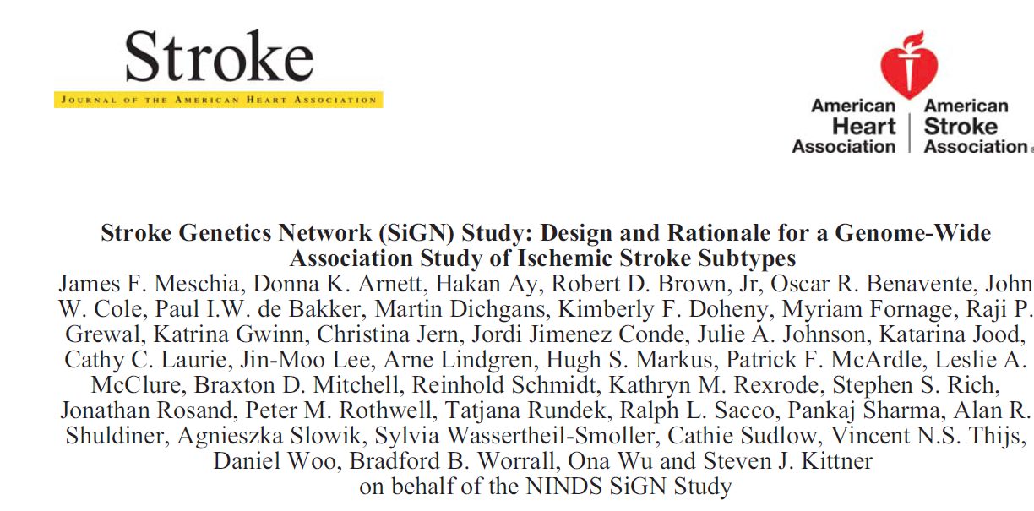
Published Papers

Slide 3
Paper in Process of Submission
Agreement between CCS and TOAST classifications with SiGN – McArdle and Worrall et. al. – To be submitted to Stroke

Slide 4
Accepted AHA ISC Abstracts
Etiology-Specific Clinical and Imaging Features in Ischemic Stroke-Arsava/Ay
Women and Men with Ischemic Stroke in SiGN Have Different Subtype Distributions and Risk Factors- Rexrode
Agreement between TOAST and CCS classification in SiGN- McArdle

Slide 5
Papers Open for Writing Group Participation
Etiologic Stroke Subtypes in the NINDS Stroke Genetics Network - Ay & Meschia
The Impact of Diagnostic Stroke Tests on Final Etiologic Subtype Assignment - Ay & Majersik
Etiology-Specific Clinical and Imaging Features in Ischemic Stroke-Ay
Women and Men with Ischemic Stroke in SiGN Have Different Subtype Distributions and Risk Factors- Rexrode & Smoller
Classification of Stroke Sub-types by Race-Ethnicities in the Stroke Genetics Network with Causative Classification System – Katsnelson, Rundek, Sacco, and Woo

Slide 6
Future Research Plans
Short term – Administrative Supplement
Funds to keep DNA in one place for fine mapping
Short term – Competitive Renewal
Analysis of exome data
Platform for continued analysis of complex SiGN GWAS data
Additional abstracting to enrich phenotype data
Longer term
Proposal for new data collection related to NINDS Priority areas- Genetics of stroke recovery, vascular cognitive impairment, (and recurrent stroke).

Slide 7
Discussion
Future research plans
Improving transparency and participation in SiGN publication process

