Slide 1
NINDS U01 – CCS subtyping
NINDS mandate for high quality phenotyping

Slide 2
Subtype Distribution in NINDS Study
Study | All Ischemic Stroke Cases | Atherosclerotic Cases | Lacunar Cases | Cardioembolic Cases | Other | Undetermined
ISGS | 656 | 127 | 114 | 160 | 30 | 225
SWISS ± | 560 | 129 | 179 | 57 | 23 | 172
GCNKSS | 672 | 89 | 142 | 138 | 11 | 292
GASROS± | 887 | 167 | 92 | 335 | 82 | 211
NOMASS | 624 | 90 | 147 | 129 | 24 | 234
BWYSS | 892 | 65 | 145 | 177 | 55 | 451
NHS | 515 | 85 | 131 | 100 | 22 | 177
REGARDS | 500 | 82 | 128 | 97 | 21 | 172
WHI | 1,100 | 109 | 286 | 238 | 80 | 387
Total | 6,406 | 943 | 1,364 | 1,431 | 348 | 2,321
* Data are estimates based on available data; ±The study is still enrolling patients. Subtype diagnoses are based on the TOAST criteria.
Notes:
SOTHEAR; PLEASE DELETE ROW HVH. The numbers in the totals row will need to be changed.

Slide 3
Subtype Distribution in NINDS Study
Study | All Ischemic Stroke Cases | Atherosclerotic Cases | Lacunar Cases | Cardioembolic Cases | Other | Undetermined
ISGS | 656 | 127 | 114 | 160 | 30 | 225
SWISS ± | 560 | 129 | 179 | 57 | 23 | 172
GCNKSS | 672 | 89 | 142 | 138 | 11 | 292
GASROS± | 887 | 167 | 92 | 335 | 82 | 211
NOMASS | 624 | 90 | 147 | 129 | 24 | 234
BWYSS | 892 | 65 | 145 | 177 | 55 | 451
NHS | 515 | 85 | 131 | 100 | 22 | 177
REGARDS | 500 | 82 | 128 | 97 | 21 | 172
WHI | 1,100 | 109 | 286 | 238 | 80 | 387
Total | 6,406 | 943 | 1,364 | 1,431 | 348 | 2,321
* Data are estimates based on available data; ±The study is still enrolling patients. Subtype diagnoses are based on the TOAST criteria.
Notes:
SOTHEAR; PLEASE DELETE ROW HVH. The numbers in the totals row will need to be changed.

Slide 4
Subtype Distribution in NINDS Study
Study | All Ischemic Stroke Cases | Atherosclerotic Cases | Lacunar Cases | Cardioembolic Cases | Other | Undetermined
ISGS | 656 | 127 | 114 | 160 | 30 | 225
SWISS ± | 560 | 129 | 179 | 57 | 23 | 172
GCNKSS | 672 | 89 | 142 | 138 | 11 | 292
GASROS± | 887 | 167 | 92 | 335 | 82 | 211
NOMASS | 624 | 90 | 147 | 129 | 24 | 234
BWYSS | 892 | 65 | 145 | 177 | 55 | 451
NHS | 515 | 85 | 131 | 100 | 22 | 177
REGARDS | 500 | 82 | 128 | 97 | 21 | 172
WHI | 1,100 | 109 | 286 | 238 | 80 | 387
Total | 6,406 | 943 | 1,364 | 1,431 | 348 | 2,321
* Data are estimates based on available data; ±The study is still enrolling patients. Subtype diagnoses are based on the TOAST criteria.
Notes:
SOTHEAR; PLEASE DELETE ROW HVH. The numbers in the totals row will need to be changed.

Slide 5
20 chart project
Random sampling
20 charts per cohort will be selected
Stripped of personal health identifiers
Sent to Mayo Clinic Florida (MCF)
Charts underwent a 3-stage review

Slide 6
TOAST Subtype Generated By Each Cohort vs. TOAST Subtype Generated By Phenotype Committee Through Chart Review
Committee Dx | Site Diagnosis
 | Large Vessel | Small Vessel | Cardioembolic | Other | Undetermined | Unknown | Total
Large Vessel | 15 | 1 | 1 |  |  | 1 | 18
Small Vessel |  | 12 |  |  | 1 |  | 13
Cardioembolic |  |  | 22 |  | 7 | 1 | 30
Other |  |  | 1 | 1 | 2 |  | 4
Undetermined | 2 | 2 | 1 |  | 28 |  | 33
Unknown |  |  |  | 2 |  |  | 2
Total | 17 | 15 | 25 | 3 | 38 | 2 | 100
Notes:
Contingency table showing TOAST Subtype generated by each cohort versus TOAST subtype generated by phenotype committee through chart review. The cohorts include GASROS: Genes Affecting Stroke Risk and Outcome Study, ISGS: Ischemic Stroke Genetics Study, NOMAS: Northern Manhattan Stroke Study, BWYSS: Baltimore-Washington Young Stroke Study, and GCNKSS: Greater Cincinnati Northern Kentucky Stroke Study.

Slide 7
TOAST Subtype Generated By Each Cohort vs. TOAST Subtype Generated By Phenotype Committee Through Chart Review
Committee Dx | Site Diagnosis
 | Large Vessel | Small Vessel | Cardioembolic | Other | Undetermined | Unknown | Total
Large Vessel | 15 | 1 | 1 |  |  | 1 | 18
Small Vessel |  | 12 |  |  | 1 |  | 13
Cardioembolic |  |  | 22 |  | 7 | 1 | 30
Other |  |  | 1 | 1 | 2 |  | 4
Undetermined | 2 | 2 | 1 |  | 28 |  | 33
Unknown |  |  |  | 2 |  |  | 2
Total | 17 | 15 | 25 | 3 | 38 | 2 | 100
Notes:
Contingency table showing TOAST Subtype generated by each cohort versus TOAST subtype generated by phenotype committee through chart review. The cohorts include GASROS: Genes Affecting Stroke Risk and Outcome Study, ISGS: Ischemic Stroke Genetics Study, NOMAS: Northern Manhattan Stroke Study, BWYSS: Baltimore-Washington Young Stroke Study, and GCNKSS: Greater Cincinnati Northern Kentucky Stroke Study.

Slide 8
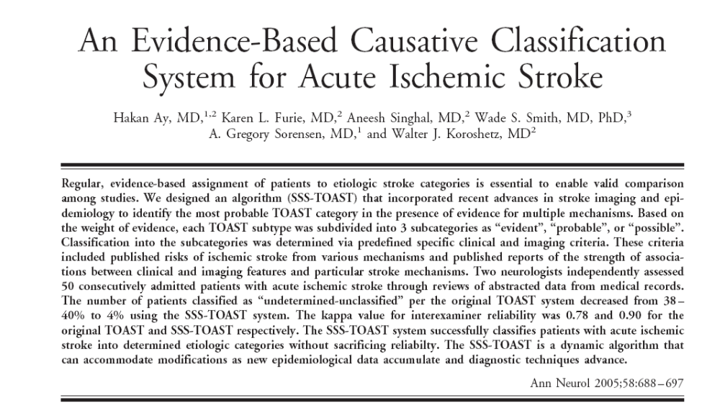
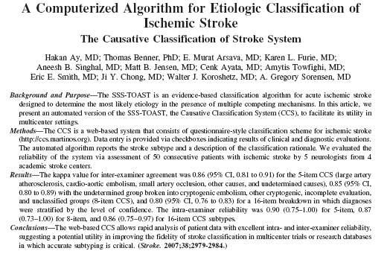
Ann Neurol 2005;58:688-697
Stroke 2007;38:2979-2984

Slide 9
The CCS System
Large artery atherosclerosis
Cardio-aortic embolism
Small artery occlusion
Other causes
Undetermined causes
  Unknown
    Cryptogenic embolism
    Other cryptogenic
    Incomplete evaluation
  Unclassified
Evident, Probable, Possible
Notes:
In the SSS-TOAST system, we used the same major categories with the original TOAST with a few minor differences. One is cardio-aortic embolism instead of cardioembolism, and the other one is the addition of cryptogenic embolism as a new subgroup, which is defined as angiographic evidence of embolus in an artery in the absence of any source. For each etiologic subtype, a mechanism is assigned with different level of confidence as evident, probable, and possible. An evident mechanism is defined as the isolated presence of a clear cause of stroke, such as atrial fibrillation. A mechanism can be probable only when there are multiple evident mechanisms. When there is no evident mechanism but some suggestive clinical features, which are not evidence-based, the etiology is classified as possible.

Slide 10
The CCS System
The Decision Algorithm
1 clear or evident mechanism = Etiology
>1 evident
mechanisms
no clear
mechanism
probable
criteria
possible
criteria
1
None
> 1
1
None
> 1
Etiology
UNC
UNC
Etiology
UNK
UNC
Notes:
We have a very simple decision algorithm. When there is only one clear or evident mechanism, that is the etiology. If there are multiple mechanisms, we look at some criteria to identify a probable etiology. If these criteria confirm to one particular mechanism, the etiology is called probable. If there is no probable criterion, the etiology is unclassified because there are multiple etiologies. If there are probable criteria for more than one subtype, the etiology is again unclassified. If there is no evident mechanism, we skip the probable criteria and look for possible evidence. If there is possible evidence for one mechanism, the etiology is called possible. If there is no possible evidence, the etiology is unknown and if there is possible evidence for more than one subtype, the etiology is unclassified. This might seem complicated at first glance but you are gonna see that it is quite straightforward as we go through some case examples.

Slide 11
International Validation of The CCS
50 case vignettes
  Consecutive admissions to the MGH in a 1-month period
  Brief clinical history and official reports of tests

Slide 12
The CCS System
Large artery atherosclerosis
Cardio-aortic embolism
Small artery occlusion
Other causes
Undetermined causes
  Unknown
    Cryptogenic embolism
    Other cryptogenic
    Incomplete evaluation
  Unclassified
κ=0.78 (95% CI, 0.76-0.80)
κ=0.77 (95% CI, 0.75-0.79)
Notes:
In the SSS-TOAST system, we used the same major categories with the original TOAST with a few minor differences. One is cardio-aortic embolism instead of cardioembolism, and the other one is the addition of cryptogenic embolism as a new subgroup, which is defined as angiographic evidence of embolus in an artery in the absence of any source. For each etiologic subtype, a mechanism is assigned with different level of confidence as evident, probable, and possible. An evident mechanism is defined as the isolated presence of a clear cause of stroke, such as atrial fibrillation. A mechanism can be probable only when there are multiple evident mechanisms. When there is no evident mechanism but some suggestive clinical features, which are not evidence-based, the etiology is classified as possible.

Slide 13
Operator-Related Factors
Missing an abstracted information
  153/500 ratings
  Led to alteration in the CCS categories in 31 occasions
Corrected kappa values for operator-related factors
  USA Validation
  CCS-5: 0.85 (95% CI, 0.83-0.87) 0.86 (95% CI, 0.81-0.91)
  CCS-8: 0.85 (95% CI, 0.83-0.87) 0.85 (95% CI, 0.80-0.89)

Slide 14
The CCS Software-Related Factors
Uncertainty in wording for
  Assignment of “incomplete evaluation” when echocardiography is absent (38 ratings)
  Differentiation between calcific aortic stenosis and other forms of aortic valve disease (6 ratings)

Slide 15
Percentage Agreement and 95% Confidence Intervals for Each Rater With
Other Raters for the 5 Major CCS Subtypes
Arsava EM et al Neurology [in press]
Notes:
Percentage Agreement and 95% Confidence Intervals for Each Rater With
Other Raters for the 5 Major CCS Subtypes

Slide 16
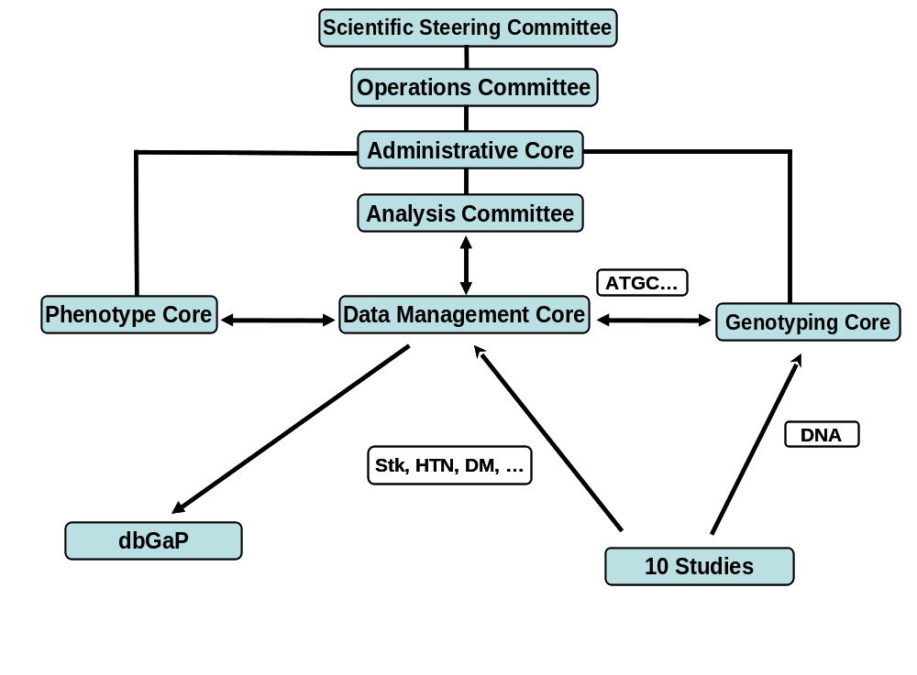
NINDS ISGC Study
Notes:
Organizational Chart for NINDS ISGC Study

Slide 17
CCS in NINDS U01
Training set (10 cases)
Development of test set
  5 of 15 cases used
Certification process
  5 attempts
  Annual/ bienial
  Post-certification monitoring (10%)
All U.S. cites using physician adjudicators

Slide 18
Certified CCS Adjudicators
Study | Name | Certification Date
GEOS | Mohammed Huq | 04/26/2010
NHS | Markus Schuerks | 04/26/2010
GASROS | Ethern Arsava | 04/21/2010
 | Chris Anderson | 04/20/2010
SWISS/ISGS | James Meschia | 05/04/2010
 | Brad Worrall | 04/28/2010
 | Kevin Barrett | 05/25/2010
 | Shaneela Malik | 6/12/2010
 | Andrew Southerland | Pending
GCNKSS | Daniel Woo | 05/01/2010
NOMAS | Michael Katenelson | 05/03/2010
REGARDS | David Rhodes | 6/10/10
 | Neha Saraf | 6/10/10
WHI | Pending | 6/10/10
MCISS | Pending | 6/09/10

Slide 19
http://ccs.martinos.org

Slide 20
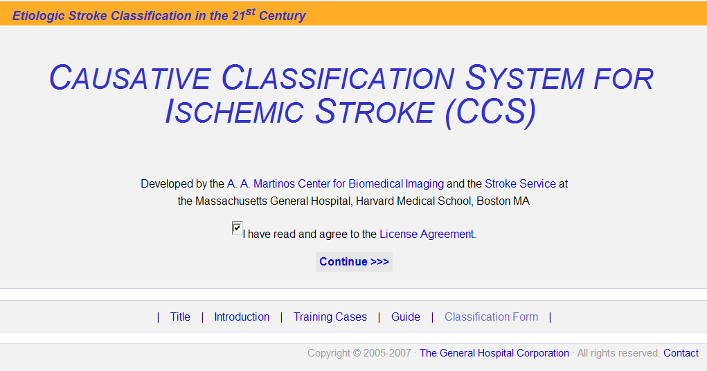

Slide 21
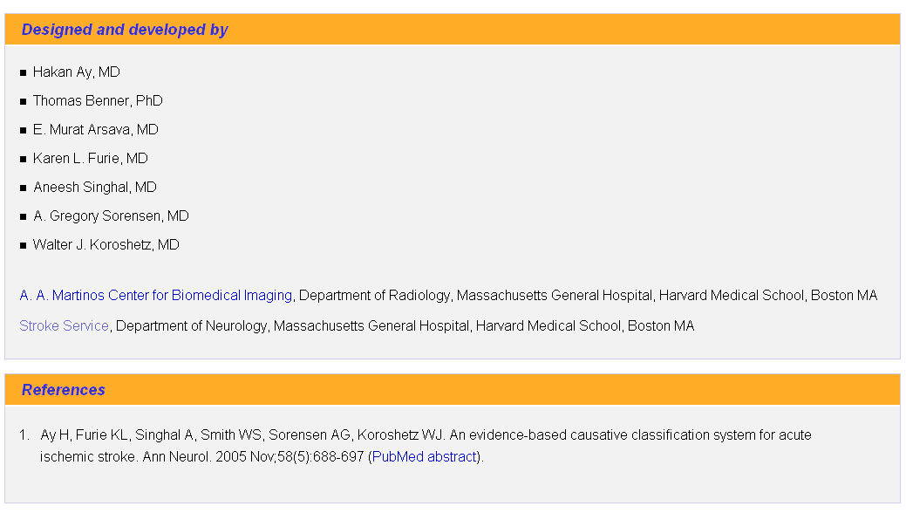

Slide 22
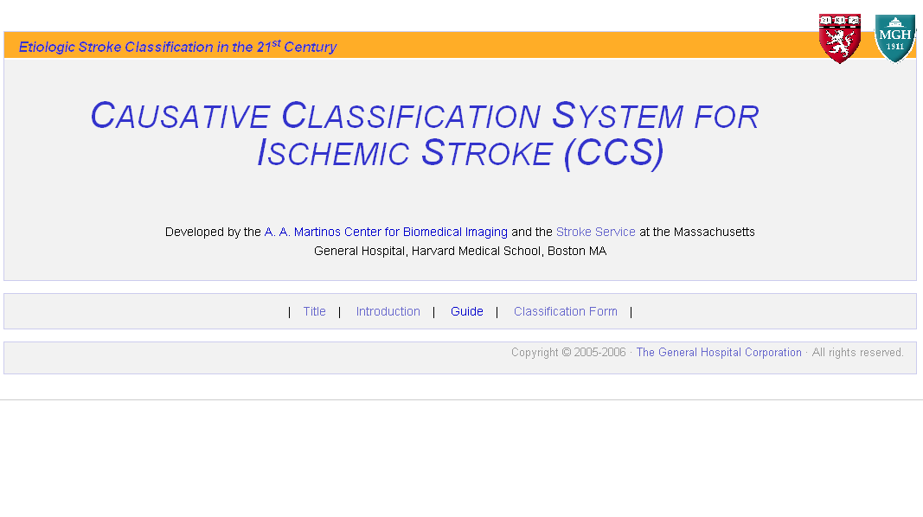

Slide 23
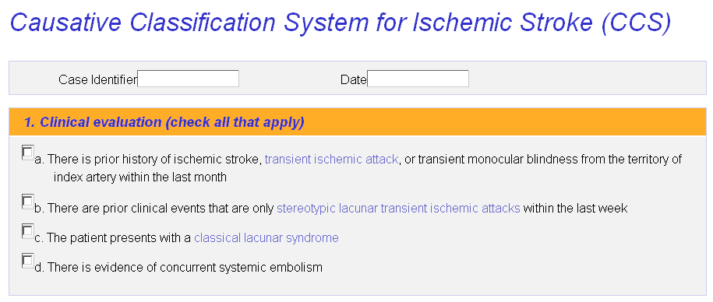
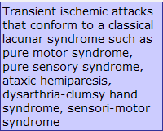

Slide 24
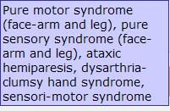

Slide 25


Slide 26


Slide 27
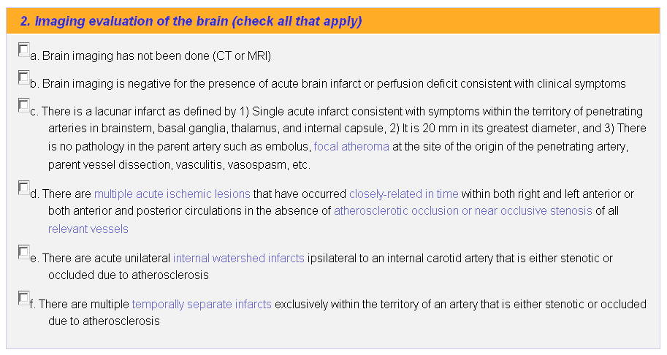

Slide 28


Slide 29
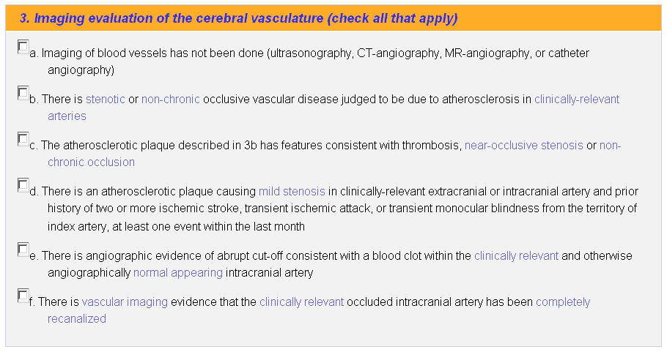

Slide 30


Slide 31
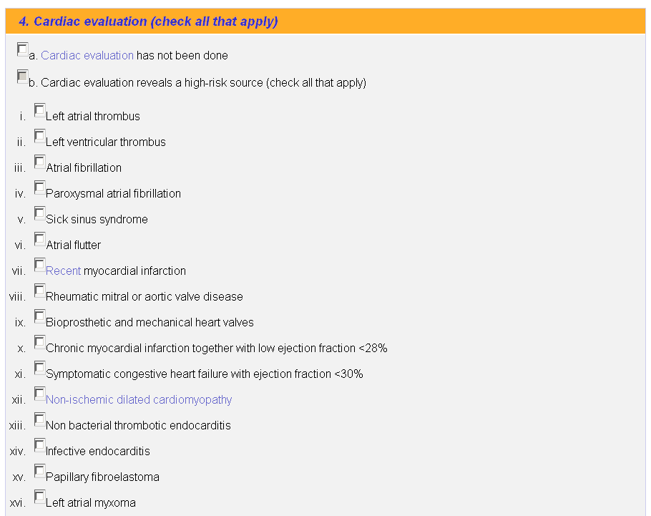

Slide 32


Slide 33
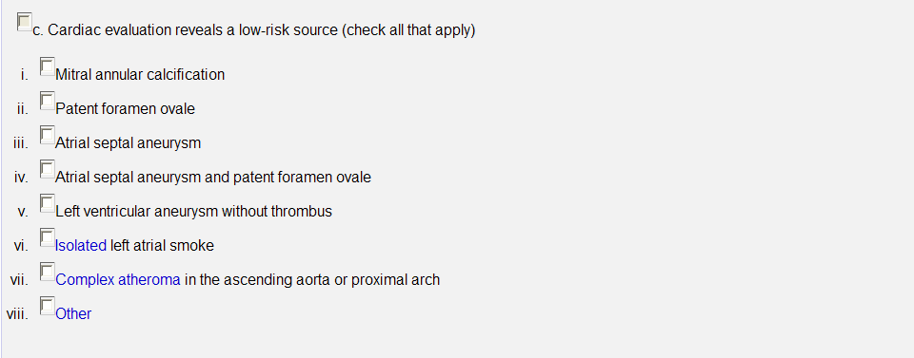

Slide 34


Slide 35
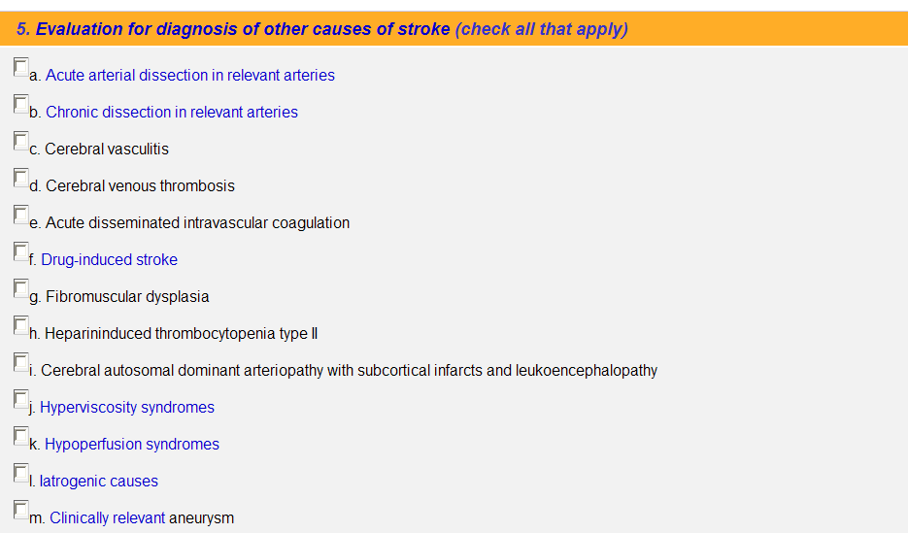

Slide 36
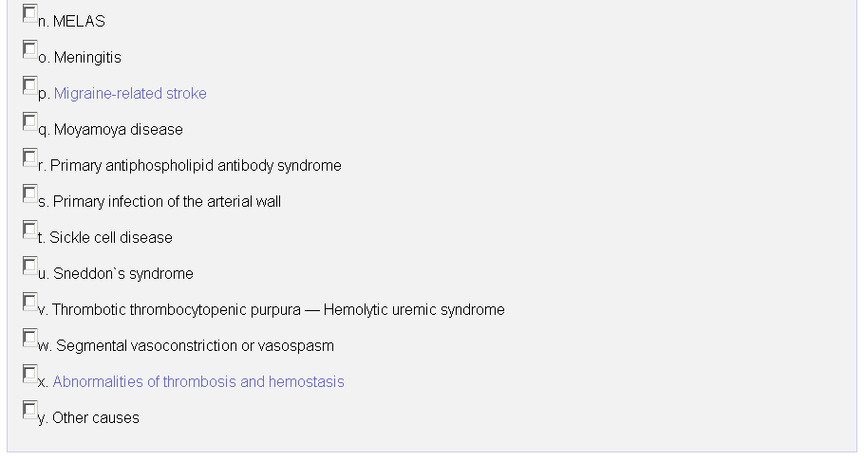

Slide 37
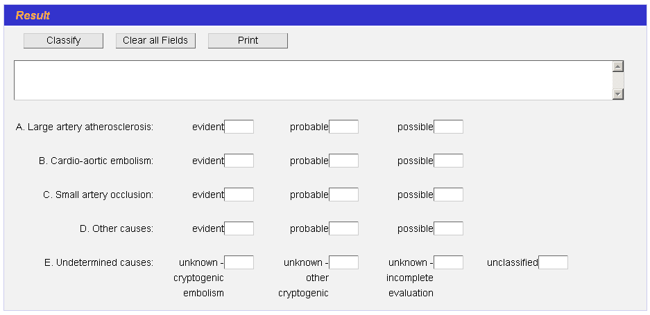

Slide 38
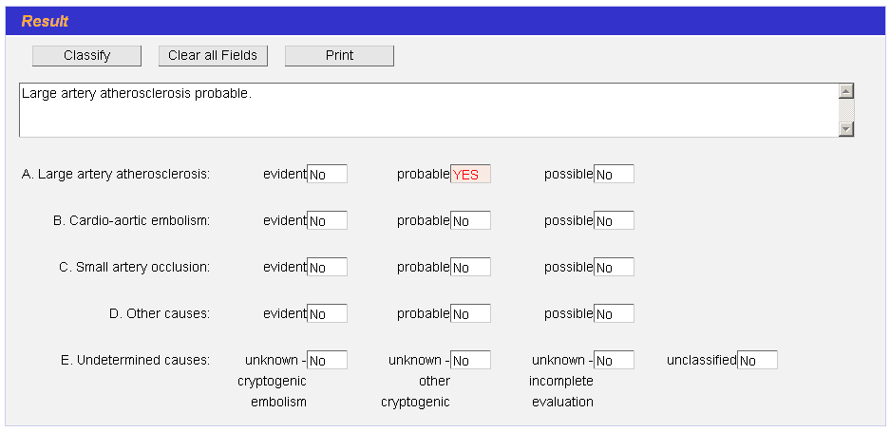

Slide 39
Before Starting the Certification Module
Take the Training Module
  Composed of 10 case vignettes
  Intervenes when critical information is missed or incorrectly entered
The module intends to measure users ability to identify important data elements in case report forms in the form the software requires as well as to measure users' familiarity with the software. It does not measure one's knowledge on stroke and stroke subtyping.

Slide 40
Points to Remember When Taking the Certification Module
Motor and sensory lacunar syndromes involve at least 2 of the 3 body parts
Cortical infarct signs typically absent
Ataxic or dysarthric syndromes – incoordination and weakness on the same side of the body

Slide 41
Points to Remember When Taking the Certification Module
Diagnosis of small artery occlusion
  Precluded by presence of focal pathology in parent artery at the site of the origin of the penetrating artery going into the lacunar infarct

Slide 42
Points to Remember When Taking the Certification Module
“Multiple acute ischemic lesions”
  Any combination of acute infarct, perfusion defect, and non-chronic clinically-relevant abrupt arterial occlusion

Slide 43
Points to Remember When Taking the Certification Module
Multiple acute ischemic lesions in more than 1 circulation:
  Supports diagnosis of a proximal cause
Multiple temporally separate infarcts exclusively within the territory of a single artery:
  Focal arterial pathology as the probable cause of stroke

Slide 44
Points to Remember When Taking the Certification Module
Evaluation of cerebral blood vessels is considered incomplete only if none of the following 4 tests is performed:
  Ultrasonography
  CT-angiography
  MR-angiography
  Catheter angiography

Slide 45
Points to Remember When Taking the Certification Module
Cardiac evaluation considered incomplete only if the following do not reveal a cardiac pathology and TTE is not performed :
  Clinical history
  Physical examination
  EKG
TEE and Holter monitoring not required for the completeness of cardiac evaluation

Slide 46
Points to Remember When Taking the Certification Module
An aortic plaque meets the criteria for complex atheroma if:
  >4mm in thickness
  Protruding, or mobile, or ulcerated

Slide 47
Points to Remember When Taking the Certification Module
Migraine induced stroke is a diagnosis of exclusion; all other causes must have been excluded
Symptoms starting as a typical migraine aura alone do not qualify for migraine induced stroke

Slide 48
Points to Remember When Taking the Certification Module
Drug-induced stroke is also a diagnosis of exclusion
Evidence for positive urine or blood test is required

Slide 49
Points to Remember When Taking the Certification Module
Prothrombotic abnormalities are considered as the cause of stroke only when there is strong clinical suspicion: history of more than one unexplained thromboembolic events, in young stroke patients, in patients with family history of thrombosis, in patients who have no other explanation for stroke.

Slide 50
Points to Remember When Taking the Certification Module
Characteristic features of vascular lesions suggestive of atherosclerosis include:
  Eccentric location
  Calcification
  Thrombosis
  Irregular stump
  Occurrence in typical arterial segments

