Slide 1
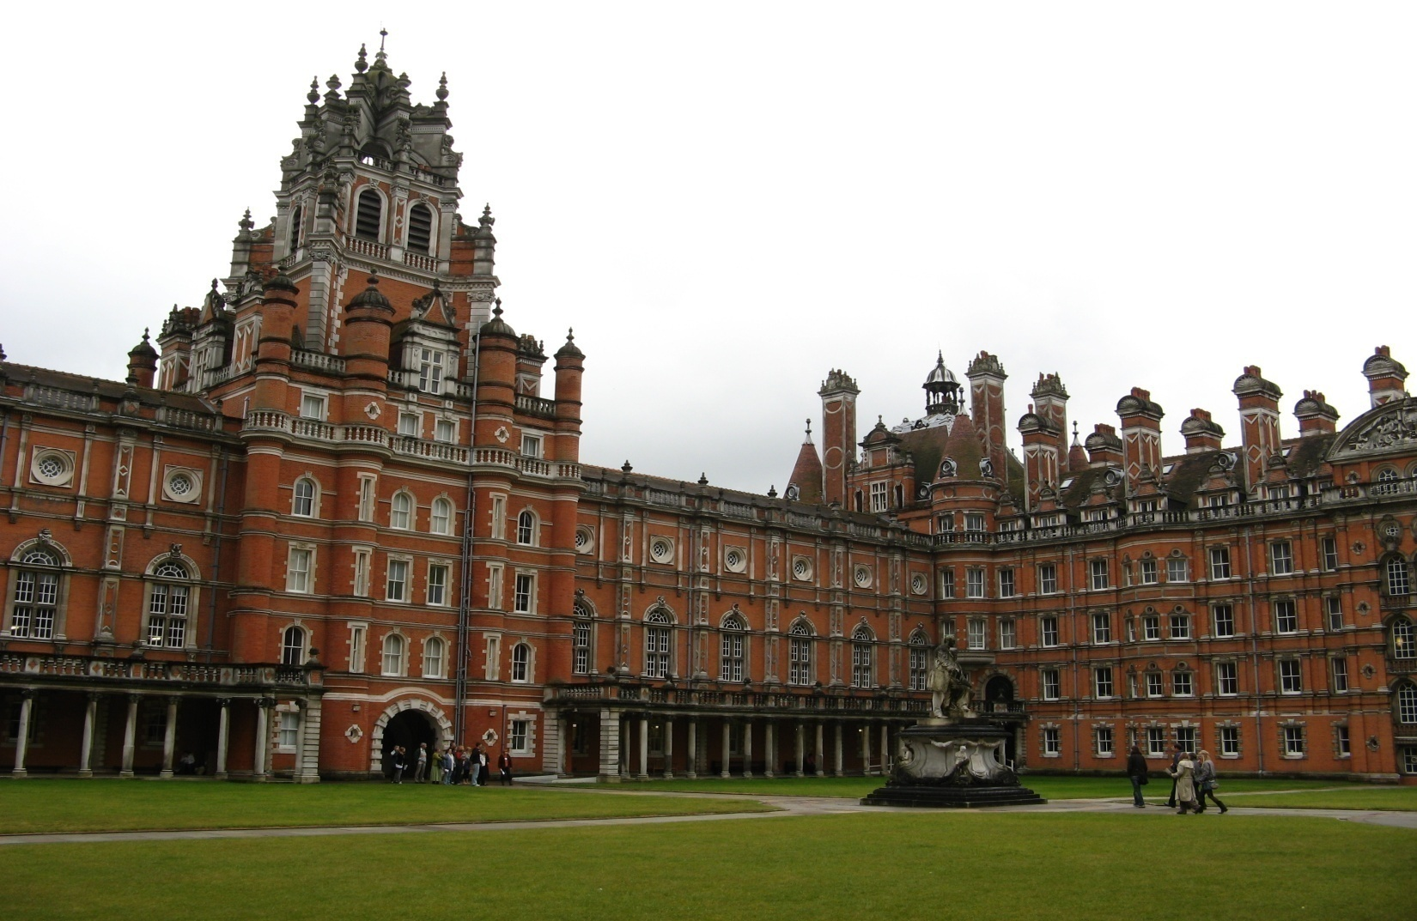
Institute of Cardiovascular Research Royal Holloway University of London (ICR2UL)
Cerebral Venous Thrombosis
- Exome Array Analysis -
on behalf of BEAST Consortium
Dr Ioana Cotlarciuc
Institute of Cardiovascular Research Royal Holloway
University of London
6th November 2014

Slide 2
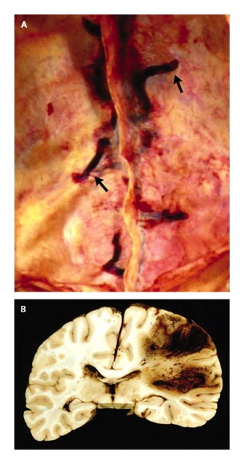
Institute of Cardiovascular Research Royal Holloway University of London (ICR2UL)
Cerebral Venous Thrombosis (CVT)
Rare form of cerebrovascular disease that accounts for <1% of all strokes (most often affects young adults and children), with an associated mortality of ≈10 - 13%.
The estimated annual incidence is 3 - 4 cases per 1 million adult population and up to 7 cases per 1 million among children.
≈ 75% of the adult patients are women.
Postmortem Views of Sinus Thrombosis.

Slide 3
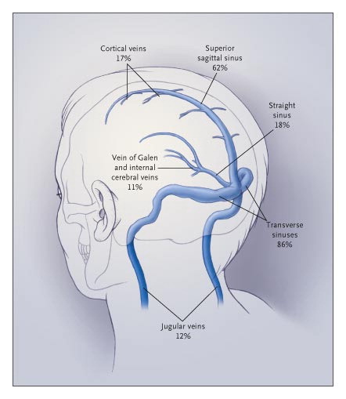
Institute of Cardiovascular Research Royal Holloway University of London (ICR2UL)
PATHOGENESIS
2 different mechanisms:
Thrombosis of the cerebral veins, with local effects caused by venous obstruction;
Thrombosis of the major sinuses which causes intracranial hypertension.
In the majority of patients, these two processes occur simultaneously.
In most patients, thrombosis occurs in more than one sinus.
Stam J. N Engl J Med 2005;352:1791-1798.

Slide 4
Institute of Cardiovascular Research Royal Holloway University of London (ICR2UL)
CVT RISK FACTORS
Risk factor | Description
Acquired prothrombotic states | Nephrotic syndrome, Antiphospholipid antibodies, Homocysteinemia, Pregnancy, Puerperium
Inflamatory disease | Systemic lupus erythematosus, Sarcoidosis, Inflamatory bowel disease, Wegener’s granulomatosis, Behcet’s syndrome
Infections | Otitis, Mastoiditis, Sinusitis, Meningitis, Systemic infectious disease
Hematologic conditions | Polycythemia (primary and secondary), Thrombocythemia, Leukemia, Anemia
Drugs | Oral contraceptives, Asparaginase
Mechanical causes, trauma | Head injury, Injury to sinuses or jugular vein, Neurosurgical procedures, Lumber puncture
Miscellaneous | Cancer , Dehydration (especially in children)

Slide 5
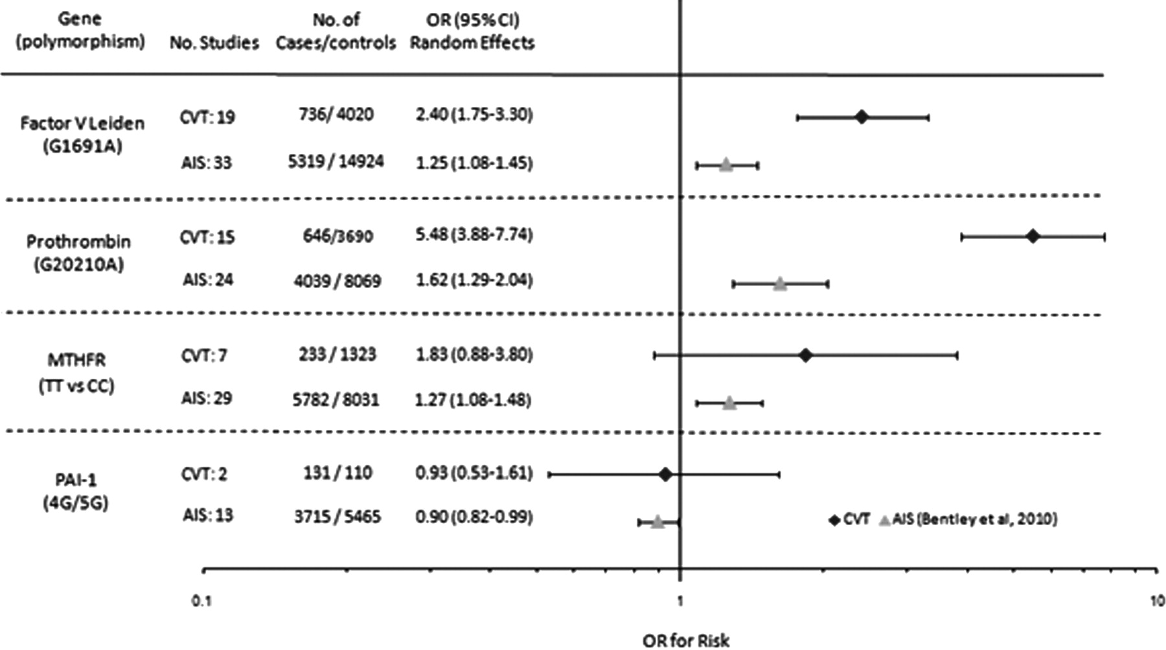
Institute of Cardiovascular Research Royal Holloway University of London (ICR2UL)
Candidate Gene Studies
- Meta-analysis of 26 candidate gene studies (1183 cases and 5189 controls) (Marjot et al, Stroke, 2011).
- Greater genetic liability for CVT compared to arterial ischemic stroke.

Slide 6
Institute of Cardiovascular Research Royal Holloway University of London (ICR2UL)
Biorepository to Establish the Aetiology of Sinovenous Thrombosis
(BEAST) Consortium
 | Collaborator | Country | Cases
1 | Vincent Thijs | Belgium (Leuven) | 43
2 | Turgut Tatlisumak | Finland (Helsinki) | 108
3 | Kostas Spengos | Greece (Athens) | 7
4 | Ida Matinelli | Italy (Milan) | 177
5 | Elvira Grandone | Italy (Foggia) | 55
6 | Allessandro Pezzini | Italy (Brescia) | 29
7 | Maurizio Margaglione | Italy (Foggia) | 25
8 | Jonathan Coutinho | Netherlands (Amsterdam) | 64
9 | Jose Ferro | Portugal (Lisbon) | 17
10 | Pankaj Sharma | UK (London) | 14
11 | Antonio Arauz | Mexico (Mexico City) | 99

Slide 7
Institute of Cardiovascular Research Royal Holloway University of London (ICR2UL)
BEAST - STUDY CHARACTERISTICS
Characteristics | Europeans n=396 | Finnish n=108 | Mexicans n=97
Age(yrs) Mean (SD) Range | 40.7 (14.0) 16-79 | 40.8 (15.2) 18-75 | 34.0 (11.0) 16-75
Female, n(%) | 296 (74.8) | 77 (71.3) | 80 (82.3)
CT/MRI on admission, n(%) | 334 (84) | 108 (100) | 87 (90)

Slide 8
Institute of Cardiovascular Research Royal Holloway University of London (ICR2UL)
CVT RISK FACTORS
Risk factors | Europeans n=396 | Finnish n=108 | Mexicans n=97
Lupus erythematosus, n(%) Antithrombin deficiency, n(%) Homocysteinemia, n(%) Oral contraceptives, n(%) Infection systemic, n(%) Infection head area, n(%) Mechanical causes, n(%) Neurosurgery, n(%) Dehydration, n(%) Pregnancy, n(%) Puerperium, n(%) | 73.0 (18.4) 66 (16.7) 55 (13.9) 180 (45.5) 24 (6.1) 2 (0.5) 9 (2.3) 19 (4.8) 2 (0.5) 3 (0.9) 6 (1.5) | 94 (87.0) 101 (93.5) 36 (33.3) 38 (35.2) 13 (12.0) 16 (14.8) 3 (2.8) None 16 (14.8) 3 (2.8) 4 (3.8) | 58 (60.0) 57 (58.7) 48 (49.5) 16 (16.5) 3 (3.1) 4 (4.1) 2 (2.1) 10 (10.3) 1 (1.0) 9 (9.3) 21 (21.7)

Slide 9
Institute of Cardiovascular Research Royal Holloway University of London (ICR2UL)
Exome Array Analysis
First stage analysis:
Identify genetic variants associated with CVT in an European population.
Quality control: SNP call rate >95%; Genotyping call rate >95% ; MAF>10⁻⁴; HWE Pvalue<10⁻⁶.
 | Cases | Controls
N | 352 | 2469
Age (mean) | 40.5 | 45
Female (%) | 73.57 | 43.29
Genotyping platform | Illumina HumanCoreExome BeadChip | Illumina HumanExome BeadChip

Slide 10
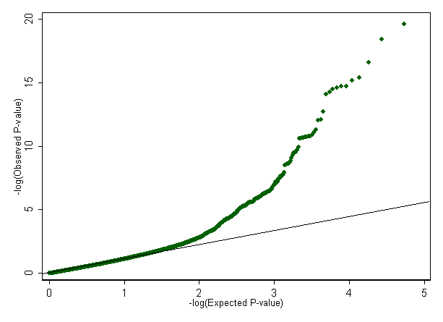
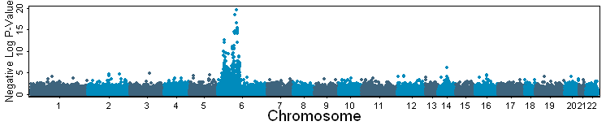
Institute of Cardiovascular Research Royal Holloway University of London (ICR2UL)
Statistical Analysis
Logistic regression adjusting for sex and first 8 principal components of population ancestry under an additive genetic model.
Quantile-Quantile (Q-Q) plot
Visual summary of the observed test statistics compared to the expected distribution under the null hypothesis;
Genomic inflation factor: λ = 1.6
P-value threshold =0.05/N = 9x10⁻⁷

Slide 11
Institute of Cardiovascular Research Royal Holloway University of London (ICR2UL)
Association Results
P<9x10⁻⁷: 85 SNPs spanning 3.4Mb located at 6p21.3 (4 SNPs with 0.01<MAF<0.05).
SNP | Chr | Position | MA | MAF Cases/ Controls | Beta | SE | P | Genes | Mutation
exm-rs9267576 | 6 | 31812038 | A | 0.085/0.13 | 2.21 | 0.29 | 2.42E-20 | C6orf48 | Silent
exm-rs3130050 | 6 | 31618761 | G | 0.10/0.14 | 1.97 | 0.27 | 3.63E-19 | BAG6 | Silent
exm-rs3132946 | 6 | 32190028 | A | 0.07/0.13 | 1.49 | 0.26 | 7.76E-13 | NOTCH4 | Silent
exm-rs1129640 | 6 | 31506624 | A | 0.12/0.18 | 1.03 | 0.19 | 1.59E-11 | DDX39B | EXON
exm530864 | 6 | 31496925 | G | 0.12/0.19 | 1.02 | 0.19 | 2.00E-11 | MCCD1 | EXON
exm-rs204993 | 6 | 32155581 | G | 0.20/0.29 | -0.71 | 0.16 | 1.71E-08 | PBX2 | Silent
exm-rs3129900 | 6 | 32305979 | C | 0.11/0.15 | 0.92 | 0.20 | 2.34E-08 | C6orf10 | Silent
exm-rs1233426 | 6 | 29498102 | A | 0.40/0.46 | -0.55 | 0.12 | 6.39E-08 | LOC100507362 | Silent
exm-rs241439 | 6 | 32797537 | C | 0.35/0.38 | -0.54 | 0.12 | 1.07E-07 | TAP2 | Silent
exm-rs9261492 | 6 | 30110058 | A | 0.18/0.24 | 0.88 | 0.21 | 5.04E-07 | TRIM40 | Silent

Slide 12
Institute of Cardiovascular Research Royal Holloway University of London (ICR2UL)
Gene characterization
All genes located within the human major histocompatibility complex (MHC) at 6p21.3.
Genes | Function | Disease
BAG6 | Control of apoptosis | Systemic lupus erythematosus, coronary artery aneurysm
NOTCH4 | Role in vascular, renal and hepatic development . | CADASIL, migraine, vascular dementia, pseudobulbar palsy
DDX39B | Plays an important role in mRNA export from the nucleus to the cytoplasm. | Autoimmune diseases, rheumatoid arthritis, lupus erythematosus systemic, necrosis, tumors
MCCD1 | Mitochondrial coiled-coil domain 1 | Systemic lupus erythematosus
PBX2 | Translocation in acute pre-B-cell leukemias. | T-cell leukemia
C6orf48 | Not characterized | Autoimmune diseases
C6orf10 | Chromosome 6 open reading frame 10 | Rheumatoid arthritis
LOC100507362 | Not characterized | Not characterized
TAP2 | Transport of antigens from the cytoplasm to the endoplasmic reticulum for association with MHC class I molecules . | Autoimmune diseases, cardiac sarcoidosis, celiac disease, lymphocyte syndrome, ankylosing spondylitis, diabetes mellitus, tumors, melanoma
TRIM40 | Negative regulator against inflammation and carcinogenesis in the gastrointestinal tract. | Multiple sclerosis

Slide 13
Institute of Cardiovascular Research Royal Holloway University of London (ICR2UL)
Gene region
All associated genes are located within the human major histocompatibility complex (MHC) at 6p21.3.
MHC: most of the genes in this region are associated with autoimmune diseases such as rheumatoid arthritis and lupus erythematosus.
Autoimune diseases = important risk factor for CVT.
Genes located in MHC are very good plausible candidate genes for CVT.

Slide 14
Institute of Cardiovascular Research Royal Holloway University of London (ICR2UL)
Conclusions
Small sample size – identified a strong signal on chromosome 6 at 6p21.3.
Increase the discovery sample to refine these preliminary association results.
Replication necessary to confirm the overall discovery association results.
Future analysis
Exome array analysis of the Finnish sample – awaiting genotyping of Finnish controls using the Illumina HumanExome BeadChip
Meta-analysis of the European sample and Finnish sample.
Exome array analysis of the Mexican CVT sample – awaiting genotyping of Mexican cases and controls.
Replication sample – continuous recruitment of CVT cases.

Slide 15
Institute of Cardiovascular Research Royal Holloway University of London (ICR2UL)
ACKNOWLEDGEMENTS
Pankaj Sharma, T Marjot, M Khan: London, UK
G Pare, R Ditta: Hamilton, Canada
R Malik, M Gonik, M Dichgans: Munich, Germany
Ida Matinelli: Milan, Italy
Elvira Grandone: Foggia, Italy
Allessandro Pezzini: Brescia, Italy
Maurizio Margaglione: Foggia, Italy
Jonathan Coutinho: Amsterdam, Netherlands
Vincent Thijs: Leuven, Belgium
Jose Ferro: Lisbon, Portugal
Kostas Spengos: Athens, Greece
Turgut Tatlisumak: Helsinki, Finland
Antonio Arauz: Mexico City, Mexico.

