Slide 1


Trans-ethnic GWAS of
MRI-defined brain infarcts: the CHARGE consortium
16th Workshop of the
International Stroke Genetics Consortium
6th & 7th November, 2014
Ganesh Chauhan
Université de Bordeaux, INSERM U897
and on behalf of the CHARGE Consortium

Slide 2

On behalf of
AGES | Lenore Launer, Albert Smith …
ARIC | Myriam Fornage, Tom Mosley …
ASPS | Helena Schmidt, Reinhold Schmidt…
CARDIA | Lenore Launer, Myriam Fornage…
CHAP | Bharat Rajan, Lori Chibnik…
CHS | Josh Bis, Will Longstreth …
ERF | Cornelia van Duijn, Sven Van der Lee …
FHS | Sudha Seshadri, Anita deStefano, Vincent Chouraki…
LBC1936 | Lorna Lopez, Gail Davies, Joanna Wardlaw, Ian Deary…
Leiden Longevity Study | Marian Beekman…
NOMAS | Ashley Beecham, Ralph Sacco…
PROSPER | Stella Trompet …
Rotterdam Study I , II, III | Arfan Ikram, Hieab Adams, Cornelia van Duijn,
SHIP | Alexander Teumer, Carsten Oliver-Schmidt …
Singapore Eye Study | Kamran Ikram…
3C-Dijon | Ganesh Chauhan, Stéphanie Debette, Christophe Tzourio …
Notes:
PLEASE UPDATE list of studies partiticipating either in the WMH GWAS or the SSBI GWAS

Slide 3

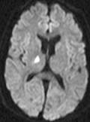
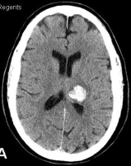
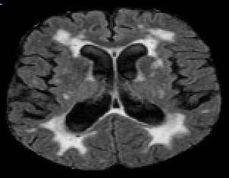
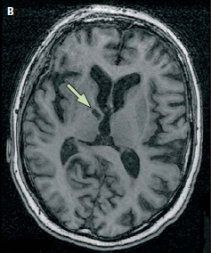
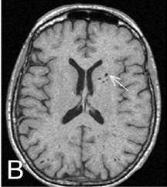
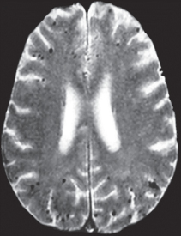
Background
Vascular Disease of the Brain
Overt: with stroke symptoms
Ischemic
stroke
Haemorrhagic
stroke
Covert: without
White Matter Hyperintensities
Brain infarcts
Dilated
peri-vascular spaces
Microbleeds
Cognitive decline, motor impairment,
↗ risk of stroke and dementia
Notes:
At the population level the burden of vascular diseqse of the brain extends fqr beyond overt disease zith stroke sy;pto;
Indeedm mzhen perfor;ing mri in the general popultion many people have covert vascular disease such as WMH, BI…I will focus on MRI defined BI. Little is known about the genetic determinants of this phenotype. A first GWAS was performed by CHARGE consortium in 2009 which did not yield any GWASig finding. We are now performing a GWAS meta-analysis in a larger sample.
At the population level the burden of vascular disease of the brain extends far beyond overt diseases with stroke symptoms.
There is a large burden of covert vascular diseases, majority of which may be attributed to these 4 MRI measures. I will focus on MRI defined BI. Little is known about the genetic determinants of this phenotype. A first GWAS which was performed by CHARGE consortium in 2009 on ~9,000 Europeans did not yield any GWASig finding. In the CHARGE consortium we are now performing a muliti-ethnic GWAS meta-analysis in a much larger data set.

Slide 4
Aim
Perform an agnostic search for genetic risk variants of MRI-defined brain infarcts
All brain infarcts (BI)
Small sub-cortical brain infarcts (SSBI)
Notes:
At the population level the burden of vascular diseqse of the brain extends fqr beyond overt disease zith stroke sy;pto;
Indeedm mzhen perfor;ing mri in the general popultion many people have covert vascular disease such as WMH, BI…I will focus on MRI defined BI. Little is known about the genetic determinants of this phenotype. A first GWAS was performed by CHARGE consortium in 2009 which did not yield any GWASig finding. We are now performing a GWAS meta-analysis in a larger sample.
At the population level the burden of vascular disease of the brain extends far beyond overt diseases with stroke symptoms.
There is a large burden of covert vascular diseases, majority of which may be attributed to these 4 MRI measures. I will focus on MRI defined BI. Little is known about the genetic determinants of this phenotype. A first GWAS which was performed by CHARGE consortium in 2009 on ~9,000 Europeans did not yield any GWASig finding. In the CHARGE consortium we are now performing a muliti-ethnic GWAS meta-analysis in a much larger data set.

Slide 5
Study participants
 | Cases |  | Controls
Ethnicity (N-studies) | BI | SSBI | No-Brain Infarcts
European (16 studies) | 3,149 | 1,806 | 11,744
African (4 studies) | 402 | 187 | 4,069
Hispanic (1 study) | 94 | 56 | 173
Chinese (1 study) | 34 | 23 | 1,069
Malays (1 study) | 47 | 40 | 168
All Ethnicities (23 studies) | 3,726 | 2,112 | 17,223
Notes:
Perhaps say here that you have added additional studies since Utah

Slide 6
Phenotype
BI
SSBI
Participants with
> 1 Brain Infarct (BI)
Participants with
> 1 Small Sub-cortical Brain Infarct (SSBI)
Area of abnormal signal intensity (hypo-intense on T1) in a vascular distribution lacking mass effect
Size >3mm
Differentiation from peri-vascular spaces and white matter lesions
BI with size <15mm
Located in basal ganglia, white matter or brainstem
  Excluded individuals who also had infarcts in cortex, cerebellum or large infarcts
Controls
Individuals without any brain infarcts

Slide 7
Genotypes and QC
Imputation to 1000G (p1, v3)
Align to same reference code across studies
Remove outliers (extreme beta or SE)
Remove variants with low frequency and/or low imputation quality
Individual studies
meta-analysis
Corrected for any residual inflation
Consider only markers: available in 5 or more studies and half of the Cases No major heterogeneity (MANTRA posterior probability < 0.95)
N-markers post QC
BI-GWAS | SSBI-GWAS
7,423,334 | 6,824,387

Slide 8
Analysis plan for multi-ethnic GWAS
METAL
METASOFT
MANTRA
Fixed effect (FE), inverse variance weighted |  | Random effects (RE-HE), Log Likelihood |  | Bayesian approach (BA)
Willer et al (2010) |  | Han and Eskin (2011) |  | Andrew Morris (2011)
Multi-ethnic GWAS: 5 ethnicities GWAS |  | Multi-ethnic GWAS: All 23 studies together |  | Multi-ethnic GWAS: All 23 studies together
Not appropriate when you expect heterogeneity |  | Less powerful when there is no heterogeneity |  | Difficult to interpret Bayesian factor in comparison to P-value
MANTRA the primary approach

Slide 9
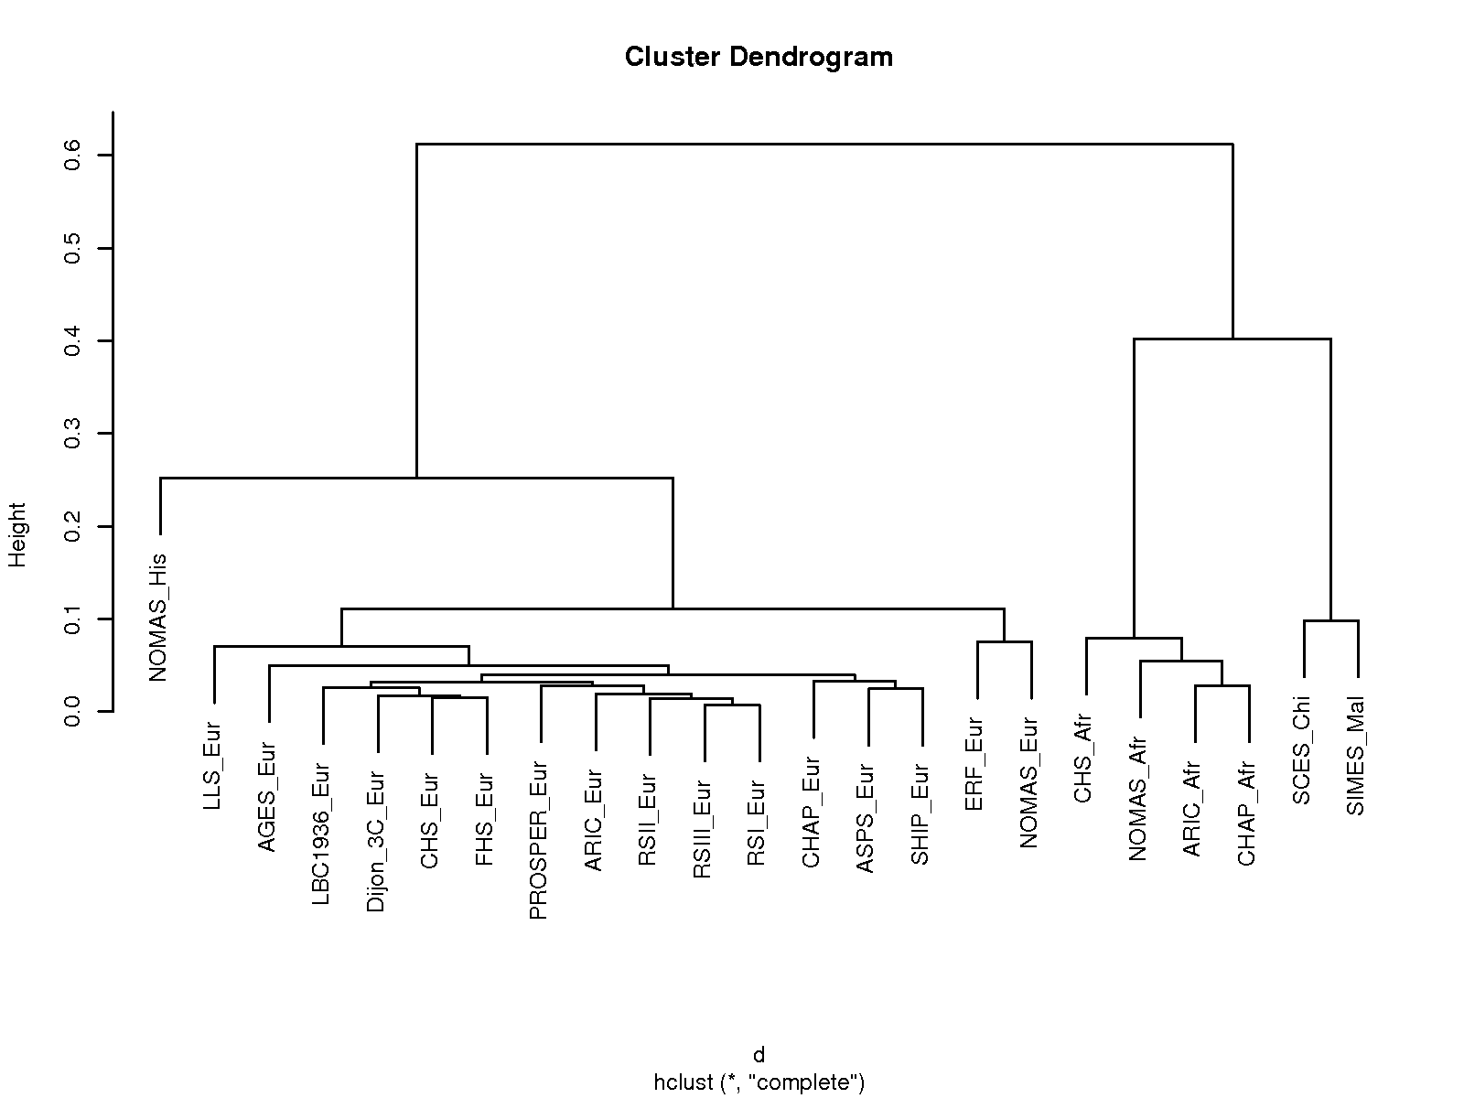
Relative clustering of the 23 studies
Distance between studies calculated based upon mean allele frequencies (Fst) using MANTRA
Distance
Hispanics
Asians
Europeans
Africans
Dendogram drawn using brain infarcts (BI) SNPs data, same as small sub-cortical brain infarcts (SSBI) SNPs data

Slide 10
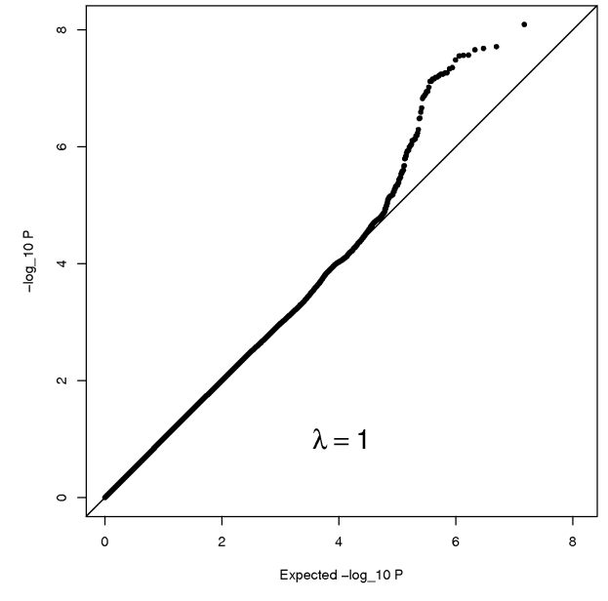
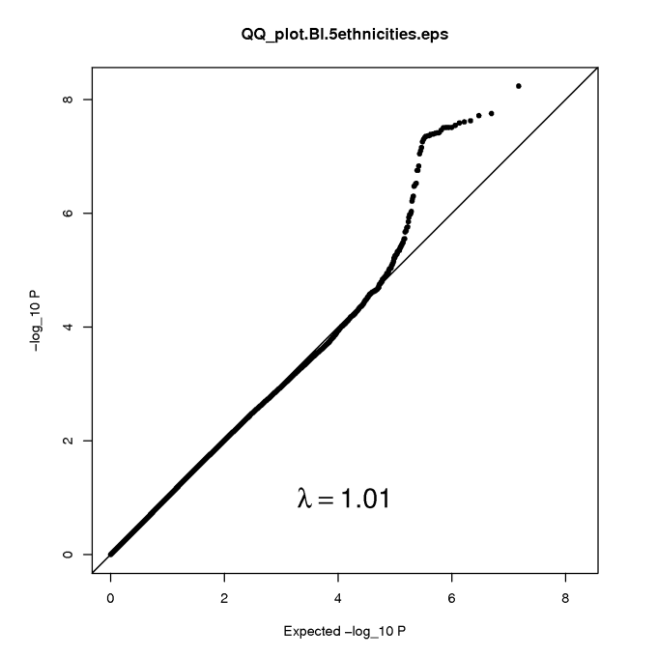
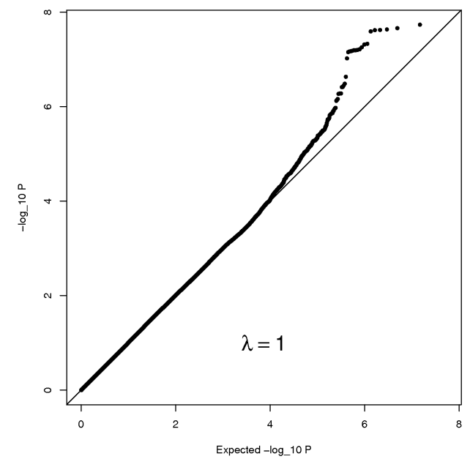
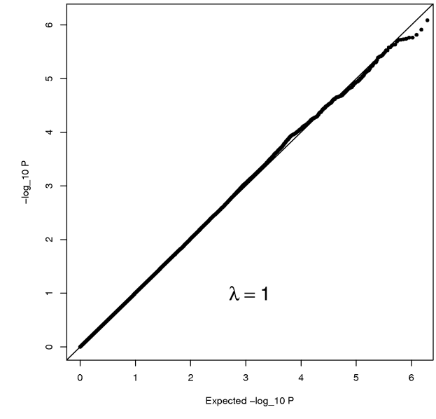
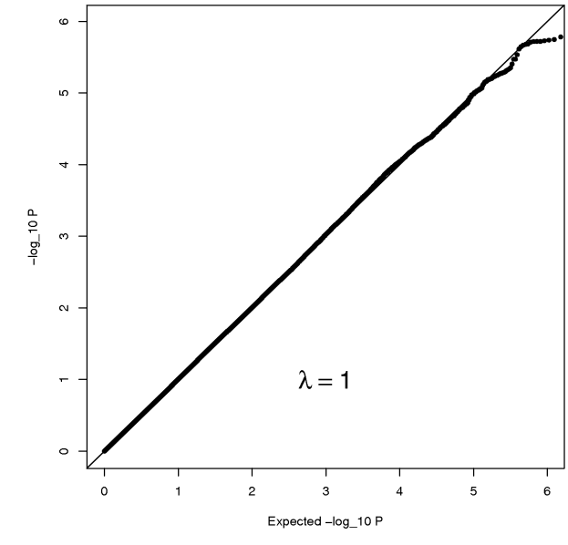
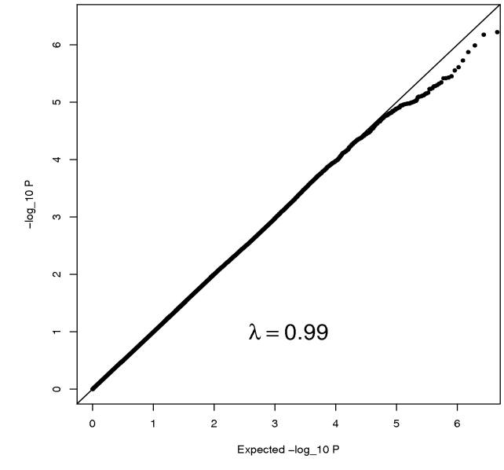
QQ plots: BI & SSBI GWAS
Brain infarcts (BI), N-markers= 7,423,334
FE-Eur
FE-5-ethnicities
RE-HE
N=3,149/11,744
N=3,726/17,223
N=3,726/17,223
λ= 1.00
λ= 1.01
λ= 1.00
Small sub-cortical brain infarcts (SSBI), N-markers= 6,824,387
FE-Eur
FE-5-ethnicities
RE-HE
N=1,806/11,744
N=2,112/17,223
N=2,112/17,223
λ= 1.00
λ= 1.00
λ= 0.99

Slide 11
Results for brain infarcts (BI) GWAS

Slide 12
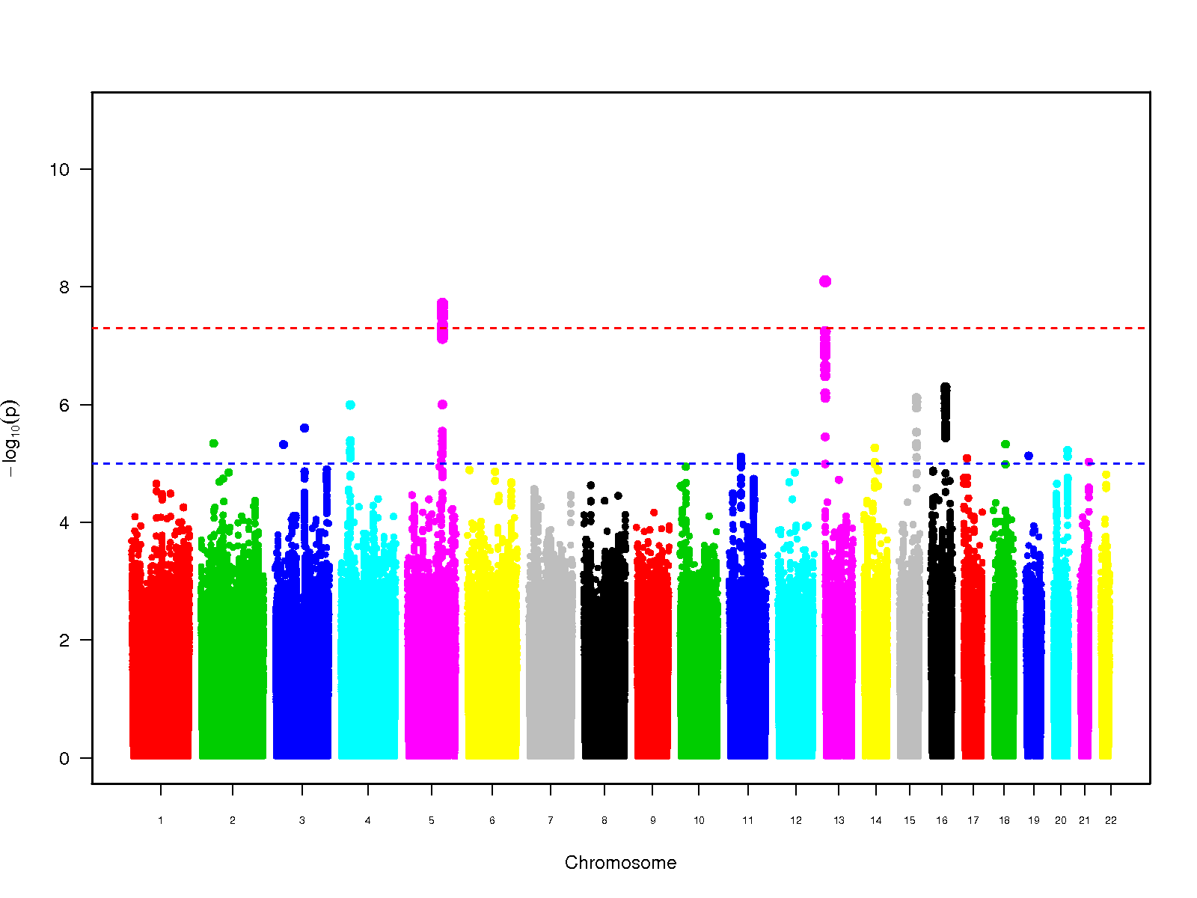

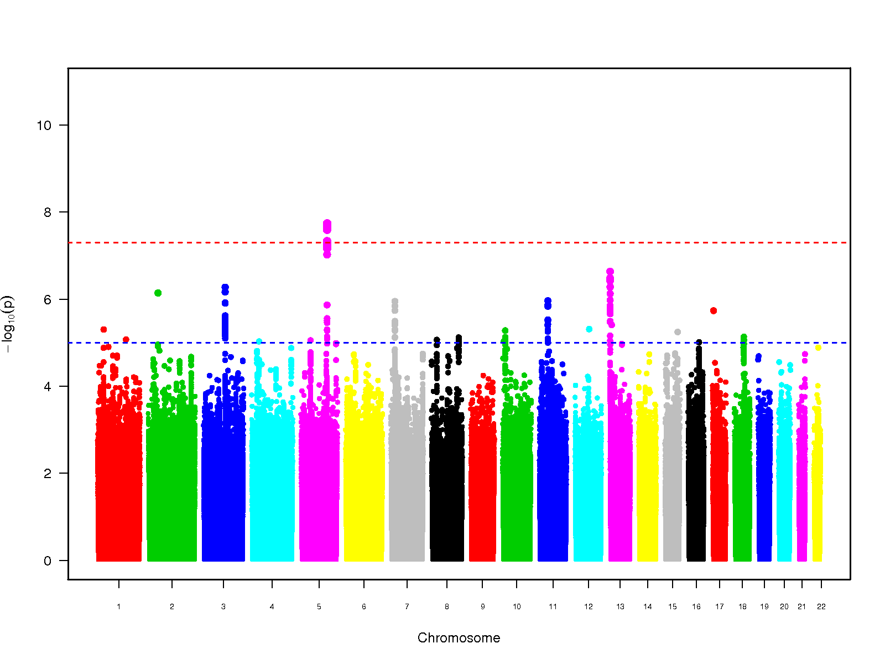
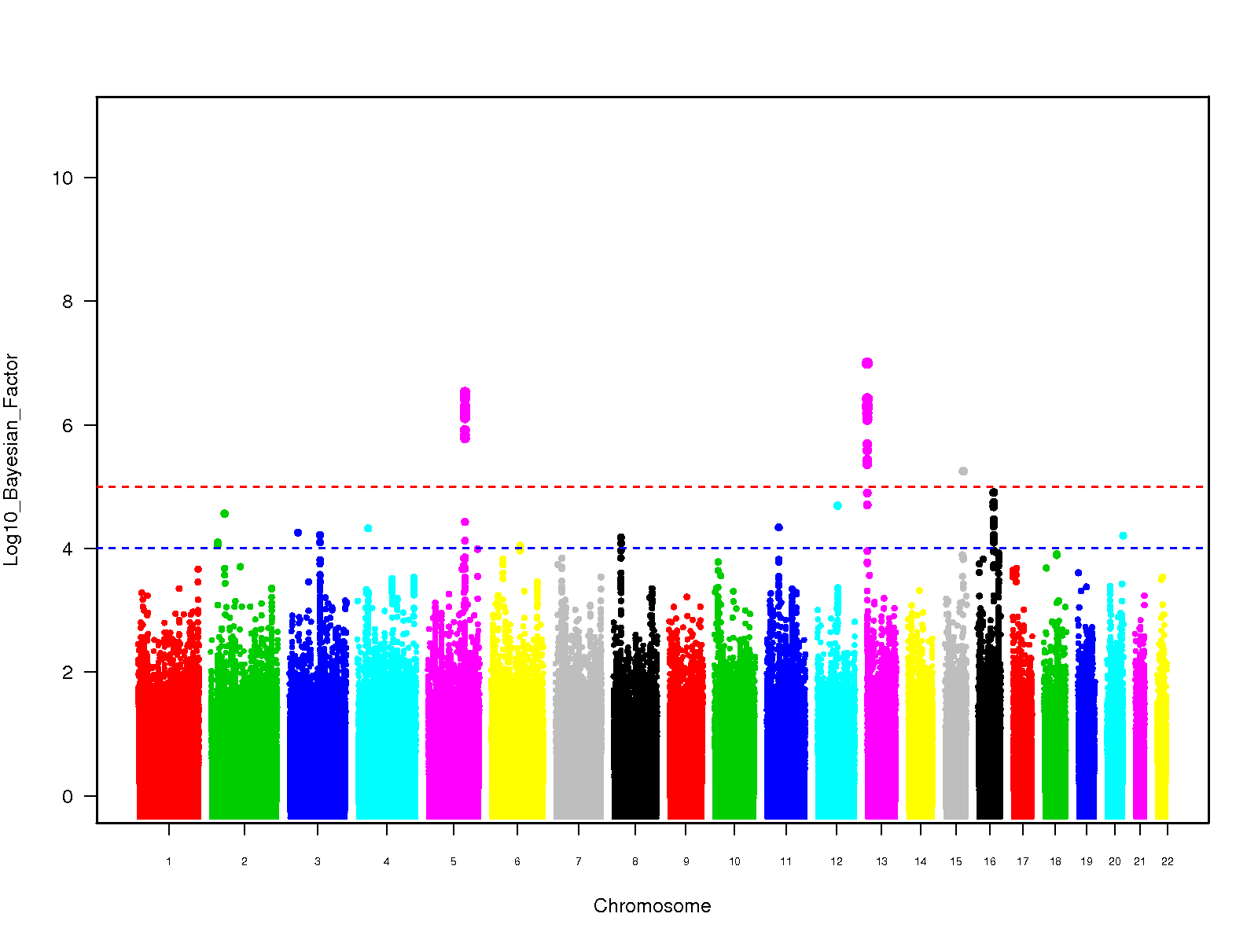
Manhattan plots: BI GWAS
FE-Eur
FE-5-ethnicities
P<5×10⁻⁸
P<5×10⁻⁸
-Log₁₀(P)
-Log₁₀(P)
Chromosome
Chromosome
RE-HE
Bayesian approach (BA)
P<5×10⁻⁸
Log10(BF) >5
-Log₁₀(P)
Log₁₀(BF)
Chromosome
Chromosome

Slide 13
Manhattan plots: BI GWAS
Bayesian approach (BA)
GRK6P1/ZDHHC20
FBN2
SV2B
CALB2/ZNF23
Log10(BF) >5

Slide 14
Results for small sub-cortical brain infarcts (SSBI) GWAS

Slide 15
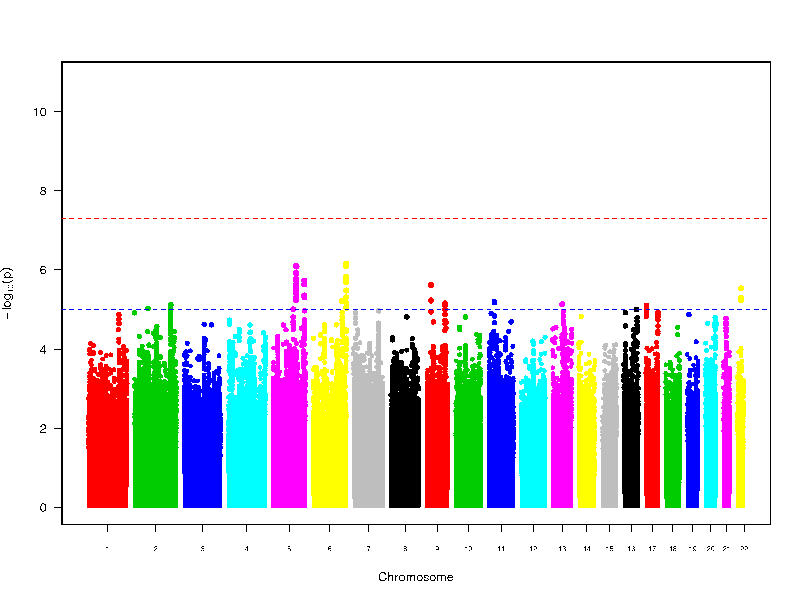
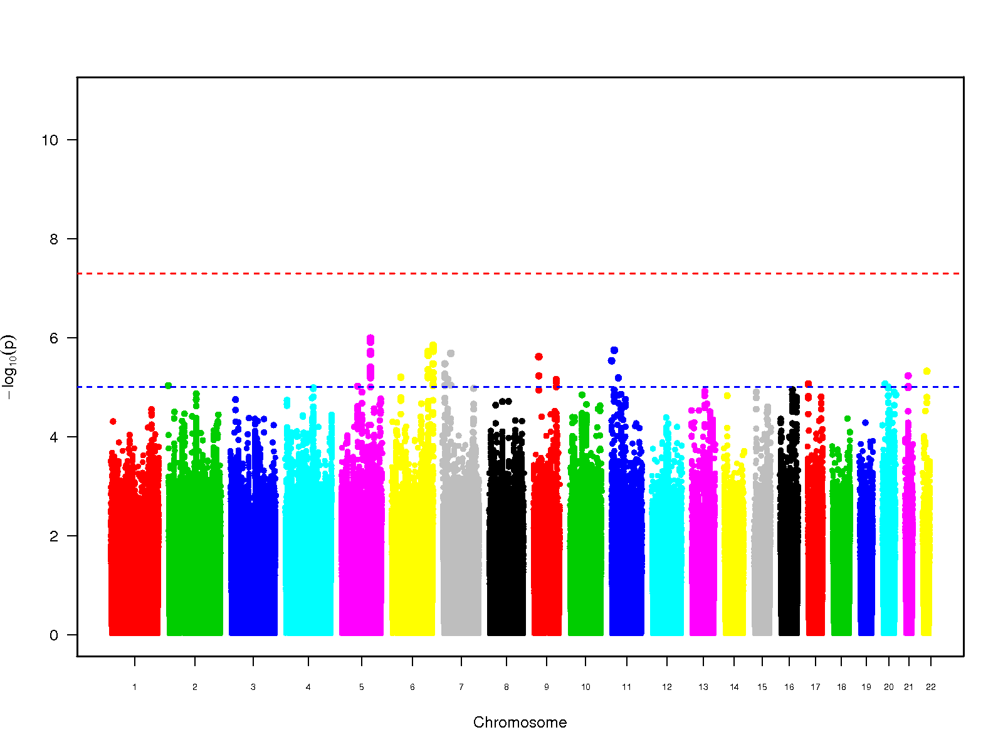
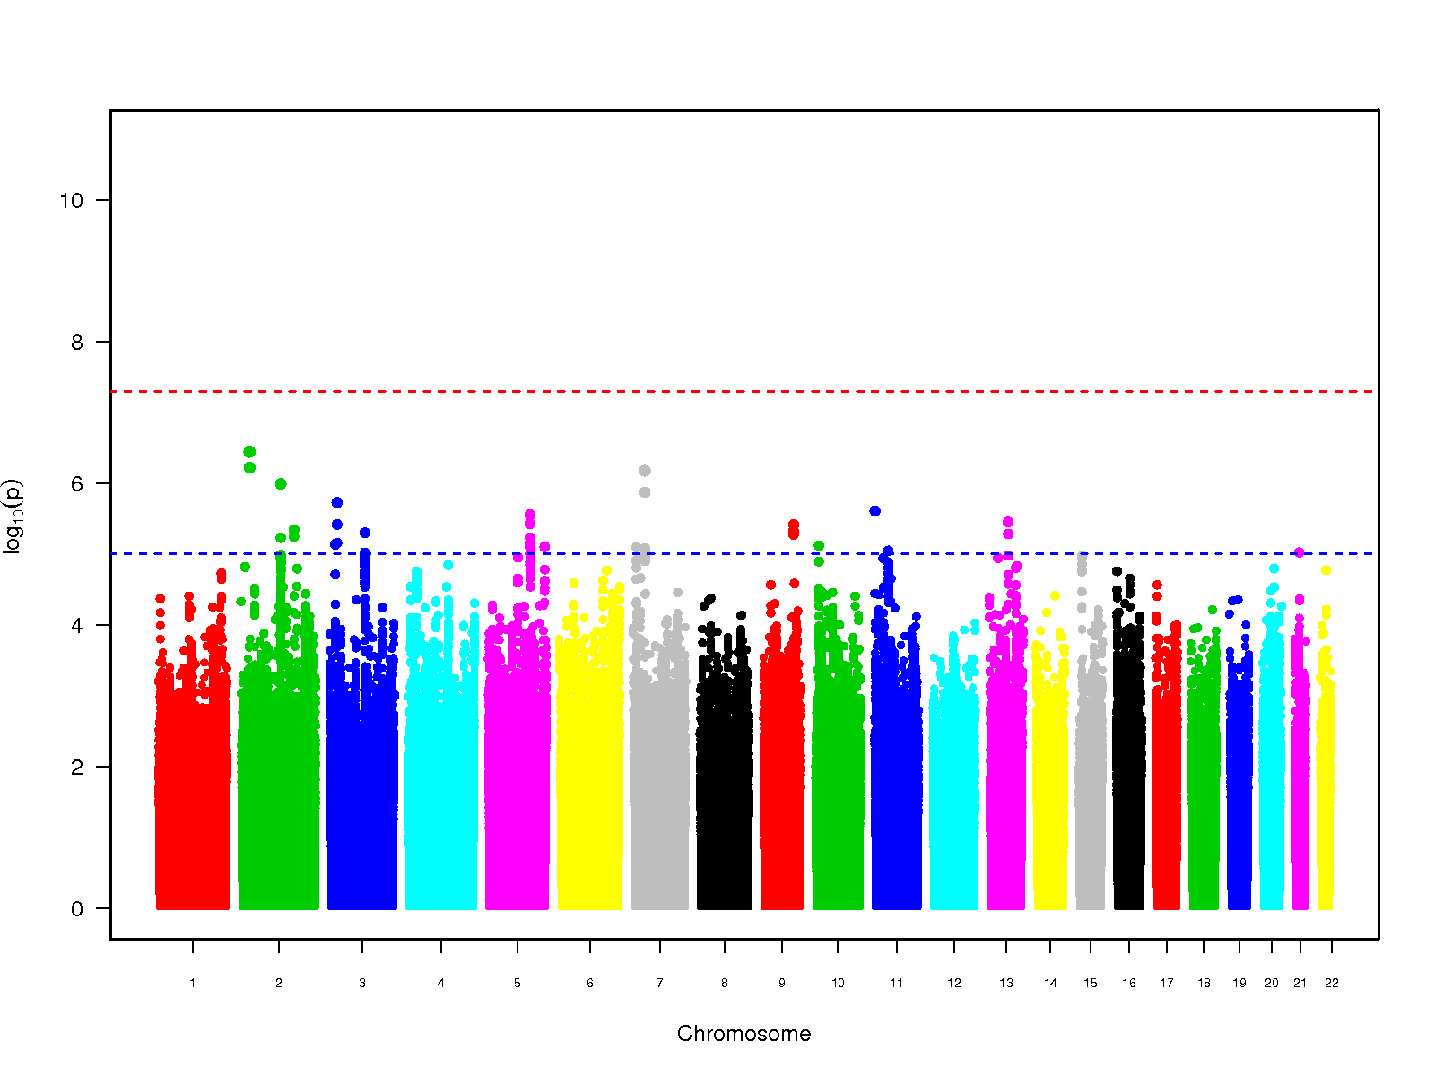
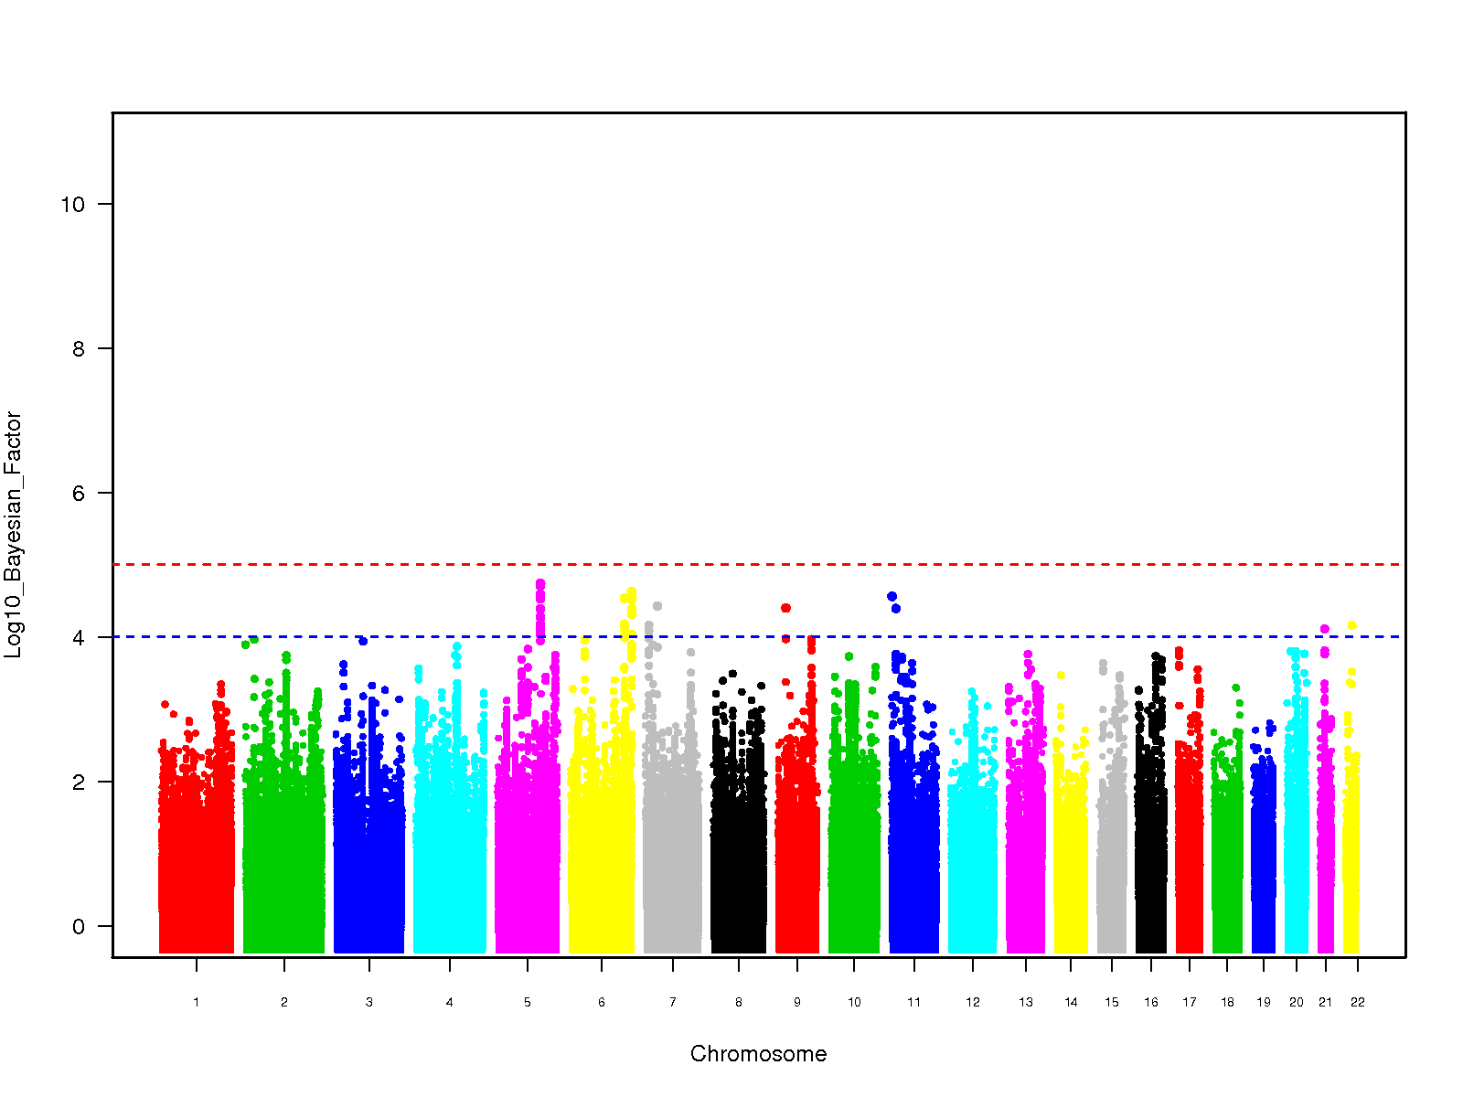
Manhattan plots: SSBI GWAS
FE-Eur
FE-5-ethnicities
P<5×10⁻⁸
P<5×10⁻⁸
-Log₁₀(P)
-Log₁₀(P)
Chromosome
Chromosome
RE-HE
Bayesian approach (BA)
P<5×10⁻⁸
Log10(BF) >5
-Log₁₀(P)
Log₁₀(BF)
Chromosome
Chromosome

Slide 16
Manhattan plots: SSBI GWAS
Bayesian approach (BA)
PLEKHG1
FBN2
FRMD1

Slide 17
Selecting loci for replication stage
Parameters to qualify for replication stage
log10(BF) > 4.5 (association statistics as per MANTRA)
mean rsq > 0.80 (high imputation quality)
Number of loci qualifying
6 loci comprising 48 variants
For in silico look-up
All 48 variants from the 6 loci
If required additional variants for 1000G SNPs not in HapMap
For de novo genotyping
The index SNP (lowest P-value) from each of the 6 loci
If funds available one additional SNP from each loci (log10(BF) > 4.5 & mean rsq > 0.80 )

Slide 18
6 loci for replication (BI & SSBI GWAS)
Locus | Index SNP | Chr | MAF | RA | BI |  |  | SSBI
 |  |  |  |  | Log10(BF) | OR (95% CI) | P-value | Log10(BF) | OR (95% CI) | P-value
FBN2 | rs39938 | 5 | 0.21 | T | 6.52 | 1.21 (1.13-1.30) | 1.77E-08 | 4.28 | 1.23 (1.13-1.34) | 3.93E-06
PLEKHG1 | rs9371194 | 6 | 0.46 | T | 3.10 | 1.12 (1.06-1.18) | 5.94E-05 | 4.54 | 1.19 (1.11-1.28) | 1.90E-06
FRMD1 | rs75889566 | 6 | 0.08 | C | 1.99 | 1.22 (1.09-1.38) | 7.71E-04 | 4.63 | 1.54 (1.29-1.83) | 1.82E-06
GRK6P1/ ZDHHC20 | rs12583648 | 13 | 0.33 | C | 7.00 | 1.21 (1.13-1.29) | 5.82E-09 | 3.07 | 1.20 (1.10-1.30) | 2.95E-05
SV2B | rs74587705 | 15 | 0.03 | T | 5.25 | 1.85 (1.46-2.34) | 3.36E-07 | -- | -- | --
CALB2/ ZNF23 | rs12373108 | 16 | 0.17 | T | 4.90 | 1.21 (1.12-1.31) | 5.02E-07 | 3.61 | 1.23 (1.12-1.36) | 1.40E-05

Slide 19
6 loci for replication (SSBI stratified for WMH)
Locus | Index SNP | Chr | MAF | RA | SSBI (No EXT-WMH) |  | SSBI (With EXT-WMH)
 |  |  |  |  | OR (95% CI) | P-value | OR (95% CI) | P-value
FBN2 | rs39938 | 5 | 0.21 | T | 1.18 (1.01-1.36) | 0.03 | 1.14 (0.97-1.35) | 0.11
PLEKHG1 | rs9371194 | 6 | 0.46 | T | 1.12 (0.99-1.27) | 0.07 | 1.23 (1.08-1.4) | 0.001
FRMD1 | rs75889566 | 6 | 0.08 | C | 0.75 (0.55-1.01) | 0.06 | 0.54 (0.37-0.79) | 0.001
GRK6P1/ ZDHHC20 | rs12583648 | 13 | 0.33 | C | 1.20 (1.04-1.41) | 0.01 | 1.28 (1.09-1.5) | 0.002
SV2B | rs74587705 | 15 | 0.03 | T | -- | -- | -- | --
CALB2/ ZNF23 | rs12373108 | 16 | 0.17 | T | 1.34 (1.12-1.6) | 0.001 | 1.23 (1.01-1.49) | 0.04
SSBI with extensive WMH: People with SSBI and in the upper quartile of 5 year age specific WMH class
SSBI no extensive WMH: People with SSBI and in the lower 3 quartile of age specific WMH class
Notes:
Perhaps we can briefly look at this slide together and see how you want to describe it.
Two things:
Could you add how extensive WMH was defined?
I’m surprised by the N you report for SSBI with ext WMH and SSBI wit no ext WMH respectively, given that it was the top quartile? Shouldn’t it be ¼ - ¾? Perhaps it’s better just to put the definition under the table and no numbers

Slide 20
eQTL and mQTL analysis
Locus | Index SNP | eQTL/mQTL SNP | Gene affected | eQTL/mQTL P-value | Tissue
eQTL
PLEKHG1 | rs9371194 | rs6557088 | AKAP12 | 2.12E-06 | Average in 10 brain regions
PLEKHG1 | rs9371194 | rs6557088 | MTHFD1L | 6.27E-07 | Intralobular white matter
FRMD1 | rs75889566 | rs7753203 | FRMD1 | 3.15E-11 | Adipose
mQTL
FRMD1 | rs75889566 | rs7753203 +2 | FRMD1 | 2.57E-27 | Adipose
GRK6P1/ ZDHHC20 | rs12583648 | rs9788333 +2 | GRK6P1 | 3.80E-35 | Adipose
CALB2/ ZNF23 | rs12373108 | rs12597949+1 | ZNF23 | 3.01E-05 | Adipose
eQTL data: Andrew Johnson’s lab (BMC Genomics, 2014)
mQTL data: GeneVar database (AJHG 2013)
Index SNPs and eQTL SNPs are in LD with r2>0.70

Slide 21
Studies participating in Replication stage
STUDY | N-BI | N-controls | Method
EVA | 88 | 558 | de novo genotyping
SMART | 332 | 854 | de novo genotyping
AGES | 589 | 1247 | de novo genotyping
OATS | 60 | 213 | in silico replication
TASCOG | 65 | 271 | in silico replication
TOTAL | 1134 | 3143
All studies have MRI defined BI and SSBI data
Notes:
The proportions of SSBI / BI differ too much between studies… It will raise criticism.
Do you have this average ratio in the discovery?

Slide 22
Validation/extension in related phenotypes
MRI confirmed small vessel disease stroke (Hugh Markus)
Ischemic stroke and small vessel disease stroke (METASTROKE consortium)
Small vessel disease stroke (SiGN consortium)
Pathologically confirmed brain infarcts (Alzheimer’s Disease Genetics Consortium-ADGC)
Blood pressure GWAS (The International Consortium for Blood Pressure-ICBP)

Slide 23

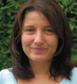









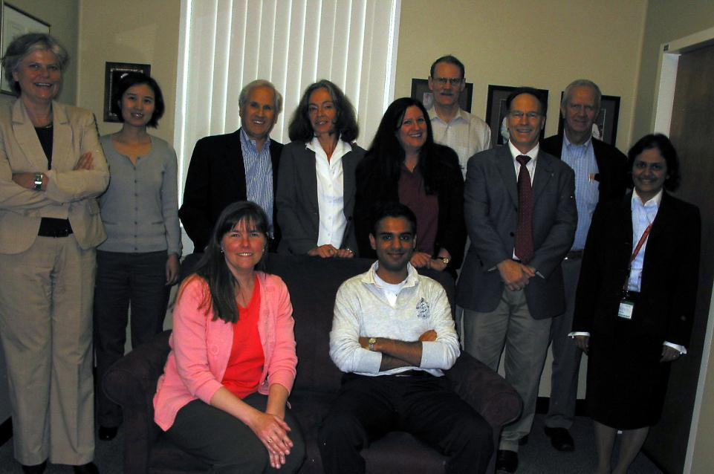












AGES-Reykjavik: Lenore Launer, Albert V. Smith, Vilmundur Gudnason, Gudny Eiriksdottir, Tamara Harris
Atherosclerosis Risk in Communities Study: Thomas Mosley, Myriam Fornage, Eric Boerwinkle, Jan Bressler
Austrian Study of Stroke Prevention: Reinhold Schmidt, Helena Schmidt, Katja-Elisabeth Petrovic, Franz Fazekas, Margherita Cavalieri
Cardiovascular Health Study: Josh Bis, Will Longstreth, Annette Fitzpatrick, Oscar Lopez, Bruce Psaty, Thomas Lumley, Kenneth Rice, Lewis Kuller, James Becker, Nicole Glazer, Jerome Rotter, Erin Wallace
ERF: Cornelia van Duijn, Maaike Schuur, Carla Ibrahim-
Framingham Heart Study: Philip Wolf, Anita L. DeStefano, Stephanie Debette, Qiong Yang, Charles DeCarli, Larry Atwood, Alexa Beiser, Rhoda Au, Yi-Chen Hsieh
Rotterdam Study: Monique Breteler, Cornelia van Duijn, M. Arfan Ikram, Ben Verhaaren, Aad Van der Lugt
Collaborating Studies: EUROSPAN, LBC, Health ABC, 3C study, ROS/MAP, WHICAP
TASCOG, Group Health, EADI, GERAD, ADGC, ISGC and METASTROKE
Fundació ACE, PROSPER, Generation Scotland, AAA, GEMS, GENOA
Neuro-CHARGE group - stroke
Stéphanie Debette
Will Longstreth
Neuro-CHARGE working group
Sudha Seshadri
Christophe Tzourio
Neuro-CHARGE Working Group

Slide 24
THANK YOU

Slide 25
Top 2 loci: BI vs SSBI and forest plots
BI SSBI
MarkerName | Gene | Odds Ratio | P (FE)-All | Odds Ratio | P (FE)-All
rs12583648 | GRK6P1/ZDHHC20 | 1.21 | 5.82E-09 | 1.20 | 2.95E-05
rs39938 | FBN2 | 1.21 | 1.77E-08 | 1.23 | 3.93E-06
SSBI BI
MarkerName | Gene | Odds Ratio | P (FE)-All | Odds Ratio | P (FE)-All
rs469294 | FBN2 | 1.25 | 1.21E-06 | 1.22 | 3.47E-08
rs75889566 | FRMD1 | 1.54 | 1.82E-06 | 1.22 | 0.000771

Slide 26
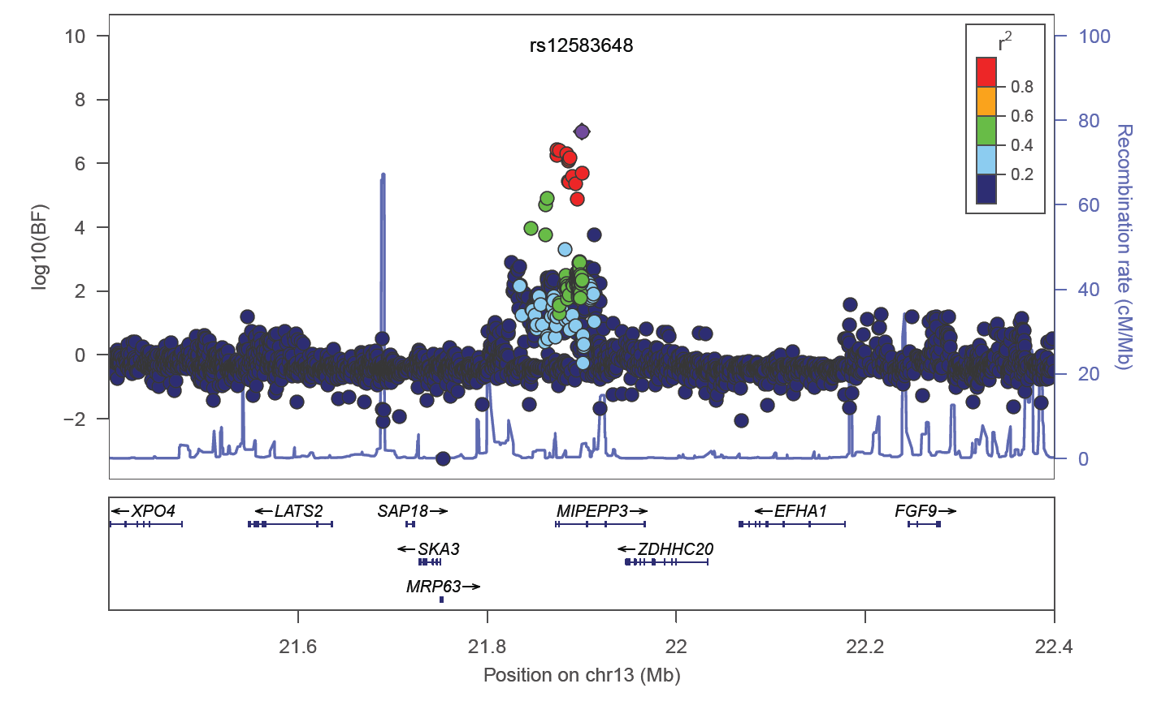
Regional plots: GRK6P1/ZDHHC20
Regional plot
P-M plot
-log(P-value)
GRK6P1
m-value
No
effect
ambiguous
Has
effect
The same locus was a suggestive hit on GWAS for adverse metabolic response to hydrochlorothiazide, a common hypertensive drug (Pharmacogenomics J. 2014) (r2=0.82 with the index SNPs)
GRK6P1: involved in glucose transport
ZDHHC20: involved in protein palmitoylation, a common post-translational lipid modification (J Biol Chem. 2013 )

Slide 27
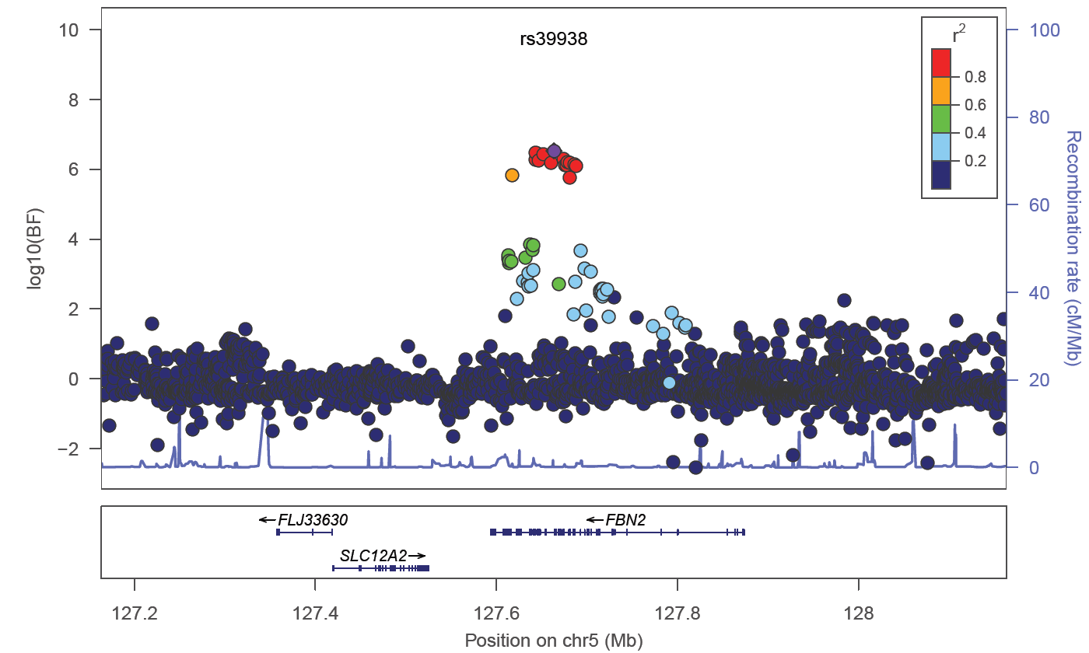
Regional plots: FBN2 (Fibrillin 2)
Regional plot
P-M plot
-log(P-value)
m-value
No
effect
ambiguous
Has
effect
Fibrillin 2 is a component of connective tissue microfibrils and involved in elastic fiber assembly
Mutations in FBN2 are associated with Adolescent idiopathic scoliosis (AIS) which causes spinal deformity in children (Hum Mol Genet. 2014 )
Mutations in FBN2 also cause congenital contractural arachnodactyly (Genet Test Mol Biomarkers. 2009)
SNPs of FBN2 were suggestive hits for GWAS of Height and Obesity (Hum Mol Genet. 2009 & PLoS Genet. 2011)

Slide 28
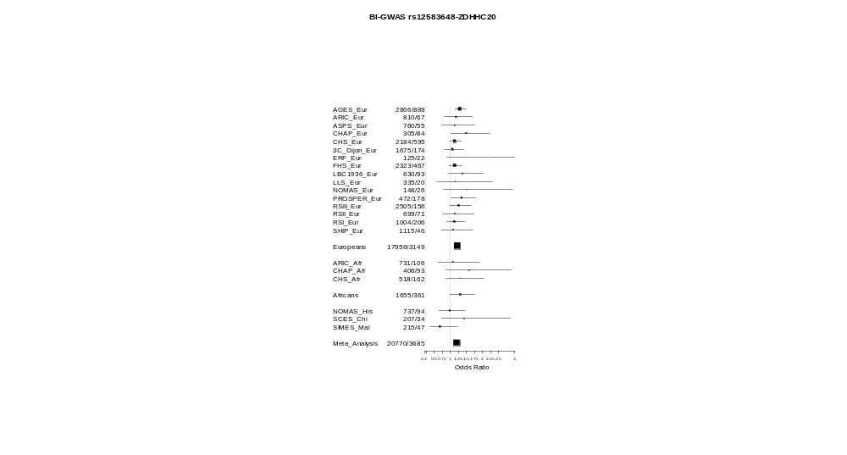
Forest plot:
GRK6P1/
ZDHHC20

Slide 29
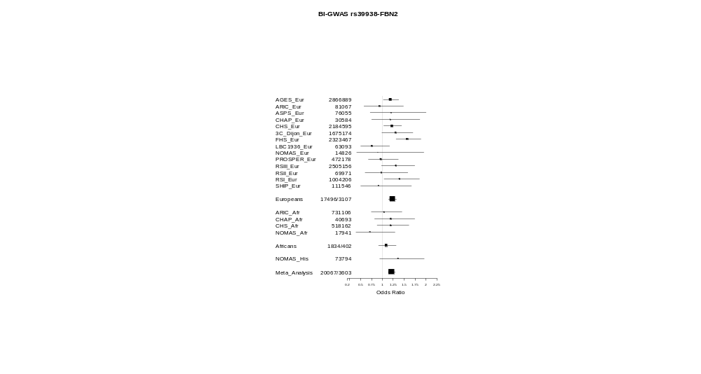
Forest plot:
FBN2
/

Slide 30
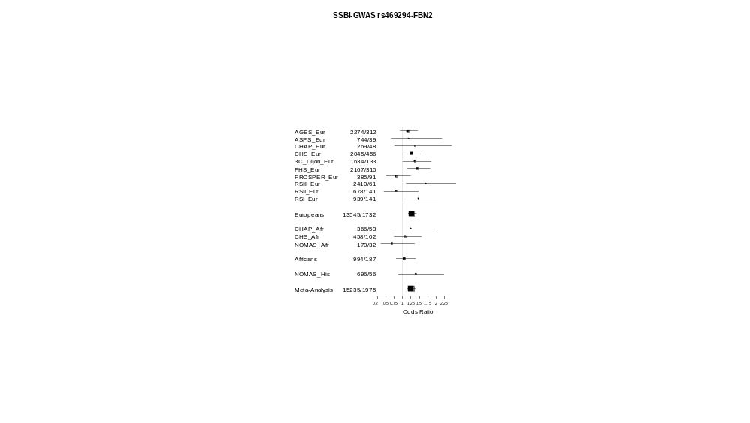
Forest plot:
FBN2

Slide 31
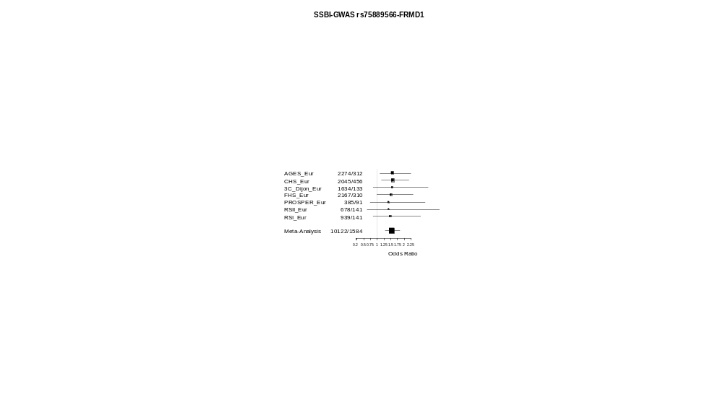
Forest plot:
FRMD1

Slide 32
Ongoing analyses and future plans
Analysis of SSBI with and without WMH
Functional annotation
  ENCODE
  Published + unpublished eQTL databases (A. Johnson)
  mQTL analysis

Slide 33
Selecting loci for replication stage
Parameters to qualify for replication stage
log10(BF) > 4.5 (association statistics as per MANTRA)
mean rsq > 0.80 (high imputation quality)
Number of loci qualifying
6 loci comprising 48 variants
For in silico look-up
All 48 variants from the 6 loci
If required additional variants for 1000G SNPs not in HapMap
For de novo genotyping
The index SNP (lowest P-value) from each of the 6 loci
If funds available one additional SNP from each loci (log10(BF) > 4.5 & mean rsq > 0.80 )

Slide 34
6 loci for replication (SSBI stratified for WMH)
Locus | Index SNP | Chr | MAF | RA | SSBI (No EXT-WMH) |  | SSBI (With EXT-WMH)
 |  |  |  |  | OR (95% CI) | P-value | OR (95% CI) | P-value
FBN2 | rs39938 | 5 | 0.21 | T | 1.18 (1.01-1.36) | 0.03 | 1.14 (0.97-1.35) | 0.11
PLEKHG1 | rs9371194 | 6 | 0.46 | T | 1.12 (0.99-1.27) | 0.07 | 1.23 (1.08-1.4) | 0.001
FRMD1 | rs75889566 | 6 | 0.08 | C | 0.75 (0.55-1.01) | 0.06 | 0.54 (0.37-0.79) | 0.001
GRK6P1/ ZDHHC20 | rs12583648 | 13 | 0.33 | C | 1.20 (1.04-1.41) | 0.01 | 1.28 (1.09-1.5) | 0.002
SV2B | rs74587705 | 15 | 0.03 | T | -- | -- | -- | --
CALB2/ ZNF23 | rs12373108 | 16 | 0.17 | T | 1.34 (1.12-1.6) | 0.001 | 1.23 (1.01-1.49) | 0.04
SSBI no WMH: 636 cases of SSBI without extensive WMH vs 5913 controls with no BI and no WMH
SSBI with WMH: 608 cases of SSBI with extensive WMH vs 6511 controls with no BI and no WMH
Notes:
Perhaps we can briefly look at this slide together and see how you want to describe it.
Two things:
Could you add how extensive WMH was defined?
I’m surprised by the N you report for SSBI with ext WMH and SSBI wit no ext WMH respectively, given that it was the top quartile? Shouldn’t it be ¼ - ¾? Perhaps it’s better just to put the definition under the table and no numbers

