Slide 1
Neuroimaging Working Group
Update
Natalia S. Rost, MD, MPH
ISGC Workshop - Paris, France
November 6th 2014

Slide 2
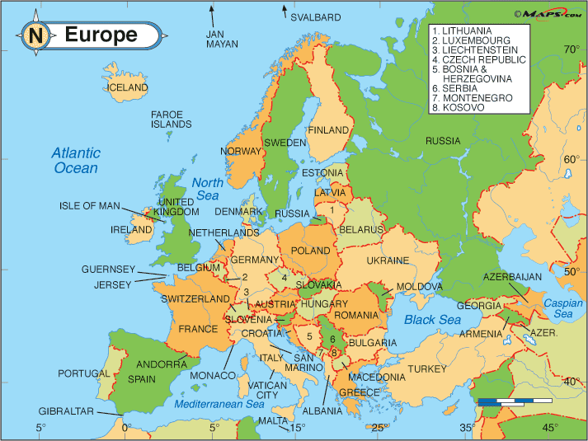
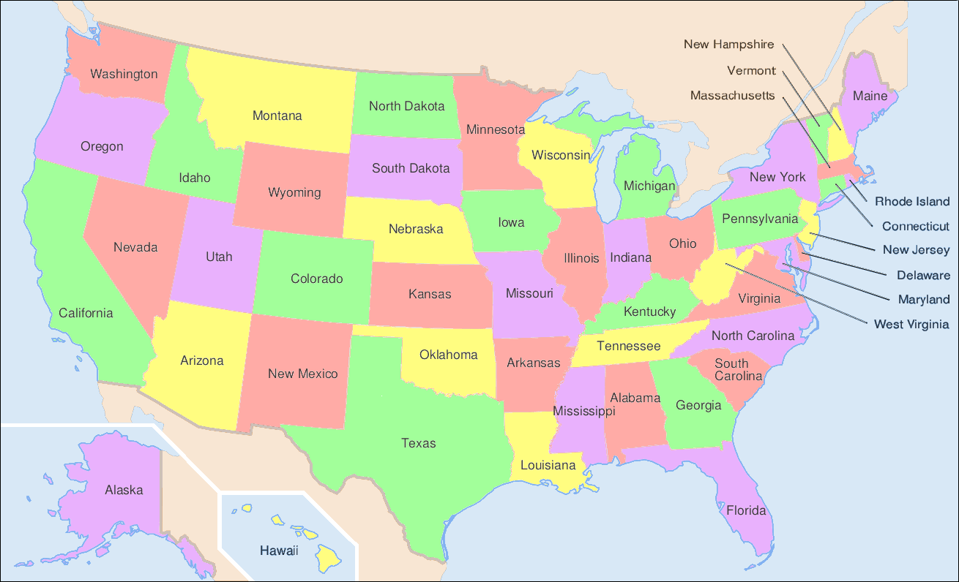
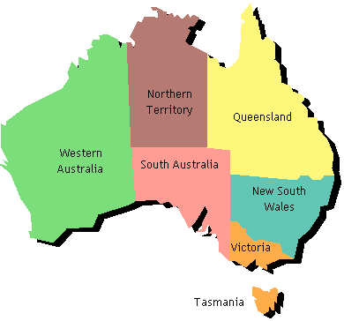
Neuroimaging Group Members (Oct 2015)
21 members (12 institutes)
  Imperial College of London
  University of Leuven
  University of Rostock
  Medical University of Graz
  Mass General Hospital
  University of Edinburgh
  University of Gothenburg
  University of Cambridge
  Hospital del Mar (IMIM)
  University of Newcastle*
  University of North Carolina*
  University of Utah*
Image courtsey ofwww.infoplease.com
Image courtsey of commons.wikimedia.org
Image courtsey of wwp.greenwichmeantime.com/
Courtesy of Lisa Cloonan, BA

Slide 3
Overall goals of the group
To assess the full potential for genetic discovery of the neuroimaging data available through the participating ISGC sites
Harmonize the neuroimaging phenotypic datasets in relation to the genotypic and clinical data in order to facilitate future analyses
Expedite and properly power the ongoing analyses (e.g., WMH GWAS)
Facilitate future analyses of neuroimaging phenotypes (DWI size, CMBs, angiography)
Develop neuroimaging phenotype assessment standards for future genetic and genomic studies in stroke
Foster collaborations for future genetic discovery in stroke
  facilitate future ISGC publications/ grant applications

Slide 4
NINDS-SiGN MRI Repository
Site | # of contributed scans
BASIC MAR (IMIM) | 124
BRAINS (Imperial) | 70
GASROS (MGH) | 542
GCNKSS (Cincinnati) | 245
GEOS (U Maryland) | 76
Gothenburg (Sweden) | 401
Graz (Austria) | 373
ISGS-SWISS (Mayo –UVA) | 425
Krakow (Poland) | 224
Leuven (Belgium) | 448
Lund (Sweden) | 195
MIAMISR (USA) | 262
n=3385

Slide 5
Projects: completed and ongoing
Recommendations to the ISGC Protocols and Standards
WMH measurements harmonization pilot study
  volumetric vs. ordinal WMH (LADIS) grading
    WMH ratings were consistent among the readers (ICC=0.82)
    Range of κ between any two readers = (0.755 - 0.93)
Genetics of posterior circulation stroke
  Leads: Petrea Frid, Arne Lindgren, Jesper Petersson
Preliminary ordinal WMH GWAS (SIFAP) (lead: AK Giese)
GWAS of MRI phenotypes in stroke (lead: Natalia Rost)
  MRI-GENIE grant (NIH/NINDS, submitted Nov 5, 2014)

Slide 6
MRI-GENetics Interface Exploration: MRI-GENIE study
Aim 1: To develop, validate, and implement a novel, fully automated, high-throughput multimodal clinical MRI analysis pipeline
Aim 2: To exhaustively phenotype the existing SiGN/ISGC MRI scans for acute and chronic MRI-based cerebrovascular traits, and to quantify the effect of these radiographic phenotypes on functional outcomes after stroke
  1⁰: WMHv and DWIv
  2⁰ MRI traits
  Joint analysis of infarct size/location
  WMH severity by CCS and other novel stroke subtype categories (lacunar vs. non-lacunar)
Aim 3: To discover genetic variants associated with acute and chronic MRI-based cerebrovascular traits
  heritability of DWIv and WMHv, overall and by stroke subtype
  common and rare genetic loci associated with variation in DWIv and WMHv
  shared contribution to MRI traits and post-stroke outcome

Slide 7
Clinical MRI trait analysis pipeline
MRI from collaborating SiGN site
SiGN neuroimaging repository
XNAT interface (automated segmentation)
MRI traits extracted and data submitted
MRI-Genetics interface exploration
Notes:
7

Slide 8
Aim 1: MR analysis pipeline feasibility
Sridharan R, Dalca A, Fitzpatrick K, Cloonan L, Kanakis A, Wu O, Furie KL, Rosand J, Rost NS, Golland P. Quantification and analysis of large multimodal clinical image studies: application to stroke. In Proc. MICCAI 2013.
Dalca A, Sridharan R, Fitzpatrick K, Cloonan L, Kanakis A, Wu O, Furie KL, Rosand J, Rost NS, Golland P. Segmentation of cerebrovascular pathologies in stroke patients with spatial and shape priors. In Proc. MICCAI 2014.
Dalca A, Sridharan R, Rost NS, Golland P. Tipix: Rapid visualization of large image collections. In Proc. MICCAI Workshop on Interactive Medical Image Computing, 2014.

Slide 9
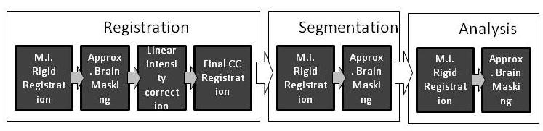
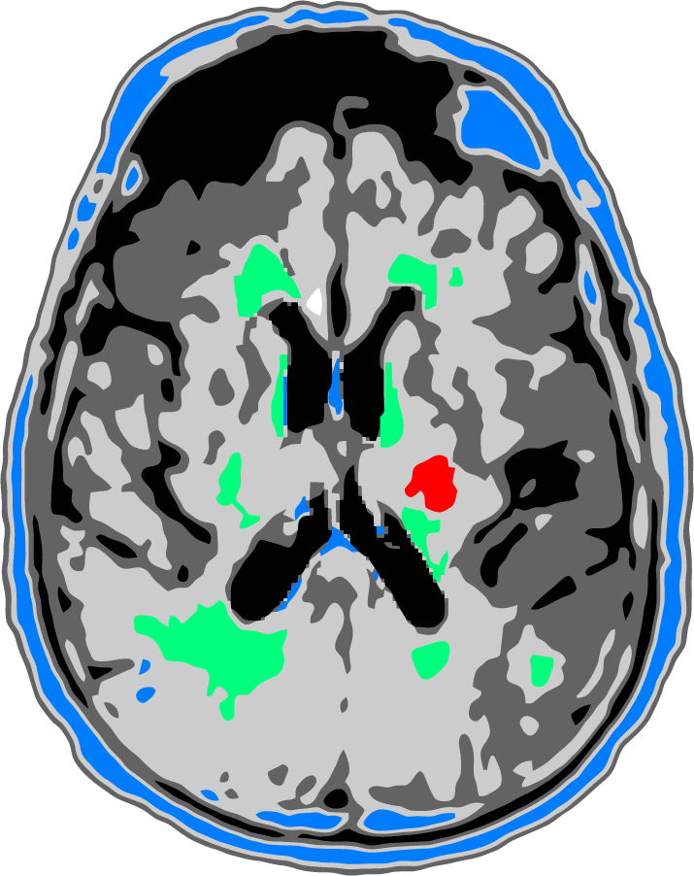
Volumetric MRI analysis: full pipeline
  WMH
  Other hyperintensities
  Acute stroke
MGH-MIT Computer Science & Artificial Intelligence Lab

Slide 10
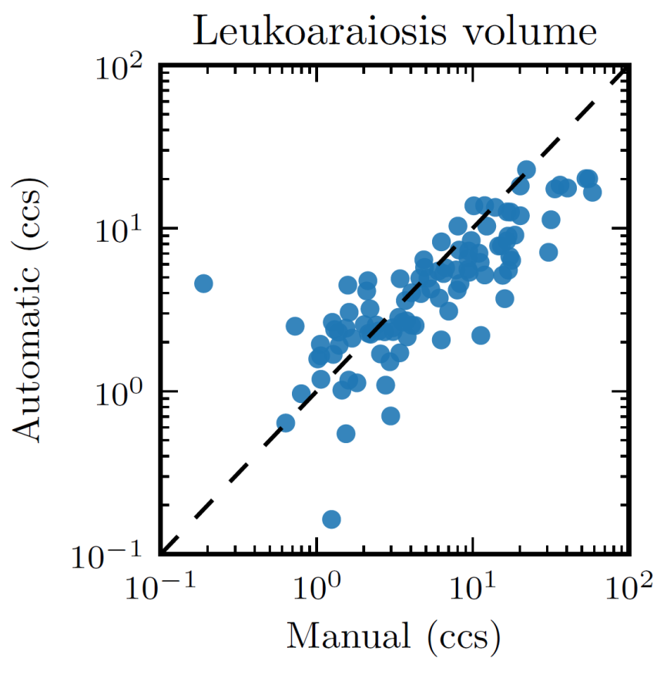
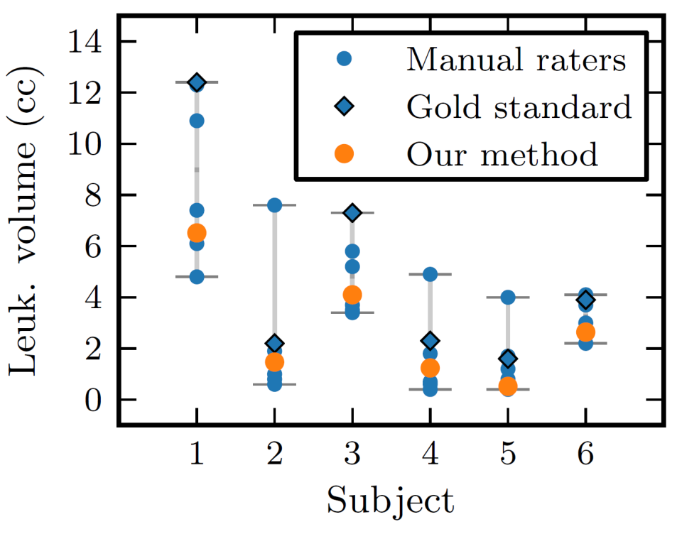
Segmentation of Cerebrovascular Pathologies in Stroke Patients with Spatial and Shape Priors
MGH-MIT Computer Science & Artificial Intelligence Lab
Dalca A et al. In Proc. MICCAI 2014.

Slide 11
Aim 2: MRI-GENIE MRI traits
DWI:
  acute infarct location (hemisphere, vascular territory, cortical, subcortical, watershed)
  single vs. multiple acute infarct lesions
  MRI-based stroke subtypes (e.g., single symptomatic lacune)
T2 FLAIR:
  evidence of subacute/chronic infarcts/SBI
  SVD subtypes
  WMH severity grade scored on Fazekas scale
GRE/SWI:
  CMB count
  CMB location (lobar vs. deep)
  macrohemorrhages, including hemorrhagic infarct transformation
MRA:
  level of arterial occlusion (MCA, ACA, PCA 1/2/3; VA or BA; or small/penetrator vessel)
  leptomeningeal collaterals grade
  evidence of significant extracranial or intracranial large artery stenosis

Slide 12
Individual MRI QC and folder annotation

Slide 13
Final QC data: MRI sequences
n=3385
n=2935
n=2847
n=1842
n=1990

Slide 14
Number of FLAIR sequences by site
n=2935

Slide 15
Number of DWI sequences by site
n=2847

Slide 16
Number of GRE/SWI sequences by site
n=1842

Slide 17
Number of MRA sequences by site
n=1990

Slide 18
Next steps
Compile a complete database of SiGN subset with MRIs
  Clinical characteristics (including mRS) & GWAS
Volumetric MRI analysis pipeline project
  proceed with all available FLAIR and DWI volumetric analysis
  conduct GWAS of 1⁰ MRI traits
2⁰ MRI-derived phenotypes – plan to proceed prospectively
Plan & process for future proposals
  MRI-GENIE vs. individual (Lund proposal, etc) – independent review, validation, per-phenotype review (?)
  “Call” for future studies (RFA-like)?
Role of the Neuroimaging Working Group & future directions
  Papers (Neuroimage, Curr Opin & Reviews Stroke, Int J Stroke)
  Grants (e.g. NIH R03)
Notes:
18

Slide 19
Prospective subjects with MRI and DNA by June 2015
N=3410

