Slide 1
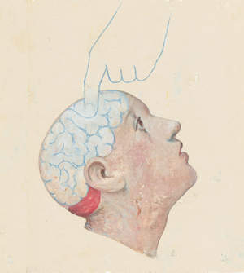




IDeA Lab Projects
P. Maillard, C. DeCarli
16th Workshop of the International Stroke Genetics Consortium
November 2014

Slide 2
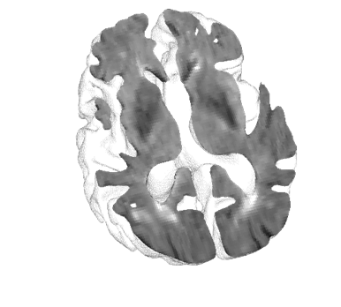
Imaging markers associated with sub-clinical cerebrovascular diseases
White Matter Hyperintensities on FLAIR MRI (WMH)
FLAIR in the White matter
Normal
Injured

Slide 3
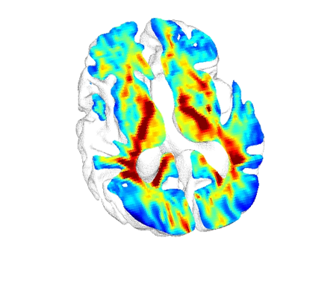

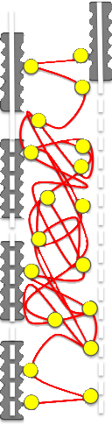

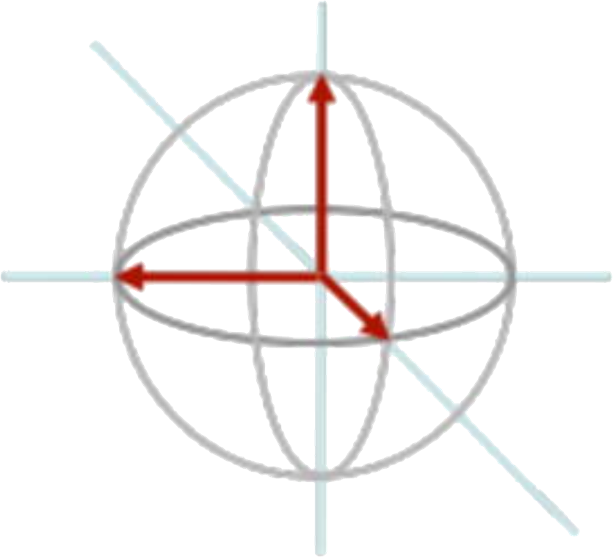
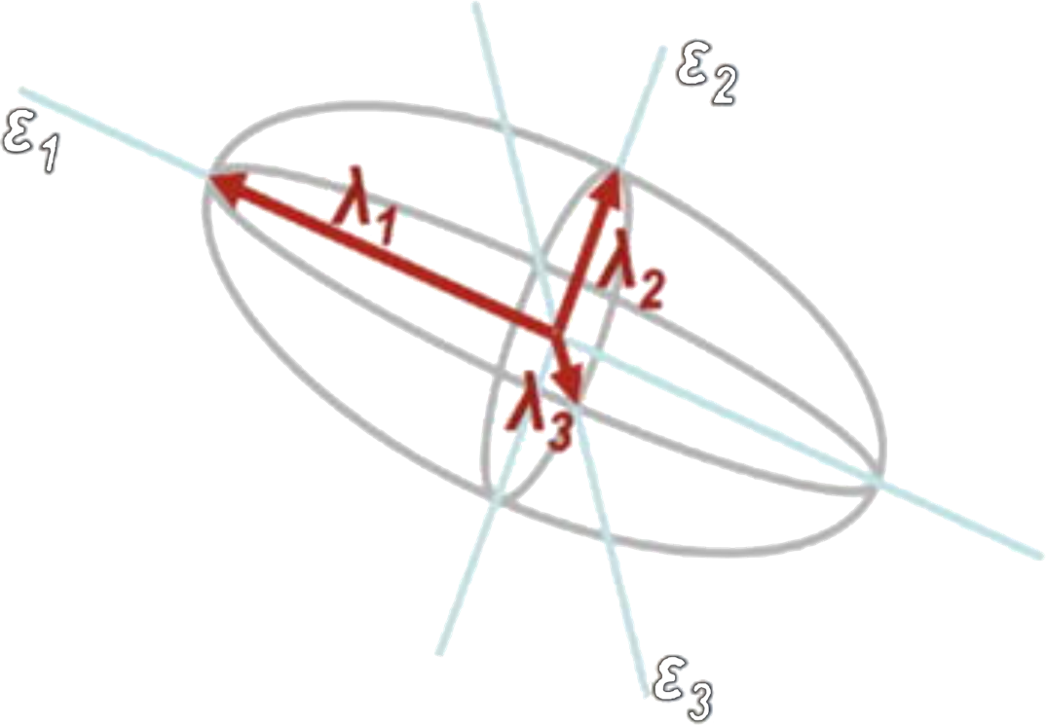
Imaging markers associated with sub-clinical cerebrovascular diseases
Diffusion tensor imaging (DTI): fractional anisotropy (FA)
Water molecule
Axon + myelin
Injured axon + myelin
Axonal loss
FA
0
(isotropy)
0.6
(anisotropy)

Slide 4
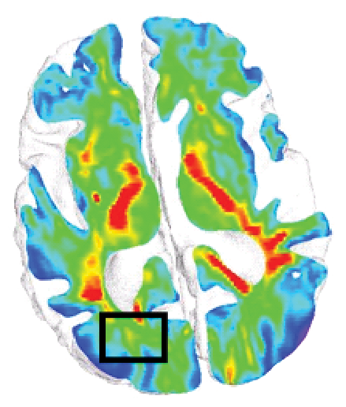
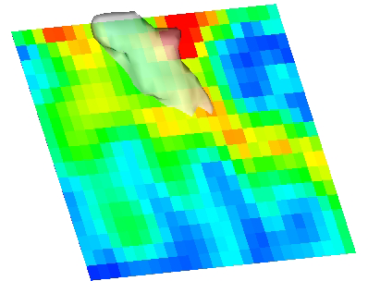
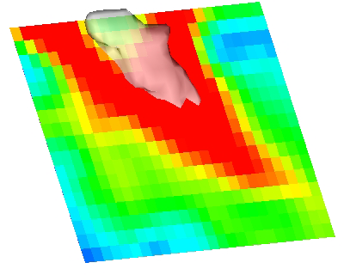

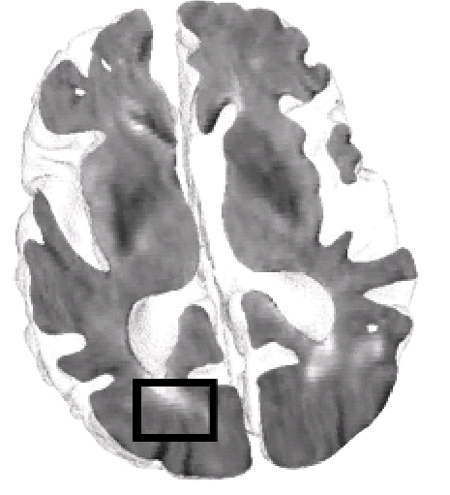
  Combining FLAIR and DTI: the White Matter Hyperintensities Penumbra
FA
Normal healthy young FA
WMH
Penumbra
Reference
0
0.6
Maillard et al., Stroke, 2011
De Groot et al., Stroke, 2013
Tsao et al., Proc Soc Photo Opt Instrum Eng, 2014

Slide 5
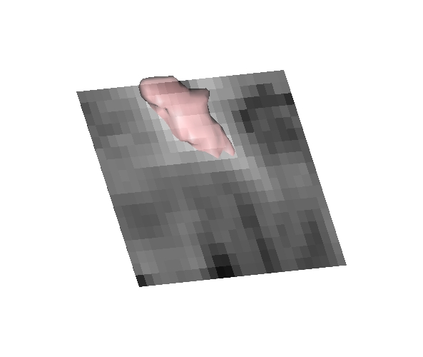
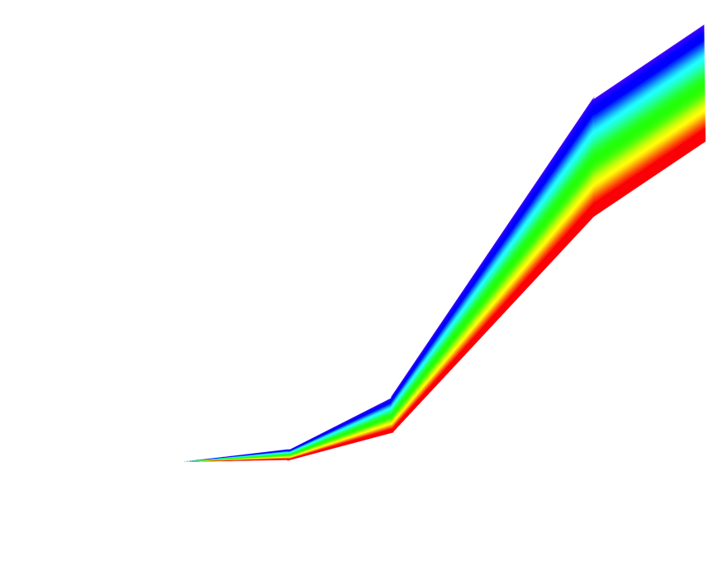
Why WMH penumbra matters?
FLAIR
FA
Normal
0
Injured
0.6
1/ Baseline WM integrity predicts conversion into WMH
50%
Decreasing baseline FA
Risk for conversion from normal appearing WM to WMH
0
Increasing baseline FLAIR
Maillard et al., AJNR, 2013

Slide 6
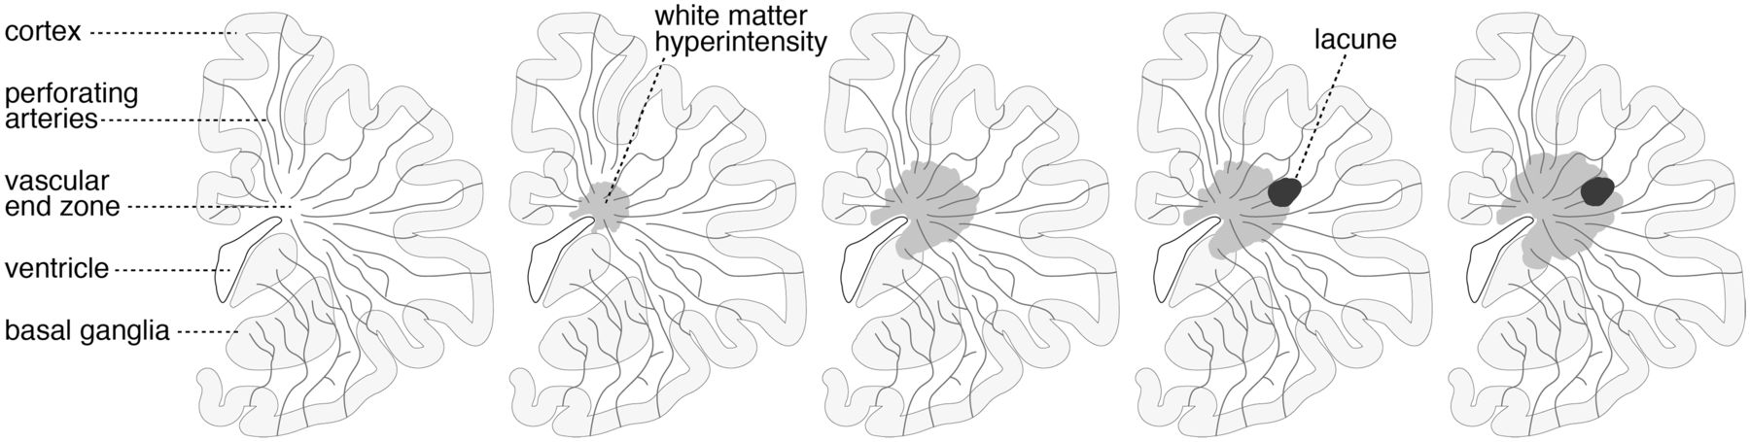
Why WMH penumbra matters?
2/ Lacunes* and WMH penumbra:
CADASIL: 90% of incident lacunes at the edge of a pre-existing WMH
ASPS**: 100% of prevalent lacunes at the edge of a pre-existing WMH
*lacunes are traditionally considered to result from occlusion of a single perforating artery whereas WMH are frequently attributed to chronic hypoperfusion
** ASPS: Austrian Stroke Prevention Study
Duering et al., Brain, 2013

Slide 7
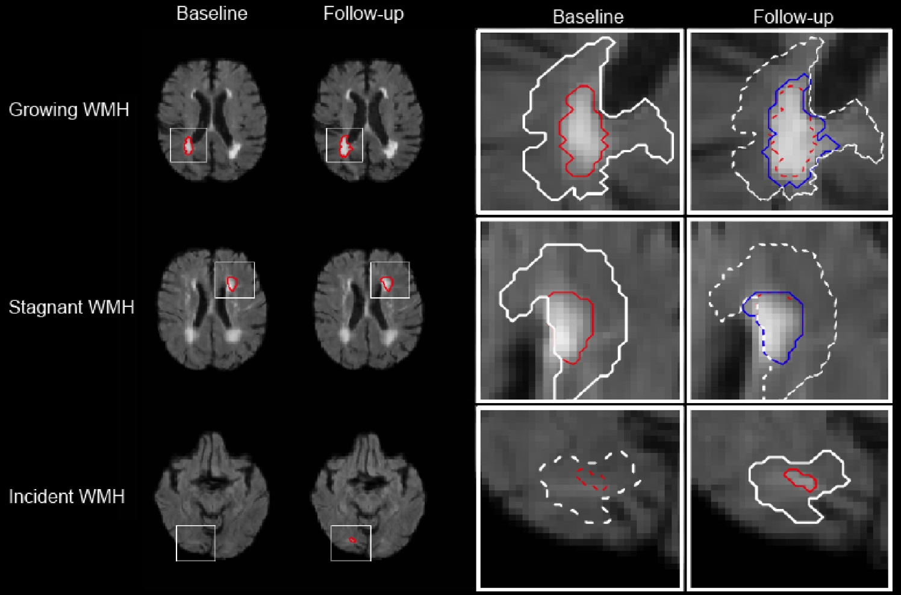
Why WMH penumbra matters?
Maillard et al., Stroke, 2014

Slide 8
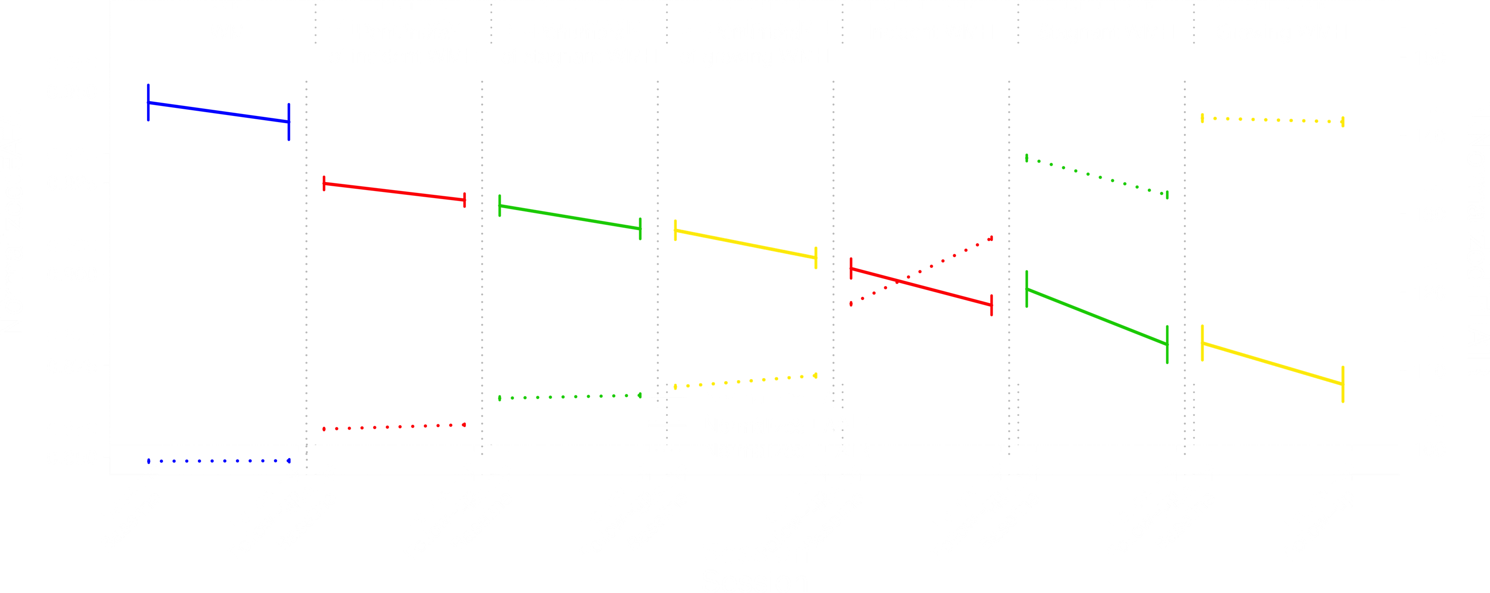

Why WMH penumbra matters?
3/ WMH growth dynamic is associated with the baseline WM integrity
4/ WM degeneration is a continuous process
Maillard et al., Stroke, 2014

Slide 9
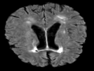
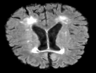
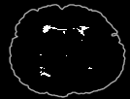
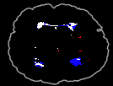
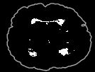
Why WMH penumbra matters?
time
Baseline FLAIR
Follow-up FLAIR
Baseline WMH Incident WMH
Growing WMH
Baseline WMH
Follow-up WMH
Follow-up WMH
80% of new WMH volume over time was due to growth of existing lesions
Maillard et al., Neurology, 2012

Slide 10
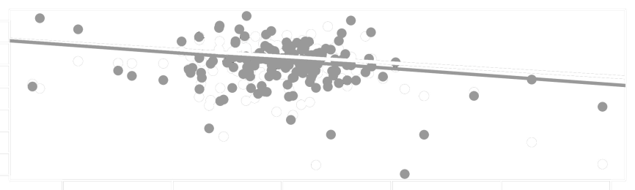
  Coevolution of WMH and Cognition in Elderly
2
0
Change in cognitive score (SD / y)
-2
-4
-1.5
-0.5
0
0.5
1
1.5
Rate of WMH growth (log cc/years)
Executive function
Episodic memory
Greater cognitive decline is associated with greater lesion growth, but not with greater emergence of incident lesions
Maillard et al., Neurology, 2012

Slide 11

0 vs. 1
1 vs. 2
2 vs. 3
  Course of WM integrity over time
Normal aging WM
WMH penumbra
DTI
WM integrity
Vascular Risk Factors
(VRF)
WMH core
Midlife
Older
Time
Seshadri et al., Arch Intern Med, 2001
Jeerakathil et al., Stroke, 2004
Debette et al., Neurology, 2011
Raz et al., Neuropsychology, 2007
Maillard et al., Neurobio Aging, submitted

Slide 12
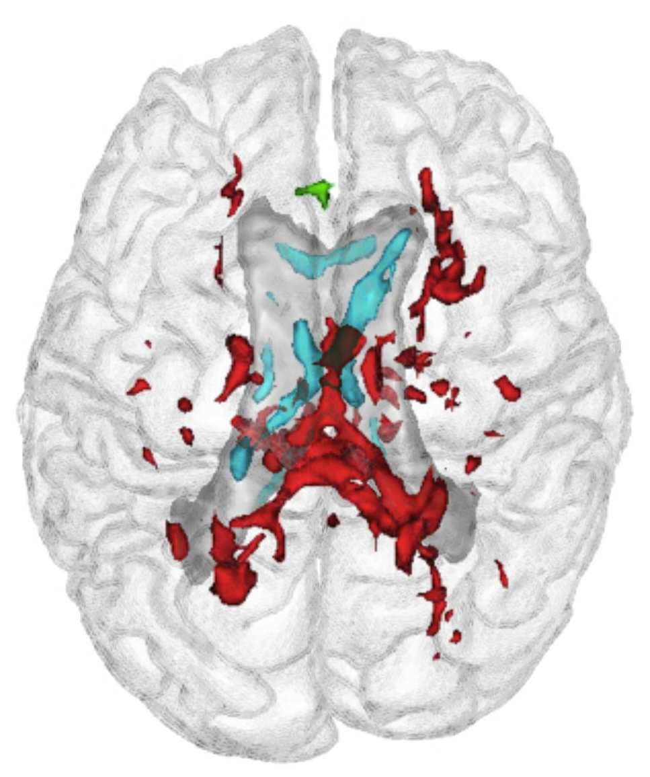
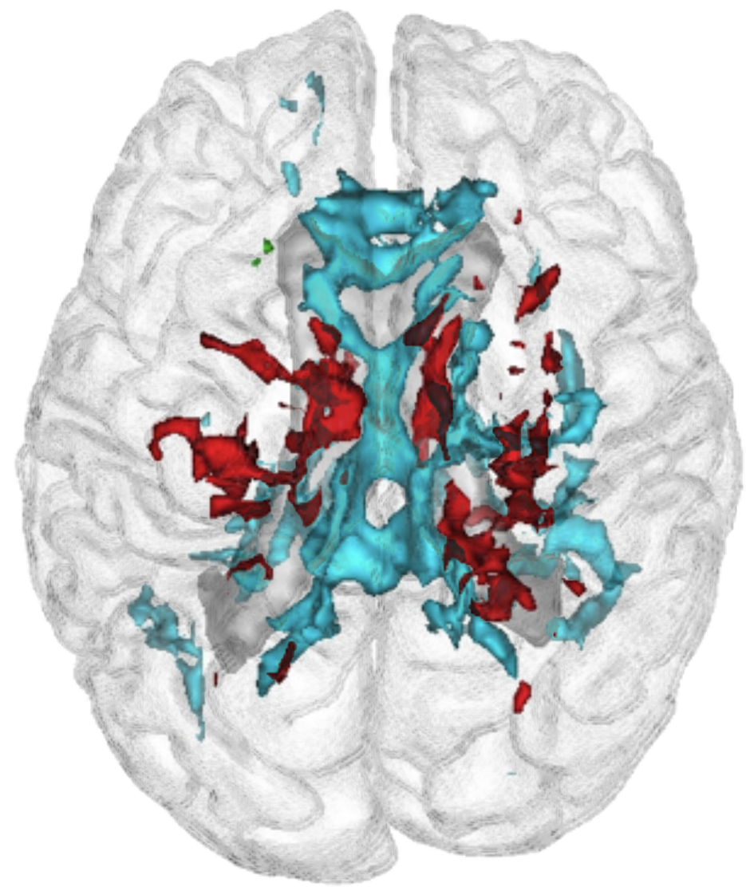
0 vs. 1
1 vs. 2
2 vs. 3
  Course of WM integrity over time
Cumulative effects of VRF
Normal aging WM
WMH penumbra
DTI
0 vs. 1 VRF history
1 vs. 2 VRF history
2 vs. 3 VRF history
WM integrity
Vascular Risk Factors
(VRF)
WMH core
Midlife
Older
Time
Baseline FA
Δ FA
(VRF included hypertension, hyperlipidemia and diabetes mellitus type II)
Seshadri et al., Arch Intern Med, 2001
Jeerakathil et al., Stroke, 2004
Debette et al., Neurology, 2011
Raz et al., Neuropsychology, 2007
Maillard et al., Neurobio Aging, submitted

Slide 13
0 vs. 1
1 vs. 2
2 vs. 3
  Course of WM integrity over time
Normal aging WM
?
WMH penumbra
DTI
WM integrity
Vascular Risk Factors
(VRF)
WMH core
Midlife
Older
Time
Seshadri et al., Arch Intern Med, 2001
Jeerakathil et al., Stroke, 2004
Debette et al., Neurology, 2011
Raz et al., Neuropsychology, 2007
Maillard et al., Neurobio Aging, submitted

Slide 14
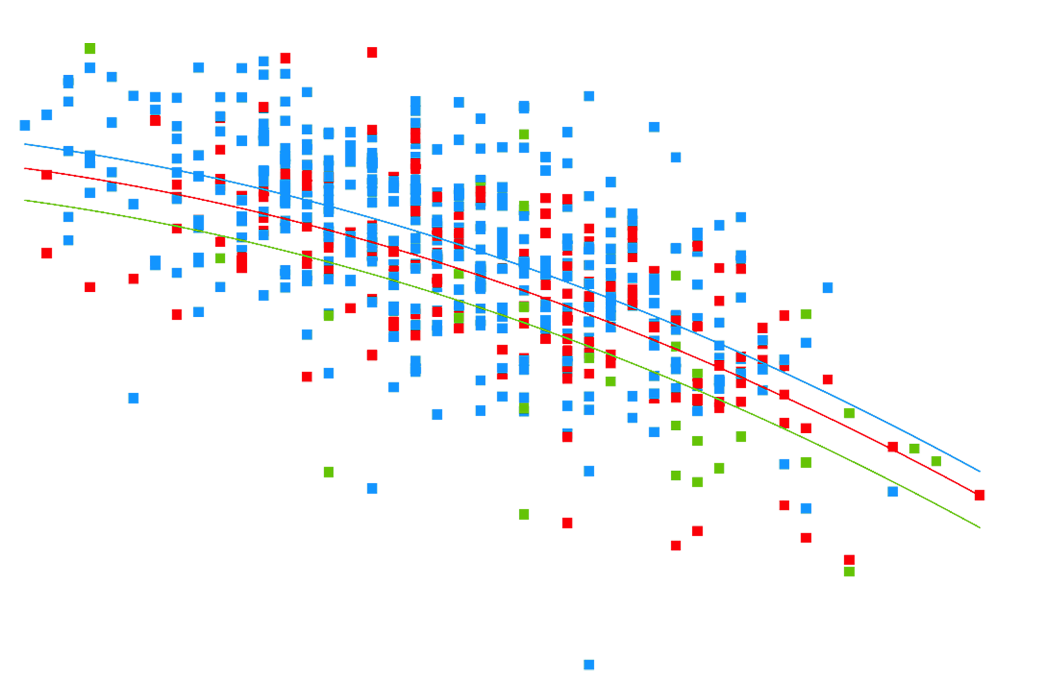
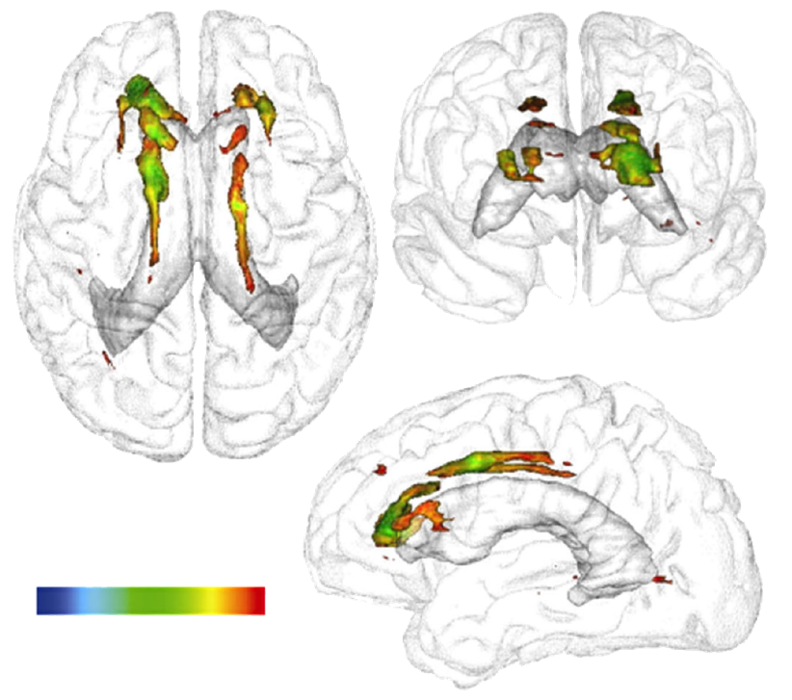
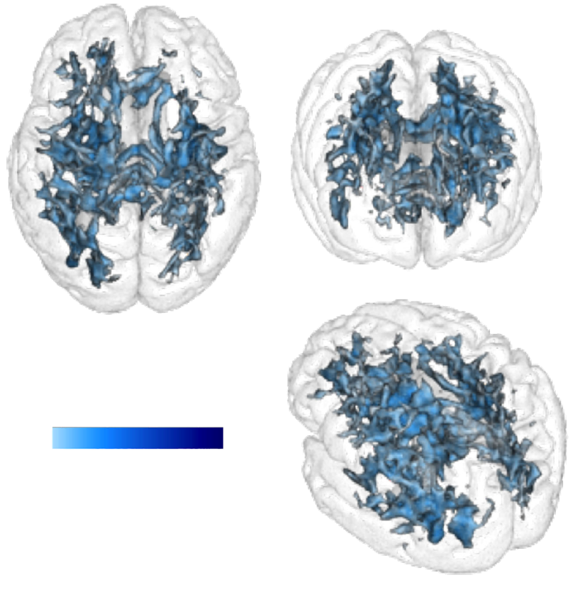
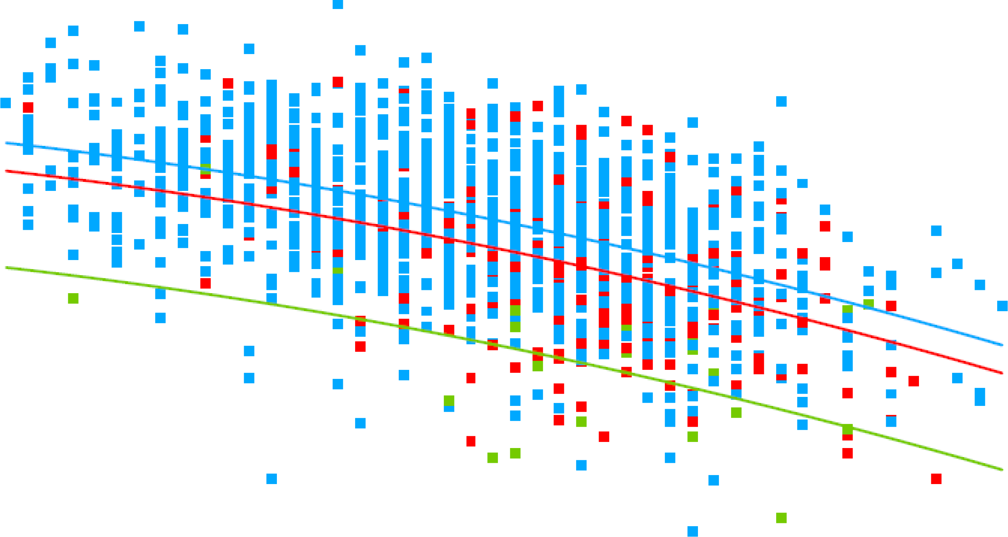
  WM integrity in midlife
The Framingham Heart Study 3rd Generation
SBP
Brain integrity
P value
Normotensive
Pre-hypertensive
Hypertensive
<0.0001
<0.05
20
Age
60
BG
Brain integrity
P value
Normal
Pre-diabetic
Diabetic
<0.0001
<0.05
Maillard et al., Lancet Neurology, 2012
Weinstein et al., Neurology, in revision
20
Age
60

Slide 15
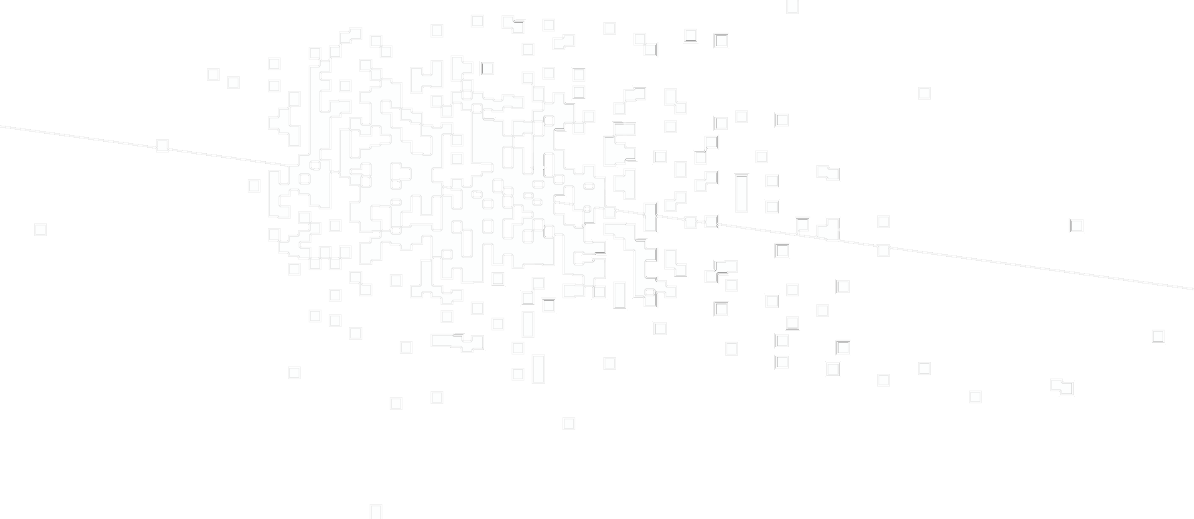

  WM integrity in midlife
The Framingham Heart Study 3rd Generation
SBP
Mean FA
in the corpus callosum
80
SBP (mm Hg)
160
WMH volume
80
SBP (mm Hg)
160

Slide 16
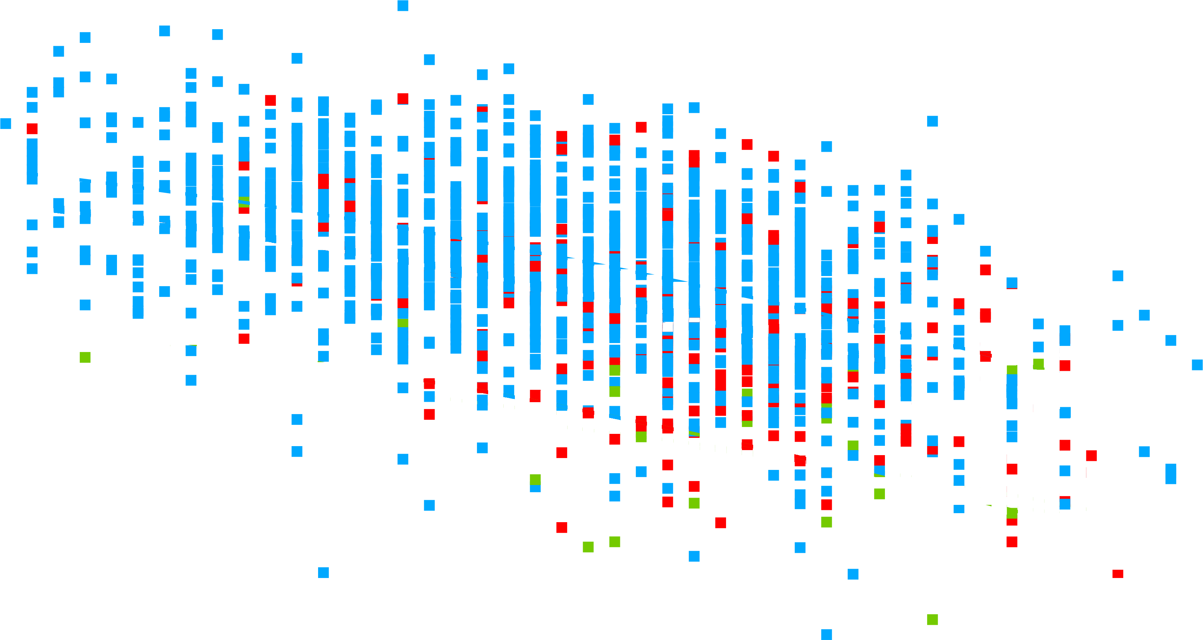
  Perspectives
Normal aging WM
WM integrity
WMH penumbra
WMH core
Midlife
Older
Time
Large variability in the WM degeneration trajectory => need for new candidates
WMH extent and progression: allele APOE e4
WMH heritability: gender and age (Framingham study) and share genetic components with blood pressure trait
WMH GWA study: 5 loci on chromosomes 17q25, 2p21, 10q24, 1q22 and 2p16 (NeuroCHARGE consortium, 21,079 elderly individuals)
Verhaaren et al.,Circ CVG, submitted
Fornage et al., Ann Neurol, 2011
Atwood et al., Stroke, 2004
Turner et al., Hypertension, 2004
Turner et al., Arch Neurol, 2009
de Leeuw et al., Stroke, 2004
Godin et al., Stroke, 2009

Slide 17
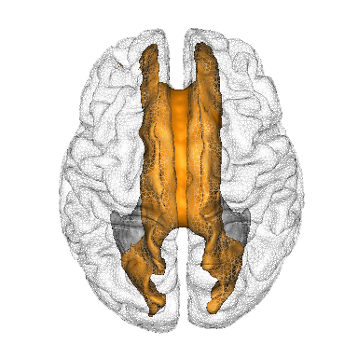
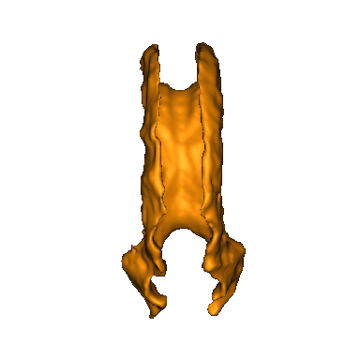
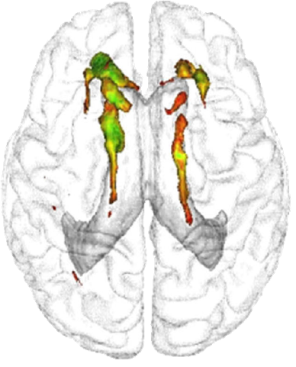
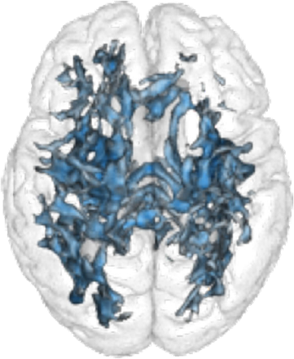
  Perspectives
=> identifying genetic variants that influence white matter microstructure using more subtle measures as provided by DTI
ROI approach:
Measures: DTI derived metrics including FA, mean diffusivity
Target: corpus callosum (body, genu and splenium), fornix?
Hypertension
Hyperlipidemia
Diabetes
Systolic blood pressure
Blood glucose

Slide 18
  Charles DeCarli
  Owen Carmichael
  Evan Fletcher
  Noel Smith
  Oliver Martinez
  Baljeet Singh
  Jing He
  Julia Scott
  Michelle Weinstein
  Rodrigo Sandoval
  Alexandra Monrroy
  Sudha Seshadri
  Philip Wolf
  Rhoda Au
  Alexa Beiser
  Galit Weinstein
  Jayandra Himal
  Claudia Satizabal
  Vincent Chouraki
  Anita DeStefano
  Qiong Yang

Slide 19
References
Maillard P, Fletcher E, Harvey D, et al. White matter hyperintensity penumbra. Stroke 2011;42:1917-1922.
de Groot M, Verhaaren BF, de Boer R, et al. Changes in normal-appearing white matter precede development of white matter lesions. Stroke 2013;44:1037-1042.
Tsao S, Ma S, Michels P, et al. The Power of Hybrid/Fusion Imaging Metrics in Future PACS Systems: A Case Study into the White Matter Hyperintensity Prenumbra using FLAIR and Diffusion MR. Proc Soc Photo Opt Instrum Eng. Apr 9, 2014; 9039: 90390I.
Maillard P, Carmichael O, Harvey D, et al. FLAIR and diffusion MRI signals are independent predictors of white matter hyperintensities. AJNR Am J Neuroradiol 2013;34:54-61.
Duering M, Csanadi E, Gesierich B, et al. Incident lacunes preferentially localize to the edge of white matter hyperintensities: insights into the pathophysiology of cerebral small vessel disease. Brain, 2013 Sep;136(Pt 9):2717-26. doi: 10.1093/brain/awt184. Epub 2013 Jul 17.
Maillard P, DeCarli C, Reed B, et al. White Matter Hyperintensities and their Penumbra Lie Along a Continuum of Injury In The Aging Brain. Stroke, 2014, in press.
Debette S, Seshadri S, Beiser A, et al. Midlife vascular risk factor exposure accelerates structural brain aging and cognitive decline. Neurology. 2011; 77(5): 461-8.
Jeerakathil T, Wolf PA, Beiser A, et al. Stroke risk profile predicts white matter hyperintensity volume: the Framingham Study. Stroke. 2004; 35(8): 1857-61.
Seshadri S, Wolf PA, Beiser A, et al. Elevated midlife blood pressure increases stroke risk in elderly persons: the Framingham Study. Arch Intern Med. 2001; 161(19): 2343-50.
Raz N, Rodrigue KM, Kennedy KM, Acker JD. Vascular health and longitudinal changes in brain and cognition in middle-aged and older adults. Neuropsychology. 2007; 21(2): 149-57.
Maillard P, Seshadri . , Beiser A.S, et al. Effects of Systolic Blood Pressure on White Matter Integrity in Young Adults in the Framingham Heart Study: a cross-sectional study. Lancet Neurology, 2012 Dec; 11(12): 1039-47
Weinstein G, Maillard P, Beiser A.S, et al. Association of Diabetes, Fasting Blood Glucose and Insulin Resistance with Cognitive and Structural Brain Measures in Young Adults: the Framingham Study. Neurology, submitted
Maillard P, Carmichael O, Fletcher E, et al. Co-evolution of white matter hyperintensities and cognitive decline in the Elderly. Neurology, 2012 Jul; 79(5): 442-8
Maillard P, Carmichael O, Reed B, et al. Effects Of Vascular Risk Factor Co-Occurrence On Late-Life White Matter Integrity Changes. Neurobiol Aging, submitted
Fornage M, Debette S, Bis JC, et al. Genome-wide association studies of cerebral white matter lesion burden: The CHARGE consortium. Ann Neurol 2011;69:928-939.
Atwood LD, Wolf PA, Heard-Costa NL, et al. Genetic variation in white matter hyperintensity volume in the Framingham Study. Stroke 2004;35:1609-1613.
Turner ST, Jack CR, Fornage M, Mosley TH, Boerwinkle E, de Andrade M. Heritability of leukoaraiosis in hypertensive sibships. Hypertension 2004;43:483-487.
Turner ST, Fornage M, Jack CR, Jr., et al. Genomic susceptibility Loci for brain atrophy, ventricular volume, and leukoaraiosis in hypertensive sibships. Arch Neurol 2009;66:847-857.
de Leeuw FE, Richard F, de Groot JC, et al. Interaction between hypertension, apoE, and cerebral white matter lesions. Stroke 2004;35:1057-1060.
Godin O, Tzourio C, Maillard P, Alperovitch A, Mazoyer B, Dufouil C. Apolipoprotein E genotype is related to progression of white matter lesion load. Stroke 2009;40:3186-3190.

