Slide 1
Partial derivatives meta-analysis
Improving effect estimation & reducing analytical burden
Arfan Ikram / Hieab Adams
HD-READY

Slide 2
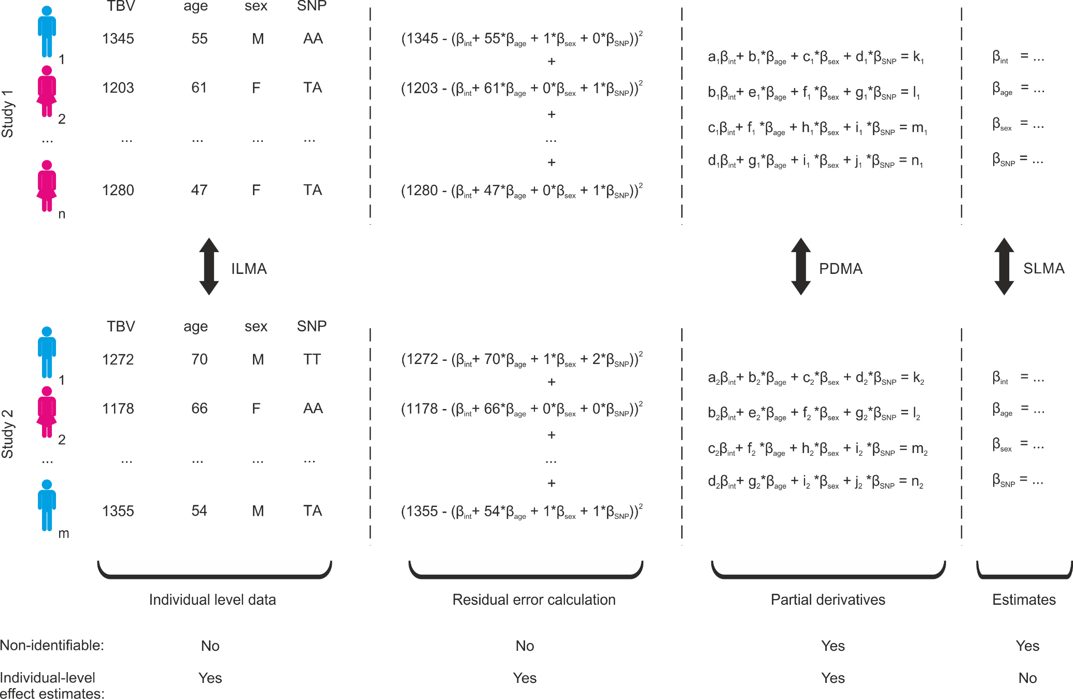
Meta-analytical approaches
ILMA
Individual-level
meta-analysis
SLMA
Study-level
meta-analysis
Notes:
Typically, two methods
In individual-level meta-analysis (ILMA), raw participant data are shared and individual-level estimates are calculated using the pooled data. In study-level meta-analysis (SLMA), only the study-specific effect estimates are provided and (weighted) averaging is used to approximate the effect for all the studies combined. Although the former provides the highest power and accuracy,[4,8,9] it is not always possible to share individual-level data. This can be the case when local legislation blocks the release of collected data, when the process of sharing data forms a logistic problem due to its size, or if its release can lead to the identification of individuals and reveal sensitive medical information.
Although the research community as well as funding agencies put considerable pressure on investigators to make datasets publicly available, not all data can be released upon publication or shared with collaborators. For these datasets, therefore, the raw data cannot be pooled for meta-analysis.

Slide 3
Meta-analytical approaches
Notes:
However, certain summary statistics retain the necessary information for performing ILMA when the sharing of participant data is not possible. Here we describe a meta-analytical method, termed partial derivatives meta-analysis (PDMA), which 1) provides effect estimates that are equivalent to ILMA, 2) does not disclose identifiable participant information, and 3) is easily applicable in current research settings.
To understand this method, it is important to first look how effect estimates are calculated

Slide 4
Linear regression model
Notes:
The rationale and methods are illustrated with a hypothetical research question, in which the aim is to determine whether the risk allele of a particular single nucleotide polymorphism (SNP) of interest is associated with a smaller brain volume. Total brain volume was modelled with linear regression analysis, using age, sex, and the SNP as predictor variables.
Linear regression using ordinary least squares
Linear regression models estimate the effects of predictor variables on the outcome variable by determining the combination of beta coefficients that minimize errors between the observed and predicted values, i.e. fitting the best model to the available data. Considering the example from the sample data, this is represented as:
Here, the total brain volume of participant i (TBV_{i}) is modelled using an intercept (β_{int}) and the predictor variables age, sex, and genotype. The squared residual error between observed and predicted values for participant i, SRE_{i}, is thus defined as:
Summed for every participant

Slide 5
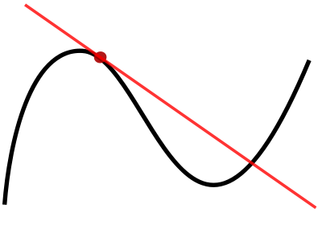
Linear regression model
Partial derivatives
NL: afgeleide
FR: dérivé
DE: Derivat
RU: производная
SP: derivado
HI: यौगिक
Notes:
These squared residual errors for each participant are then added together, generating a single, large residual error equation with the four beta coefficients representing unknown values of interest. For those of you who haven’t recently attended high school: In mathematics, a partial derivative of a function of several variables is its derivative with respect to one of those variables, with the others held constant
For each beta coefficient, the summed squared residual error function is smallest when its derivative with respect to that beta coefficient is equal to zero. This generates the following four (partial) derivatives:
Solving this set of equations gives you the combination of beta estimates that explain most of the variance of you dependent variable, in this case TBV. Basically, this process is what you what describe as fitting a model.

Slide 6
Meta-analytical approaches
Notes:
Every participant contributes to values a-n. Crucial part is that these values are aggregated through simple addition! So if within a study, these values can be added together for every participants, that also means that this same principle can be applied between studies in a two-step process. The values for a-n will be mathematically identical to those obtained after pooling all the individual-level data together.

Slide 7
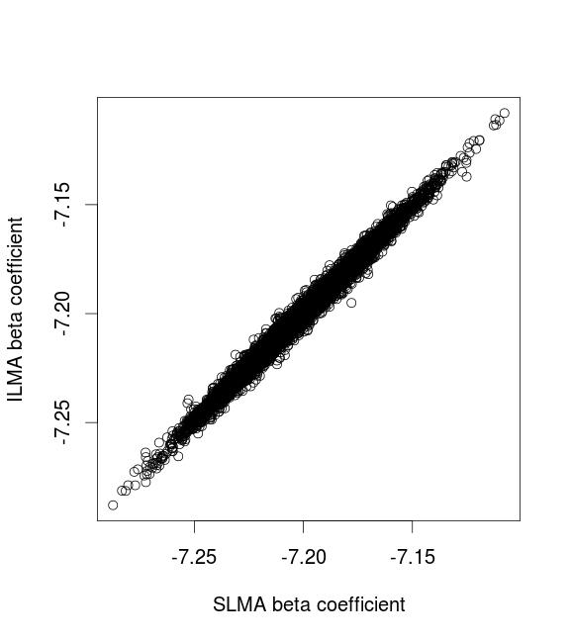
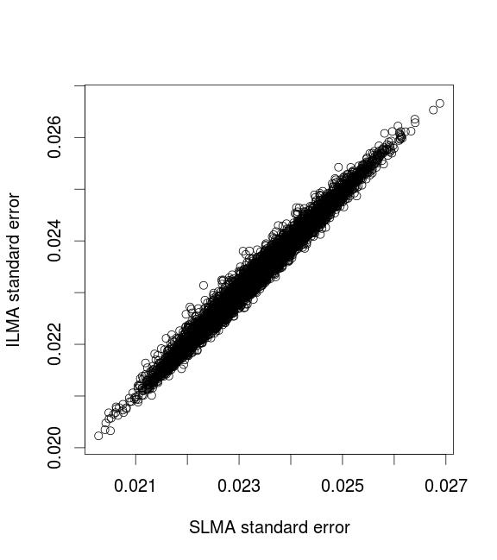
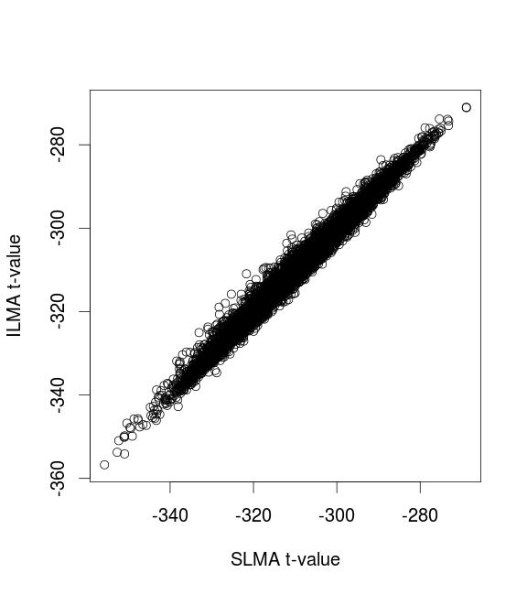

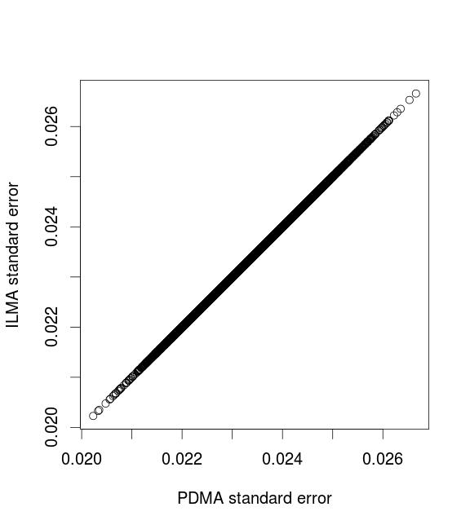
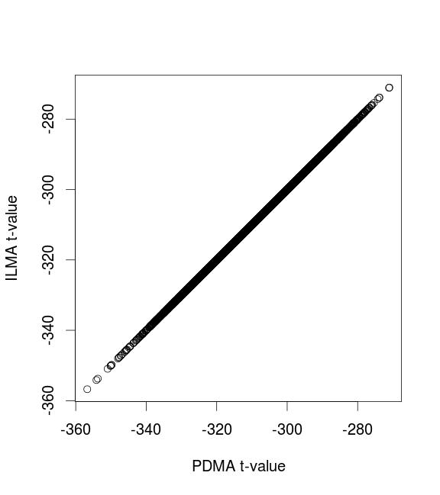
Comparison of simulated data

Slide 8
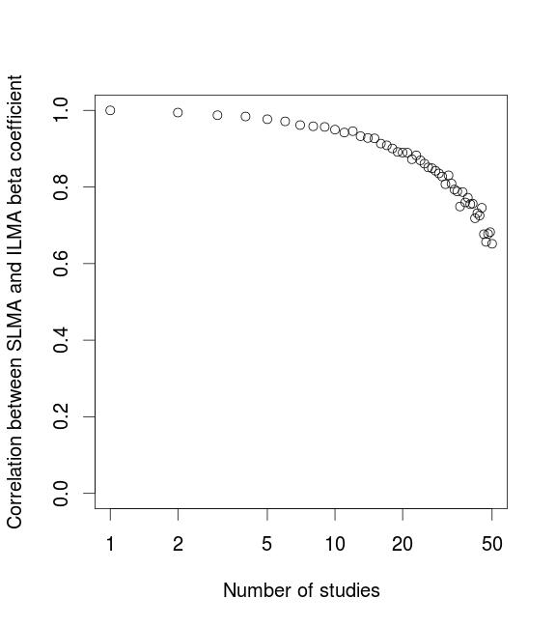
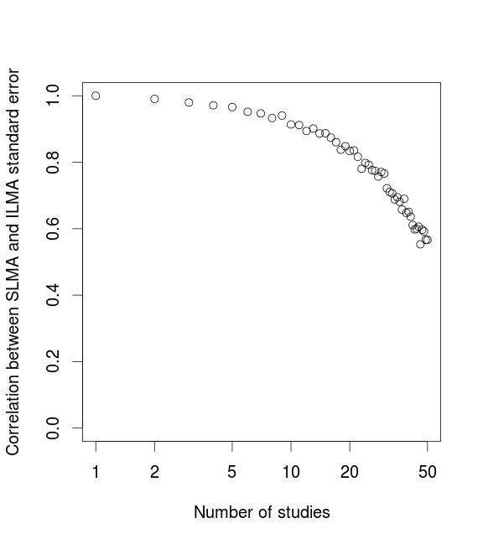
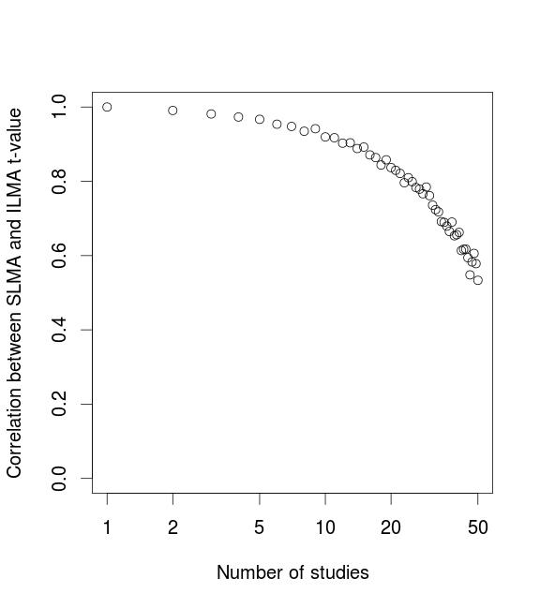
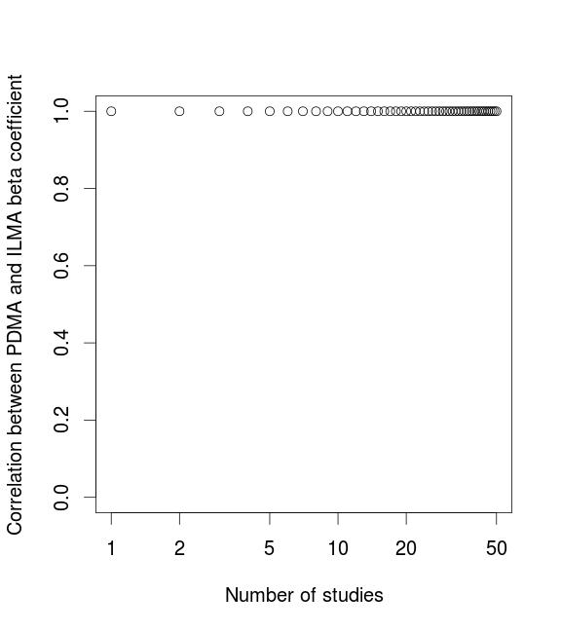
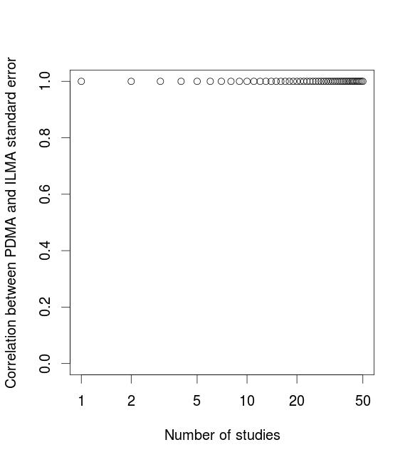
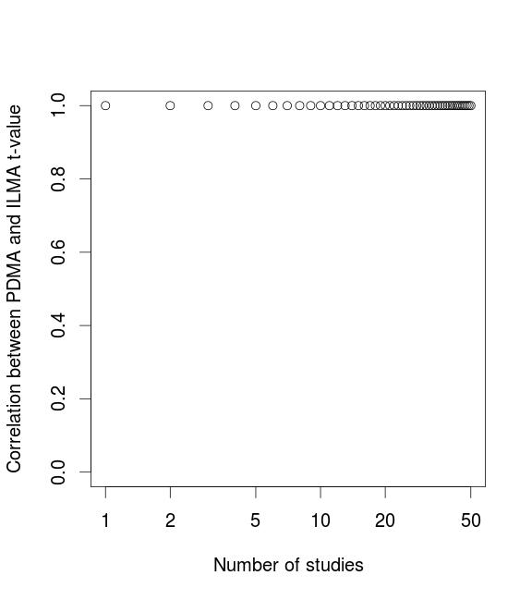
Comparison of simulated data

Slide 9
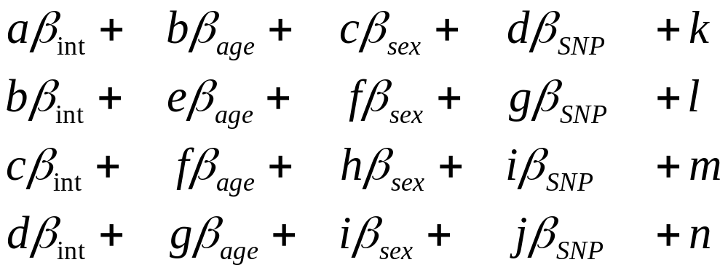
Partial derivatives
Constant values
SNP-specific values equal to the number of covariates
Descriptives
Values that we are already sharing
Symmetrical matrix
Unique values only needed
Notes:
So what are we really sharing?
First: symmetrical matrix, less unique values
Second, some values we are already sharing
Third, if we think of the application: high-throughput analyses, such as GWAS, even more of these values become unnecessary, since they are not dependent on SNP values. This means that the number of values you need to share scales linearly with the number of covariates you have. So the more complex your model, the more column you need to share per SNP.

Slide 10
So what does it all mean?
Partial derivatives meta-analysis:
Provides effect estimates equivalent to ILMA
Is performed using summary statistics
Only requires a ‘partial’ regression to be run
Notes:
Summary stats -> non-identifiable, except in the case of single person: but important to note that even with a single person it is possible to use this method. Currently, some cohorts are not considered to join projects because sample too small (since model would become unstable): this not only reduces the total sample size, but might also cause a bias since you’re selectively including/excluding cohorts based on their size.
Partial regression: imagine GWAS now, where every cohort is running a complete regression analysis for every SNP. What we are doing is first fitting a model for every study separately, and then combining the estimates afterwards. However, what PDMA does is just fit a single model at the meta-analytical level. This means that you don’t need to do the final part of the regression, saving computational time in every site and transferring that burden to the meta-analytical level. Not only that, but there is also no need to even calculate all the values a-n, but only the SNP-specific ones.

Slide 11
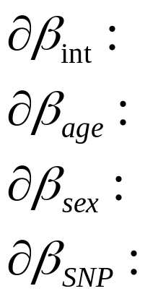
And there’s more…
Model flexibility
Making use of independent error terms
Notes:
Imagine situation where you would have preferred another model, for example without adjustment for sex. What would the partial derivatives look like?
-changing model, e.g. TBV and ICV, Vincent and incident AD (education), WML progressions and baseline load.
Also, if you specify beforehand, it’s possible to do more elaborate analyses such as WML stratified analyses. Another example is the subcortical project, where we discussed excluding people with lacunar infarcts, since those might affect the volumes, but could also reduce our sample size. Eventually, we decided that the burden on cohorts would be too large, since we already asked for 8 GWAS, and this would then become 16.
-random effects

Slide 12
Proof of principle study
Obesity and brain volume:
10,903 persons from 15 cohort studies
rs9939609 variant at the FTO/IRX3 locus
Risk allele was associated with a smaller brain volume
  β = -16.4, p = 9.6x10⁻⁵
Attenuated after adjustment for BMI
  β = -12.9, p = 2.1x10⁻³

Slide 13
From HD-READY to Full-HD
Proof of principle
Fine-tuning of script
Draft manuscript in November
High-throughput analyses
Developing software for ‘partial’ GWAS
Adding additional features
  Heritability estimates
  Other ideas
Notes:
Given the proof of principle, what should be the next steps?

Slide 14
Acknowledgments
JPND Working-group grant
HD-READy (High-Dimensional Research in Alzheimer’s Disease)
NeuroCHARGE MRI Working Group

