Slide 1
Genetic Architecture of Lacunar Stroke

Slide 2
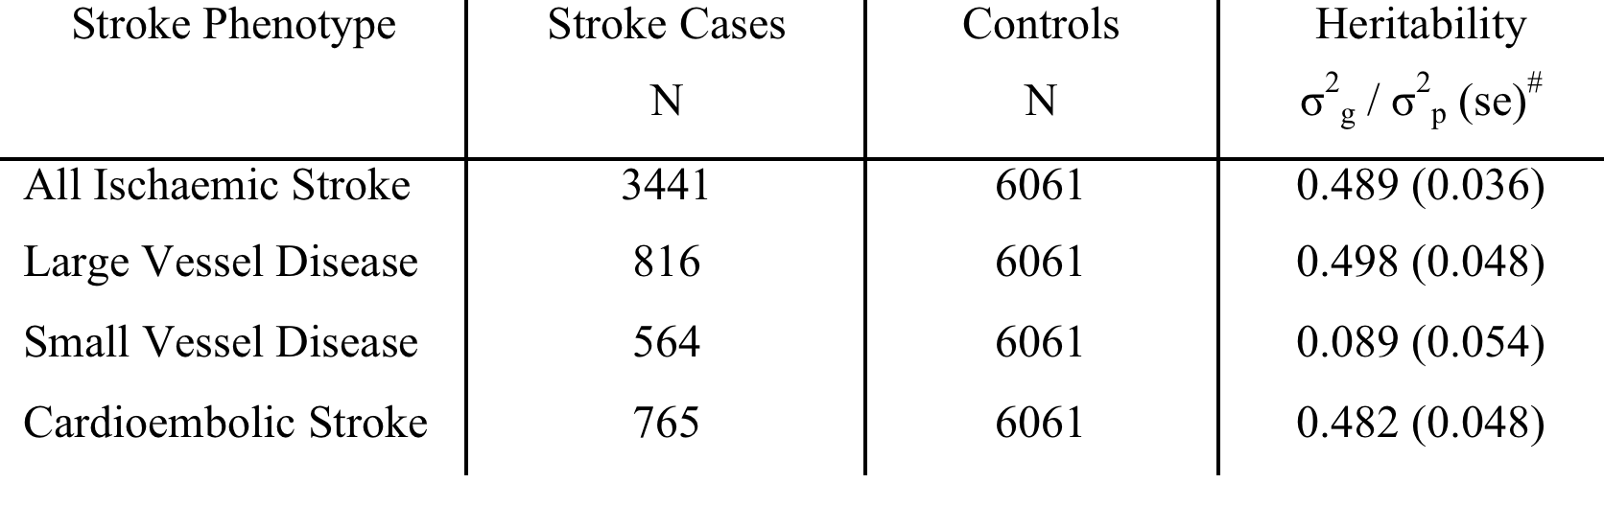
GWAS in lacunar stroke
GWAS in lacunar stroke disappointing compared with other subtypes
Heritability estimates from GWAS data for lacunar stroke low
Bevan et al. Stroke 2012

Slide 3
What going on in lacunar stroke?
Possibilities
Its possible genetic factors not important
BUT :
  Family history data suggests genetic risk is important for SVD
  Mendelian stroke disorders show SVD as commonest stroke subtype
Genetic factors are important but we are missing them
  Heterogeneity in phenotypes
  Diagnostic difficulties
  Rare variants

Slide 4
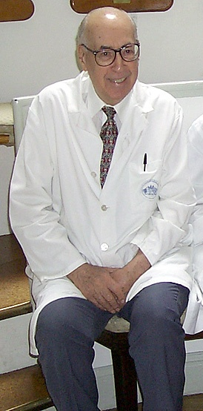
Phenotypic Heterogeneity
Two types of lacunar infarction
Isolated larger lacunar infarction
  perforators 400-900 µm diameter
  microatheroma at origin or proximal perforators
Multiple smaller lacunar infarcts
  perforators 40-200 µm diameter
  Diffuse arteriopathy
  Lipohyalinosis / arteriosclerosis
C Miller Fisher

Slide 5
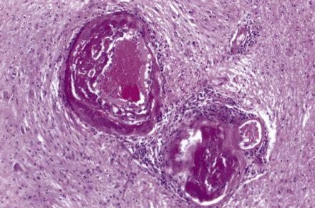
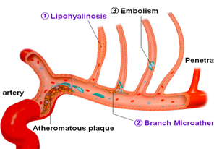
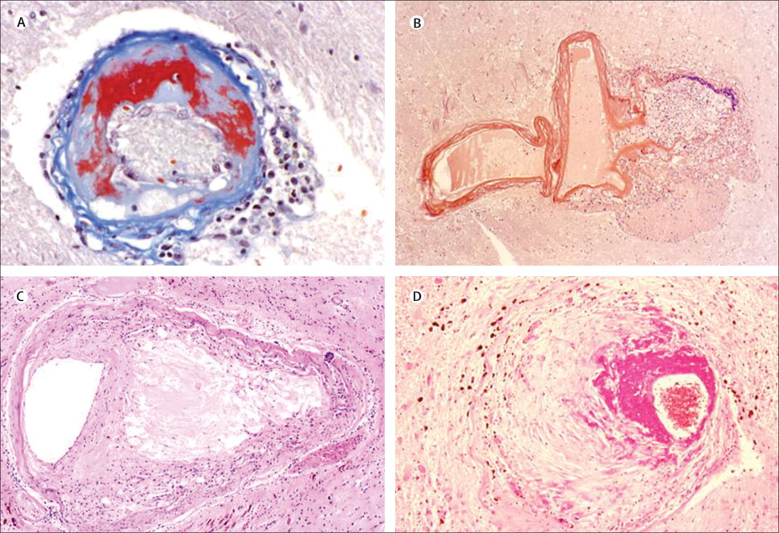
Lacunar infarcts – Possible mechanisms
Embolism
Lipohyalinosis
Perforating artery
Large artery
Atheromatous plaque
Branch microatheroma
Notes:
What is the cerebral small vessel abnormality?
The lacunar hypothesis supports the concept that lacunar ischaemic stroke is due to an intrinsic cerebral arterial abnormality/specific disease of a single perforating vessel.
Early pathological studies in the 1950s by Miller Fisher suggested there are 2 proposed mechanisms. Lipohyalinosis (which he termed as segmental arterial disorganisation – see the loss of normal vessel wall architecture replaced by eosinophic deposit and thickening – small vessels 40-200 um). Note this is different from the concentric thickening that is a feature of most ageing brains. and atherosclerosis (micratheroma), In a small minority embolism is presumed.
Atherosclerosis is thickening of the artery walls as a result of accumulation of fatty materials such as cholesterol and triglyceride.

Slide 6
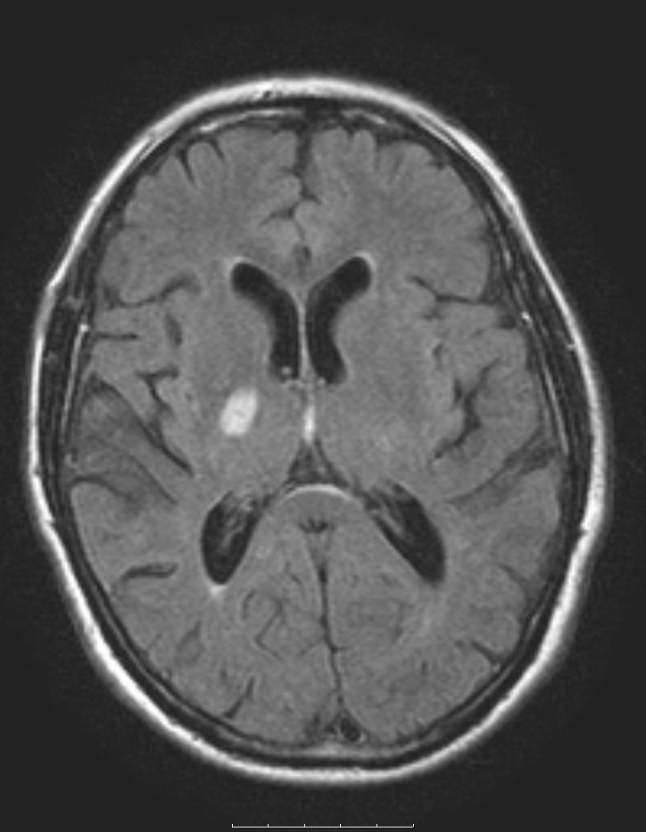
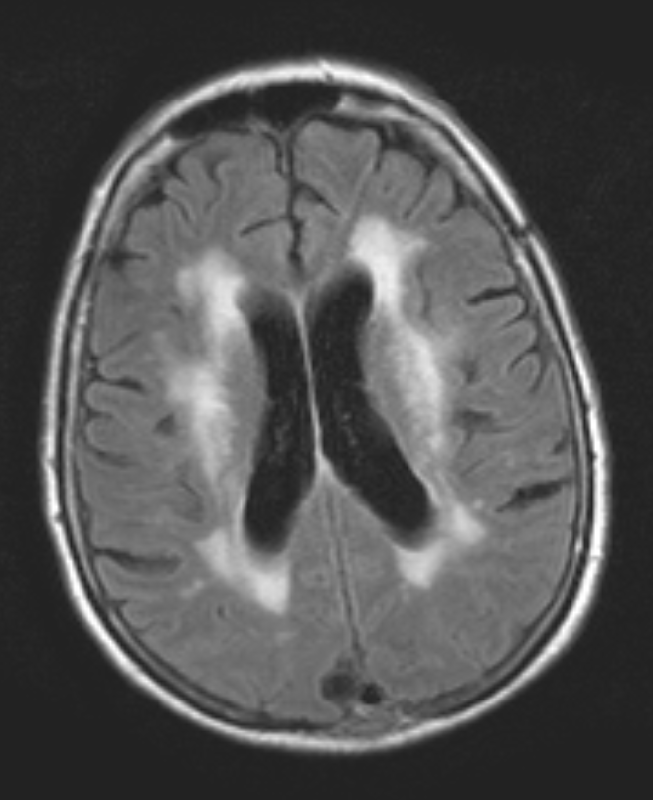
Isolated lacunar stroke
Multiple lacunar infarcts /
Leukoaraiosis variant

Slide 7
Leukoaraiosis subtype v Isolated LI
Khan U JNNP 2007
ILI
(%)
82.7
63.7
70.3
8.1
17.8
7.6
72.3
62.7
ILA
(%)
93.4
72.8
56.3
3.1
9.2
7.0
70.7
61.1
Odds ratio
(95% CI)
3.32 (1.56-7.07)
1.11 (1.09-1.14)
0.45 (0.28-0.74)
0.18 (0.06-0.52)
0.42 (0.21-0.84)
1.15 (0.47-2.83)
1.18 (0.71-1.97)
0.93 (0.57-1.50)
P
0.002
<0.001
0.002
0.001
0.001
0.763
0.518
0.927
Hypertension
Age (years)
Hypercholesterolaemia
Myocardial Infarction
Diabetes
PVD
Smoking
Male gender

Slide 8
MRI phenotyped Lacunar Stroke Dataset
Patients subtyped into two groups:
ILI: isolated lacunar infarct, single lacunar infarct with absent or mild leukoaraiosis (Fazekas grade <2);
MLI / LA: multiple lacunar infarcts (MLI) or lacunar infarct with moderate or severe confluent leukoaraiosis (LA) (Fazekas grade >2)
Centre | Lacunar stroke | ILI | MLI/LI | Number of controls
DNA-lacunar | 1,012 | 501 | 505 | 970
UK-WTCCC2 | 258 | 83 | 175 | 5,175
Germany-WTCCC2 | 37 | 15 | 22 | 797
Leuven | 42 | 21 | 18 | 455
TOTAL | 1,358 | 620 | 720 | 7,804

Slide 9
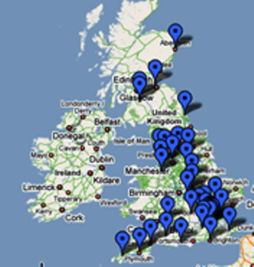
DNA lacunar young stroke study
1000 MRI confirmed lacunar stroke
2000 controls
Detailed phenotyping and MRI images

Slide 10
DNA Lacunar Investigators
Study managers: Josie Monaghan, Samantha Febrey, Alan Zanich, Eithne Smith, Jenny Lennon, St George’s University of London
Database cleaning: Loes Rutten-Jacobs, University of Cambridge
Participating centres (number of enrolled patients per centre; local investigators):
Aberdeen Royal Infirmary, Aberdeen (12; Mary Macleod). Addenbrooke’s Hospital, Cambridge (54; Jean-Claude Baron, Elizabeth Warburton, Diana J Day, Julie White). Airedale General Hospital, Steeton (4; Samantha Mawer). Barnsley Hospital, Barnsley (3; Mohammad Albazzaz, Pravin Torane, Keith Elliott, Kay Hawley). Bart’s and the London, London (2; Patrick Gompertz). Basingstoke and North Hampshire Hospital, Basingstoke (13; Elio Giallombardo, Deborah Dellafera). Blackpool Victoria Hospital, Blackpool (11; Mark O'Donnell). Bradford Royal Infirmary, Bradford (1; Chris Patterson). Bristol Royal Infirmary, Bristol (8; Sarah Caine). Charing Cross Hospital, London (12; Pankaj Sharma). Cheltenham General and Gloucester Royal Hospitals, Cheltenham and Gloucester (10; Dipankar Dutta). Chesterfield Royal Hospital, Chesterfield (4; Sunil Punnoose, Mahmud Sajid). Countess of Chester Hospital, Chester (22; Kausik Chatterjee). Derriford Hospital, Plymouth (4; Azlisham Mohd Nor). Dorset County Hospital NHS Foundation Trust, Dorchester (6; Rob Williams). East Kent Hospitals University NHS Foundation Trust, Kent (22; Hardeep Baht, Guna Gunathilagan). Eastbourne District General Hospital, Eastbourne (4; Conrad Athulathmudali). Frenchay Hospital, Bristol (1; Neil Baldwin). Frimley Park Hospital NHS Foundation Trust, Frimley (6; Brian Clarke). Guy’s and St Thomas’ Hospital, London (14; Tony Rudd). Institute of Neurology, London (25; Martin Brown). James Paget University Hospital, Great Yarmouth (1; Peter Harrison). King's College Hospital, London (16; Lalit Kalra). Leeds Teaching Hospitals NHS Trust, London (125; Ahamad Hassan). Leicester General Hospital and Royal Infirmary, Leicester (9; Tom Robinson, Amit Mistri). Luton and Dunstable NHSFT University Hospital, Luton (16; Lakshmanan Sekaran, Sakthivel Sethuraman, Frances Justin). Maidstone andTunbridge Wells NHS Trust (3; Peter Maskell). Mayday University Hospital, Croydon (14; Enas Lawrence). Medway Maritime Hospital, Gillingham (5; Sam Sanmuganathan). Milton Keynes Hospital, Milton Keynes (1; Yaw Duodu). Musgrove Park Hospital, Taunton (9; Malik Hussain). Newcastle Hospitals NHS Foundation Trust, Newcastle upon Tyne (12; Gary Ford). Ninewells Hospital, Dundee (5; Ronald MacWalter). North Devon District Hospital, Barnstaple (8; Mervyn Dent). Nottingham University Hospitals, Nottingham (17; Philip Bath, Fiona Hammonds). Perth Royal Infirmary, Perth (2; Stuart Johnston). Peterborough City Hospital, Peterborough (1; Peter Owusu-Agyei). Queen Elizabeth Hospital, Gateshead (5; Tim Cassidy, Maria Bokhari). Radcliffe Infirmary, Oxford (5; Peter Rothwell). Rochdale Infirmary, Rochdale (4; Robert Namushi). Rotherham General Hospital, Rotherham (1; James Okwera). Royal Cornwall Hospitals NHS Trust, Truro (11; Frances Harrington, Gillian Courtauld). Royal Devon and Exeter Hospital, Exeter (22; Martin James). Royal Hallamshire Hospital, Sheffield (1; Graham Venables). Royal Liverpool University Hospital and Broadgreen Hospital, Liverpool (9; Aravind Manoj). Royal Preston Hospital, Preston (18; Shuja Punekar). Royal Surrey County Hospital, Guildford (23; Adrian Blight, Kath Pasco). Royal Sussex County Hospital, Brighton (14; Chakravarthi Rajkumar, Joanna Breeds). Royal United Hospital, Bath (6; Louise Shaw, Barbara Madigan). Salford Royal Hospital, Salford (16; Jane Molloy). Southampton General Hospital, Southampton (1; Giles Durward). Southend Hospital, Westcliff-on-Sea (26; Paul Guyler). Southern General Hospital, Glasgow (34; Keith Muir, Wilma Smith). St George’s Hospital, London (108; Hugh Markus). St Helier Hospital, Carshalton (10; Val Jones). Stepping Hill Hospital, Stockport (4; Shivakumar Krishnamoorthy). Sunderland Royal Hospital, Sunderland (1; Nikhil Majumdar). The Royal Bournemouth Hospital, Bournemouth (15; Damian Jenkinson). The Walton Centre, Liverpool (15; Richard White). Torbay Hospital, Torquay (19; Debs Kelly). University Hospital Aintree, Liverpool (19; Ramesh Durairaj). University Hospital of North Staffordshire, Stoke-on-trent (16; David Wilcock). Wansbeck General Hospital and North Tyneside Hospital, Ashington and North Shields (6; Christopher Price). West Cumberland Hospital, Whitehaven (6; Olu Orugun, Rachel Glover). West Hertfordshire Hospital, Watford (20; David Collas). Western General Hospital, Edinburgh (12; Cathie Sudlow). Western Infirmary, Glasgow (33; Kennedy R. Lees, Jesse Dawson). Wycombe Hospital and Stoke Mandeville, High Wycombe (20; Dennis Briley and Matthew Burn). Yeovil District Hospital, Yeovil (46; Khalid Rashed). York Teaching Hospital, York (1; John Coyle).

Slide 11
Genetic analysis
All cases genotyped on Illumina HumanExome Core
Imputed to 1000 Genomes phase 1 integrated set (~9M SNPs)
 | All Lacunar | MLI / LA subtype | ILI subtype | Controls
N | 1012 | 502 | 501 | 964
Age (mean (sd)) | 57.2 (9.6) | 59.5 (9.1) | 54.7 (9.2) | 59.7 (4.3)

Slide 12
  SNP Heritability
  Heritability analysis using GCTA
 |  | K=0.2% | K=0.6%
Phenotype | N (case/control) | h² (SE) | h² (SE) | p-value
Lacunar stroke | 1012 / 964 | 0.20 (0.064) | 0.25 (0.080) | 0.00054
MLI / LA subtype | 502 / 964 | 0.23 (0.087) | 0.28 (0.11) | 0.0035
ILI subtype | 501 / 964 | 0.15 (0.084) | 0.18 (0.10) | 0.029
  K, prevalence of lacunar stroke

Slide 13
Heritability by eQTLs and regulatory regions
Is an excess of heritability explained by SNPs that affect transcription and regulation?
Use RegulomeDB database to partition data on known eQTLs and regulatory regions:
  eQTLs defined as SNPs shown to affect expression of any gene + overlap transcription factor binding site, DNAse footprint or DNAse peak from ENCODE (N=24,722 (3.0% of SNPs))
  Regulatory regions defined as SNPs which overlap a transcription factor binding site and DNase peak, as well as either having a matched transcription factor motif and/or a matched DNase footprint (N=938,693 (11.6% of all SNPs))
  strongly tagging SNPs with r²>0.98 also included

Slide 14
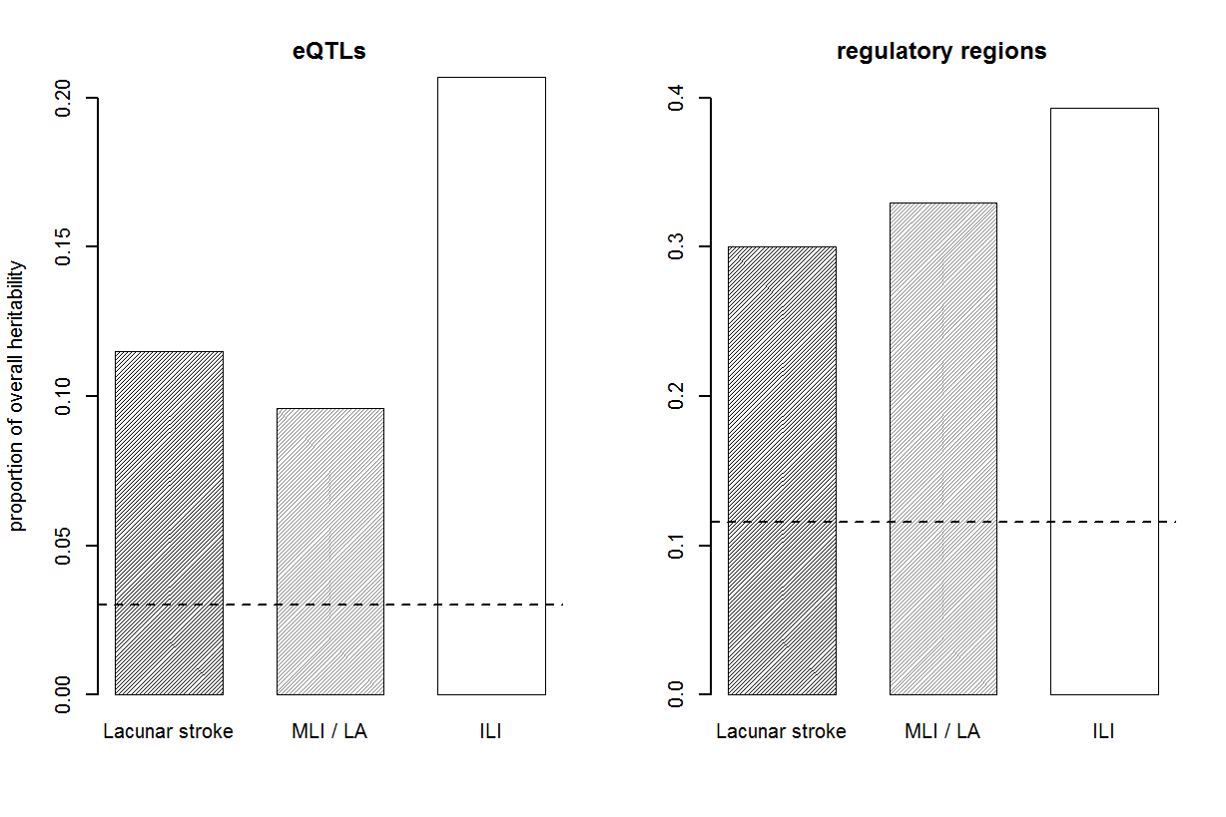
dotted line indicates expected proportion of heritability, given the number of SNPs used
excess of heritability explained by eQTLs and regulatory regions

Slide 15
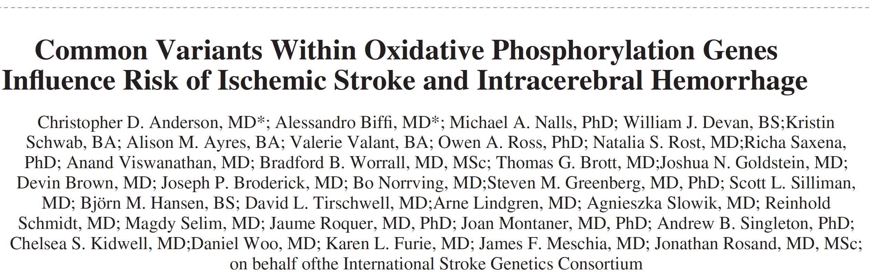

Oxidative phosphorylation pathway
Previously shown to be associated with SVD stroke
We test for enrichment of OXPHOS genes in our dataset:
Test for excess of OXPHOS genes in top 1%, 5%, 10% of all genes + use GSEA approach
P-values derived from randomly sampling gene sets of same size as OXPHOS

Slide 16
Oxidative Phosphorylation Pathway
Gene Set | Phenotype | Enrichment at 1% | Enrichment at 5% | Enrichment at 10% | GSEA
OXPHOS | Lacunar Stroke | 0.07 | 0.27 | 0.43 | 0.05
 | MLI / LA | 0.0017** | 0.07 | 0.55 | 0.74
 | ILI | 1 | 0.50 | 0.83 | 0.61
  oxidative phosphorylation pathway association is with MLI/LA subtype

Slide 17
Conclusions
Lacunar stroke, when verified by MRI, is heritable
A significant proportion of heritability is from SNPs affecting the regulation of genes
OXPHOS association is with MLI/LA subtype in isolation
Rare genetic variants contribute to risk of lacunar stroke subtypes
  this is not identified when the subtypes are combined
There appears to be genetic heterogeneity within the lacunar stroke subtype
The genetic architecture of the ILI and MLI/LA subtypes looks different

Slide 18
Future plans
GWAS in subtypes of lacunar stroke
Increase sample sizes:
Additional Cohorts
SIGN : SVD with lacunes
CHARGE silent brain infarcts
Any with lacunar stroke and MRI available for review welcome
Overlap with ICH
Centre | Lacunar stroke | ILI | MLI/LI | Number of controls
DNA-lacunar | 1,012 | 501 | 505 | 970
UK-WTCCC2 | 258 | 83 | 175 | 5,175
Germany-WTCCC2 | 37 | 15 | 22 | 797
Leuven | 42 | 21 | 18 | 455
TOTAL | 1,358 | 620 | 720 | 7,804

Slide 19

Acknowledgements
Cambridge
Matthew Traylor
Steve Bevan
Boston
Chris Anderson
Jonathan Rosand
KCL
Cathryn Lewis
WTCCC2 stroke group
Martin Dichgans, Rainer Malik
Cathie Sudlow
Peter Rothwell
Leuven
Vincent Thijs, Robin Lemmnes
DNA Lacunar collaborators

Slide 21
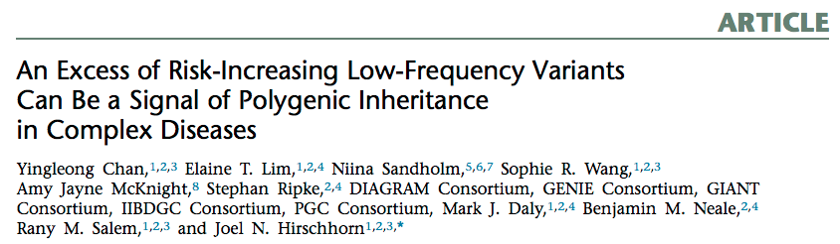
Polygenic contribution from rare variants
Define protective variants as those where the major allele is associated with disease and risk variants as those where the minor allele is associated with disease
Under the null, an equal proportion of genetic associations should be from either protective or risk variants
An increase in the ratio of risk to protective variants at low allele frequencies can indicate a polygenic contribution from low-frequency variants to disease risk

Slide 22
Polygenic contribution from rare variants
 |  | Lacunar stroke |  |  | MLI / LA subtype |  |  | ILI subtype
Freq (%) | p-value cutoff | O (R/P) | E (R/P) | p-value | O (R/P) | E (R/P) | p-value | O (R/P) | E (R/P) | p-value
1-5 | 0.05 | 1.02 | 0.99 | 0.15 | 1.30 | 1.20 | 0.007** | 1.23 | 1.20 | 0.19
5-10 | 0.05 | 0.99 | 0.99 | 0.56 | 1.10 | 1.00 | 0.004** | 1.14 | 1.00 | <0.001**
30-50 | 0.05 | 1.00 | 1.00 | 0.51 | 1.01 | 1.02 | 0.62 | 1.02 | 1.02 | 0.49
O (R/P), observed risk to protective ratio; E (R/P), expected risk to protective ratio.
  An excess of rare variants are risk variants in the two subtypes, but NOT for lacunar stroke as a whole
  => implies polygenic contribution from rare variants to the subtypes

