Slide 1
International Stroke Genetics Consortium
Outreach Committee:
Jennifer Majersik, Salt Lake City, USA
Agnieszka Slowik, Krakow, Poland
Juan Jose Martin, Cordoba, Argentina

Slide 2
Our activity
Letterhead
An updated flyer
Letter of Invitation

Slide 3


Slide 4
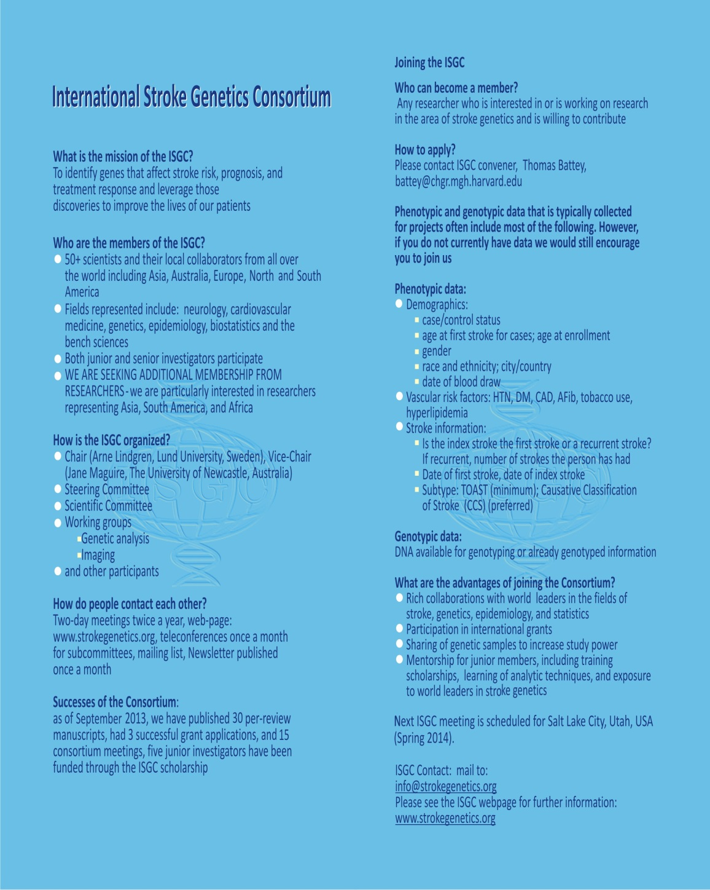

Slide 5
Arne Lindgren, MD, PhD
Chair of the International Stroke Genetics Consortium
Professor of Neurology
Department of Clinical Sciences Lund, Neurology
Skane University Hospital
SE-221 85 Lund
Sweden
arne.lindgren@med.lu.se
May 5, 2013
Dear dr ….
I am writing this letter as Chair of the International Stroke Genetics Consortium (ISGC) to invite you and your team to join our collaborative international research group focused on stroke genetics.
The ISGC was founded in 2007 in Boston. Its main purpose is to identify genetic influence on stroke risk, prognosis, and treatment response. In order to bring increased power and reliability to our studies, the ISGC has brought together prominent researchers from around the world. ISGC members now include more than 50 scientists and their local collaborators from all over the world and represent neurology, cardiovascular medicine, genetics, epidemiology, biostatistics and the bench sciences. Our members come from leading centers in Asia, Australia, Europe, and North and South America. As of February 2013, the ISGC group has published more than 20 peer-review manuscripts, has had several successful grant applications and organized 14 Consortium meetings. Detailed information on ISGC is available on www.strokegenetics.org.
The quality of genetics studies increases with the number of cases and controls with detailed phenotypic information. Despite our great successes in a short few years, we recognize that our Consortium and the science of stroke genetics would benefit from more cases and controls representing broader geographic and ethnic diversity, and also from addressing new questions and using new methods in stroke genetics research.. Thus we are looking for additional research scientists and centers from all over the world to join and participate in the ISGC. This participation could include bringing samples and phenotypes to joint projects or enriching the group with new ideas and collaborative energy. We are an open organization with scientific and creative contributions recognized in our publications. Junior investigators are welcome and are mentored by senior members.
It would be very valuable for the ISGC Consortium and future research on stroke genetics if you would be able to join the group. If you are interested in joining the ISGC or have any questions, please contact me or the ISGC convener, Thomas Battey (info@strokegenetics.org).
Sincerely,
Arne Lindgren

Slide 6
Future directions:
Distribution of the invitation for joing the consortium by:
Letter of Invitation (through local members of the ISGC) to investigators publishing in the field
Flyers distributed during the meetings
Advertisements in the neurological journals?

Slide 7
Future directions
The process of acceptance of the new members
-all researchers interested to become new members will be automatically accepted
Someone from the Outreach Committee will contact them to discuss what ISGC is and about the role the would like to play
Each month on the call they will be introduced to the Committee, during meetings they will be recognized

