Slide 1
GISCOME – Results
Steve Bevan
On behalf of the GISCOME Investigators
Paris November 2014

Slide 2
Introduction
GISCOME – Genetics of Ischaemic Stroke Outcome
Are there genetic determinants of recovery after stroke?
Primary Outcome 1 defined by mRS score 60-190 days post stroke
Primary Outcome 2 includes death prior to 60 days
Analysis controlled for age, gender and stroke severity (NIHSS baseline)
Stroke severity acts as a proxy for stroke subtype

Slide 3
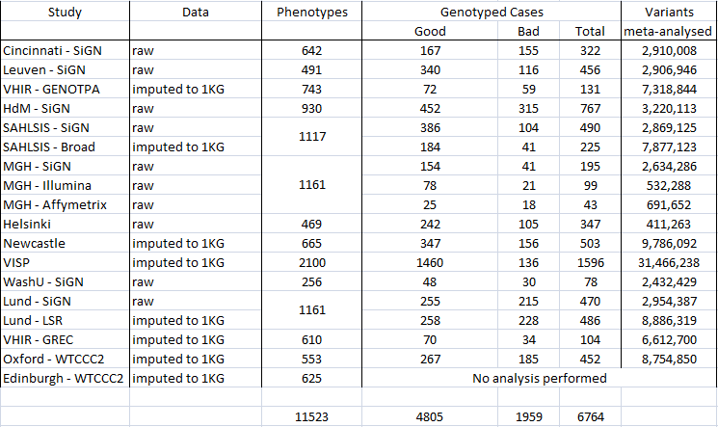
Primary Outcome 1
Outcome 60-190 days, mRS 0-2 = good, mRS 3-6 = bad
Controlled for Age, Gender and Stroke severity (NIHSS baseline)

Slide 4
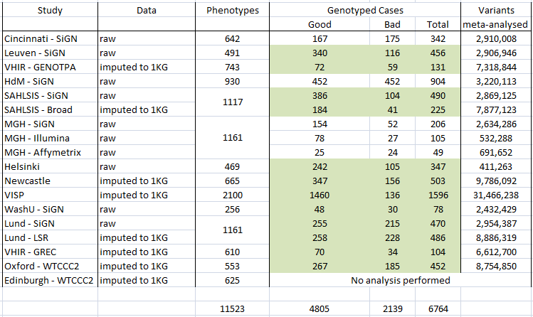
Primary Outcome 2
Outcome 60-190 days including death < 60 days, mRS 0-2 = good, mRS 3-6 = bad
Controlled for Age, Gender and Stroke severity (NIHSS baseline)

Slide 5
Preliminary Results
Primary 1 – 4,805 good versus 1,959 bad
Primary 2 – 4,805 good versus 2,139 bad
Fixed effects meta-analysis using METAL, results examined in 4+ cohorts and 9+ cohorts

Slide 6
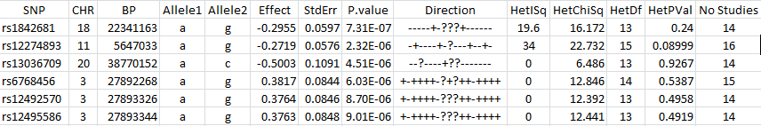
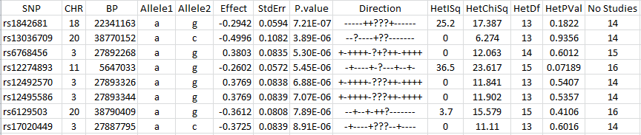
9+ studies – hits below 1 x 10⁻⁶
Primary 1
Primary 2

Slide 7
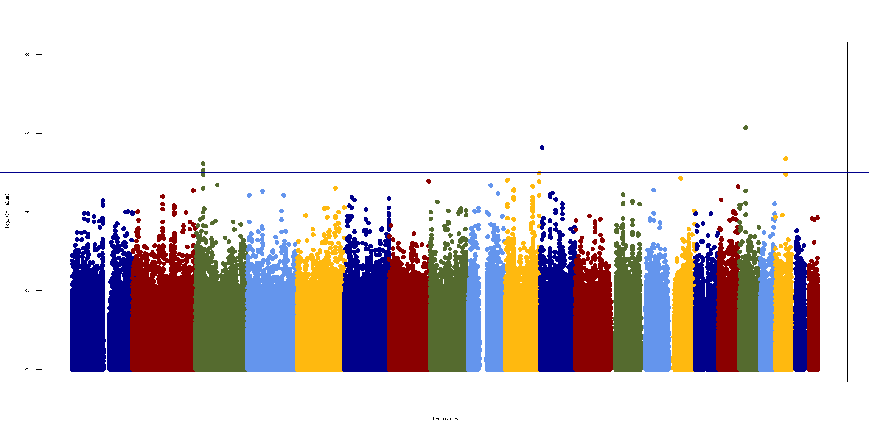
Primary 1, hits within 9 or more of 17 cohorts
0 within 100kb
TRIM34
0 within 100kb

Slide 8
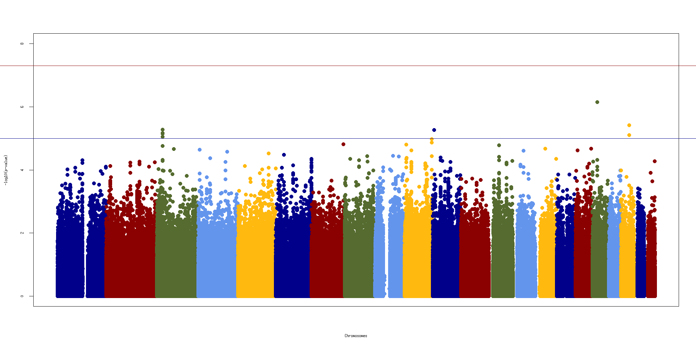
Primary 2, hits within 9 or more of 17 cohorts
0 within 100kb
TRIM34
0 within 100kb

Slide 9
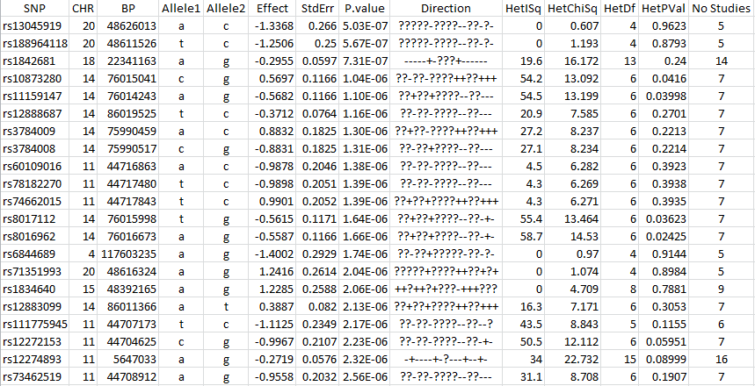
4+ studies – hits below 1 x 10⁻⁶
Primary 1 – 63 SNPs below 1x10⁻⁶
Top 22 SNPs show 3 main ‘peaks’ on chr 20, 14 and 11

Slide 10
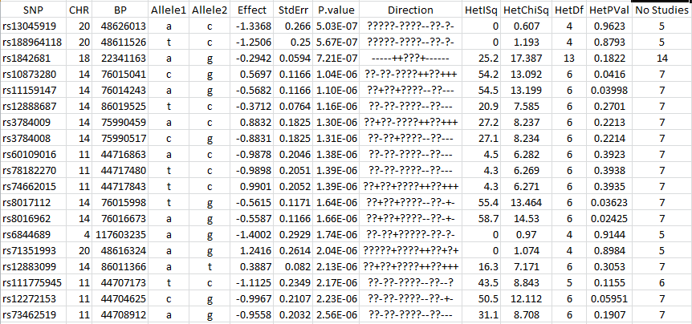
4+ studies – hits below 1 x 10⁻⁶
Primary 2 – 65 SNPs below 1x10⁻⁶
Top 19 SNPs show 3 main ‘peaks’ on chr 20, 14 and 11

Slide 11
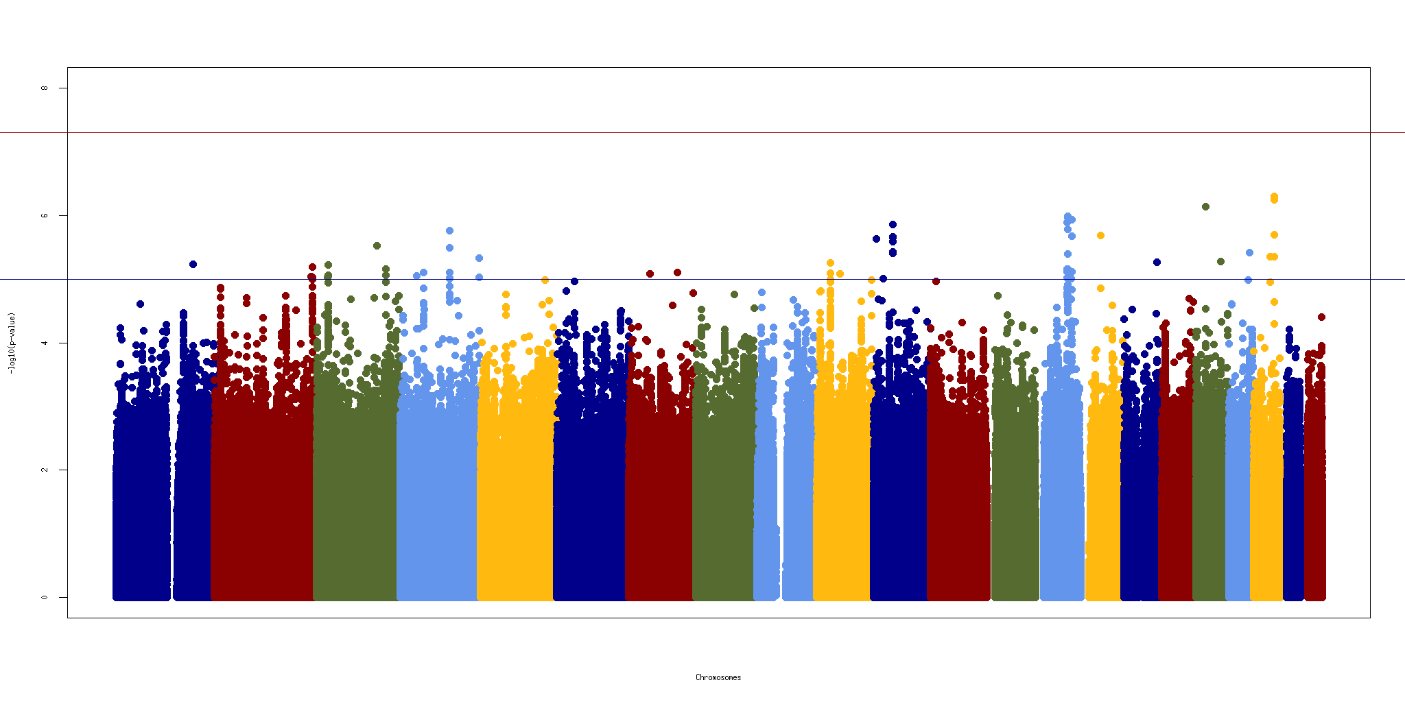
Primary 1, hits within 4 or more of 17 cohorts
0 within 100kb
0 within 100kb
TSPAN18
BATF, FLRT2
SNAI1
TRIM34

Slide 12

Primary 2, hits within 4 or more of 17 cohorts
0 within 100kb
0 within 100kb
TSPAN18
BATF, FLRT2
SNAI1

Slide 13
Discussion
To Do:
- Generate detailed plots of the 3 regions to look at LD
- Examine genetic heterogeneity of stroke outcome
- Seek imputed data from all cohorts
To Consider:
- Increase in sample size
- Additional novel samples with outcome data?
- Fold in non-Caucasian samples akin to SiGN?
Subtype analyses , is severity as a covariate a good proxy?
Outcome ‘good’ modified by baseline severity?
- Widen the 60 – 190 day window of outcome measures?
- 125 cases with data < 60 days only
- 565 cases with data > 190 days only
- 119 cases with data < 60 days and > 190 days
- 56 cases died at time unknown

