Slide 1
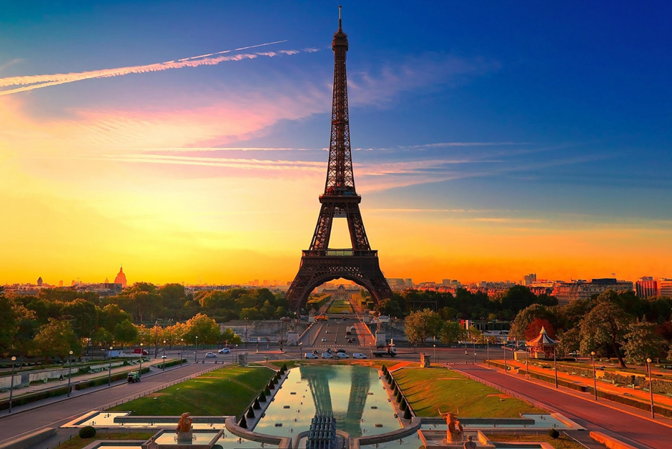


Chair’s Welcome address
ISGC 16th Workshop
Paris, France
November 6-7 2014
Associate Professor Jane Maguire
University of Newcastle
Faculty of Health and Medicine
Newcastle, Australia

Slide 2
Overview of Paris Program
Host: Dr Stephanie Debette, Co-Host Dr Guillaume Pare,
    Scientific Committee and local Paris team
Invited speakers
  Roderick Corriveau, NIH/NINDS (Bethesda, USA): Vascular Contributions to Cognitive Impairment and Dementia (VCID), Genetics and Stroke/Alzheimer’s Synergy
  Josee Dupois, (Boston University, USA): Association and meta-analysis strategies for rare variants
  Elisabeth Tournier-Lasserve, (Lariboisiere Hospital, Paris): Genetics of monogenic small vessel disease: what’s new?
  Scientific Focus….
    GWAs results, stroke, associated endophenotypes
    Small vessel disease
    Analytic techniques progress
    Large consortia, GWAs, lessons and results
    Rare variant analysis
    Biobanking efforts

Slide 3
Founding principles….
7th year, initially established in 2007.
Founding Chair: Prof Jonathan Rosand
Guiding principles
Cerebrovascular disease is a complex disorder influenced by variation in many genetic and non-genetic exposures, each of which contributes only a small influence on disease risk. Therefore large (larger than any single centre can assemble on its own) well-characterised samples will be necessary to discover these exposures.
ISGC is open to all who can contribute
All contributions will be fairly recognised in publication
We work together in a spirit of co-operation and open communication in order to promote the best science in the present and the best science in the future

Slide 4
Governance
Statutes developed in Krakow 2012.
http://www.strokegenetics.org/
Informal
Support 6/12 monthly Scientific Workshops, Working groups.
ISGC Steering Committee (SC) (8 members)
Adjuncts
  ISGC Convenor: Thomas Battey
  ISGC Webmaster: Steve Bevan
  Scientific Committee Chair and Co chair
  Working groups Representative
    Analytic working group
    Imaging working group
    Outreach working group- Chair nominations welcome
    Translational Science working group
Monthly TC
ISGC Scholarship
Newsletters/Minutes available on ISGC websit

Slide 5
Elections due
Committee has 8 elected members
TWO new members required, 2 year term, active involvement in meeting every second month
Process of election
  Self nominate
  Be nominated by a friend…..
  Please advise me or Dan Woo (Vice Chair) by 1000 today if you would like to be considered
  Conduct anonymous Poll online today
  Members present at this meeting eligible to vote
  Results announced at General Assembly tomorrow

Slide 6
ISGC Steering Committee- who are we?
Steering Committee:
Jane Maguire (Chair) Dan Woo (Vice-Chair),
  Arne Lindgren (Previous Chair),
  James Meschia, (outgoing)
  Guillaume Paré,
  Agnieszka Slowik, (outgoing)
  Cathie Sudlow,
  Israel Fernandez-Cadenas,
Adjuncts and invited guests:
Thomas Battey, Steve Bevan, Jennifer Majersik, Paul Nyquist, Jonathan Rosand, Stephanie Debette, Brad Worrall, Christopher Anderson, Natalia Rost, Sudha Seshadri , Christina Jern

Slide 7
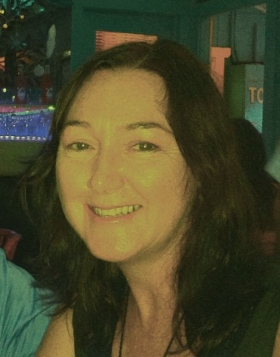
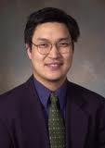
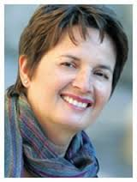
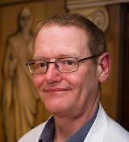
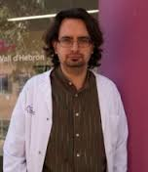
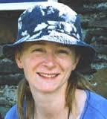
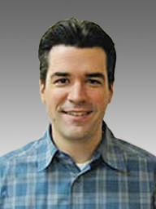
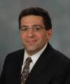
Jane Maguire (Chair)
Dan Woo (Vice-Chair)
Arne Lindgren (Past Chair)
Agnieszka Slowik
James Meschia
Israel Fernandez-Cadenas
Cathie Sudlow
Guillaume Pare

Slide 8
ISGC Scientific Committee
Stephanie Debette (Co-Chair/Current Host)
Guillaume Paré (Incoming Host Co-Chair)
Jane Maguire, (Chair ISGC)
Myriam Fornage,
Christina Jern,
Arne Lindgren
Jenny Majersik
Paul Nyquist

Slide 9
ISGC Activities 2014
6/12 Workshops
  15th Workshop, Salt Lake City, Utah , 2014, Host, Jennifer Majersik
  16th Workshop, 2014, Paris, Host Stephanie Debette
  17th Workshop, 2015 Hamilton, Canada, Host Guillaume Pare
  18th Workshop ,2015 Barcelona, Host Israel Fernandez
2014 Grants submitted, multiple collaborative efforts…
  R24 Grant cross continent
  NHMRC (Australia)
  Others…
Conferences attendance planned for 2014
  ISC San Diego,
  ESC,
  Stroke Society of Australasia,
  WSF and more…
  Manuscripts
  Over 16 published articles on behalf of ISGC for 2014
  19 In press 2014
  MS TITLE: Recommendations from the International Stroke Genetics
  Consortium, Part 1: Standardized Phenotypic Data Collection, Stroke
  MS TITLE: Recommendations from the International Stroke Genetics Consortium, Part 2:
  Biological Sample Collection and Storage, Stroke

Slide 10
ISGC Directions 2014
Key directions 2014 | Activity
Centralised infrastructure/ common project | R24 grant - Pipeline for individual level data Rosand team, Guido Falcone
Networking and Outreach | Welcome letters Introduce new members at each workshop Expanded Working group membership > 15 Broader International Scope Nominations for Chair now open
Scientific Directions | Focussed role of Scientific Committee, separated from Steering Committee Improved support for in coming hosts Increase planning period to at least 12 months prior
Translational Science Working group | Functioning since Utah, Chaired by Chris Anderson
New ISGC Scholarship establishment | Minority group representation Small donation ($20 US) at next workshop registration, no obligation, administered by host site

Slide 11
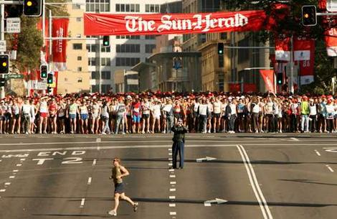
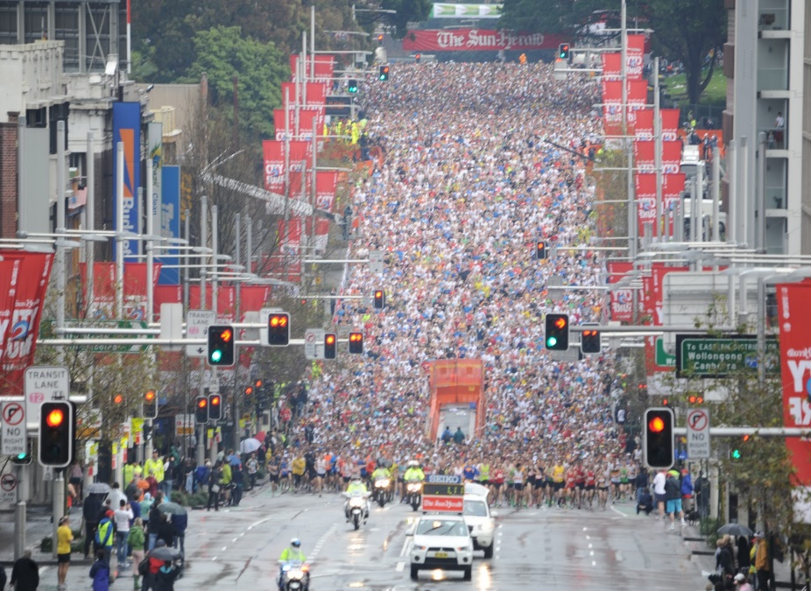

ISGC Health Check
Vital signs are stable
No evidence of serious comorbidities
Ready to take on a half marathon
Lean, building our muscle mass, not much excess body fat
Fitness, stamina, here for the full marathon

Slide 12
We welcome your involvement…..
Please contact any of the Steering committee or Adjunct members……
  Committee membership
  Writing groups- group specific
  Data sharing- ongoing
  Data management- ongoing
  Grant writing support- evolving
  Working groups- contact respective Chairs
  Participation in Workshops leads to increased collaborative research

